Slide 1
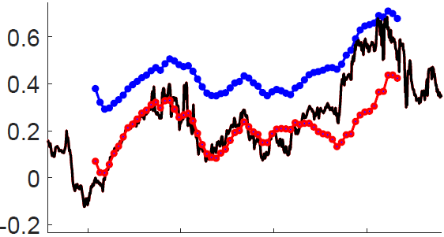
Normalized Oxygen
oxygen data
1 – 1 Prediction
3 – 1 Prediction
30 Sept 2018
02 Oct 2018

