Slide 1
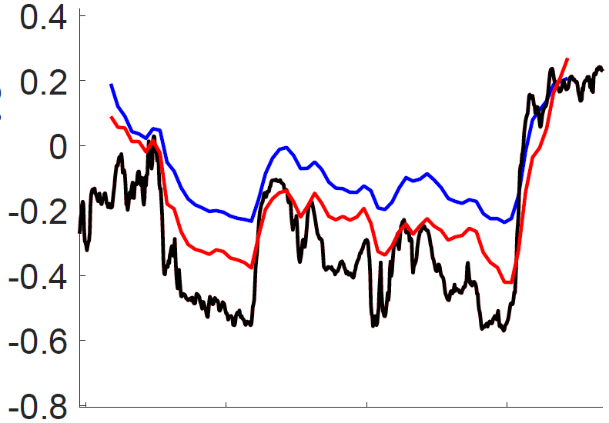
Normalized Oxygen
oxygen data
1 – 1 Prediction
3 – 1 Prediction
04 Oct 2018
06 Oct 2018

