Slide 1
ROBOTICS
LIST OF TOPICS
INTRODUCTION
TYPES OF A ROBOT
ROBOT A MODEL OF LIVING BEINGS
CONSTRUCTION- COMPONENTS
CONCEPTS
MOTION PLANNING
ROBOTIC CONTROL
NAVIGATION -PROBABILISTC ROBOTICS
TRAINING
SWARM ROBOTICS
SOFTWARE LIBRARIES & FRAMEWORK
MECHANICAL DESIGN SOFTWARE
CONSTRUCTION PROJECTS
MATEMATICS AND STATISTICS TOPICS
CARRICULUM
VIDIO COURSES
BOOKS

Slide 8
ROBOTICS
INTRODUCTION
DEFINITION
TIME LINE
EARLY CONTRIBUTORS
EARLY ROBOTS
A robot is a machine—especially one programmable by a computer— capable of carrying out a complex series of actions automatically. And thus the heart of robotics is study of motion – controlled programmable motion- the nature of motion, the motions available to rigid bodies, the use of kinematic constraint to organize motions, the mechanisms that enable general programmable motion, the static and dynamic character of mechanisms, and the challenges and approaches to control, programming, and planning motions.

Slide 9
ROBOTICS
INTRODUCTION-Timelines
1920 Karel Capek made famous the word ‘ROBOT’ in his play R.U.R ,coined in 1917, derived from a check word robotnik meaning slave in a play called Opilek
1938 Asimov coined the word Robotics and formulates Three Laws of Robotics
1961 George C Devol makes the first production industrial version of Robot the ‘UNIMATE’
1968 ‘Shakey’ the first complete robot system built at Stanford Research Institute, capable of autonomous motion
1980 Robotics languages developed to overcome bottleneck of programming
1997 the first Humanoid robot developed by Honda
2002 The Roomba, the first household robot introduced (cleaning)
2005 Autonomous Car Navigation in complex terrain in the DARPA challenge

Slide 10
ROBOTICS
INTRODUCTION-Pioneers
1. Joseph Engelberger "The Father of Robotics"
2. George D. Devol: The Inventor of the First Programmable Industrial Robot
3. Marvin Minsky Was a Pioneer of Artificial Intelligence
4. Victor Scheinman Invented the First Electrically Powered Computer Controlled Robotic Arm
5. Ichiro Kato Built The World's First Real Android
6. Takeo Kanade Built the First Direct Drive Robotic Arm
7. Nobuyuki Okude Popularised Robots To a New Generation
8. David Barrett Built RoboTuna in 1996
9. Dr. Toshitada Doi Was Behind SONY's Groundbreaking AIBO Robodog
10. Satoshi Shigemi Is the Man Behind Honda's Iconic ASIMO Series
10. Satoshi Shigemi Is the Man Behind Honda's Iconic ASIMO Series
12. Jacob Matijevic, and Donna Shirley and NASA's Sojourner Took Robots To Mars
13. Joe Jones: The Inventor of the Roomba
14. Marc Raibert and His 'Spooky' Boston Dynamics Robots
15. David Hanson - The Man Responsible for the Creation of Sophia
16. Steve Cousins, CEO of Savioke and formerly of Willow Garage
17. Rodney Brooks, founder of Rethink Robotics and Panasonic Professor of Robotics at MIT, also popularized the idea of behavior-based robotics and subsumption architecture

Slide 11
ROBOTICS
EARLY ROBOTS
The top 50 robots ever

Slide 12
ROBOTICS
LIVING BEINGS MODEL FOR ROBOT
A robot resembles living beings as:
Body- It has a skeleton, sensors and actuators
Nervous System - The control mechanisms:
Architecture,
control system comprising of
desired behavior,
sampling of sensors and
operate actuators to lead to the desired behavior
Brain:
The world view in terms of maps of various types
Memory in terms of history of actions
Learning by imitation, Kinesthetic learning and by trial and error called Reinforcement learning

Slide 13
ROBOTICS
TYPES OF ROBOT
INDUSTRIAL : Early robots served a specific operation on shop floor mainly remaining at one point and had to be programmed one type of function lacking versatility Common Types of Industrial Robots:
Articulated
Cartesian
Cylindrical
Polar
SCARA
Delta
MOBILE : These type of Robots move around with motion imparted by wheels, tracks or legs from one to many on land or in air and under water. The types are:
Land-based wheeled robot
Land-based tracked robot
Land-based legged robot
Air-based: plane, helicopter, blimp
Water-based; boat, submarine
Misc. and combination robot

Slide 14
ROBOTICS
CONSTRUCTION- COMPONENTS
Physical parts or anatomy,
Mechanical part or manipulator (Body, Arm, Wrist)
End effectors (Tool or Gripper)
Power supply,
Vehicle (optional)
Actuators Types:
Electric Motors, like: Servomotors, Stepper motors or Direct-drive electric motors
Hydraulic actuators
Pneumatic actuators
Controller (Sensors, Processor) Types of sensor:
Potentiometers
Switch sensors-contact, limit, shaft encoders
Ultrasonic Sensors
Light Sensors, Infra Red Sensors
RADAR and LiDAR

Slide 15
ROBOTICS
CONCEPTS IN MANIPULATION OF A ROBOT
Mechanics
Joints of links, Types: Revolute, Prismatic, Helical, Cylindrical, Spherical
Configuration, Degrees of Freedom-DOF, Configuration space-topology and representation
Task space, Work space
Holonomic and nonholonomic constraints
Rigid body Motion, Coordinate frames, Rotation Matrix, Euler Angles.
Manipulation: A robot’s ability to physically interact with and modify its environment—that is, manipulate it. Manipulation is an advanced capability that sets robots apart from most other computerized or automated systems.

Slide 16
ROBOTICS
CONCEPTS IN MANIPULATION OF A ROBOT
In Static Condition
Forward kinematics of a robot refers to the calculation of the position and orientation of its end-effectors frame from its joint coordinates θ.
Inverse kinematics: The process of working out the joint coordinates for a given position of the end effectors. Multiple solutions possible.

Slide 17
ROBOTICS
CONCEPTS IN MANIPULATION OF A ROBOT
In Static Condition
The velocity kinematics: the relationship, in 3D, between the velocity of the joints and the velocity of the end-effectors. This relationship is described by a Jacobian matrix which also provides information about how easily the end-effectors can move in different Cartesian directions.
By inverting the Jacobian matrix we can find the joint velocities required to achieve a particular end-effector velocity, so long as the Jacobian is not singular.
Singularity: a kinematic singularity is a point in the workspace where the robot loses its ability to move the end effector in some direction no matter how it moves its joints. It typically occurs when two of the robot's joints line up, making them redundant.

Slide 18
ROBOTICS
CONCEPTS IN MANIPULATION OF A ROBOT
In Dynamic Condition
The Study of the motions of open-chain robots taking into account the forces and torques that cause them; this is the subject of robot dynamics.
The Forward Dynamics: to know its motion given the torques applied to the joints. This is called the forward dynamics problem.
The Inverse Dynamics: The Inverse Dynamics is the process of finding the joint forces and torques τ corresponding to the robot’s state and a desired acceleration.
Two ways: by a direct application of Newton’s and Euler’s dynamic equations for a rigid body (often called the Newton–Euler formulation) or by the Lagrangian dynamics formulation derived from the kinetic and potential energy of the robot
Reference: http://hades.mech.northwestern.edu/images/7/7f/MR.pdf A book ‘MODERN ROBOTICS MECHANICS, PLANNING, AND CONTROL’ by ‘Kevin M. Lynch and Frank C. Park’
Linear Algebra

Slide 19
ROBOTICS
TRAJECTORY AND MOTION PLANNING
During robot motion, the robot controller is provided with a steady stream of goal positions and velocities to track. This specification of the robot position as a function of time is called a trajectory.
When the task is simply to move from one position to another in a given time, we have freedom to design the trajectory to meet these constraints. This is the domain of trajectory planning.
A trajectory is the combination of a path- geometric description of the sequence of configurations the robot achieves and time scaling- specifying the time at which these configurations are reached
The trajectory should be a sufficiently smooth function of time, and respect any given limits on joint velocities, accelerations, or torques.
Three cases:
point-to-point straight-line trajectories
trajectories passing through a sequence of timed via points
minimum-time trajectories along specified paths taking actuator limits into consideration.
Constraints of trajectory : start and goal state, limits on speed and acceleration. Time scale

Slide 20
ROBOTICS
TRAJECTORY AND MOTION PLANNING
Various methods of time scaling:
Third-order Polynomials
Fifth-order Polynomials
Trapezoidal Motion Profiles
S-Curve Time Scalings
Polynomial Via Point Trajectories
Time-Optimal Time Scaling
Time scaling is achieved using an algorithm (beyond the scope of the note)

Slide 21
ROBOTICS
TRAJECTORY AND MOTION PLANNING
Path planning is one of the fundamental problems in robotics . It is typically defined as finding a sequence of state transitions for a robot from its initial state to some desired goal state. According to the information of obstacles, the working environment of a robot can be categorized as a completely known environment, a partially known environment, a completely unknown environment, and a dynamic environment .
A key concept in motion planning is configuration space, or C-space C ⊂ R^{n}
Every configuration of robot is a point in the C-space say q
The state of the robot is defined by its configuration and velocity
The control inputs available to drive the robot are written as an m-vector u ∈ U ⊂ R^{m}
The state of the robot is defined by its configuration and velocity, x = (q, v) ∈ X
The notation q(x) indicates the configuration q corresponding to the state x
The equations of motion of the robot x˙ = f(x, u) or
x(T) = x(0) + ∫₀^{T} f(x(t), u(t))dt

Slide 22
ROBOTICS
TYPES OF MOTION PLANNING PROBLEM
The basic problem of motion is defined as
Given an initial state x(0) = x-start and a desired final state x-goal, find a time T and a set of controls u : [0, T] → U such that the motion equation satisfies x(T) = x-goal and q(x(t)) ∈ C for all t ∈ [0, T].
There are many variations of the basic problem:
The path planning problem is a sub problem of the general motion planning problem - purely geometric problem of finding a collision-free path which can be time scaled to create a feasible trajectory
m=n holonomic and m<n non holonomic
Online versus offline: for dynamic environment vs static environment
Optimal versus satisficing : apart from optimising time optimise other factors such as cost, effort
Exact versus approximate
With or without obstacles

Slide 23
ROBOTICS
PROPERTIES OF MOTION PLANNERS
The planner – planning algorithms should satisfy all the above requirements.
In addition the planning algorithms have the variations
Multiple-query versus single-query planning
“Anytime” planning
Completeness
resolution completeness
probabilistically complete
Computational complexity

Slide 24
ROBOTICS
MOTION PLANNING METHODS
There is no single planner applicable to all motion planning problems. some of the many motion planners available are:
Complete methods
Grid methods
Sampling methods
Virtual potential fields
Nonlinear optimization
Smoothing
Many motion planners explicitly or implicitly represent the C-space as a graph. Once the free space is represented as a graph, a motion plan can be found by searching the graph for a path from the start to the goal.
Various search algorithms are:
A* :One of the most powerful and popular graph search algorithms finds a minimum-cost path on a graph efficiently, uses Grid Methods
Dijkstra’s algorithm.
Breadth-first search.
Suboptimal A* search
RRTs: rapidly exploring random trees uses sampling method
PRMs: probabilistic roadmaps uses sampling method

Slide 25
ROBOTICS
CONTROL
Control is usually defined as the power to influence or direct the course of events or determine the behaviour or supervise the running of something, The Robot control is defined the technology needed to control the electromechanical systems of a robot.
Controller: is an information processing device whose inputs are both the desired and measured position, velocity or other pertinent variables in a process and whose outputs are drive signals to a controlling motor or actuator.
the job of the robot controller is to convert the task specification to forces and torques at the actuators. Hence, precisely controlling a robot requires an understanding of the relationship between the joint forces and torques and the motion of the robot; this is the domain of dynamics.

Slide 26
ROBOTICS
CONTROL
Controller: There are two types: a feedback controller and a feed forward controller.
A feedback controller measures the output of a process and then manipulates the input as needed to drive the process variable toward the desired set point, thus the control variable adjustment is error-based. It repeats this measure-decide-actuate sequence over and over until the process variable matches the set point.
In feed forward controller the control variable adjustment is not error-based. Instead it is based on knowledge about the path in the form of a mathematical model of the dynamics of the robot and hence it is an open system, does not have any feedback loop to control its output.

Slide 27
ROBOTICS
CONTROL
The types of task the robot is supposed to perform are:
moving an object from one place to another
tracing a trajectory for manufacturing applications
act as a source of forces, for example when grinding or polishing a work piece
control forces in some direction and motions in another, e.g. writing on a board with a chalk
In some tasks the robot acts like a programmable spring, damper, or mass, by controlling its position, velocity, or acceleration in response to forces applied to it.
Control strategies to achieve the behaviors described above are known as :
motion (or position) control,
force control,
hybrid motion–force control,
impedance control.

Slide 28
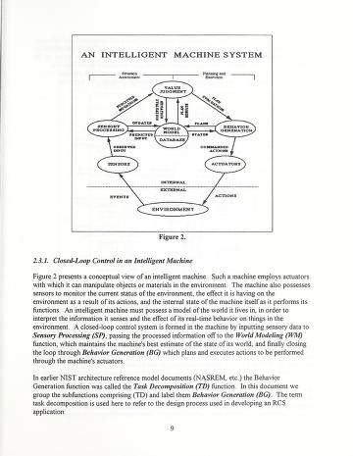
ROBOTICS
CONTROL: The conceptual view of an intelligent machine
NIST A real time control system methodology for
developing intelligent control systems NISTIR 4936
Value Judgment
Sensor processing
World view(database)
Behavior generation
Sensors
Actuators
-----------------------------------
Environment
A feedback controller measures the output of a process and then manipulates the input as needed to drive the process variable toward the desired setpoint.

Slide 29
ROBOTICS
Joint space and task space
In a motion control problem, the manipulator moves to a position to pick up an object, transports that object to another location, and deposits it.
Tasks are usually specified in the task space in terms of a desired trajectory of the end-effectors,
while control actions are performed in the joint space to achieve the desired goals
The main goal of the joint space control is to design a feedback controller such that the joint coordinates q(t) ∈ Rn track the desired motion qd(t) as closely as possible
Firstly, the desired motion, which is described in terms of end-effectors coordinates, is converted to a corresponding joint trajectory using the inverse kinematics of the manipulator. Then the feedback controller determines the joint torque necessary to move the manipulator along the desired trajectory specified in joint coordinates starting from measurements of the current joint states
The main goal of the operational space control is to design a feedback controller that allows execution of an end-effectors motion x(t) ∈ Rn that tracks the desired end-effectors motion xd(t) as closely as possible.
Task space controllers employ a feedback loop that directly minimizes task errors.

Slide 30
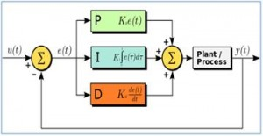
ROBOTICS
PID CONTROL
Approximately 95% of the closed loop operations of industrial automation sector use PID controllers. PID stands for Proportional-Integral-Derivative. These three controllers are combined in such a way that it produces a control signal. all PID controllers are processed by the microprocessors.

Slide 31
ROBOTICS
FEEDBACK FEED FORWARD CONTROLLERS
A feedback controller measures the output of a process and then manipulates the input as needed to drive the process variable toward the desired setpoint.

Slide 32
ROBOTICS
ARCHITECTURE
Robot architectures and programming began in the late 1960s
NEED: Robot software systems tend to be complex. This complexity is due, in large part, to the need to control diverse sensors and actuators in real time, in the face of significant uncertainty and noise. Robot systems must work to achieve tasks while monitoring for, and reacting to, unexpected situations. Doing all this concurrently and asynchronously adds immensely to system complexity. The use of a well-conceived architecture, together with programming tools that support the architecture, can often help to manage that complexity.
A robot control architecture provides guiding principles and constraints for ARCHITECTURE organizing a robot’s control system (its brain), comprises of specific styles, tools, constraints, and rules.
Four types of architecture depending upon control paradigms:
1. Deliberative control: Think hard, act later (Sense- Plan- Act)
2. Reactive control : Don’t Think, React!
3. Hybrid control : Think and Act Separately, in Parallel
4. Behavior-based control: Think the Way You Act

Slide 33
ROBOTICS
ARCHITECTURE
Considerations for selection of architecture:
Is there a lot of sensor noise?
• Does the environment change or stay static?
• Can the robot sense all the information it needs? If not, how much can it sense?
• How quickly can the robot sense?
• How quickly can the robot act?
• Is there a lot of actuator noise?
• Does the robot need to remember the past in order to get the job done?
•Does the robot need to think into the future and predict in order to get the job done?
• Does the robot need to improve its behavior over time and be able to learn new things?

Slide 34
ROBOTICS
ARCHITECTURE
Various architectures differ in the way they treat
Time scale: Response time vs. sensing and thinking time
Deliberative takes time to think as it deals with long term
Reactive acts in real time
Hybrid takes combination of the two
Behaviour based works to bring the time scales together
Modularity: components and their interaction
Deliberative multiple modules sensing (perception), planning, and acting work in sequence
Reactive Multiple modules work in parallel
Hybrid Three parts deliberative, reactive and a part in between act parallelly.
Business based: more than three modules but work parallelly.
Representation: (next slide)

Slide 35
ROBOTICS
ARCHITECTURE
Representation is the form in which information is stored in the robot.
• Representation of the world around the robot is called a world model.
• Representation can take a great variety of forms and can be used in a great variety of ways by a robot.
• A robot can represent information about itself, other robots, objects, people, the environment, tasks, and actions.
• Representations require constructing and updating, which have computational and memory costs for the robot.
• Different architectures treat representation very differently, from not having any at all, to having centralized world models, to having distributed ones.

Slide 36
ROBOTICS
ARCHITECTURE
Subsumption Architecture: In the early 1980s, it became apparent that the SPA paradigm had problems.
The best known architecture for reactive control is Subsumption Architecture, introduced by Prof. Rodney Brooks at MIT in 1985.
Subsumption systems consist of a collection of modules or layers, each of which achieves a task.
The modules or layers are designed and added to the robot incrementally one on top of the other.
Higher layers can also temporarily disable one or more of those below them. For example, avoid-obstacles can stop the robot from moving around.
The name "Subsumption Architecture" comes from the idea that higher layers can assume the existence of the lower ones and the goals they are achieving, so that the higher layers can use the lower ones to help them in achieving their own goals, either by using them while they are running or by inhibiting them selectively. In this way, higher layers "subsume" lower ones.
There is no use of internal models; "the world is its own best model."

Slide 37
ROBOTICS
ARCHITECTURE

Slide 38
ROBOTICS
ARCHITECTURE

Slide 39
ROBOTICS
PROBABILISTIC ROBOTICS
Hitherto we addressed the kinematics exclusively deterministically ignoring the uncertainty in various components of the robotic models. What is all about uncertainty?
Sensor noise and errors are inherent in physical measurement
It refers to the robot’s inability to be certain, to know for sure, about the state of itself and its environment, in order to take absolutely optimal actions at all times.
• Sensor limitations
• Effector and actuator noise and errors
• Hidden and partially observable state
• Lack of prior knowledge about the environment, or a dynamic and changing environment.
Fundamentally, uncertainty stems from the fact that robots are physical mechanisms that operate in the physical world, the laws of which involve unavoidable uncertainty and lack of absolute precision.

Slide 40
ROBOTICS
PROBABILISTIC ROBOTICS
To discover how mathematical statistics and probability are used to help robots cope with uncertainty in navigation, we refer Probabilistic Robotics by Sebastian Thrun, Wolfram Burgard, and Dieter Fox Building.
They key idea of probabilistic robotics is to represent uncertainty explicitly, using the calculus of probability theory. Put differently, instead of relying on a single “best guess” as to what might be the case in the world, probabilistic algorithms represent information by probability distributions over a whole space of possible hypotheses. By doing so, they can represent ambiguity and degree of belief in a mathematically sound way, enabling them to accommodate all sources of uncertainty listed above. Moreover, by basing control decisions on probabilistic information, these algorithms degrade nicely in the face of the various sources of uncertainty described above, leading to new solutions to hard robotics problems.
At the core of probabilistic robotics is the idea of estimating state from sensor data.
State is the collection of all aspects of the robot and its environment that can impact the future. A state will be called complete if it is the best predictor of the future.

Slide 41
ROBOTICS
PROBABILISTIC ROBOTICS
In probabilistic robotics, the dynamics of the robot and its environment are characterized in the form of two probabilistic laws: the state transition distribution, and the measurement distribution. The state transition distribution characterizes how state changes over time, possible as the effect of a robot control. The measurement distribution characterizes how measurements are governed by states.
A robot that carries a notion of its own uncertainty and that acts accordingly is superior to one that does not.(why probabilistic approach)
probabilistic algorithms are computationally inefficient and they need to approximate.
The belief (momentary estimate)of a robot is the posterior distribution over the state of the environment. the belief reflects the robot’s internal knowledge about the state of the environment.
The Bayes filter is the principal algorithm for calculating the belief in robotics and is applied recursively.
The Bayes filter makes a Markov assumption that specifies that the state is a complete summary of the past.

Slide 42
ROBOTICS
PROBABILISTIC ROBOTICS
Perception is the process by which the robot uses its sensors to obtain information about the state of its environment.
Control actions change the state of the world. They do so by actively asserting forces on the robot’s environment.
the goal of a proper probabilistic model may appear to accurately model the specific types of uncertainty that exist in robot actuation and perception. In practice, the exact shape of the model often seems to be less important than the fact that some provisions for uncertain outcomes are provided in the first place.

Slide 43
ROBOTICS
NAVIGATION WITH PROBABILISTIC ROBOTICS
MAPPING
Navigation is the process or activity of accurately ascertaining one's position and planning and following a route. Navigation in a realistic environment is a fundamental requirement for obtaining an autonomous mobile robot. The problem of navigation is the problem of mapping and localization.
The elements are:
Map: For anybody—animals or robots, for navigation, map is essential. A coordinate system and the set of information about of the location of features in the environment is called a map. If it is provided, it can be used, if not robot needs to develop its own map.
Robotic mapping addresses the problem of acquiring spatial models of physical environments through mobile robots. At present, we have robust methods for mapping environments that are static, structured, and of limited size. Mapping unstructured, dynamic, or large-scale environments remains largely an open research problem.
To acquire a map, robots must possess sensors that enable it to perceive the outside world.
The taxonomy of map types is
Metric maps capture the geometric properties of the environment
Topological maps describe the connectivity of different places.
World centric maps are represented in terms of global coordinates
Robot centric maps are represented in measurement space, i.e. they describe the sensor measurements the robot would receive at different locations.

Slide 44
ROBOTICS
NAVIGATION WITH PROBABILISTIC ROBOTICS
MAPPING ALGORITHMS– Kalman Filters
A classical approach to generating maps is based on Kalman filters.
Kalman filters are Bayes filters that represent posteriors p(st , m | z t , ut ) with Gaussians.
Kalman filter mapping relies on three basic assumptions.
First, the next state function (motion model) must be linear with added Gaussian noise.
Second, the same characteristics must also apply to the perceptual model.
Third, the initial uncertainty must be Gaussian.
However, the robot motion is governed by non linear relations. To accommodate such nonlinearities, Kalman filters approximate the robot motion model using a linear function obtained via Taylor series expansion. The resulting Kalman filter is known as Extended Kalman filter

Slide 45
ROBOTICS
NAVIGATION WITH PROBABILISTIC ROBOTICS
MAPPING ALGORITHMS—Expectation Maximization (EM)
Alternative to the Kalman filter paradigm is known as the expectation maximization family of algorithms, or in short, EM.
EM have to process the data multiple times.
EM iterates two steps: An expectation step or E-step, where the posterior over robot poses is calculated for a given map, and a maximization step or M-step, in which EM calculates the most likely map given these pose expectations. The result is a series of increasingly accurate maps, m[0], m[1], m[2] , . . .. The initial map, m[0], is an empty map.

Slide 46
ROBOTICS
NAVIGATION WITH PROBABILISTIC ROBOTICS
MAPPING ALGORITHMS– OCCUPANCY GRID MAPPING
This algorithm is used by a number of autonomous robots, typically in combination with one of the algorithms described above. It addresses the problem of generating a consistent metric map from noisy or incomplete sensor data.
Applications of occupancy grid maps require robots with range sensors, such as sonar sensors or laser range finders.
occupancy grid maps are represented by grids, which are usually two-dimensional but may also cover all three spatial dimensions.
This algorithm is popular because it is extremely robust and easy to implement.

Slide 47
ROBOTICS
NAVIGATION WITH PROBABILISTIC ROBOTICS
MAPPING ALGORITHMS–OBJECT MAPS
This addresses the problem of building maps composed of basic geometric shapes or objects, such as lines, walls, etc.
Advantages of object maps over grid maps:
object maps can be more compact than occupancy grid maps,
they can also be more accurate,
object representations appear to be necessary for describing dynamic environments where objects might change their location over time.
object maps are often closer to people’s perception of environments than grid maps, however, they are usually confined to environments that can be expressed through simple geometric shapes and objects.
This can be overcome by allowing for hybrid maps, which represent some parts of the environment via objects and others using grid map-style representations.

Slide 48
ROBOTICS
NAVIGATION WITH PROBABILISTIC ROBOTICS
MAPPING ALGORITHMS--DOGMA
Dogma-- dynamic occupancy grid mapping algorithm
The algorithms upto now work on static world assumption. The Dogma algorithm is among the first to address dynamic environments. Dogma works on the assumption that the environment possesses objects whose locations are static in the short run, but which change over longer periods in time.
Dogma learns models of dynamic objects, represented by local, object-specific occupancy grid maps.

Slide 49
ROBOTICS
NAVIGATION WITH PROBABILISTIC ROBOTICS
LOCALISATION
Localisation is to estimate the location of the robot, i.e. its current state in its three-dimensional (x; y; ) configuration space within its environment given a map and incoming sensory information.
Two situations:
Position tracking : Knowing original position, to find current location compensating odometric errors.
Global: to estimate the position of the robot even under global uncertainty also known as initialisation and kidnapped robot’s problem.
Markov Localisation algorithm: In the beginning this technique starts with a uniform distribution over the whole three-dimensional state-space of the robot. By integrating sensory input this method keeps track of multiple hypotheses and incrementally refines the density until it ends up with a unimodal distribution. It can also do global localisation.
Grid based localisation: a variation that uses a fine-grained geometric discretization to represent the position of the robot. It provides very precise estimates for the position of a mobile robot and the high resolution grids allow the integration of raw (proximity) sensor readings. The disadvantage of this technique, i.e., the huge state space which has to be maintained is overcome by 1) The selective update strategy which focuses the computation on the relevant part of the state space and 2) A sensor model designed especially for proximity sensors.

Slide 50
ROBOTICS
NAVIGATION WITH PROBABILISTIC ROBOTICS
LOCALISATION
The collision avoidance system of the robots is based on the dynamic window algorithm (DWA) , a purely sensor-based approach designed to quickly react to obstacles blocking the robot's path.
Preventing collisions with obstacles which are “invisible" to the robot's sensors (glass or any other transparent objects) . By referring the Map “virtual" sensor readings that underestimate the true distance to the next obstacle in the map with probability 0:99 are generated to avoid any such objects.

Slide 51
ROBOTICS
PROBABILISTIC ROBOTICS
LOCALISATION
Monte Carlo Localisation Algorithm: (MCL) uses fast sampling techniques to represent the robot’s belief. MCL uses many samples during global localization when they are most needed, whereas the sample set size is small during tracking, when the position of the robot is approximately known. Several key advantages:
In contrast to existing Kalman filtering based techniques, it is able to represent multi-modal distributions and thus can globally localize a robot.
It drastically reduces the amount of memory required compared to grid-based Markov localization and can integrate measurements at a considerably higher frequency.
It is more accurate than Markov localization with a fixed cell size, as the state represented in the samples is not discretized.
It is much easier to implement.

Slide 52
ROBOTICS
PROBABILISTIC ROBOTICS
MCL is a version of sampling/importance re-sampling (SIR) (Rubin 1988). It is known alternatively as
the bootstrap filter (Gordon, Salmond, & Smith 1993),
the Monte-Carlo filter (Kitagawa 1996),
the Condensation algorithm (Isard & Blake 1998), or
the survival of the fittest algorithm (Kanazawa, Koller, & Russell 1995).
All these methods are generically known as particle filters,

Slide 53
ROBOTICS
PROBABILISTIC ROBOTICS
SLAM The term SLAM was originally initiated by Hugh Durrant-Whyte and John J. Leonard at the 1995 International Symposium on Robotic Research.
SLAM: Simultaneous Localisation And Mapping, it is concerned with building a map of an environment with a mobile robot while at the same time navigating the environment with the map. The approaches to SLAM main categories: (1) “grid-based”, (2) “feature-based”, and (3) “topological”.
Grid-based approaches are intuitively simple, easy to implement, and naturally extendible to higher dimensions, disadvantages-the high computational cost of localization and the high storage requirement .
Feature-based approaches use easily identifiable elements in the environment, such as planes, corners and edges in an indoor environment, and build an internal representation (map) with the location of these landmarks.
The topological approach attempts to create a graph-like description of the environment rather than a precise accurate metric map. In the topological description nodes correspond to “significant places” in the environment which are easy to distinguish, and arcs connecting these nodes correspond to sequences of actions that connect neighboring places.

Slide 54
Steps in SLAM
Landmark Extraction.
Data association.
State estimation.
State update.
Landmark update.

Slide 55
Hardware:
Mobile robot to test the algorithms and programs
Range measurement devices:
Laser scanner – Cant be used in underwater and foggy environments
Sonar – not exactly accurate
Vision – needs a constant light source

Slide 56
Landmarks
Landmarks are features which can easily be re-observed and distinguished from the environment.
These are used by the robot to find out where it is (to localize itself).

Slide 57
Characteristics of a good landmark:
Landmarks should be easily re-observable.
Individual landmarks should be distinguishable from each other.
Landmarks should be plentiful in the environment.
Landmarks should be stationary.

Slide 58
Landmark Extraction
Once the types of landmarks are decided by the user, we need to successfully extract them from the robot’s sensory inputs
The algorithms that are used in landmark extraction are spikes and RANSAC

Slide 59
Spikes
Spike landmark extraction is a simple algorithm concerned with landmark extraction from laser or sonar scan range data.
In scanning systems where scans yield multiple values within a certain angle of scanning, this algorithm tries to find extreme differences in the values read by the scanners

Slide 60
Spikes
This happens when the distance measured at one angle is different to the distance measured at the next angle.
Which in turn indicates that there is a geometric change between the angles, which can be interpreted as a landmark.

Slide 61
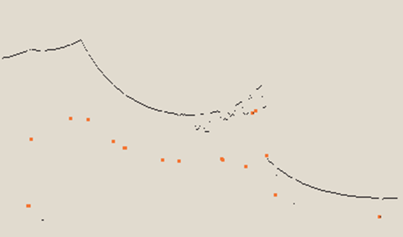
Spikes
It relies a lot of environment changing between two beams. This means that the algorithm will fail in smooth environments.

Slide 62
RANSAC (Random Sampling Consensus):
This method can be used to extract lines from a laser scan that can in turn be used as landmarks.
RANSAC finds these line landmarks by randomly taking a sample of the laser readings and then using a least squares approximation to find the best fit line that runs through these readings.

Slide 63
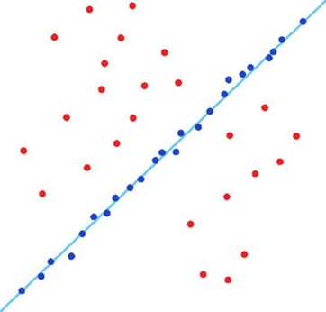
RANSAC (Random Sampling Consensus):

Slide 64
Data Association
The problem of data association is that of matching observed landmarks from different (laser) scans with each other.
Problems in Data Association
You might not re-observe landmarks every time.
You might observe something as being a landmark but fail to ever see it again.
You might wrongly associate a landmark to a previously seen landmark.

Slide 65
Algorithm – Nearest Neighbor Approach
When you get a new laser scan use landmark extraction to extract all visible landmarks.
Associate each extracted landmark to the closest landmark we have seen more than N times in the database.
Pass each of these pairs of associations (extracted landmark, landmark in database) through a validation gate.

Slide 66
Algorithm – Nearest Neighbor Approach
If the pair passes the validation gate it must be the same landmark we have re-observed so increment the number of times we have seen it in the database.
If the pair fails the validation gate add this landmark as a new landmark in the database and set the number of times we have seen it to 1.

Slide 67
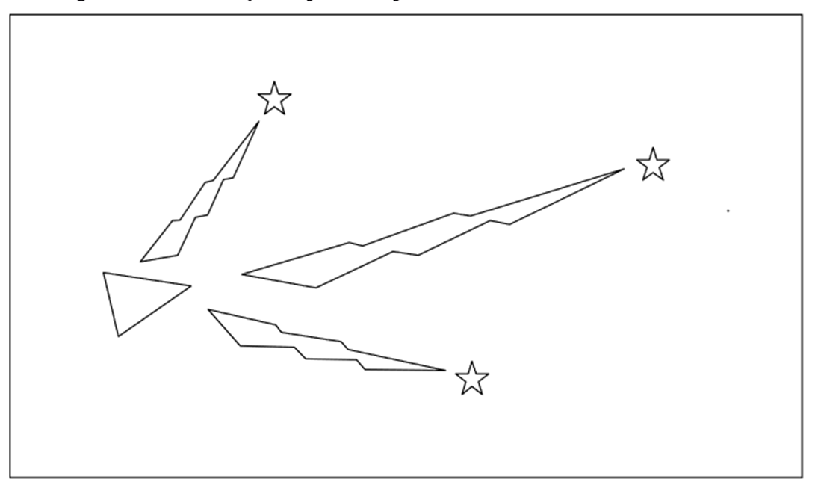
Basic principle of SLAM
Stars represent landmarks, initially position is estimated by sensors

Slide 68
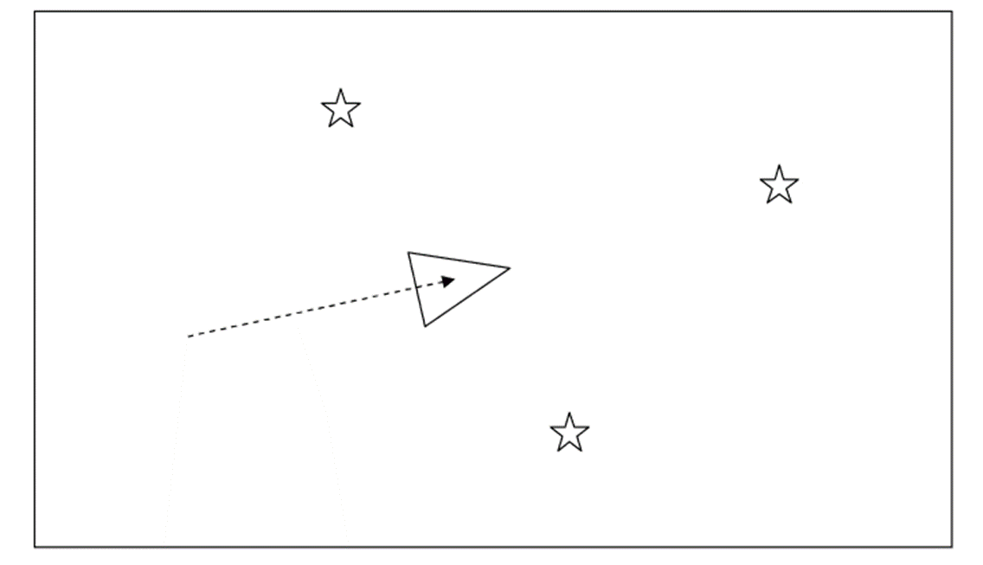
Basic principle of SLAM
The robot moves and it now thinks it is here, distance given by odometry alone

Slide 69
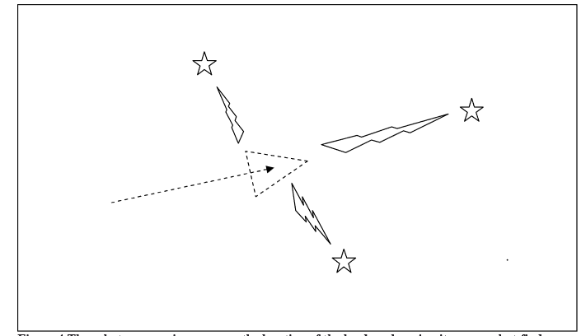
Basic principle of SLAM
Robot measures distance now using sensors and landmarks

Slide 70
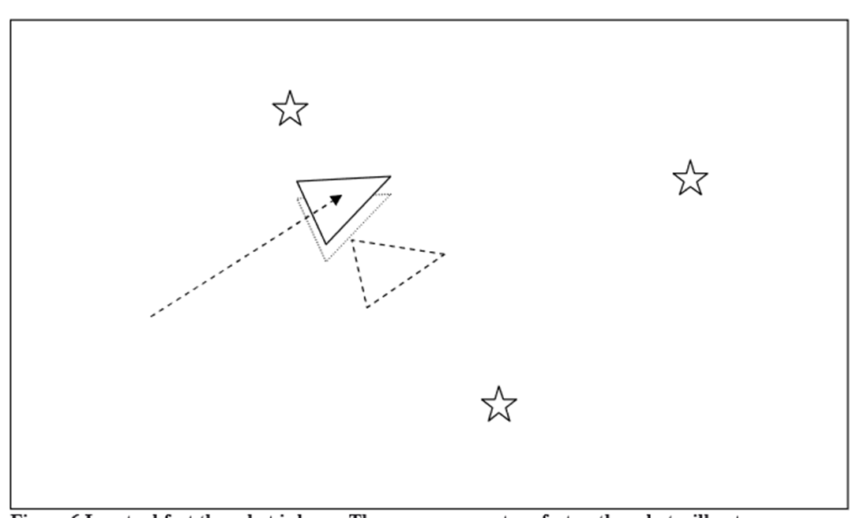
Basic principle of SLAM
Robot starts relying more on sensors than odometry. The dotted triangle represents where it thinks it is while the solid triangle shows where exactly the robot is.

Slide 71
Extended Kalman Filter (EKF):
The Extended Kalman Filter is used to estimate the state (position) of the robot from odometry data and landmark observations.
The EKF is usually described in terms of state estimation alone.

Slide 72
Overview of the process in EKF
Update the current state estimate using the odometry data.
Update the estimated state from re-observing landmarks.
Add new landmarks to the current state.

Slide 73
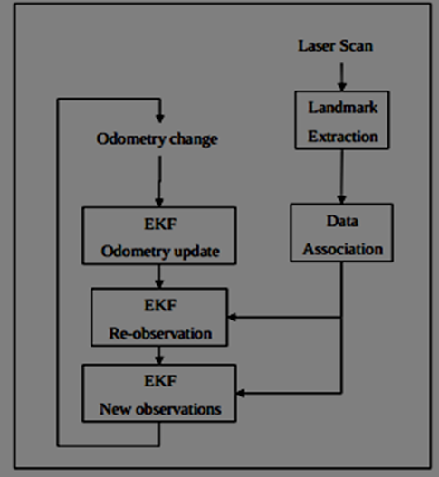
Overview of SLAM using EKF
SLAM cannot be based on odometry alone
Correction of robot’s position is achieved by observing the robots position
EKF is responsible for updating the robots position and also keeps track of the estimate of the uncertainty in the robots position and also the uncertainty in these landmarks it has seen in the environment

Slide 74
ROBOTICS
ROBOT LEARNING --TRAINING
Endowing robots with human-like abilities to perform motor skills in a smooth and natural way is one of the important goals of robotics. A promising way to achieve this is by creating robots that can learn new skills by themselves, similarly to humans. However, acquiring new motor skills is not simple and involves various forms of learning.
Three types of learning:
direct programming,
imitation learning and
reinforcement learning.
The ultimate goal of these approaches is to give robots the ability to learn, improve, adapt and reproduce tasks with dynamically changing constraints.

Slide 75
ROBOTICS
ROBOT LEARNING --TRAINING
Direct programming
This is the lowest-level approach, but it is still being actively used in industrial settings, where
the environment is well-structured and complete control over the precise movement of the robot is crucial.
it is not really a teaching method; hence, we classify it as programming.
Industrial robots are usually equipped with the so-called teach pendant—a device that is used to manually set the desired robot positions.

Slide 76
ROBOTICS
ROBOT LEARNING --TRAINING
Imitation learning:
This approach is called learning instead of programming, in order to emphasize the active part that the agent (the robot) has in the process. This approach is also known as programming by demonstration or learning from demonstration . There are three main methods used to perform demonstrations for imitation learning:
Kinesthetic teaching: This is the process of manually moving the robot’s body and recording its motion , works only for smaller, lightweight robots .
Teleoperation: This is the process of remotely controlling the robot’s body using another input device, such as a joystick or a haptic device.
Observational learning: In this method, the movement is demonstrated using the teacher’s own body and is perceived using motion capture systems or video cameras or other sensors.

Slide 77
ROBOTICS
ROBOT LEARNING --TRAINING
REINFORCED LEARNING (RL)
This is the process of learning from trial-and-error, by exploring the environment and the robot’s own body. The goal in RL is specified by the reward function, which acts as positive reinforcement or negative punishment depending on the performance of the robot with respect to the desired goal. The main motivation for using reinforcement learning to teach robots new skills is that it offers three previously missing abilities:
To learn new tasks, which even the human teacher cannot physically demonstrate or cannot directly program.
To learn to achieve optimization goals of difficult problems that have no analytic formulation or no known closed form solution, by using only a known cost function.
To learn to adapt a skill to a new, previously unseen version of a task.

Slide 78
ROBOTICS
ROBOT LEARNING --TRAINING
REINFORCEMENT LEARNING (RL)
Reinforcement learning offers to robotics a framework and set of tools for the design of sophisticated and hard-to-engineer behaviors.
The state s of the system – providing a complete statistic for predicting future observations.
The actions a available to the robot might be the torque sent to motors or the desired accelerations sent to an inverse dynamics control system.
A function π that generates the motor commands (i.e., the actions) based on current internal arm observations (i.e., the state) would be called the policy.
A reinforcement learning problem is to find a policy that optimizes the long term sum of rewards R(s, a); a reinforcement learning algorithm is one designed to find such a (near)-optimal policy, by policy, we mean a decision maker (Agent) that decide on an action based on some parameterized rules given an input observation of environment (State). The policy can be a set of weights that linearly combine the features in a state or different structured Neural Network.

Slide 79
ROBOTICS
ROBOT LEARNING --TRAINING
REINFORCEMENT LEARNING (RL)
In RL an agent explores the space of possible strategies and receives feedback on the outcome of the choices made. From this information, a “good” – or ideally optimal – policy (i.e., strategy or controller) must be deduced.
While optimal control assumes perfect knowledge of the system’s description in the form of a model, (For such models, optimal control ensures strong guarantees which, nevertheless, often break down due to model and computational approximations.) reinforcement learning operates directly on measured data and rewards from interaction with the environment.

Slide 80
ROBOTICS
CONTROL OF ROBOT
REINFORCEMENT LEARNING (RL) PROBLEM AND CONCEPTS
Markov Decision Process (MDP) consists of the set of states S, set of actions A, the rewards R and transition probabilities T that capture the dynamics of a system. Transition probabilities (or densities in the continuous state case) T(s ′ , a, s) = P(s ′ |s, a) describe the effects of the actions on the state. The Markov property requires that the next state s ′ and the reward are fully defined by the previous state s and action a. The goal of RL is to define an optimum policy π* that maps states to actions so as to maximize the average return J (π) = ∑_{s,a}µ^{π} (s)π(s, a)R(s, a) where µ^{π} is the stationary state distribution generated by policy π acting in the environment, i.e., the MDP. Optimisation can be done by either policy search or value-function based approach.

Slide 81
ROBOTICS
CONTROL OF ROBOT
REINFORCEMENT LEARNING (RL) PROBLEM AND CONCEPTS
2. Bellman Equation: The value function based optimisation approach attempts to find a policy that maximizes the return by maintaining a set of estimates of expected returns for some policy. A policy is called optimal if it achieves the best expected return from any initial state.
the value of a policy π is defined as V^{π} (s)=E[R|s, π ] and V* (s) as the maximum possible value of V^{π} (s).
V* (s) = max(at a*) [ ∑R(s, a* ) − R(bar) + X s ′ V ∗ (s ′ )T(s, a ∗ , s ′ )] ,
“An optimal policy has the property that whatever the initial state and initial decision are, the remaining decisions must constitute an optimal policy with regard to the state resulting from the first decision.” Thus, we have to perform an optimal action a* , and, subsequently, follow the optimal policy π* in order to achieve a global optimum.
Many traditional reinforcement learning approaches are based on identifying (possibly approximate) solutions to this equation, and are known as value function methods.

Slide 82
ROBOTICS
CONTROL OF ROBOT
REINFORCEMENT LEARNING (RL) PROBLEM AND CONCEPTS
3. Value function based RL Algorithms three types:
dynamic programming-based optimal control approaches such as policy iteration or value iteration,
(ii) rollout-based Monte Carlo methods and
(iii) temporal difference methods such as TD(λ) (Temporal Difference learning), Q-learning, and SARSA (State-Action-Reward State-Action)
value function methods are sometimes called critic-only methods.
4. Policy Search based methods: Robot learning systems often employ policy search methods rather than value function-based approaches. These are:
(i) Policy gradient approaches based on likelihood ratio estimation (Sutton et al., 1999),
(ii) policy updates inspired by expectation-maximization (Toussaint et al., 2010), and (iii) the path integral methods.
Policy search methods are sometimes called actor - only methods.

Slide 83
ROBOTICS
CONTROL OF ROBOT
REINFORCEMENT LEARNING (RL) PROBLEM AND CONCEPTS
5. Model based vs model free learning: Model free reinforcement algorithms try to directly learn the value function or the policy without any explicit modeling of the transition dynamics. In contrast, many robot reinforcement learning problems can be made tractable by learning forward models, i.e., approximations of the transition dynamics based on data. Such model-based reinforcement learning approaches jointly learn a model of the system with the value function or the policy and often allow for training with less interaction with the real environment.
What is a Model ?
In an abstract way a model is your own representation of the reality or the environment you are in. In RL this translates into having a representation M of the MDP [S, A, P, R]. This means having a version i (better be as accurate as possible) of the real MDP.If we assume that the states space S and the the transition probabilities A are known the model Mi will become [S, A, Pi, Ri].

Slide 84
ROBOTICS
CONTROL OF ROBOT
REINFORCEMENT LEARNING (RL) PROBLEM AND CONCEPTS
6. Markov Decision Process (MDP) consists of the set of states S, set of actions A, the rewards R and transition probabilities T that capture the dynamics of a system. Transition probabilities (or densities in the continuous state case) T(s ′ , a, s) = P(s ′ |s, a) describe the effects of the actions on the state. The Markov property requires that the next state s ′ and the reward are fully defined by the previous state s and action a. The goal of RL is to define an optimum policy π* that maps statesto actions so as to maximize the expected return J, which corresponds to the cumulative expected reward.

Slide 85
ROBOTICS
CONTROL OF ROBOT
REINFORCEMENT LEARNING (RL) PROBLEM AND CONCEPTS
7. Deep Reinforcement Learning

Slide 86
ROBOTICS
CONTROL OF ROBOT
REINFORCEMENT LEARNING (RL) PROBLEM AND CONCEPTS
8. Simulation Environment: Learning on robots is often difficult due to the large number of samples needed for learning algorithms. Simulators are one way to decrease the samples time needed from the robot by incorporating prior knowledge of the dynamics into the learning algorithm.
Some Widely Used Simulation Environment：
- Gym
- Mujoco
- Gazebo (https://github.com/erlerobot/gym-gazebo/)
Bullet (https://github.com/benelot/bullet-gym/tree/master/pybulletgym)
Roboschool(https://blog.openai.com/roboschool/)

Slide 87
ROBOTICS
CONTROL OF ROBOT
VISUAL SERVOING-VISUAL CONTROL OF ROBOTS
Visual servoing is an approach to the control of robot manipulators that is based on visual perception of robot and work piece location, involves the use of one or more cameras and a computer vision system to control the position of the robot's end-effector relative to the work piece as required by the task. The same for mobile robots becomes control of robot’s pose wrt. some landmarks.
Vision-guided robotics emulates the visual system of humans and allows intelligent machines to be developed. With higher intelligence, complex tasks that require the capability of human vision can be performed and replaced by machines. They are often found in tasks that demand high accuracy and consistent quality which are hard to achieve with manual labor. Tedious, repetitive and dangerous tasks, which are not suited for humans, are now performed by robots. Using visual feedback to control a robot has shown distinctive advantages over traditional methods, and is commonly termed visual servoing. Visual features are used, for example, to enable the alignment of a manipulator with an object. Hence, vision is a part of a robot control system providing feedback about the state of the interacting object.

Slide 88
ROBOTICS
CONTROL OF ROBOT
VISUAL SERVOING-VISUAL CONTROL OF ROBOTS
The robotic controllers which process and analyze this sensory information are usually based on three types of sensors (visual, force/torque and tactile) which identify the most widespread robotic control strategies: visual servoing control, force control and tactile control.
On the one hand, vision provides the global information which is required to localize the objects in the environment and compute their relative spatial relations. This information can be used by the robot controller to avoid undesired obstacles or to reach the target objects which are necessary for the development of its tasks. On the other hand, touch provides the local information which is required to characterize the way the robot contacts the objects in the environment. This information can be used by the robot controller to manipulate the contacting object or to explore it so that its surface properties (e.g., shape, stiffness, heat…) are extracted for its identification.
These three control strategies determine the movements that have to be executed by the robot in order to perform the desired task according to the measurements registered by the corresponding sensors.

Slide 89
ROBOTICS
CONTROL OF ROBOT
VISUAL SERVOING-VISUAL CONTROL OF ROBOTS
Initial vision control systems were open-loop . This technique is known as “look and move”, i.e., first the robot sees and recognizes the environment helped by a computer vision system, and after that, it performs the motion based on the data acquired in the previous step.
An alternative to the previous approach is visual servoing.
a visual servoing system uses the information acquired from a scene by one or more cameras connected to a computer vision system in order to control the robot end-effector pose with respect to a specific object in the scene. This closed-control loop approach permits to correct possible errors in the object position estimation obtained from the computer vision system. Moreover, it permits to change the robot trajectory in view of possible movements of the objects in the workspace.
Areas of visual servoing:
(i) High speed image processing, (ii) Kinematics/ Dynamics, (iii) Control theory and (iv) Real time computing

Slide 90
ROBOTICS
CONTROL OF ROBOT
VISUAL SERVOING-VISUAL CONTROL OF ROBOTS
Visual servoing taxonomy:
Two configurations:
Eye-in-hand, or end-point closed-loop control, where the camera is attached to the moving hand and observing the relative position of the target.
Eye-to-hand, or end-point open-loop control, where the camera is fixed in the world and observing the target and the motion of the hand.
Visual Servoing control techniques are classified as:
Image-based (IBVS): is based on the error between current and desired features on the image plane, and does not involve any estimate of the pose of the target. The features may be the coordinates of visual features, lines or moments of regions.
Position/pose-based (PBVS): is a model-based technique. The pose of the object of interest is estimated with respect to the camera and then a command is issued to the robot controller, which in turn controls the robot. In this case the image features are extracted as well, but are additionally used to estimate 3D information (pose of the object in Cartesian space), hence it is servoing in 3D.
Hybrid approach: uses some combination of the 2D and 3D servoing with approaches like
2-1/2-D Servoing , motion partition-based and Partitioned DOF based.

Slide 91
ROBOTICS
CONTROL OF ROBOT
VISUAL SERVOING-VISUAL CONTROL OF ROBOTS
The advantages of robotic visual servoing:
It will relax the requirement for the exact specification of the work piece pose. Therefore, it will reduce the costs associated with robot teaching and special-purpose fixtures. For example, it will allow operations on moving or randomly placed work pieces.
The requirement for exact positioning of the endpoint will be relaxed. Therefore, the robot operation will not highly depend on stiffness and mechanical accuracy of the robot structure so the robot mechanisms could be built lighter. This will lead to reduced cost of robot manufacture and operation, and decreased robot cycle time.

Slide 92
ROBOTICS
CONTROL OF ROBOT
VISUAL SERVOING-VISUAL CONTROL OF ROBOTS
Use of CNN/ Deep Learning for VS:
Over the last years deep neural networks, especially CNNs, have progressed the state-of-the art in a number of computer vision tasks:
image classification for object recognition ,
inferring a depth map from a single RGB image ,
computing displacement through homography estimation and performing camera relocalization
Deep learning has also started to become more prominent in robotics. For example, CNNs have also been trained for predicting grasp locations.
Recent progress in deep learning reaching tasks has achieved promising results:
learning complex positioning tasks facilitated by vision coupled with reinforcement learning,
and purely from vision without the use of any prior knowledge.

Slide 93
ROBOTICS
CONTROL OF ROBOT
VISUAL SERVOING-VISUAL CONTROL OF ROBOTS
Software platforms and libraries:
ViSP-Open source visual servoing platform library: It is a modular cross platform library that allows prototyping and developing applications using visual tracking and visual servoing technics at the heart of the researches done by Inria Rainbow team. ViSP is able to compute control laws that can be applied to robotic systems. It provides a set of visual features that can be tracked using real time image processing or computer vision algorithms. ViSP provides also simulation capabilities. ViSP can be useful in robotics, computer vision, augmented reality and computer animation.
Matlab Visual Servoing Toolbox : This project deals with the implementation of a set of components for the simulation of "visual servoing" systems with Matlab and Simulink. Visual servoing is the direct control of robots with vision, i.e., visual features are used in the control loop.

Slide 94
ROBOTICS
SWARM ROBOTICS
Swarm robotics is the use of numerous, autonomous robots to accomplish a task. Robot swarms coordinate the behaviours of a large number of relatively simple robots in a decentralised manner. Swarm robotics plays an important role in the development of collective artificial intelligence (AI).
The group of robots is not just a group. It has some special characteristics, which are found in swarms of insects, that is, decentralised control, lack of synchronisation, simple and (quasi) identical members.
Swarm robotics is the study of how large number of relatively simple physically embodied agents can be designed such that a desired collective behaviour emerges from the local interactions among agents and between the agents and the environment.
a set of criteria in order to have a better understanding and be able to differentiate it from other multi-robot types of systems:
(i)The robots of the swarm must be autonomous robots, able to sense and actuate in a real environment.(ii)The number of robots in the swarm must be large or at least the control rules allow it.(iii)Robots must be homogeneous. There can exist different types of robots in the swarm, but these groups must not be too many.(iv)The robots must be incapable or inefficient respect to the main task they have to solve, this is, they need to collaborate in order to succeed or to improve the performance.(v)Robots have only local communication and sensing capabilities. It ensures the coordination is distributed, so scalability becomes one of the properties of the system.

Slide 95
ROBOTICS
SWARM ROBOTICS
Taxonomy axes and explanation from Dudek et al. [8]
.Axis Description
Collective size Number of robots in the collective.
Communication range Maximum communication range.
Communication topology Of the robots in the communication range, those which can be communicated with.
Communication Bandwidth How much information the robots can send to each other.
Collective reconfigurability The rate at which the organisation of the collective can be modified. Process ability The computational model used by the robots.
Collective composition Are the robots homogeneous or heterogeneous.

Slide 96
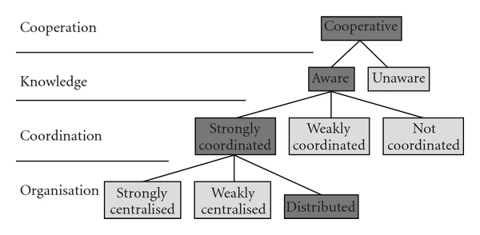
ROBOTICS
SWARM ROBOTICS
Taxonomy from Iocchi et al. For each level the corresponding type of system is marked in dark grey for a swarm-robotic system

Slide 97
ROBOTICS
SWARM ROBOTICS
A list of advantages and disadvantages of multi-robotic systems compared to single-robot systems.
Advantages:
(i)Improved performance: if tasks can be decomposable then by using parallelism, groups can make tasks to be performed more efficiently.(ii)Task enablement: groups of robots can do certain tasks that are impossible for a single robot.(iii)Distributed sensing: the range of sensing of a group of robots is wider than the range of a single robot.(iv)Distributed action: a group a robots can actuate in different places at the same time.(v)Fault tolerance: under certain conditions, the failure of a single robot within a group does not imply that the given task cannot be accomplished, thanks to the redundancy of the system.
Drawbacks:
(i)Interference: robots in a group can interfere between them, due to collisions, occlusions, and so forth.(ii)Uncertainty concerning other robots’ intentions: coordination requires to know what other robots are doing. If this is not clear robots can compete instead of cooperate.(iii)Overall system cost: the fact of using more than one robot can make the economical cost bigger. This is ideally not the case of swarm-robotic systems, which intend to use many cheap and simple robots which total cost is under the cost of a more complex single robot carrying out the same task.

Slide 98
ROBOTICS
SWARM ROBOTICS
Summary of platforms used for swarm robotics

Slide 99
ROBOTICS
SWARM ROBOTICS
Description of the platforms:
(i)Khepera robot [11], for research and educational purposes, developed by École Polytechnique Fédérale de Lausanne (EPFL, Switzerland), widely used in the past, nowadays has fallen in disuse;
(ii)Khepera III robot (http://www.k-team.com/) [12], designed by K-Team together with EPFL;
(iii)e-puck robot (http://www.e-puck.org/) [13], designed at EPFL for educational purposes;
(iv)The miniature Alice robot [14] also developed at EPFL;
(v)Jasmine robot (http://www.swarmrobot.org/) [15], developed under the I-swarm project;
(vi)I-Swarm robot (http://www.i-swarm.org/) [16], very small, also developed by the I-swarm project;
(vii)S-Bot (http://www.swarm-bots.org/) [17], very versatile, with many actuators, developed in the Swarm-bots project;
(viii)Kobot (http://www.kovan.ceng.metu.edu.tr/) [18], designed by Middle East Technical University (Turkey);
(ix)SwarmBot (http://www.irobot.com/) [19], designed by i-Robot company for research.

Slide 100
ROBOTICS
SWARM ROBOTICS
Simulators:
There exist many mobile robotic simulators available which can be used for multi-robotic experiments, and more concretely for swarm-robotic experiments. They differ not only in their technical aspects but also in the license and cost.
Player/Stage/Gazebo (http://playerstage.sourceforge.net/) [26] is an open source simulator with multi-robotic capabilities and a wide set of available robots and sensors ready to use. The use for swarm-robotic experiments is analysed for 2D simulations [27] with very good results. Runtime scales approximately linearly with population sizes up to at least 100,000 simple robots. It works on real time for 1000 robots running a simple program. It is a good solution for swarm robotic experiments.
Webots (http://www.cyberbotics.com/) [28] is a realistic, commercial mobile simulator that allows multi-robot simulation, with already built models of real robots. It is 3D, simulating physics and collisions. According to our experience, its performance when working with more than 100 robots decreases very fast, making the simulations with a large number of robots difficult.
Microsoft Robotics Studio [29] is a simulator developed by Microsoft Corporation. It allows multi-robotic simulation. It requires a Windows platform to run.
SwarmBot3D [17] is a simulator for multi-robotics but designed specifically for the S-Bot robot of the SwarmBot project.

Slide 101
ROBOTICS
SWARM ROBOTICS
Basic Behaviours and Tasks in Swarm Robotics:
Aggregation
Dispersion
Pattern Formation
Collective Movement
Task Allocation
Source Search
Collective Transport of Objects
Collective Mapping

Slide 102
ROBOTICS
SWARM ROBOTICS
Current uses for robot swarms include search and rescue, precision agriculture, supply chain management (SCM) and military reconnaissance.
Jasmine swarm robot platform: Its an Open-source micro-robotic project.
http://www.swarmrobot.org/#
This site is devoted to development of the open-source hardware and software micro-robotic platform in the size of less-then-3cm-cube. The main goal of this project is to develop a cheap, reliable and swarm-capable micro-robot that can be easily reproduced even at home. This robot allows building a large-scale swarm system (100 and more robots) to investigate artificial self-organization, emergent phenomena, control in large robotic groups and so on. This research is important to understand underlying principle of information and knowledge processing, adaptation and learning for the design and development of very limited autonomous systems.

Slide 103
ROBOTICS
SOFTWARE LIBRARIES & FRAMEWORKS
The following are some of the most relevant software frameworks and tools in robotics:
• ROS (Robotics Operating System)
• Microsoft Robotics Studio
• NXJ (Open source Java for the Lego robot kit)
• Player (robot framework) • Orocos (C++ framework for component based robot control)
• Rock (Robot Construction kit)
• Orca (robot framework)
• MOOS (robot framework)
• CARMEN (robot simulator)
• Simbad robot simulator
• Gazebo (multi-robot simulator)
Pyro: A Python-based Versatile Programming Environment for Teaching Robotics

Slide 104
ROBOTICS
SOFTWARE LIBRARIES & FRAMEWORKS
Programming libraries:
MRPT: Mobile Robot Programming Toolkit provides developers with portable and well-tested applications and libraries covering data structures and algorithms employed in common robotics research areas. It is open source, released under the BSD license.
Top 10 programming languages
C/C++ are a good starting point for new roboticists because a lot of hardware libraries use these languages. As robotics is very dependent on real time performance, C and C++ are probably the closest thing that we roboticists have to "a standard language".
Python is preferred as one of the reasons for this is probably that Python (and C++) are the two main programming languages found in ROS. There are a huge number of free libraries for it, which means you don't have to "reinvent the wheel" when you need to implement some basic functionality.
Java : The theory for using Java is that you can use the same code on many different machines, thanks to the Java Virtual Machine. In practice, this doesn't always work out and can sometimes cause code to run slowly. However, Java is quite popular in some parts of robotics, so you might need it.

Slide 105
ROBOTICS
SOFTWARE LIBRARIES & FRAMEWORKS
Top 10 programming languages
4. C#/.NET: C# is a proprietary programming language provided by Microsoft. It is included because of the Microsoft Robotics Developer Studio, which uses it as its primary language. If you are going to use this system, you're probably going to have to use C#. However, learning C/C++ first might be a good option for long term development of your coding skills.
5. MATLAB and its open source relatives, such as Octave, is very popular with some robotic engineers for analyzing data and developing control systems. There is also a very popular Robotics Toolbox for MATLAB. If you want to analyze data, produce advanced graphs or implement control systems, you will probably want to learn MATLAB.
6. Assembly allows you to program at "the level of ones and zeros”. This is programming at the lowest level (more or less). In the recent past, most low level electronics required programming in Assembly. With the rise of Arduino and other such microcontrollers, you can now program easily at this level using C/C++, which means that Assembly is probably going to become less necessary for most roboticists.

Slide 106
ROBOTICS
SOFTWARE LIBRARIES & FRAMEWORKS
Top 10 programming languages
7. Hardware Description Languages (HDLs) are basically a programming way of describing electronics. These languages are quite familiar to some roboticists, because they are used to program Field Programmable Gate Arrays (FPGAs). FPGAs allow you to develop electronic hardware without having to actually produce a silicon chip, which makes them a quicker and easier option for some development. If you don't prototype electronics, you may never use HDLs. Even so, it is important to know that they exist, as they are quite different from other programming languages. For one thing, all operations are carried out in parallel, rather than sequentially as with processor based languages.
8. LISP
LISP is the world's second oldest programming language (FORTRAN is older, but only by one year). It is not as widely used as many of the other programming languages on this list; however, it is still quite important within Artificial Intelligence programming. Parts of ROS are written in LISP, although you don't need to know it to use ROS.

Slide 107
ROBOTICS
SOFTWARE LIBRARIES & FRAMEWORKS
Top 10 programming languages
9. Industrial Robot Languages
Almost every robot manufacturer has developed their own proprietary robot programming language, which has been one of the problems in industrial robotics. You can become familiar with several of them by learning Pascal. However, you are still going to have to learn a new language every time you start using a new robot.
ABB has its RAPID programming language. Kuka has KRL (Kuka Robot Language). Comau uses PDL2, Yaskawa uses INFORM and Kawasaki uses AS. Then, Fanuc robots use Karel, Stäubli robots use VAL3 and Universal Robots use URScript.
In recent years, programming options like ROS Industrial have started to provide more standardized options for programmers. However, if you are a technician, you are still more likely to have to use the manufacturer's language.

Slide 108
ROBOTICS
SOFTWARE LIBRARIES & FRAMEWORKS
Top 10 programming languages
10. BASIC / Pascal : They are the basis for several of the industrial robot languages, described below. BASIC was designed for beginners (it stands for Beginners All-Purpose Symbolic Instruction Code), which makes it a pretty simple language to start with. Pascal was designed to encourage good programming practices and also introduces constructs like pointers, which makes it a good “stepping stone” from BASIC to a more involved language. These days, both languages are a bit outdated to be good for “everyday use”. However, it can be useful to learn them if you're going to be doing a lot of low level coding or you want to become familiar with other industrial robot languages.

Slide 109
ROBOTICS
MECHANICAL DESIGN SOFTWARE
Altium
Autodesk
Blender
CadSoft
Dassault Systemes SolidWorks
DesignSpark
Linkage
Mentor Graphics
Microsoft
PTC
SolidWorks Tutorial # 310: Robotic arm (layout design, mate controller)
www.youtube.com/watch?v=pVY0Wt4LXUs
introduction to serial arm mechanical design - IITK
http://home.iitk.ac.in/~adutta/Manual_serial_arm.pdf

Slide 110
ROBOTICS
CONSTRUCTION PROJECTS
www.circuito.io/blog/arduino-projects-for-beginners/
10 ARDUINO PROJECTS FOR BEGINNERS ANYONE CAN MAKE
www.generationrobots.com/en/content/59-speech-recognition-system-robot-parallax
Controling a robot using voice - Speech recognition module for robots
www.popularmechanics.com/technology/robots/a7388/build-your-first-robot/
Build Your First Robot
https://www.instructables.com/id/Your-First-Robot/
"Your First Robot“ complete step-by-step instructions for 15 different easy robotics projects.
https://create.arduino.cc/projecthub/projects/tags/robot
158 robot projects with Arduino
There are many such sites on internet.

Slide 111
ROBOTICS
Mathematics topics used in Robotics
1. Solution of Linear Equations
2. Polynomial Interpolation and Approximation.
3. Solution of Nonlinear Equations.
4. Roots of Polynomials, Resultants.
5. Approximation by Orthogonal Functions (includes Fourier series).
6. Integration of Ordinary Differential Equations.
7. Optimization.
8. Calculus of Variations (with applications to Mechanics).
9. Probability and Stochastic Processes (Markov chains).
10. Computational Geometry.
11. Differential Geometry.

Slide 112
ROBOTICS
Statistics topics used in Robotics
Probability Theory
Bayes Filtering
Beam Sensors, Monte Carlo
Importance Sampling, Particle Filters
Inverse Sensor Model, Binary Bayes Filters, and Mapping
Graphical Models
Undirected Graphical Models and the Hammersley-Clifford Theorem
Bayesian Linear Regression, Gaussian properties
Kalman Filtering
Linear System Identification, Maximum Likelihood, EM
Predictive State Representations, Method of Moments, Subspace Identification
Gaussian Processes
Functional Gradient Descent for Nonlinear Regression and Classification
Kernel Embeddings, Kernel Bayes' Rule
Fast Approximate Kernel Methods, Applications
Imitation Learning, Data Aggregation, Data as Demonstrator
Markov Models (MDP, HMM, POMDP)

Slide 113
ROBOTICS
Curriculum
Carnegie Mellon University
https://www.ri.cmu.edu/ri-education/
Mechanics of Manipulation 16-741 http://www.cs.cmu.edu/afs/cs/academic/class/16741-s
s07/www/index.html

Slide 114
ROBOTICS
BOOKS
Handbook_Springer_of_Robotics Bruno Siciliano, Oussama Khatib (Eds.)
Industrial Robotics_ Theory, Modelling and Control
introduction to autonomic robots
Introduction to Robotics mechanics and control
Introduction to robotics
Modern Robotics MECHANICS, PLANNING, AND CONTROL
robot builder's bonanza
robot building for beginners d cook
robotic primer Dr. Mataric
Robotics modelling and control
VISUAL CONTROL of robots
wikibooks robotics
basic_dynamics_and_control_aug_2010_29jun2010.dvi
A DS-based Approach to modeling stable control policies via IL.pdf
modern control systems dorf bishop

Slide 115
ROBOTICS
BOOKS
Introduction to Mobile Robot Control
Robot Modeling and Control
optimum control theory
Robot Dynamics and Control
Mechatronic systems design methodlogy
A DS-based Approach to modeling stable control policies via Imitation Learning
Localization and Mapping with Autonomous Robots
planning algorithms
Robot Localization and Kalman Filters
Approaches to Probabilistic Model Learning for Mobile Manipulation Robots
generative models for learning robot manipulation skills from humans
Introduction to AI Robotics
introduction to Robotics John J. Craig
RPROBABILISTIC ROBOTICS
Reinforcement Learning for Motor Primitives
Reinforcement Learning in Robotics-Asurvey
Development environments for autonomous Robots- A survey

