Slide 1
Analysis Housing Prices in Metropolitan Areas
of India
1.Introuction
Overview
Housing prices surge 7% across top eight metros; Kolkata the unlikely topper
City Chennai | Average Price Q2 2023(₹/sq ft) 7,653 | Y-o-Y Change 3%
Delhi NCR | 8,652 | 3%
Hyderabad | 10,530 | 1%
Kolkata Purpose: | 7,315 | 1%
Prediction house prices are expected to help people who plan to buy a house so they can know the price range in the future, then they can plan their finance well. In addition, house price predictions are also beneficial for property investors to know the trend of housing prices in a certain location.
2. Problem Definition & Design Thinking
Empathy Map

Slide 2
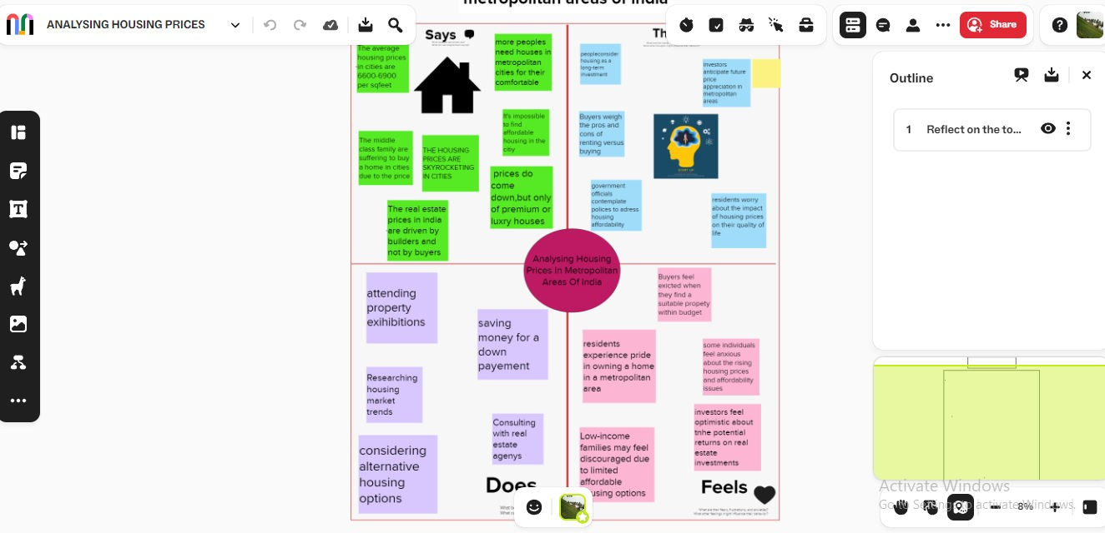
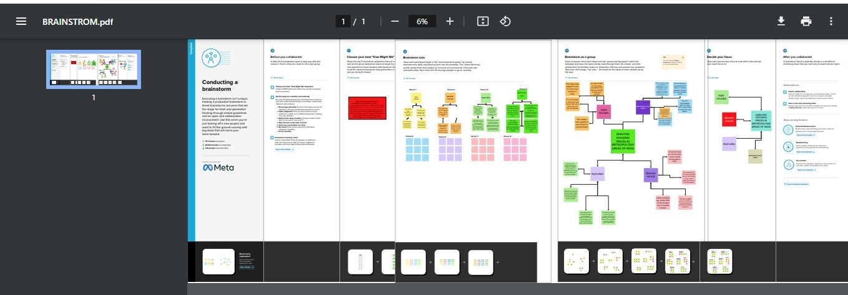
Ideation & Brainstorming Map
3. Result:
Dashboard

Slide 3
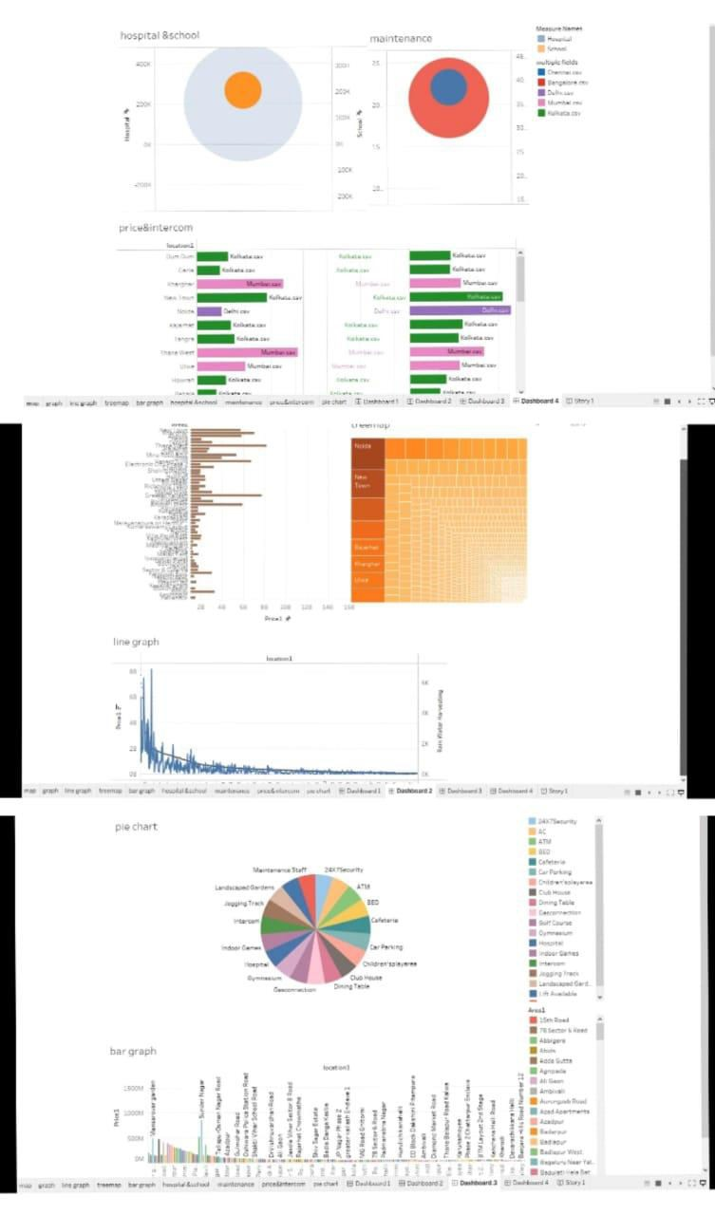
Story

Slide 4
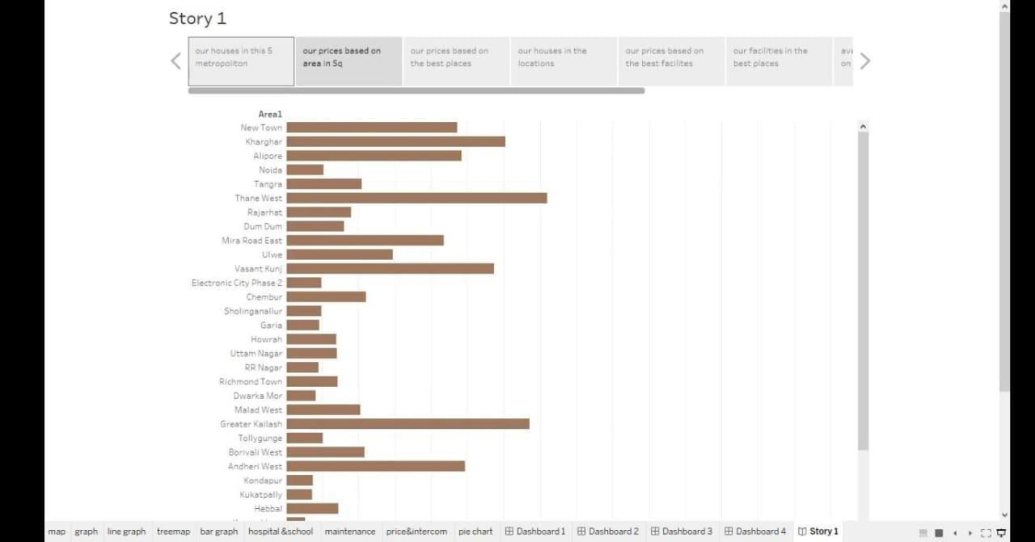
4.Advantages
House price prediction can help the developer determine the selling price of a house and can help the customer to arrange the right time to purchase a house. There are three factors that influence the price of a house which include physical conditions, concept and location.
As a resident of the metropolitan area you are located closer to the city. In the city you have better opportunities for jobs with higher paying salaries. You also have better access to public transportation. There is generally a more diverse population and lifestyle.
Security, convenience, low maintenance and extra features such as a pool, make apartment living attractive to buyers and tenants alike
Disadvantages
The disadvantages of owning a home mostly fall into the category of permanence, with a dash of financial uncertainty. Buying a new house costs money, and a lot of that money comes out of your pocket at the time of the purchase. Later, there are no guarantees that home prices will rise.
Modern buildings use materials like asbestos, lead, etc., which are very hazardous and are not recyclable or disposable, these materials harm the environment and promote global warming and pollution.
The problems of metropolitan areas in India start mainly due to overcrowding, bad living conditions, lack of basic facilities, high unemployment, extreme poverty and lack

Slide 5
of social infrastructure. The government needs to provide jobs, education, healthcare and infrastructure to solve urban poverty in India.
Application
House price prediction can help the developer determine the selling price of a house and can help the customer to arrange the right time to purchase a house. The values of X and Y variables are training datasets for the model representation of linear regression.
conclusion
This paper analyzes whether the Law of One Price (LOOP) holds in the housing market of fifteen metropolitan areas in India, namely Delhi, Mumbai, Bengaluru, Kolkata, Chennai, Jaipur, Lucknow, Hyderabad, Pune, Surat, Ahmedabad, Patna, Faridabad, Kochi and Bhopal. We test the existence of LOOP using the Im, Pesaran and Shin (2003) panel unit root test based on quarterly data on residential property prices covering the period of 2007Q1 to 2011Q4 of the Indian housing market. Based on the criterion of price convergence, house prices in the 15 metropolitan cities do not converge to the LOOP. This implies that the housing markets in the different areas operate as segmented independent local markets. Therefore, house prices in one location in India cannot impose a competitive constraint on house prices in other location, and as such a home owner can freely set the price of his house.
Future scope
"India's real estate sector is expected to expand to USD 5.8 trillion or USD 5,833 billion by 2047. This estimated real estate output value will contribute 15.5 per cent to the total economic output in 2047 from an existing share of 7.3 per cent," Naredco-Knight Frank said in a statement.

