Slide 1
Applying Regression Analysis to Investigate Spatiotemporal Variability in Bearded Seal Calls
Megan C. Ferguson
9 December 2021

Slide 2
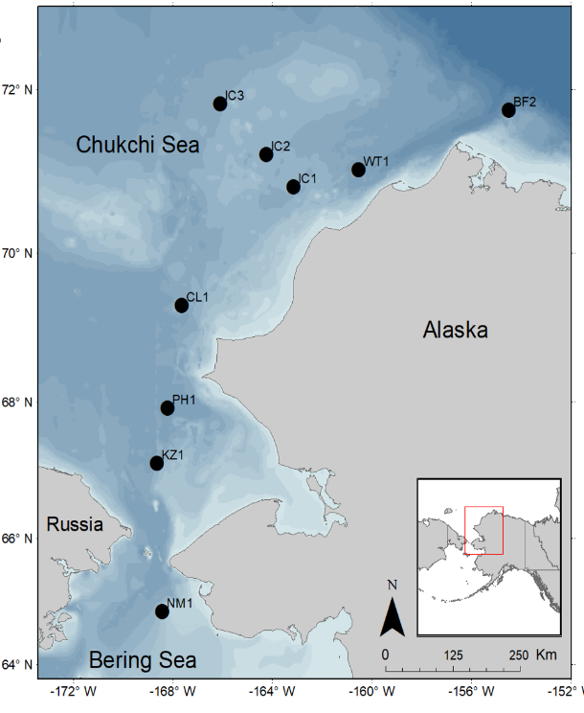
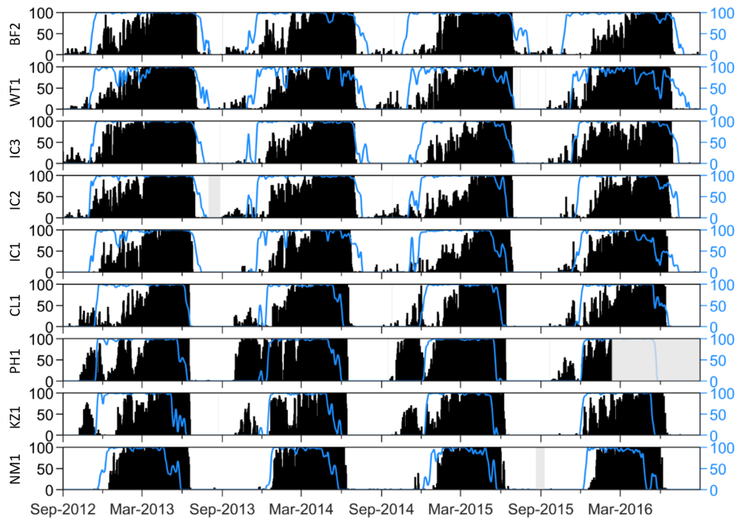
Bearded Seal Case Study
90 s
…
+
-
-
-
+
+
+
+
+
-
+
+
+
-
+
T=0
T=80 or 85 min
T=300 min
-
Experiment or trial with negative outcome: no calls detected during the 90-s interval
+
Experiment or trial with positive outcome: calls detected during the 90-s interval
9 moorings
4 years

Slide 3
In terms of probability
Simple Question: What is the probability of a call at mooring $m_{i}$ on date $d_{j}$ during interval $k$?
For each mooring, collect data on a sample of 90-s intervals between 2012-2016.
Let random variable $Y$ represent the outcome of each trial (interval per mooring per day).
-
Experiment or trial with negative outcome: no calls detected during the 90-s interval
+
Experiment or trial with positive outcome: calls detected during the 90-s interval
Denote each observation as $y_{ijk}$, where $i$ is the mooring index, $j$ is the date index, and $k$ is the interval index.
The possible values for$y_{ijk}$ may be any set of pairs like: {+,-}, {calls present, calls absent}, {success, failure}, {1, 0}.
In the case of one trial per day per mooring, $Y$ is a binary variable.
However, because there are multiple trials per day per mooring, this is a binomial problem.

Slide 4
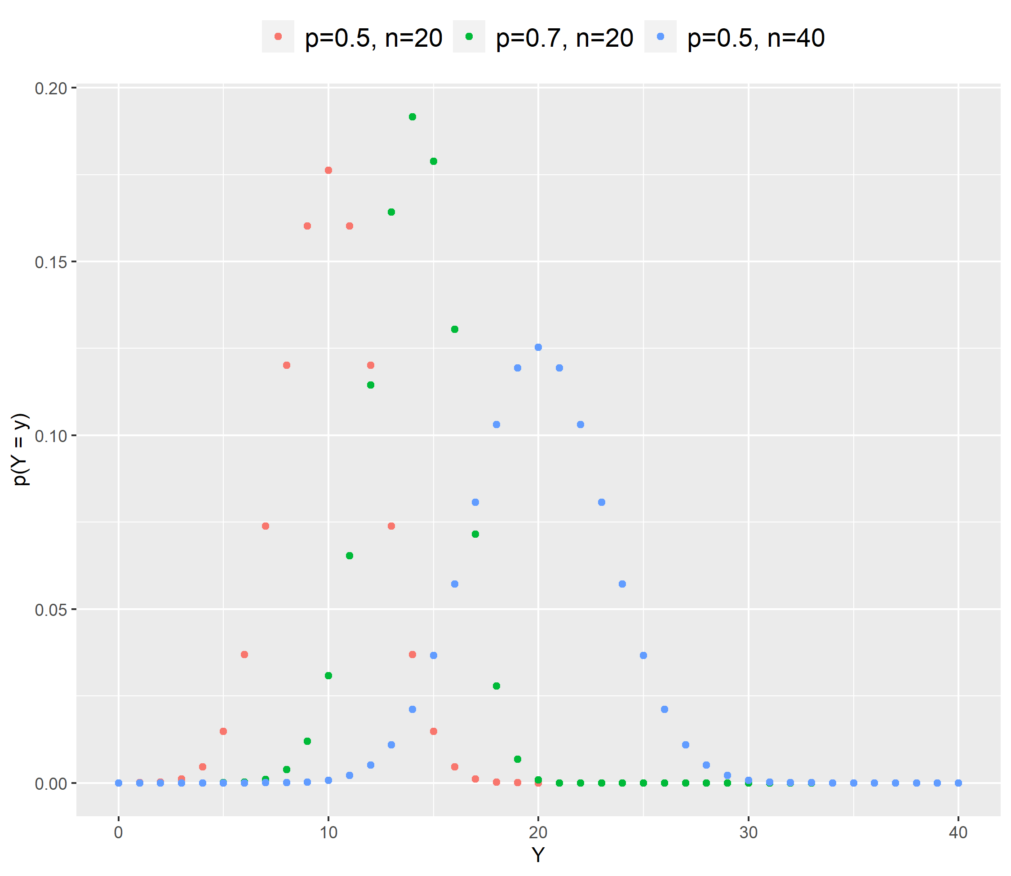
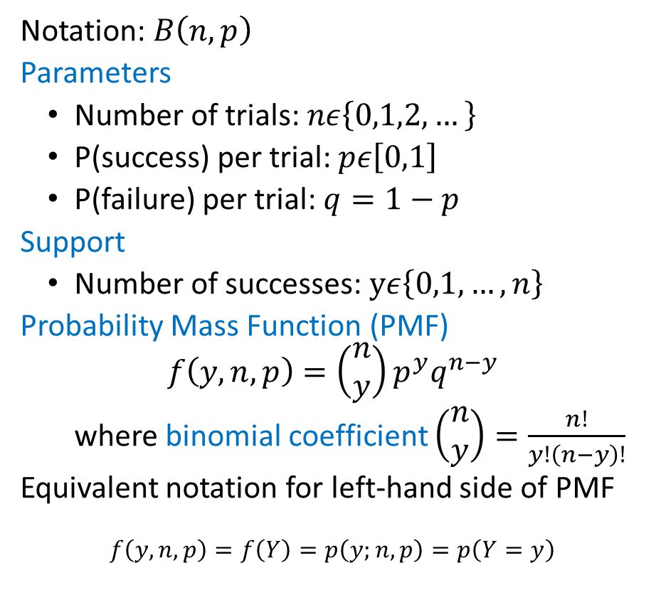
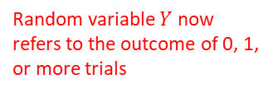
Binomial Probability Distribution
Random variable $Y$ now refers to the outcome of 0, 1, or more trials
Notation: $B\left(n,p\right)$
Parameters
Number of trials: $nε\left\{0,1,2,…\right\}$
P(success) per trial: $pε\left[0,1\right]$
P(failure) per trial: $q=1−p$
Support
Number of successes: $yε\left\{0,1,…,n\right\}$
Probability Mass Function (PMF)
$$f\left(y,n,p\right)=\left(\begin{matrix}n \\ y\end{matrix}\right)p^{y}q^{n−y}$$
where binomial coefficient $\left(\begin{matrix}n \\ y\end{matrix}\right)=\frac{n!}{y!\left(n−y\right)!}$
Equivalent notation for left-hand side of PMF
$$f\left(y,n,p\right)=f\left(Y\right)=p\left(y;n,p\right)=p\left(Y=y\right)$$

Slide 5
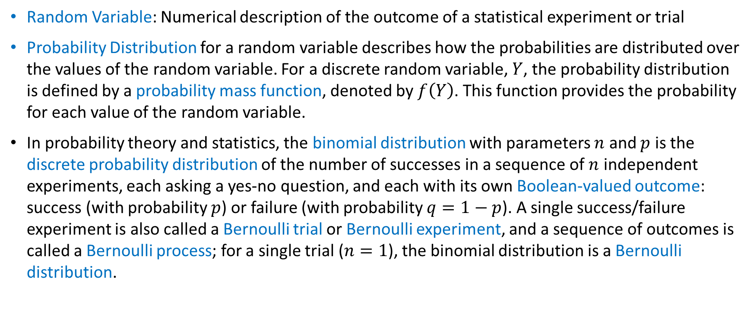
Definitions
Random Variable: Numerical description of the outcome of a statistical experiment or trial
Probability Distribution for a random variable describes how the probabilities are distributed over the values of the random variable. For a discrete random variable, $Y$, the probability distribution is defined by a probability mass function, denoted by $f\left(Y\right)$. This function provides the probability for each value of the random variable.
In probability theory and statistics, the binomial distribution with parameters $n$ and $p$ is the discrete probability distribution of the number of successes in a sequence of $n$ independent experiments, each asking a yes-no question, and each with its own Boolean-valued outcome: success (with probability $p$) or failure (with probability $q=1−p$). A single success/failure experiment is also called a Bernoulli trial or Bernoulli experiment, and a sequence of outcomes is called a Bernoulli process; for a single trial ($n=1$), the binomial distribution is a Bernoulli distribution.

Slide 6
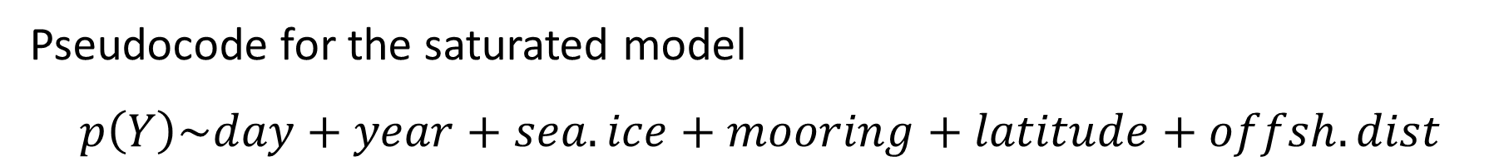
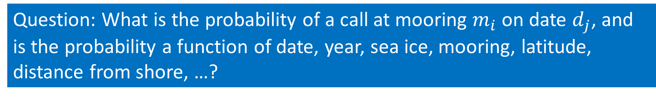
Refining our question
Question: What is the probability of a call at mooring $m_{i}$ on date $d_{j}$, and is the probability a function of date, year, sea ice, mooring, latitude, distance from shore, …?
Pseudocode for the saturated model
$$p\left(Y\right)\sim day+year+sea.ice+mooring+latitude+offsh.dist$$
“is a function of”

Slide 7
Brief* Overview of Regression Models
*For further details and references, see “Overview of Regression Models” section at the end of the presentation

Slide 8
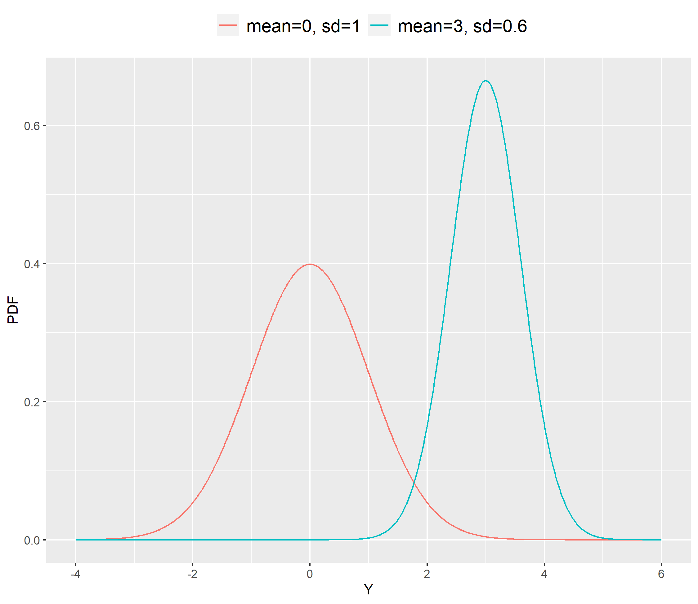
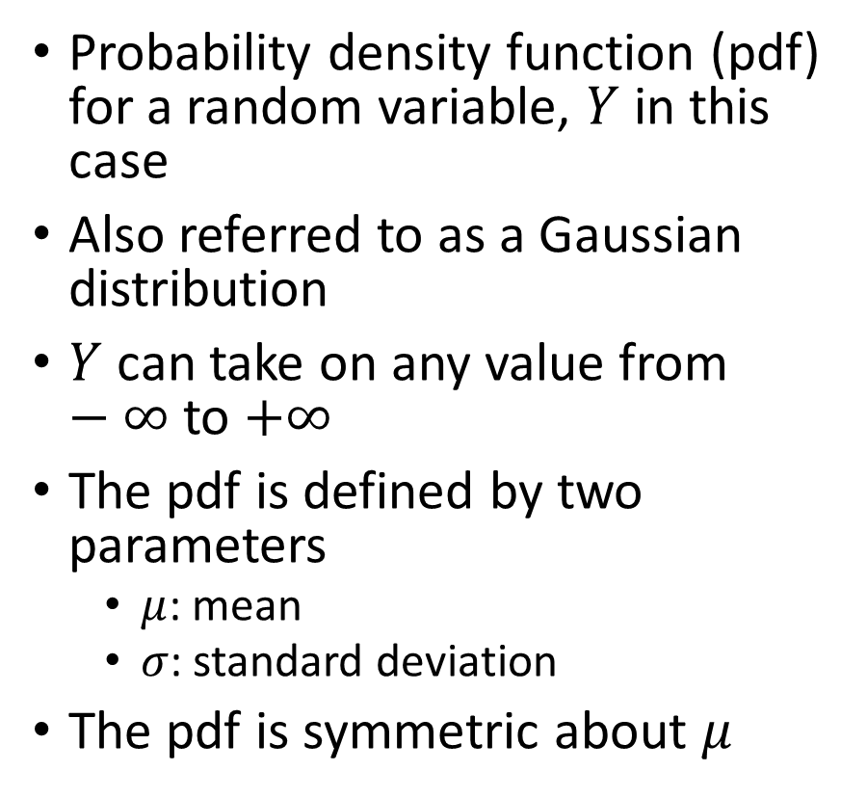
What is the normal distribution?
Probability density function (pdf) for a random variable, $Y$ in this case
Also referred to as a Gaussian distribution
$Y$ can take on any value from $−∞$ to $+∞$
The pdf is defined by two parameters
$μ$: mean
$σ$: standard deviation
The pdf is symmetric about $μ$

Slide 9
Examples of Non-normal Distributions
Continuous
Discrete
Binomial p=0.5
is symmetric; other values of p are asymmetric
Symmetric
Asymmetric

Slide 10
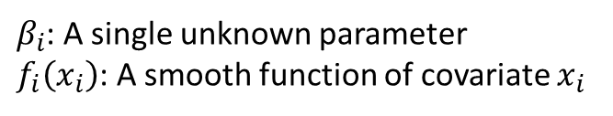
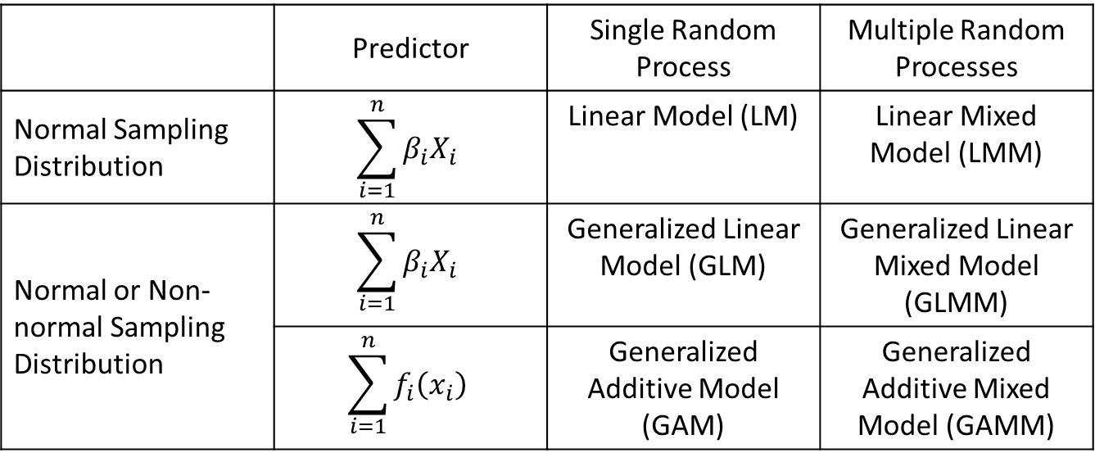
Regression Model Distinguishing Characteristics
 | Predictor | Single Random Process | Multiple Random Processes
Normal Sampling Distribution | $$\sum_{i=1}^{n}{β_{i}X_{i}}$$ | Linear Model (LM) | Linear Mixed Model (LMM)
Normal or Non-normal Sampling Distribution | $$\sum_{i=1}^{n}{β_{i}X_{i}}$$ | Generalized Linear Model (GLM) | Generalized Linear Mixed Model (GLMM)
 | $$\sum_{i=1}^{n}{f_{i}\left(x_{i}\right)}$$ | Generalized Additive Model (GAM) | Generalized Additive Mixed Model (GAMM)
Sometimes called hierarchical GAMs
$β_{i}$: A single unknown parameter
$f_{i}\left(x_{i}\right)$: A smooth function of covariate $x_{i}$

Slide 11
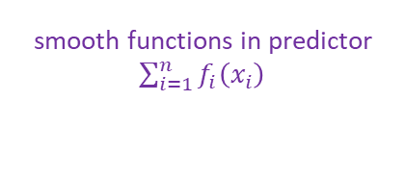
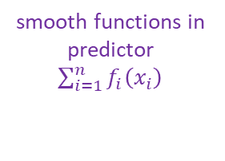
multiple random processes
Generalized Additive Mixed Model
smooth functions in predictor
$\sum_{i=1}^{n}{f_{i}\left(x_{i}\right)}$
Generalized Additive Model
Generalized Linear Mixed Model
smooth functions in predictor
$\sum_{i=1}^{n}{f_{i}\left(x_{i}\right)}$
multiple random processes
non-normal sampling distributions
Generalized Linear Model
Linear Mixed Model
non-normal sampling distributions
multiple random processes
Linear Model

Slide 12
Example Logistic GAM in terms of mgcv
Based on example on pg. 200 of mgcv.pdf.
Step-by-step explanation provided in RegressionModelOverview.r.
library(mgcv)
## simulate binomial data...
set.seed(0)
n.samp <- 400
dat <- gamSim(1,n=n.samp,dist="binary",scale=.33)
p <- binomial()$linkinv(dat$f) ## binomial p
n <- sample(c(1,3),n.samp,replace=TRUE) ## binomial n
dat$y <- rbinom(n,n,p)
dat$n <- n
lr.fit <- gam(y/n~s(x0)+s(x1)+s(x2)+s(x3),family=binomial(link=“logit),data=dat,weights=n,method="REML“)
p(success in one trial)
total number of trials
randomly-generated observations: success or failure
Additive predictor with smooth functions s( ) of predictor variables x0, x1, x2, x3
probability
distribution
link
function
REstricted
Maximum
Likelihood
proportion
of total
trials that
were successful

Slide 13
Back to Bearded Seals

Slide 14
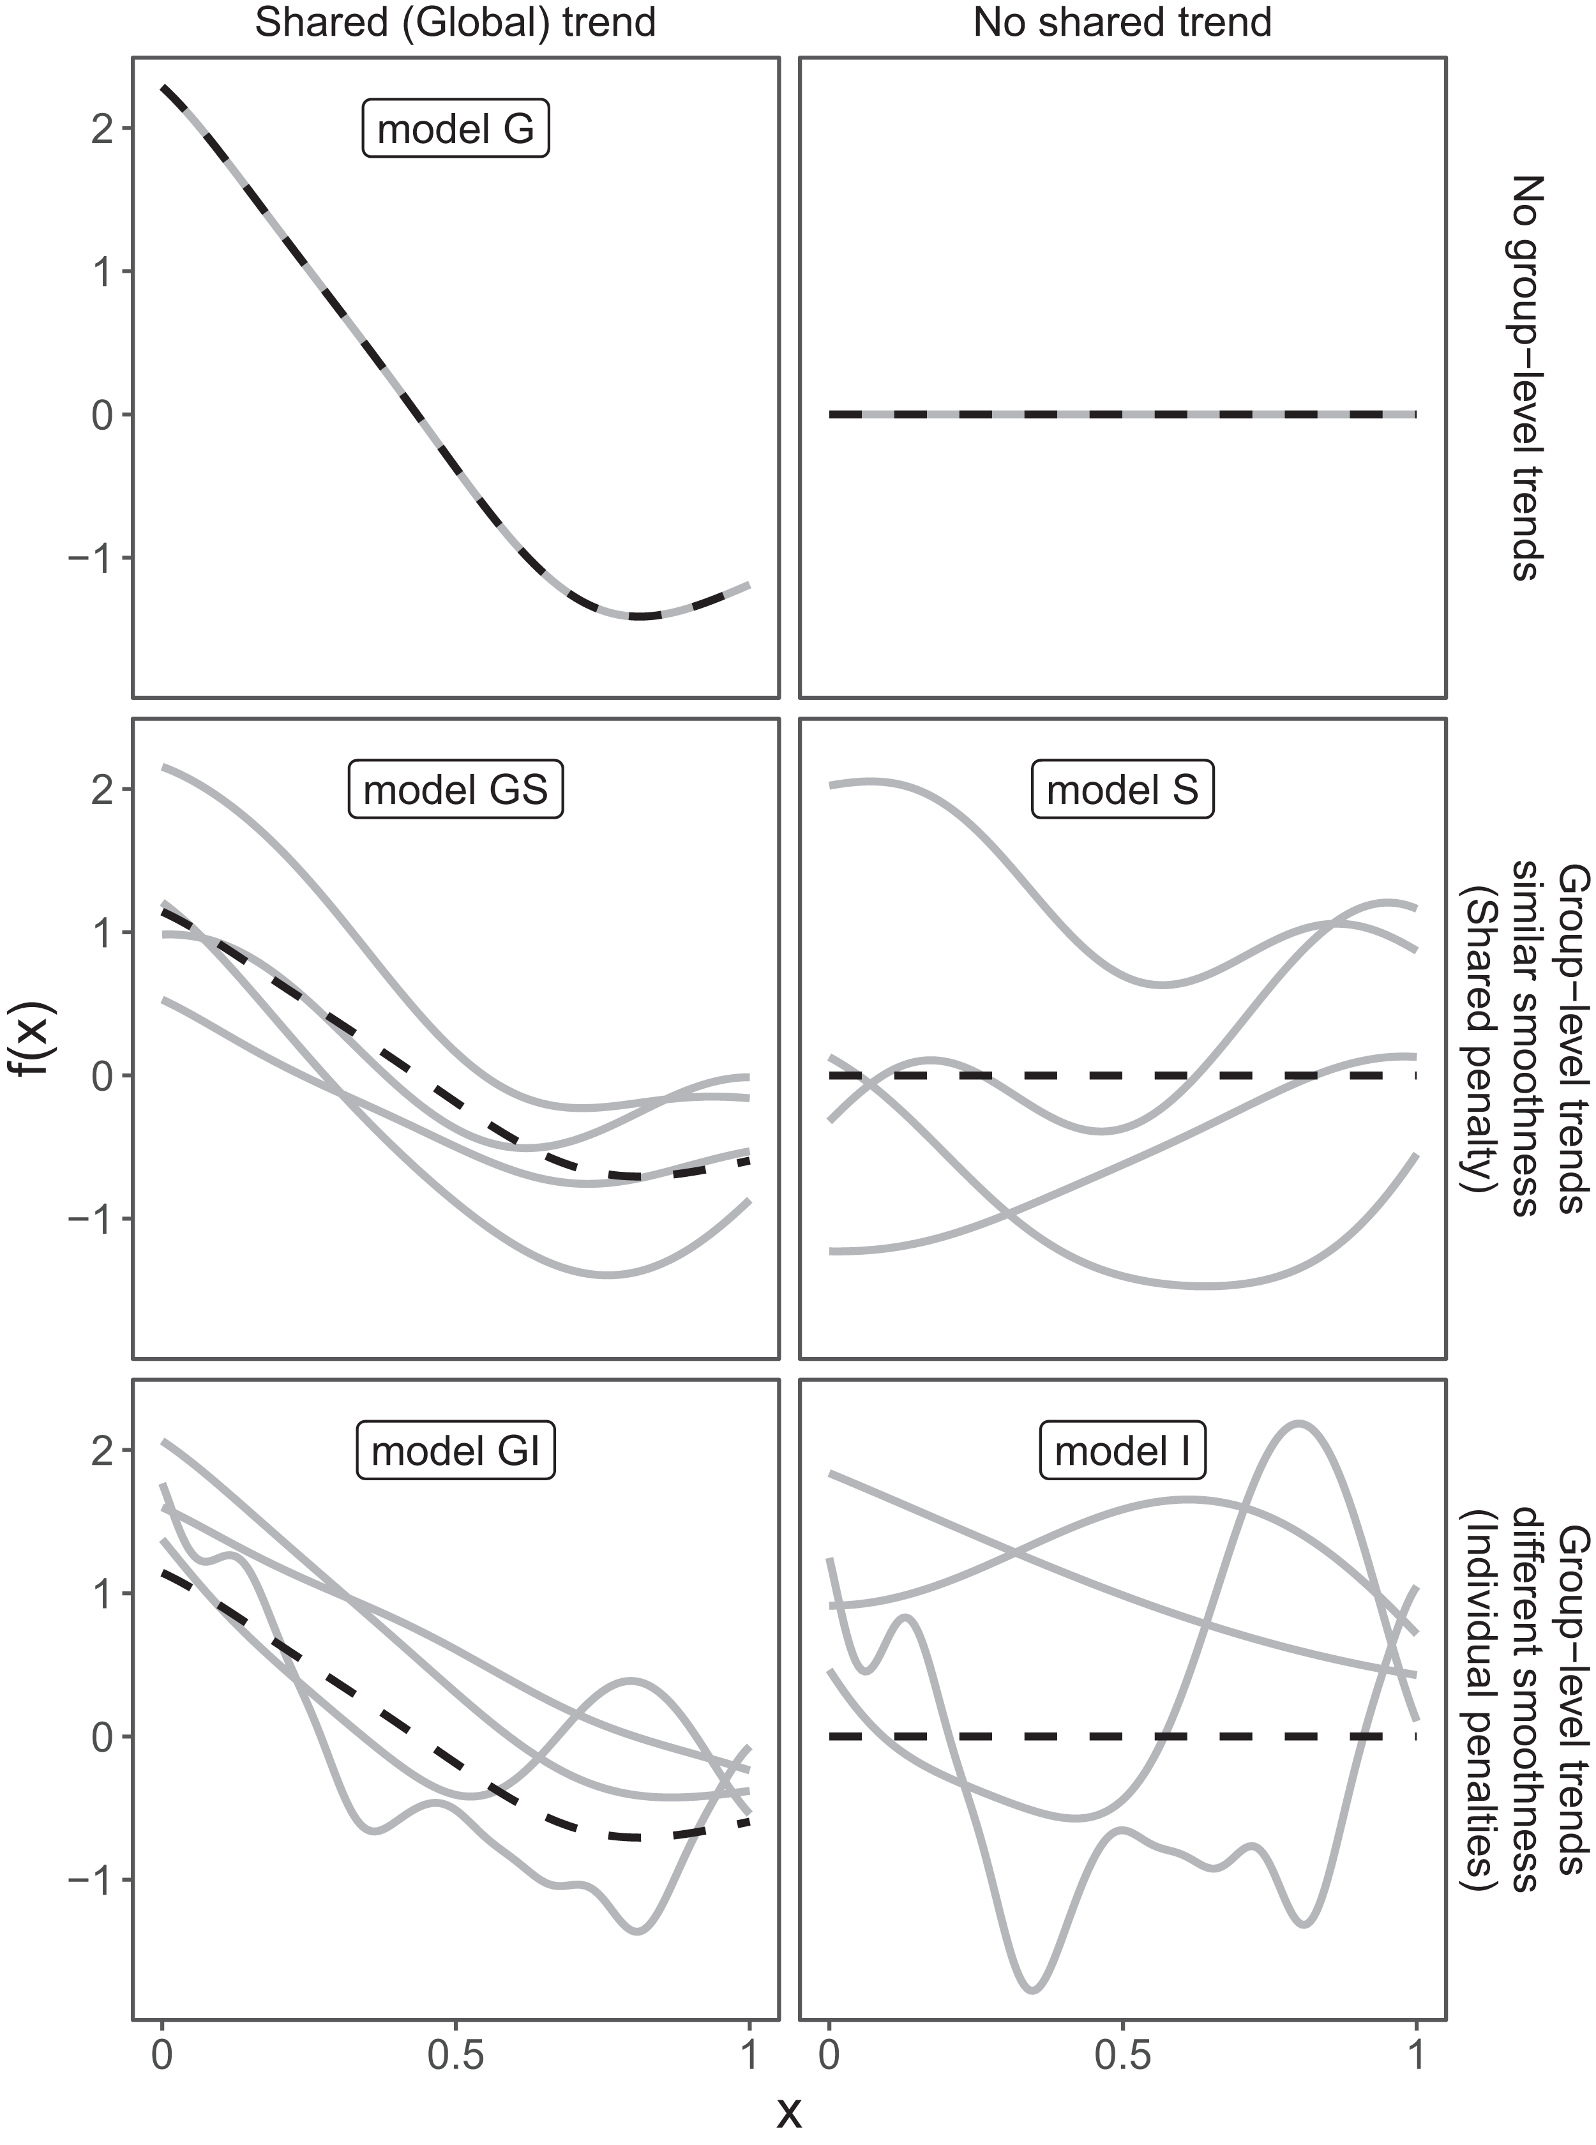
For Starters
Run through code in RegressionModelOverview.r to see how to build different types of GAM and hierarchical GAM models.
The figure to the right is from Pedersen et al. (2019). It is helpful for understanding various types of hierarchical GAMs.
Ideas for next steps are at the bottom of RegressionModelOverview.r.
Pedersen EJ, Miller DL, Simpson GL, Ross N. 2019. Hierarchical generalized additive models in ecology: an introduction with mgcv. PeerJ 7:e6876 https://doi.org/10.7717/peerj.6876

Slide 15
Overview of Regression Models
Megan C. Ferguson
9 December 2021

Slide 16
Goals
Understand the basic structure and differences among different types of regression models (LM, GLM, GAM, LMM, GLMM, GAMM)
Develop intuition for determining when a regression model might help to provide insight into a specific question, given a particular dataset
Understand when and how to add model complexity
Learn basic R programming for regression models based on familiar case studies
Know where to go for help!

Slide 17
What will we not cover except in passing?
Mechanics of parameter estimation and prediction
Model diagnostics: assessing a model’s fit to the data
Model selection: comparing a suite of similar models fit to the data
Correlation structures to handle correlated errors
Hypothesis testing
Maximum likelihood inference
Bayesian inference

Slide 18
Types of Regression Models Covered
Linear model: LM
Generalized linear model: GLM
Generalized additive model: GAM
Linear mixed model: LMM
Sometimes called “linear mixed effects model”
Generalized linear mixed model: GLMM
Sometimes called “generalized linear mixed effects model” or “hierarchical generalized linear model” (HGLM)
Generalized additive mixed model: GAMM
Sometimes called “hierarchical generalized additive model” (HGAM)

Slide 19
What is the normal distribution?
Probability density function (pdf) for a random variable, $Y$ in this case
Also referred to as a Gaussian distribution
$Y$ can take on any value from $−∞$ to $+∞$
The pdf is defined by two parameters
$μ$: mean
$σ$: standard deviation
The pdf is symmetric about $μ$

Slide 20
Examples of Non-normal Distributions

Slide 21
Regression Model Distinguishing Characteristics
 | Predictor | Single Random Process | Multiple Random Processes
Normal Sampling Distribution | $$\sum_{i=1}^{n}{β_{i}X_{i}}$$ | Linear Model (LM) | Linear Mixed Model (LMM)
Normal or Non-normal Sampling Distribution | $$\sum_{i=1}^{n}{β_{i}X_{i}}$$ | Generalized Linear Model (GLM) | Generalized Linear Mixed Model (GLMM)
 | $$\sum_{i=1}^{n}{f_{i}\left(x_{i}\right)}$$ | Generalized Additive Model (GAM) | Generalized Additive Mixed Model (GAMM)
$β_{i}$: A single unknown parameter
$f_{i}\left(x_{i}\right)$: A smooth function of covariate $x_{i}$

Slide 22
multiple random processes
Generalized Additive Mixed Model
smooth functions in predictor
$\sum_{i=1}^{n}{f_{i}\left(x_{i}\right)}$
Generalized Additive Model
Generalized Linear Mixed Model
smooth functions in predictor
$\sum_{i=1}^{n}{f_{i}\left(x_{i}\right)}$
multiple random processes
non-normal sampling distributions
Generalized Linear Model
Linear Mixed Model
non-normal sampling distributions
multiple random processes
Linear Model

Slide 23
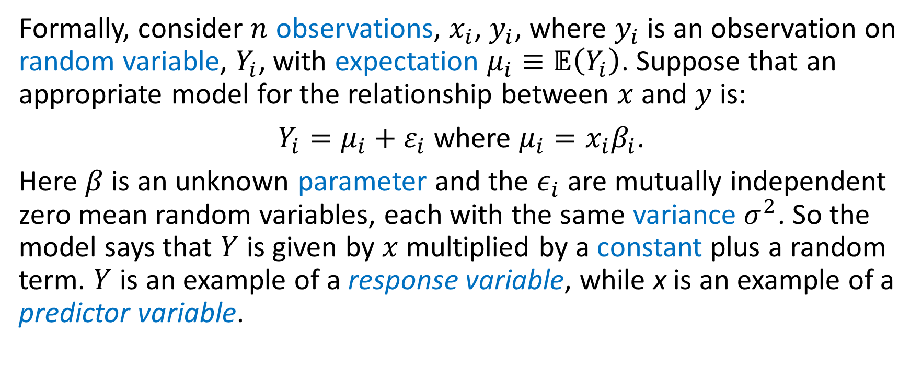
Simple Linear Model (LM): Formal Definition
Formally, consider $n$ observations, $x_{i}$, $y_{i}$, where $y_{i}$ is an observation on random variable, $Y_{i}$, with expectation $μ_{i}≡𝔼\left(Y_{i}\right)$. Suppose that an appropriate model for the relationship between $x$ and $y$ is:
$Y_{i}=μ_{i}+ε_{i}$ where $μ_{i}=x_{i}β_{i}$.
Here $β$ is an unknown parameter and the $ε_{i}$ are mutually independent zero mean random variables, each with the same variance $σ^{2}$. So the model says that $Y$ is given by $x$ multiplied by a constant plus a random term. $Y$ is an example of a response variable, while x is an example of a predictor variable.
Wood, S.N. 2006. Generalized Additive Models: An introduction with R. Chapman & Hall/CRC.
Notes:
Wood 2006 = GAM book

Slide 24
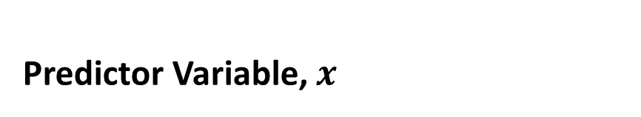

LM: Equivalent Terminology
Response Variable, $Y$
Predictor Variable, $x$
Dependent variable
Independent variable
Driver
Covariate

Slide 25

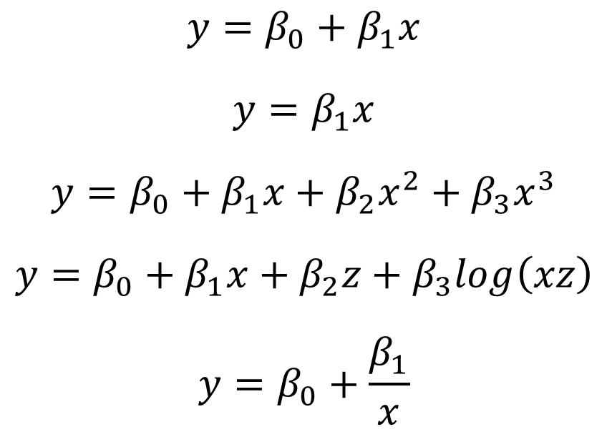
LM Examples
The simple linear model, introduced above, can be generalized by allowing the response variable to depend on multiple predictor variables (plus an additive constant). These extra predictor variables can themselves be transformations of the original predictors. (Wood 2006)
Linear Models
Non-linear Models
$$y=β_{0}+β_{1}x$$
$$y=β_{1}x$$
$$y=β_{0}+β_{1}x+β_{2}x^{2}+β_{3}x^{3}$$
$$y=β_{0}+β_{1}x+β_{2}z+β_{3}log\left(xz\right)$$
$$y=β_{0}+\frac{β_{1}}{x}$$
$$y=β_{0}^{β_{1}x}$$
$$y=\frac{β_{0}}{β_{1}}x$$
$$y={β_{0}∗β}_{1}x$$
$$y=β_{0}∗x^{β_{1}}$$

Slide 26
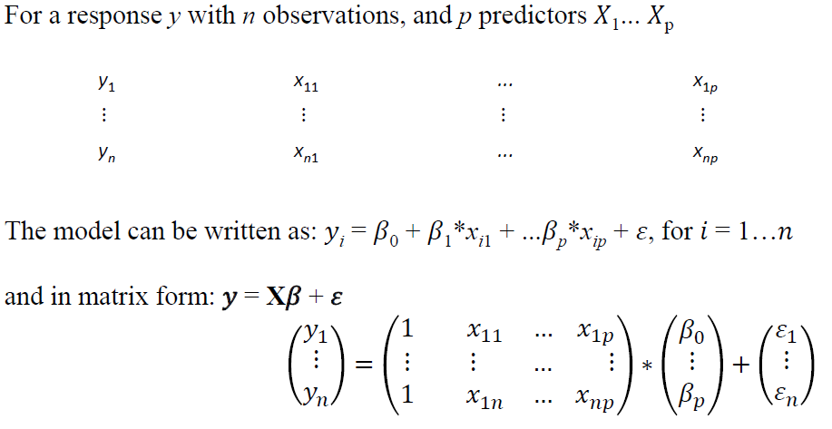
LM Matrix Notation
Parameters
Errors
Design Matrix

Slide 27
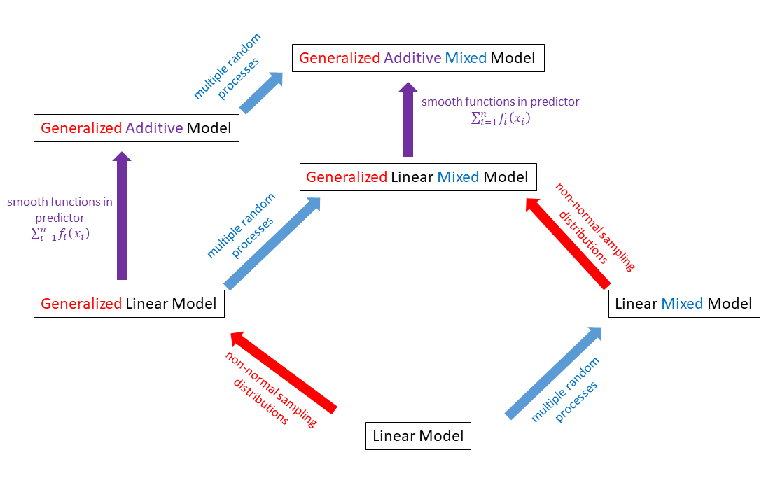
Generalized Linear Model (GLM)
Common approach for a class of regression models with single response variables
Examples: linear, logistic, Poisson regression
General applicability to distributions in the exponential family

Slide 28
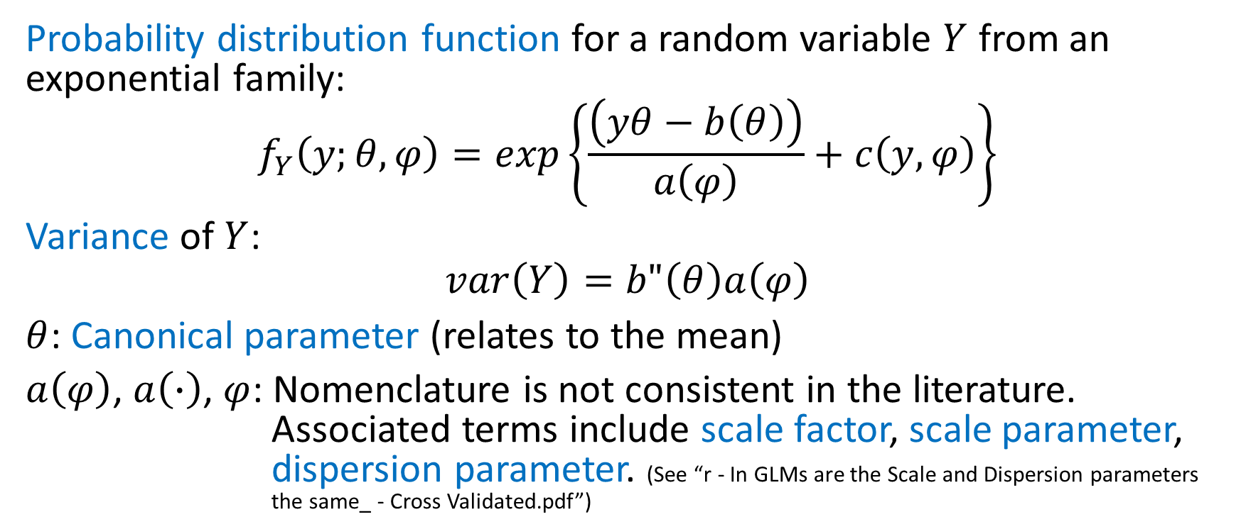
Mathematical form of Probability Distributions in the Exponential Family
Probability distribution function for a random variable $Y$ from an exponential family:
$$f_{Y}\left(y;θ,φ\right)=exp\left\{\frac{\left(yθ−b\left(θ\right)\right)}{a\left(φ\right)}+c\left(y,φ\right)\right\}$$
Variance of $Y$:
$$var\left(Y\right)=b"\left(θ\right)a\left(φ\right)$$
$θ$: Canonical parameter (relates to the mean)
$a\left(φ\right)$, $a\left(∙\right)$, $φ$: Nomenclature is not consistent in the literature. Associated terms include scale factor, scale parameter, dispersion parameter. (See “r - In GLMs are the Scale and Dispersion parameters the same_ - Cross Validated.pdf”)

Slide 29
3 Key Components of a GLM
Random Component
Also referred to as: sampling distribution, error distribution
Systematic Component
Also referred to as: linear model, linear predictor
Link function

Slide 30
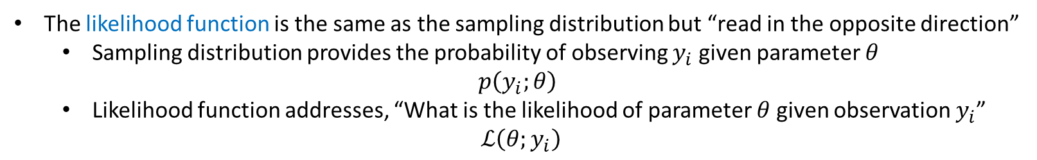
Random Component
Examples of sampling distributions from the exponential family of probability distribution functions
Continuous Distributions
Normal (Gaussian)
Gamma
Beta
Inverse Normal
Exponential
Chi-Square
Dirichlet
Discrete Distributions
Bernoulli
Binomial
Poisson
Negative binomial
Multinomial
Geometric
Zero-inflated…
A probability distribution functions for a continuous distribution is referred to as a probability density function (pdf). The term for a discrete distribution is probability mass function (pmf).
The likelihood function is the same as the sampling distribution but “read in the opposite direction”
Sampling distribution provides the probability of observing $y_{i}$ given parameter $θ$
$p\left(y_{i};θ\right)$
Likelihood function addresses, “What is the likelihood of parameter $θ$ given observation $y_{i}$”
$$ℒ\left(θ;y_{i}\right)$$
Mathematical notation:$Y_{i}\sim$ some exponential family distribution

Slide 31

Systematic Component
Covariates $x_{1}$, $x_{2}$, $x_{3}$,…, $x_{p}$ produce a linear predictor $η$ given by:
$η=β_{1}x_{1}+β_{2}x_{2}$+$β_{3}x_{3}$+…+$β_{p}x_{p}$
$$η=\sum_{j=1}^{p}{β_{j}x_{j}}$$

Slide 32
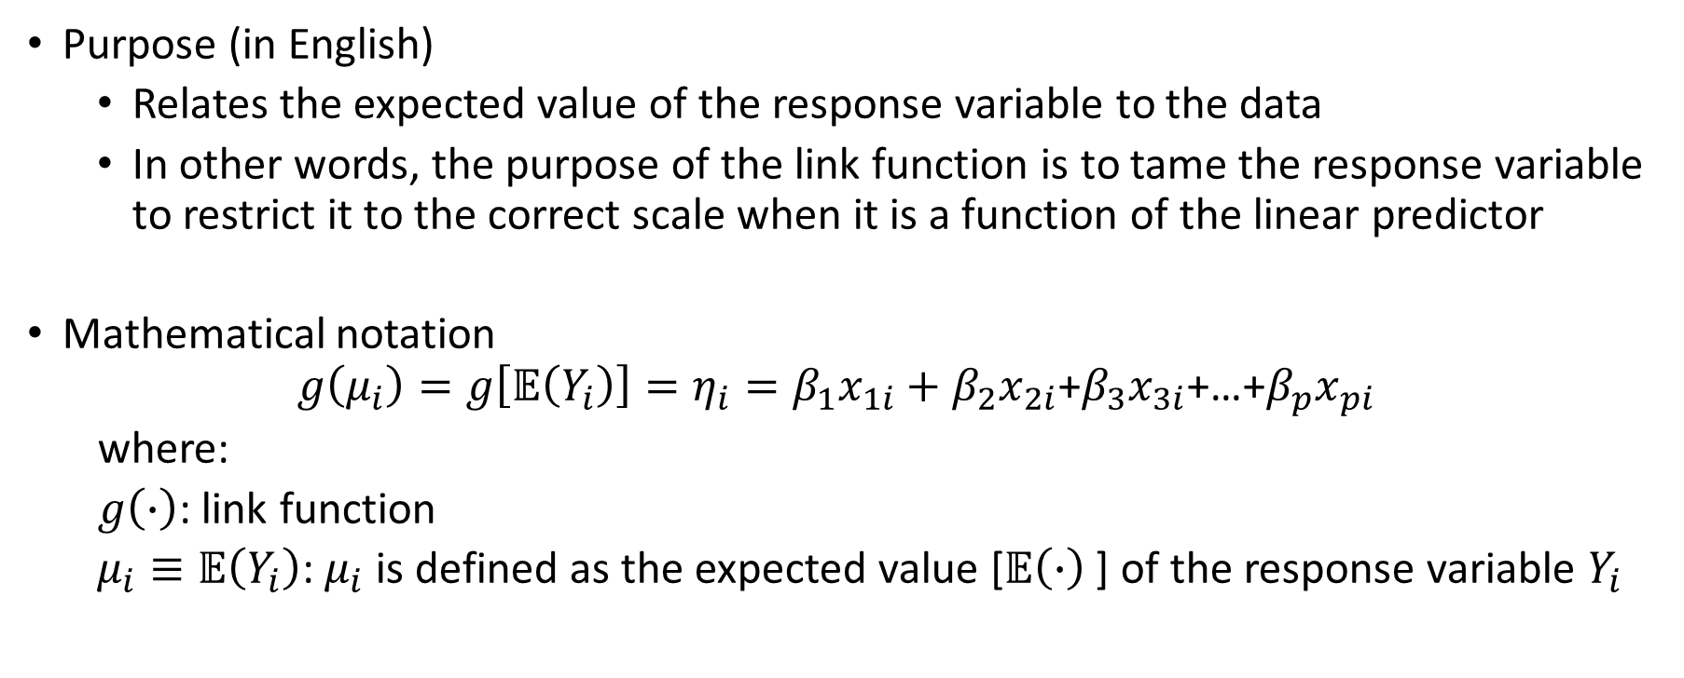
Link Function
Purpose (in English)
Relates the expected value of the response variable to the data
In other words, the purpose of the link function is to tame the response variable to restrict it to the correct scale when it is a function of the linear predictor
Mathematical notation
$$g\left(μ_{i}\right)=g\left[𝔼\left(Y_{i}\right)\right]=η_{i}=β_{1}x_{1i}+β_{2}x_{2i}\text{+}β_{3}x_{3i}\text{+…+}β_{p}x_{pi}$$
where:
$g\left(∙\right)$: link function
$μ_{i}≡𝔼\left(Y_{i}\right)$: $μ_{i}$ is defined as the expected value [$𝔼\left(∙\right)$] of the response variable $Y_{i}$

Slide 33
Canonical Link Function
Each exponential family distribution has a special link function called a canonical link function
Using the canonical link leads the model to have desirable statistical properties
Notes:
See crawley_cap16.pdf p. 3 for derivation of the logit and its relationship to parameter p of the binomial distribution.

Slide 34
A few GLM References
“Module11_Generalized Linear Models_TL Zhang.pdf”
Barry, S. C. and A. H. Welsh (2002). "Generalized additive modelling and zero inflated count data." Ecological Modelling 157: 179-188.
Ghosh, S. K., P. Mukhopadhyay, et al. (2006). "Bayesian analysis of zero-inflated regression models." Journal of Statistical Planning and Inference 136(4): 1360-1375.
McCullagh, P. and J.A. Nelder. 1999. Generalized linear models. Chapman & Hall/CRC.
Ver Hoef, J. M., & Boveng, P. L. (2007). QUASI-POISSON VS. NEGATIVE BINOMIAL REGRESSION: HOW SHOULD WE MODEL OVERDISPERSED COUNT DATA? Ecology, 88(11), 2766-2772. doi:10.1890/07-0043.1
Warton, D. I. (2005). "Many zeros does not mean zero inflation: comparing the goodness-of-fit of parametric models to multivariate abundance data." Environmetrics 16: 275-289.

Slide 35
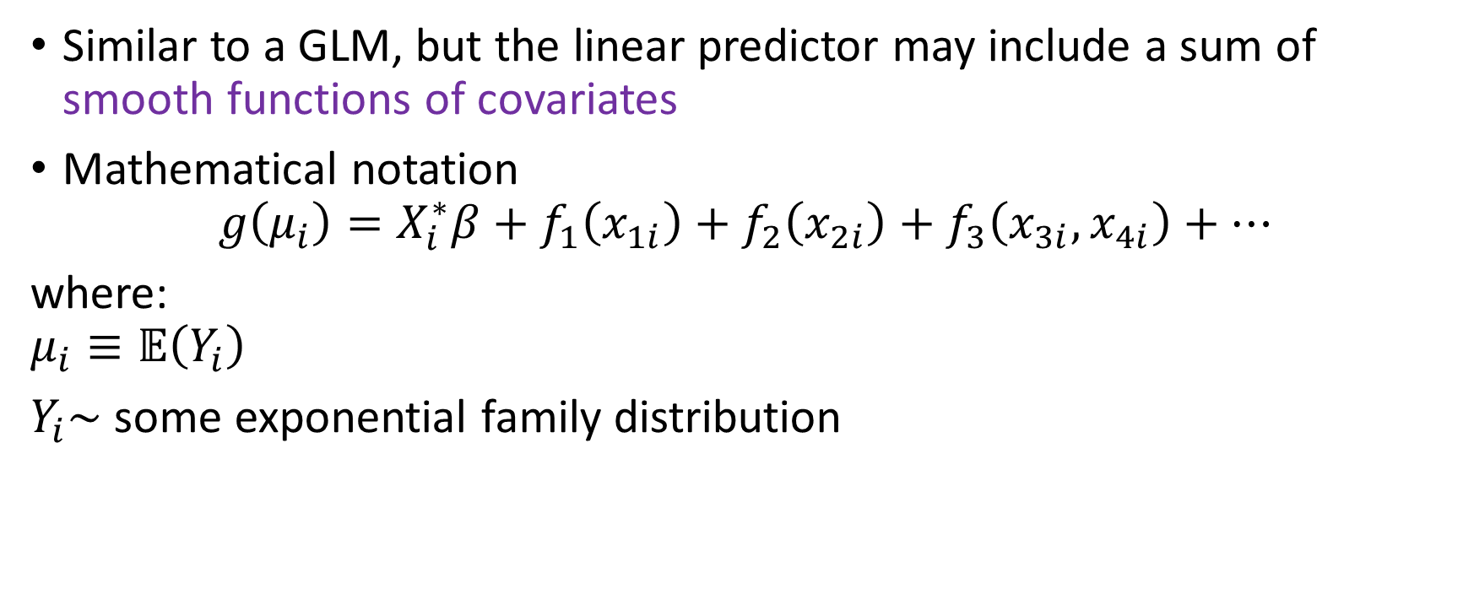
Generalized Additive Model (GAM)
Similar to a GLM, but the linear predictor may include a sum of smooth functions of covariates
Mathematical notation
$$g\left(μ_{i}\right)=X_{i}^{∗}β+f_{1}\left(x_{1i}\right)+f_{2}\left(x_{2i}\right)+f_{3}\left(x_{3i},x_{4i}\right)+…$$
where:
$$μ_{i}≡𝔼\left(Y_{i}\right)$$
$Y_{i}\sim$ some exponential family distribution
We’ve seen this before!

Slide 36
Intro to the Linear Mixed Model (LMM)
A linear mixed model accommodates multiple random processes by adding random effects
Why would you want to incorporate multiple random effects?
Account for variation across a population and make inference to that larger population
Use the population mean to strengthen estimates for groups in the population with poor or limited data
Account for within-sample correlation when observations are grouped (repeated measures)

Slide 37
Fixed Effects vs. Random Effects
Fixed Effects
Random Effects
Interest in specific levels of these factors
Not interpreted as coming from a larger population
Factor levels sampled from a distribution
Recognition of correlation structure in data because data are:
Nested
Fish within schools, multiple schools measured
Longitudinal
Repeated observations on individual objects through time
Spatial
Locations closer in space are more similar than distant locations

Slide 38
Random Effects Structures
Random intercepts
Random slopes
Random intercepts and slopes
Nested effects
Crossed effects
Harrison, X. A., Donaldson, L., Correa-Cano, M. E., Evans, J., Fisher, D. N., Goodwin, C. E. D., . . . Inger, R. (2018). A brief introduction to mixed effects modelling and multi-model inference in ecology. PeerJ, 6, e4794. doi:10.7717/peerj.4794
Schielzeth, H., & Nakagawa, S. (2013). Nested by design: model fitting and interpretation in a mixed model era. Methods in Ecology and Evolution, 4(1), 14-24. doi:10.1111/j.2041-210x.2012.00251.x

Slide 39

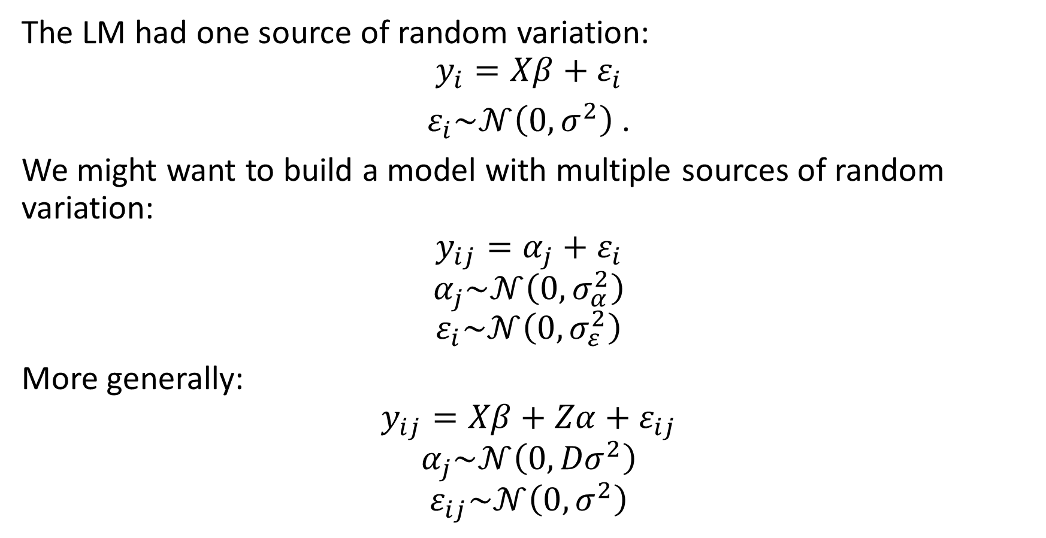

LMM Mathematical Notation
The LM had one source of random variation:
$$y_{i}=Xβ+ε_{i}$$
$ε_{i}\sim 𝒩\left(0,σ^{2}\right)$ .
We might want to build a model with multiple sources of random variation:
$$y_{ij}=α_{j}+ε_{i}$$
$$α_{j}\sim 𝒩\left(0,σ_{α}^{2}\right)$$
$$ε_{i}\sim 𝒩\left(0,σ_{ε}^{2}\right)$$
More generally:
$$y_{ij}=Xβ+Zα+ε_{ij}$$
$$α_{j}\sim 𝒩\left(0,{Dσ}^{2}\right)$$
$$ε_{ij}\sim 𝒩\left(0,σ^{2}\right)$$
$Z$: Random Effect Design Matrix
$D$: Random Effect Variance-Covariance Matrix

Slide 40
Random Effects: Advantages & Challenges
Advantages
Challenges
Broadens inference to a larger population
Represents a “compromise” in terms of information used
Ignore factor levels: pool all levels of the factor
Fixed effects: no pooling
Random effects: partial pooling, with degree of pooling dependent on relative size of among-group and within-group variation, and on sample size
With too few levels, estimates are imprecise
Factors with less than 5-10 levels are typically treated as fixed effects
Random effects are often more difficult to understand or explain

Slide 41
To be continued.

