Slide 1
Overview of Regression Models
Megan C. Ferguson
7 December 2021

Slide 2
Goals
Understand the basic structure and differences among regression models
Develop intuition for determining when a regression model might help to provide insight into a question, given a particular dataset
Understand when and how to add model complexity
Learn basic R programming for regression models
Know where to go for help!

Slide 3
What will we not cover except in passing?
Mechanics of parameter estimation and prediction
Model diagnostics (assessing model fit)
Model selection (choosing among a suite of similar models)
Correlation structures to handle correlated errors
Hypothesis testing
Maximum likelihood estimation
Bayesian inference

Slide 4
Types of Regression Models Covered
Linear model (LM)
Linear mixed model (LMM)
Equivalently, “linear mixed effects model”
Generalized linear model (GLM)
Generalized linear mixed model (GLMM)
Equivalently, “generalized linear mixed effects model” or “hierarchical generalized linear model” (HGLM)
Generalized additive model (GAM)
Generalized additive mixed model (GAMM)
Equivalently, “hierarchical generalized additive model” HGAM

Slide 5
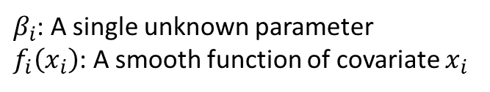
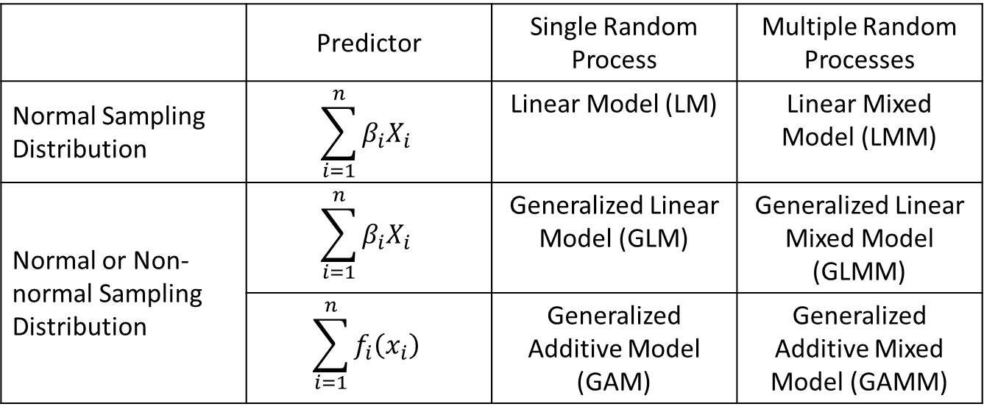
 | Predictor | Single Random Process | Multiple Random Processes
Normal Sampling Distribution | $$\sum_{i=1}^{n}{β_{i}X_{i}}$$ | Linear Model (LM) | Linear Mixed Model (LMM)
Normal or Non-normal Sampling Distribution | $$\sum_{i=1}^{n}{β_{i}X_{i}}$$ | Generalized Linear Model (GLM) | Generalized Linear Mixed Model (GLMM)
 | $$\sum_{i=1}^{n}{f_{i}\left(x_{i}\right)}$$ | Generalized Additive Model (GAM) | Generalized Additive Mixed Model (GAMM)
$β_{i}$: A single unknown parameter
$f_{i}\left(x_{i}\right)$: A smooth function of covariate $x_{i}$

Slide 6
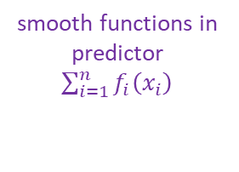
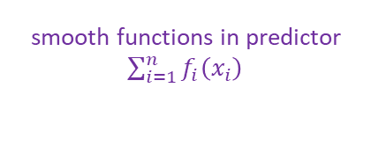
multiple random processes
Generalized Additive Mixed Model
smooth functions in predictor
$\sum_{i=1}^{n}{f_{i}\left(x_{i}\right)}$
Generalized Additive Model
Generalized Linear Mixed Model
smooth functions in predictor
$\sum_{i=1}^{n}{f_{i}\left(x_{i}\right)}$
multiple random processes
non-normal sampling distributions
Generalized Linear Model
Linear Mixed Model
non-normal sampling distributions
multiple random processes
Linear Model

Slide 7
Linear Model (LM)

