Slide 1
Overview of Regression Models
Megan C. Ferguson
7 December 2021

Slide 2
Goals
Understand the basic structure and differences among different types of regression models (LM, LMM, GLM, GLMM, GAM, GAMM)
Develop intuition for determining when a regression model might help to provide insight into a specific question, given a particular dataset
Understand when and how to add model complexity
Learn basic R programming for regression models based on familiar case studies
Know where to go for help!

Slide 3
What will we not cover except in passing?
Mechanics of parameter estimation and prediction
Model diagnostics: assessing a model’s fit to the data
Model selection: comparing a suite of similar models fit to the data
Correlation structures to handle correlated errors
Hypothesis testing
Maximum likelihood inference
Bayesian inference

Slide 4
Types of Regression Models Covered
Linear model: LM
Linear mixed model: LMM
Sometimes called “linear mixed effects model”
Generalized linear model: GLM
Generalized linear mixed model: GLMM
Sometimes called “generalized linear mixed effects model” or “hierarchical generalized linear model” (HGLM)
Generalized additive model: GAM
Generalized additive mixed model: GAMM
Sometimes called “hierarchical generalized additive model” (HGAM)

Slide 5
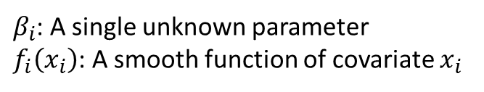
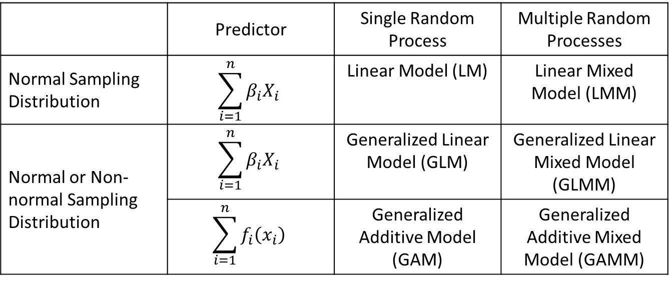
Regression Model Distinguishing Characteristics
 | Predictor | Single Random Process | Multiple Random Processes
Normal Sampling Distribution | $$\sum_{i=1}^{n}{β_{i}X_{i}}$$ | Linear Model (LM) | Linear Mixed Model (LMM)
Normal or Non-normal Sampling Distribution | $$\sum_{i=1}^{n}{β_{i}X_{i}}$$ | Generalized Linear Model (GLM) | Generalized Linear Mixed Model (GLMM)
 | $$\sum_{i=1}^{n}{f_{i}\left(x_{i}\right)}$$ | Generalized Additive Model (GAM) | Generalized Additive Mixed Model (GAMM)
$β_{i}$: A single unknown parameter
$f_{i}\left(x_{i}\right)$: A smooth function of covariate $x_{i}$

Slide 6
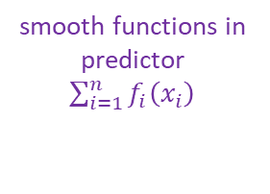
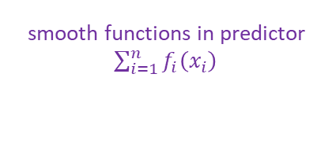
multiple random processes
Generalized Additive Mixed Model
smooth functions in predictor
$\sum_{i=1}^{n}{f_{i}\left(x_{i}\right)}$
Generalized Additive Model
Generalized Linear Mixed Model
smooth functions in predictor
$\sum_{i=1}^{n}{f_{i}\left(x_{i}\right)}$
multiple random processes
non-normal sampling distributions
Generalized Linear Model
Linear Mixed Model
non-normal sampling distributions
multiple random processes
Linear Model

Slide 7
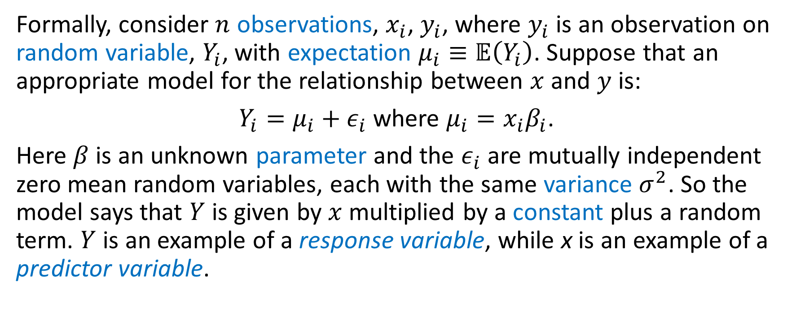
Simple Linear Model (LM): Formal Definition
Formally, consider $n$ observations, $x_{i}$, $y_{i}$, where $y_{i}$ is an observation on random variable, $Y_{i}$, with expectation $μ_{i}≡𝔼\left(Y_{i}\right)$. Suppose that an appropriate model for the relationship between $x$ and $y$ is:
$Y_{i}=μ_{i}+ε_{i}$ where $μ_{i}=x_{i}β_{i}$.
Here $β$ is an unknown parameter and the $ε_{i}$ are mutually independent zero mean random variables, each with the same variance $σ^{2}$. So the model says that $Y$ is given by $x$ multiplied by a constant plus a random term. $Y$ is an example of a response variable, while x is an example of a predictor variable.
(Wood 2006)
Notes:
Wood 2006 = GAM book

