Slide 1
Chapter 20
Management of Patients with Chronic Pulmonary Disease

Slide 2
Chronic Pulmonary Disease
Chronic obstructive pulmonary disease (COPD) is a slowly progressive respiratory disease of airflow obstruction
  Chronic bronchitis, emphysema
  Preventable and treatable but not fully reversible
  Involving the airways, pulmonary parenchyma, or both
  Fourth leading cause of death in the United States for people of all ages
Other chronic pulmonary diseases
  Bronchiectasis, asthma, cystic fibrosis
Notes:
Chronic obstructive pulmonary disease (COPD) is a preventable and treatable slowly progressive respiratory disease of airflow obstruction involving the airways, pulmonary parenchyma, or both (Global Initiative for Chronic Obstructive Lung Disease [GOLD], 2019). The airflow limitation or obstruction in COPD is not fully reversible. Most patients with COPD present with overlapping signs and symptoms of emphysema and chronic bronchitis, which are two distinct disease processes.
Other diseases such as cystic fibrosis (CF), bronchiectasis, and asthma are classified as chronic pulmonary disorders

Slide 3
Pathophysiology of COPD
Airflow limitation is progressive, associated with abnormal inflammatory response to noxious particles or gases
Chronic inflammation damages tissue
Scar tissue in airways results in narrowing
Scar tissue in the parenchyma decreases elastic recoil (compliance)
Scar tissue in pulmonary vasculature causes thickened vessel lining and hypertrophy of smooth muscle (pulmonary hypertension)
Notes:
COPD accentuates and accelerates these physiologic changes normally associated with aging. Airflow limitation with an abnormal inflammatory response to noxious particles or gases. In the trachea and bronchi greater than 2 mm in diameter, there is an increased in the numbers of goblet cells and enlarged submucosal glands, which lead to hypersecretion of mucus. In the peripheral airways (bronchioles less than 2 mm diameter), inflammation causes thickening of the airway wall, peribronchial fibrosis, exudate in the airway, and overall airway narrowing (obstructive bronchiolitis). Over time, scar tissue forms and results in a narrowing of the airway lumen (GOLD, 2019). Alveolar wall destruction leads to loss of alveolar attachments and a decrease in elastic recoil. Finally, the chronic inflammatory process causes thickening of the lining of the vessel and hypertrophy of smooth muscle, which may lead to pulmonary hypertension (GOLD, 2019).

Slide 4
Chronic Bronchitis
Cough and sputum production for at least 3 months in each of 2 consecutive years
Ciliary function is reduced, bronchial walls thicken, bronchial airways narrow, and mucous may plug airways
Alveoli become damaged, fibrosed, and alveolar macrophage function diminishes
The patient is more susceptible to respiratory infections
Notes:
Chronic bronchitis is defined as the presence of cough and sputum production for at least 3 months in each of 2 consecutive years.
Sometimes smoke or other environmental pollutants irritate the airways, resulting in inflammation and hypersecretion of mucus. Constant irritation causes the mucus-secreting glands and goblet cells to increase in number, leading to increased mucus production. Mucus plugging of the airway reduces ciliary function. Bronchial walls thicken causing narrowing the lumen of the bronchioles. The alveoli become damaged and the macrophage function diminishes. For that reason, the patient may become more susceptible to respiratory infections.

Slide 5
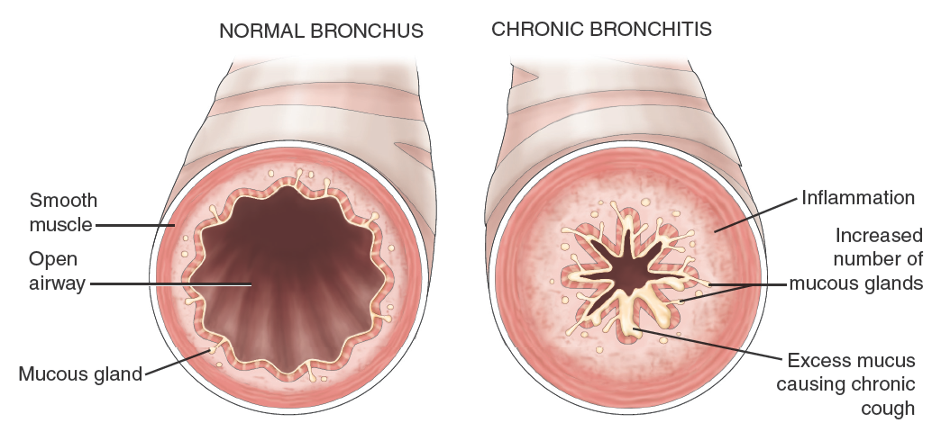
Pathophysiology of Chronic Bronchitis

Slide 6
Question #1
Is the following statement true or false?
Patients with chronic bronchitis are more susceptible to respiratory infection.

Slide 7
Answer to Question #1
True
Rationale: The functions of alveolar macrophages are altered in patients with chronic bronchitis. Macrophages are essential to destroy foreign materials, such as bacteria. Without functional macrophages, bacterial, viral and mycoplasma infections become more likely with acute episodes of bronchitis. Exacerbations of chronic bronchitis are most likely to occur during the winter when viral and bacterial infections are more prevalent.

Slide 8
Clinical Manifestations of COPD
Three primary symptoms
  Chronic cough
  Sputum production
  Dyspnea
Weight loss due to dyspnea
“Barrel chest”
Notes:
COPD is a progressive disease characterized by three primary symptoms: chronic cough, sputum production, and dyspnea.

Slide 9
Emphysema
Type of COPD
Destruction of the walls of overdistended alveoli
  Result in impaired oxygen and carbon dioxide exchange
Notes:
Emphysema is a pathologic term that describes an abnormal distention of the airspaces beyond the terminal bronchioles and destruction of the walls of the alveoli
There are two main types of emphysema, In one type, there is destruction of the respiratory bronchiole, alveolar duct, and alveolus. All airspaces within the lobule are essentially enlarged, but there is little inflammatory disease. A hyperinflated (hyperexpanded) chest, marked dyspnea on exertion, and weight loss typically occur.
In the other form, pathologic changes take place mainly in the center of the secondary lobule, The ventilation–perfusion ratios may be effected causing chronic hypoxemia, hypercapnia, polycythemia (i.e., an increase in red blood cells), and episodes of right-sided heart failure. This can lead to respiratory failure.

Slide 10
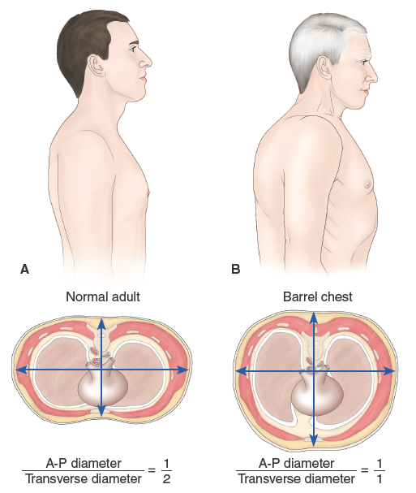
Characteristics of Normal Chest Wall and Chest Wall in Emphysema

Slide 11
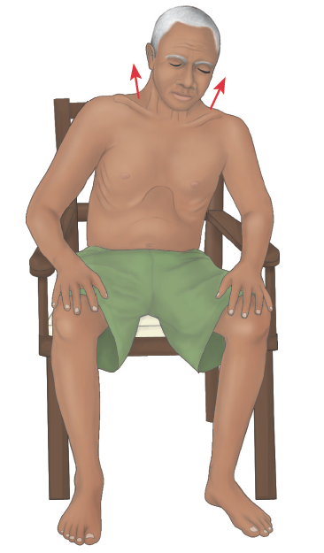
Typical Posture of a Person with COPD

Slide 12
Risk Factors for COPD
Exposure to tobacco smoke
  Accounts for an estimated 80–90% of cases
•Secondhand smoke
•Increased age
•Occupational exposure—dust, chemicals
•Indoor and outdoor air pollution
•Genetic abnormalities, including a deficiency of alpha1-antitrypsin
Notes:
Alpha1-antitrypsin is an enzyme inhibitor that normally counteracts the destruction of lung tissue by certain other enzymes

Slide 13
Assessment and Diagnosis of COPD
Health history, refer to Chart 20-2
Pulmonary function tests
Spirometry
Arterial blood gas
Chest x-ray
Notes:
Health history:
How much exposure has the patient had to secondhand smoke?
•Is there occupational exposure to smoke or other pollutants?
•Does the patient have a past medical history of respiratory diseases/problems, including asthma, allergy, sinusitis, nasal polyps, or respiratory infections?
•Does the patient have a family history of chronic obstructive pulmonary disease or other chronic respiratory diseases?
•How long has the patient had respiratory difficulty?
•What is the pattern of symptom development?
•Does exertion increase the dyspnea? What type of exertion?
•What are the limits of the patient’s tolerance for exercise?
•At what times during the day does the patient complain most of fatigue and shortness of breath?
•Does the patient describe any discomfort or pain in any part of the body? If so, where does it occur, how intense is this pain, when does it occur, and does it interfere with activities of daily living? Is there any intervention that helps to alleviate the pain or discomfort?
•Which eating and sleeping habits have been affected?
•What is the impact of respiratory disease on quality of life?
•What does the patient know about the disease and their condition?
•What is the patient’s smoking history?
•Does the patient have a history of using electronic nicotine delivery systems (ENDS) (e.g., vaping, e-cigarettes, e-pens, e-pipes, e-hookah, e-cigars)?
•What are the triggering events (e.g., exertion, strong odors, dust, exposure to animals)?
•Does the patient have a history of exacerbations or previous hospitalizations for respiratory problems?
•Are comorbidities present?
•How appropriate are current medical treatments?
•Does the patient have available social and family support?
•What is the potential for reducing risk factors (e.g., smoking cessation)?
************************************************************************************
Assessment:
What position does the patient assume during the interview?
•What are the pulse and the respiratory rates?
•What is the character of respirations? Even and without effort? Other?
•Can the patient complete a sentence without having to take a breath?
•Does the patient contract the abdominal muscles during inspiration?
•Does the patient use accessory muscles of the shoulders and neck when breathing?
•Does the patient take a long time to exhale (prolonged expiration)?
•Is central cyanosis evident?
•Are the patient’s neck veins distended?
•Does the patient have peripheral edema?
•Is the patient coughing?
•What are the color, amount, and consistency of the sputum?
•Is clubbing of the fingers present?
•What types of breath sounds (i.e., clear, diminished or distant, crackles, wheezes) are heard? Describe and document findings and locations.
•Are there any sensory deficits?
•Is there short- or long-term memory impairment?
•Is there increasing stupor?
•Is the patient apprehensive?

Slide 14
Complications of COPD
Respiratory insufficiency and failure
Pneumonia
Chronic atelectasis
Pneumothorax
Cor pulmonale
Notes:
XXXX
This end-stage process progresses slowly for many years. Recurrent infections accelerate the destruction of the walls of the alveoli are destroyed. This causes an increase in dead space (lung area where no gas exchange can occur) and impaired oxygen diffusion, which leads to hypoxemia. Carbon dioxide elimination is eventually impaired, which results in hypercapnia which can lead to respiratory acidosis. Resistance to pulmonary blood flow is increased, This can cause pulmonary hypertension and cor pumonale which can cause dependent edema, distended neck veins, or pain in the region of the liver.

Slide 15
Medical Management of COPD
Promote smoking cessation
Reducing risk factors
Managing exacerbations
Providing supplemental oxygen therapy
Pneumococcal vaccine
Influenza vaccine
Pulmonary rehabilitation
Notes:
Pulmonary rehabilitation services are multidisciplinary and include assessment, education, smoking cessation, physical reconditioning, nutritional counseling, skills training, and psychological support. Patients are taught methods to alleviate symptoms. Breathing exercises, as well as retraining and exercise programs, are used to improve the patient’s functional status.

Slide 16
Nursing Management of COPD
Refer to Chart 20-4
Assessing the patient: obtain history, review diagnostic tests
Achieving airway clearance
Improving breathing patterns
Improving activity tolerance
MDI patient education

Slide 17
Education Plan for Patients with COPD
Patient education for
  Smoking cessation
  Medication administration
  Breathing exercises
    Diaphragmatic breathing
    Pursed-lip breathing
  Regular exercise
  Realistic goals
  Emergency management
Refer to Chart 20-5
Notes:
General Instructions
The nurse instructs the patient to:
•Breathe slowly and rhythmically to exhale completely and empty the lungs completely.
•Inhale through the nose to filter, humidify, and warm the air before it enters the lungs.
•Breathe more slowly by prolonging the exhalation time when feeling out of breath.
•Keep the air moist with a humidifier.
Diaphragmatic Breathing
Goal: To use and strengthen the diaphragm during breathing
The nurse instructs the patient to:
•Place one hand on the abdomen (just below the ribs) and the other hand on the middle of the chest to increase the awareness of the position of the diaphragm and its function in breathing.
•Breathe in slowly and deeply through the nose, letting the abdomen protrude as far as possible.
•Breathe out through pursed lips while tightening (contracting) the abdominal muscles.
•Press firmly inward and upward on the abdomen while breathing out.
•Repeat for 1 min; follow with a rest period of 2 min.
•Gradually increase duration up to 5 min, several times a day (before meals and at bedtime).
Pursed-Lip Breathing
Goal: To prolong exhalation and increase airway pressure during expiration, thus reducing the amount of trapped air and the amount of airway resistance
The nurse instructs the patient to:
•Inhale through the nose while slowly counting to 3—the amount of time needed to say “Smell a rose.”
•Exhale slowly and evenly against pursed lips while tightening the abdominal muscles. (Pursing the lips increases intratracheal pressure; exhaling through the mouth offers less resistance to expired air.)
•Count to 7 slowly while prolonging expiration through pursed lips—the length of time to say “Blow out the candle.”
•While sitting in a chair:
Fold arms over the abdomen.
Inhale through the nose while counting to 3 slowly.
Bend forward and exhale slowly through pursed lips while counting to 7 slowly.
•While walking:
Inhale while walking two steps.
Exhale through pursed lips while walking four or five steps.

Slide 18
Nursing Care of Patients with COPD
Evaluate exposure to respiratory irritants
Nursing interventions to promote oxygenation
  Incentive spirometry
  Postural drainage
  Chest percussion and vibration
  Breathing exercises
Administer medications to promote gas exchange and oxygenation
  Oxygen
  Bronchodilators
Notes:
For the patient receiving oxygen at home, the nurse instructs the patient or family in the safe administration of oxygen. Humidity must be provided while oxygen is used (except with portable devices) to counteract the dry, irritating effects of compressed oxygen on the airway (Chart 20-7). The nurse should explain the proper flow rate and required number of hours for oxygen use as well as the dangers of arbitrary changes in flow rate or duration of therapy. The nurse also reassures the patient that oxygen is not “addictive” and explains the need for regular evaluations of blood oxygenation.

Slide 19
Oxygen Therapy
Administration of oxygen at greater than 21% to provide adequate transport of oxygen in the blood while:
  Decreasing the work of breathing and reducing stress on the myocardium
Hypoxemia: a decrease in the arterial oxygen tension in the blood
Hypoxia: a decrease in oxygen supply to the tissues and cells that can also be caused by problems outside the respiratory system
Severe hypoxia can be life threatening

Slide 20
Oxygen Therapy Considerations
Given to increase PaO2 back to normal baseline (60 to 95mm Hg)
Frequent assessment for inadequate oxygenation
Oxygen toxicity
Hypercapnia and depressed respiratory drive
Absorption atelectasis
Fire danger
Equipment source of bacteria
Table 20-2, pg. 610, Hinkle “Oxygen Administration Devices”
Notes:
The main objective in treating patients with hypoxemia and hypercapnia is to give sufficient oxygen to improve oxygenation. Patients with COPD who require oxygen may have respiratory failure that is caused primarily by a ventilation–perfusion mismatch. These patients respond to oxygen therapy and should be treated to keep the resting oxygen saturation at or above 90%, which is associated with a PaO2 of 60 mm Hg or higher. Arterial hemoglobin at these levels is 80% to 98% saturated with oxygen; higher fraction of inspired oxygen (FiO2) flow values add no further significant amounts of oxygen to the red blood cells or plasma. Instead of helping, increased amounts of oxygen may produce toxic effects on the lungs and central nervous system or may depress ventilation, which is a particularly lethal adverse effect in patients with COPD.
The patient should be assessed frequently for inadequate oxygenation. The patient should be assessed for confusion, restlessness progressing to lethargy, diaphoresis, pallor, tachycardia, tachypnea, and hypertension. Intermittent or continuous pulse oximetry is used to monitor oxygen levels.
Oxygen toxicity may occur when too high concentration of oxygen is given for an extended period (generally longer than 24 hours). It is caused by overproduction of oxygen free radicals which cause a severe inflammatory response that can severely damage the alveolar capillary membrane and lead to pulmonary edema and cell death.
Clinical manifestations of oxygen toxicity causing lung damage are similar to acute respiratory distress syndrome (ARDS). They include substernal discomfort, paresthesias, dyspnea, restlessness, fatigue, malaise, progressive respiratory difficulty, refractory hypoxemia, alveolar atelectasis, and alveolar infiltrates evident on chest x-rays.
To prevent oxygen toxicity, the lowest amount of oxygen needed should be used to maintain an acceptable PaO2 level and to treating the underlying condition.
Administering too much oxygen can result in the retention of carbon dioxide. The high O2 levels can then suppress CO2 chemoreceptors, which in turn would depress the respiratory drive and disrupt ventilation–perfusion balance (Kacmarek et al., 2017). The resulting increased O2 tension in the alveoli causes a ventilation–perfusion mismatch that presents as hypercapnia.
An additional adverse effect of the administration of high concentrations of oxygen (greater than 50%) to patients who are sedated and breathing small tidal volumes of air (volume of air inspired and expired with each breath) is absorption atelectasis. 79% of room air is comprised of nitrogen. During inhalation, nitrogen, in addition to other gases, fills the alveoli and helps keep the alveoli open. With the administration of high concentrations of oxygen, nitrogen is diluted and replaced with oxygen. Oxygen in the alveoli is absorbed quickly into the bloodstream and cannot be replaced rapidly enough to keep the alveoli open. The alveoli then collapse, causing atelectasis.
Because oxygen supports combustion, there is always a danger of fire when it is used. It is important to post “No Smoking” signs when oxygen is in use. Oxygen therapy equipment is also a potential source of bacterial contamination; therefore, the nurse (or respiratory therapist) changes the tubing according to infection prevention policy, manufacturer’s recommendations, and the type of oxygen delivery equipment.

Slide 21
Oxygen Administration
Cylinder, piped-in, concentrator
Classified as low flow or high flow
Devices (Refer to Table 20-2)
  Low-flow systems
    Nasal cannula
    Oropharyngeal catheter
    Masks
  High-flow systems
    Venturi mask
    Transtracheal catheter
Notes:
Oxygen is dispensed from a cylinder, piped-in system, or concentrator. A flow meter regulates the flow of oxygen in liters per minute (L/min). When oxygen is used at high flow rates, it should be moistened by passing it through a humidification system to prevent it from drying the mucous membranes of the respiratory tract. The type of device and flow rates for oxygen therapy are best determined by arterial blood gas levels.
Oxygen delivery systems are classified as low-flow systems or high-flow systems. In low-flow systems the patient breathes some room air along with the oxygen. These systems do not provide a constant or precise concentration of inspired oxygen. High-flow systems provide the total inspired air. A specific percentage of oxygen is delivered independent of the patient’s breathing. Patients who require a constant and precise amount of oxygen are provided with high-flow systems.

Slide 22
Types of Oxygen Delivery Systems
Nasal cannula
Simple mask
Venturi
Partial rebreather
Full rebreather
https://www.youtube.com/watch?v=GPqPpW6jSeo&t=21s
Retrieved from the internet April 12, 2023, Nurse Teach on YouTube: Oxygen Delivery Devices: How to Give Oxygen

Slide 23
Oxygen Toxicity
May occur when too high a concentration of oxygen (greater than 50%) is administered for an extended period
Symptoms include substernal discomfort, paresthesias, dyspnea, restlessness, fatigue, malaise, progressive respiratory difficulty, refractory hypoxemia, alveolar atelectasis, and alveolar infiltrates on x-ray
Notes:
Prevention:
Use lowest effective concentrations of oxygen
PEEP (Positive end expiratory pressure (PEEP), is a pressure applied by the ventilator at the end of each breath to ensure that the alveoli are not so prone to collapse)) or CPAP (continuous positive airway pressure) is a machine that uses mild air pressure to keep airways open) prevent or reverse atelectasis and allow lower oxygen percentages to be used

Slide 24
Medications to Treat COPD
Bronchodilators, MDIs (metered dose inhalers)
  Beta-adrenergic agonists
  Muscarinic antagonists (anticholinergics)
  Combination agents
  Refer to Figure 20-5 and Tables 20-3 and 20-4
Corticosteroids
Antibiotics
Mucolytics
Antitussives
Notes:
Bronchodilators - Bronchodilators relieve bronchospasm by improving expiratory flow through widening of the airways and promoting lung emptying with each breath. Their use is central to the management of COPD, but does not modify the decline of function or the prognosis of COPD.
Several classes of bronchodilators are used that include beta-adrenergic agonists, muscarinic antagonists (anticholinergics) and combination agents. Beta-adrenergic agonists include short-acting beta-2-adrenergic agonists (SABAs) and long-acting beta-2 adrenergic agonists (LABAs). The anticholinergic agents include short-acting muscarinic antagonists (SAMAs) and long-acting muscarinic antagonists (LAMAs). Fixed dose combinations of LABAs and LAMAs have become the foundation for treating COPD.

Slide 25
Home Oxygen
Nurse instructs the patient about oxygen:
  Safe methods for administering in the home
  Available in gas, liquid, concentrated
  Portable devices
  Humidity must be provided
  Community resources
See Chart 20-7
Notes:
State proper care of and administration of oxygen to patient.
•State primary provider’s prescription for oxygen and the manner in which it is to be used.
•Indicate when a humidifier should be used.
•Identify signs and symptoms indicating the need for change in oxygen therapy.
•Describe precautions and safety measures to be used when oxygen is in use:
•Know NOT to smoke or be around people who are smoking while using oxygen.
•Post “No Smoking—Oxygen in Use” signs on doors.
•Notify local fire department and electric company of oxygen use in home.
•Never use paint thinners, cleaning fluids, gasoline, aerosol sprays, and other flammable materials while using oxygen.
•Keep all methods of oxygen delivery at least 15 feet away from matches, candles, gas stove, or other source of flame, and 5 feet away from television, radio, and other appliances.
•Keep oxygen tank out of direct sunlight.
•When traveling in automobile, place oxygen tank on floor behind front seat.
•If traveling by airplane, notify air carrier of need for oxygen at least 2 wks in advance.
•State how and when to place an order for more oxygen.
•Maintain and use equipment properly:
•Identify when a portable oxygen delivery device should be used.
•Demonstrate safe and appropriate use of and how to change from one oxygen delivery system to another (e.g., from oxygen concentrator to portable oxygen delivery).
•Demonstrate correct adjustment of prescribed flow rate.
•Describe how to clean and when to replace oxygen tubing.
•Identify causes of malfunction of equipment and when to call for the replacement of equipment.
•Describe the importance of determining that all electrical outlets are working properly.

Slide 26
Surgical Management of COPD
Bullectomy
Lung volume reduction
Lung transplant
Notes:
Bullectomy
A bullectomy is a surgical option for select patients with bullous emphysema. Bullae are enlarged airspaces that do not contribute to ventilation but occupy space in the thorax; these areas may be surgically excised. These bullae compress areas of the lung and may impair gas exchange. Bullectomy may help reduce dyspnea and improve lung function. It can be performed via a video-assisted thoracoscope or a limited thoracotomy incision (GOLD, 2019).
Lung volume reduction surgery involves the removal of a portion of the diseased lung parenchyma. This reduces hyperinflation and allows the functional tissue to expand, resulting in improved elastic recoil of the lung and improved chest wall and diaphragmatic mechanics. This type of surgery does not cure the disease but may improve health status, exercise tolerance, and the patient’s overall quality of life.
Lung transplantation is a viable option for definitive surgical treatment of severe COPD in select patients. It has been shown to improve quality of life and functional capacity in some patients with COPD. It iis limited by the shortage of donor organs, It is also a costly procedure with financial implications for months to years because of complications and the need for costly immunosuppressive medication regimens

Slide 27
Bronchiectasis
Bronchiectasis is a chronic, irreversible dilation of the bronchi and bronchioles
Caused by:
  Airway obstruction, pulmonary infections
  Diffuse airway injury
  Genetic disorders
  Abnormal host defenses
  Idiopathic causes
Notes:
Bronchiectasis is a chronic, irreversible dilation of the bronchi and bronchioles that results from destruction of muscles and elastic connective tissue. The inflammatory process associated with pulmonary infections damages the bronchial wall, causing a loss of its supporting structure and resulting in thick sputum that ultimately obstructs the bronchi. The walls become permanently distended and distorted, impairing mucociliary clearance.

Slide 28
Clinical Manifestations and Medical Management of Bronchiectasis
Chronic cough
Purulent sputum in copious amounts
Clubbing of the fingers
Postural drainage
Chest physiotherapy
Smoking cessation
Antimicrobial therapy
Bronchodilators and mucolytics

Slide 29
Nursing Management of Bronchiectasis
Focus is on alleviating symptoms and clearing pulmonary secretions
Patient teaching
  Smoking cessation
  Postural drainage
  Early signs and symptoms of respiratory infections
  Conserving energy

Slide 30
Asthma
Chronic inflammatory disease of the airways that causes hyperresponsiveness, mucosal edema, and mucus production
Inflammation leads to cough, chest tightness, wheezing, and dyspnea
Allergy is the strongest predisposing factor
Notes:
Unlike other obstructive lung diseases, asthma is largely reversible, either spontaneously or with treatment. Patients with asthma may experience symptom-free periods alternating with acute exacerbations that last from minutes to hours or days.

Slide 31
Clinical Manifestations of Asthma
Cough, dyspnea, wheezing
Exacerbations
  Cough, productive or not
  Generalized wheezing
  Chest tightness and dyspnea
  Diaphoresis
  Tachycardia
  Hypoxemia and central cyanosis
Notes:
Common triggers for asthma symptoms and exacerbations include airway irritants (e.g., air pollutants, cold, heat, weather changes, strong odors or perfumes, smoke, occupational exposure), foods (e.g., shellfish, nuts), exercise, stress, hormonal factors, medications, viral respiratory tract infections, and gastroesophageal reflux.

Slide 32
Medications Used in the Treatment of Asthma
Quick-relief medications
  Beta-2 adrenergic agonists
  Anticholinergics
Long-acting medications
  Corticosteroids
  Long-acting beta-2 adrenergic agonists
  Leukotriene modifiers
Notes:
Short-acting beta-2–adrenergic agonists (SABAs) (e.g., albuterol, levalbuterol, pirbuterol) are the medications of choice for relief of acute symptoms and prevention of exercise-induced asthma. They are used to relax smooth muscle.
Anticholinergics (e.g., ipratropium) inhibit muscarinic cholinergic receptors and reduce intrinsic vagal tone of the airway. These may be used in patients who do not tolerate short-acting beta-2–adrenergic agonists.
Corticosteroids are the most potent and effective anti-inflammatory medications currently available. They are broadly effective in alleviating symptoms, improving airway function, and decreasing peak flow variability. Initially, an inhaled form is used. All patients should rinse their mouth with water (and should not swallow the rinse) after administration of ICSs to prevent thrush, a common complication associated with the use of these drugs.
Long-acting beta-2 adrenergic agonists (LABAs) are used with anti-inflammatory medications to control asthma symptoms, particularly those that occur during the night. These agents are also effective in the prevention of exercise-induced asthma. LABAs are not indicated for immediate relief of symptoms. Salmeterol and formoterol have duration of bronchodilation of at least 12 hours.
Leukotriene modifiers (inhibitors), or antileukotrienes, are a class of medications that include montelukast, zafirlukast, and zileuton. Leukotrienes, which are synthesized from membrane phospholipids through a cascade of enzymes, are potent bronchoconstrictors that also dilate blood vessels and alter permeability.

Slide 33
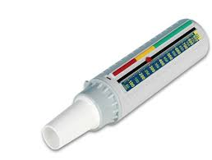
Asthma Action Plan – Example Pg. 640

Slide 34
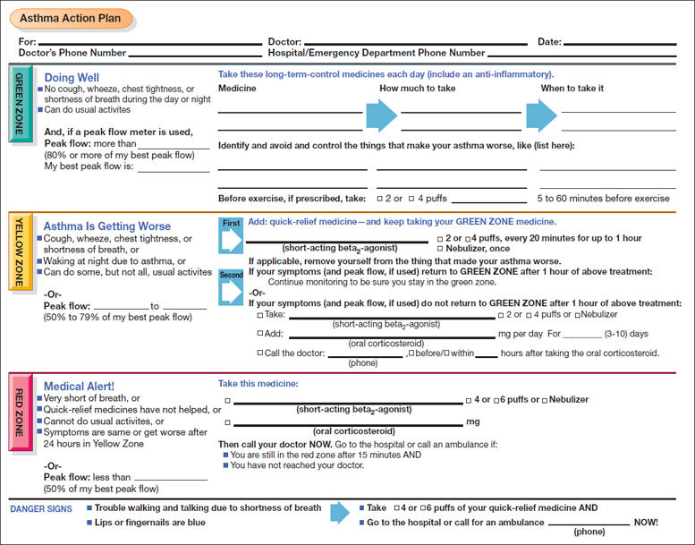
Action Plan – Pg. 640

Slide 35
Status Asthmaticus
Rapid onset, severe, and persistent asthma that does not respond to conventional therapy.
Can be life-threatening.
Close monitoring
Corticosteroids
Inhaled SABA’s
Supplemental oxygen
IV fluids for hydration
Magnesium sulfate (possible used in severe cases)
Mechanical ventilation
Notes:
The attacks can occur with little or no warning and can progress rapidly to asphyxiation. It may begin with severe bronchospasm, with mucus plugging leading to asphyxia. A ventilation–perfusion abnormality results in hypoxemia. There is a reduced PaO2 and initial respiratory alkalosis, with a decreased PaCO2 and an increased pH. As status asthmaticus worsens, the PaCO2 increases and the pH decreases, reflecting respiratory acidosis.
In status asthmaticus, increasing PaCO2 (to normal levels or levels indicating respiratory acidosis) is a danger sign signifying impending respiratory failure.
Corticosteroids are critical in the therapy of status asthmaticus and are used to decrease the intense airway inflammation and swelling. Inhaled short-acting beta-2–adrenergic agonists provide the most rapid relief from bronchospasm.
Oxygen therapy is initiated to treat dyspnea, central cyanosis, and hypoxemia. High-flow supplemental oxygen is best delivered using a partial or complete non-rebreathing mask.
In severe status asthmaticus, magnesium sulfate, a calcium antagonist, may be given to induce smooth muscle relaxation. IV magnesium sulfate is not recommended for routine use in asthma exacerbations. Adverse effects of magnesium sulfate may include facial warmth, flushing, tingling, nausea, central nervous system depression, respiratory depression, and hypotension.

Slide 36
Patient Teaching for Asthma
How to identify and avoid triggers
Proper inhalation techniques
How to perform peak flow monitoring, pg. 640
How to implement an action plan
  Figure 20-11, pg. 640
When and how to seek assistance
Notes:
Peak flow meters measure the highest airflow during a forced expiration (Fig. 20-12). The patient is instructed in the proper technique (Chart 20-8), particularly about using maximal effort; peak flows are monitored for 2 or 3 weeks after receipt of optimal asthma therapy. Then, the patient’s “personal best” value is measured. The green (80% to 100% of personal best), yellow (60% to 80%), and red (less than 60%) zones are determined, and specific actions are delineated for each zone, enabling the patient to monitor and manipulate their own therapy after careful instruction.

Slide 37
Cystic Fibrosis
Most common autosomal recessive disease among the Caucasian population
Genetic screening to detect carriers
Genetic counseling for couples at risk
Genetic mutation changes chloride transport which leads to thick, viscous secretions in the lungs, pancreas, liver, intestines, and reproductive tract
Respiratory infections are the leading cause of morbidity and mortality
Notes:
CF is the most common fatal autosomal recessive disease among Caucasians. It is less frequently found among Hispanic, Asian, and African Americans. CF is caused by mutations in the protein cystic fibrosis transmembrane conductance regulator (CFTR), which normally transports chloride ions across epithelial cell membranes. The defect caused by the mutation leads to CF, which is characterized by thick, viscous secretions in the lungs, pancreas, liver, intestine, and reproductive tract as well as increased salt content in sweat gland secretions.
The median survival age has increased to 37 years for patients with CF, and it is projected to rise to 57 years. The improved survival rate is due to advances in medical management and procedures such as lung transplantation. Because of this, there are issues that were not present in past generations such as antibiotic resistance and the desire for patients with CF to have their own biologic children.
Chronic respiratory inflammation and infection are caused by impaired mucus clearance. Nonpulmonary manifestations include gastrointestinal problems (e.g., pancreatic insufficiency, recurrent abdominal pain, biliary cirrhosis, vitamin deficiencies, recurrent pancreatitis, weight loss), CF-related diabetes, and genitourinary problems (male and female infertility). In males, there may be a congenital bilateral absence of the vas deferens.

Slide 38
Cystic Fibrosis
https://www.youtube.com/watch?v=Ihx19-56Kzc&t=7s

Slide 39
Medical Management of CF
Chronic: control of infections; antibiotics
Acute: aggressive therapy involves airway clearance and antibiotics based on results of sputum cultures
Anti-inflammatory agents
Corticosteroids; inhaled, oral, IV during exacerbations
Inhaled bronchodilators
Oral pancreatic enzyme supplementation with meals
Cystic fibrosis transmembrane conductance regulator (CFTR) modulators are a new class of drugs and help to improve function of the defective CFTR protein

Slide 40
Nursing Management of CF
Strategies that promote removal of pulmonary secretions
  CPT and breathing exercises
Remind patient to reduce risk factors for resp infection
Adequate fluid and electrolyte intake
Palliative care
Discuss end-of-life issues and concerns
Notes:
Nursing care includes helping patients manage pulmonary symptoms and prevent complications. Specific measures include strategies that promote removal of pulmonary secretions, CPT (including postural drainage, chest percussion, and vibration), and breathing exercises which are implemented and taught to the patient and family when the patient is very young). The patient is reminded to avoid crowds or to people with known infections) The nurse emphasizes the importance of an adequate fluid and dietary intake to promote removal of secretions and to ensure an adequate nutritional status.

Slide 41
Question #2
Which of the following should a patient do after using a metered dose inhaler (MDI) containing a corticosteroid?
Wait at least 5 minutes before drinking any liquid
Use a soft bristle toothbrush for brushing teeth during the next 24 hours
Monitor for hyperthermia which could be a sign of an infection
Rinse mouth with water immediately after use

Slide 42
Answer to Question #2
D. Rinse mouth with water immediately after use.
Rationale: Rinsing the mouth with water after using an MDI with corticosteroid is necessary to avoid development of thrush in the oral cavity.

Slide 43
Question #3
Is the following statement true or false?
An advantage of the Venturi mask is the high level of supplemental oxygen delivery even though the mask is poorly fitted to the patient’s face.

Slide 44
Answer to Question #3
False
Rationale: The Venturi mask is tighter fitting than the non-rebreathing mask but delivers low levels of supplemental oxygen. Whereas a low-flow oxygen delivery system may imprecisely deliver high concentrations of oxygen (e.g., up to 100% via a non-rebreathing mask), the Venturi mask, which is a high-flow system, is specifically designed to deliver precise but lower concentrations of oxygen (less than 30% oxygen).

Slide 45
Question #4
Is the following statement true or false?
Increasing PaCo2 levels for a patient in status asthmaticus is a sign of improvement.

Slide 46
Answer to Question #4
False
Rationale: Status asthmaticus is a rapid onset, severe, and persistent asthma that does not respond to conventional therapy. Patients are often hospitalized for treatment. Increasing levels of PaCO2 indicate a worsening condition with inadequate gas exchange.

