Slide 1

AUTOMATED DOOR ACCESS BASED ON RFID USING AURDINO
BATCH-9 [AA1]

Slide 2

INTRODUCTION
Radio Frequency Identification abbreviated as RFID. It is a progressive development that can be used to advance the passageway control framework. It gives a robotization in different procedures extending from mechanical parts to home control. RFID innovation will assist us with developing a door access control framework which can permit the passage of approved faculty in the confined zones. This RFID framework gives a wide scope of frequencies from low recurrence range to microwave recurrence range. With the expansion in the quantity of illicit sections over the previous decade, different organizations and workplaces empower creation and establishment of robotized door security frameworks. These frameworks are planned to give wellbeing to confined room in companies, shops and workplaces .

Slide 3
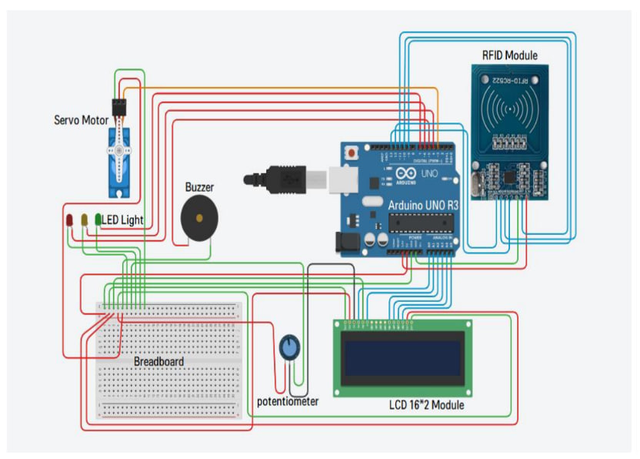
SIMPLIFIED BLOCK DIAGRAM
Here in this model the hardware components that are used to make the model are : i) Servo motor
ii) RFID module
iii) LED light
iv) Buzzer
v) Breadboard
vi) Potentiometer
vii) LCD 16*2 Module
viii) Arduino UNO R3
ix) Jumper Cables

Slide 4
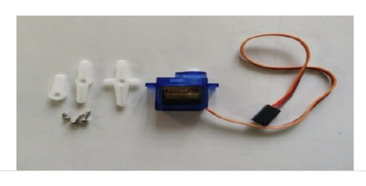
i) SERVO MOTOR
A servomotor control the angular position, speed, and acceleration. It comprises of a reasonable engine coupled to a sensor for position feedback . Servomotors have various applications in the field of mechanical autonomy, computerized producing and so on. Engine in our work is to open and close the door consequently when the RFID per user recognizes the RFID tag of the client.
Servo motors or “servos”, as they are known, are electronic devices and rotary or linear actuators that rotate and push parts of a machine with precision. Servos are mainly used on angular or linear position and for specific velocity and acceleration.

Slide 5
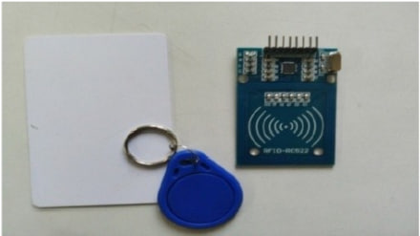
ii) RFID MODULE
RFID is contracted as Radio Frequency Identification. It makes a remote correspondence and empowers information move between RFID tag and RFID reader.
This module can read and compose information without direct contact. The RFID label comprises of kilobytes of rich data in it.
The RFID reader is a functioning segment .The RFID tag, then again, is a detached segment that is situated on the item we need to distinguish. It has an antenna attached to a microchip.
So as we place the tag is near the scope of RFID reader than some voltage is created in reception apparatus curl and voltage act as power. In our work, we have utilized RC522 MODULE to get to door control framework.

Slide 6
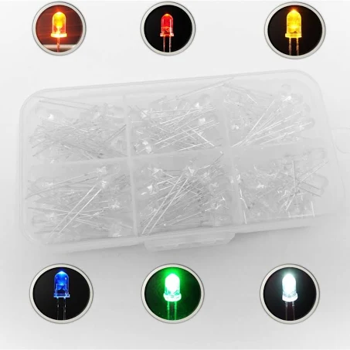
iv) LED LIGHT
A light emitting diode is a diode that produces visible light when an electric current goes through it.
They are profoundly effective and produces monochromatic light. In our work, we have utilized 3 LEDs.

Slide 7
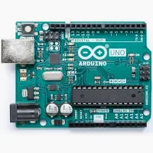
iv) ARDUINO UNO
Arduino UNO is an open-source microcontroller board dependent on the Microchip ATmega328P microcontroller. It utilizes a type B USB port for power.
It is programmable with a product called ARDUINO IDE (incorporated improvement condition) . In our work, we have utilized an Arduino board.

Slide 8
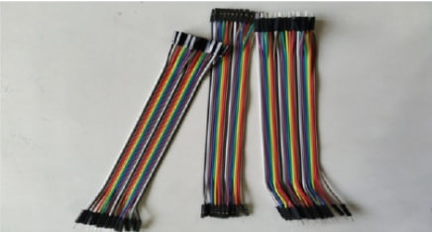
v) JUMPER CABLES
Jumper links are utilized to move electric flow from one point to other inside a circuit. Because of high conductivity, jumper links are made of copper and aluminum .
In this model, we have utilized three mix of jumper link for example male to male, female to female and male to female

Slide 9

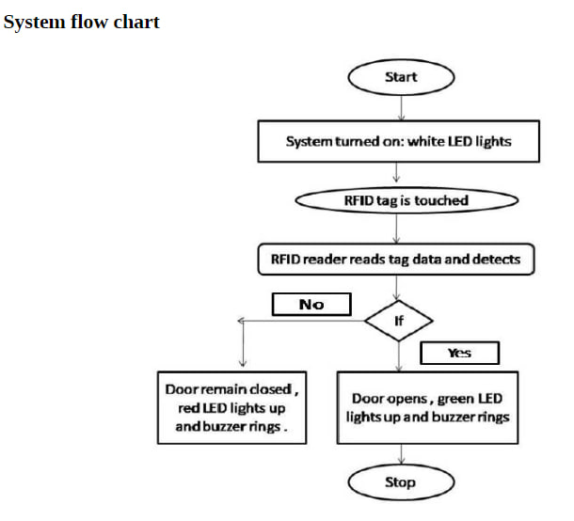
HOW THE SYSTEM WORKS (chart)

Slide 10
Software technology : Arduino
The program can be written in a programming language for a compiler to produces binary code. This code editor
has salient features like syntax highlighting. It provides one-click mechanisms to compile and upload programs
to an Arduino board. Our undertaking gives the Arduino incorporated advancement condition (IDE), which is a
cross-stage application written in the programming language PYTHON. It has begun from the IDE for the
dialects Handling and Wiring.
THE NEXT SLIDE IS THE CODE PART USED IN THIS MODEL -

Slide 11
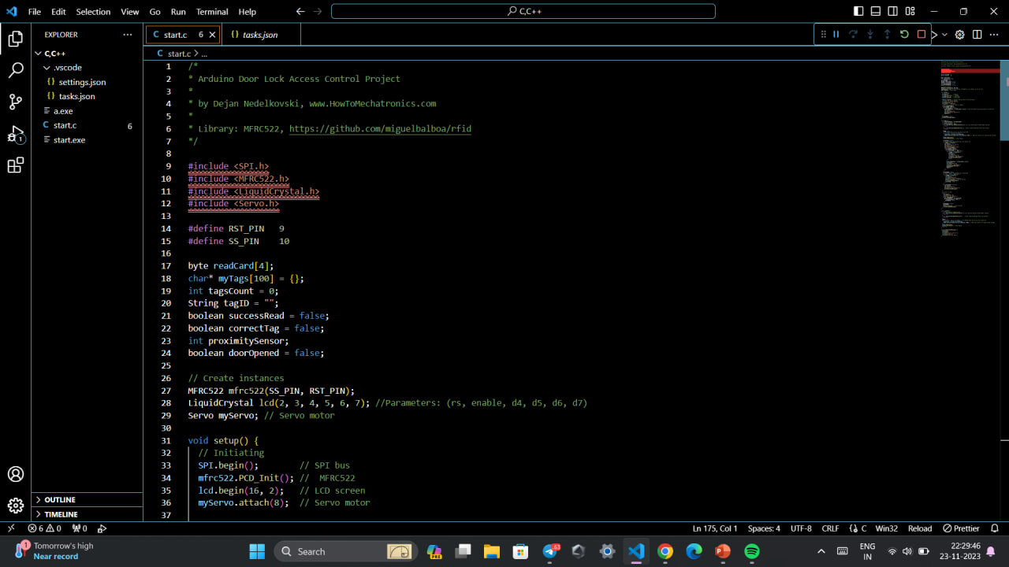
SOURCE CODE

Slide 12
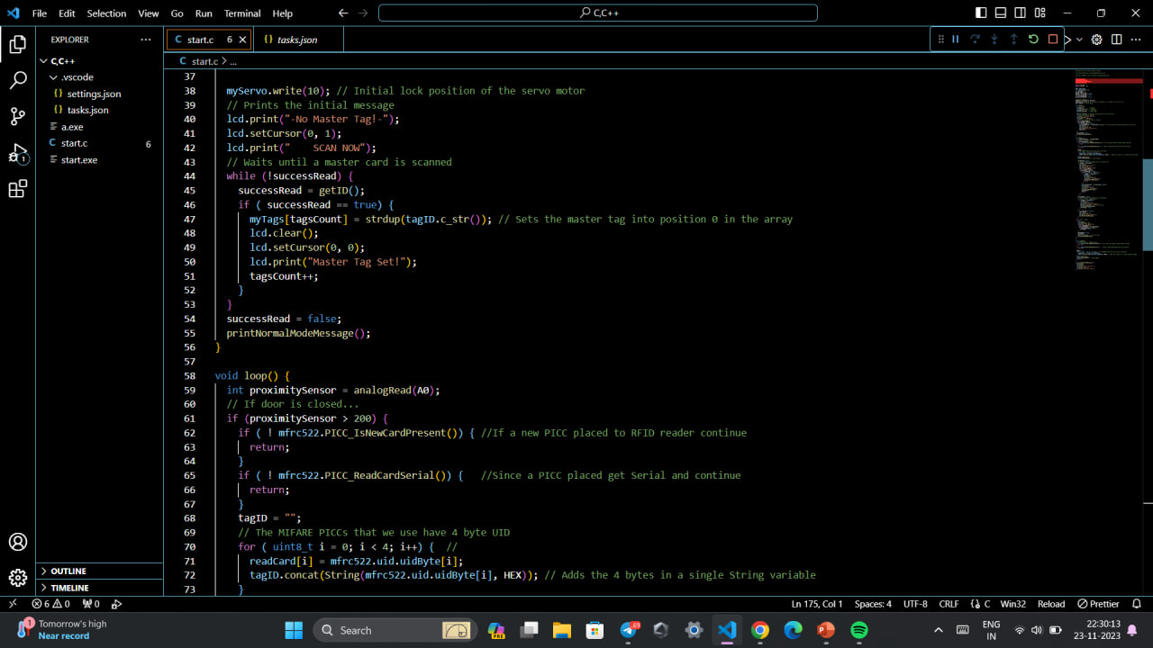

Slide 13
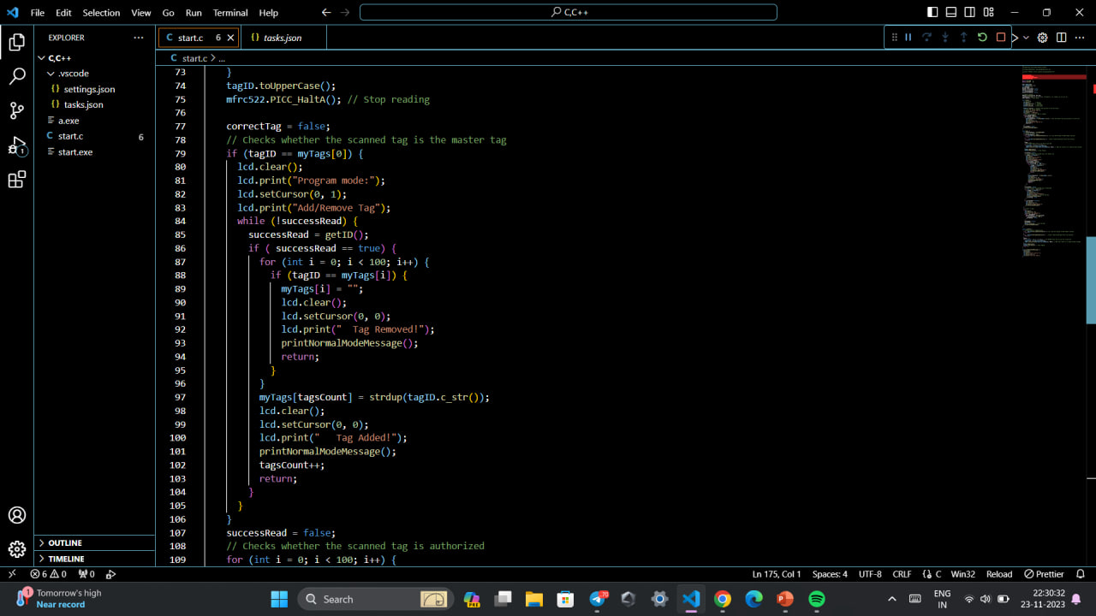

Slide 14
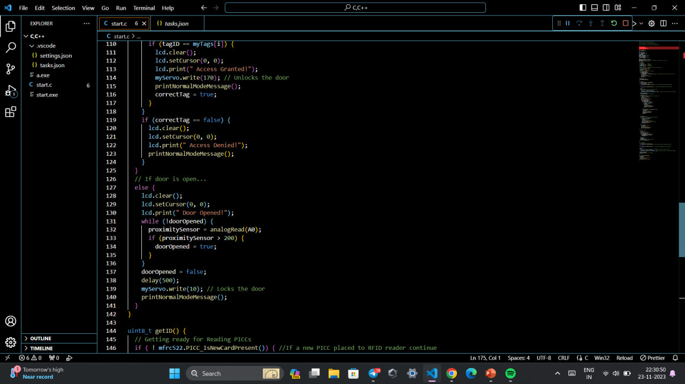

Slide 15
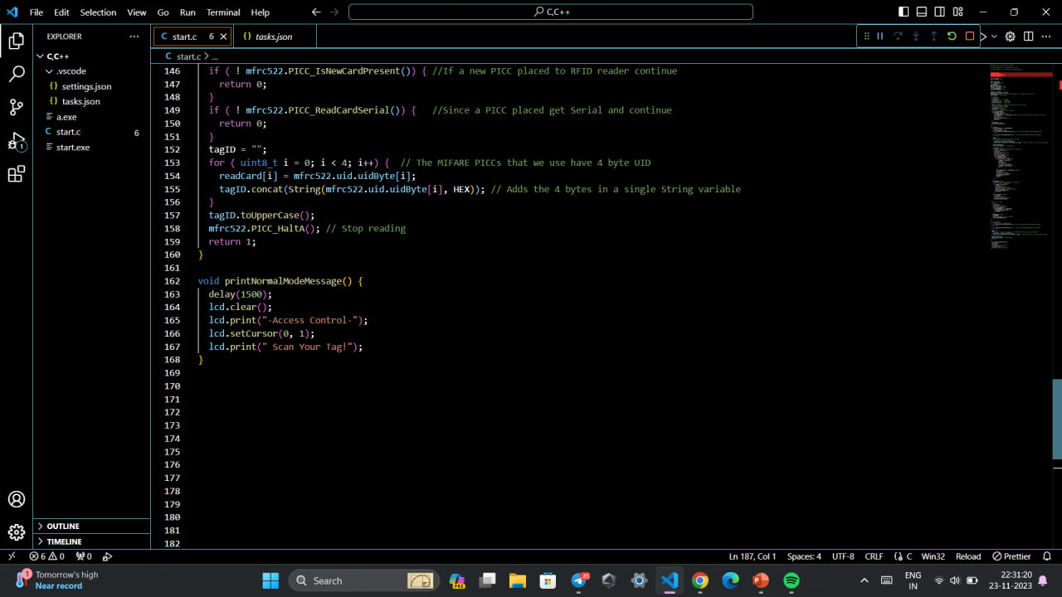

Slide 16

RESULTS AND CONCLUSION
RFID based security and access control framework is a quick and profoundly tied down framework when contrasted with some other biometric frameworks. It gives contact less correspondence and works without the observable pathway. With the assistance of Arduino, the framework are effectively open and works inconclusively. Clients can change the capacities in the Arduino code . RFID control framework decreases human exertion and mistake. Also, with the assistance of this numerous RFID labels can be read at once which prompts high proficiency of RFID framework. Radio Frequency Identification (RFID) is a remote advancement that can be used to develop the passageway control framework. This innovation gives a progressive robotization in different procedures running from modern divisions to home control.

Slide 17

REFERENCES
https://www.researchgate.net/deref/https%3A%2F%2Fwww.arduino.cc%2Fen%2Fmain%2Fsoftware?_tp=eyJjb250ZXh0Ijp7ImZpcnN0UGFnZSI6InB1YmxpY2F0aW9uIiwicGFnZSI6InB1YmxpY2F0aW9uIn19
( ARDUINO UNO SOFTWARE )
https://www.hackster.io/user8523373/RFID-based-automatic-door-system-7b2065
www.elprocus.com/understanding-about-types-of-access-control-systems/

