Slide 1
Practical Detection Engineering at Scale
Jared Atkinson
SpecterOps

Slide 2

@jaredcatkinson
Adversary Detection Technical Director @ SpecterOps
Former
U.S. Air Force Hunt Team (92d Cyberspace Ops Squadron)
Veris Group Adaptive Threat Division
Open Source Developer
PowerForensics
PSReflect-Functions
OSSEM
OSQuery
Microsoft Cloud and Data Center Management (PowerShell) MVP
Technically a Professional Minesweeper Player

Slide 3
Why are we here?
There’s no shortage of cybersecurity tools, services, and frameworks to help an enterprise emulate, detect, and respond to adversaries. Many factors influence the design and maturity of a security program, but the most effective organizations make use of strategies that can scale across systems and environments.

Slide 4


Continuum of Defense
Prevention
Detection
Triage
Investigation
Response

Slide 5
Prevention
Prevention
Prevent malicious files & or activity when/if possible
Ongoing engineering and operation of defensive controls
Firewalls
Anti-Virus
Intrusion Detection/Preventions Systems
Data Loss Prevention
Email/Spam/Network filters
This phase includes automatic consumption of static & brittle IOCs
Controls may produce alerts to be used for context in later phases
These controls are in place but also assumed to fail or be bypassed

Slide 6
Detection
Detection
Rooted in the analysis of centralized data for building enterprise-wide detections
Focused on detecting anomalous/malicious behaviors (techniques) as opposed to the method (tool) to do so, resulting in a level of robustness
Detecting processes accessing lsass.exe memory as opposed to detecting “mimikatz”
Hypothesis generation -> Analysis -> Validation -> Conclusion
Reducing the noise in data to produce high fidelity alerts to be triaged in the next phase

Slide 7
Triage
Triage
Answering the question: Is this benign or malicious?
Consumption of alerts from the Prevention and Detection phases
Use of additional data sources: Internal & External
Conclusions: Benign, Suspicious, Malicious
Benign events - Known to be good
Used to tune detection
Suspicious events - Neither known to be good nor bad
Passed to the investigated phase
Malicious events - Known to be bad
Passed directly to the response phase

Slide 8
Investigation
Investigation
Deep level analysis of an individual event or sequence of events
Gathering data that isn’t made available for centralization, or hard to collect at scale in a targeted manner
Memory
Malware
Network
File System Collection and Analysis
Goal is to determine if the event(s) constitute a security incident requiring response

Slide 9
Response
Response
Determining scope of incident
What category of incident
How many systems involved
Impact to organization
Taking actions to eradicate the malicious entity from the network
Post Incident breakdown for purpose of improvement
Detection/Prevention at a earlier phase
Improving Response time

Slide 10
Where does “Threat Hunting” fit in?
Prevention
Detection
Triage
Investigation
Response

Slide 11
Where does “Threat Hunting” fit in?
Threat Hunting
Prevention
Detection
Triage
Investigation
Response

Slide 12
What about “Digital Forensics/Incident Response”?
Threat Hunting
DFIR
Prevention
Detection
Triage
Investigation
Response

Slide 13
Detection is HARD!
Lack of sufficient/relevant telemetry
Inadequate documentation of available data sources
Insufficient understanding of the attack techniques we are facing
Insufficient understanding of the underlying technology that is affected/abused by the attacks
Missing process for sharing this information amongst our team of analysts

Slide 14
Detection Engineering Methodology
Select Target Technique
Research Underlying Technology
Proof of Concept Malware Sample
Identify Data Sources
Build Atomic Detection
Test Detection at Scale
Make sure you are documenting throughout this process!!

Slide 15
Step 1 - Select Target Technique
Choose the technique that you will build your detection around
Detections should be built at the most generic level possible, but many times a single technique will require multiple detections for completion
Input
MITRE ATT&CK Framework
Your organization’s data sources
Threat Intelligence
Twitter
Output
A specific Technique that you will be targeting
Possibly, a specific implementation of that Technique (Procedure)

Slide 16
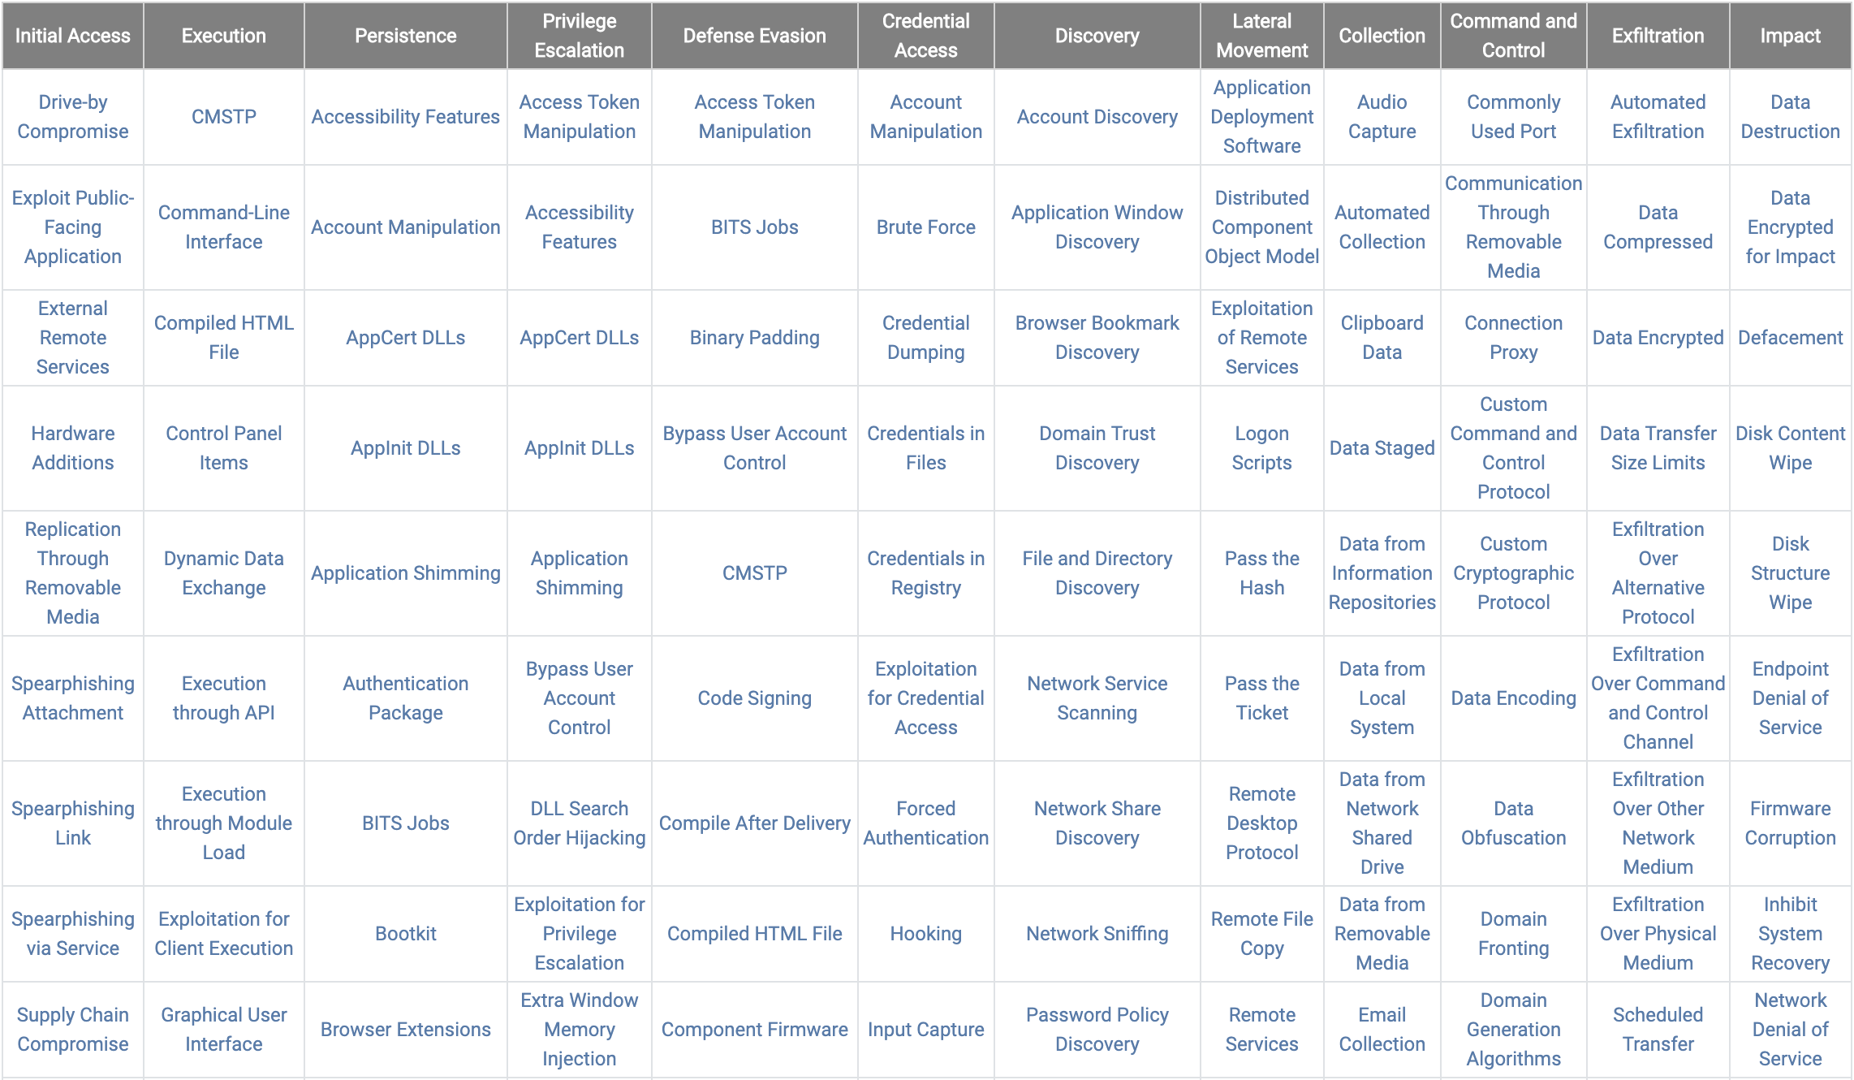
MITRE ATT&CK Framework
https://attack.mitre.org/matrices/enterprise/windows/

Slide 17
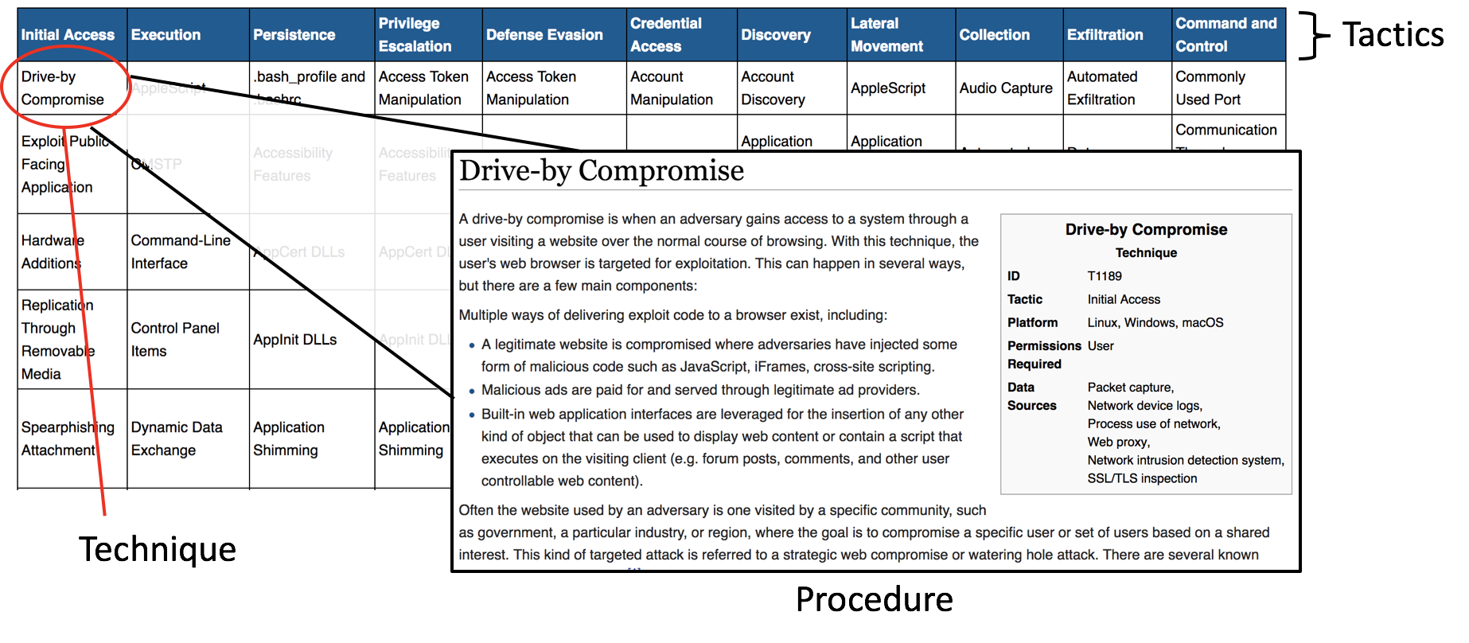
Understanding TTPs in the Context of ATT&CK

Slide 18
How to select a technique
Data Driven
The organization currently only collects Windows Security Event Logs from Domain Controllers, so the Threat Hunters decide to focus their hunts on Active Directory attacks
Intelligence Driven
A threat report is released describing a threat actor that is targeting your industry vertical, so you focus your hunts around the techniques that threat actor is known to use
Entity Driven
Members of the executive board are traveling to a foreign country with tendencies for espionage, but the CEO demands that he take his laptop and mobile phone
Research Driven
Your Threat Hunters have done some great research on detecting Kerberos abuse, so you build you hunts around techniques involved in that area
Tactic Driven
You decide that you haven’t spent much time focusing on detecting Lateral Movement techniques, so you focus your hunts around that tactic

Slide 19
Choose a Technique
At SpecterOps, our offensive researchers had success using HTAs for initial access during phishing engagements. I’d like to spend some time looking into the MSHTA technique.

Slide 20
Choose a Technique
At SpecterOps, our offensive researchers had success using HTAs for initial access during phishing engagements. I’d like to spend some time looking into the MSHTA technique.
Research Driven

Slide 21
Step 2 - Research the Underlying Technology
Research the technology associated with the technique to help understand the use cases, related data sources, and detection opportunities
Defenders often create superficial detections because they lack an understanding of the technology involved
Input
Selected Technique
MITRE ATT&CK Wiki Page for
Output
How the technique works (low level)
Why attackers would use this technique?
What alternatives to this technique do attackers have?
List of potential data sources

Slide 22
MITRE ATT&CK Wiki Demo https://attack.mitre.org/techniques/T1170/

Slide 23
ads-mshta-localfile.mp4

Slide 24
ads-mshta-vbscript.mp4

Slide 25
Initial Questions
Is vbscript the only scripting language that can be executed inline?
What about mshta allows this syntax “vbscript:” to work how it does?
Can this syntax be used outside of the context of mshta?

Slide 26
Checking Threat Reports Demo https://redcanary.com/blog/microsoft-html-application-hta-abuse-part-deux/

Slide 27
ads-mshta-javascript.mp4

Slide 28
Initial Questions
Is vbscript the only scripting language that can be executed inline?
No, at least javascript can be used as well
What about mshta allows this syntax “vbscript:” to work how it does?
Can this syntax be used outside of the context of mshta?
What other scripting languages can be executed “inline” (besides vbscript and javascript)?

Slide 29
ads-procmon.mp4

Slide 30
ads-javascriptinbrowser.mp4

Slide 31
Initial Questions
Is vbscript the only scripting language that can be executed inline?
No, at least javascript can be used as well
What about mshta allows this syntax “vbscript:” to work how it does?
Protocol Handlers
Can this syntax be used outside of the context of mshta?
What other scripting languages can be executed “inline” (besides vbscript and javascript)?
It appears that the only default supported “scriptable” protocol handlers are vbscript: and javascript:

Slide 32
ads-registry-investigation.mp4

Slide 33
Initial Questions
Is vbscript the only scripting language that can be executed inline?
No, at least javascript can be used as well
What about mshta allows this syntax “vbscript:” to work how it does?
Protocol Handlers
mshtml.dll
Can this syntax be used outside of the context of mshta?
What other scripting languages can be executed “inline” (besides vbscript and javascript)?
It appears that the only default supported “scriptable” protocol handlers are vbscript: and javascript:

Slide 34
ads-mshtml-exports.mp4

Slide 35
Initial Questions
Is vbscript the only scripting language that can be executed inline?
No, at least javascript can be used as well
What about mshta allows this syntax “vbscript:” to work how it does?
Protocol Handlers
mshtml.dll
RunHTMLApplication
Can this syntax be used outside of the context of mshta?
It can also be used by Rundll32.exe due to the unique nature of that application’s use case
What other scripting languages can be executed “inline” (besides vbscript and javascript)?
It appears that the only default supported “scriptable” protocol handlers are vbscript: and javascript:

Slide 36
Step 3 - Proof of Concept Malware Sample
Build or Find a benign malware sample to allow for data source evaluation and detection validation
Input
Target technique/procedure
Output
Ability to execute the technique for validation purposes
Command Line parameters
Script
Binary

Slide 37
Example Command Lines
Mshta.exe
mshta vbscript:CreateObject("Wscript.Shell").Run("calc.exe",0,true)(window.close)
mshta javascript:alert(‘foo’);
rundll32.exe
rundll32.exe javascript:"\..\mshtml,RunHTMLApplication ";alert(‘foo’);

Slide 38
Step 4 - Identify Data Sources
Evaluate what data sources are necessary to allow for detection of the technique
This step is part of a cycle with the next step (Build Atomic Detection)
Input
Selected Technique/Procedure
Understanding of involved technology (hta files, mshta, protocol handlers)
Understanding of attacker’s motivation
Proof of concept malware sample
Output
List of selected data sources
Necessary data sources are enabled and being centralized

Slide 39
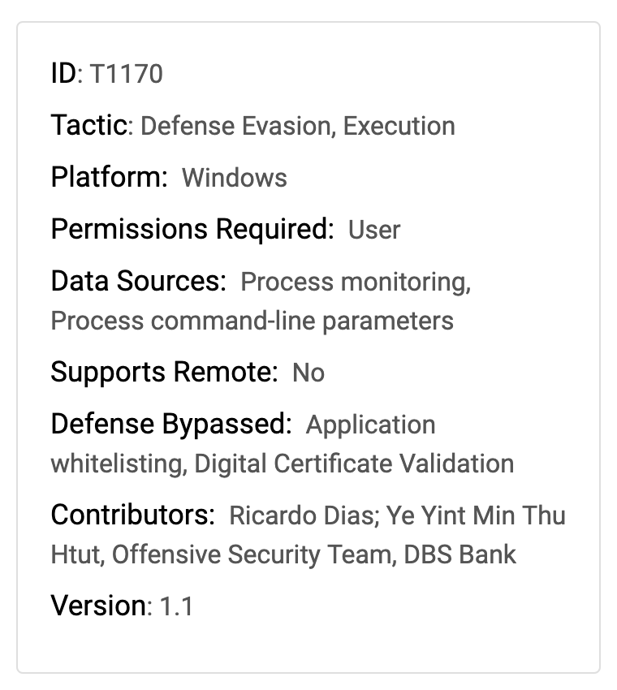
ATT&CK Data Sources

Slide 40
OSSEM Demo https://github.com/Cyb3rWard0g/OSSEM/blob/master/common_information_model/process.md https://github.com/Cyb3rWard0g/OSSEM/blob/master/data_dictionaries/windows/sysmon/event-1.md https://docs.google.com/spreadsheets/d/1ow7YRDEDJs67kcKMZZ66_5z1ipJry9QrsDQkjQvizJM/edit#gid=0

Slide 41
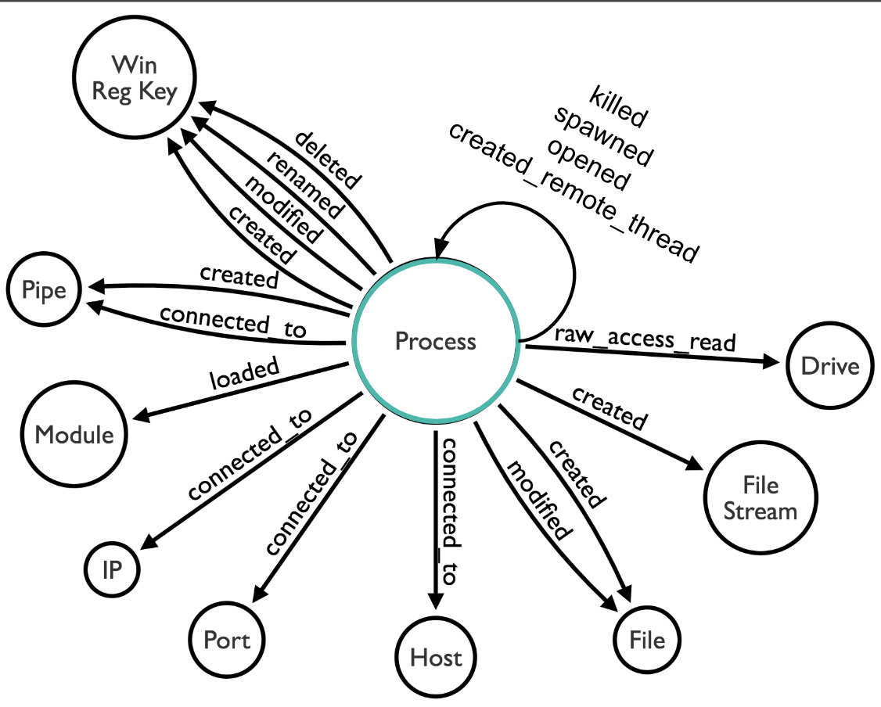
Sysmon Data Model

Slide 42
Data Modeling - MSHTA
T1170
Process Monitoring
Process Command-Line Parameters

Slide 43
Data Modeling - MSHTA
Process Creation
Process Termination
T1170
Process Monitoring
Process Write To Process
Process Command-Line Parameters
Process Access

Slide 44
Data Modeling - MSHTA
Process Creation
Process
created
Process
Process Termination
T1170
Process Monitoring
user
terminated
Process
Process Write To Process
Process
wrote_to
Process
Process Command-Line Parameters
Process Access
Process
accessed
Process

Slide 45
Data Modeling - MSHTA
Security 4688
Process Creation
Process
created
Process
Sysmon 1
Process Termination
Security 4689
T1170
Process Monitoring
user
terminated
Process
Sysmon 5
Process Write To Process
Sysmon 8
Process
wrote_to
Process
Process Command-Line Parameters
Process Access
Sysmon 10
Process
accessed
Process

Slide 46
Step 5 - Build Atomic Detection
Create a detection in a lab environment (know that the end detection will likely change)
Turn on verbose logging to help identify if any data sources were missed in the previous step
Focus on the “what’s possible” to find gaps in your real world environment
Input
Test lab
Data sources
Proof of concept malware sample
Output
Query/logic for detecting the attack in a vacuum (small network)
List of data sources that were previously not considered

Slide 47
Step 6 - Test Detection at Scale
Take the output of Steps 1 - 5 and apply to YOUR enterprise
Identify and account for high false positive events
Input
Desired data sources
Atomic query logic
Validation steps
Output
Perform Data Quality Assessment (at least completeness).
Query/logic for detecting the attack in YOUR enterprise
List of any assumptions that were made for your detection
List of false positives

Slide 48
Documentation

Slide 49
Alerting and Detection Strategy Framework
Open source project created by Palantir in 2017
Blog Post
https://medium.com/palantir/alerting-and-detection-strategy-framework-52dc33722df2
Github
https://github.com/palantir/alerting-detection-strategy-framework
“To combat the issues and deficiencies previously noted, we developed an ADS Framework which is used for all alerting development. This is a natural language template which helps frame hypothesis generation, testing, and management of new ADS.”
https://medium.com/palantir/alerting-and-detection-strategy-framework-52dc33722df2

Slide 50
ADS Overview
Prior to agreeing on such a framework, we faced major challenges with the implementation of alerting strategies, including a lack of:
Rigor
Documentation
Peer-review
An overall quality bar
Allowed the deployment of low-quality alerts to production systems
Frequently led to alerting apathy or additional engineering time and resources to fix and update alerts

Slide 51
ADS Format
The ADS Framework has the following sections, each which must be completed prior to production implementation:
Goal
Categorization
Strategy Abstract
Technical Context
Blind Spots and Assumptions
False Positives
Validation
Priority
Response
Additional Resources

Slide 52
ADS Sections
Goal
Short, plaintext description of the behavior the ADS is designed to detect
Categorization
Mapping of the ADS to the relevant entry in MITRE ATT&CK
Strategy Abstract
High-level walkthrough of how the ADS functions
Technical Context
Detailed information and background needed for a responder to understand all components of the alert
Blind Spots and Assumptions
Recognized issues, assumptions, and areas where an ADS may not fire

Slide 53
ADS Sections
False Positives
Known instances of an ADS misfiring due to a misconfiguration, idiosyncrasy in the environment, or other non-malicious scenario
Validation
Steps required to generate a representative true positive event which triggers this alert
Priority
Alerting levels that an ADS may be tagged with
Response
General response steps in the event that this alert fired
Additional Resources
Any other internal, external, or technical references that may be useful for understanding the ADS

Slide 54
Introduce New Detections into the SOC
Once a new detection is fully developed, it must be integrated into the SOC workflow
Provides all of the necessary information for the SOC to begin responding to alerts
Outlines purpose of alert as well as response actions
Work with SOC to improve ADS over time

Slide 55
mshta.md

Slide 56
Detection Engineering “Takes Time”
Take the time to understand your available telemetry/data
Take the time to understand the attack that you want to detect
Take the time to understand the technology that is being abused
Take the time to document your work so that others can benefit

Slide 57
References
MITRE ATT&CK
https://attack.mitre.org/
https://attack.mitre.org/techniques/T1170/
https://attack.mitre.org/techniques/T1085/
MSHTA Research
https://www.redcanary.com/blog/microsoft-html-application-hta-abuse-part-deux/
https://thisissecurity.stormshield.com/2014/08/20/poweliks-command-line-confusion/
OSSEM
https://github.com/Cyb3rWard0g/OSSEM
https://github.com/Cyb3rWard0g/OSSEM/tree/master/data_dictionaries/windows/sysmon
https://docs.google.com/spreadsheets/d/1ow7YRDEDJs67kcKMZZ66_5z1ipJry9QrsDQkjQvizJM/edit
Palantir ADS
https://medium.com/palantir/alerting-and-detection-strategy-framework-52dc33722df2
https://gist.github.com/jaredcatkinson/f42e02a7d1900847aa17a440782d5e60

