Slide 1



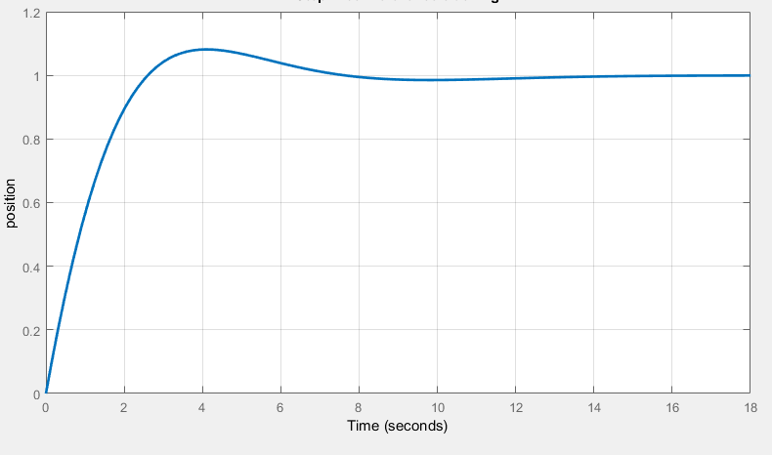
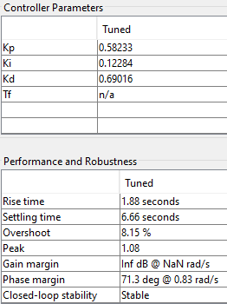
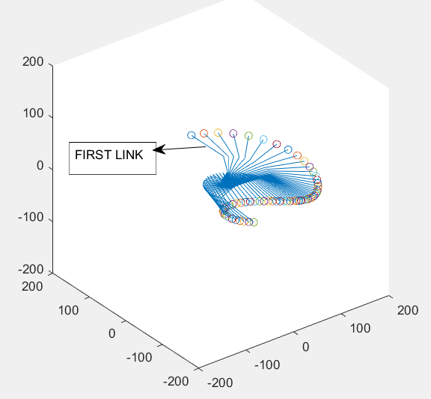
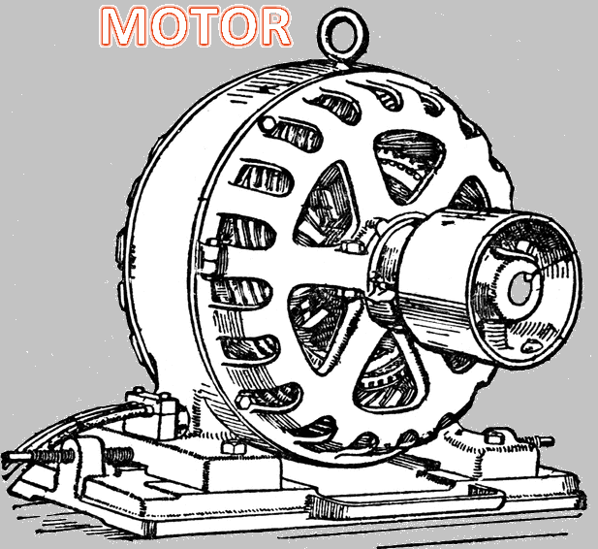

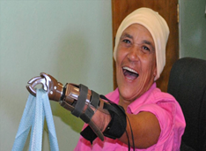

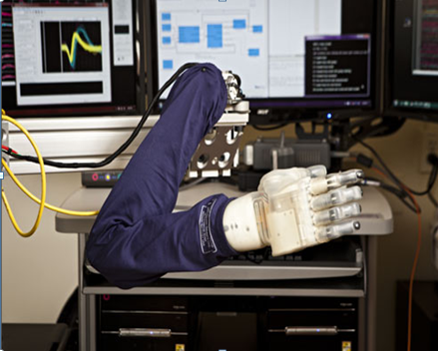
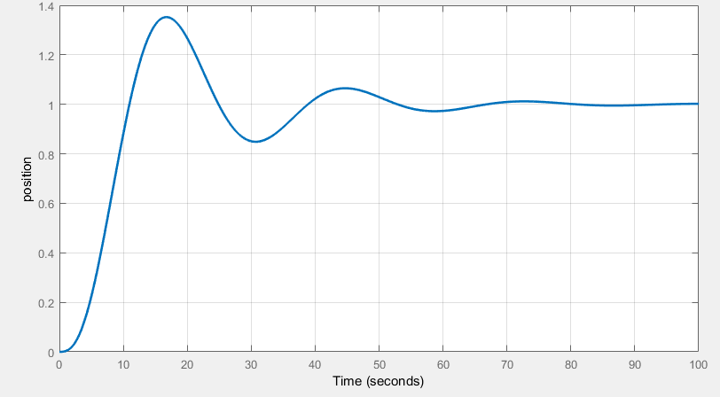
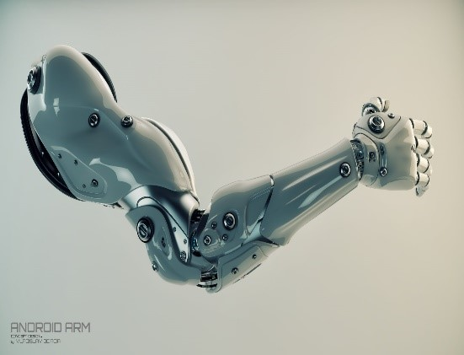
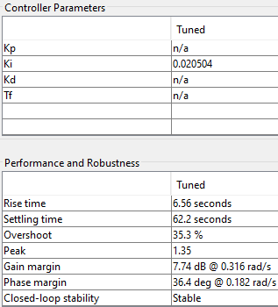
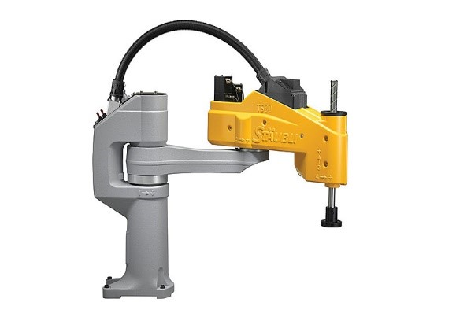
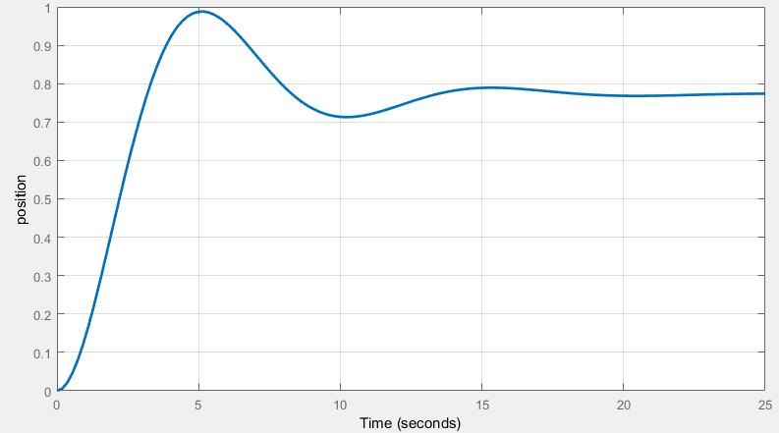

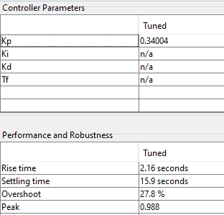

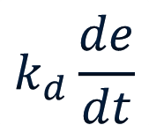
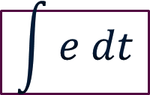
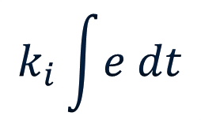
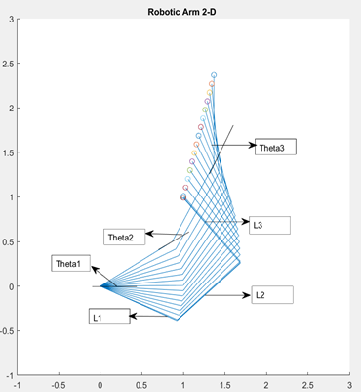
Robotic Arm
MTH124B
ROBOTIC ARM
OBJECTIVE
AbSTRACT
THE RESPONSE OF PID
Recognize that Designing of robotic arm requires :
Studying Robot dynamics .
Studying robot kinematics.
Designing a suitable control system
Simulate the result in mat lab .
When we want to talk about robotics and its design, we can’t ignore the mathematical modeling of them
So , we will discuss:
How they move.
the types of methods we use to describe its motion .
How to control its motion.
How to determine the desired position .
MAT
LAB
Rancho Robotic arm
(IN 1963) which Help the disabled
HISTORY
Stanford arm
(IN 1969)
The first computer controlled arm
PID
THE RESPOSE OF I AND P PARAMETERS
Silver arm
(IN 1974)
Had touch sensor and pressure micro controller
SCARA robot
(IN 1979) used in the electronics industry
ESRAA KHALED
MARINA MAHER
Kinetics and kinematics
Kinematics
It neglects the forces, and studies: 1.position 2.velocity 3.acceleration
Kinetics
It is concerned with the forces affecting the arm
ALZAHRAA EID
ERENE ADEL
PID CONTROLLER
CONCLUSION
PID control is essential for robot to do its task with highest possible efficiency , in other words: moving with high speed and minimum possible oscillations and reaching the exact position without great deviation.
The motion of robot consists of :kinematics and dynamics .
Kinematics deals with velocities , accelerations and position and neglecting the forces, while dynamics is concerned with the forces affected to the arm. The important thing we should know to describe the motion completely is the control system . It is responsible for guiding robot to the desired position.
FORWARD VS INVERSE KINEMATICS
P
I
D
Forward Kinematics
The angles between joints are given , so we can find the position of end effector
Inverse Kinematics
The final position of the end effector is given .. so we get the possible angles between links.
PROPORTION
INTEGRAL
DERIVATION
reference value
error
kp
+
input volt
REFERENCE
+ -
d/dt
kd
[1] Allonrobots.com. (2018). Types of robots. [online]Availableat:http://www.allonrobots.com/types-of-robots.html [Accessed 6 Apr. 2018]. [3]Control, R. (2018). Robot Dynamics and Control - PDF Drive. [online] Pdfdrive.net. Available at: https://www.pdfdrive.net/robot-dynamics-and-control-webnode-e8408999.html [Accessed 6 Apr. 2018].
measured value
ki
Position sensor
Feedback control
actuator
Robotic
arm
NEWTON VS EULER
MATLAB 2D
OPENED VS CLOSED LOOP
OPEN,CLOSE MATLAB
Newton Euler
Euler Lagrange
computer controller
system driver or actuator
process or robot
servo
computer controller
system driver or actuator
process or robot
Each link is treated separately
The robotic arm is treated as a whole.

