Slide 1
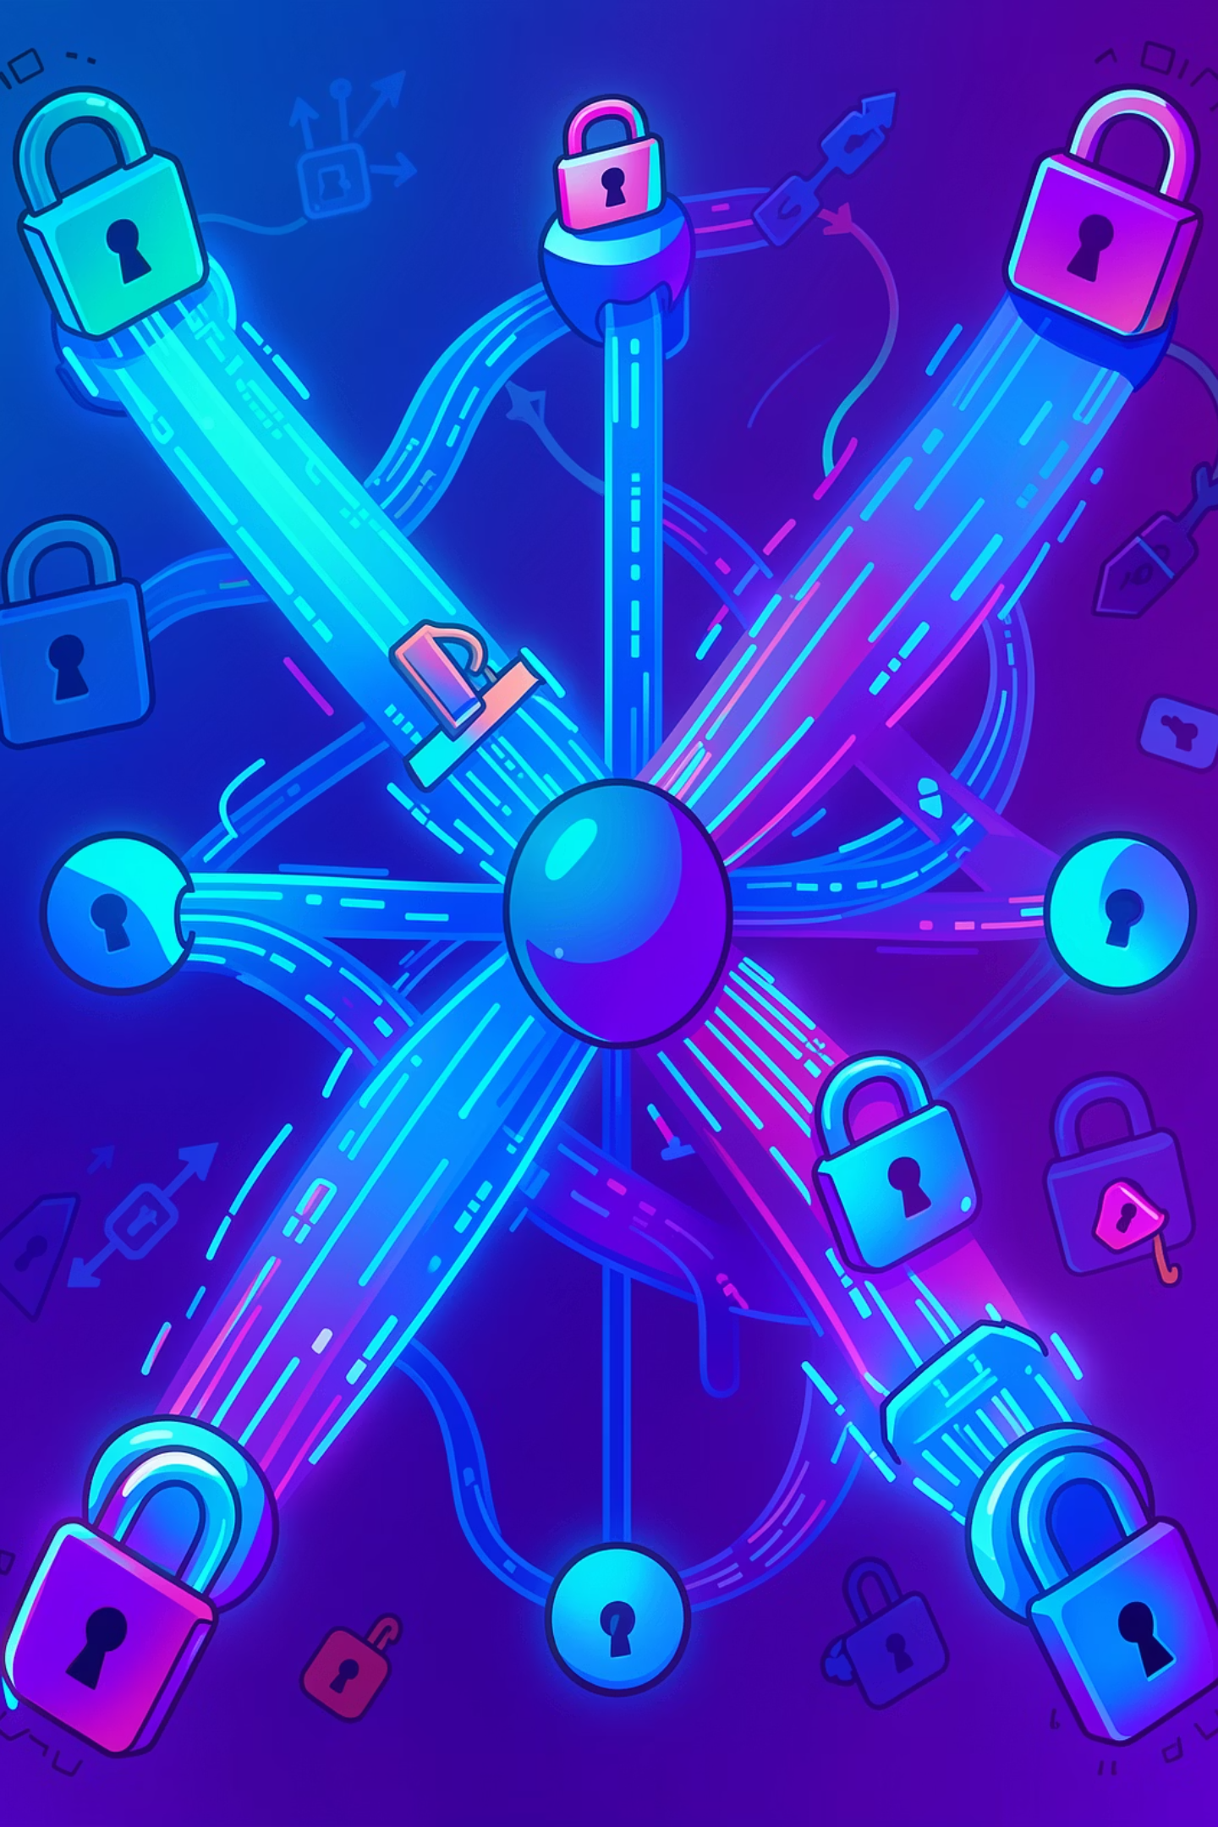
Public Key Infrastructure (PKI)
Course: Cryptography and Computer Security
Prepared by: Layal Zioud & Eman Bani Odeh
Submitted to: Dr. Jihad Hammamra
15/04/2026

Slide 2
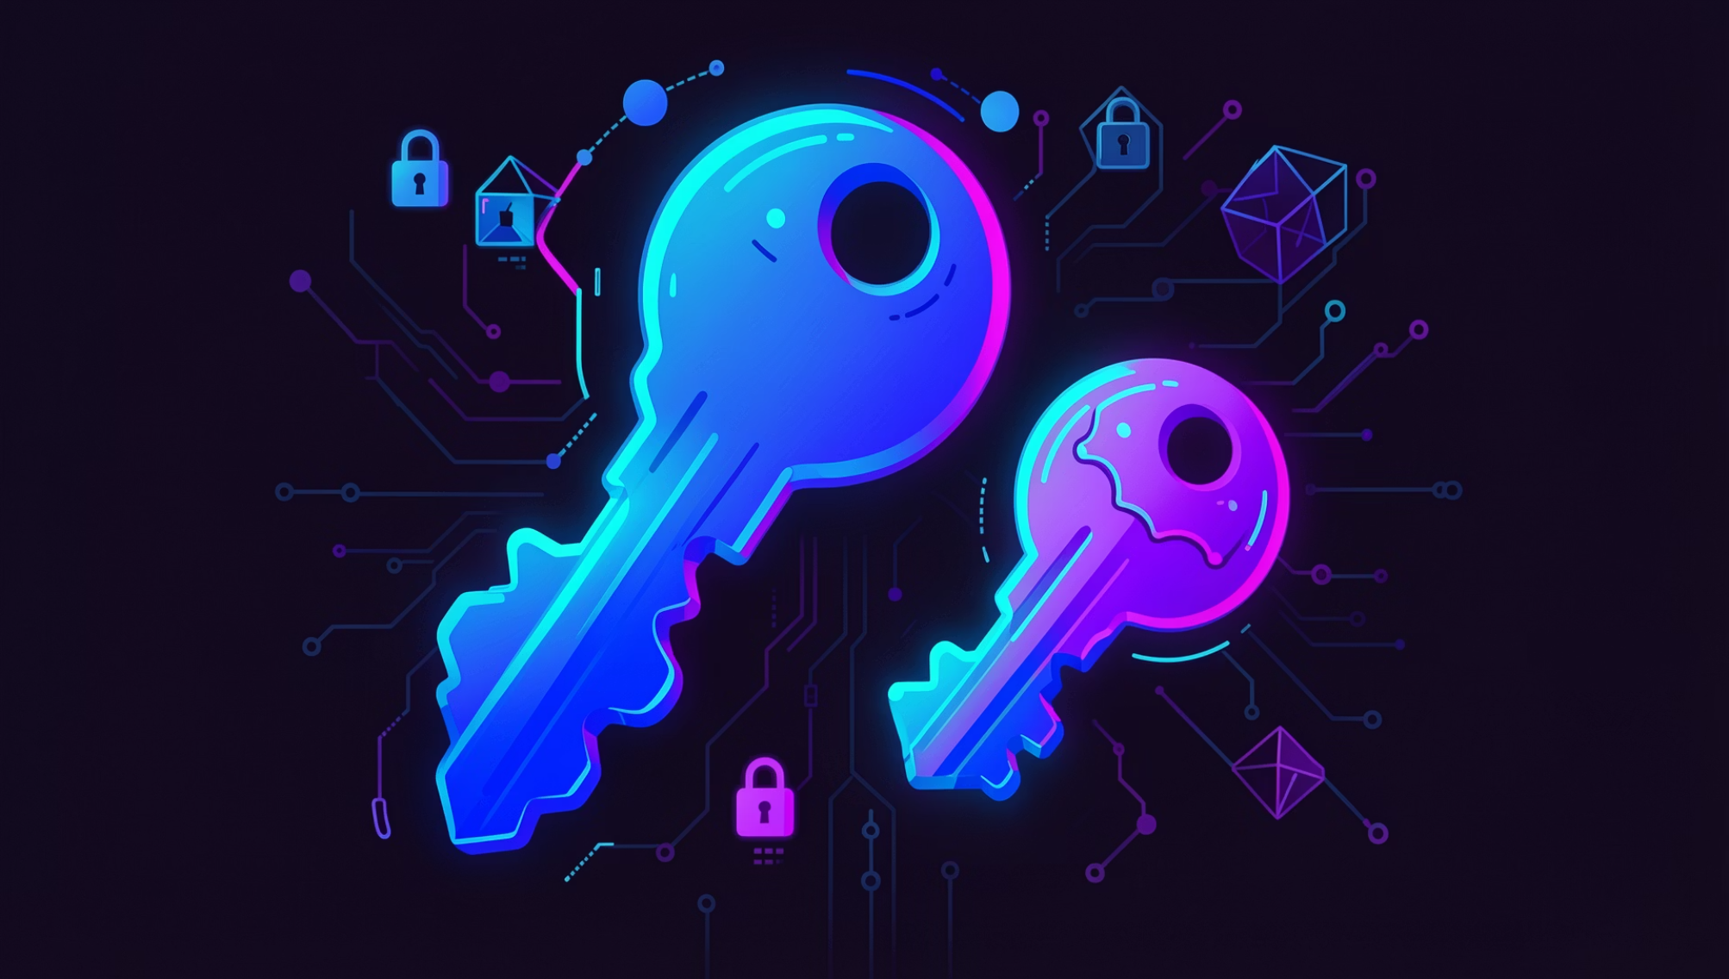
What is PKI?
A cryptographic framework enabling secure communication over untrusted networks.
Foundation of HTTPS, S/MIME, VPNs, and digital signatures
Asymmetric Cryptography
Trusted Authorities
Core Services
Public key shared openly; private key kept secret
Certificate Authorities (CAs) manage digital identities
Confidentiality · Authentication · Integrity · Non-repudiation

Slide 3
PKI Architecture
Certificate Authority (CA)
Registration Authority (RA)
Issues & signs certificates · Root and Intermediate CAs
Verifies identity before forwarding to CA
Digital Certificates
CRL / OCSP
X.509 standard · Binds identity to public key
Certificate revocation & validation mechanisms

Slide 4
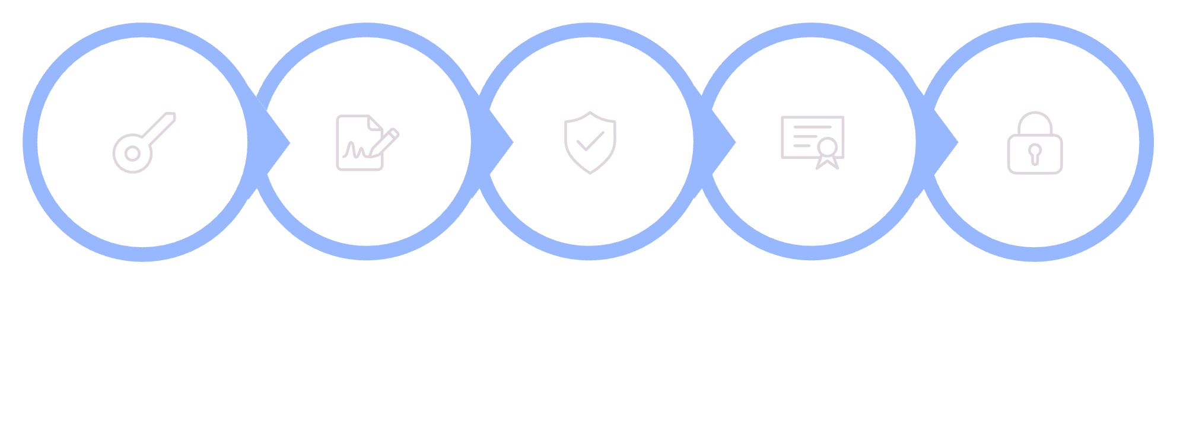

How PKI Works
Key Pair
CSR
Verify
Issue Cert
Secure Comm
Each step integrates cryptographic techniques and trusted authorities to establish secure, authenticated communication over untrusted networks.

Slide 5

PKI's Role in Secure Communication
Confidentiality
Encrypt with recipient's public key; decrypt with private key only
Authentication
CA-issued certificates verify communicating parties
Integrity
Hash functions & digital signatures detect tampering
Non-Repudiation
Digital signatures prove origin — essential for legal & financial transactions

Slide 6
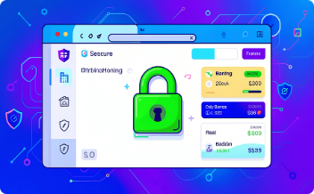


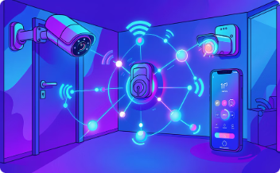
Where PKI Is Used
HTTPS (Web Security)
Secure Email
VPN & Enterprise
IoT & Mobile
S/MIME encryption and digital signatures
Secure remote access and internal network protection
Device authentication and secure app communication
SSL/TLS encryption between browser and server

Slide 7



Strengths & Limitations
Implementation Complexity
Requires specialized expertise; risk of misconfiguration
Strong Confidentiality
Scalable & Flexible
Asymmetric encryption protects data in transit
Fits small to enterprise-scale deployments
Centralized Trust Risk
Compromised CA = single point of failure
Certificate Management
Structured Key Management
Expiry, revocation, and lifecycle overhead
Full lifecycle: generation, renewal, revocation

Slide 8

Attacks on PKI
Man-in-the-Middle (MITM)
Fake certificates intercept secure channels
Certificate Forgery & CA Compromise
Fraudulent certs issued; entire trust model collapses
Private Key Theft
Full impersonation — decryption and signature forgery
Replay & Social Engineering
Session hijacking and phishing exploit user trust

Slide 9
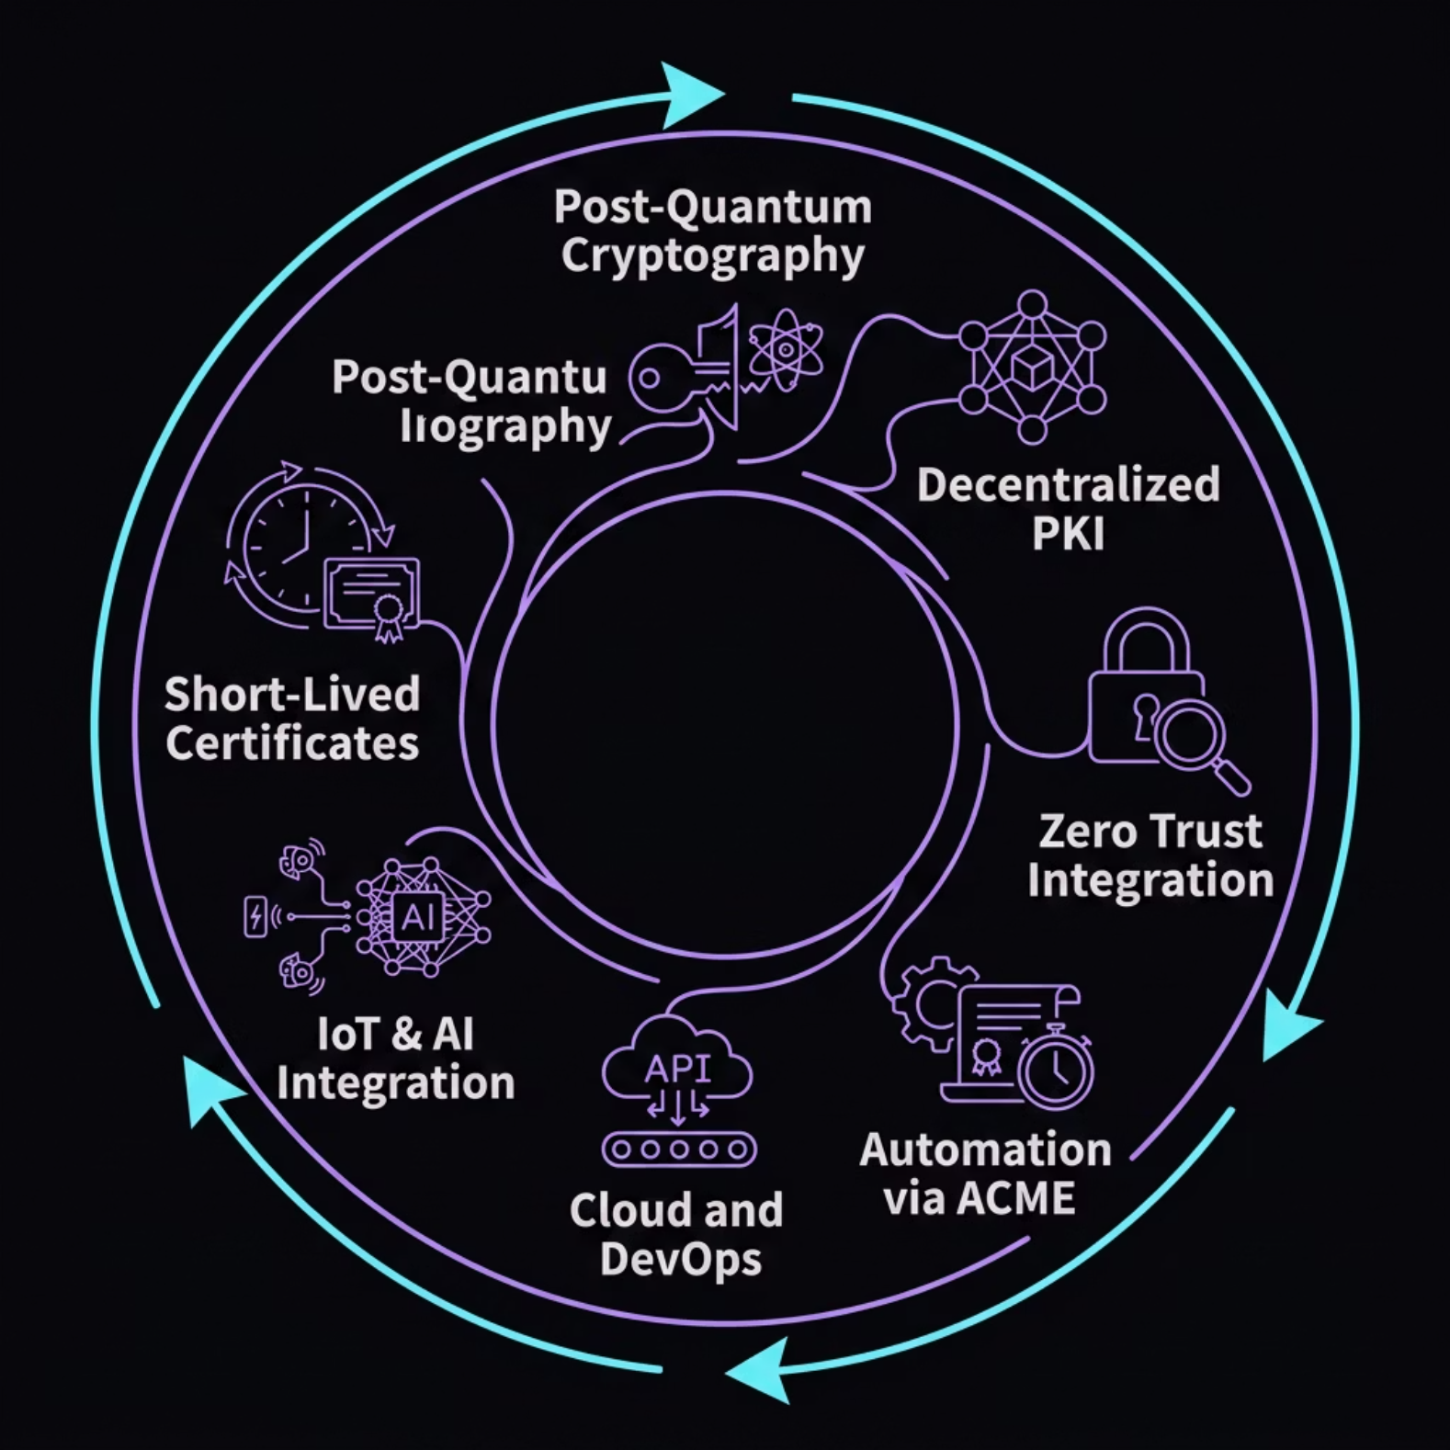

The Evolution of PKI
Post-Quantum Cryptography
Decentralized PKI (DPKI)
Quantum-resistant algorithms to replace RSA/ECC
Blockchain eliminates single points of failure
Zero Trust Architecture
Automation (ACME)
Continuous verification — no entity trusted by default
Faster issuance, renewal, reduced human error

Slide 10

Conclusion
Foundation of Trust
PKI underpins HTTPS, email, VPNs, and enterprise security
Four Pillars
Confidentiality · Authentication · Integrity · Non-Repudiation
Challenges Remain
Complexity, CA dependency, and certificate lifecycle management
Future-Ready
Post-quantum, DPKI, and Zero Trust will shape PKI's next era
PKI remains a critical foundation for secure, reliable, and scalable communication in today's interconnected digital world.
Key References: Stallings (2017) · RFC 5280 · DigiCert · Cloudflare · Microsoft Learn · Let's Encrypt

