Slide 1
PharmaFinder
Rx GW5X-MU8N
Digital prescriptions linked to live pharmacy stock in Uasin Gishu County, Kenya
Metformin 500 mg, twice daily, 30 days
Amlodipine 5 mg, once daily, 30 days
All items in stock at 1 pharmacy, 2.6 km away
Group 3, ALU Foundations Project, technical presentation
Pauline Miyienda
Frontend, project manager
Marion Gitau
Backend
Emmanuel Masambu
Database architect
Sylvie Uwera
Frontend
Ahmed Osman
UI/UX design
Batsinda Benoit
Backend
Notes:
SPEAKER: Pauline Miyienda (about 30 seconds)
Good morning. We are Group 3 and this is PharmaFinder.
In one sentence: a Flask and MySQL web app where doctors issue structured digital prescriptions, patients see which nearby pharmacies have every medicine in stock, and pharmacists verify a one-time code and dispense, with stock updating automatically.
The card on the right is a real prescription from our running app, with synthetic demo data.
Introduce the team briefly: each of us will present the part we owned.
TRANSITION: "Let me start with the problem we are solving."

Slide 2




Two problems, one workflow
21%
How PharmaFinder answers both
Doctor issues a structured prescription
Every field validated by the API; unique code, expiry date, alert to the patient
of handwritten prescriptions were legible at a Uasin Gishu public hospital, even after an improvement project (Amdany & Kiprop, 2023)
Patient finds pharmacies that can fill it
Ranked by full stock coverage, then distance and price, on a Leaflet map
16.1%
Patient shares it with one pharmacy
Time-limited access the patient can revoke at any moment
availability of NCD medicines at Kenyan dispensaries across 8 counties, so patients travel between pharmacies (Ashigbie et al., 2020)
Pharmacist verifies and dispenses
Stock falls in the same transaction; the code can never be used again
Notes:
SPEAKER: Pauline Miyienda (about 45 seconds)
Two problems from our proposal.
First, prescriptions are hard to read: in the Uasin Gishu audit only 21 percent were legible even after training.
Second, medicines are often not where the patient goes: 16 percent availability of NCD medicines at dispensaries. Patients with diabetes or hypertension make repeat trips.
Our workflow addresses both in four steps (walk through the four rows). The key ideas: the prescription is structured and validated by the server, the patient sees real stock before travelling, the patient controls who can open the prescription, and dispensing is single-use.
TRANSITION: "Here is what is actually built."

Slide 3
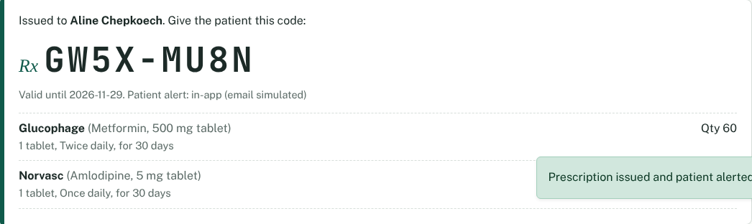
What is built, and what changed
Feature | Status | Evidence
Registration, login, four roles | Working | test_auth.py (9 tests)
Prescription form, unique code, issue alert | Working | test_prescriptions.py
Patient prescription history | Working | test_patient_sees_only_own…
Share with a pharmacy, revoke | Working | test_sharing.py (6 tests)
Medicine search, filters, sort, map | Working | test_stock_search.py
Stock management | Working | test_stock_search.py
Code verification and dispensing | Working | test_dispense.py (7 tests)
Admin dashboard and audit log | Working | test_admin_journey.py
Deployment on Vercel | Ready, not deployed | Steps in README
Changed from the proposal
QR code replaced by an 8-character code
Reservations and payment dropped
Digital signature dropped
No self-registration for doctors or pharmacists; the admin creates them
A prescription issued in the running app (synthetic data)
Notes:
SPEAKER: Pauline Miyienda (about 45 seconds)
Eight of our nine planned features work end to end, and each has automated tests listed in the Evidence column.
Deployment to Vercel is ready (configuration and steps in the README) but not yet live, so we say so honestly.
On the right are the scope changes the team agreed: we replaced the QR code with a short code, dropped reservations, payment and the digital signature, and instead of a doctor verification workflow, the admin creates doctor and pharmacist accounts, so nobody can sign up as a doctor.
The screenshot is a real prescription issued in the app.
TRANSITION: "Marion will explain the technology choices behind this."

Slide 4





Technology choices
Python 3 + Flask
MySQL 8
HTML, CSS, JS + Bootstrap 5
Small REST API with blueprints per role. Chosen over Django: we need an API, not an admin site or ORM.
Linked data, foreign keys and transactions for dispensing. Chosen over MongoDB, which lacks relational joins and constraints.
No build step, so every team member can edit pages. Chosen over React for a 6-week build.
Leaflet.js + OpenStreetMap
pytest + Postman
Git, GitHub, Vercel
Free and open, no API key or billing. Google Maps needs a paid key.
pytest for unit, integration and security tests on real MySQL; Postman for HTTP-level checks.
Version control and pull requests; Vercel hosts Flask free as a serverless function.
Notes:
SPEAKER: Marion Gitau (about 45 seconds)
All six choices come from our proposal; here is why each beats the obvious alternative.
Flask instead of Django: we only need a JSON API, so Flask keeps the code small and easy to read.
MySQL instead of MongoDB: prescriptions, items, stock and pharmacies are tightly linked, and dispensing needs a transaction that updates several tables at once.
Plain HTML and Bootstrap instead of React: no build step, so all six of us could work on pages.
Leaflet with OpenStreetMap instead of Google Maps: free, no API key.
pytest and Postman for testing; GitHub for collaboration; Vercel for hosting, with MySQL on Aiven because Vercel does not host MySQL.
TRANSITION: "Here is how these pieces fit together."

Slide 5
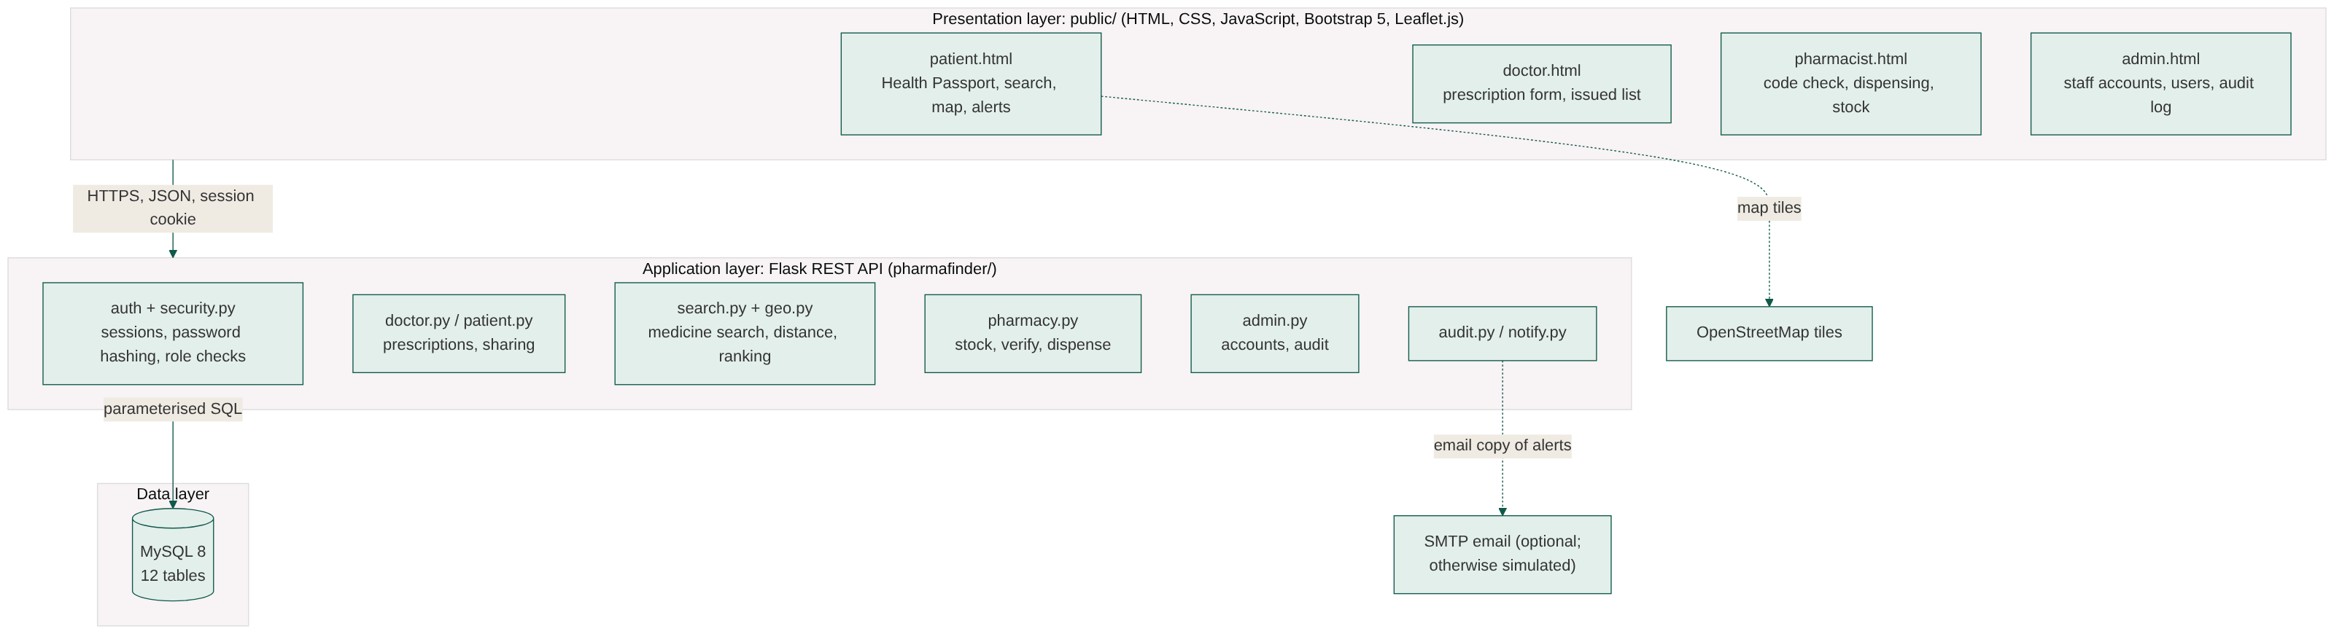


Three-tier architecture
Presentation
Application
Data
4 role pages call the API with fetch() and escape all server data before display
Flask checks login, role and ownership on every request, validates input, writes the audit log
MySQL is reached only by the API, with parameterised SQL and transactions
Notes:
SPEAKER: Marion Gitau (about 45 seconds)
We follow the three layers from our proposal.
Presentation: four pages, one per role, in plain HTML and JavaScript. They talk to the API only through JSON over HTTPS with a session cookie.
Application: the Flask API in the pharmafinder package. Every request goes through security.py, which checks the user is logged in, still active, has the right role, and owns the record. Hiding a button is never the protection; the server is.
Data: MySQL. The browser never touches it. Every query is parameterised, and the operations that change several tables run in a transaction.
External services: OpenStreetMap tiles for the map, and email alerts only if SMTP is configured; otherwise alerts are stored in the app and labelled "simulated".
Because the API keeps no state in memory and writes nothing to disk, it runs on Vercel's serverless platform.
TRANSITION: "Emmanuel will take you through the database."

Slide 6
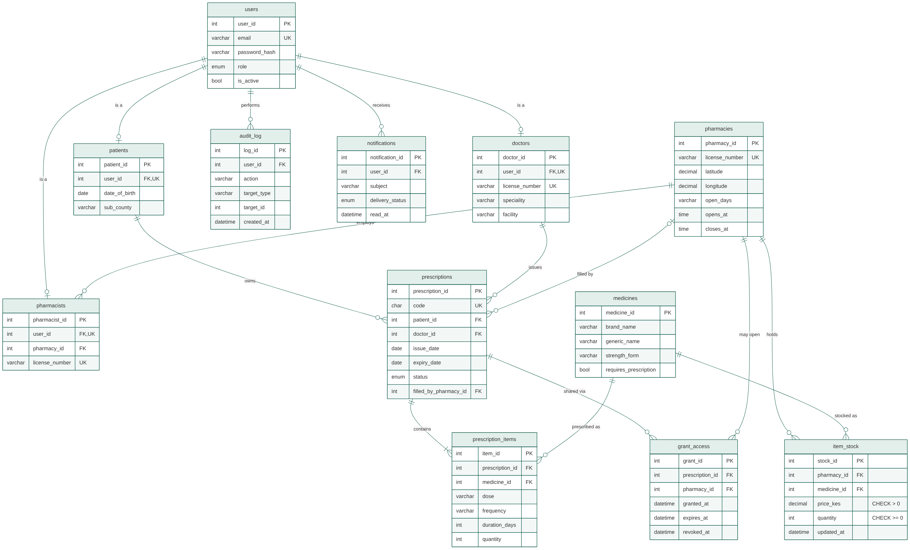
Database design: 12 tables
Keys and constraints
Patient, Doctor, Pharmacist are 1:1 with User via a unique user_id
Prescription code is UNIQUE
CHECK quantity >= 0 and price_kes > 0 on stock
UNIQUE (pharmacy, medicine) stock line
Indexes on generic name and on grant lookups
Changed from proposal
Reservation replaced by notifications; added password hash, coordinates, generic name, revoked_at; 'update' column renamed (MySQL reserved word); prices in KES
Notes:
SPEAKER: Emmanuel Masambu (about 45 seconds)
This is the ERD generated from our actual schema.sql. Twelve tables, keeping the proposal's entities.
Patient, Doctor and Pharmacist each link one-to-one to User through a unique user_id; an admin is just a user with the admin role.
A Prescription belongs to one patient and one doctor and has one or more Prescription Items. GrantAccess links one prescription to one pharmacy for a time window. ItemStock links pharmacies to medicines.
The database enforces rules itself, not just the API: a unique prescription code, stock can never go negative, price must be positive, and a pharmacy has only one stock line per medicine.
We changed some things from the proposal (bottom right): Reservation became Notification after the scope change, and we added the columns the proposal was missing, such as the password hash and pharmacy coordinates. The proposal also used a column called "update", which is a reserved word in MySQL.
CRUD: prescriptions and grants are never deleted, only their status changes, so the history stays complete.
TRANSITION: "Batsinda will show the core code."

Slide 7
Core logic: codes and single-use dispensing
Unguessable prescription codes (rx.py)
Dispensing in one transaction (routes/pharmacy.py, abridged)
# No 0/O, 1/I/L, so codes are read
# correctly at the counter
CODE_ALPHABET = "ABCDEFGHJKMNPQRSTUVWXYZ23456789"
def generate_code():
raw = "".join(secrets.choice(CODE_ALPHABET)
for _ in range(8))
return f"{raw[:4]}-{raw[4:]}"
rx = query_one("SELECT ... FROM prescriptions"
" WHERE code=%s FOR UPDATE", (code,))
# check grant, status, expiry, stock for all items
for i in items:
cur.execute("UPDATE item_stock SET quantity ="
" quantity - %s WHERE stock_id=%s"
" AND quantity >= %s", (...))
cur.execute("UPDATE prescriptions SET status='filled'"
" WHERE prescription_id=%s"
" AND status='active'", (...))
if cur.rowcount != 1:
raise ApiError("Already filled", 409)
log_action(...); notify(...); conn.commit()
31⁸ ≈ 850 billion possible codes, from a cryptographic random source
UNIQUE in MySQL; on the rare clash the API retries
10 wrong codes in 15 minutes locks the pharmacist out (429)
Row locks and conditional updates: if anything fails, nothing changes
Notes:
SPEAKER: Batsinda Benoit (about 1 minute)
Two pieces of code carry the main guarantees.
Left: the prescription code. We use Python's secrets module, which is cryptographically random, over an alphabet without look-alike characters. That gives about 850 billion combinations, the column is UNIQUE in MySQL, and wrong guesses are rate-limited.
Right: dispensing. It runs as one transaction. First SELECT ... FOR UPDATE locks the prescription row, so a second pharmacist trying the same code waits. We check the patient's grant, the status and expiry, and that there is enough stock for every item. Then each stock update only succeeds if quantity is still high enough, and the status update only succeeds if the prescription is still active. If any check fails we roll back, so stock is never half-deducted.
We tested exactly this: two pharmacists dispensing the same code at the same moment get one success and one 409, and stock drops once.
TRANSITION: "Sylvie will show how patients find their medicine."

Slide 8
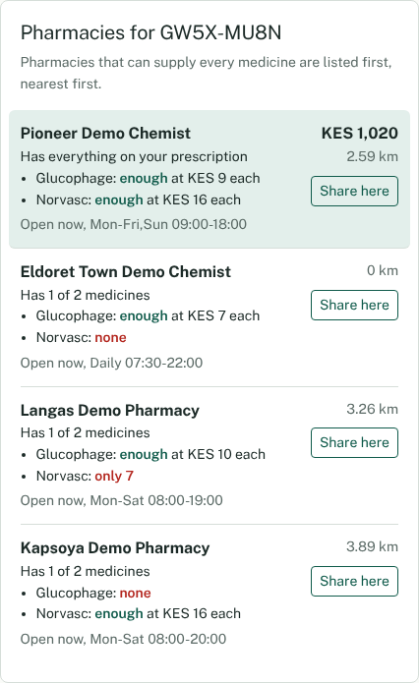
Search, ranking and the map
1
Distance
Haversine great-circle distance from the patient (browser location, or Eldoret CBD in the demo) to each pharmacy
2
Coverage
Each prescribed item is matched against the pharmacy's stock: enough only if quantity ≥ prescribed amount
3
Rank
Can fill everything first, then more items covered, then nearest, then cheapest total
def key(p): # geo.py
full = p["items_available"] == needed_count
return (0 if full else 1, -p["items_available"],
p["distance_km"], p["total_price_kes"])
Search by name: brand or generic, sort by distance, price or stock, filter by open now and distance. Map: Leaflet markers on OpenStreetMap tiles; stock times shown so patients see how fresh it is.
Real ranking from the app (synthetic data)
Notes:
SPEAKER: Sylvie Uwera (about 45 seconds)
This is the feature patients care about most.
On the left is a real result from the app for a two-medicine prescription. The nearest pharmacy, 0 km away, is not first, because it only has one of the two medicines. The pharmacy 2.6 km away has both, so it ranks first.
The algorithm has three steps: haversine distance, matching each item against stock with enough quantity, and then a sort key in geo.py: full coverage first, then number of items, then distance, then total price.
Patients can also search by medicine name, by brand or generic, and sort or filter.
The map uses Leaflet with OpenStreetMap tiles. In the demo the patient's location is the browser's geolocation, or Eldoret CBD if the browser refuses.
A test checks the search returns exactly the pharmacies with stock in the database, no more and no fewer.
TRANSITION: "Batsinda will cover security."

Slide 9






Security and data protection
Passwords
Roles and ownership
Hashed with scrypt and a random salt (Werkzeug); never stored in plain text
Checked on the server on every request: 401 not logged in, 403 wrong role, 404 not yours
Patient-controlled sharing
Single use and expiry
A pharmacy opens a prescription only during a 1–72 h grant; revoking blocks it instantly
Filled, expired or cancelled prescriptions cannot be dispensed; access closes after dispensing
Audit log
Attempt limits
Logins, prescriptions, sharing, stock changes, dispensing and admin actions, with user and time
5 failed logins or 10 wrong codes in 15 minutes returns 429
Not claimed: encryption of stored data, anonymised search and account deletion from the proposal are not implemented yet. HTTPS comes from Vercel; TLS to MySQL when configured.
Notes:
SPEAKER: Batsinda Benoit (about 45 seconds)
Six security measures, all implemented and all covered by tests.
Passwords are hashed with scrypt and a salt. Roles and ownership are checked on the server for every endpoint; a patient asking for someone else's prescription gets 404, so they cannot even learn it exists.
Sharing is controlled by the patient, time-limited, and revocable; a revoked grant blocks the pharmacy on its very next request. A prescription cannot be dispensed twice, or after it expires or is cancelled.
Every sensitive action goes into the audit log, and brute-force attempts are limited.
At the bottom, to be honest: our proposal promised encryption of stored data and anonymised search. These are not implemented, so we do not claim them.
TRANSITION: "Emmanuel will show how we tested all this."

Slide 10
Code quality and testing
66 / 66
Example cases from the test report
Full journey: doctor issues, patient shares, pharmacist dispenses; stock 200 to 140 and 170
Code reuse: second dispense returns 409 and stock is unchanged
Invalid input: 10 bad prescriptions all rejected, none saved
Role escalation: signing up as doctor still creates a patient
pytest tests passed, on real MySQL rebuilt before each test
30 / 30
Postman assertions passed across 22 API requests (Newman)
Code quality: one Flask blueprint per role, shared helpers for validation, security and audit; PEP 8 style; every SQL query parameterised; generated test report in docs/TEST_REPORT.md.
Notes:
SPEAKER: Emmanuel Masambu (about 45 seconds)
We used the two tools from our proposal.
pytest: 66 tests, all passing, run against a real MySQL database that is rebuilt from schema.sql before every test, so no mocks. They split into unit tests (distance, ranking, code format, validation), integration tests (API plus database), security tests, and one full system journey.
Postman: a collection of 22 requests with 30 assertions, run with Newman, all passing.
Some examples on the right: the full journey checks stock drops by exactly the prescribed amounts; reusing a code returns 409; ten different invalid prescriptions are all rejected and nothing is saved.
The test report in the repo is generated from the actual run, not written by hand.
TRANSITION: "Ahmed will talk about the challenges we hit."

Slide 11
Technical challenges and solutions
Challenge | Solution | Did it work?
Two pharmacists dispensing one code at once | SELECT … FOR UPDATE row locks and updates conditional on status | Concurrency test: one 200, one 409, stock reduced once
Vercel has no background jobs, memory or disk between requests | Expiry applied whenever prescriptions are read; attempt limits counted from the audit log | Works locally as stateless code; live Vercel deploy still to do
Codes without QR can be guessed or misread | Random 8-character code without look-alike characters; 10 failures in 15 min blocked | Rate-limit test passes; lower-case and spaced input accepted
Proposal schema could not support the features | Added password hash, coordinates, generic name, revoked_at; renamed the reserved-word column | All 12 tables created from schema.sql in every test run
Notes:
SPEAKER: Ahmed Osman (about 45 seconds)
Four real challenges.
One: concurrency. If two pharmacists dispense the same code at the same moment, both could succeed. Row locks plus conditional updates fixed it, and a test fires both requests together.
Two: Vercel. Serverless functions have no background jobs and forget everything between requests. So expiry is checked when prescriptions are read, and brute-force limits are counted from the audit log in MySQL. We have proven this locally; the live deployment is our next step.
Three: dropping the QR code. A typed code can be guessed or misread, so we use a long random code without look-alike characters and limit wrong attempts.
Four: our own proposal's database was missing columns we needed, such as password hashes and pharmacy coordinates, and used a reserved word. We fixed and documented each one.
TRANSITION: "Next, how review shaped the project."

Slide 12




Feedback integration
We have not yet received formal reviewer feedback on the implementation. Changes so far came from the team's own design review of the proposal.
Design review of the proposal
How we will handle feedback
Finding: schema missing password hash, pharmacist-pharmacy link, coordinates
Change: columns added (slide 6)
Finding: anyone could register as a doctor
Change: only patients self-register; admin creates staff
Finding: QR expiry and reservation timer were mixed up
Change: scope simplified to one code with patient-controlled access
Log each comment as a card on our board
Fix it on a branch with a pull request
Add or update a test that proves the fix
Re-run pytest and Postman before merging
Notes:
SPEAKER: Sylvie Uwera (about 30 seconds)
To be transparent: we have not yet had formal reviewer feedback on the implementation, so we will not invent any.
What did shape the project was our own review of the proposal before building. We found the schema could not support login or the map, that anyone could have registered as a doctor, and that two different timers had been mixed up. Each finding led to a concrete change.
When we receive feedback from today's session, we will log each point on our board, fix it on a branch through a pull request, add a test that proves the fix, and re-run all tests before merging.
TRANSITION: "Ahmed will take us through next steps."

Slide 13
Next technical steps
Owner | Task
Marion Gitau | Deploy the Flask API and pages to Vercel; set environment variables
Emmanuel Masambu | Create the Aiven MySQL database, run the seed, set up backups
Batsinda Benoit | Run the Postman collection against the live URL; connect real email for alerts
Sylvie Uwera | Test on phones over slow connections; capture screenshots with live map tiles
Ahmed Osman | Usability test with 5 users using the proposal's 5-point Likert scale
Pauline Miyienda | Coordinate review and merge of pull request #1; track tasks on the board
Milestones
Week 5
Live on Vercel, all tests re-run against it
Week 6
User evaluation and security testing, per the proposal timeline
After the course
Pilot with real Eldoret pharmacies
Notes:
SPEAKER: Ahmed Osman (about 30 seconds)
Each of us has a concrete next task (read the table briefly, one line per person).
The biggest is deployment: Marion and Emmanuel will put the API on Vercel and the database on Aiven, and Batsinda will re-run the Postman tests against the live site.
I will run a usability test with five users, using the five-point Likert scale from our evaluation plan.
Milestones follow our proposal's timeline: live in week 5, evaluation in week 6, and a pilot with real pharmacies after the course.
TRANSITION: "Pauline will close."

Slide 14
References and acknowledgements
Research
Libraries and services
Amdany, H., & Kiprop, J. W. (2023). Handwritten prescription practices in a public hospital in Uasin Gishu County, Kenya. JBI Evidence Implementation, 21(4), 345–354.
Ashigbie, P. G., et al. (2020). Availability and prices of medicines for non-communicable diseases in Kenya. BMJ Open, 10(5), e035132.
Kommey, B., et al. (2024). MeDASH: checking the availability of pharmaceutical drugs in proximity using QR codes. SPEKTA, 5(2), 144–167.
Wondmagegn, M. T., et al. (2023). A framework for locating prescribed medication at pharmacies. Integrated Pharmacy Research and Practice, 12, 127–136.
Ariaga, A., et al. (2023). A scoping review of legibility of hand-written prescriptions and drug-orders. Expert Review of Clinical Pharmacology, 16(7), 617–621.
Toroitich, A. M., et al. (2022). Patients access to medicines: a critical review of the healthcare system in Kenya. Risk Management and Healthcare Policy, 15, 361–374.
Flask 3, Werkzeug, PyMySQL (Pallets; PyMySQL contributors)
Bootstrap 5.3, Leaflet 1.9.4
Map data © OpenStreetMap contributors
pytest, Postman and Newman, Mermaid
Vercel, Aiven for MySQL (deployment)
Thank you
To our ALU facilitators. Development was assisted by Claude (Anthropic), as permitted for this project. Code: github.com/EMANU02004/Pharma
Notes:
SPEAKER: Pauline Miyienda (about 15 seconds)
These are our main research sources and the open-source libraries we built on. We also used Claude as a development assistant, which was permitted for this project, and every result we have shown comes from running our own code and tests.
Thank you. We are happy to take your questions, and we can run a live demo if time allows.
Q&A PREPARATION (3 minutes):
- Why not QR? Simpler to build and test; a typed code works without a camera; we compensate with long random codes and attempt limits.
- What if a pharmacy's stock is wrong? Each stock line shows its last-update time; live sync with pharmacy systems is future work.
- How do you stop someone posing as a doctor? Only patients can sign up; doctor and pharmacist accounts are created by the admin.
- What happens if two pharmacists dispense at once? Row locks; tested, exactly one succeeds.
- Is health data encrypted? In transit via HTTPS on Vercel and TLS to MySQL when configured; not encrypted at rest in the app, which we state openly.

