Slide 1

Movie Database using SQL
A Simple Implementation with Queries

Slide 2
Introduction
This project demonstrates a simple SQL-based movie database.
We use a dataset inspired by IMDb with two tables: Movies and Directors.
Basic SQL operations are used: CREATE, INSERT, SELECT, and JOIN.

Slide 3


Tools Used
DBMS: MySQL
Tools: MySQL Workbench
Languages: SQL

Slide 4
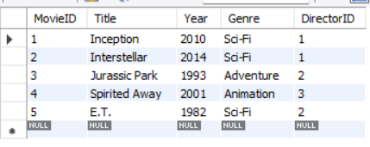
Query 1 – View All Movies
Query:
SELECT * FROM Movies;
Explanation: Lists all movies in the database

Slide 5

Query 2 – Filter by Genre
Query:
SELECT Title, Year FROM Movies WHERE Genre = 'Sci-Fi';
Explanation: Shows Sci-Fi movies only

Slide 6
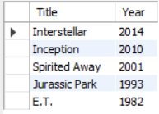
Query 3 – Sort by Year
Query:
SELECT Title, Year FROM Movies ORDER BY Year DESC;
Explanation: Sorts movies from latest to oldest

Slide 7
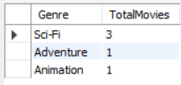
Query 4 – Count by Genre
Query:
SELECT Genre, COUNT(*) AS TotalMovies FROM Movies GROUP BY Genre;
Explanation: Aggregates movie count by genre

Slide 8
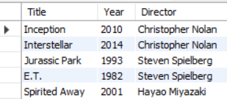
Query 5 – INNER JOIN with Directors
Query:
SELECT M.Title, D.Name AS Director FROM Movies M JOIN Directors D ON M.DirectorID = D.DirectorID;
Explanation: Combines movies and directors

Slide 9
Conclusion
Successfully demonstrated a basic movie database using SQL.
Covered table creation, data insertion, and 5 different SELECT queries.
Gained hands-on experience in writing and understanding SQL commands.

Slide 10
Thank You
Thank you for your time and attention!
Any questions?

