Slide 1
A wide-coverage free/open-source deep parser for Brazilian Portuguese: a work in progress
Leonel Figueiredo de Alencar
http://www.leonel.profusehost.net/
Research Group on Language and Computation
(CompLin)
Postgraduate Program in Linguistics
Federal University of Ceará (UFC)

Slide 2
Our goals
Long-term goal: development of a free/open-source robust parser for unrestricted text in Brazilian Portuguese (henceforth BP), integrating symbolic and statistical NLP techniques
Short-term goal: development of shallow processing tools for BP, adapting/integrating available resources as much as possible

Slide 3
AeliusDonatus
Aelius: tools for shallow processing of BP
  Already implemented: tokenizers and taggers
  Under development: chunker
http://aelius.sourceforge.net/
Donatus: tools for deep processing of BP
  Implemented: ALEXP, a tagger-parser interface (ALENCAR, 2011)
  Under development: deep grammar for BP nominal expressions in a constraint-based formalism

Slide 4
Who was Aelius Donatus?
Roman grammarian (mid 4th century ), author of Ars Grammatica, which popularized the notion of parts of speech (partes orationis), such as Nouns, Verbs, Adjectives, etc (JUNGEN; LOHNSTEIN, 2006). However, in computational linguistics, parsing a sentence implies labeling the sentence constituents (typically word groups forming a unit), assigning the sentence a hierarchical structure.

Slide 5
Deep parsing of Portuguese: state of the art
Freely accessible parsers | claims robustness? | FOSS | disclosed source | freely downloadable | X-bar theory
CURUPIRA | yes | no | no | yes | no
Grammar Play | no | yes | yes | yes | yes
VISL | yes | no | no | no | no
LX-Parser | yes | no | yes | yes | yes
LX-Gram | yes | no | yes | yes | yes

Slide 6
Freely accessible deep parsers of Portuguese
Curupira
http://www.nilc.icmc.usp.br/nilc/tools/curupira.html
Grammar Play
http://sites.google.com/site/gabrielothero/home/publicacoes
VISL
http://beta.visl.sdu.dk/visl/pt/parsing/automatic/trees.php
LX-Parser
http://lxcenter.di.fc.ul.pt/services/en/LXServicesParser.html
LX-Gram
http://nlxgroup.di.fc.ul.pt/lxgram/

Slide 7
Robustness
A robust parser always delivers some useful (though somewhat degraded) output, even under unpredicted circumstances (LJUNGLÖF; WIRÉN, 2010, p. 79-80)

Slide 8
Free/open source software (FOSS)
FOSS = software whose license complies with the licenses approved either by the Free Software Foundation (FSF) or the Open Source Initiative (OSI):
http://www.gnu.org/licenses/license-list.html
http://www.opensource.org/licenses

Slide 9
LX-Center's tools are not FOSS
LX-Parser and LX-Gram (as well as other LX-Center's products like the LX-Tagger) are freely distributed (by anonymous download) in source form
http://lxcenter.di.fc.ul.pt/tools/en/
However, at least two license conditions are not compliant with FSF/OSI principles:

Slide 10
FOSS incompatible conditions in the LX-Parser license
  “6. The user is not allowed to distribute or market any derivative product or service based on all or part of the parser.“
  “7. The user is not permitted to make available to the public all or part of the contents of the parser, by the distribution of copies, by renting, leasing or any other form of distribution, including free or open-source ones, web services, 'mash-up' or others.“
http://lxcenter.di.fc.ul.pt/tools/en/conteudo/LX-Parser_License.pdf

Slide 11
Some basic formal language theory
For a given string language there is a infinite number of grammars generating this language
Example: Drummond's language (from poem Quadrilha)
L={„John loved Theresa”, „John loved Theresa who loved Raymond“, „John loved Theresa who loved Raymond who loved Mary“, ...}

Slide 12
A grammar representing an inelegant solution for parsing Drummond's language
S -> N V N Sbar
Sbar -> REL V N Sbar |
REL -> 'que'
N -> 'João' | 'Teresa' | 'Joaquim' | 'Raimundo' | 'Lili' | 'Maria' | 'se'
V -> 'suicidou' | 'amava'

Slide 13
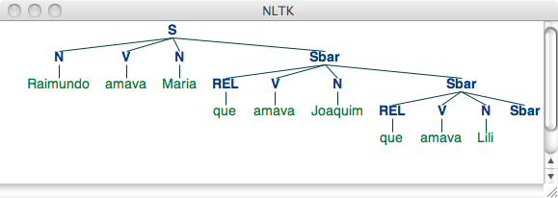
Parse tree generated by the inelegant grammar

Slide 14
A grammar representing a more elegant solution for parsing Drummond's language
S -> NP VP
VP -> V NP
NP -> NP S
NP -> 'João' | 'Teresa' | 'Joaquim' | 'Raimundo' | 'Lili' | 'Maria' | 'que' | 'se'
V -> 'suicidou' | 'amava'

Slide 15
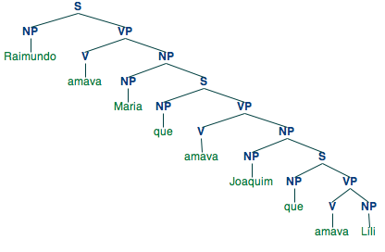
Parse tree #1 generated by the more elegant solution

Slide 16
Traditional grammar revisited
The latter tree can straightforwardly be interpreted in traditional grammar terms
  The subject of the sentence is the NP daughter node of S
  The predicate of the sentence is the VP daughter node of S
  The object of the sentence is the NP daughter node of VP
  The higher level relative clause is a modifier of its sister NP node
These syntactic-semantic relations are not so clearly reflected in the former tree (e.g. “Mary” and the relative clause do not form a constituent)

Slide 17
Linguistic elegance and its usefulness for natural language technology
Example of a task in a natural language-based database querying (see Bird; Klein; Loper, 2009, p. 361-365):
  Quem Raimundo amava?
  “Whom did Raymond love?”
With linguistically well-motivated trees like the previous one, solving this task is quite straightforward: search for sentence trees with Raymond as subject and main verb love and then search for the verb's object

Slide 18
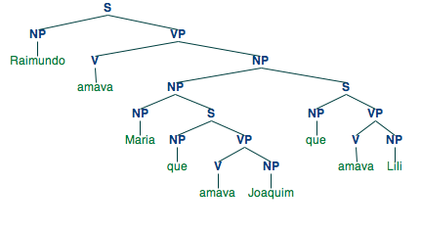
Pervasive ambiguity: separating the wheat from the chaff

Slide 19
X-bar theory: the X-bar schema
X and Y are variables ranging over lexical categories (N, V, A, etc.):
(i) XP → YP, X' (specifier rule)
(ii) X' → X', YP (adjunct rule)
(iii) X' → X, YP* (complement rule)
(RADFORD, 1988, p. 277)

Slide 20
Some instantiations of X-bar theory rules
The left-hand sides of the rules (i) – (iii) are unordered sets.
Thus, rule (iii) derives both head-first and head-last orderings:
  weil Hans [_{VP} Teresa liebte] (German)
  because John [_{VP} loved Teresa] (English)
  Ich laufe [_{PP} den Fluss entlang] (German)
  I walk [_{PP} along the river] (English)

Slide 21
X-bar theory
X-bar theory is an effort by generative linguists to capture cross-categorial generalizations (e.g. complements are sisters of their governing heads)
It aims at constraining the search space for the task of formulating the grammar of a natural language
It is argued that, without such constraints, which are claimed to be hard-wired into the human brain, the language acquisition problem is unsolvable (a child would never attain the right hypothesis due to impoverished input)

Slide 22
X-bar theory
This effort was initiated by Chomsky about 40 years ago
In the meantime, there are several (conflicting) versions of X-bar theory
Chomskyan generative linguists (i.e. working under the Minimalist Program) claim all phrases are endocentric; apparent exceptions are derived by movement
Non-transformational generative models like LFG admit of exocentric constructions (typically in non-configurational languages like Malayalam)

Slide 23
Is X-bar theory useful in NLP outside generative linguistics?
X-bar theory results from applying software design principles (e.g. economy, elegance, and generality) to the task of formally describing a natural language or the general architecture of human language
The linguist/programer writing a symbolic parser for a natural language can be compared in some respects to a child acquiring its first language

Slide 24
Is X-bar theory useful in NLP outside generative linguistics?
X-bar theory is definitely not the only constrained syntactic theory; it is perhaps the one with the oldest tradition and all formal linguists are familiar with
For a large number of languages, there exists some X-bar theoretic description, so that a programmer writing a parser for a given language does not have to reinvent the wheel

Slide 25
Is X-bar theory useful in NLP outside generative linguistics?
As far as Brazilian Portuguese is concerned, Othero (2009) is a good starting point for implementing a symbolic parser based on X-bar theory

Slide 26
Relevance of X-bar theory for natural language technologies
Grammar development and maintenance
Rule-based machine translation (RBMT)
Corpus linguistics/text technology
Statistical NLP

Slide 27
Grammar Development and Maintenance
Different people working within the same X-bar theoretic approach can more easily collaborate in a grammar engineering effort for one specific natural language

Slide 28
Rule-Based Machine Translation
Grammars for different languages implemented in the same X-bar framework by different teams can more easily be integrated into a rule-based machine translation system

Slide 29
Treebanks and statistical NLP
Treebanks are becoming increasingly more important resources for statistical NLP
Statistical parsers trained on treebanks with more hierarchized structures perform better (in terms of F-Score) than with less hierarchized structures (MAIER, 2007)

Slide 30
X-bar theory as a tool for principled syntactic corpus annotation
X-bar theory fulfills the following criterium:
„[...] one of the prerequisites for achieving a reliably annotated corpus is to base the annotation scenario on a well-defined linguistic theory“ (HAJIČOVÁ et al., 2010, p. 171)

Slide 31
Development environment for the first phases of the project
The Natural Language Toolkit (NLTK):
http://www.nltk.org
The most user-friendly and apparently the richest free/open-source NLP library
Implemented in Python with interfaces to libraries implemented in other languages
Python: ideal language for prototyping

Slide 32
NLTK's typical NLP Pipelines: some basic terminology
Pipeline 1
(1) sentence tokenization => (2) word tokenization => (3) tagging => (4) chunking => (5) NER => (6) relation extraction
Pipeline 2
(1) sentence tokenization => (2) word tokenization => (7) deep (complete) parsing => (8) natural language understanding
(1) – (4): shallow processing
(4): shallow (partial) parsing

Slide 33
AeliusDonatus' Pipeline
(1) sentence tokenization => (2) word tokenization => (3) tagging => (4) contraction splitting => (5) chunking => (6) deep syntactic parsing

Slide 34
Aelius: customized NLTK resources for shallow processing of Brazilian Portuguese
In its current release version, Aelius is a suite of Python, NLTK-based modules and language data for tokenizing and POS-tagging Brazilian Portuguese texts (ALENCAR, 2010):
http://aelius.sourceforge.net/
It offers Python/NLTK interfaces to some external resources (e.g. MXPOST taggers, Stanford taggers and parsers, etc.)
The present development version also includes a chunking module

Slide 35
Aelius taggers: near state-of-the-art accuracy in some texts
Taggers | Architecture | Accuracy on sample LH | Accuracy on sample CT | Accuracy on sample DC
AeliusRUBT | Hybrid (NLTK regular expression/n-gram tagger) | 95.29% | 94.70% | 92.10%
AeliusHunPos | HunPos (HMM based) | 96.35% | 95.83% | 92.78%
AeliusBRUBT | Brill (NLTK transformation-based learning tagger) | 95.30% | 95.10% | 91.83%

Slide 36
Samples used for evaluating taggers
LH: the first 8 chapters (about 18k tokens) from the novel Luzia-Homem by Domingos Olímpio (1906)
CT: excerpts from different 19th century literary works (about 4k tokens)
CJ: 2 scientific texts in the fields of medical science and forestry (about 2k tokens)

Slide 37
Tagset used by Aelius taggers
Aelius taggers were trained on the Tycho Brahe Parsed Corpus of Historical Portuguese
http://www.tycho.iel.unicamp.br/~tycho/corpus/en/
This corpus uses a very informative tagset with 376 tags labeling not only parts of speech, but also inflectional features
Due to data sparsity, it is expected that tagger performance decreases with the increase of the tagset, if the training material remains constant

Slide 38
Aelius interfaces to external, non-NLTK taggers
HunPos open-source POS-Tagger (HALÁCSY; KORNAI; ORAVECZ, 2007) (NLTK's hunpos module)
  Language model for BP: AeliusHunPos
Stanford POS-Tagger (NLTK's stanford module)
  No language model for BP available

Slide 39
Aelius interfaces to external, non-NLTK taggers
MXPOST (RATNAPARKHI, 1996)
  Language model for European Portuguese: LX-Tagger (BRANCO; SILVA, 2004) with reported 96.24% accuracy:
http://lxcenter.di.fc.ul.pt/tools/en/conteudo/LXTagger.html

Slide 40
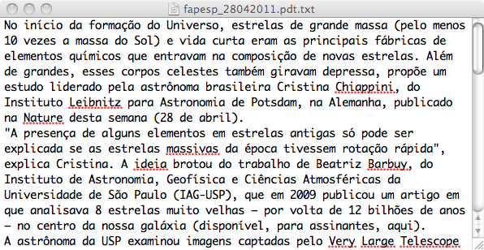
Example input to Aelius POS-Tagging module

Slide 41
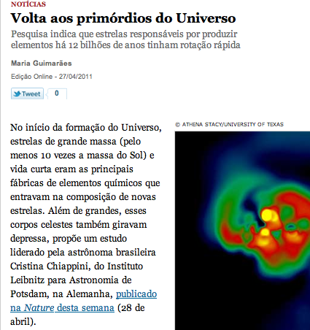
Original text
http://revistapesquisa.fapesp.br/?art=71494&bd=2&pg=1&lg=

Slide 42
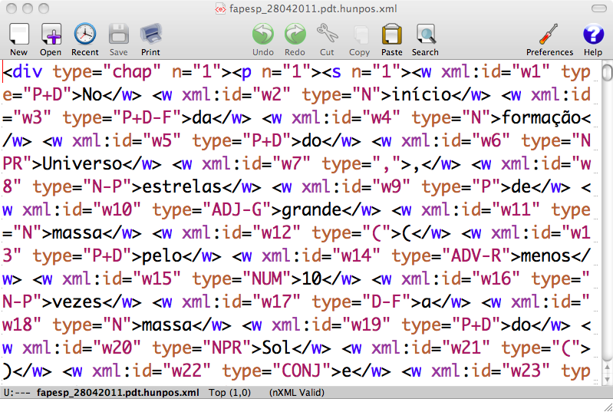
Example xml output from AeliusHunPos

Slide 43
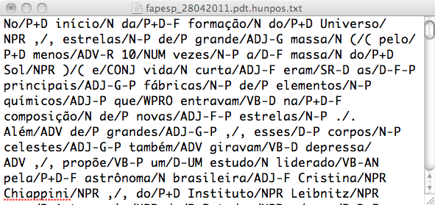
Example simple text output from AeliusHunPos

Slide 44
Tokenizing, tagging, and chunking a sentence with Aelius
Cientistas mostram que reservas florestais comunitárias podem retardar a fragmentação da floresta amazônica
Source: http://lba.cptec.inpe.br/lba/site/?p=reservasf&t=0

Slide 45
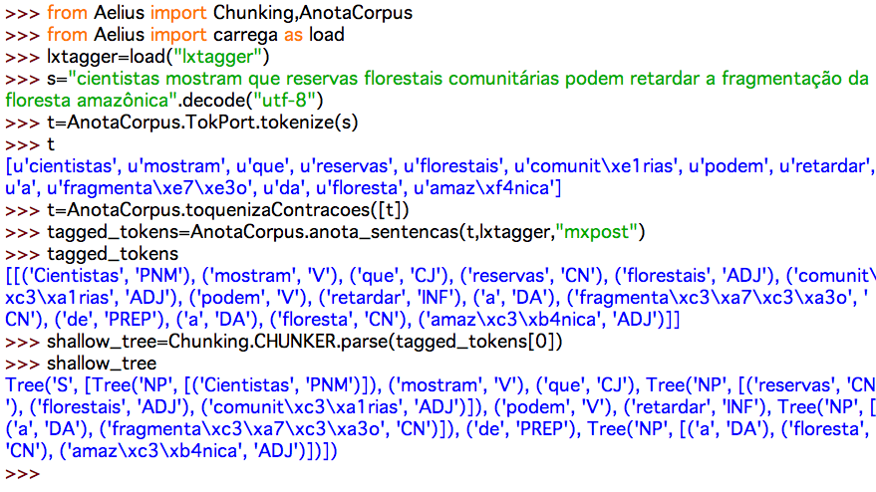
Tokenizing, tagging, and chunking a sentence with Aelius

Slide 46
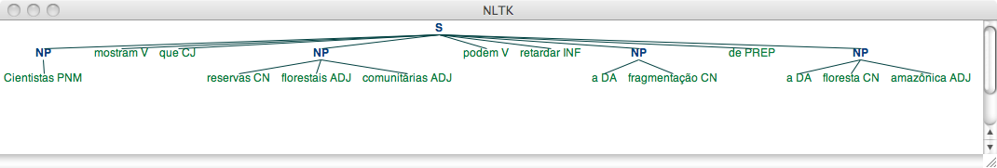
Chunk tree

Slide 47
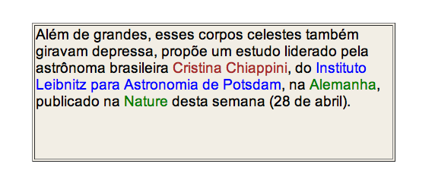
Proper names correctly chunked by LX-NER
http://lxcenter.di.fc.ul.pt/services/en/LXServicesNer.html

Slide 48
A less trivial example
O INPE – órgão vinculado ao Ministério da Ciência e Tecnologia – é responsável pelo monitoramento e estudo do território brasileiro por satélite, pela coleta de dados científicos sobre camadas atmosféricas e a formação de pesquisadores na área.
Source: http://www.ufc.br/portal/index.php?option=com_content&task=view&id=11284&Itemid=1

Slide 49
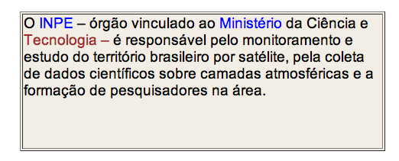
Failure of LX-NER in correctly chunking more complex proper names
http://lxcenter.di.fc.ul.pt/services/en/LXServicesNer.html

Slide 50
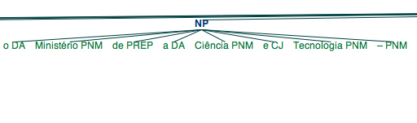
Comparison with Aelius chunking module using LX-Tagger

Slide 51
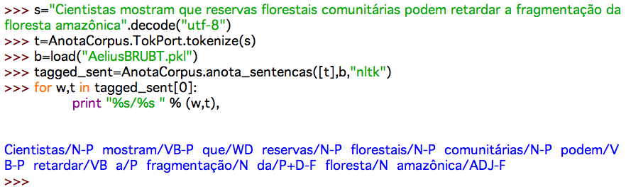
Tagging a sentence with AeliusBRUBT

Slide 52
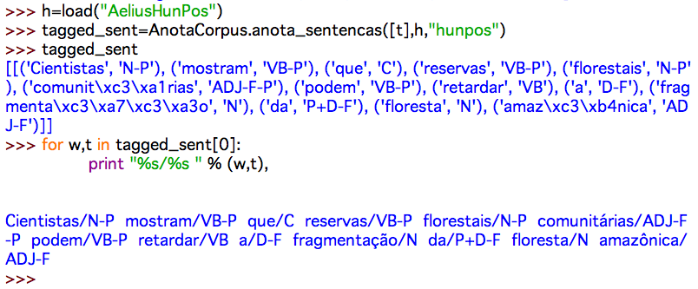
Tagging a sentence with AeliusHunPos

Slide 53
Evaluating tagger accuracy: AeliusBRUBT versus AeliusHunPos
AeliusBRUBT: 4 errors in 13 tokens
  Cientistas/N-P mostram/VB-P que/WD@C reservas/N-P florestais/N-P@ADJ-G-P comunitárias/N-P@ADJ-F-P podem/VB-P retardar/VB a/P@D-F fragmentação/N da/P+D-F floresta/N amazônica/ADJ-F
AeliusHunPos: 2 errors in 13 tokens
  Cientistas/N-P mostram/VB-P que/C reservas/VB-P@N-P florestais/N-P@ADJ-G-P comunitárias/ADJ-F-P podem/VB-P retardar/VB a/D-F fragmentação/N da/P+D-F floresta/N amazônica/ADJ-F

Slide 54
Evaluating tagger accuracy: LX-Tagger
LX-Tagger: 1 (light) error in 14 tokens
  Cientistas/PNM@CN mostram/V que/CJ reservas/CN florestais/ADJ comunitárias/ADJ podem/V retardar/INF a/DA fragmentação/CN de/PREP a/DA floresta/CN amazônica/ADJ

Slide 55
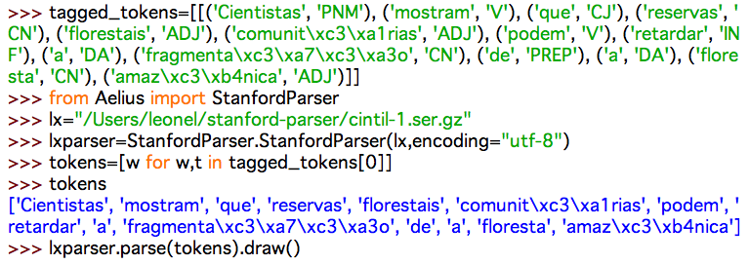
Parsing example

Slide 56
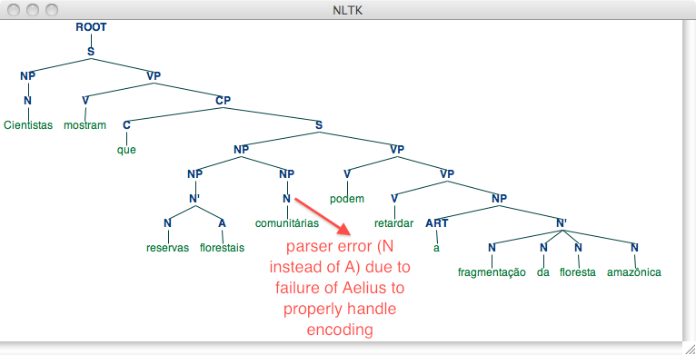
Parse tree generated by the LX-Parser via the Aelius interface

Slide 57
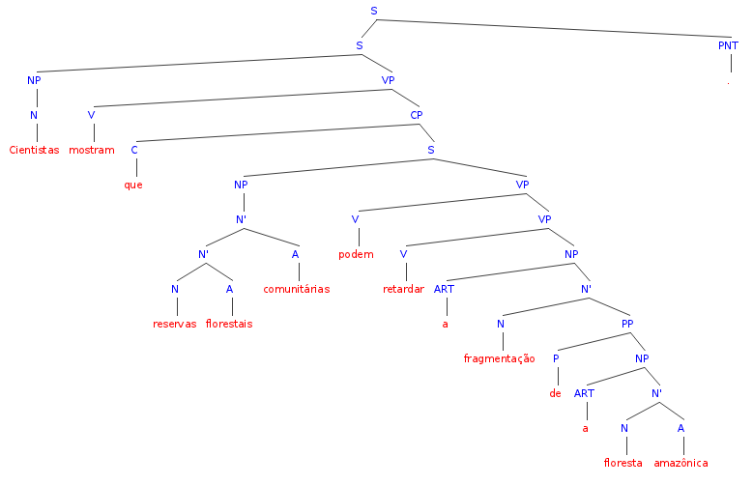
Parse tree generated on-line by the LX-Parser

Slide 58
Piping tagger output into the parser
In the previous example from the Python shell, we extracted the tokens to be parsed by the LX-Parser (via Aelius interface to the StanfordParser) from the output of the LX-Tagger (generated via Aelius)
The tagger was used in this case to expand contractions (da was split into the preposition de and the article a), since it efficiently handles ambiguous contractions like deste
This is a typical example of resource reuse in our project

Slide 59
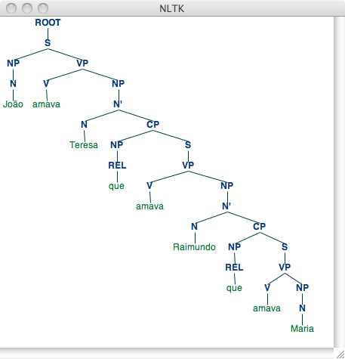
Drummond analyzed by the LX-Parser via Donatus

Slide 60
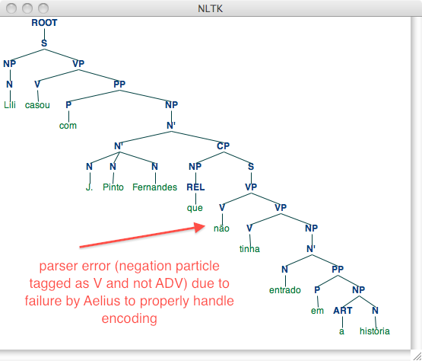
Performance decrease of the LX-Parser: example #1

Slide 61
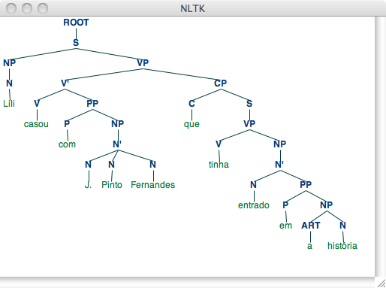
Performance decrease of the LX-Parser: example #2

Slide 62
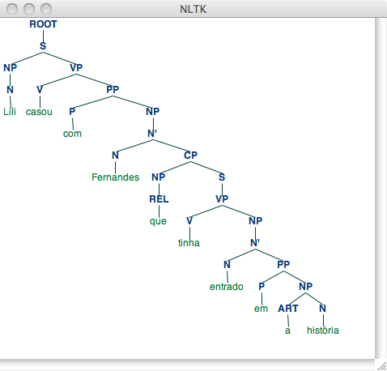
Effect of eliminating compound names in parser performance

Slide 63
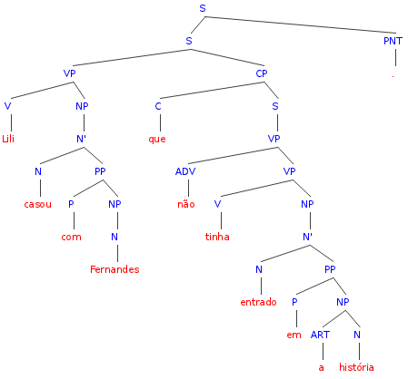
Parsing failure in the on-line version of the LX-Parser

Slide 64
The Lexicon Bottleneck in Deep Parsing
We hypothesize that the main problem to overcome in developing a robust parser for unrestricted text is modeling the lexicon, majorly due to
  The sheer amount of entries needed (> 2M)
  Categorial ambiguity of words
  Productive word formation processes
  Non-standard spelling
  (ALENCAR, 2011)

Slide 65
Overcoming the Lexicon Bottleneck
We propose to handle these difficulties using taggers as lexicon analyzers (ALENCAR, 2011), instead of modeling lexical morphosyntactic knowledge through finite-state transducers or extracting these informations from corpora

Slide 66
A simple NLTK toy grammar for Drummond's language
S -> NP VP
VP -> V | V PP | V NP | V VP | VP PP | ADV VP
NP -> D N
NP -> NP S
NP -> D PNM | REL | CL
PP -> P NP
N -> CN
P -> PREP
D -> DA |
V -> PPA

Slide 67
Generating lexicon entries on the fly from tagger output
The previous grammar has no lexical entries
These are generated on the fly by the Donatus module ALEXP from the output of a tagger
Example using LX-Tagger via Aelius:
Lili/PNM casou/V com/PREP J/PNM ./PNT Pinto/PNM Fernandes/PNM que/REL não/ADV tinha/V entrado/PPA em/PREP a/DA história/CN ./PNT

Slide 68
Handling complex proper names
The chunker is applied to the tagger output to identify complex proper names
The individual elements of proper name chunks are joined with an underscore “_“
  J/PNM ./PNT Pinto/PNM Fernandes/PNM
  J_Pinto_Fernandes/PNM

Slide 69
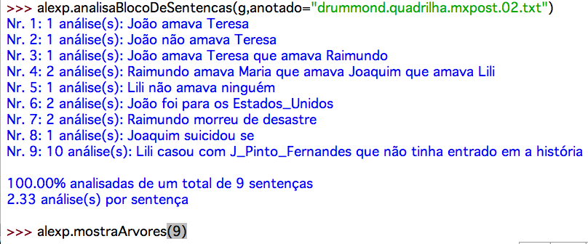
ALEXP: The Tagger-Parser Interface

Slide 70
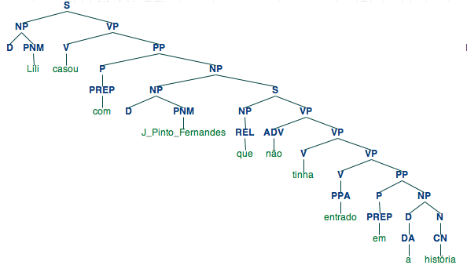
A correct parse tree generated by our toy grammar

Slide 71
Concluding remarks
AeliusDonatus is still mostly a single person's research effort
We are thankful to our students who have collaborated in preparing gold standards for evaluating tagger and chunker performance

Slide 72
Concluding remarks
In many aspects, our work is complementary to the following PhD research projects under our supervision:
  Tiago Martins da Cunha's work on a RBMT system for English nominal expressions (CAPES doctoral sandwich scholarship – Universität des Saarlandes, Germany, 2012, supervised by Johann Haller)
  Andréa Feitosa dos Santos' future implementation of a LFG fragment for BP (DAAD doctoral sandwich scholarship – Universität Konstanz, Germany, March 2012 – February 2014, supervised by Miriam Butt and Georg A. Kaiser)

Slide 73
Concluding remarks
As a FOSS effort, collaboration by other people is welcome!
Annotated corpus data covering social, regional, and diaphasic variation of BP are urgently needed.

Slide 74
Thank you!

Slide 75
References
ALENCAR, L. F. de. Aelius: uma ferramenta para anotação automática de corpora usando o NLTK. ELC 2010 – IX Encontro de Linguística de Corpus, PUCRS, Porto Alegre, 8 e 9 de outubro de 2010.
On-line: <http://corpuslg.org/gelc/elc2010.php>
ALENCAR, L. F. de. Utilização de informações lexicais extraídas automaticamente de corpora na análise sintática computacional do português. Revista de Estudos da Linguagem, Belo Horizonte, vol. 19, n. 1, jan./jun. 2011. To appear.

Slide 76
References
BRANCO, A.; SILVA, J. 2004. Evaluating Solutions for the Rapid Development of State-of-the-Art POS Taggers for Portuguese. In: LINO, M. T. et al. (Eds.). INTERNATIONAL CONFERENCE ON LANGUAGE RESOURCES AND EVALUATION, n. 4, 2004, Lisboa. Proceedings... Paris: ELRA, 2004. p. 507-510.
BIRD, S.; KLEIN, E.; LOPER, E. Natural language processing with Python: analyzing text with the Natural Language Toolkit. Sebastopol: O’Reilly, 2009. 502 p.
BIRD, S.; KLEIN, E.; LOPER, E. Natural Language Toolkit. [s.l]: [s.n.], 2011. On-line: <http://www.nltk.org>.

Slide 77
References
JUNGEN, O.; LOHNSTEIN, H. Einführung in die Grammatiktheorie. München: Wilhelm Fink, 2006.
HAJIČOVÁ, E. et al. Treebank annotation. In: INDURKHYA, N.; DAMERAU, F. J. Handbook of Natural Language Processing. 2. ed. Boca Raton, FL: Chapman & Hall/CRC, 2010. p. 167-188.
HALÁCSY, P.; KORNAI, A. ; ORAVECZ, C. HunPos: an open source trigram tagger. ANNUAL MEETING OF THE ASSOCIATION FOR COMPUTATIONAL LINGUISTICS, n. 45, 2007, Praga. Proceedings... Stroudsburg: Association for Computational Linguistics, 2007. p. 209-212.

Slide 78
References
LJUNGLÖF, P. ; WIRÉN, M. Syntactic parsing. In: INDURKHYA, N.; DAMERAU, F. J. (Eds.). Handbook of Natural Language Processing. 2. ed. Boca Raton, FL: Chapman & Hall/CRC, 2010. p. 59-91.
MAIER, W. NeGra und TüBa-D/Z: ein Vergleich. In: REHM, G.; WITT, A.; LEMNITZER, L. (Eds.). Data structures for linguistic resources and applications: Proceedings of the Biennial GLDV Conference 2007. Tübingen: Gunter Narr, 2007. p. 29-38.

Slide 79
References
OTHERO, G. A. Teoria X-barra: descrição do português e aplicação computacional. São Paulo: Contexto, 2006. 160 p.
OTHERO, G. A. A gramática da frase em português: algumas reflexões para a formalização da estrutura frasal em português. Porto Alegre: Edipucrs, 2009. 160 p. On-line:< http://www.pucrs.br/edipucrs/gramaticadafrase.pdf>.

Slide 80
References
RADFORD, A. Transformational grammar: a first course. Cambridge: Cambridge University Press, 1988.
RATNAPARKHI, A. A Maximum Entropy Model for Part-Of-Speech Tagging. EMPIRICAL METHODS IN NATURAL LANGUAGE PROCESSING, 1996, Philadelphia, Pennsylvannia. Proceedings... Pennsylvannia: University of Pennsylvannia, 1996. p. 133-142. On-line: <http://acl.ldc.upenn.edu/W/W96/W96-0213.pdf>.

