Slide 1
Social Data Science Law, Privacy and Ethics in Big Data Production and Use
David Dreyer Lassen
SODAS, UCPH
August 16, 2019

Slide 2
Why privacy?
Privacy for its own good – a principle of privacy
Privacy to preserve informational rents
Consumers, firms
Privacy and politics

Slide 3
Why privacy?
Privacy for its own good – a principle of privacy
May simply value privacy in itself
But: public goods problems
Example: medical research. Share existing info on medical history, no cost to individuals. Some will not contribute, citing privacy concerns – but benefits of research accrue to everybody
DK: no consent necessary for register studies or re-use of data
Similar: Privacy for social science research, or monitoring in public places

Slide 4
Why privacy?
Privacy to preserve informational rents
Consumers: willingness to pay (WTP), characteristics, and behavior often private information
Willingness to pay: 1st class vs. 2nd class
Characteristics: Taste, Genetics, Personality
Behavior: e.g. driving and insurance, physical activity
Value of time / search costs
Example: Internet steering
Firms: Intellectual Property Rights, strategy
Industrial espionage major problem
LinkedIn-story; Firms where data is only asset

Slide 5
Why privacy?
Privacy and politics
Authorities may not register party identification
Originally for freedom of political expression but also: majority in city council could pay out cash assistance / kontanthjælp based on, say, union membership
These days: Privacy as a political platform

Slide 6
Legal framework guiding personal data
Before 2018: Persondataloven
After 2018: GDPR + ”Lov om supplerende bestemmelser til forordning om beskyttelse af fysiske personer i forbindelse med behandling af personoplysninger og om fri udveksling af sådanne oplysninger (databeskyttelsesloven)”
https://www.retsinformation.dk/Forms/r0710.aspx?id=201319

Slide 7
From 2018: Danish law under EU data protection directive (GDPR)
Link: http://ec.europa.eu/justice/data-protection/
”The objective of this new set of rules is to give citizens back control over of their personal data, and to simplify the regulatory environment for business.”
Individual consent plays are much larger role (but special rules for DK)

Slide 8
GDPR
Very different rules for
Research
Public administration
Private firms / organizations
Potentially large penalties for non-compliance or misuse
New job: DPO – Data Protection Officer

Slide 9
Research and business don’t mix
What can we know from Facebook-likes? Quite a lot
“Private traits and attributes are predictable from digital records of human behavior” Kosinski et al. PNAS 2013.
58,000 volunteers gave access to Facebook-likes, demographic info + took psychometric test
Results: Facebook-likes -> stat learning model that correctly predicts
Sexual orientation 88%
Afri-Am vs Causcasian 95%
Dem vs. Rep 85 %
As good as personality test for traits & FB uses this
Implications for privacy and online behavior?
When is a probability personal data?
What if these data were passed on to private companies and political parties? (Cambridge Analytica, The Great Hack on Netflix)

Slide 10
§ 10. Oplysninger som nævnt i databeskyttelsesforordningens artikel 9, stk. 1, og artikel 10 må behandles, hvis dette alene sker med henblik på at udføre statistiske eller videnskabelige undersøgelser af væsentlig samfundsmæssig betydning, og hvis behandlingen er nødvendig af hensyn til udførelsen af undersøgelserne.
Stk. 2. De oplysninger, der er omfattet af stk. 1, må ikke senere behandles i andet end videnskabeligt eller statistisk øjemed. Det samme gælder behandling af andre oplysninger, som alene foretages i statistisk eller videnskabeligt øjemed efter databeskyttelsesforordningens artikel 6.

Slide 11
Apropos of Facebook
EU DPD posits a right to data portability (Art. 20)
This means: easier to move personal data from one provider to another, incl social networks
Compare: Phone companies
Interesting regulatory consequences
Old days: Phone companies owned phone number, large costs if switching. Now, individually owned
Could one own one’s social graph?

Slide 12
Special for DK, also under GDPR: Can re-use data collected for other purposes for research or stats
(50)Behandling af personoplysninger til andre formål end de formål, som personoplysningerne oprindelig blev indsamlet til, bør kun tillades, hvis behandlingen er forenelig med de formål, som personoplysningerne oprindelig blev indsamlet til. I dette tilfælde kræves der ikke andet retsgrundlag end det, der begrundede indsamlingen af personoplysningerne.
Hvis behandling er nødvendig for at udføre en opgave i samfundets interesse eller henhører under offentlig myndighedsudøvelse, som den dataansvarlige har fået pålagt, kan EU-retten eller medlemsstaternes nationale ret fastsætte og præcisere de opgaver og formål, hvortil det bør være foreneligt og lovligt at foretage viderebehandling. Viderebehandling til arkivformål i samfundets interesse, til videnskabelige eller historiske forskningsformål eller til statistiske formål bør anses for at være forenelige lovlige behandlingsaktiviteter.

Slide 13
Individual data and privacy
Stat Denmark: Data users cannot present data at the individual level
Examples
Max of the income distribution
Median of income distribution
Max income in parish
Well-known examples of re-identification from public data
Often in combination with auxiliary data
An overview
An example based on credit card data

Slide 14
Trade-offs
Sometimes: Sacrifice accuracy for privacy
In some cases: no trade-off in analysis, only in presentation

Slide 15
Trade-offs
Hariri and Lassen, 2016
Public Opinion Quarterly
Sometimes: Sacrifice accuracy for privacy
In some cases: no trade-off in analysis, only in presentation

Slide 16
Trade-offs
Sometimes: Sacrifice accuracy for privacy
In some cases: no trade-off in analysis, only in presentation
Sometime: only have, say, interval data
Danish firm data: Stat Denmark does not report figures for industries with very few firms
New approaches: analysts don’t see data, but can make calculations on it
May limit feel for data
More general problem: how much info do we get from data under constraint of ‘no identifiability’? Active research area in computer science

Slide 17
Economic analysis of privacy
Heffetz and Ligett: Principles for privacy preserving data handling
a bit complicated in places
Active research area
Combine with mechanism design
Economic theory
Combine computer science and economics
See Acquisti et al. for more on this (if interested)
Also: behavioral economics aspects + genuine uncertainty: “Even ex post, only few of the consequences of privacy decisions are actually quantifiable; ex ante, fewer yet are.”
from Acquisti&Grossklags, 2007 “What Can Behavioral Economics Teach Us About Privacy?”

Slide 18
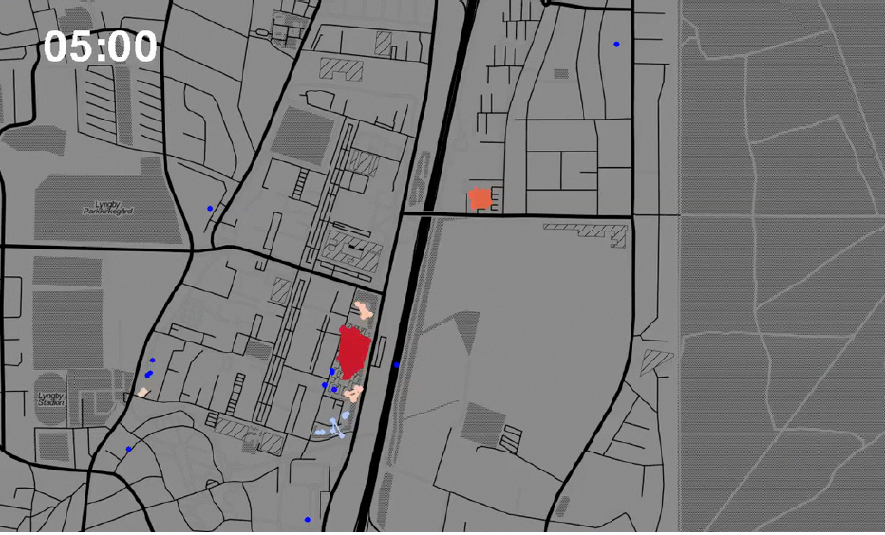
Social Fabric data
Phone locations 0500h Monday morning -> can predict where people at given time with 85% accuracy

Slide 19
Ethics of Big data
Bit by Bit chapter 6
Also:
”Web scraping: a journalist’s guide” + ”on the ethics of web scraping and data journalism”
For journalists, but interesting for us as well
Additional readings:
Neuhaus and Webmoor 2012: ”Agile ethics for massified research and visualization”
Also (google): Zimmer (2010) ”But the data is already public”: on the ethics of research in Facebook.

Slide 20
What is Ethics?
In practice, so far:
social science: Ethics as a set of constraints; mixture of law and ”corporate social responsibiliy” / impression management
Data science: No ethics as absense of constraints; this is changing
Compare: Medical science Are invasive procedures proportional to expected benefit?
Ethics:
A systematic approach to moral judgments based on reason, analysis, synthesis and reflection
Moral standards: Impartial, take precedence over self-interest, universal
But not one set of standards Are student or researcher ethics different from personal ethics?

Slide 21
Ethics of Big data
Ethics in universities and research often governed by
Institutional Reviews Boards (IRBs)
Personal ethics or feelings of right and wrong
Professional norms and codes of conduct (e.g. Econ vs Psychology)
The law: (also) the institutional embodiment of ethics
Denmark: Only formal ethics board for bio-medical research
no IRBs in economics (yet)
But what about firms?

Slide 22
Key goal of ethical considerations
Reduce potential risk of participants in research
In medicine: benefits vs. harms
In social science: typically identifiability/privacy, but could also be stigma or long term consequences in field experiments
Is informed consent enough?
Is consent informed if shrouded in 80 pages of legal click-thru?
If photographing people in public places is ok, is noting what they say on Facebook also ok?
Monopoly, mobility and informed consent

Slide 23
Is informed consent enough? Is it too much?
Is informed consent enough?
Is consent informed if shrouded in 80 pages of legal click-thru?
If photographing people in public places is ok, is noting what they say on Facebook also ok?
Monopoly, mobility and informed consent
Before GDPR: Firms often limited in what they could collect by law; now: jusk ask for informed consent
But: Informed consent and public goods problems. Easy to say no and not give consent, but what if everyone does this?

Slide 24
Challenges
Is it unethical find correlation btw smoking and lung cancer, even if insurance companies use this to increase premiums for smokers?
What about correlation between genetic markers and, say, chronic diseases, increased mortality risk?
ethics is not about preventing stuff from being done – but reasonable balance between costs and benefits (ex: hidden camera/mike : not ok for mundane things, but maybe ok if benefits are huge; random drug screening of employees may violate privacy, but ok if job involves public safety)

Slide 25
ethical considerations for big data
What about business ethics?
Example: Google Location. Show where friends/family are in real time – but requires consent
Are predictive location algorithms ethical?
Algorithms as ”Weapons of Math Destruction”
Insurance based on where you live, your name/ethnicity
Entry into university based on prediction of completion?
Loan interest rates based on past behavior?
FAT ML: Fair, Accountable, and Transparent Machine Learning

Slide 26
Ethical/legal considerations for big data
Is it ethical to scrape competitors’ likes on Facebook? Is it illegal?
ethics (and law) sometimes used as arguments to stiffle competition. See LinkedIn case, also here and here
Can you scrape data and resell? Or repackage?
Does data collection cause significant costs (time or money) to firms and/or individuals?

Slide 27
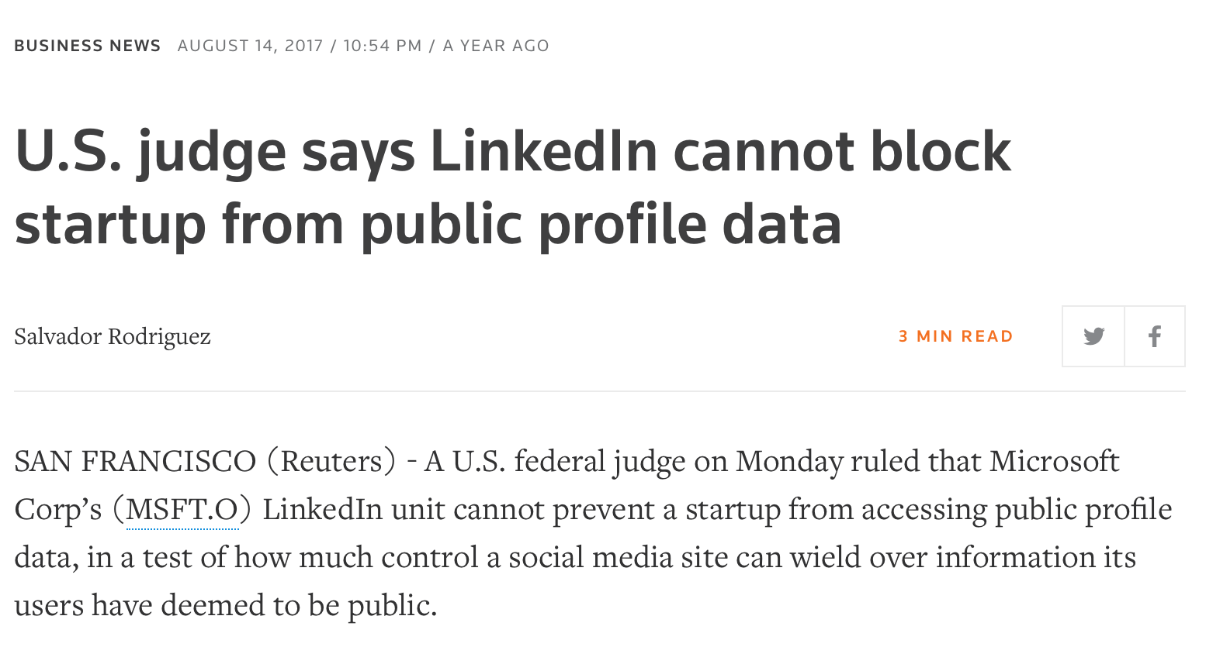

Slide 28
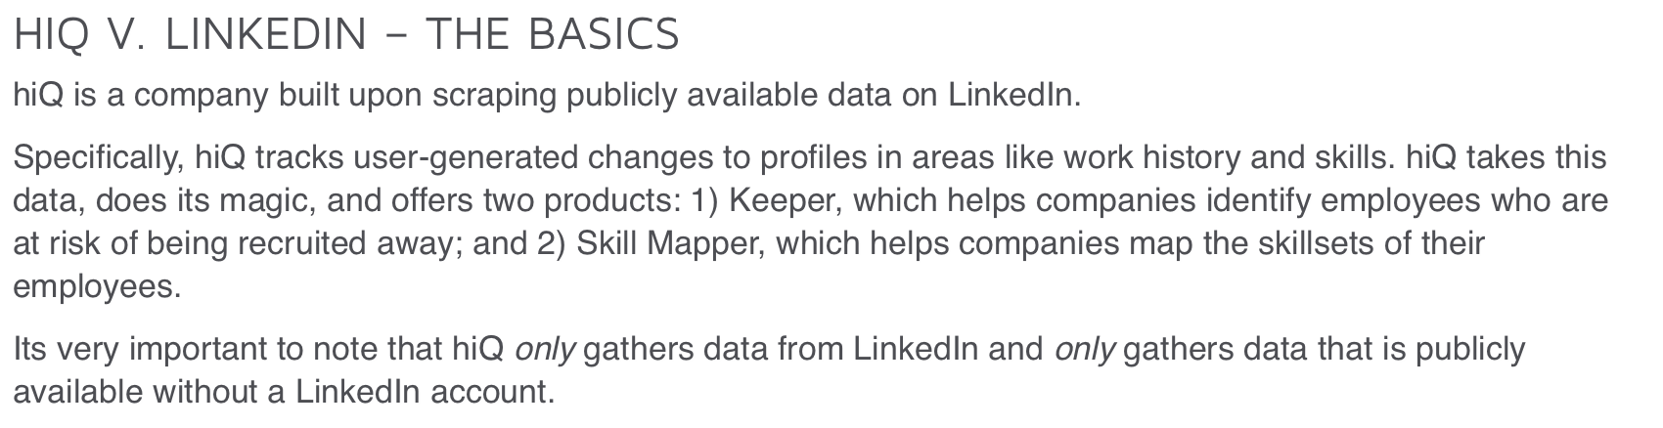

Slide 29
Ethical/legal considerations for big data
Is it ethical to scrape competitors’ likes on Facebook? Is it illegal?
ethics (and law) sometimes used as arguments to stiffle competition. See LinkedIn case, also here and here
Can you scrape data and resell? Or repackage?
Does data collection cause significant costs (time or money) to firms and/or individuals?

Slide 30
Questions for proposed projects
Do you respect privacy?
Can single individuals be identified?
What are potential consequences?
Are there ethical considerations
With respect to individuals?
With respect to firms or organizations?

