Slide 1
SEIR: Overview, design and details
Purpose
Airborne transmission of infectious diseases
States
Susceptible Exposed Infected Recovered
General Concept on SEIR Model
Latent state controls the movement of the people from the exposed state to the infected.
The SEIR differs from the SIR model in the addition of the latency period.
Stochasticity
random movement of people, if you close enough you make a contact then a transmission occurs.

Slide 2
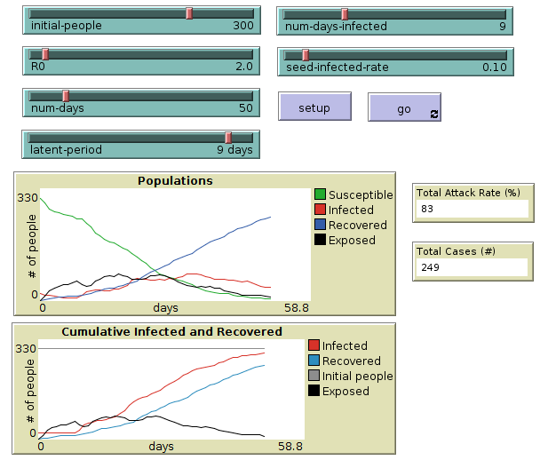
Results from the SEIR model
In the original SIR model where people move from susceptible to infected state directly, the infection was severe. In our SEIR model where people become exposed when they have a contact with infected person, the infection is not severe with no real real peak observed in the graph.

Slide 3
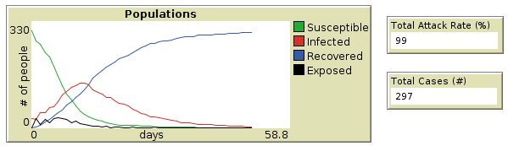
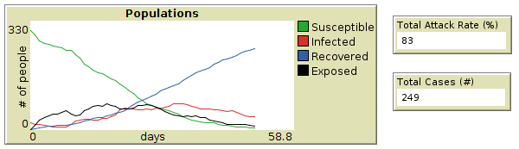
Latent period is 2 days
Latent period is 9 days
When the latent period is short the attack rate is high and the infection is severe
as opposed to when the latent period is long.

