Slide 1
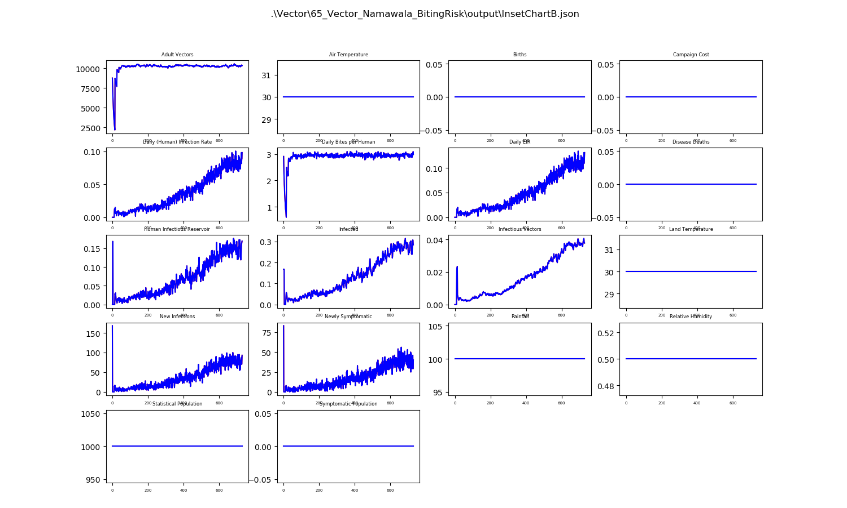
Baseline Test
About 10K vectors
Daily Bites Per Human ~ 3
< 30% Infected
Infectious Vectors < 4%

Slide 2
Different Risk Levels for Total Population
Using RiskDistribution found in demographics
RiskDistributionType = 0
RiskDistributionParam1 = 0.1, 1, 10, 100, 1000
All give EXACTLY the same results
Expected Results

Slide 3
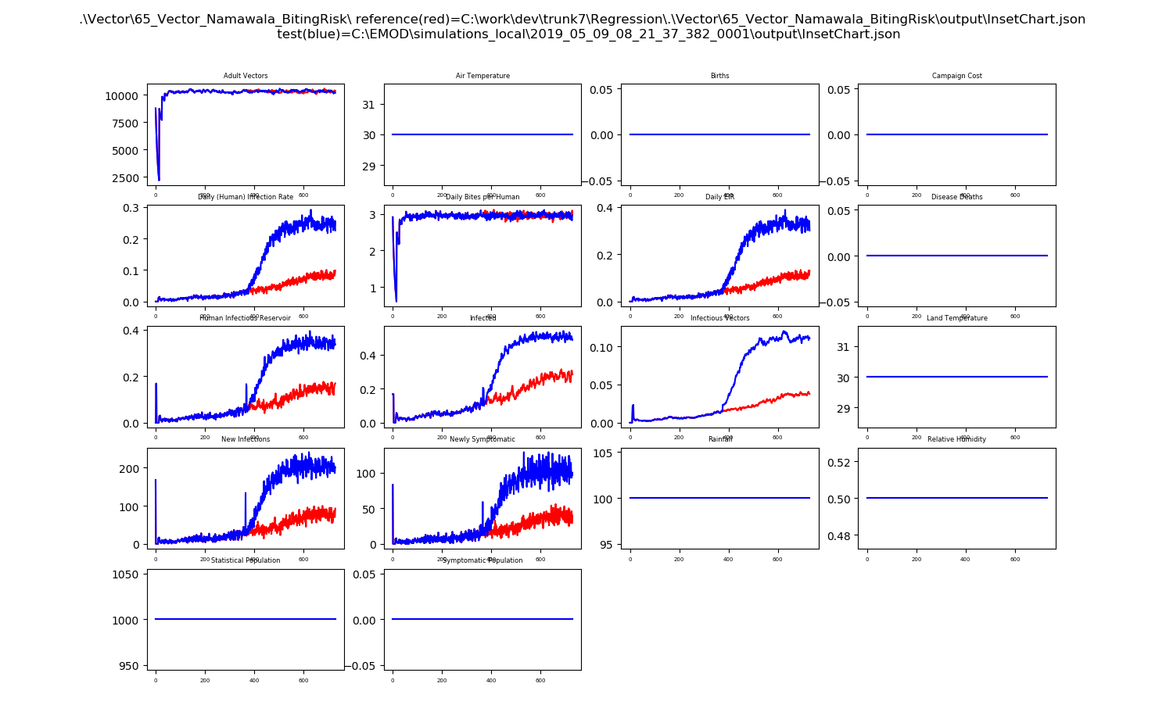
Changing BitingRisk via Intervention
RiskDistributionParam1 = 1
IP Risk with 50% LOW, 50% HIGH
Intervention at Day 1 sets total population to BitingRisk = 0.1
Intervention at Day 365 sets individuals with Risk=HIGH, BitingRisk to 1.0
More Infected People and more infectious vectors

Slide 4
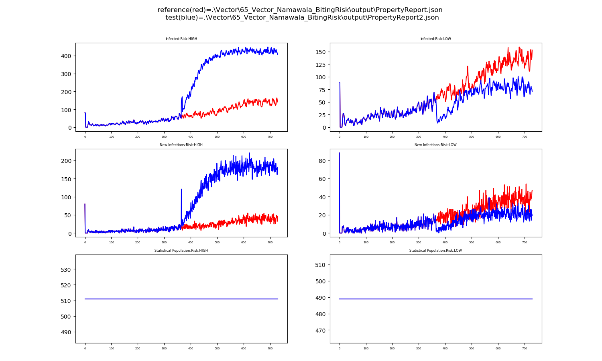
Changing BitingRisk via Intervention - PropertyReport
Expected Results – Notice that for New Infections, HIGH has 10x more than LOW
Risk=HIGH population is getting infected more after day 365 since they have a higher biting risk
Risk=LOW population drops because the biting gets distributed to the Risk=HIGH population.
LOW and HIGH populations are the same. Should the LOW population dropped more?
HOWEVER…

Slide 5
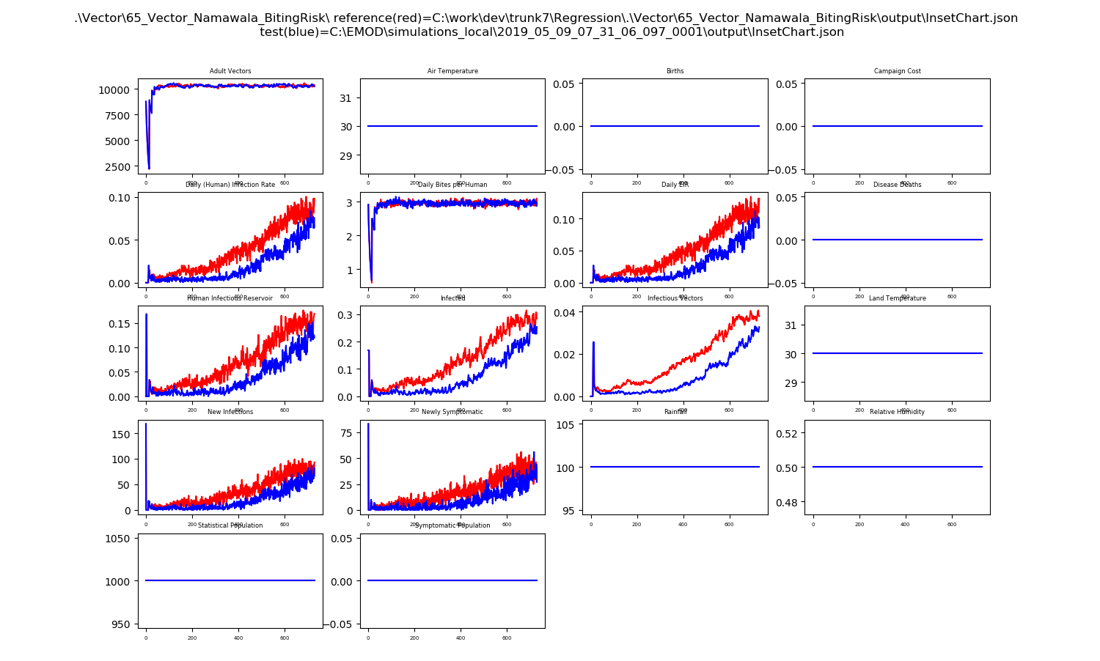
However
Verified that this is due to floating point rounding errors causing noise.
Changing only RiskDistributionParam1
Values of 1.5, 0.01, 0.001, 0.0001 have EXACTLY the blue line
Is this just noise? param_sweep on next slide says the test is somewhat noisy, but four values resulting in the EXACT same results?

Slide 6
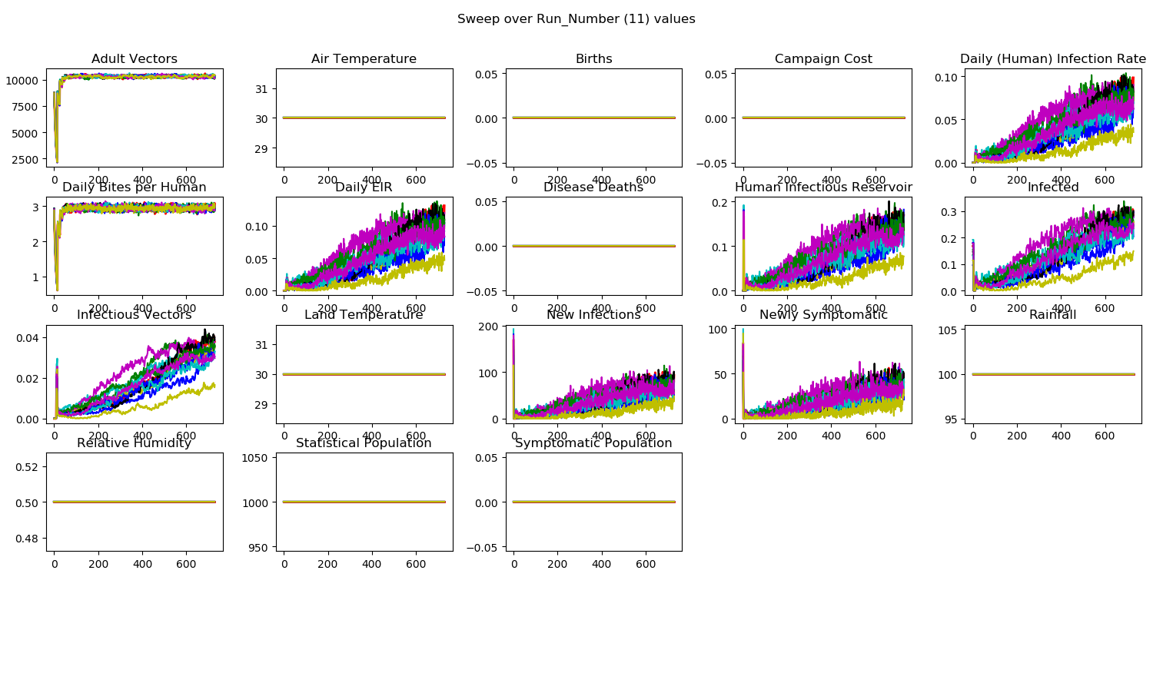
Param Sweep on Run_Number with RiskDistributionParam1 = 1
Changed test to have more people so that it is less noisy

