Slide 1
River flow rate and sea level data accessing from EMODnet Physics using Python Jupyter Notebook

Slide 2
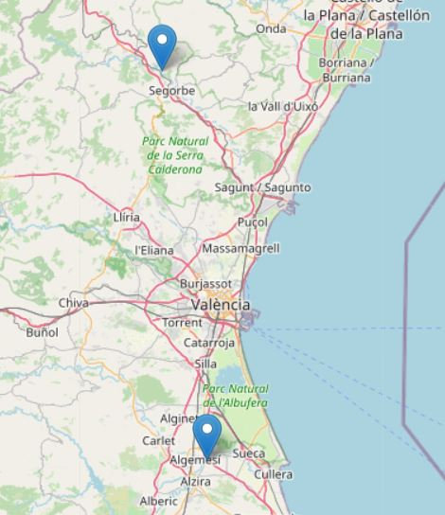
River flow rate data gathering and analysis
In this example we will use Python to access and analyze data from stations containing river flow rate and sea level data regarding the recent extreme flooding event that took place in Valencia the 29th of October 2024.
The data will be accessed from EMODnet Physic’s ERDDAP, found at https://ercompwebapps.emodnet-physics.eu/erddap/
For the River flow rate (RVFL) data two stations have been chosen, one to the north of Valencia and one to the south. They respectively measure the river flow rate for the rivers Palancia and Jucar. On the map we can see their location.

Slide 3
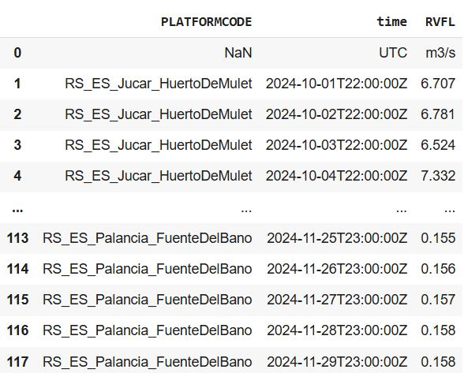
The next step will be making the request for the data to ERDDAP. To the URL we will pass in the query the desired variables and filter by the chosen station codes and a time range. In this case we will get RVFL data for October and November 2024 to later plot the variation in river flow rate for both the rivers. The response from the ERDDAP server can be easily loaded into a Python pandas DataFrame, shown below.

Slide 4
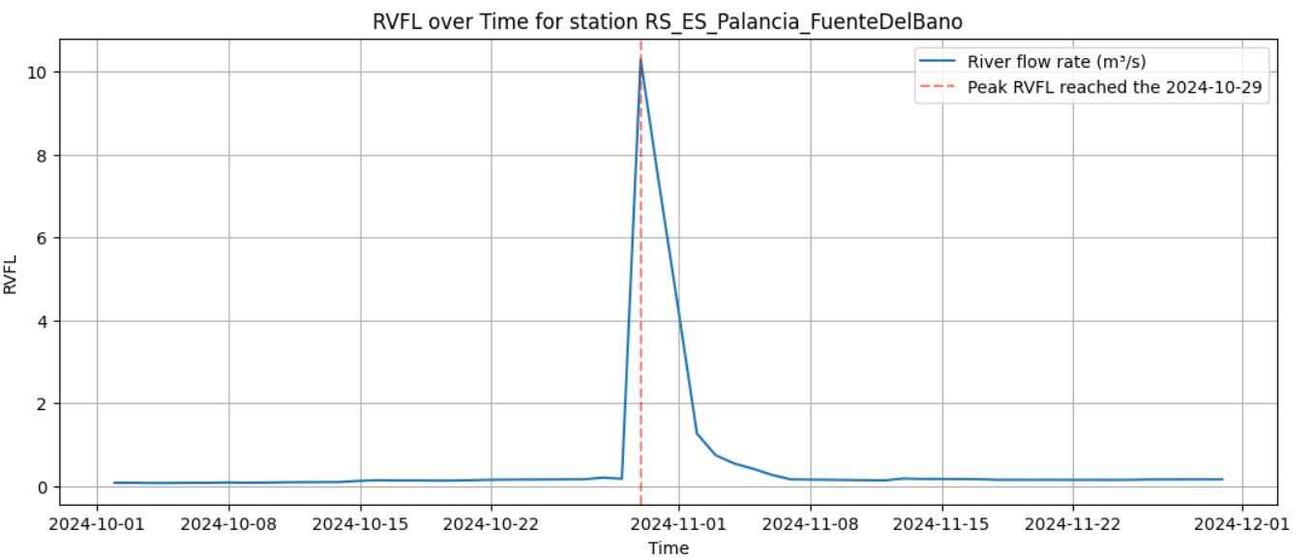
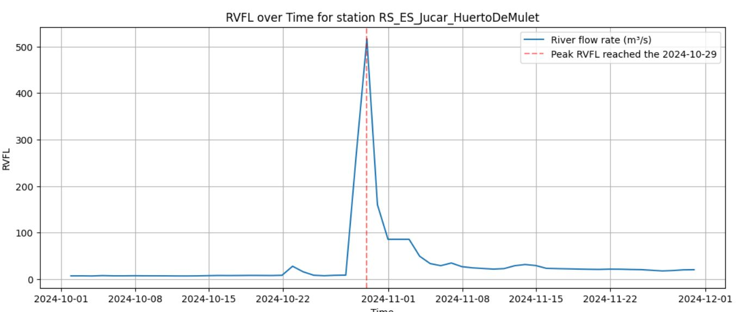
Once the data has been imported into a DataFrame, Python’s library matplotlib can be used to show the variation in river flow rate for both the stations and show the intensity and timestamp of the peak.

Slide 5
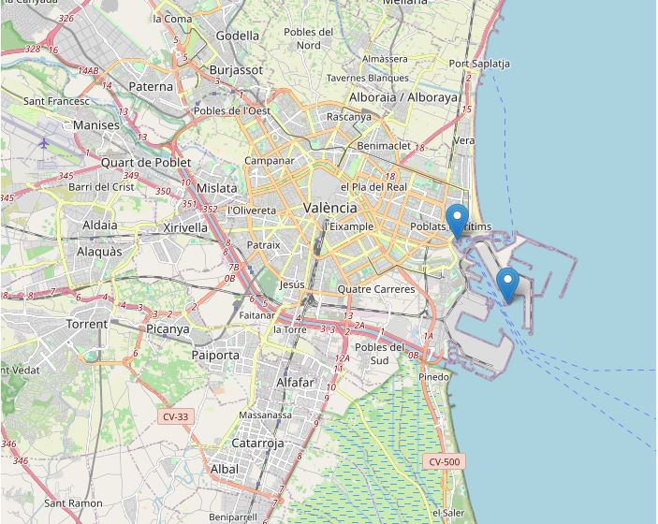
Sea level data gathering and analysis
Now we can repeat the same process for sea level (SLEV) stations and their data.
In this case both stations are taking measurements in the port of Valencia.

Slide 6
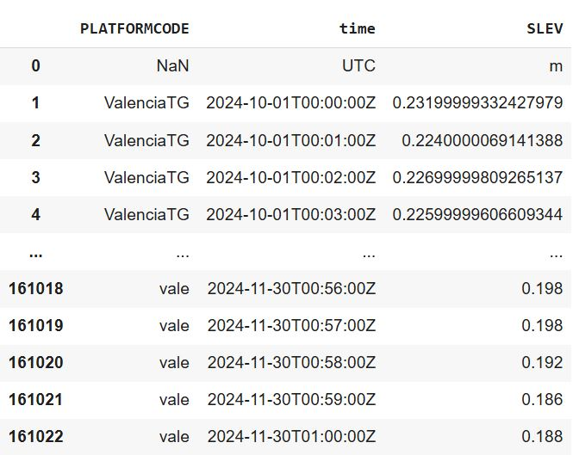
Like it has been done for RVFL data, now with a request to EMODnet Physics’ ERDDAP we can gather the data in CSV format and load it into a pandas DataFrame.

Slide 7
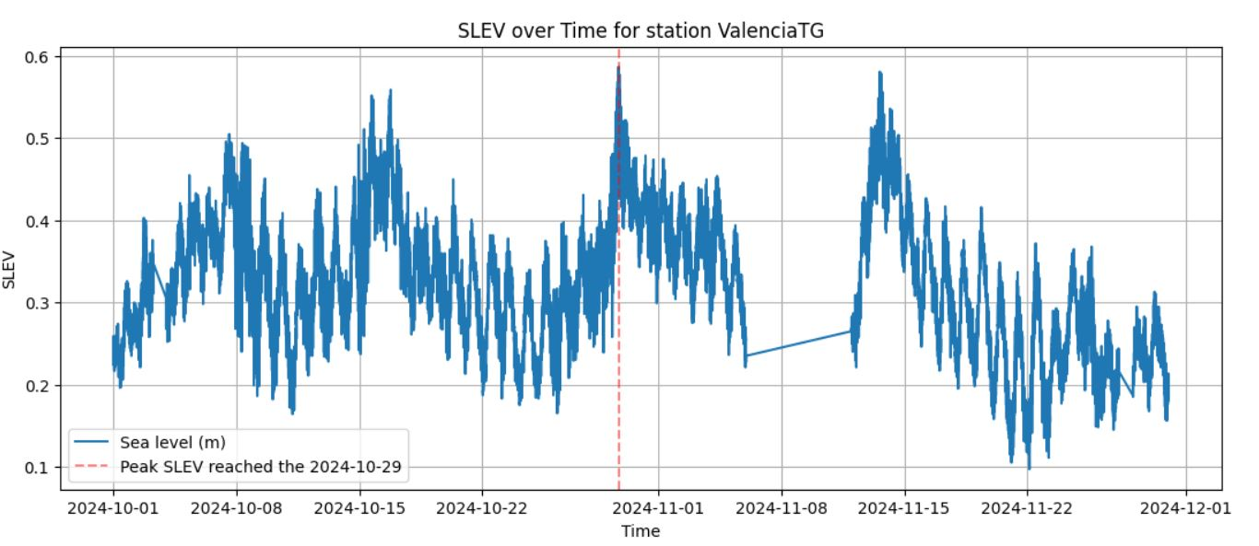
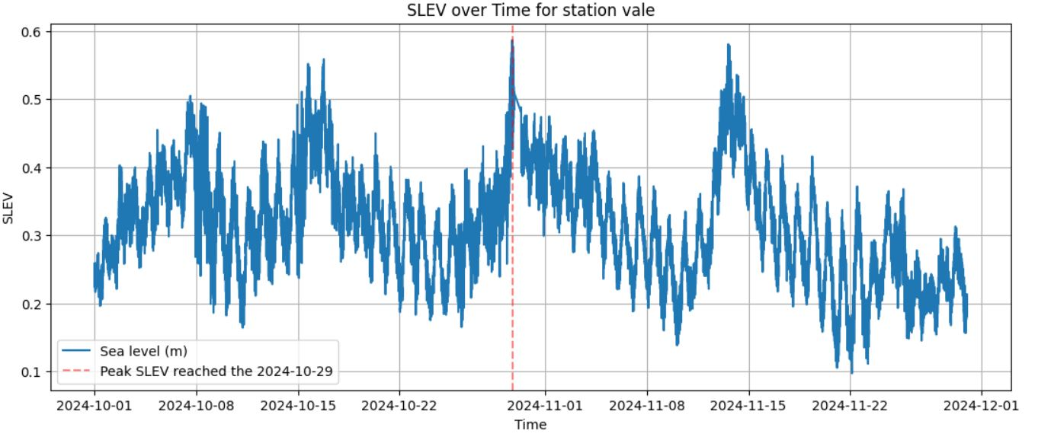
With the data imported into the pandas DataFrame, we can generate the plots to show the variation in sea level for both the stations and show the intensity and timestamp of the peak.

Slide 9
THANK YOU

