Slide 1
Case Study 2
Erin McClure-Price DDS 6306

Slide 2


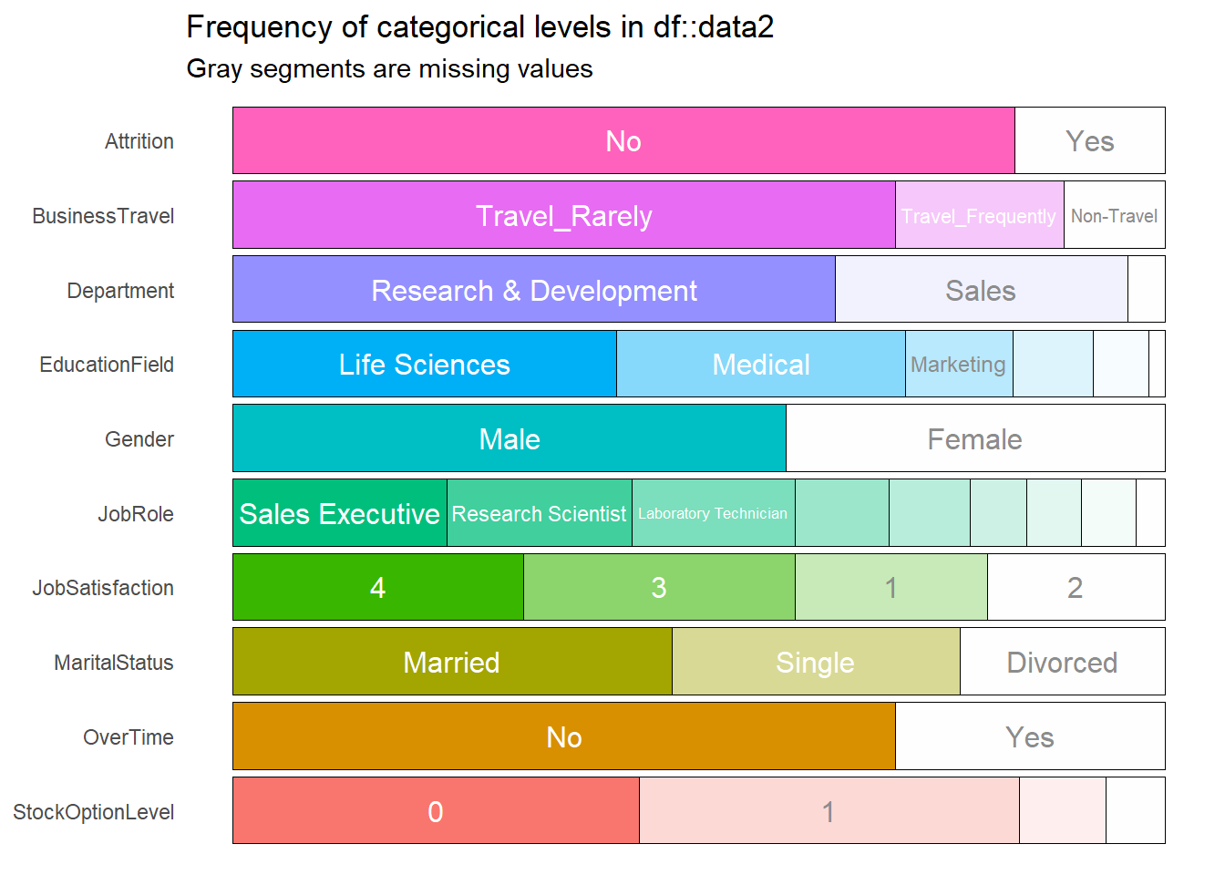

Quick and Dirty EDA
z
Visual anaysis of data

Slide 3
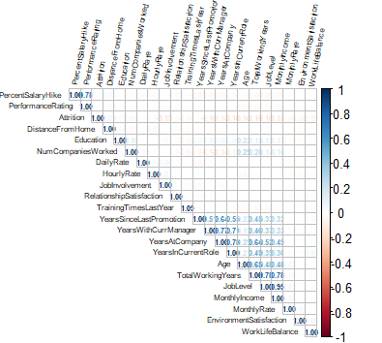
Correlations Within Dataset
z
Heatmap to indicate correlation between numerical data
Correlations were found between:
  Monthly Income & Total Working Years
  Age & Years Since Last Promotion
  Age & Years at Company

Slide 4
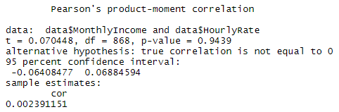
Correlations Within Dataset
z
Focus on Income showed:
  Hourly rate, daily rate, and monthly rate did not affect attrition
  Monthly income does affect attrition

Slide 5
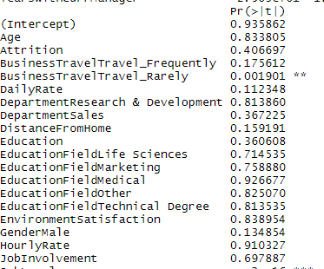
Cleaning up the Dataset
z
Using VIF allowed for the removal of
  Over 18 (all entries were “yes”)
  Employee ID, Employee Count, Employee Number, Job Role and Standard Hours

Slide 6
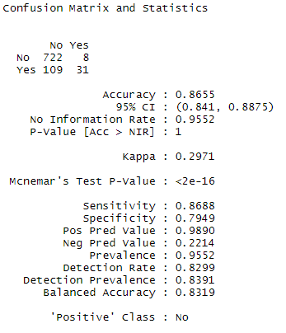

KNN Analysis
z
KNN model of CaseStudy data provided an accuracy of 86%
Test dataset: 98% accurate
Train dataset: 86% accurate
Final dataset: 87% accurate
  Sensitivity: 87%
  Specificity: 79%

Slide 7

Attrition: Working Overtime
Employee attrition is 16%
Rate for employees who work overtime is greater than 30%
Rate for employees who do not work overtime is ~10%

Slide 8

Attrition:
Marital Status
Approximately 30% of employees are single
Attrition rate for employees who are single is 25%
Attrition rate for employees who are divorced or married is significantly reduced

Slide 9

Attrition:
Income
Employees making less than $30k per year are more likely to quit
Interns?
Non-specialized fields?

Slide 10
Thanks for watching!

