Slide 1
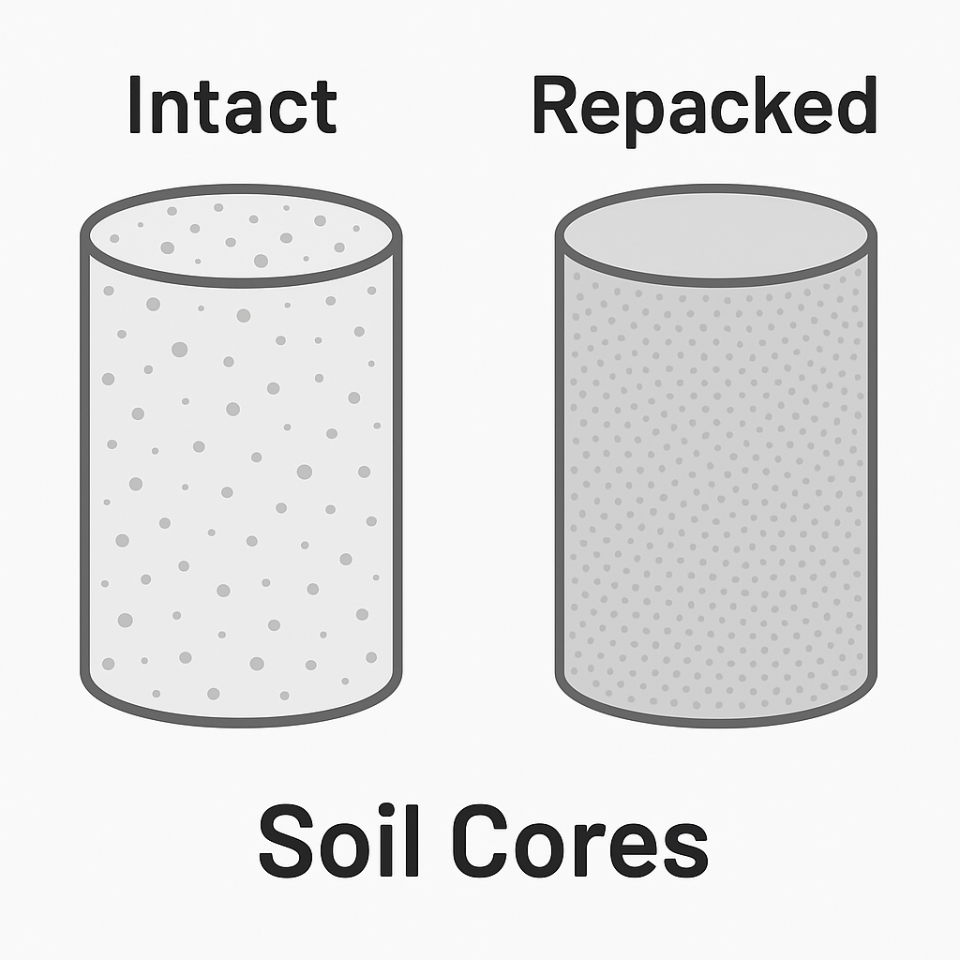

Rainfall
ET
Simulate
Runoff
Millennial model
Annual Respiration
Total SOC at steady-state
Soil moisture dynamics
Soil hydraulic properties
$$Z_{r}\frac{dθ}{dt }=rain−ET−Runoff −leakage$$
Texture:
Loam, Sandy Loam, Silt Loam, Silty Clay
With moisture modifier from Yan et al. (2018)

Slide 2
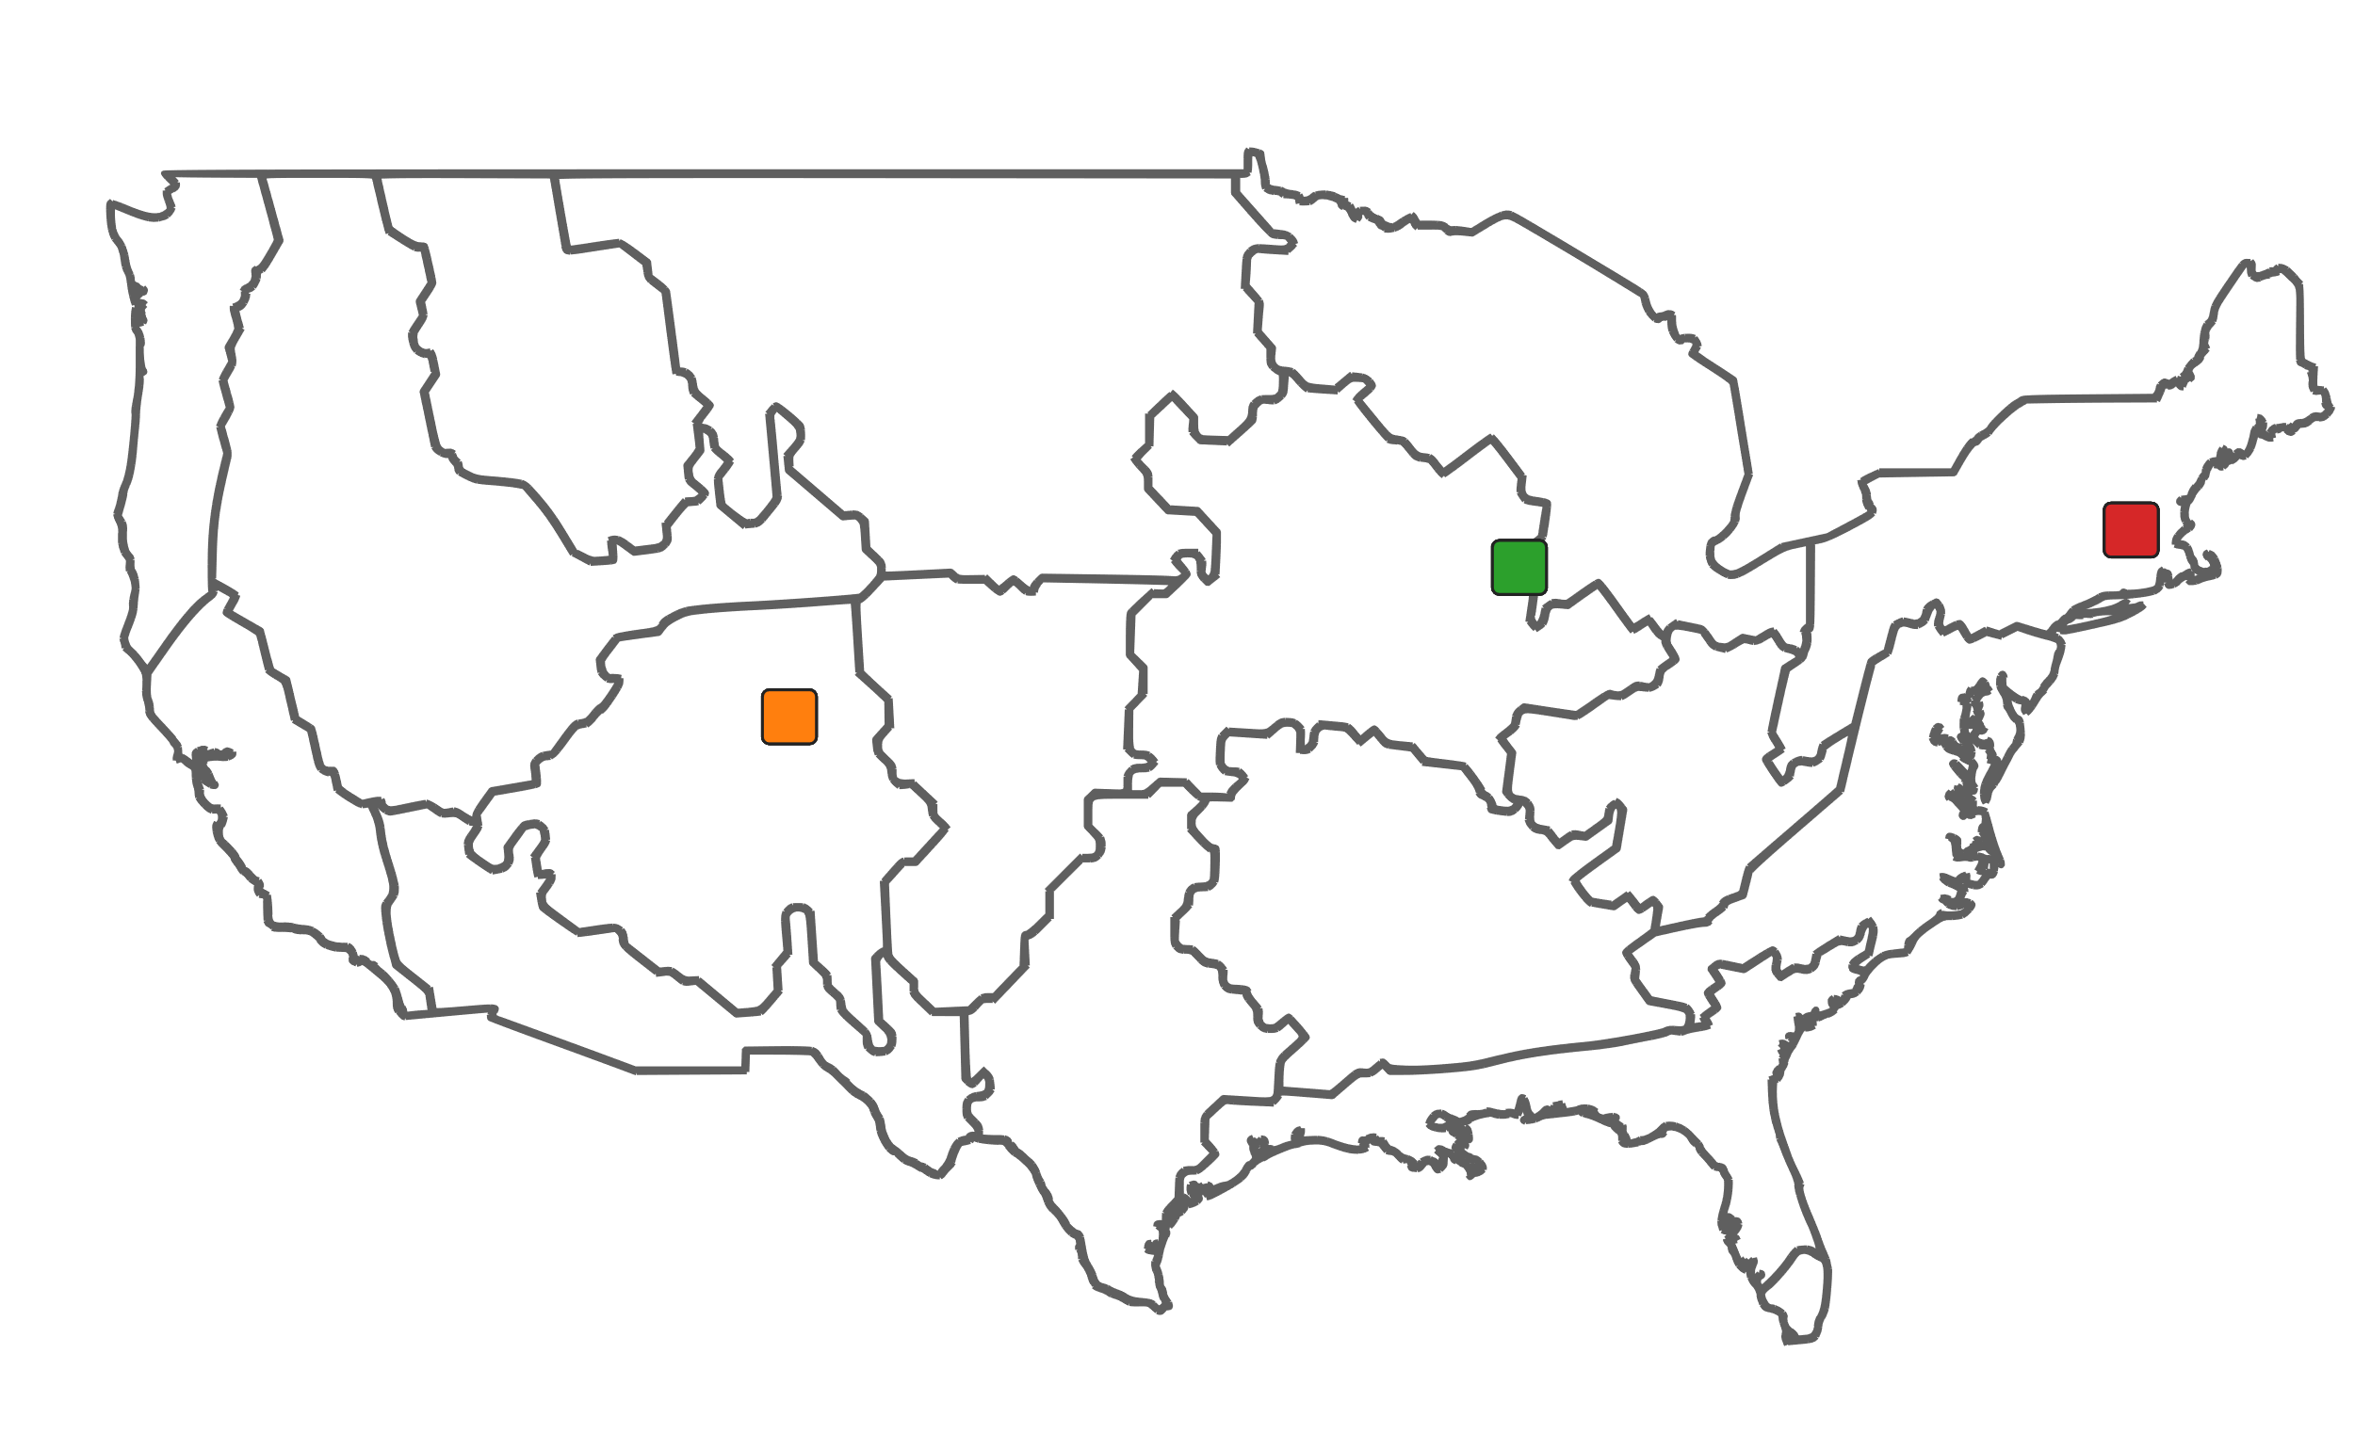
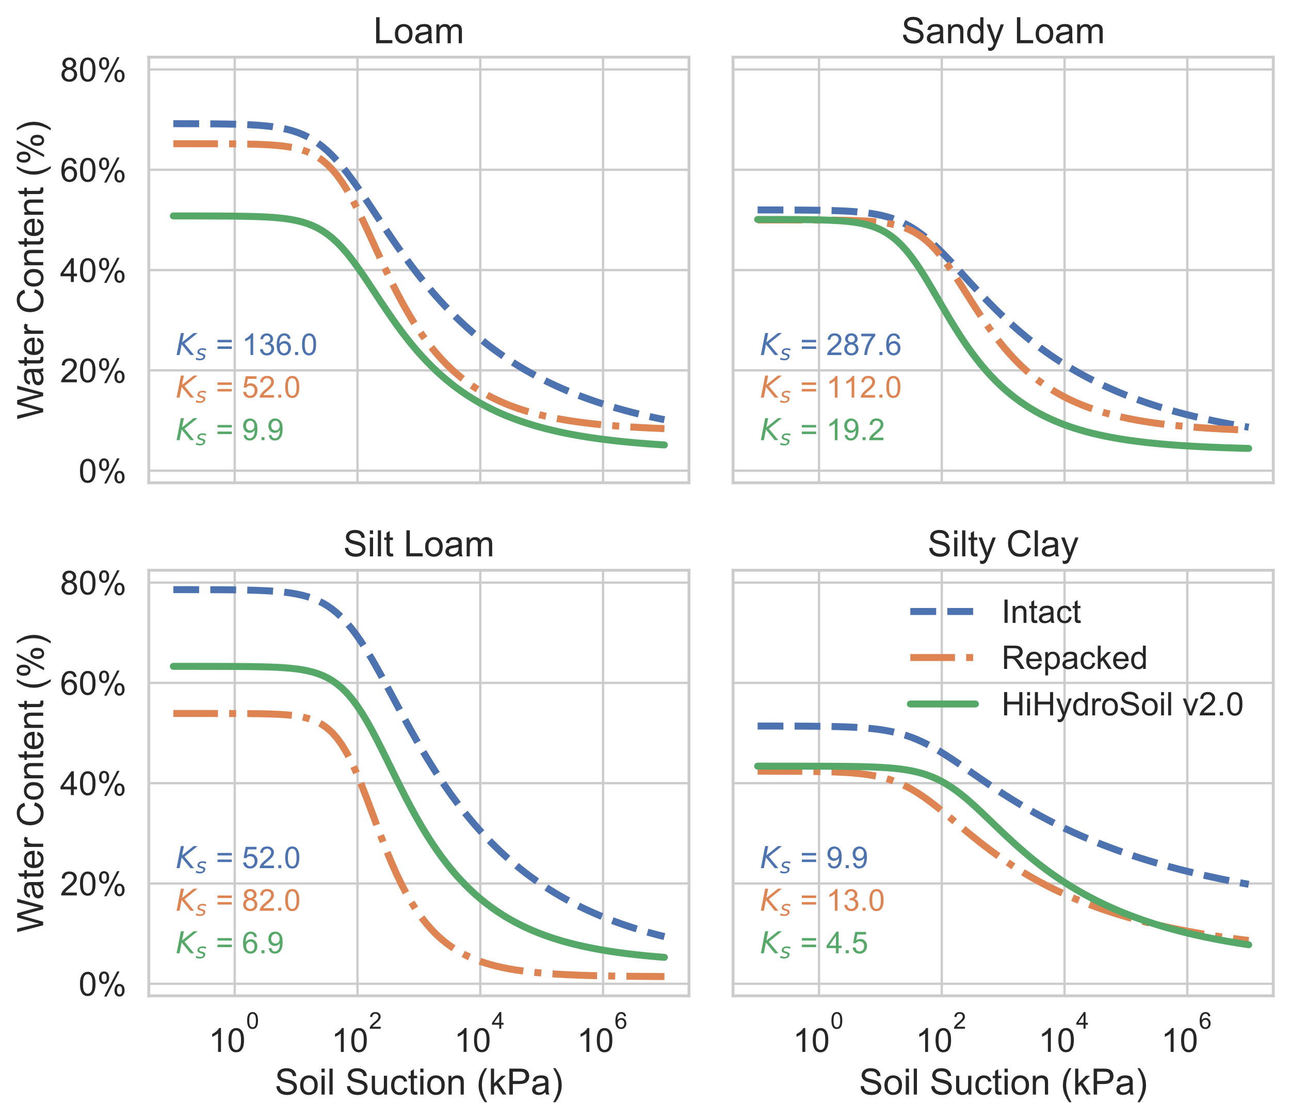
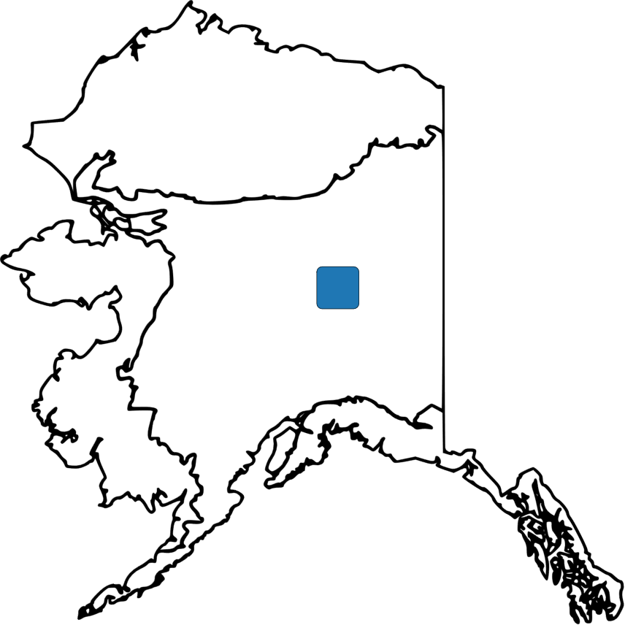
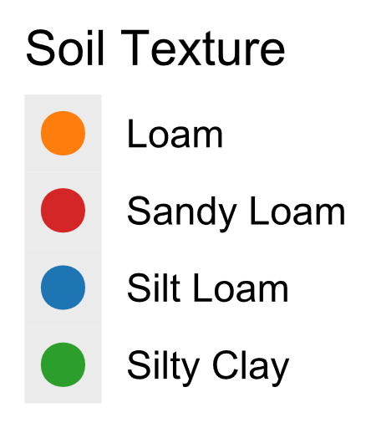
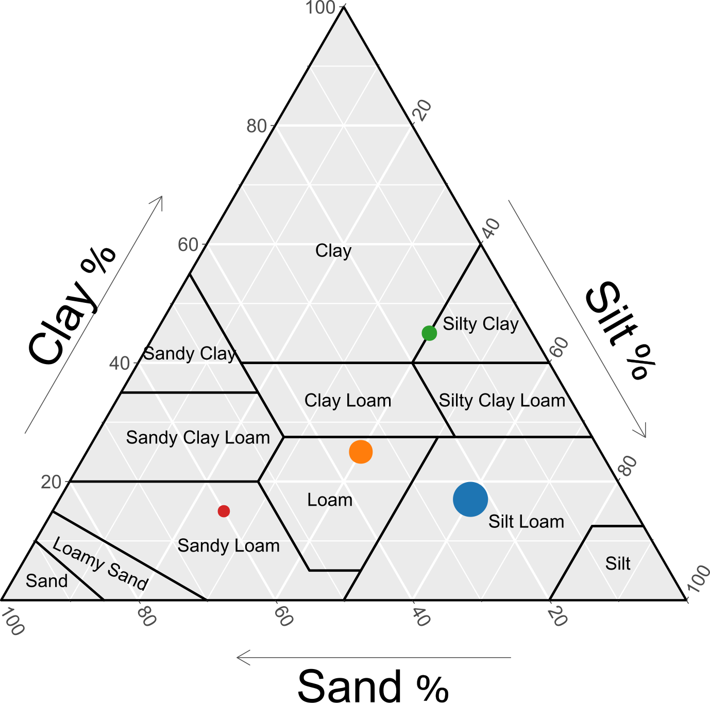
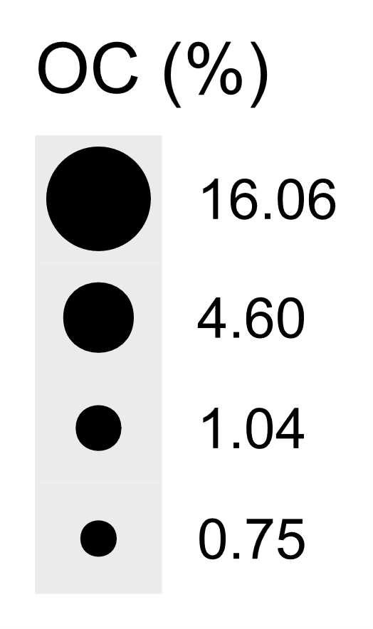
(A)
(C)
(B)

Slide 3
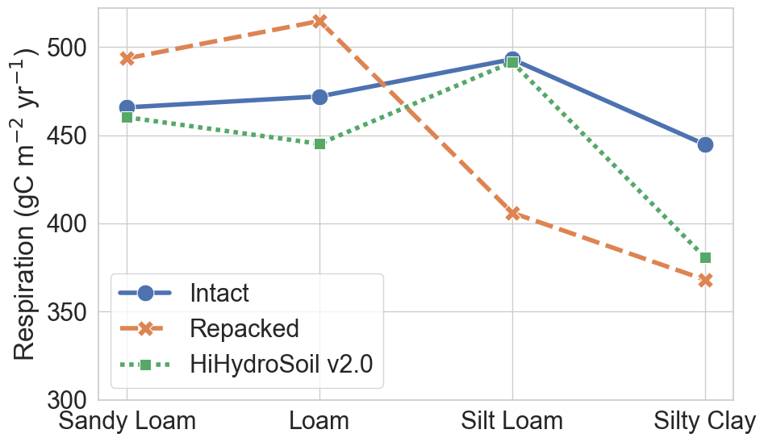
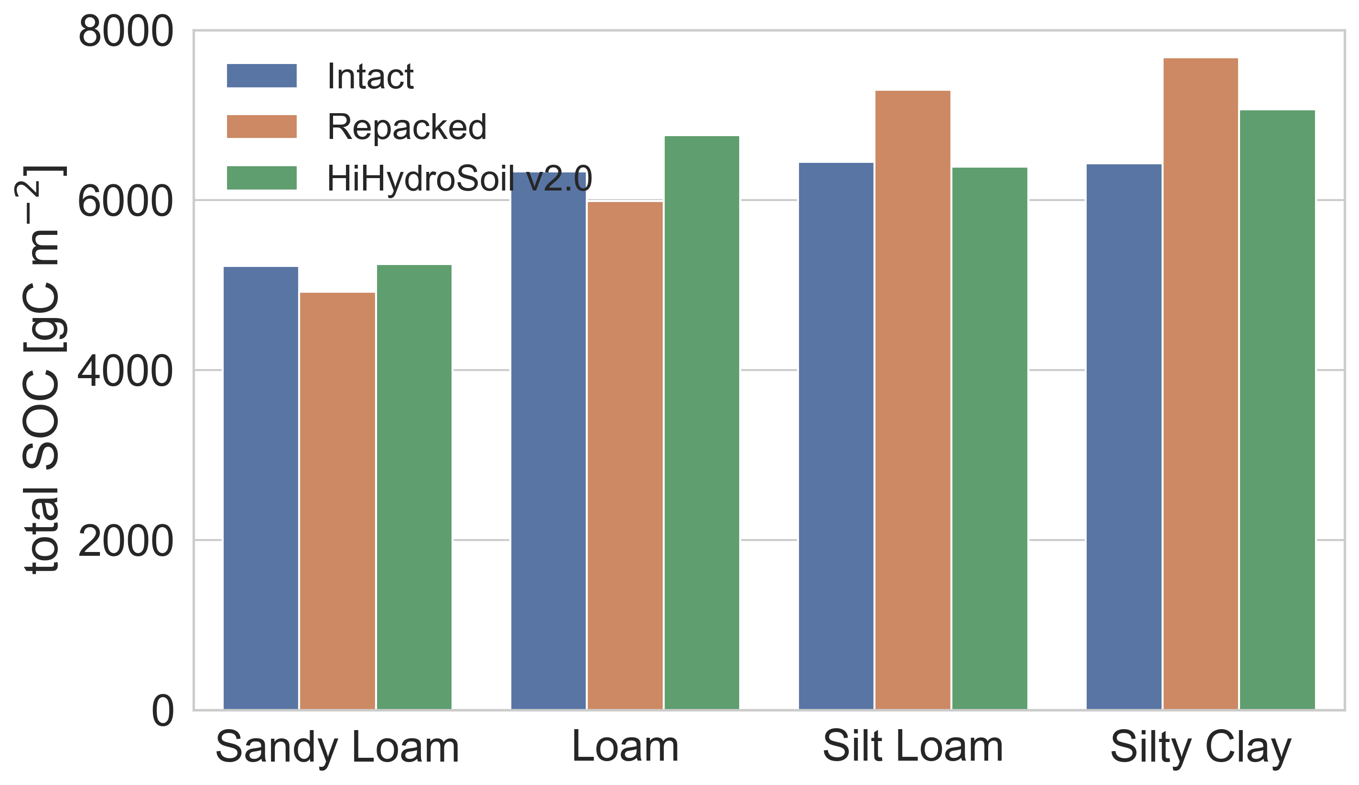
(A)
(B)

