Slide 1
Making Images with Matlab

Slide 2
What these slides are about
How to make publication worthy images in matlab

Slide 3
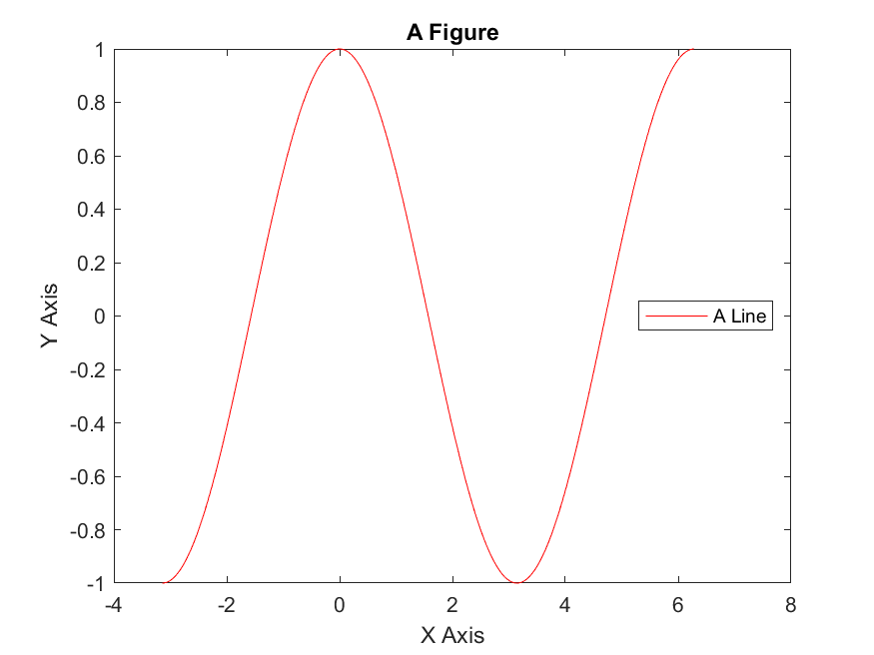
Here’s a picture
Background Stuff

Slide 4
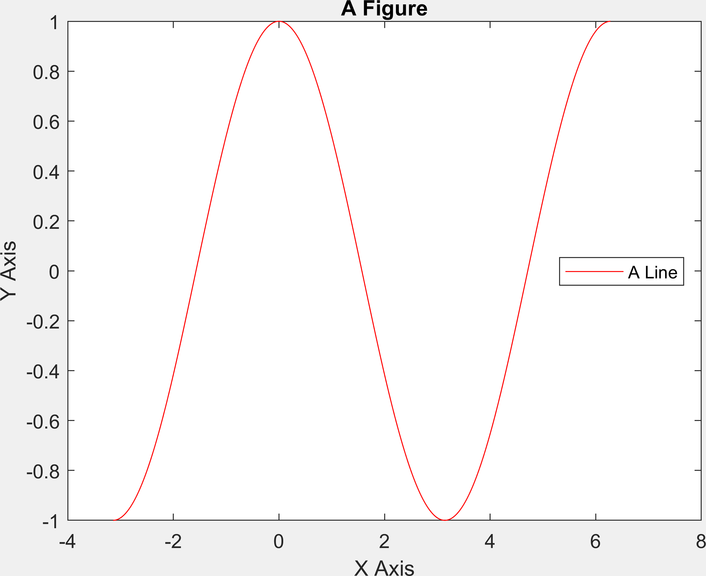
Another picture
Background Stuff
Higher resolution and precisely cropped.

Slide 5
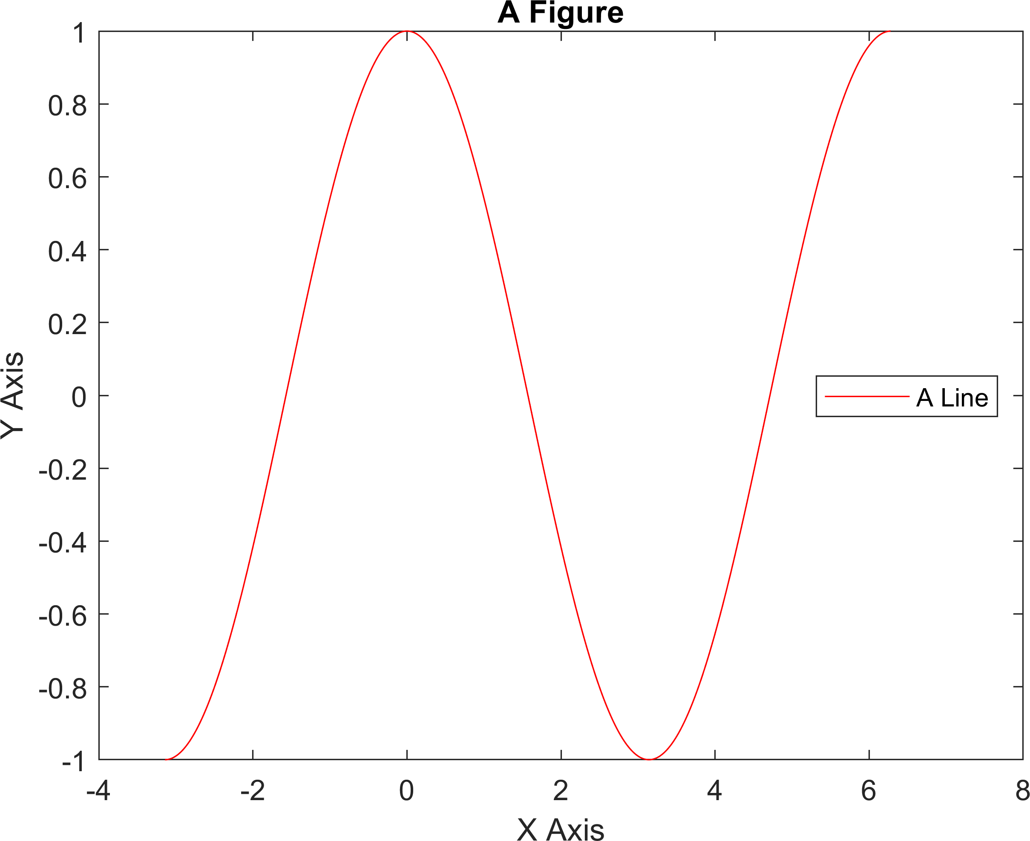
A transparent picture
Background Stuff

