Slide 1
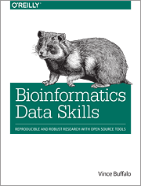
Shawn Goggins
Felipe Reyes
Preface
Chapter 1
Chapter 2
https://github.com/MorrellLAB/Applied-Bioinformatics-Discussion

Slide 2
Preface
Aid readers toward practicing bioinformatics to answer scientific questions in a robust and reproducible way.
Robust:
Your work is resilient against silent errors, confounders, software bugs, and mess or noisy data
Reproducible:
Well documented in your methods, code, and data so that other researchers can arrive at the same result.

Slide 3
Assumptions
1. You know a scripting language:
- Working with a text editor
- Running/executing programs on the command line
2. You know basic Unix command line skills
- Options/flags and arguments
- Unix file hierarchy
- Ownership/permissions
3. Have a basic understanding of biology
- DNA -> RNA -> protein
4. Have a basic understanding of regular expressions for scripting
5. Be able to get help and read documentation!
- man (UNIX); help( ) `R`

Slide 4
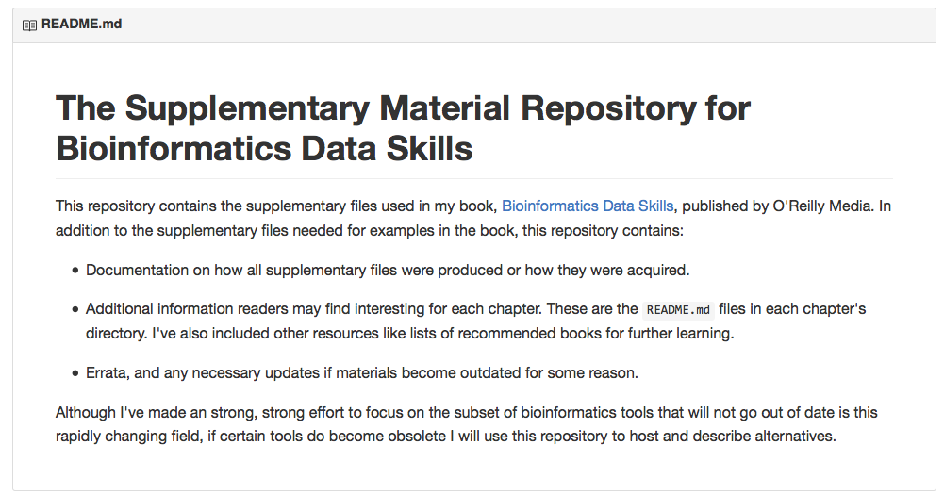
Supplementary material
Github

Slide 5
Part I. Ideology: Data Skills for Robust and Reproducible Bioinformatics

Slide 6
Chapter 1. How to Learn Bioinformatics
A bioinformatician with good data skills can receive a huge sequencing dataset and immediately start using a set of tools to see what story the data tells.
Notes:
More and better sequence data is rapidly becoming available as well as more and better bioinformatics tools to handle the data.

Slide 7
Robust research
Never ever trust your tools (or data)
Check input data and intermediate results, run quick sanity checks, maintain proper controls, and test programs.
Input data: formatted for computer readability
Use consistent naming methods
Use assert statements to identify values outside of our expected values
assert( ) in Python; stopifnot( ) in `R`

Slide 8
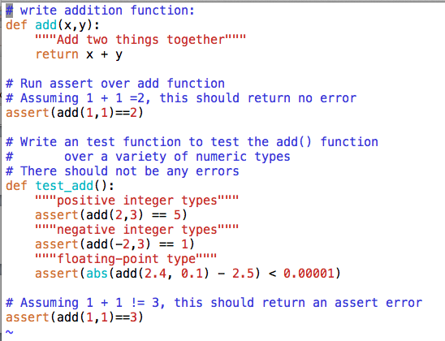

Assert() example

Slide 9
Robust research
Use existing libraries when possible
Treat data as read-only
Develop a tool instead of a one-off script
Notes:
Existing libraries: They have a longer history and wider audience to catch bugs in the software.
Read only: This leads to less corrupted results.
Tools: This allows the tool be to be run over and over again saving time and preventing headaches in the long run.

Slide 10
Reproducible Research
Release your code and data:
Documentation
Detailed methods
Data versions
Input parameters
Code
Should be readable, modular, and reusable
COMMENT
Produce images/tables when possible

Slide 11
Part II. Prerequisites: Essential Skills for Getting Started with a Bioinformatics Project Chapter 2. Setting Up and Managing a Bioinformatics Project

Slide 12
Project directories
Naming directories matters
Bad: $ mkdir barley project
Good: $ mkdir barley_project
Sample sub-directories
analysis, data, scripts
Keep your internal project directory structure intact (hierarchy)
Allows you to use relative paths
(../barley_project/data/seqs/hordeumA.fasta)
Notes:
Do NOT put spaces in names
Make multiple data files with consistent names using ‘_’

Slide 13
Project documentation
What to document?
Any command that generates results needs to be documented somewhere
When/where/how data was downloaded
Metadata
Data and software version information
Where to document?
README
$ touch README data/README
Notes:
A good place for metadata is a README.
Document everything about our experiment and analysis, making it reproducible.

Slide 14
1 project; 1 directory
Bioinformatics involves many intermediate files
Simplify subdirectories:
Data
Scripts
Analysis
Shell expansion*
$ mkdir -p barley_project/{data/seqs,scripts,analysis}
Notes:
Sub-projects and sub-analyses such as removing poor quality regions from raw experimental data.
-p flag tells mkdir to created any subdirectories needed

Slide 15
Automating File Processing Tasks
Start thinking programmatically
How to use the Unix shell programmatically?
Shell Expansion
‘ ~ ’ expands to the full path to your home directory (/Users/Felipe/Desktop)
‘ * ’ expands to all matching files (wildcards)
Brace expansion
$ touch seqs/hordeum{A,B,C}_R{1,2}.fastq
Notes:
Doing something programmatically means doing it through code rather than manually, using a method that can effortlessly scale to multiple objects, like files. (Reduce human error when manually handling each file individually)
Expansion: shell expands text for you so you don’t have to type it out

Slide 16
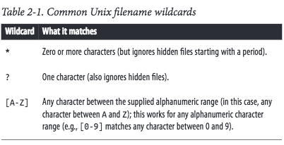
…a note on Wildcards
Retrieve all the files from the sample hordeumB?
$ touch seqs/hordeum{A,B,C}_R{1,2}.fastq
Retrieve all but hordeumC ?
$ ls hordeum[AB]_R1.fastq”
Protip: use leading zeros to make files with numbers easier to find (e.g. 001, 013, etc.)
Notes:
Constant naming is required to access files with wildcards.
“Wildcards are expanded to all matching file or directory names (this process is known as globbing).”

Slide 17
Markdown
Used to create a project notebook
(Visual Studio Code suggested)
Use plain text, it’s future-proof format
Version control friendly
Markdown syntax reference:
http://daringfireball.net/projects/markdown/syntax
Notes:
“Detailed information about the chronology of your computational work, steps you’ve taken, information about why you’ve made decisions, and of course all pertinent information to reproduce your work.”
“Markdown is just plaintext, which means that it’s portable and programs to edit and read it will exist.”

Slide 18
Challenge
Make a new directory
Make an empty README file
Open and edit your README in visual studio code
Bold something
Bullet points
Link something

