Slide 1

A basic ML model for EOR
Screening
Dept. of Petroleum Engineering,
Indian Institute of Petroleum and Energy, Vizag(AP)
Course-Enhanced Oil Recovery
Course Instructor- Dr. Sivasankar P.
Presented by- Shashwat Singh
Roll no-18PE10023

Slide 2

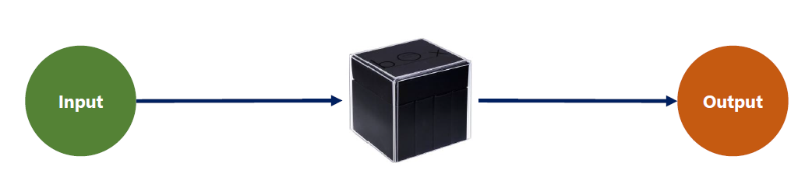
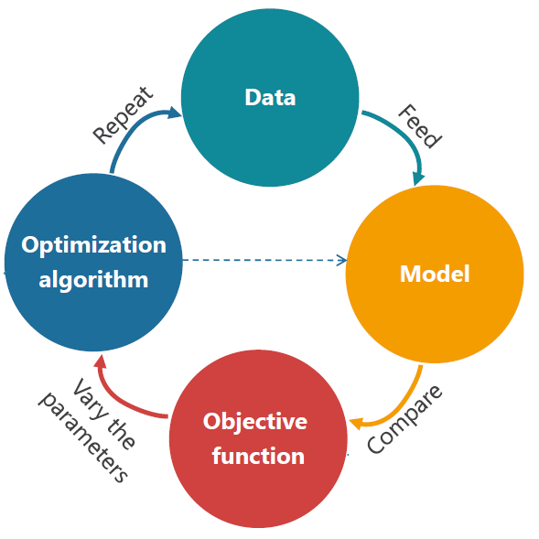
Once we have a model, we must train it. Training is the iterative process through which, the model learns how to make sense of input data.
Training an algorithm involves 4 ingredients:
Types of ML:
Supervised-labelled input
Unsupervised-input not labelled
Reinforcement-reward based

Slide 3
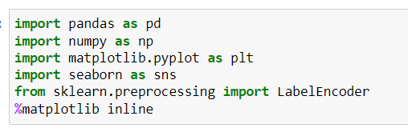
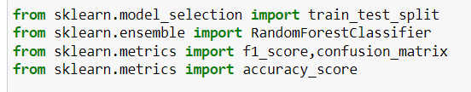
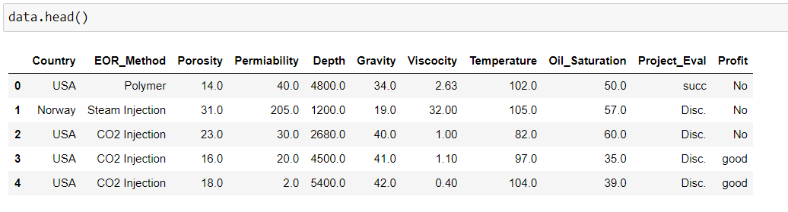
Understanding the problem statement and libraries used
Problem statement-To build a machine learning model which predicts EOR to be applied on being given petrophysical properties of rocks.
Python Libraries
Tabula:-for data extraction from pdf files
NumPy:-ndarray, fast computation
Pandas-data structures for statistical computing
Matplotlib and Seaborn:-for visualisation
Sklearn:- pre-processing , model selection, scoring etc

Slide 4
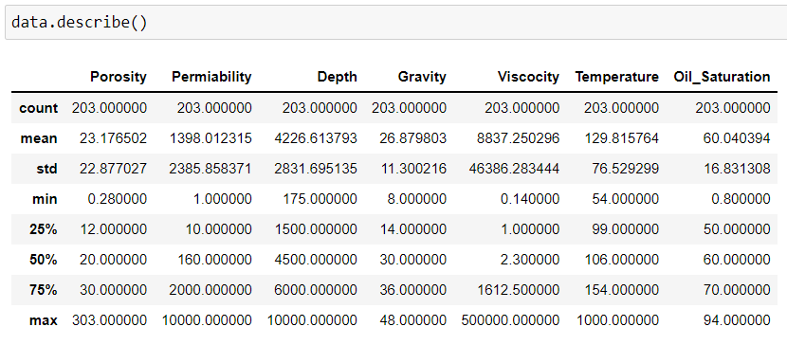
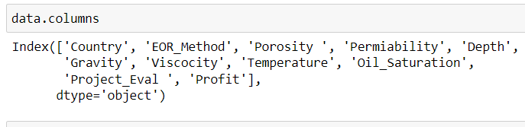
Data Preparation and Insights
Data Extraction method and source:
Source- Research papers in pdf format and open source
200 tuples, extracted using tabula library in python and
online softwares.
11 Columns in dataset
Data Preprocessing and EDA
Null values?
Outliers?
Descriptive statistics, box plots, count plots and catplots?
Label encoding Country, Project_Eval and Profit.

Slide 5
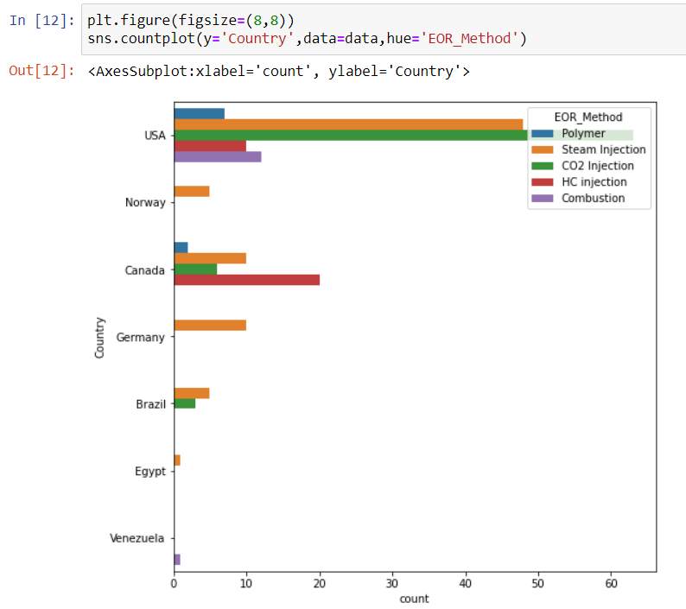
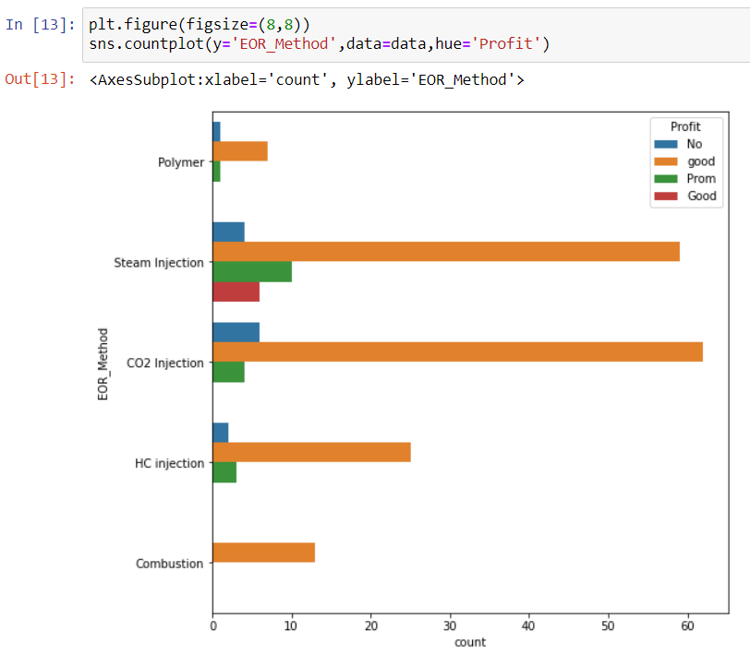
Steam injection and CO2 injection are most widely applied EOR

Slide 6
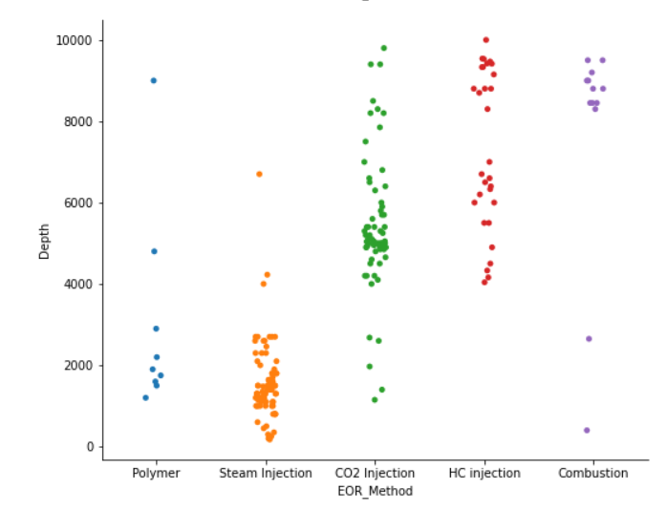
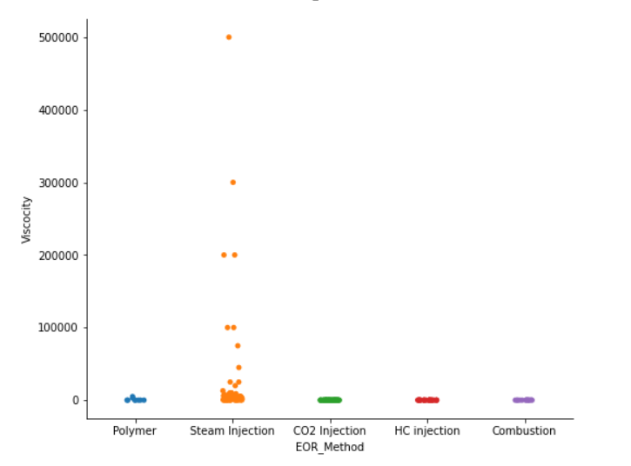
from count plots of EOR_Methods, for lower depths and higher viscosity steam injection was favored

Slide 7
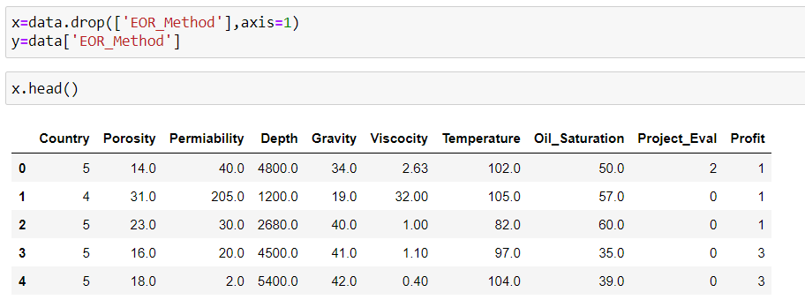
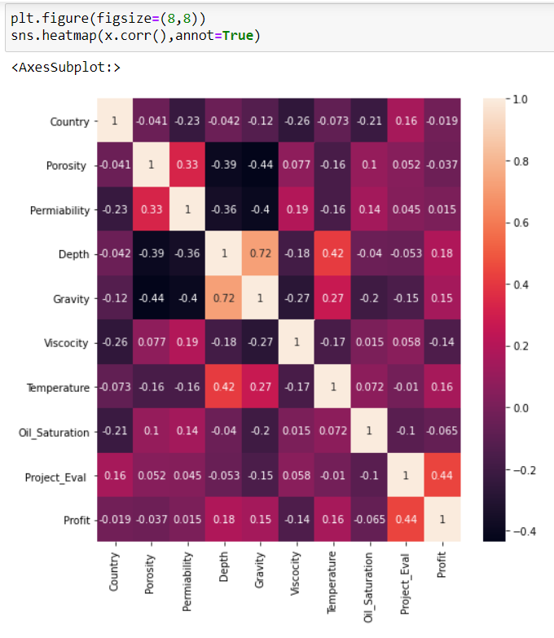

Target and predictors
Correlation-
numerical features- Pearson correlation
For categorical or cross features-
Cramer’s V: V(X,Y)=V(Y,X), any information related to asymmetry is lost
Thiel’s U:U(X,Y)!=U(Y,X)
Implementation details in dython
Label encoded so that we can use simple Pearson correlation in heatmap, and also for best capturing of underlying pattern and avoid runtime errors in further statistical procedures. only gravity vs depth highly correlated

Slide 8
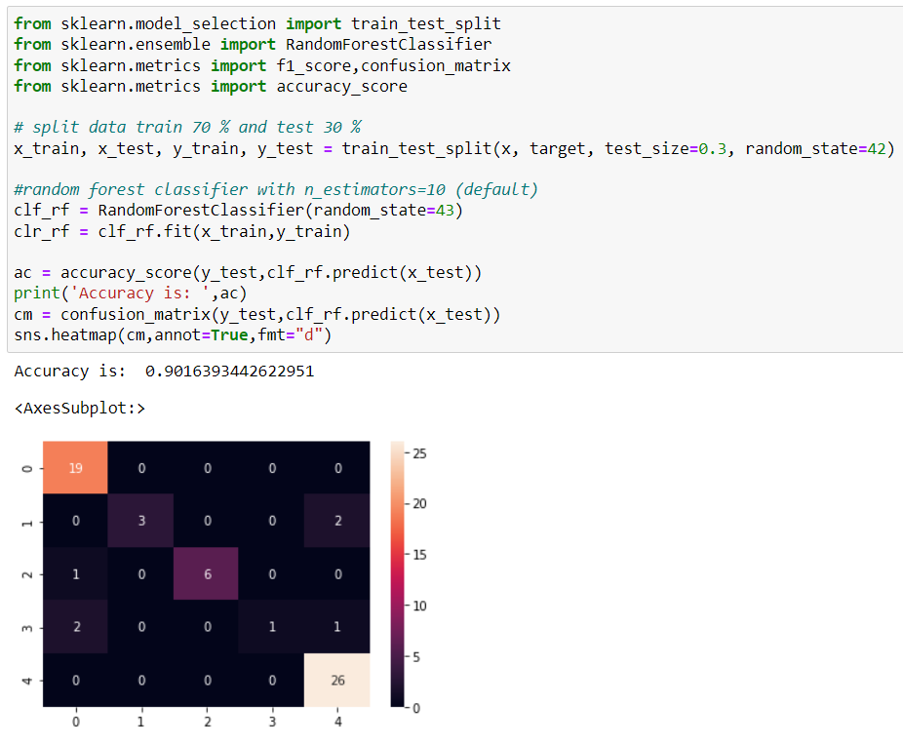
70-30 train-test split and training our model
30% testing data
Random forest classifier
Test-metric: confusion matrix
Is it the best accuracy we can achieve using this classifier?
Are these 10 features that we selected, optimal?

Slide 9
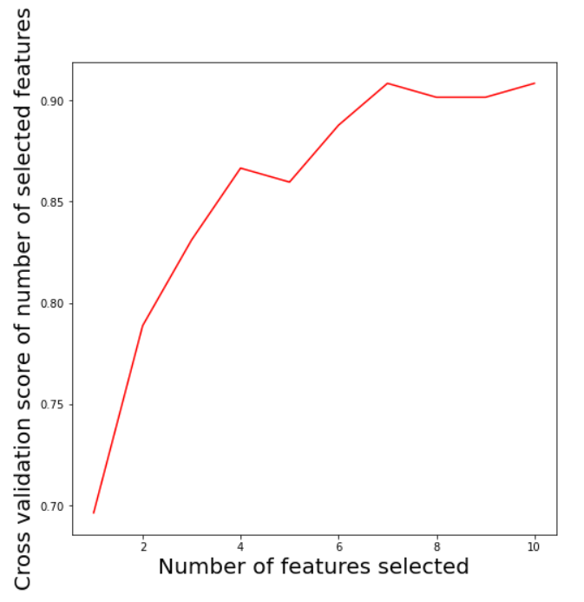
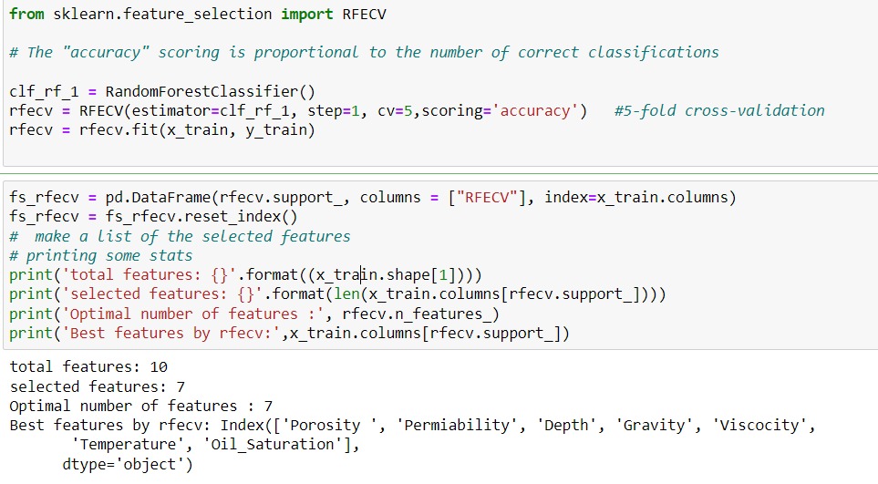
Feature Selection Using RFECV and CV score

Slide 10
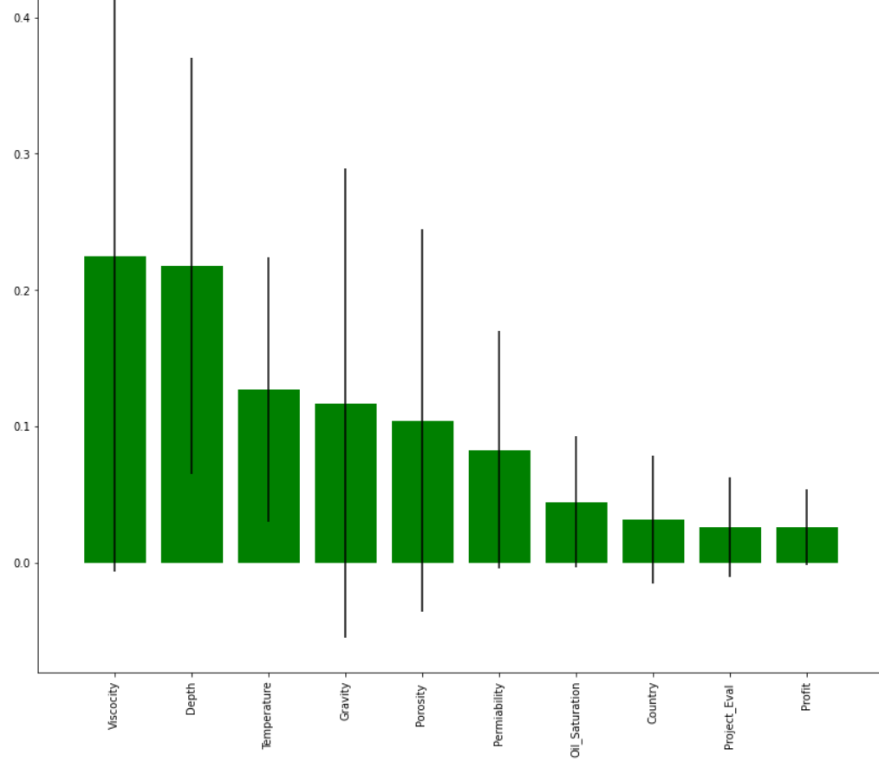
Feature Importance

Slide 11
References..
Development of a hybrid scoring system for EOR screening by combining conventional screening guidelines and random forest algorithm https://doi.org/10.1016/j.fuel.2019.115915
Pedregosa, F., Varoquaux, Ga"el, Gramfort, A., Michel, V., Thirion, B., Grisel, O., … others. (2011). Scikit-learn: Machine learning in Python. Journal of Machine Learning Research, 12(Oct), 2825–2830.
McKinney, W., & others. (2010). Data structures for statistical computing in python. In Proceedings of the 9th Python in Science Conference (Vol. 445, pp. 51–56).
Harris, C.R., Millman, K.J., van der Walt, S.J. et al. Array programming with NumPy. Nature 585, 357–362 (2020). DOI: 10.1038/s41586-020-2649-2.

Slide 12


