Slide 1
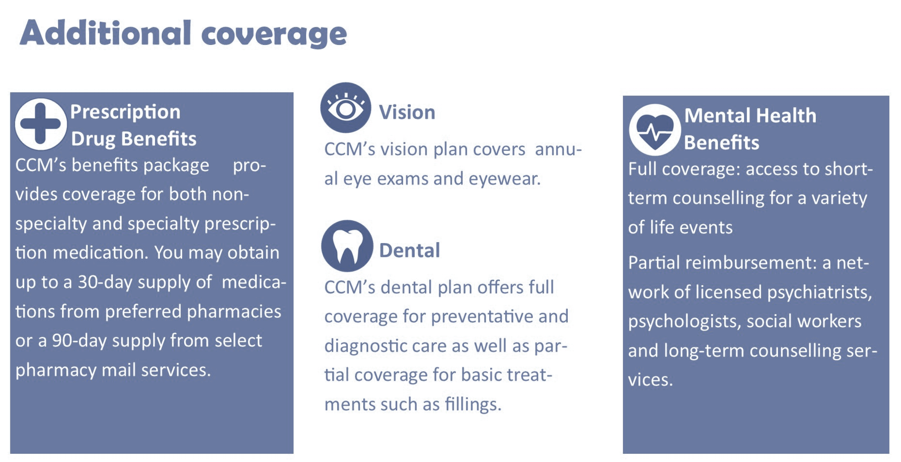
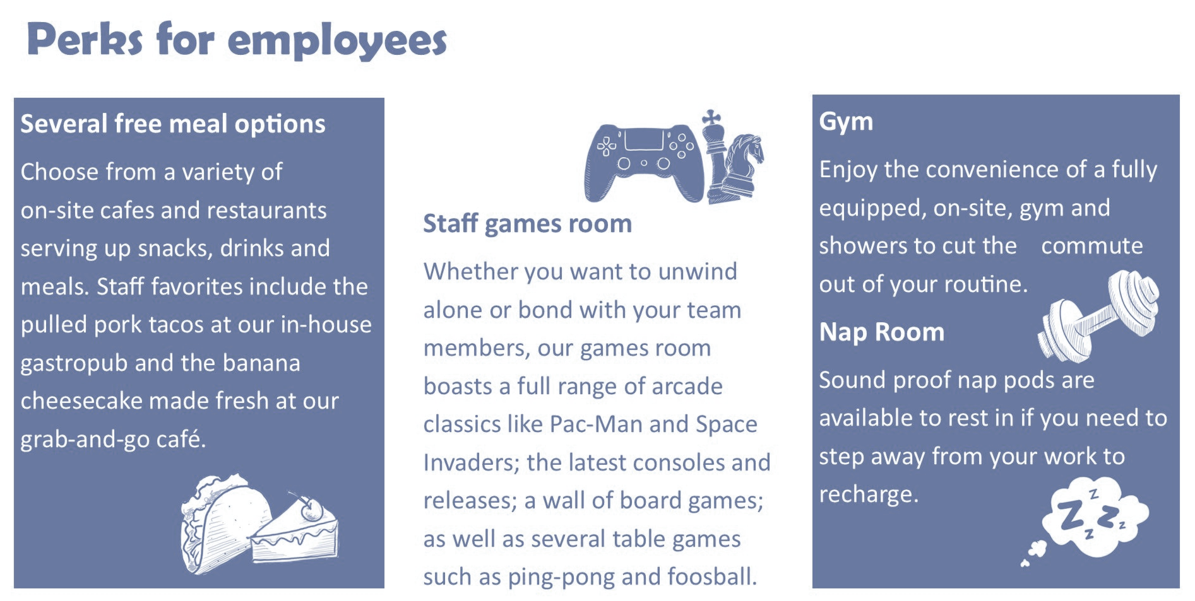
Culture Signaling at Work: System Justification in High Tech
Elizabeth Cyr (1), Dr. William Hall (2)
Psychology Department, Brock University
Research Summary
Methodology
When an outsider thinks a company is more fun to work at, they are more likely to justify unfair treatment of employees within that company
Introduce Participants to a fake tech company and employee
Participants in the control condition are taught about the company's standard employee benefits (e.g., dental) while those in the experimental condition are shown that the company provides its employees with exciting perks such as an in-house pub, a games room, an on-site staff gym and an employee nap room.
Stories involving employee mistreatment at the company are presented
Theoretical Foundations
“A manager at CCM is sick, and no one from management can fill in. John is asked to take over the manager's duties until they come back... without compensation”
Organizational Culture
Flexibility
“John works as a software developer for a San Francisco based tech company called CCM as a software developer…”
“The following two pages briefly describe some of the perks and benefits offered to employees of CCM…”
Control
Experimental
Shared beliefs, values and assumptions
Determine the norms and patterns of behaviour that develop in an organizations (Johns & Saks, 2020)
CLAN
ADHOCRACY
The Competing Values Framework
Internal Focus
External Focus
Measures are scored on 7-point Likert Scales
Measures where an organizations values lay along two dimensions to diagnose its primary culture as one of four styles.
Clan culture is focused on its employee's well-being, while Adhocracy culture prioritizes flexibility and rapid innovation to stay ahead of the competition.
HIERARCHY
MARKET
“CCM is behaving reasonably in asking John to take over these duties.”
Please rank how strongly you agree:
1= Strongly disagree – 7 = Strongly Agree
Stability
System Justification
Findings
Conclusions and Implications
The social and psychological tendency to defend the status quo
System Justification Theory
Exposed to system/social order
Use first evidence to form positive perception of it
Want to feel good about the system
Defend system in face of threats against positive perception
Research Question
When people see the novel perks offered at modern technology companies, do they use this as evidence that the company prioritizes its employee's well-being and ignore instances of employee exploitation (e.g., unpaid overtime) as they challenge this positive perception?
Hypotheses
H1
Presence of clan culture perks
Justification of Exploitation
H2
Presence of clan culture perks
Justification of Mistreatment
H3
Presence of clan culture perks
Expectations of Perfectionism
Key Variable Definitions
Future Directions
IV
Clan culture perk :
A perk offered by a company that is novel and fun (e.g., staff gym)
DV
Exploitation :
Unfairly compensated tasks and/or beyond job scope
Mistreatment :
Unfair or demeaning treatment from superior
Perfectionism :
Unreasonably high work standards
Sample
165 Brock University students (M_{age} = 19.36, SD_{age} = 1.99, 82.6% Female), were recruited over SONA and compensated with class credit. The majority of this sample studied Social Science (35%) and Health Science (32%).
Control: n=82 Experimental: n=83
Social Sciences (35%)
Health Sciences (32%)
Education (18%)
References
Mathematics and Science (5%)
>20 years old (69%)
20-25 years old (31%)
Female (83%)
Male (17%)

