Slide 1

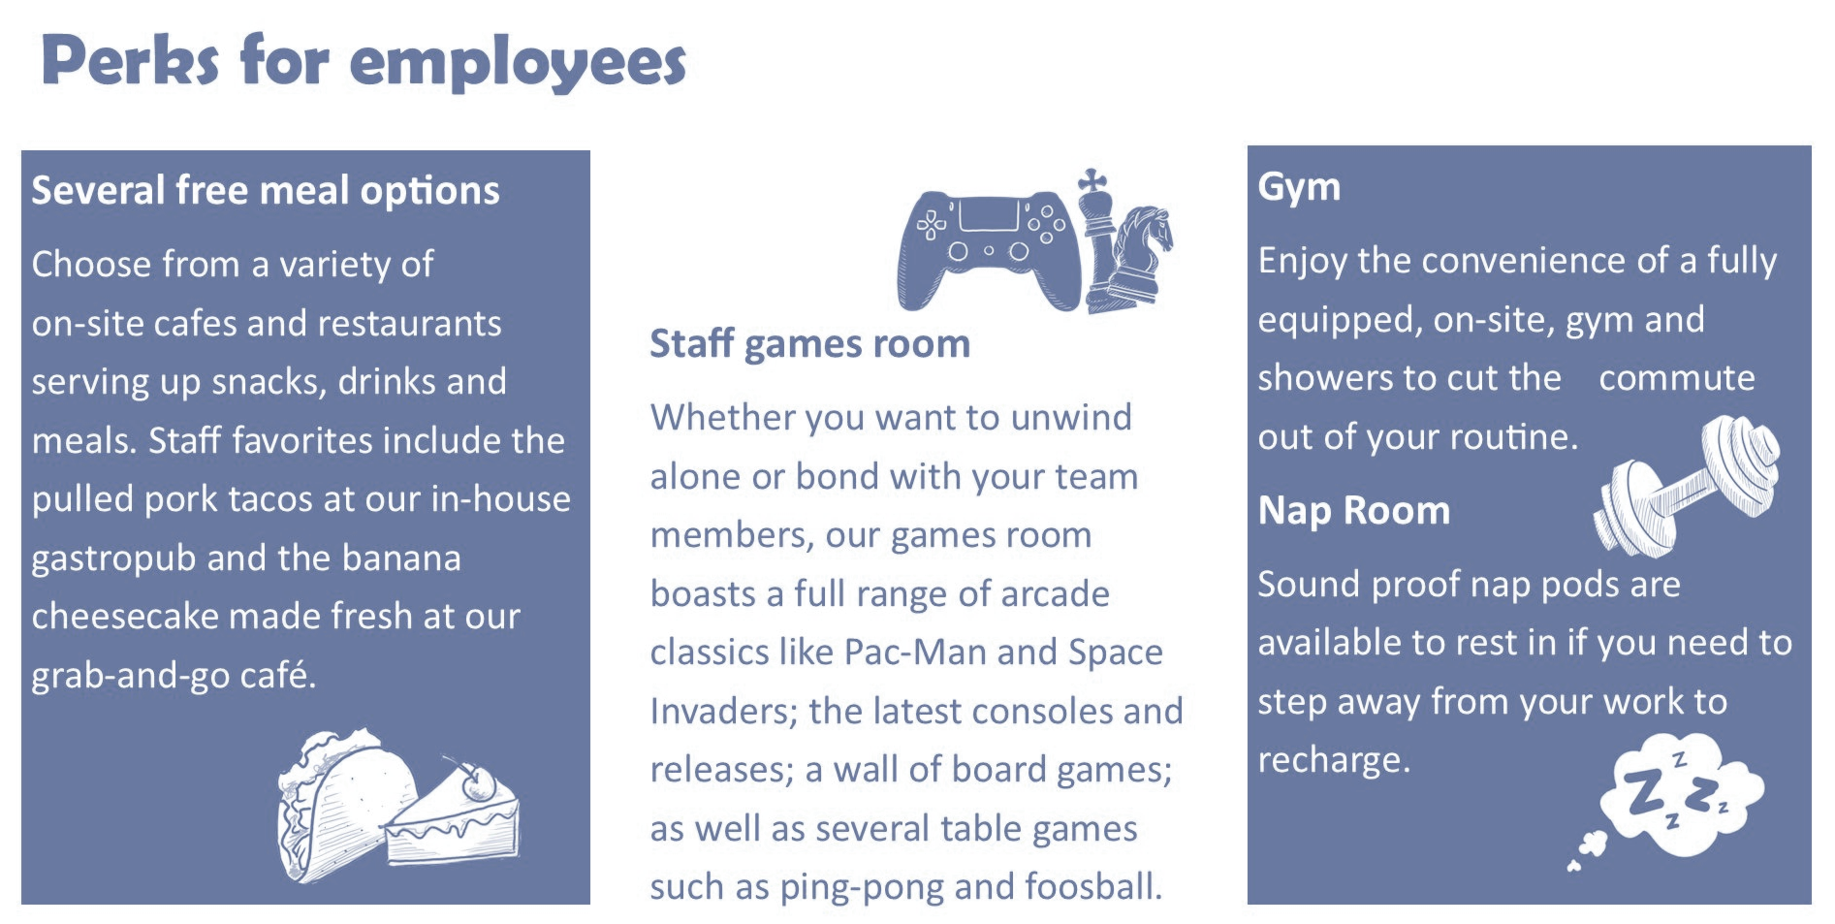
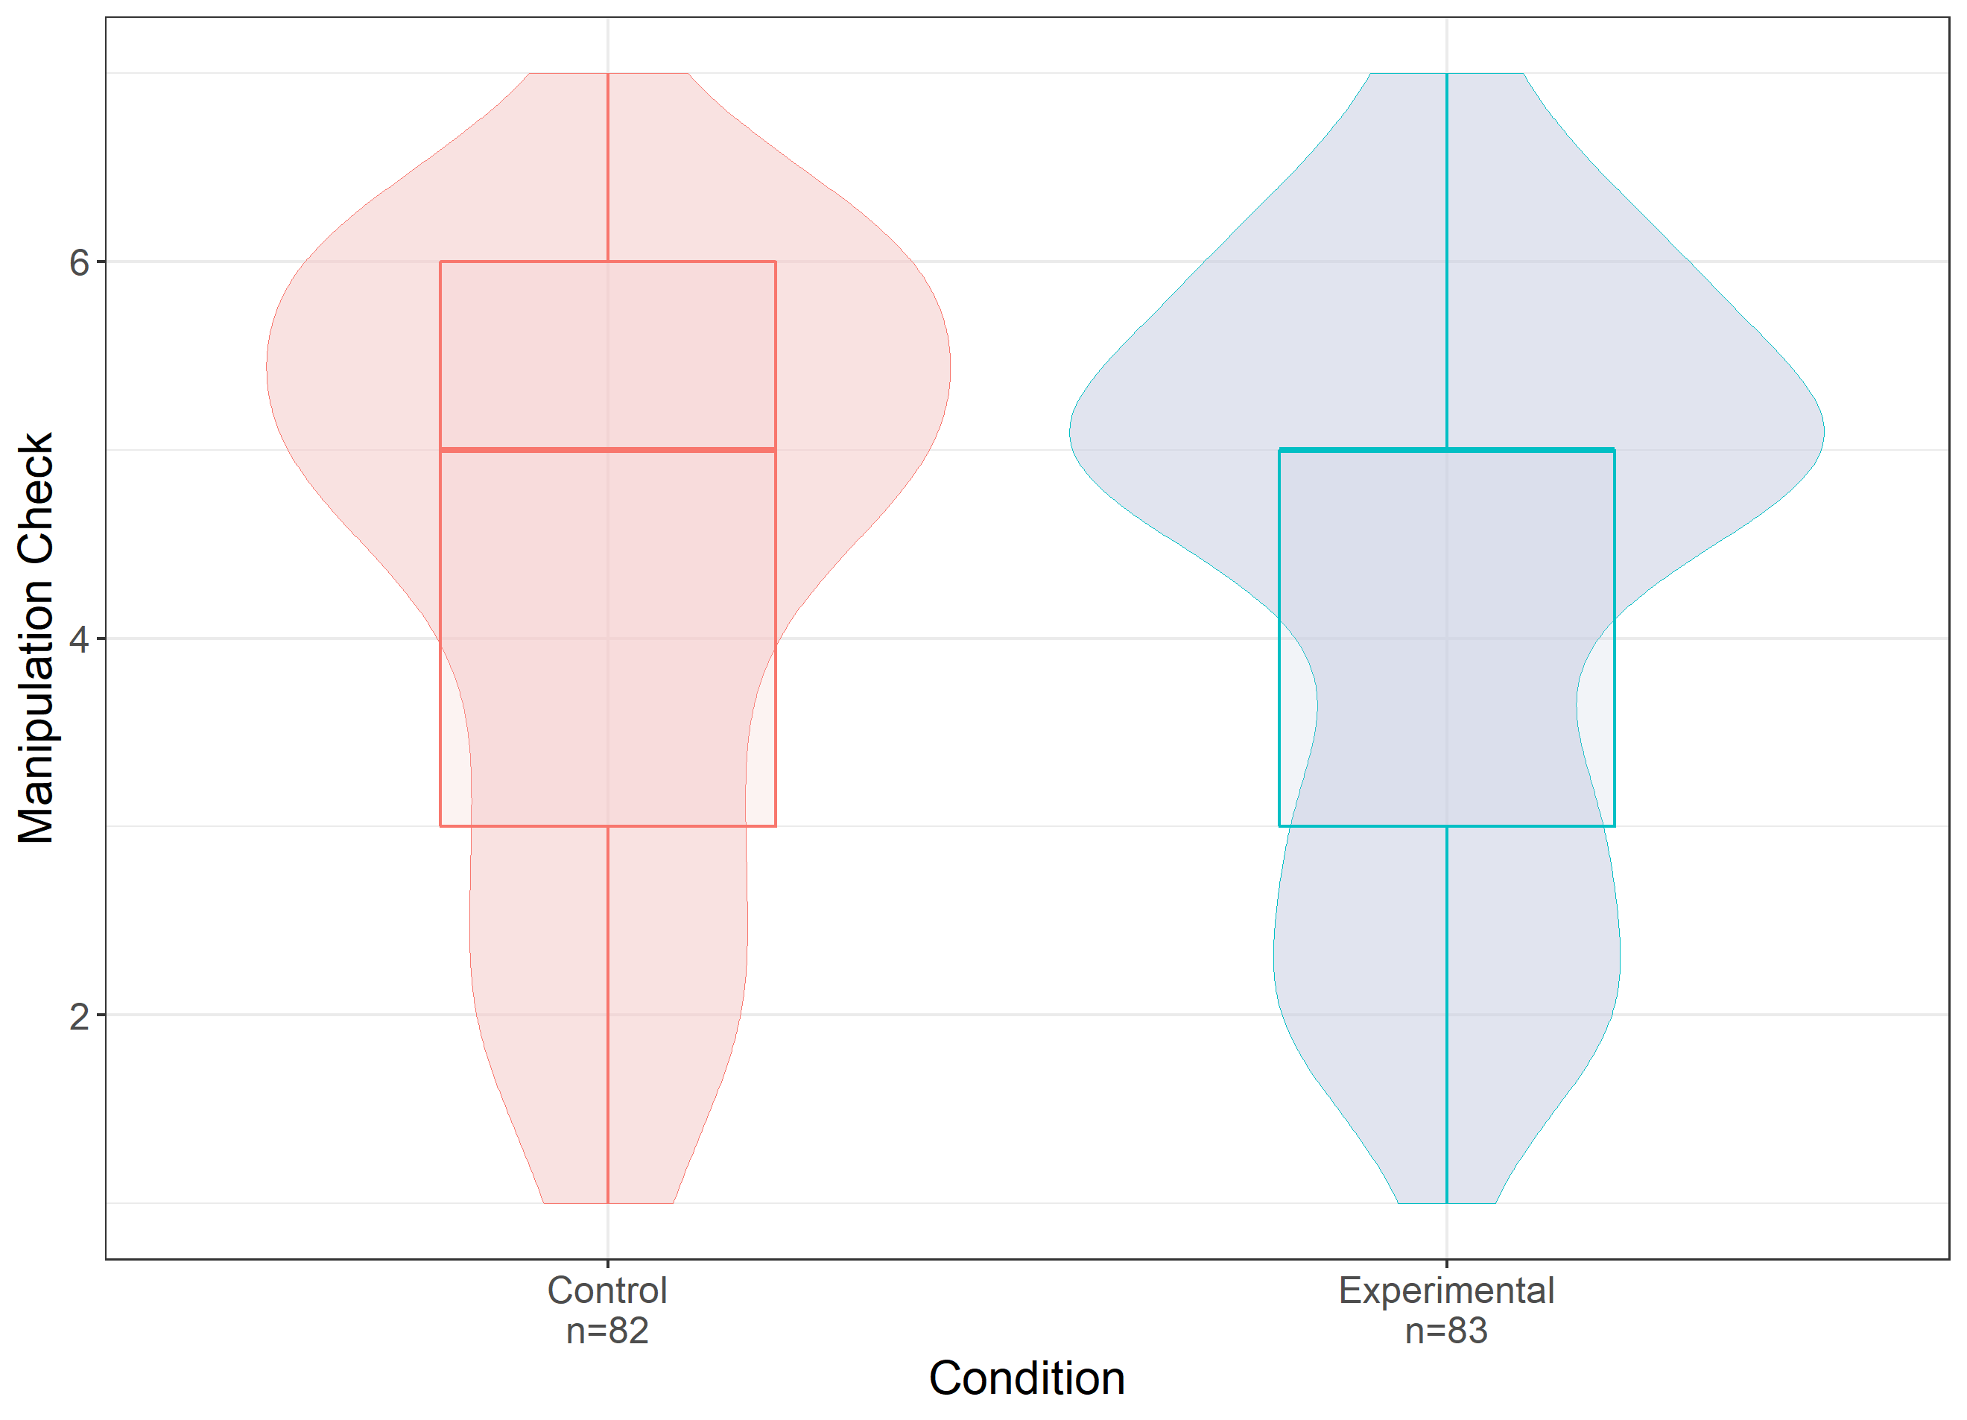
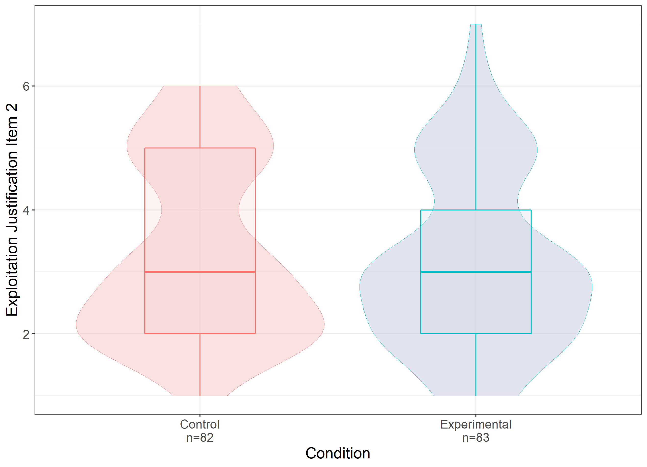
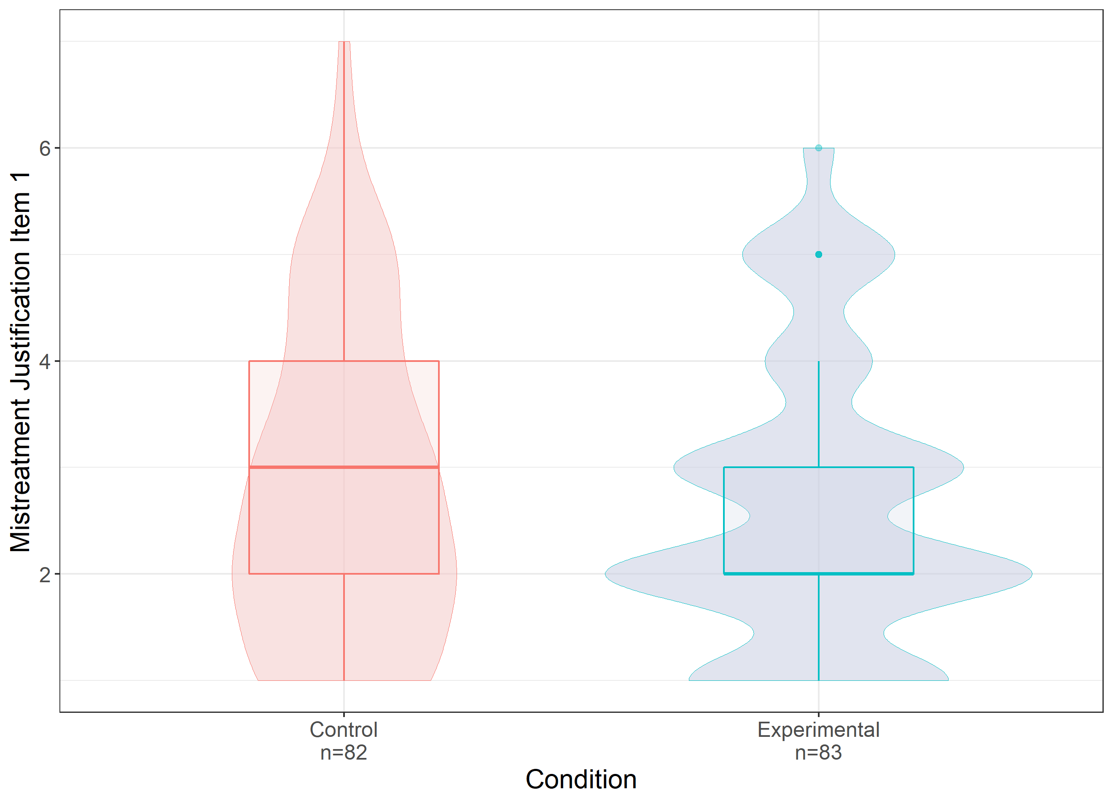
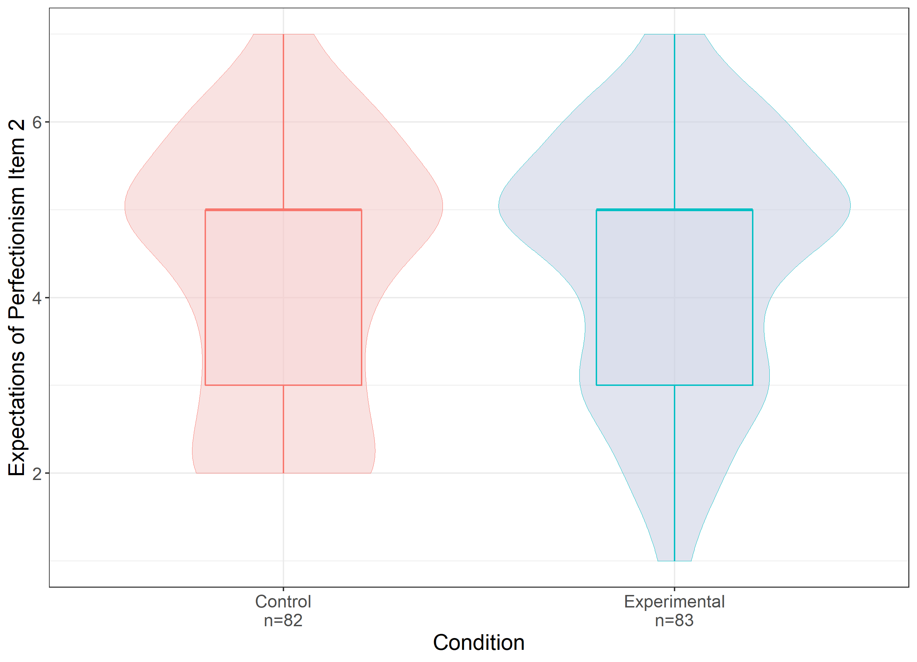
Culture Signaling at Work: System Justification in High Tech
Elizabeth Cyr (1), Dr. William Hall (2)
Psychology Department, Brock University
Research Summary
Methodology
When an outsider thinks a company is more fun to work at, they are more likely to justify unfair treatment of employees within that company
Introduce Participants to a fake tech company and employee
Participants in the control condition are taught about the company's standard employee benefits (e.g., dental) while those in the experimental condition are shown that the company provides its employees with exciting perks such as an in-house pub, a games room, an on-site staff gym and an employee nap room.
Stories involving employee mistreatment at the company are presented
Theoretical Foundations
“A manager at CCM is sick, and no one from management can fill in. John is asked to take over the manager's duties until they come back... without compensation”
Organizational Culture
Flexibility
“John works as a software developer for a San Francisco based tech company called CCM as a software developer…”
“The following two pages briefly describe some of the perks and benefits offered to employees of CCM…”
Control
Experimental
Shared beliefs, values and assumptions
Determine the norms and patterns of behaviour that develop in an organizations (Johns & Saks, 2020)
CLAN
ADHOCRACY
The Competing Values Framework
Internal Focus
External Focus
Measures are scored on 7-point Likert Scales
Diagnoses a company culture as one of four. Relevant to this study are Clan culture and Adhocracy. Modern workplaces use cool perks and offices to signal that they are a clan culture and prioritize employee well-being. This is rarely in-line with their business needs.
HIERARCHY
MARKET
“CCM is behaving reasonably in asking John to take over these duties.”
Please rank how strongly you agree:
1= Strongly disagree – 7 = Strongly Agree
Stability
System Justification
Findings
Conclusions and Implications
The social and psychological tendency to defend the status quo
Manipulation Check
H1: Exploitation Justification
Insignificant difference in means for the manipulation check between conditions
Suggests our manipulation was ineffective
Brings analysis of outcome variable into question but no key hypothesis confirmed
Significant correlations between our manipulation check and several measures of observer perceptions of CCM as a clan culture
Suggests a relationship does exist between clan culture signalling and justification of unfair expectations put on employees
If relationship does exist:
Informs organizations of the importance of clearly defining their culture and allows them to better meet the needs of their employees
Builds on Organizational Culture literature
Speaks to the impact of misleading culture signaling
Adds to workplace perk literature
Bulk of perk research studies positive outcomes so this provides a balancing perspective
Informs prospective employees seeking new employers
Learning to accurately identify an organizations culture
System Justification Theory
See a company from the outside
Notice fun perks/ modern style → from positive perception of it
Want to maintain positive perception
Defend perception in face of threats (mistreatment)
Research Question
When people see the novel perks offered at modern technology companies, do they use this as evidence that the company prioritizes its employee's well-being and ignore instances of employee exploitation (e.g., unpaid overtime) as they challenge this positive perception?
Hypotheses
H2: Mistreatment Justification
H3: Expectations of Perfectionism
H1
Presence of clan culture perks
Justification of Exploitation
H2
Presence of clan culture perks
Justification of Mistreatment
H3
Presence of clan culture perks
Expectations of Perfectionism
Limitations and Future Directions
Key Variable Definitions
Ineffective manipulation → inability to interpret t-test analysis
Measure and delivery of IV and DV’s may be too subtle or lack construct validity
Change manipulation →
Delivery of IV through more direct means than brochure
Measure of DV’s through more direct means than vignettes
Sample not reflective of individuals working in the tech sector
More female (though this is changing!!)
Younger and may lack career experience
Very few studying math or science
Collect from a more representative sample
Mechanical Turk to access employed adults
Stack Overflow to access tech employees, ideally managers
Correlational study
Participants diagnose company’s organizational culture
Respond to measures of DVs
IV
Clan culture perk :
A perk offered by a company that is novel and fun (e.g., staff gym)
DV
Exploitation :
Unfairly compensated tasks and/or beyond job scope
Mistreatment :
Unfair or demeaning treatment from superior
No significant difference in perception of perks between conditions (t(163) = 0.27, p = 0.79)
No significant difference in justification of exploitation (t(163) = 0.93, p = 0.35), justification of mistreatment (t(163) = 0.7, p = 0.49) or expectations of perfectionism (t(163) = -0.57, p = 0.57) between conditions .
Correlational analysis of all outcome variables found relationships between:
Manipulation check and expectations of perfectionism (r = 0.32, p<.01)
Manipulation check and expectations of gratitude (r=0.39, p<.01)
Perception of CCM as a fun place and:
Exploitation legitimization (r=.24, p<.01)
Mistreatment legitimization (r=.23, p<.01)
Expectation of perfectionism (r=.21, p<.01)
Belief that CCM cares about its employees well being and:
Exploitation legitimization (r=.35, p<.01)
Mistreatment legitimization (r=.35, p<.01)
Expectation of perfectionism (r=.21, p<.01)
Perfectionism :
Unreasonably high work standards
Sample
165 Brock University students (M_{age} = 19.36, SD_{age} = 1.99, 82.6% Female), were recruited over SONA and compensated with class credit. The majority of this sample studied Social Science (35%) and Health Science (32%).
Control: n=82 Experimental: n=83
Social Sciences (35%)
Health Sciences (32%)
Education (18%)
References
Mathematics and Science (5%)
Kim, C. S., & Quinn, R., E. (2000). Diagnosing and Changing Organizational Culture: Based on the Competing Values Framework. San Francisco, CA: John Wiley & Sons.
Johns, G., & Saks, A. M. (2020). Organizational behaviour: Understanding and managing life at work (11 ed.). North York, Ontario: Pearson Canada.
Jost, J. T., Banaji, M. R., & Nosek, B. A. (2004). A decade of system justification theory: Accumulated evidence of conscious and unconscious bolstering of the status quo. Political Psychology, 25(6), 881-919. doi:10.1111/j.1467-9221.2004.00402.x
Kim, J. Y., Campbell, T. H., Shepherd, S., & Kay, A. C. (2020). Understanding contemporary forms of exploitation: Attributions of passion serve to legitimize the poor treatment of workers. Journal of Personality and Social Psychology, 118(1), 121-148. doi:10.1037/pspi0000190
Tharani, A. (2020). ‘Googleplex Cultures’: A Marxist analysis of Silicon Valley workplace cultures. Crossing Borders, 2(1), 1-4. doi:10.31542/cb.v2i1.1995
>20 years old (69%)
20-25 years old (31%)
Female (83%)
Male (17%)

Slide 2
Culture Signaling at Work: System Justification in High Tech
Elizabeth Cyr (1), Dr. William Hall (2)
Psychology Department, Brock University
Theoretical Foundations
Methodology
Organizational Culture
Introduce Participants to a fake tech company and employee
Participants in the control condition are taught about the company's standard employee benefits (e.g., dental) while those in the experimental condition are shown that the company provides its employees with exciting perks such as an in-house pub, a games room, an on-site staff gym and an employee nap room.
Stories involving employee mistreatment at the company are presented
Shared beliefs, values and assumptions
Determine the norms and patterns of behaviour that develop in an organizations (Johns & Saks, 2020)
Flexibility
“A manager at CCM is sick, and no one from management can fill in. John is asked to take over the manager's duties until they come back... without compensation”
CLAN
ADHOCRACY
“John works as a software developer for a San Francisco based tech company called CCM as a software developer…”
“The following two pages briefly describe some of the perks and benefits offered to employees of CCM…”
Control
Experimental
The Competing Values Framework
Internal Focus
External Focus
Diagnoses a company culture as one of four. Relevant to this study are Clan culture and Adhocracy. Modern workplaces use cool perks and offices to signal that they prioritize employee well-being, which would be indicative of a clan culture. Despite this they are often diagnosed as otherwise base on their needs.
Measures are scored on 7-point Likert Scales
HIERARCHY
MARKET
“CCM is behaving reasonably in asking John to take over these duties.”
Please rank how strongly you agree:
1= Strongly disagree – 7 = Strongly Agree
Stability
System Justification Theory
Findings
Conclusions and Implications
See a company from the outside
Notice fun perks/ modern style → from positive perception of it
Want to maintain positive perception
Defend perception in face of threats (mistreatment)
Manipulation Check
H1: Exploitation Justification
Insignificant difference in means for the manipulation check between conditions
Suggests our manipulation was ineffective
A relationship does exist between clan culture signalling and justification of unfair expectations put on employees
Informs organizations of the importance of clearly defining their culture and allows them to better meet the needs of their employees
Builds on Organizational Culture literature
Speaks to the impact of misleading culture signaling
Adds to workplace perk literature
Bulk of perk research studies positive outcomes so this provides a balancing perspective
Informs prospective employees seeking new employers
Learning to accurately identify an organizations culture
Hypotheses
H1
Modern culture signals
Justification of Exploitation
H2
Modern culture signals
Justification of Mistreatment
H2: Mistreatment Justification
H3: Expectations of Perfectionism
H3
Modern culture signals
Expectations of Perfectionism
Key Variable Definitions
Limitations and Future Directions
IV
A perk offered by a company that is novel and fun (e.g., staff gym)
Ineffective manipulation due to subtle delivery→
Delivery of IV through more direct means than brochure
Measure of DV’s through more direct means than vignettes
Sample not reflective of individuals working in the tech sector. It was more female, younger and predominantly educated in fields other than math and computer science
Collect from a more representative sample
Mechanical Turk to access employed adults
Stack Overflow to access tech employees, ideally managers
Clan culture perk :
DV
Exploitation :
Unfairly compensated tasks and/or beyond job scope
Mistreatment :
Unfair or demeaning treatment from superior
No significant difference in perception of perks between conditions (t(163) = 0.27, p = 0.79)
No significant difference in justification of exploitation (t(163) = 0.93, p = 0.35), justification of mistreatment (t(163) = 0.7, p = 0.49) or expectations of perfectionism (t(163) = -0.57, p = 0.57) between conditions .
Correlational analysis of all outcome variables found relationships between:
Manipulation check and expectations of perfectionism (r = 0.32, p<.01)
Manipulation check and expectations of gratitude (r=0.39, p<.01)
Perception of CCM as a fun place and:
Exploitation legitimization (r=.24, p<.01)
Mistreatment legitimization (r=.23, p<.01)
Expectation of perfectionism (r=.21, p<.01)
Belief that CCM cares about its employees well being and:
Exploitation legitimization (r=.35, p<.01)
Mistreatment legitimization (r=.35, p<.01)
Expectation of perfectionism (r=.21, p<.01)
Perfectionism :
Unreasonably high work standards
Sample
165 Brock University students (M_{age} = 19.36, SD_{age} = 1.99, 82.6% Female), were recruited over SONA and compensated with class credit. The majority of this sample studied Social Science (35%) and Health Science (32%).
Control: n=82 Experimental: n=83
Social Sciences (35%)
References
Health Sciences (32%)
Kim, C. S., & Quinn, R., E. (2000). Diagnosing and Changing Organizational Culture: Based on the Competing Values Framework. San Francisco, CA: John Wiley & Sons.
Johns, G., & Saks, A. M. (2020). Organizational behaviour: Understanding and managing life at work (11 ed.). North York, Ontario: Pearson Canada.
Jost, J. T., Banaji, M. R., & Nosek, B. A. (2004). A decade of system justification theory: Accumulated evidence of conscious and unconscious bolstering of the status quo. Political Psychology, 25(6), 881-919. doi:10.1111/j.1467-9221.2004.00402.x
Kim, J. Y., Campbell, T. H., Shepherd, S., & Kay, A. C. (2020). Understanding contemporary forms of exploitation: Attributions of passion serve to legitimize the poor treatment of workers. Journal of Personality and Social Psychology, 118(1), 121-148. doi:10.1037/pspi0000190
Tharani, A. (2020). ‘Googleplex Cultures’: A Marxist analysis of Silicon Valley workplace cultures. Crossing Borders, 2(1), 1-4. doi:10.31542/cb.v2i1.1995
Education (18%)
Mathematics and Science (5%)
>20 years old (69%)
20-25 years old (31%)
Female (83%)
Male (17%)

