Slide 1
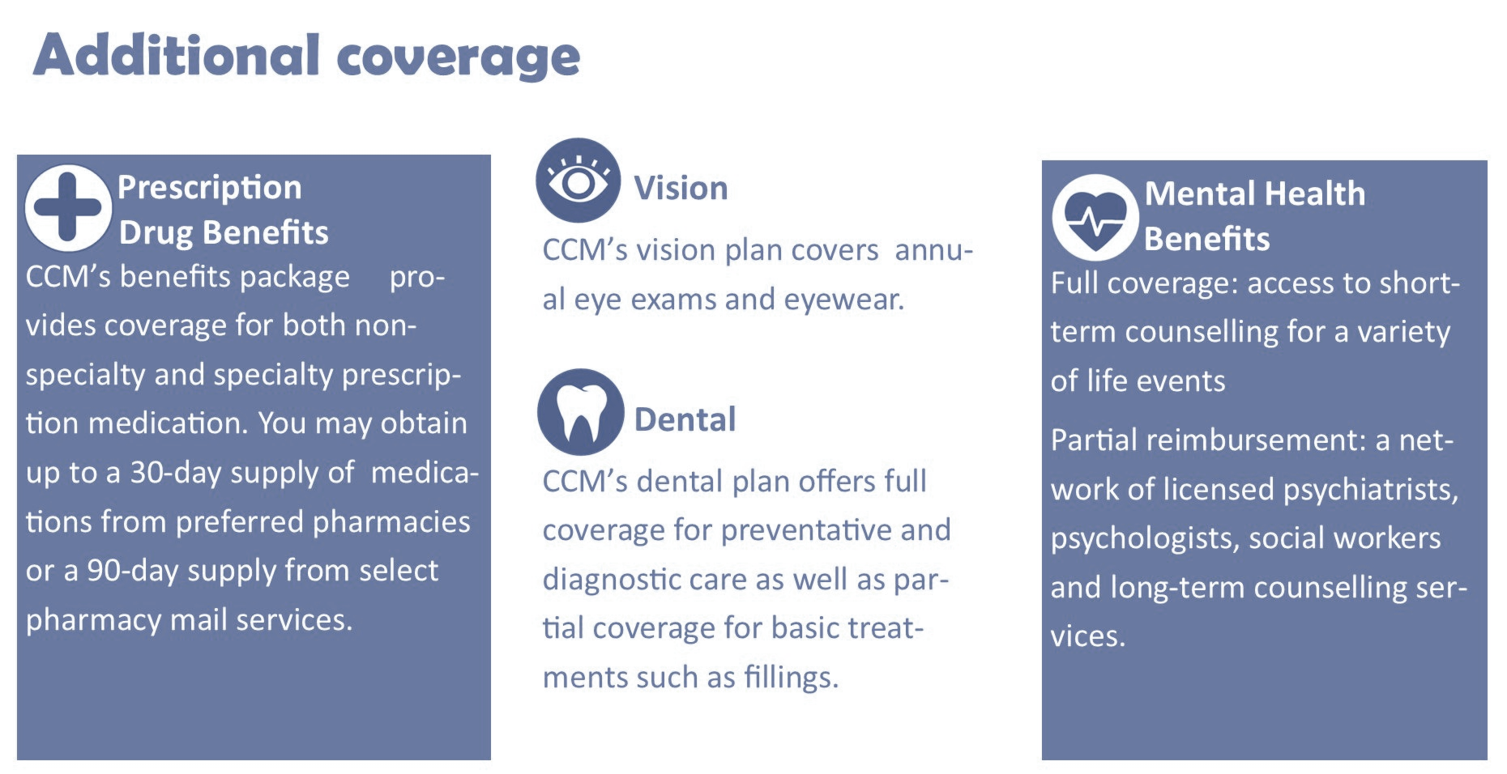
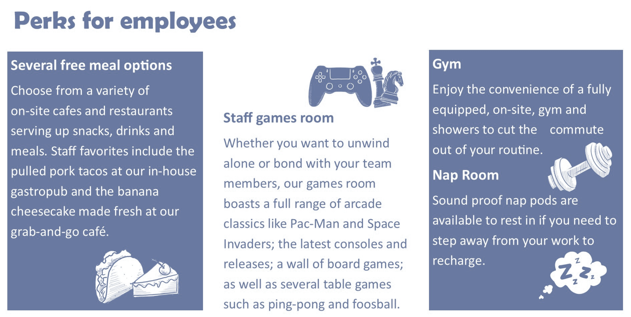
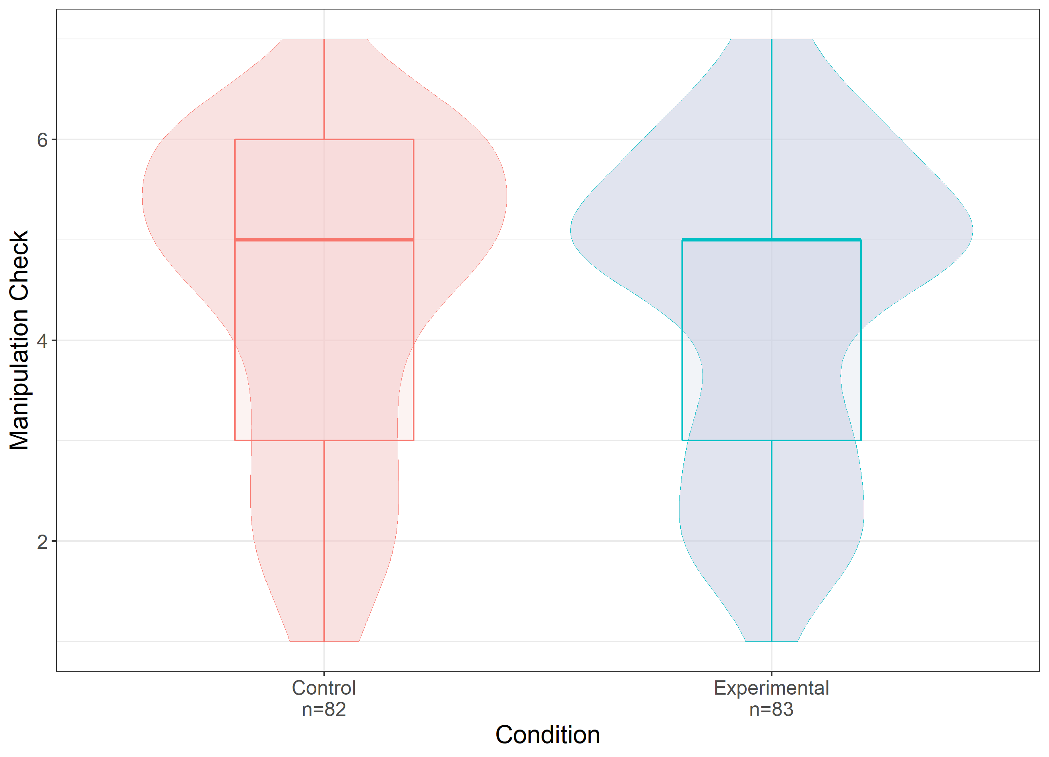
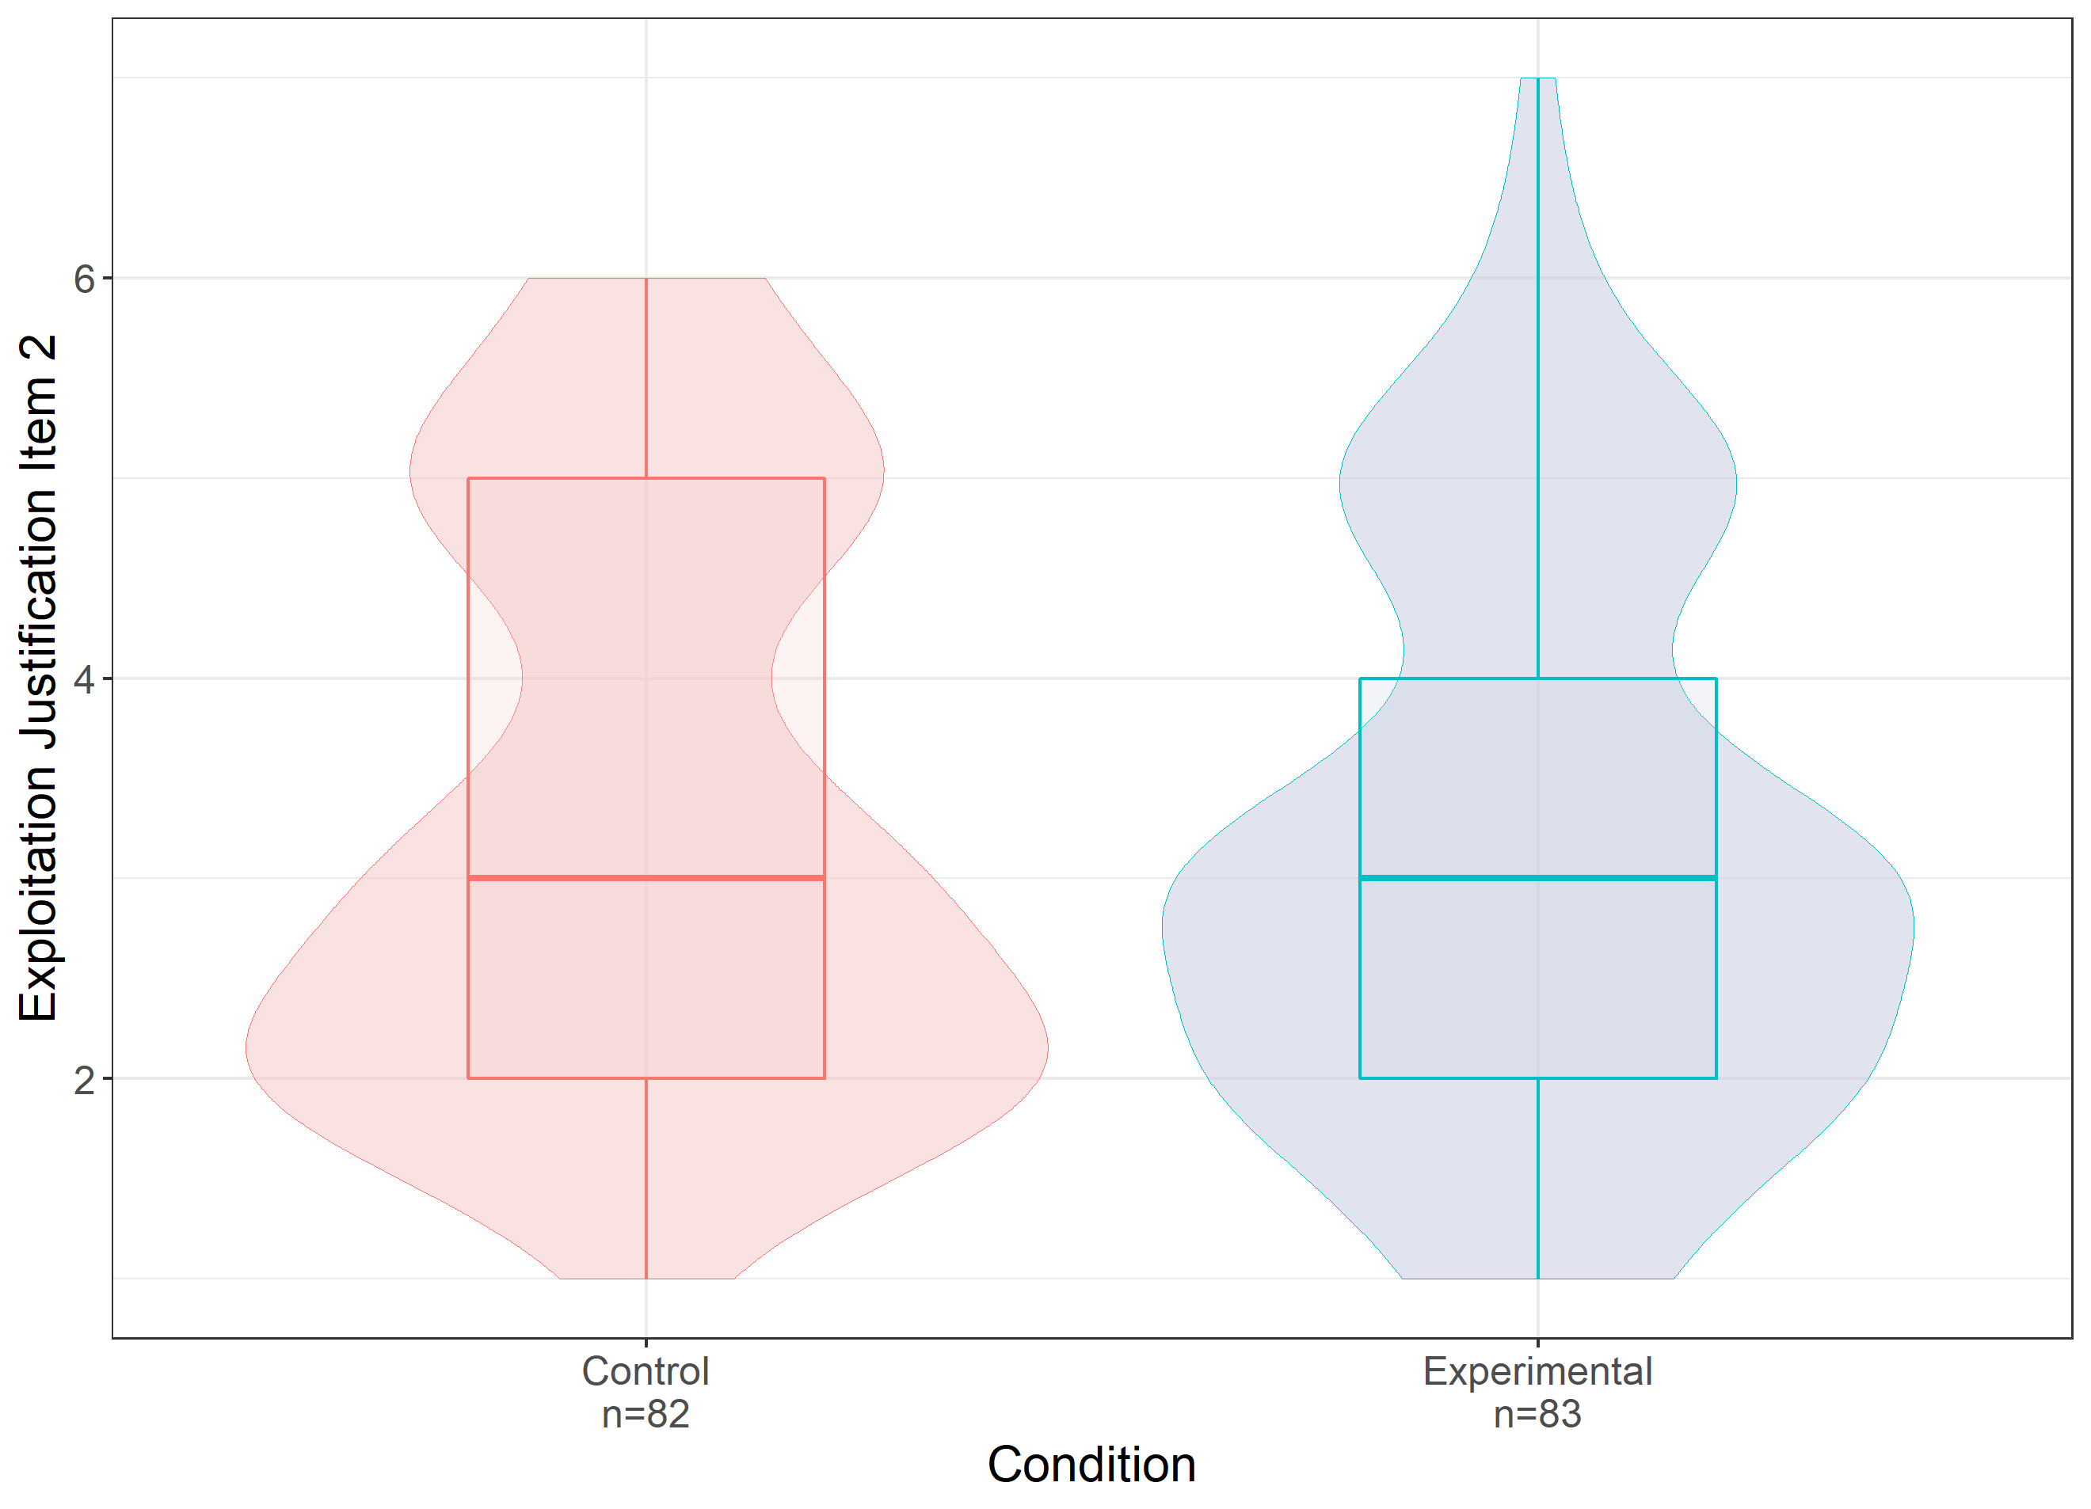
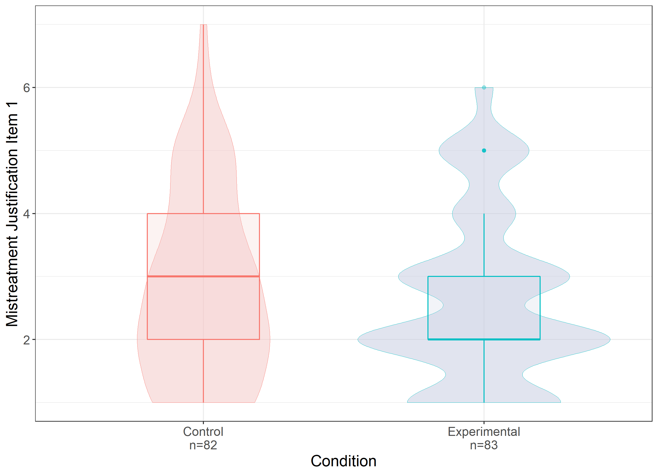
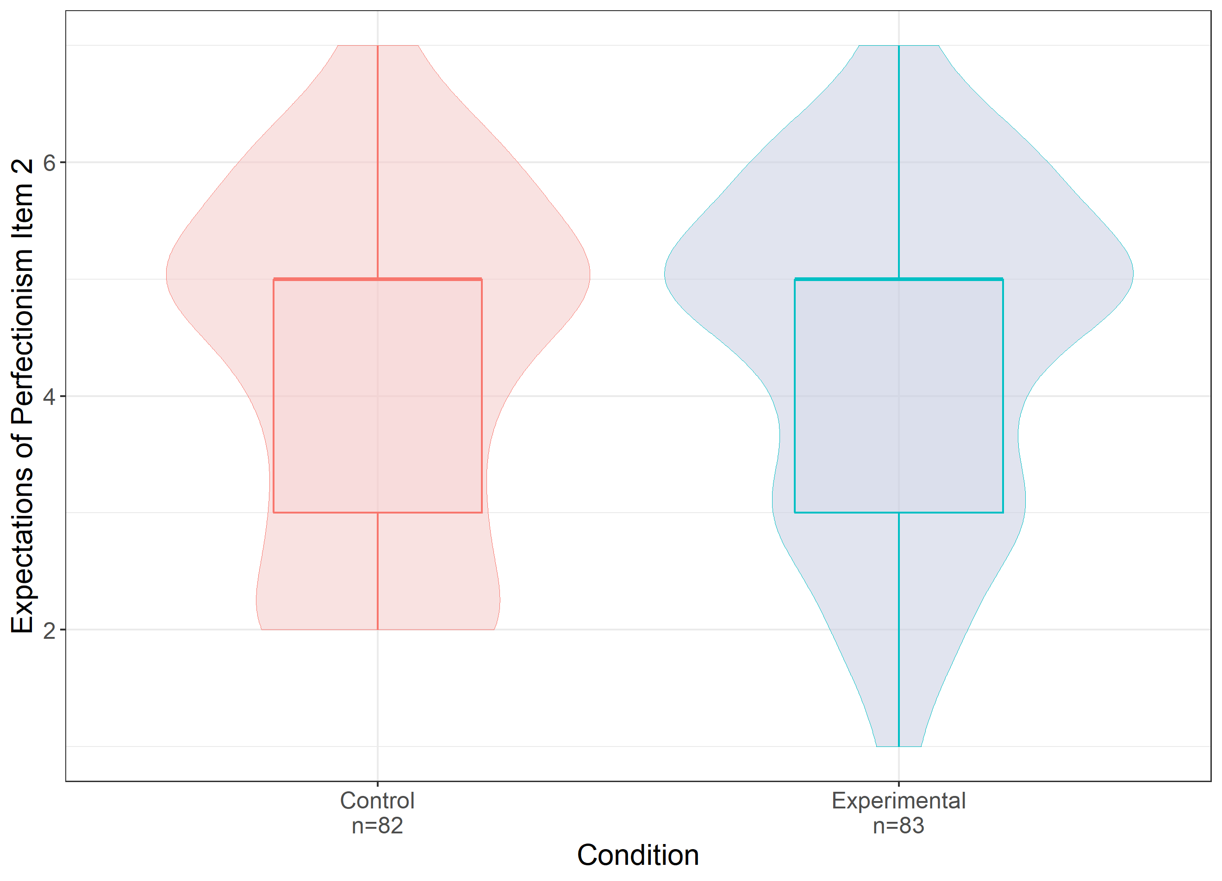
Employee Prioritization or Exploitation?
What Extravagant Perks Say About Organizational Culture in the Modern Workplace
Elizabeth Cyr (1), Dr. William Hall (2)
Psychology Department, Brock University
Theoretical Foundations
Methodology
Organizational Culture
Introduce Participants to a fake tech company and employee
Participants in the control condition are taught about the company's standard employee benefits (e.g., dental) while those in the experimental condition are shown that the company provides its employees with exciting perks such as an in-house pub, a games room, an on-site staff gym and an employee nap room.
Stories involving employee mistreatment at the company are presented
Shared beliefs, values and assumptions
Determine the norms and patterns of behaviour that develop in an organizations (Johns & Saks, 2020)
Flexibility
“A manager at CCM is sick, and no one from management can fill in. John is asked to take over the manager's duties until they come back... without compensation”
CLAN
ADHOCRACY
“John works as a software developer for a San Francisco based tech company called CCM as a software developer…”
“The following two pages briefly describe some of the perks and benefits offered to employees of CCM…”
Control
Experimental
The Competing Values Framework
Internal Focus
External Focus
Diagnoses a company culture as one of four. Relevant to this study are Clan culture and Adhocracy. Modern workplaces use cool perks and offices to signal that they prioritize employee well-being, which would be indicative of a clan culture. Despite this they are often diagnosed as otherwise base on their needs.
Measures are scored on 7-point Likert Scales
HIERARCHY
MARKET
“CCM is behaving reasonably in asking John to take over these duties.”
Please rank how strongly you agree:
1= Strongly disagree – 7 = Strongly Agree
Stability
System Justification Theory
Findings
Conclusions and Implications
See a company from the outside
Notice fun perks/ modern style → from positive perception of it
Want to maintain positive perception
Defend perception in face of threats (mistreatment)
Manipulation Check
H1: Exploitation Justification
Insignificant difference in means for the manipulation check between conditions
Suggests our manipulation was ineffective
A relationship does exist between clan culture signalling and justification of unfair expectations put on employees
Provides explanation for justification of exploitation in tech
Builds on Organizational Culture literature
Speaks to the impact of misleading culture signaling
Adds to workplace perk literature
Bulk of perk research studies positive outcomes so this provides a balancing perspective
Informs prospective employees seeking new employers
Learning to accurately identify an organizations culture
Hypotheses
H1
Clan culture perk
Justification of Exploitation
H2
Clan culture perk
Justification of Mistreatment
H2: Mistreatment Justification
H3: Expectations of Perfectionism
H3
Clan culture perk
Expectations of Perfectionism
Key Variable Definitions
Limitations and Future Directions
IV
A perk offered by a company that is novel and fun (e.g., staff gym)
Ineffective manipulation due to subtle delivery→
Delivery of IV through more direct means than brochure
Measure of DV’s through more direct means than vignettes
Sample not reflective of individuals working in the tech sector. It was more female, younger and predominantly educated in fields other than math and computer science
Collect from a more representative sample
Mechanical Turk to access employed adults
Stack Overflow to access tech employees, ideally managers
Clan culture perk :
DV
Exploitation :
Unfairly compensated tasks and/or beyond job scope
Mistreatment :
Unfair or demeaning treatment from superior
No significant difference in perception of perks between conditions (t(163) = 0.27, p = 0.79)
No significant difference in justification of exploitation (t(163) = 0.93, p = 0.35), justification of mistreatment (t(163) = 0.7, p = 0.49) or expectations of perfectionism (t(163) = -0.57, p = 0.57) between conditions .
Correlational analysis of all outcome variables found relationships between:
Manipulation check and expectations of perfectionism (r = 0.32, p<.01)
Manipulation check and expectations of gratitude (r=0.39, p<.01)
Perception of CCM as a fun place and:
Exploitation legitimization (r=.24, p<.01)
Mistreatment legitimization (r=.23, p<.01)
Expectation of perfectionism (r=.21, p<.01)
Belief that CCM cares about its employees well being and:
Exploitation legitimization (r=.35, p<.01)
Mistreatment legitimization (r=.35, p<.01)
Expectation of perfectionism (r=.21, p<.01)
Perfectionism :
Unreasonably high work standards
Sample
165 Brock University students (M_{age} = 19.36, SD_{age} = 1.99, 82.6% Female), were recruited over SONA and compensated with class credit. The majority of this sample studied Social Science (35%) and Health Science (32%).
Control: n=82 Experimental: n=83
Social Sciences (35%)
References
Health Sciences (32%)
Kim, C. S., & Quinn, R., E. (2000). Diagnosing and Changing Organizational Culture: Based on the Competing Values Framework. San Francisco, CA: John Wiley & Sons.
Johns, G., & Saks, A. M. (2020). Organizational behaviour: Understanding and managing life at work (11 ed.). North York, Ontario: Pearson Canada.
Jost, J. T., Banaji, M. R., & Nosek, B. A. (2004). A decade of system justification theory: Accumulated evidence of conscious and unconscious bolstering of the status quo. Political Psychology, 25(6), 881-919. doi:10.1111/j.1467-9221.2004.00402.x
Kim, J. Y., Campbell, T. H., Shepherd, S., & Kay, A. C. (2020). Understanding contemporary forms of exploitation: Attributions of passion serve to legitimize the poor treatment of workers. Journal of Personality and Social Psychology, 118(1), 121-148. doi:10.1037/pspi0000190
Tharani, A. (2020). ‘Googleplex Cultures’: A Marxist analysis of Silicon Valley workplace cultures. Crossing Borders, 2(1), 1-4. doi:10.31542/cb.v2i1.1995
Education (18%)
Mathematics and Science (5%)
>20 years old (69%)
20-25 years old (31%)
Female (83%)
Male (17%)
Notes:
This focus of this study was understanding how cues of a company's culture, which is the shared beliefs, values and assumptions, impact the way outsiders perceive employee treatment within. Namely, we wanted to see if people were more likely to justify mistreatment and exploitation within an organization if they had previously encountered information that suggested the company treated it’s employees well and prioritized their well-being. The competing values framework suggests that companies have to prioritize certain values over others such as focusing inwards on employee well being versus outward on their market and customers.
System justification theory suggests that if a company were to present a signal that they prioritize employee well being, the observer would use that information to form their perception of the company and remain motivated to protect that image in the face of contradicting information such as instances of employee mistreatment in the name of productivity.
We hypothesized that if a participant observed a modern culture signal, in this case clan culture perks, they would be more likely to justify instances of exploitation, mistreatment and unfair expectations observed towards employees of the company to protect their positive image.
To quickly define these terms, a clan culture perk is A perk offered by a company that is novel and fun (e.g., staff gym) and signals to outsiders that the company has a clan culture which prioritizes it’s employees. Exploitation is Unfairly compensated tasks and/or beyond job scope, mistreatment is Unfair or demeaning treatment from superior and expectations of perfectionism are when a superior holds unreasonably high work standards for their employees.
We studied this on a sample of 165 University students which were notably, predominantly young, female and studying Social Science (35%) and Health Science (32%).
To study this we chose to use an industry that has remained at the forefront of workplace modernization which is technology. We introduces participants to a fake tech company and an employee, john, who works there as a software engineer. We then showed participants brochures containing information on the benefits available to employees at the company, CCM. Those in the control condition were shown typical perks such as dental and vision coverage while those in the control condition were shown how CCM has free on-site pubs, a games room, a gym and a nap room for it’s employees. Then all participants read through stories of instances of mistreatment and exploitation as CCM and asked to rate how strongly they felt the treatment of employees was justified.
Ultimately there were no significant differences in justification of any measure between conditions however our manipulation check showed that the manipulation was unsuccessful so this comes as no surprise.
More importantly, correlational analysis of the perception of CCM as a fun place to work and as one that cares about it’s employees were strongly linked to greater justification of every signal negative outcome for employees.
As such, while our manipulation was ineffective, a relationship does exist between signaling positive organizational culture and justification of poor treatment of employees. This provides a potential explanation for why the rampant exploitation and mistreatment of computer scientists is often justified as par for the course. It also built on IO research that has largely focused on the benefits of perks and failed to look at potential downsides. Most importantly these findings that better inform future employees on how to look past external signals of culture to avoid pitfalls of falling into exploitative situations.
In future studies we shall need to develop manipulations of perceived organizational culture with greater internal validity and perhaps use correlational studies in the mean time to studies these relationships. Additionally, these studies should focus on samples that better represent the population at hand, in this case the sample did not reflect the tech industry references in our material and this may have led to some participants having a harder time connecting with the scenarios.

