Slide 1
Process Mining Tutorial
Adapted from fluxicon.com/academic/material/
Edited by Andrea Vandin, SSSA

Slide 2
Goals of this tutorial
Understand the phases of process mining analysis
Be able to get started and play around with your own data
2

Slide 3
Outline
0. What is Process mining?
Example Scenario
Roadmap
Hands-on Session
Take-away Points
3

Slide 4
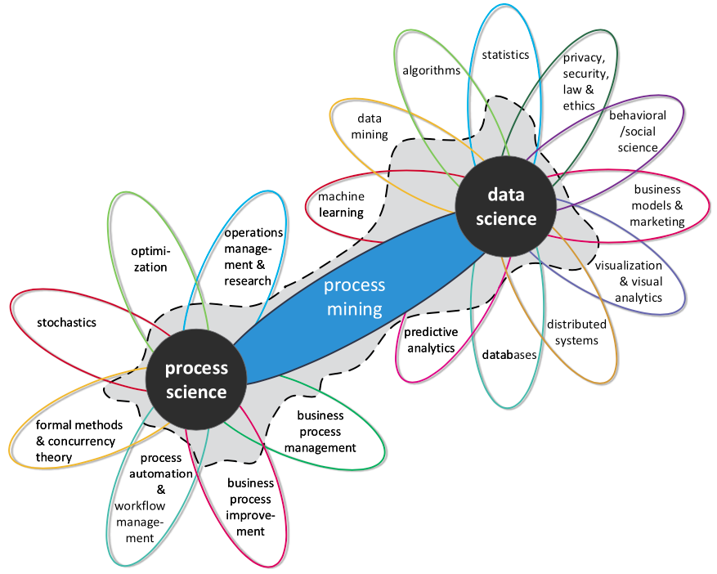
What is Process Mining?
Process mining is a family of techniques linking data science and process management to support the analysis of operational processes based on event logs.
The goal of process mining is to turn event data into insights and actions. Process mining is an integral part of data science, fueled by the availability of data and the desire to improve processes.
E.g., process mining uses event data to automatically discover a process model by observing events recorded by some enterprise system
Van Der Aalst, W., et al. (2011, August).
Process mining manifesto. In International Conference on Business Process Management (pp. 169-194). Springer
Notes:
Van Der Aalst, W. (2012). Process mining: Overview and opportunities. ACM Transactions on Management Information Systems (TMIS), 3(2), 1-17.

Slide 5
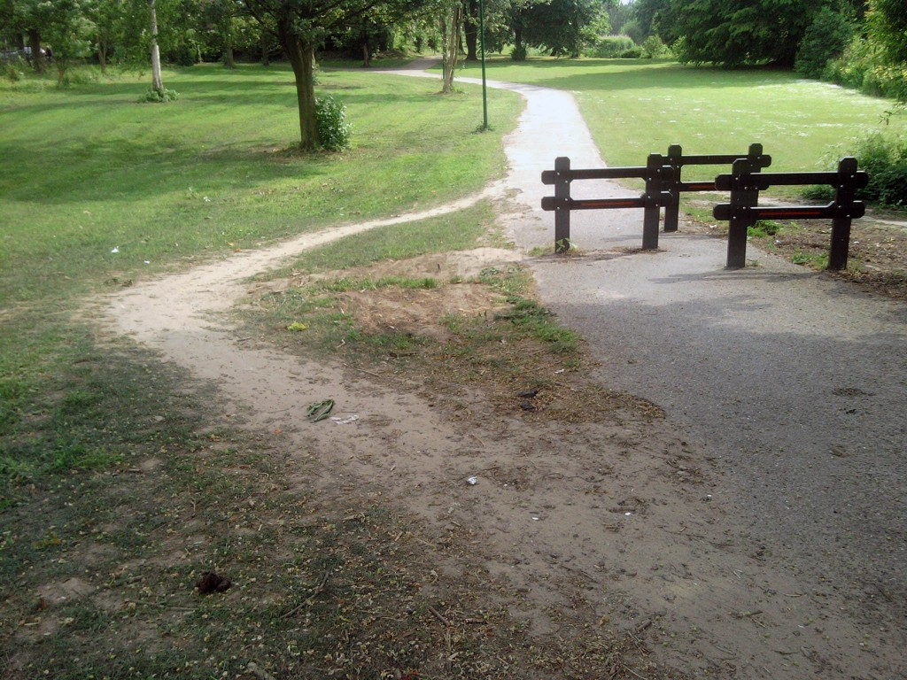
What can we do with Process Mining?
With PM we can find the actual process is different from the one we designed!
Picture by Koen Olsthoorn
Notes:
http://www.olifantenpaadjes.nl/wp-content/uploads/2011/06/Koen-Olsthoorn.jpg

Slide 6

What can we do with Process Mining?
With PM we can find the actual process is different from the one we designed!
Picture by Koen Olsthoorn
Our traces are the process logs…
Notes:
http://www.olifantenpaadjes.nl/wp-content/uploads/2011/06/Koen-Olsthoorn.jpg

Slide 7
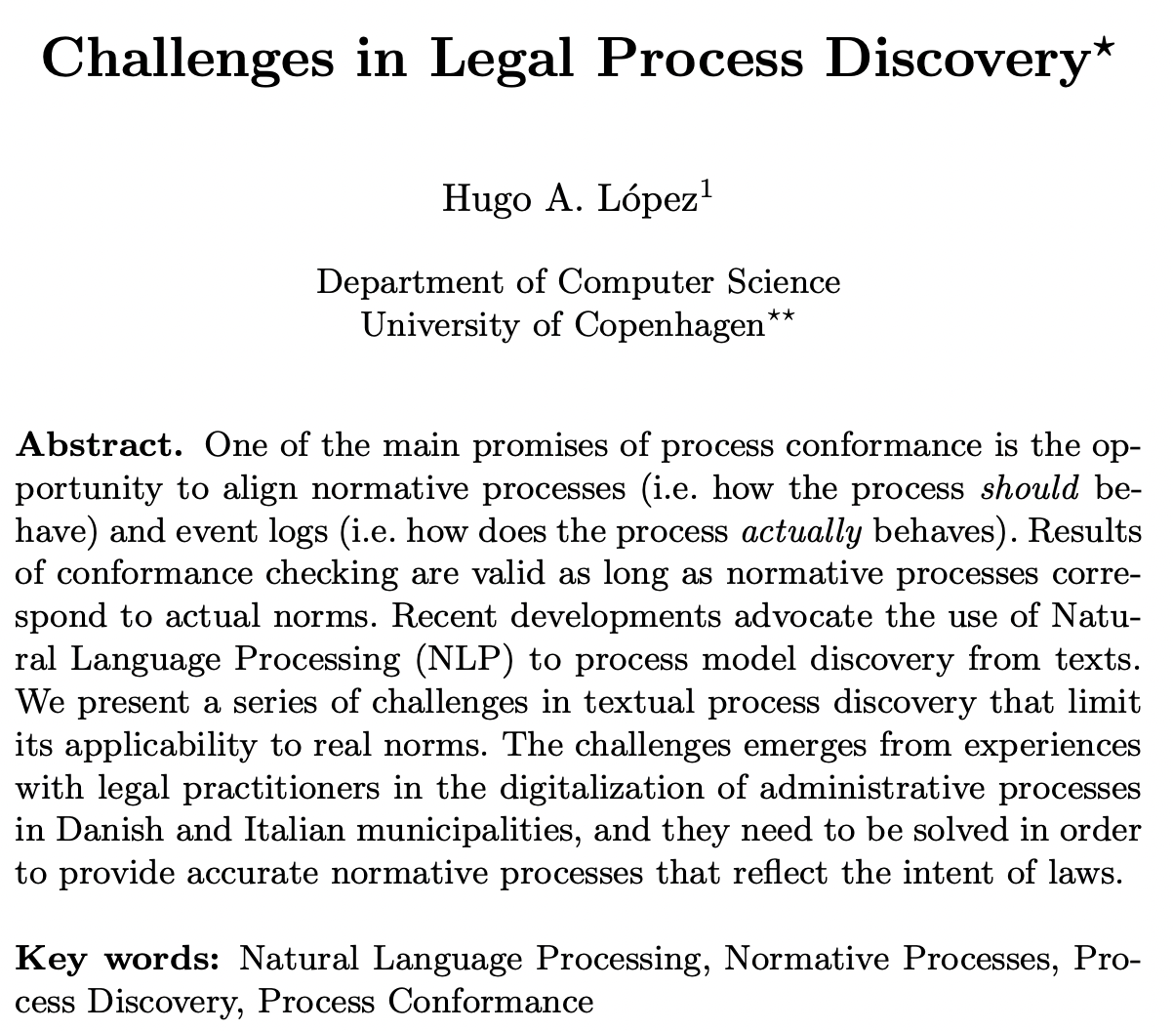
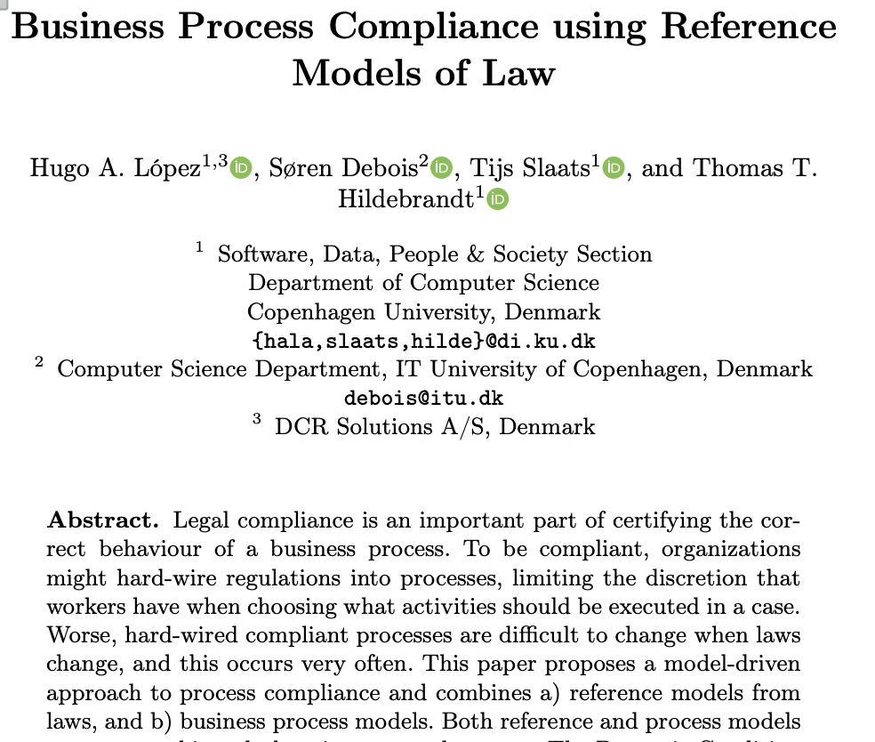
We will see a simple example (purchasing process)
However, PM has been applied to several domains, e.g., the legal one
The process of a law?
Does my process comply with law?
Picture by Koen Olsthoorn
Notes:
http://www.olifantenpaadjes.nl/wp-content/uploads/2011/06/Koen-Olsthoorn.jpg

Slide 8
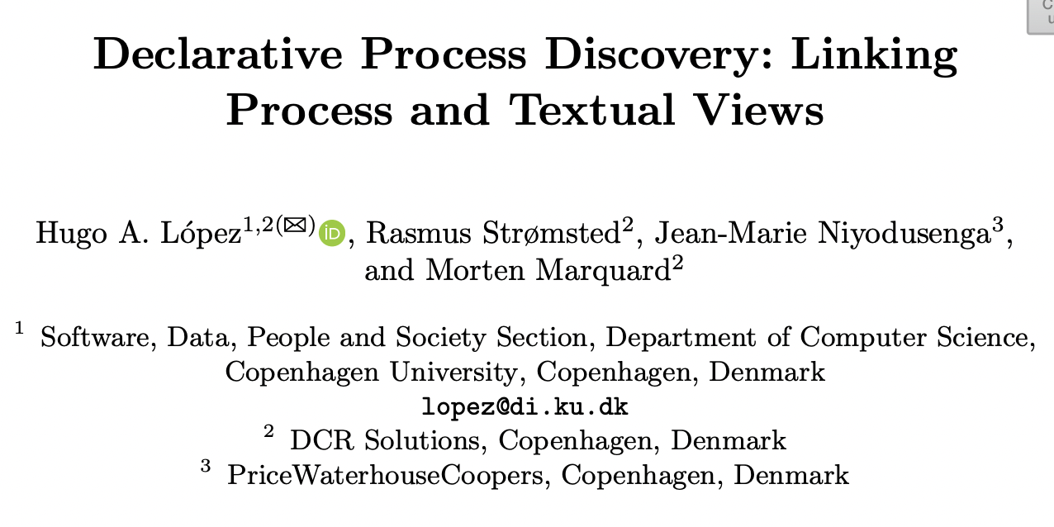
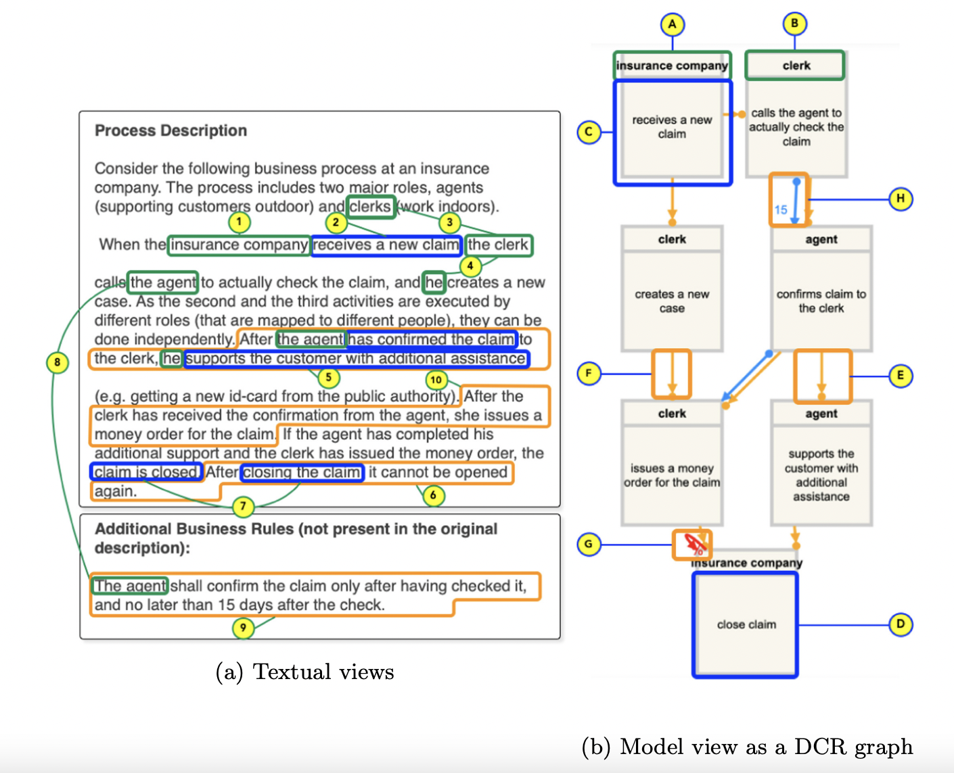
We will see a simple example (purchasing process)
However, PM has been applied to several domains, e.g., the legal one
Picture by Koen Olsthoorn
Notes:
http://www.olifantenpaadjes.nl/wp-content/uploads/2011/06/Koen-Olsthoorn.jpg

Slide 9
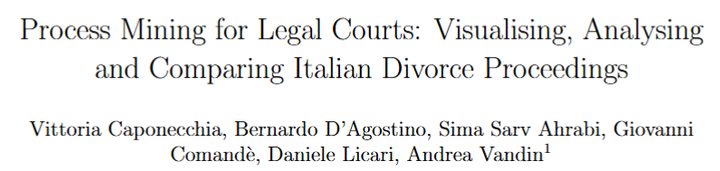
We will see a simple example (purchasing process)
However, PM has been applied to several domains, e.g., the legal one
How efficient is my law court?
Picture by Koen Olsthoorn
Notes:
http://www.olifantenpaadjes.nl/wp-content/uploads/2011/06/Koen-Olsthoorn.jpg

Slide 10
We will see a simple example (purchasing process)
However, PM has been applied to several domains, e.g., the legal one
How efficient is my law court?
Picture by Koen Olsthoorn
Notes:
http://www.olifantenpaadjes.nl/wp-content/uploads/2011/06/Koen-Olsthoorn.jpg

Slide 11
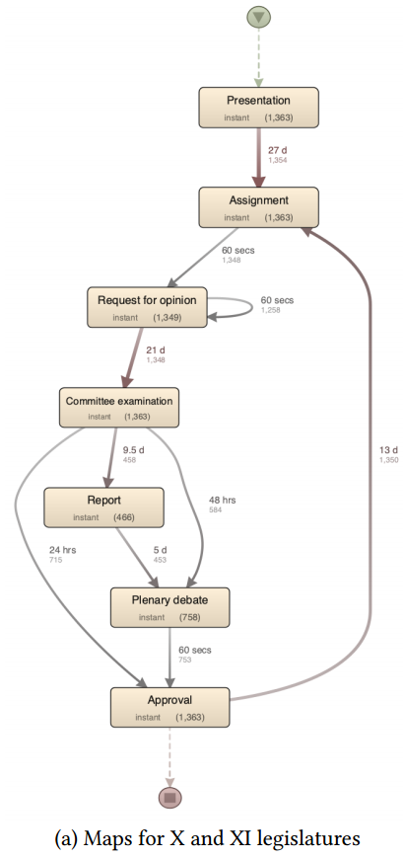
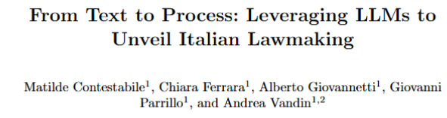
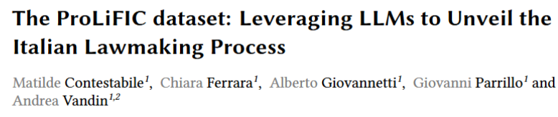
We will see a simple example (purchasing process)
However, PM has been applied to several domains, e.g., the legal one
How does the Italian parliament work?
Picture by Koen Olsthoorn
Notes:
http://www.olifantenpaadjes.nl/wp-content/uploads/2011/06/Koen-Olsthoorn.jpg

Slide 12
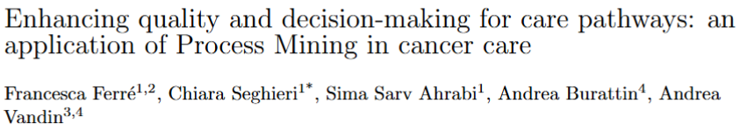
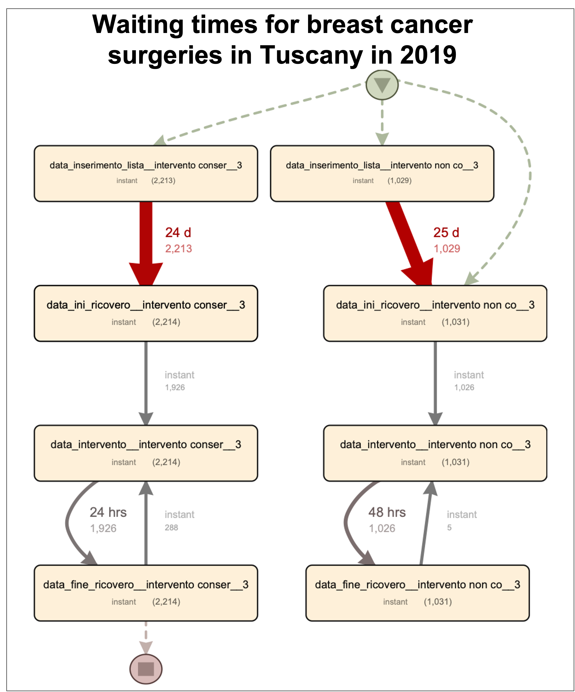
We will see a simple example (purchasing process)
However, PM has been applied to several domains, e.g., the healthcare one
Picture by Koen Olsthoorn
Notes:
http://www.olifantenpaadjes.nl/wp-content/uploads/2011/06/Koen-Olsthoorn.jpg

Slide 13
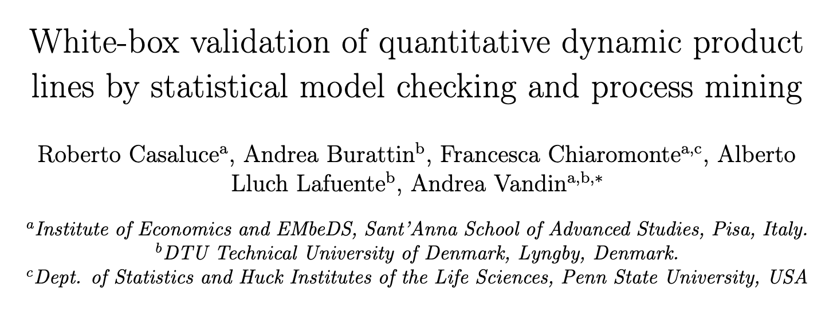
We will see a simple example (purchasing process)
However, PM has been applied to several domains, e.g., the security one
Picture by Koen Olsthoorn
Notes:
http://www.olifantenpaadjes.nl/wp-content/uploads/2011/06/Koen-Olsthoorn.jpg

Slide 14
Outline
0. What is Process mining?
Example Scenario
Roadmap
Hands-on Session
Take-away Points
14

Slide 15





Example Scenario
Purchasing process
ERP
Requester
Requester
Manager
Purchasing
Agent
Supplier
Financial
Manager
15

Slide 16
Problems
Inefficient operations
Need to demonstrate compliance
Complaints about process duration
16

Slide 17
Analysis Goals
Understand the process in detail
Check whether there are deviations from the payment guidelines
Control performance targets
    Complete process in at most 21 days
17

Slide 18
Outline
0. What is Process mining?
Example Scenario
Roadmap
Hands-on Session
Take-away Points
18

Slide 19

Roadmap
Determine questions
Process scope
Which IT systems
Via DB administrator
CSV file or database extract
Extract ‘As-is’ process
Answer questions
Present results (e.g., report, presentation, workshop etc.)
19

Slide 20
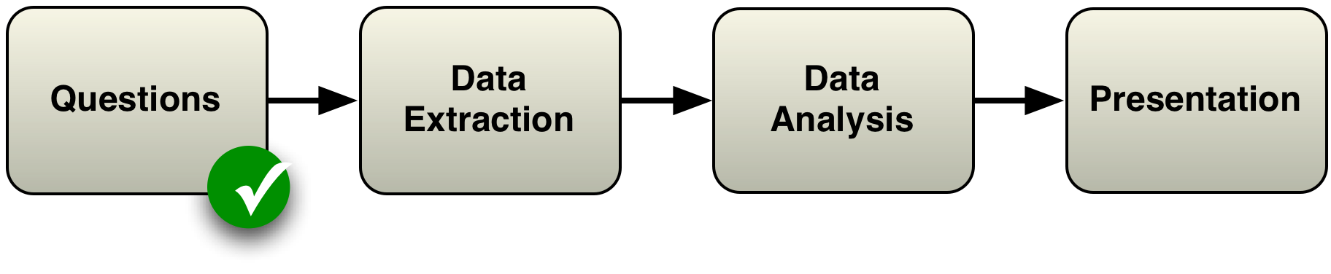
Roadmap
    How does the process actually look like?
    Are there deviations from the prescribed process?
    Do we meet the performance targets?
20

Slide 21
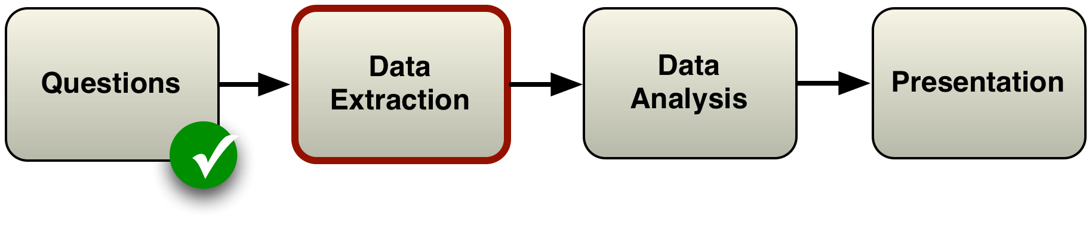
Roadmap
21

Slide 22

Data Extraction
IT staff extracts history logs (from the Enterprise Resource Planning system, ERP) in a CSV file
Such CSV file is the starting point for our tutorial
Please download it from our wiki (Slides page)
Or here: PurchaseExample.csv
ERP
CSV
Data
22

Slide 23
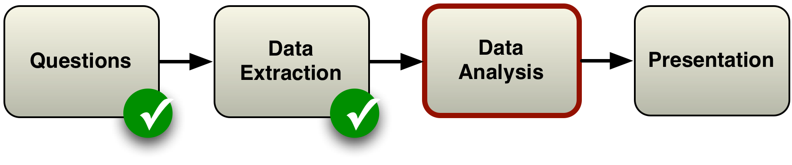
Roadmap
23

Slide 24
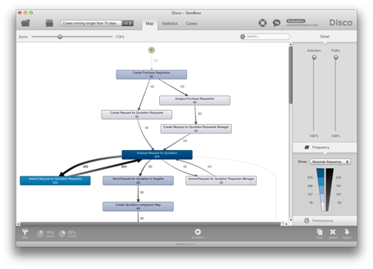
Data Analysis
We use the process mining tool Disco to perform the data analysis
CSV
Data
Download from fluxicon.com/disco
Sant’Anna is Academic Partner: free license with @santannapisa.it email
24

Slide 25

Roadmap
Focus of this session
25

Slide 26
Outline
0. What is Process mining?
Example Scenario
Roadmap
Hands-on Session
Take-away Points
26

Slide 27
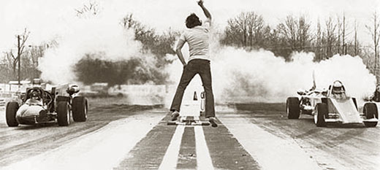
Hands-on Session
Let’s get started!
27

Slide 28
Step 1 - Inspect Data
Open PurchasingExample.csv file in python/pandas (or Excel) and inspect its contents
  Every row corresponds to one event
  You find information on Case IDs, Activities, Start and end times, Resources, Roles
28

Slide 29
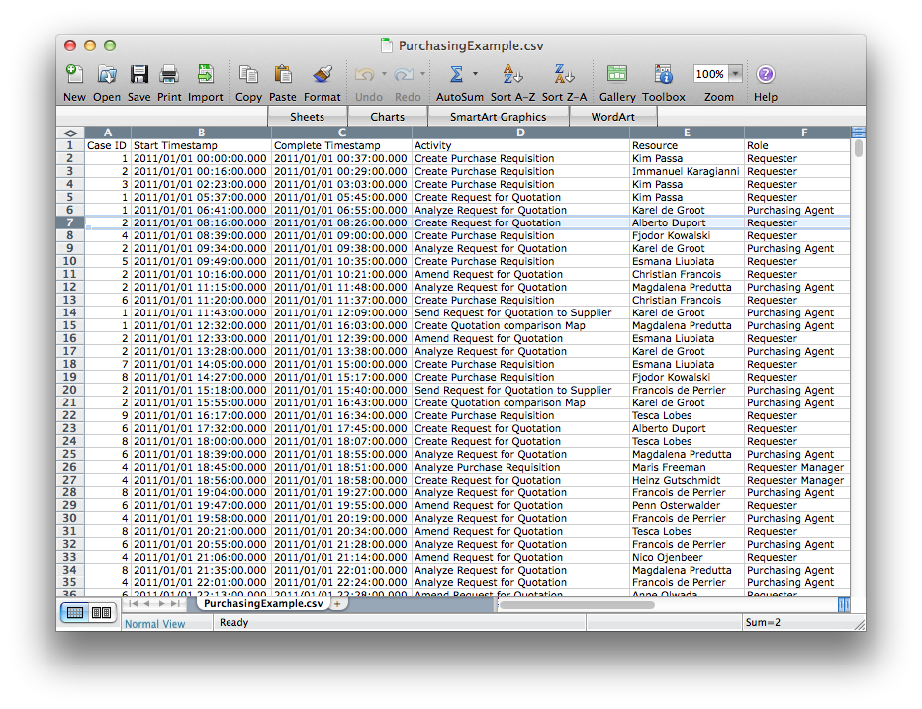
If using excel…
29

Slide 30
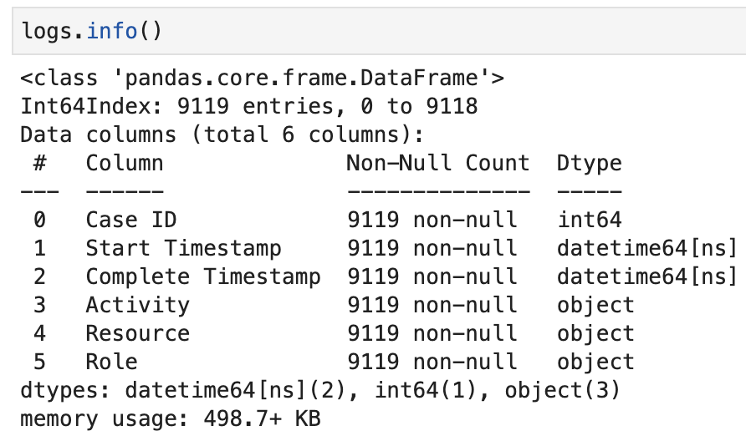
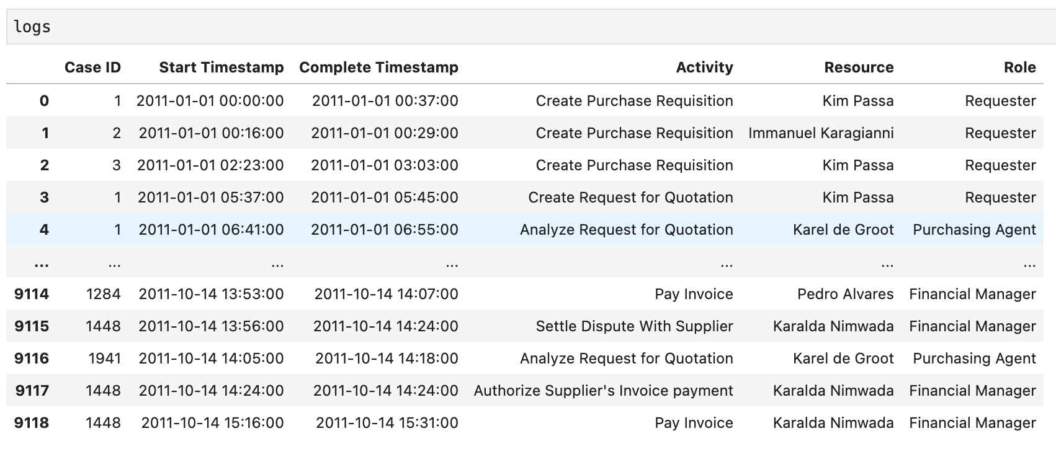
If using pandas (python)…
30

Slide 31
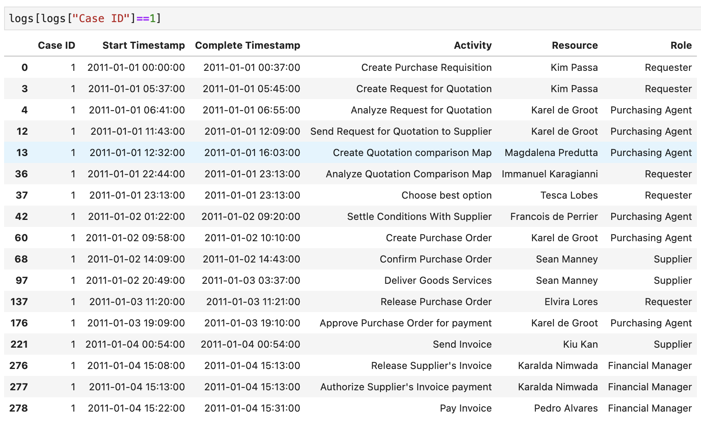
If using pandas (python)…

Slide 32
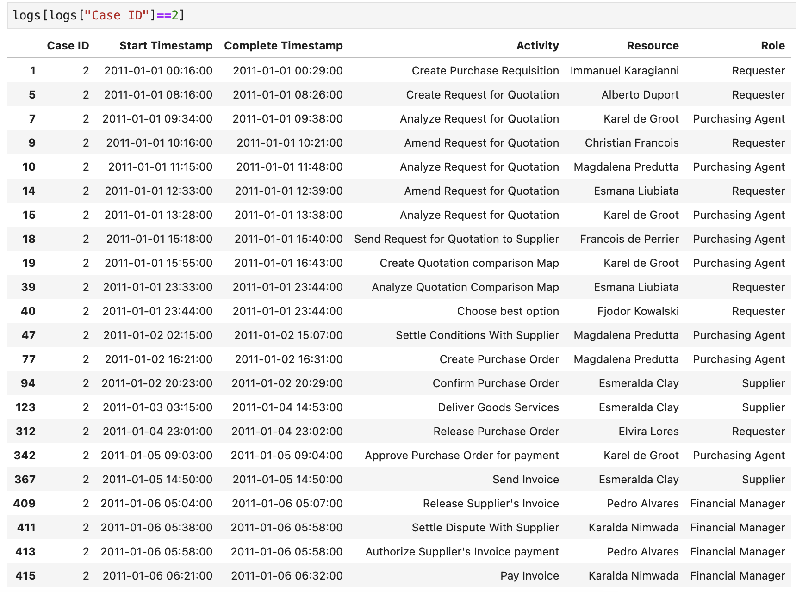
If using pandas (python)…

Slide 33
Step 2 - Import Data
Load PurchasingExample.csv in Disco
Assign columns as follows:
    Case ID ➞ Case ID
    Start and Complete Timestamp ➞ Timestamp
    Activity ➞ Activity
    Resource ➞ Resource
    Role ➞ Other
Click ‘Start import’
33

Slide 34
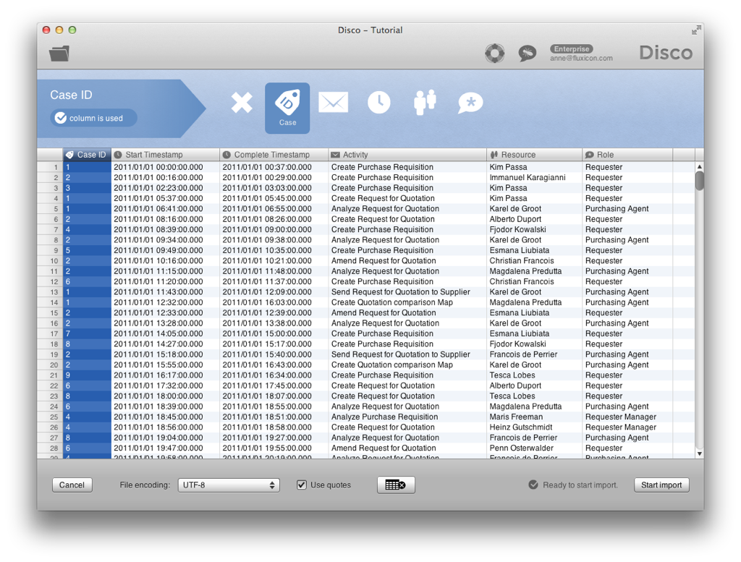
34

Slide 35
Step 3 - Inspect Process
Look at the resulting process model
    Numbers in rectangles are activity frequencies
    Number at arcs is frequency of connection
→ You see the main process flows
    All 608 cases start with activity ‘Create Purchase Requisition’
    Lots of changes were made (amendments)!
35

Slide 36
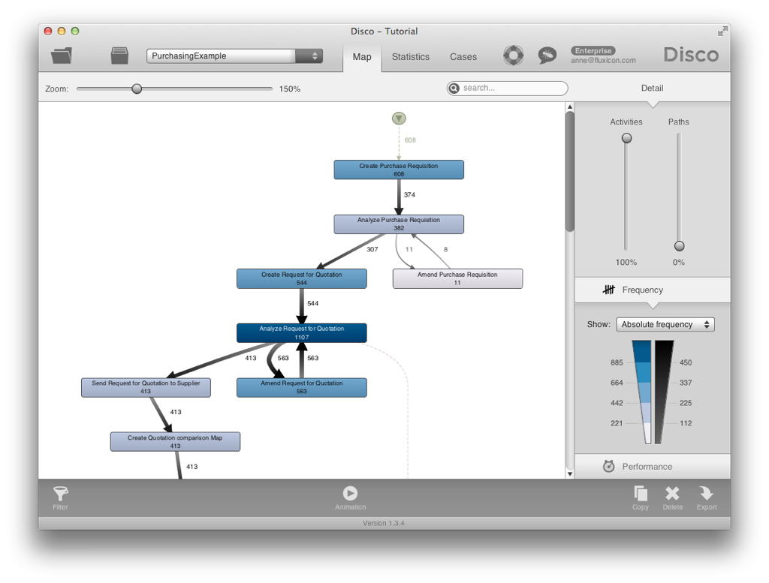
Start point
36

Slide 37
Step 3 - Inspect Process
It’s important to be able to adjust the level of detail for the process map
Move up the ‘Activities’ slider down to lowest position (0%)
    Only the activities from the most frequent process variant are shown
37

Slide 38
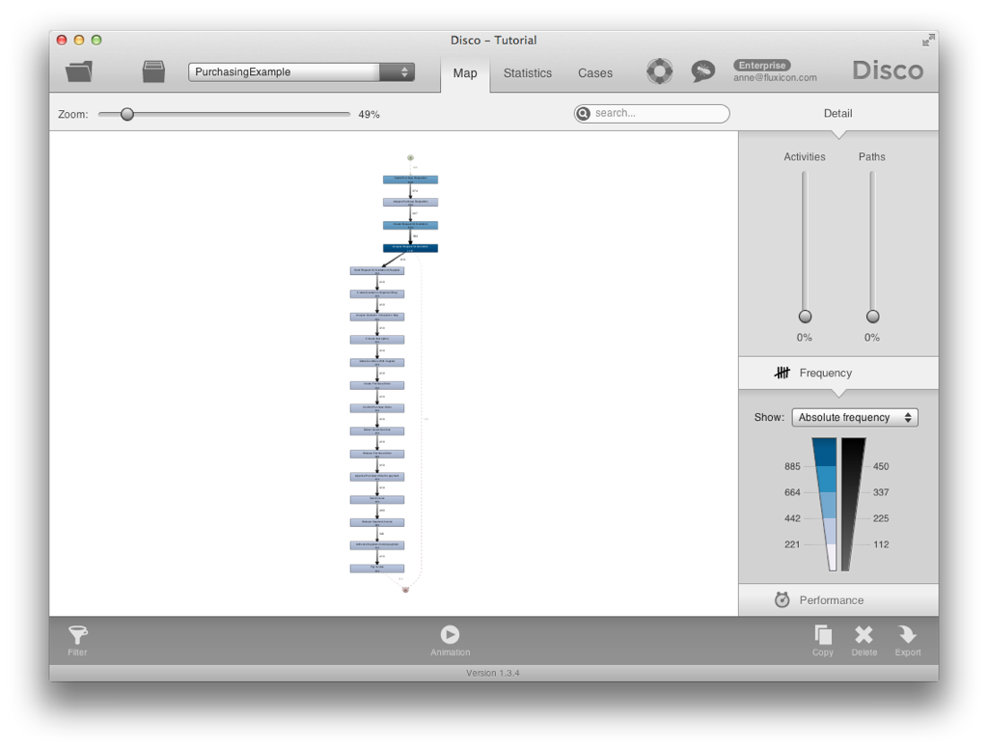
38

Slide 39
Step 3 - Inspect Process
Gradually move the ‘Activities’ slider up to 100% again until all activities are shown
    Even infrequent activities such as ‘Amend Purchase Requisition’ are shown
You’ll notice that 11 cases are flowing in to ‘Amend Purchase Requisition’ but only 8 are moving out - Where are the other 3?
39

Slide 40
40

Slide 41
Step 3 - Inspect Process
Move up the ‘Paths’ slider up to the top
You now see a 100% detailed picture of the executed process
    The 3 missing cases move from ‘Amend Purchase Requisition’ to ‘Create Request for Quotation’
41

Slide 42
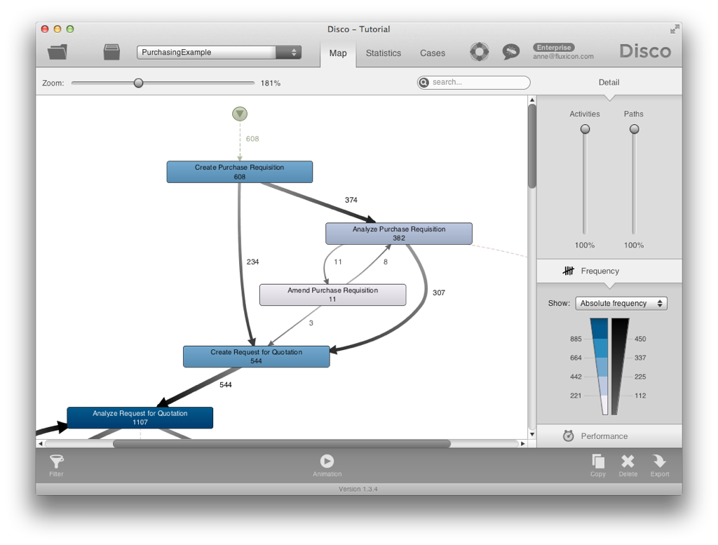
42

Slide 43
Step 4 - Inspect Statistics
Look at ‘Statistics’ tab to see ‘Overview’ information about the event log
    9,119 events were recorded for 608 cases
    Timeframe is January - October 2011
The ‘Case duration’ is typically up to 15 or 16 days, but some cases take very long (more than 70 or 80 days!)
43

Slide 44
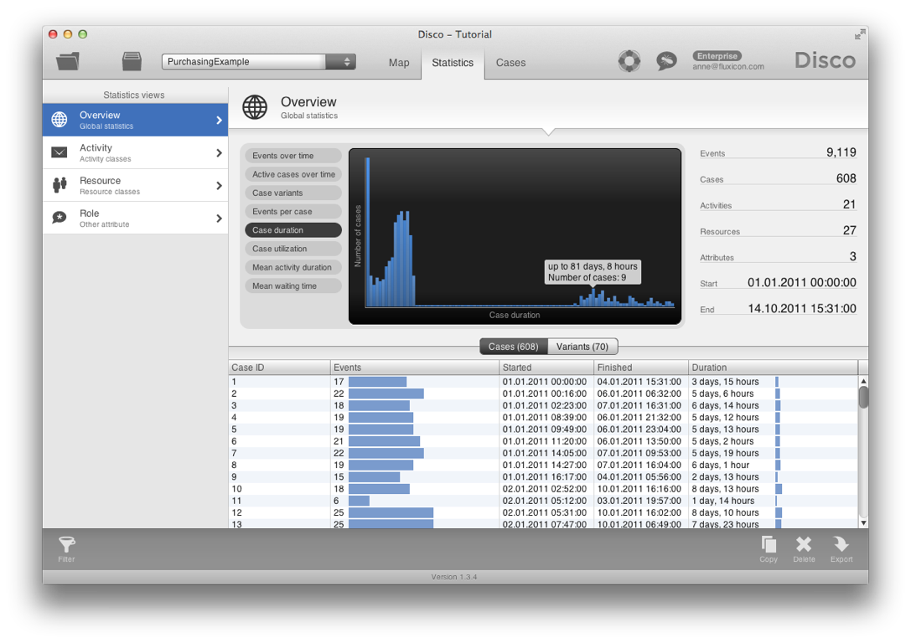
44

Slide 45
Step 5 - Inspect Cases
Select ‘Cases’ tab to inspect variants and individual service instances
    The third most frequent process variant ends after ‘Analyze Purchase Requisition’ (ca. 10.36% of all cases follow this pattern)
→ Why are so many requests abrupted?
    Do people not know what they can buy?
    We can find this back in the process map, too
45

Slide 46
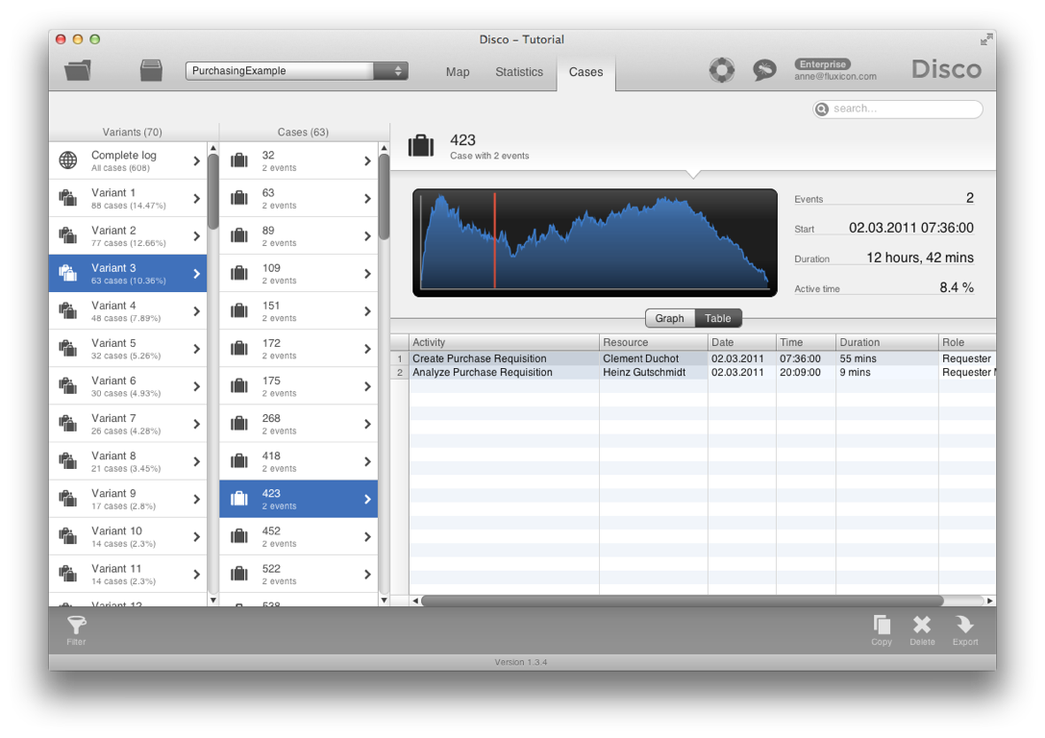
46

Slide 47
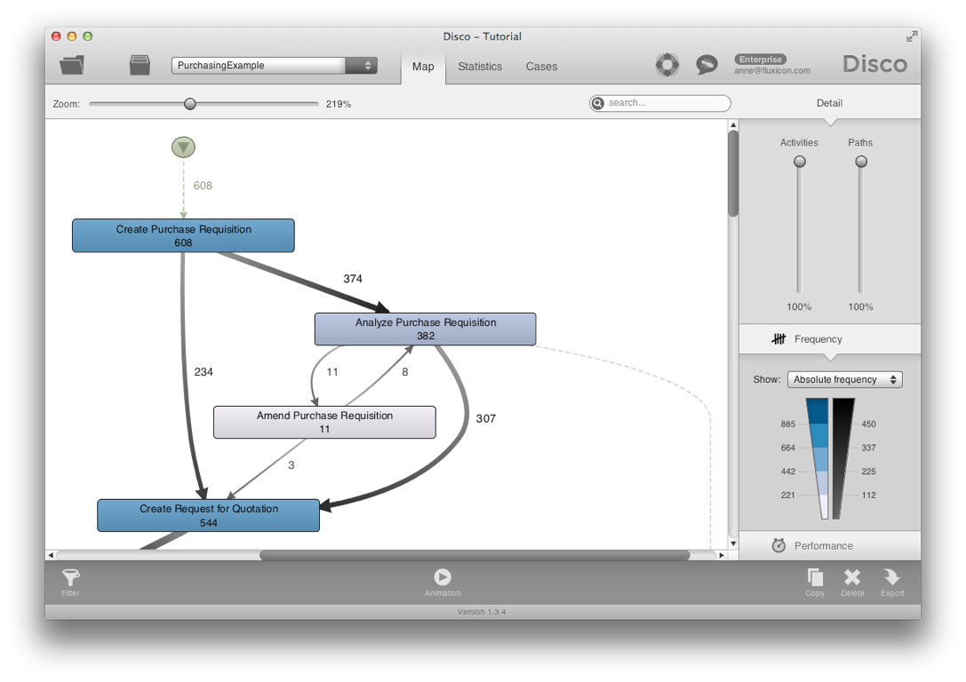
Leading to
End point
47

Slide 48

Results so far...
Original Questions:
    How does the process actually look like?
        Objective process map discovered
        Lots of amendments and stopped requests: Update of purchasing guidelines needed
    Are there deviations from the prescribed process?
    Do we meet the performance targets?
        Not by all (some take longer than 21 days):
        Is there a bottleneck in the process? -> Next
48

Slide 49
Step 6 - Filter on Performance
Click on the Filter symbol in the lower left corner and add a Performance filter
    Select 21 days as lower boundary
    You’ll see that ca. 15% of the purchase orders take longer than 21 days
Press ‘Apply filter’ to focus only on those cases that take longer than 21 days
49

Slide 50
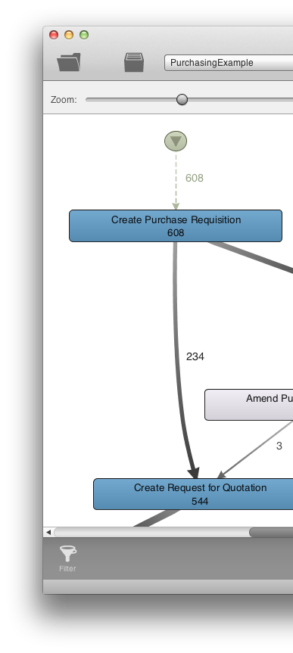
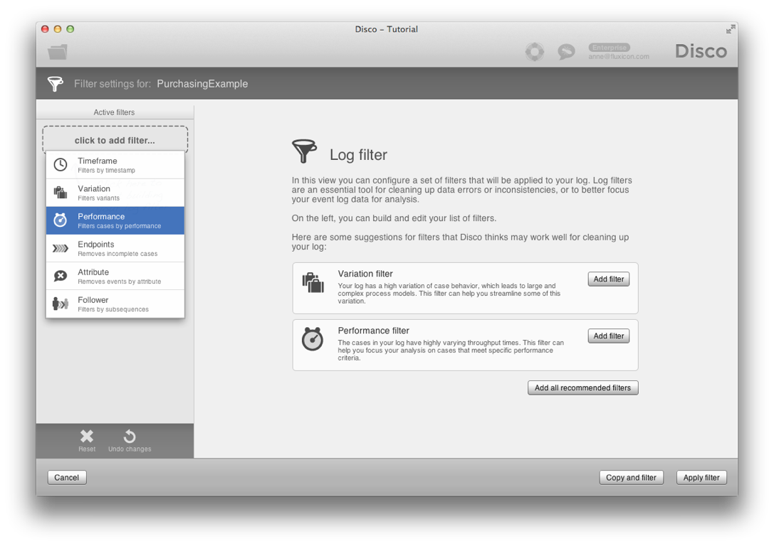
2
1
50

Slide 51
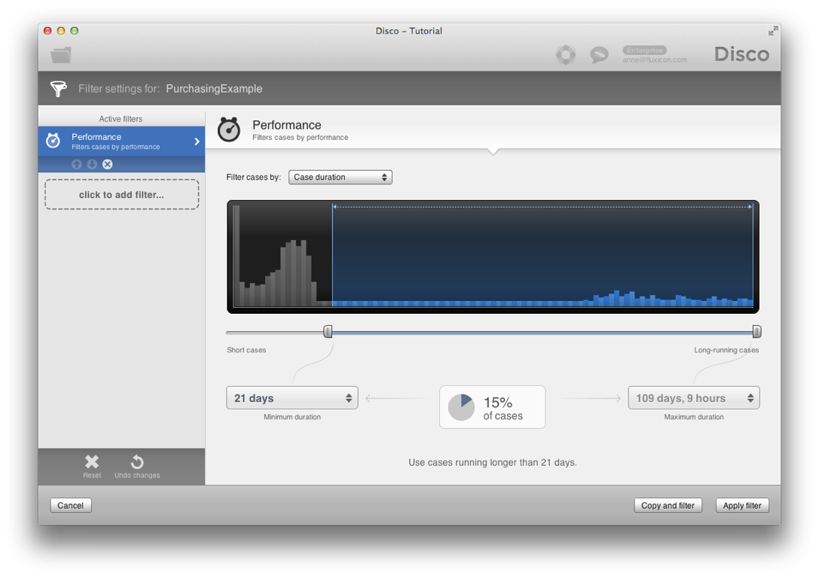
51

Slide 52
Step 7 - Spot Bottlenecks
The filtered process map shows the process flow for the 92 (15%) ‘slow’ cases
    On average 3 amendments per case!
      92 cases, 302 amendments…
52

Slide 53
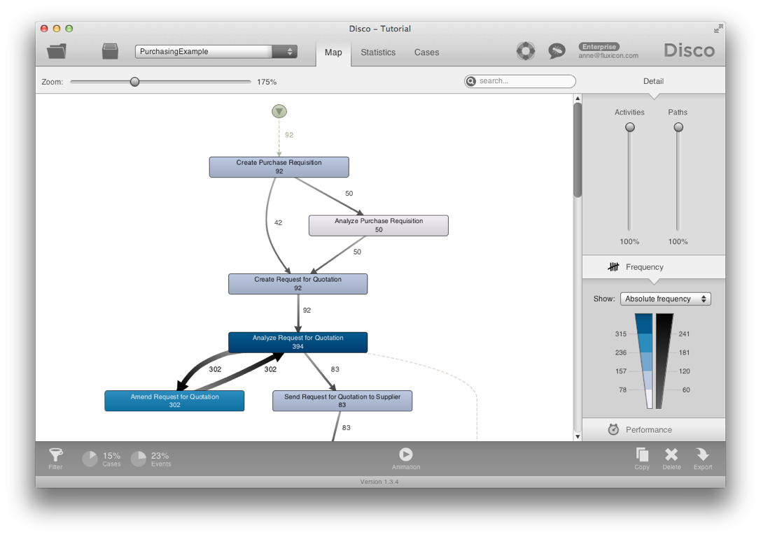
53

Slide 54
Step 7b - Spot Bottlenecks
Switch to ‘Performance’ view
    ‘Total duration’ shows the high-impact areas
    Switch to ‘Mean duration’:
      On average it takes more than 14 days to return from the rework loop to the normal process
      What about min and max duration?
54

Slide 55
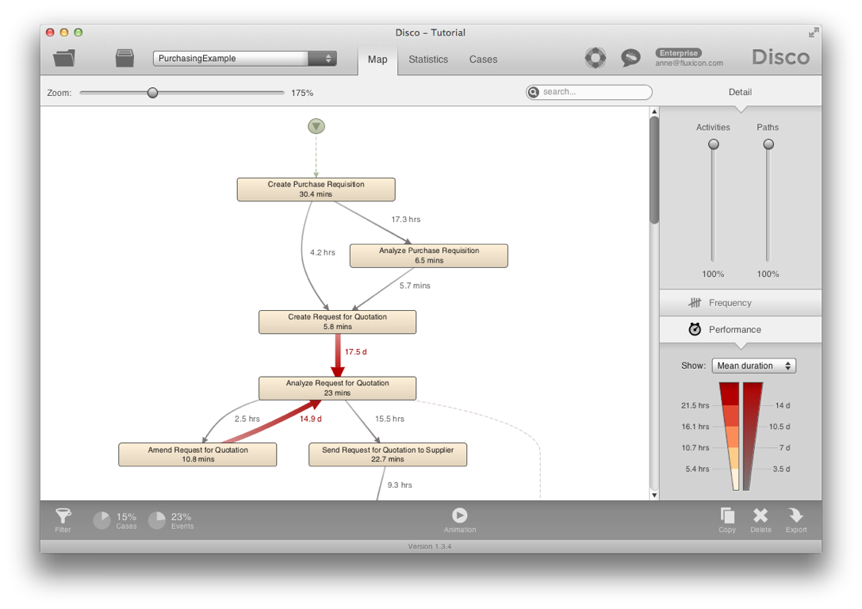
Switch to ‘Mean duration’
55

Slide 56
Step 8 - Animate Process
Visualize bottleneck:
Press ▷ button to start animation
Observe how purchase orders move through the process
Drag needle to the end of the timeline
observe how the most used paths get thicker and thicker
56

Slide 57
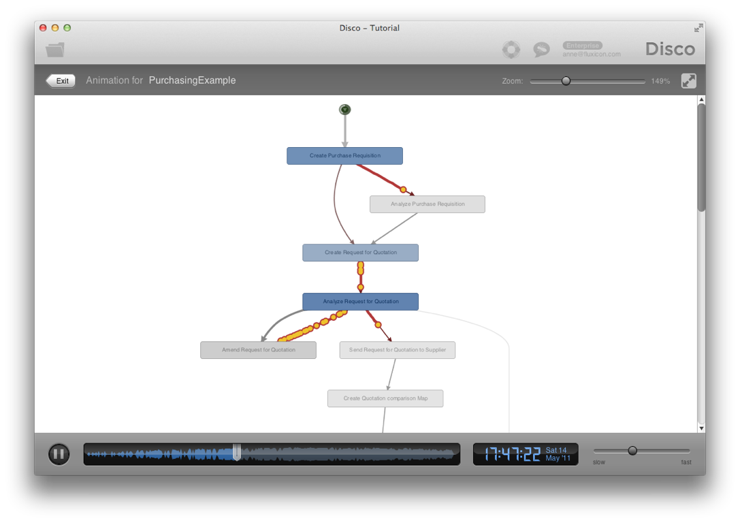
57

Slide 58
Results so far...
    How does the process actually look like?
        Objective process map discovered
        Lots of amendments and stopped requests: Update of purchasing guidelines needed
    Are there deviations from the prescribed process? -> Next
    Do we meet the performance targets?
        Not by all (some take longer than 21 days)
        The ‘Analyze Request for Quotation’ activity is a huge bottleneck: Process change is needed
58

Slide 59


Step 9 - Compliance Check
Exit the animation, return to Filter settings, and remove performance filter
Switch back to Frequency Map view and scroll to end of the process
    10 cases skip the mandatory ‘Release Supplier’s Invoice’ activity!
2
1
59

Slide 60
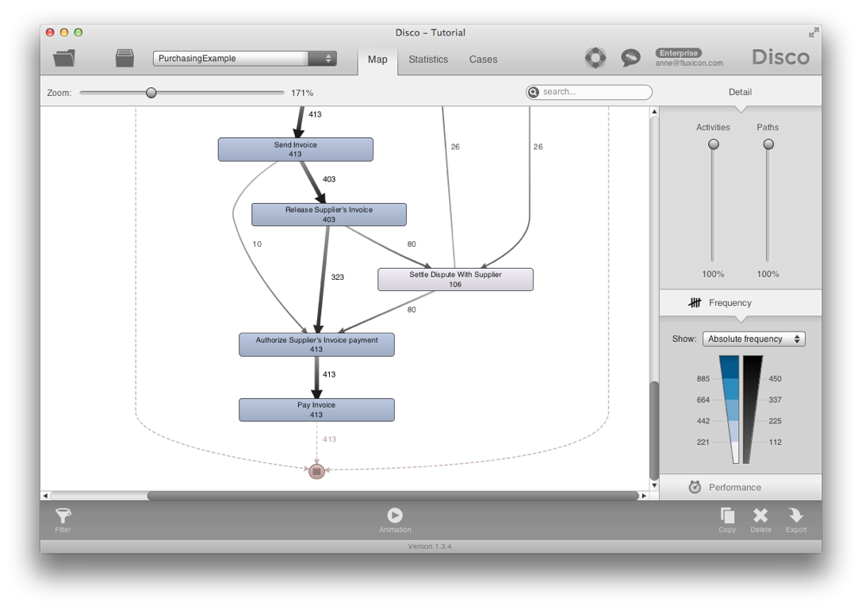
60

Slide 61
Step 9 - Compliance Check
Drill down: Click on the path from ‘Send invoice’ to ‘Authorize Supplier’s Invoice payment’ and press ‘Filter this path...’
Switch to Cases view to see the 10 cases
    Actionable result: We can either change the operational system to prevent the violation or provide targeted training
61

Slide 62
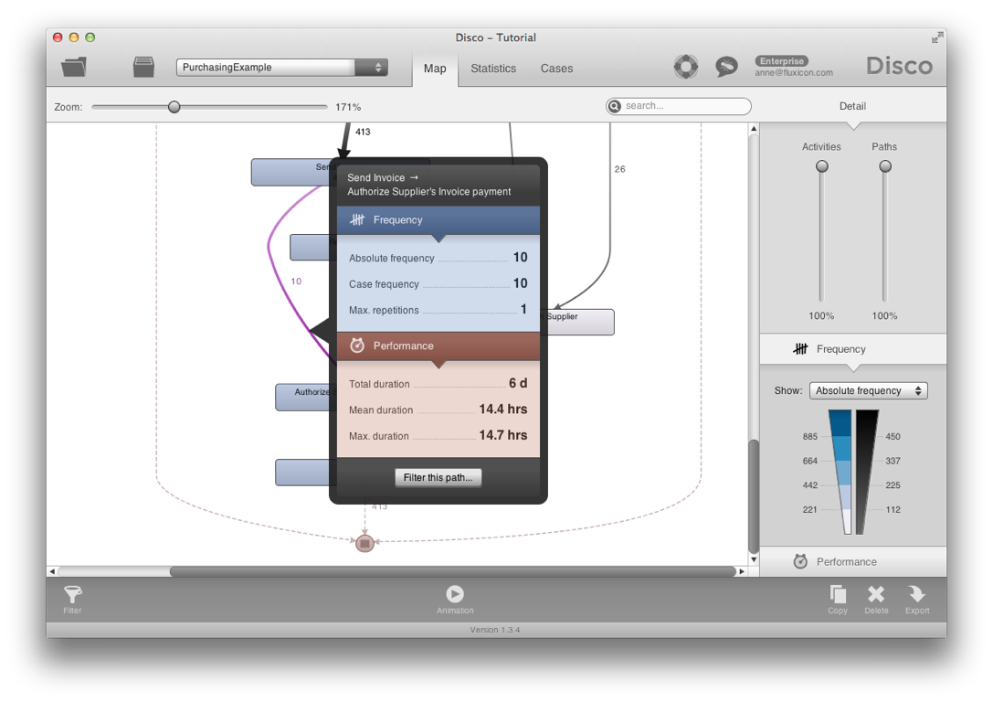
Shortcut to
filter this path
62

Slide 63
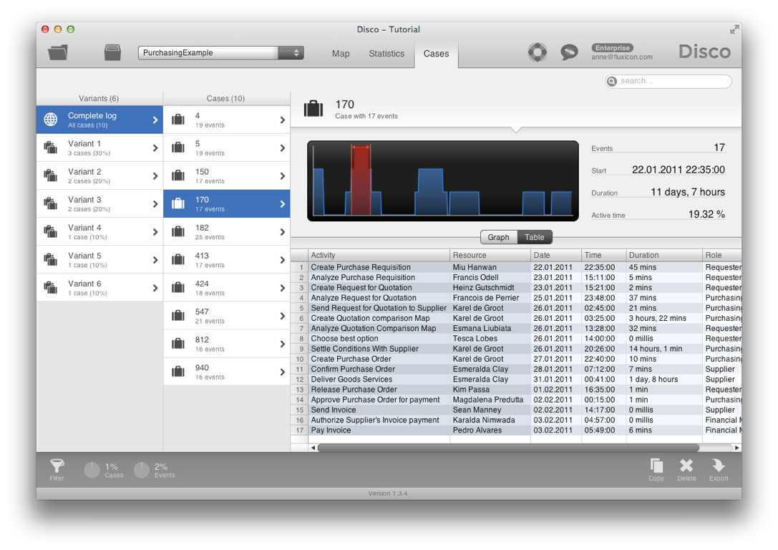
63

Slide 64
Results so far...
    How does the process actually look like?
        Objective process map discovered
        Lots of amendments and stopped requests: Update of purchasing guidelines needed
    Are there deviations from the prescribed process? -> Yes, training or system change needed
    Do we meet the performance targets?
        Not by all (some take longer than 21 days)
        The ‘Analyze Request for Quotation’ activity is a huge bottleneck: Process change is needed
64

Slide 65
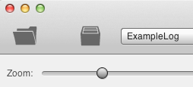
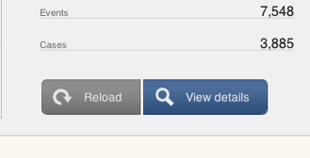
Step 10 - Organizational View
Last Step: We seek an alternative view on the data to visualize the organizational flow
Go to ‘Project view’ and press ‘Reload’:
Set ‘Activity’ column to ‘Other’ and configure ‘Role’ column as ‘Activity’
1
2
65

Slide 66
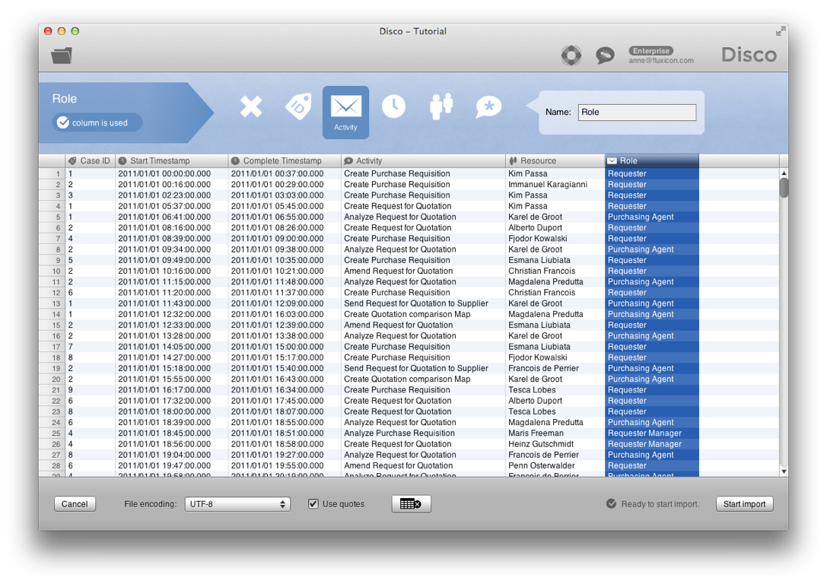
66

Slide 67
Step 10 - Organizational View
Instead of the activity flow, we are now looking at how the process moves through different roles in the organization
    Inefficiencies can often be found at the borders of organizational units
    Clearly, the Purchasing agents are causing the biggest delays in the process!
67

Slide 68
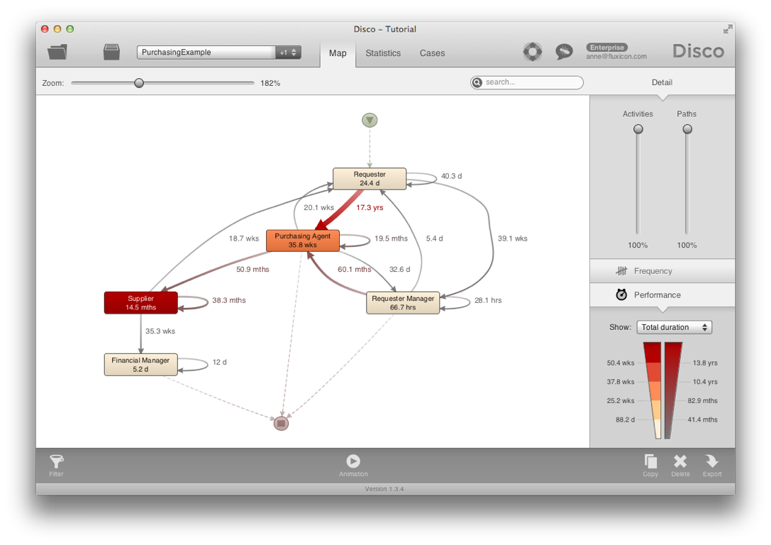
68

Slide 69
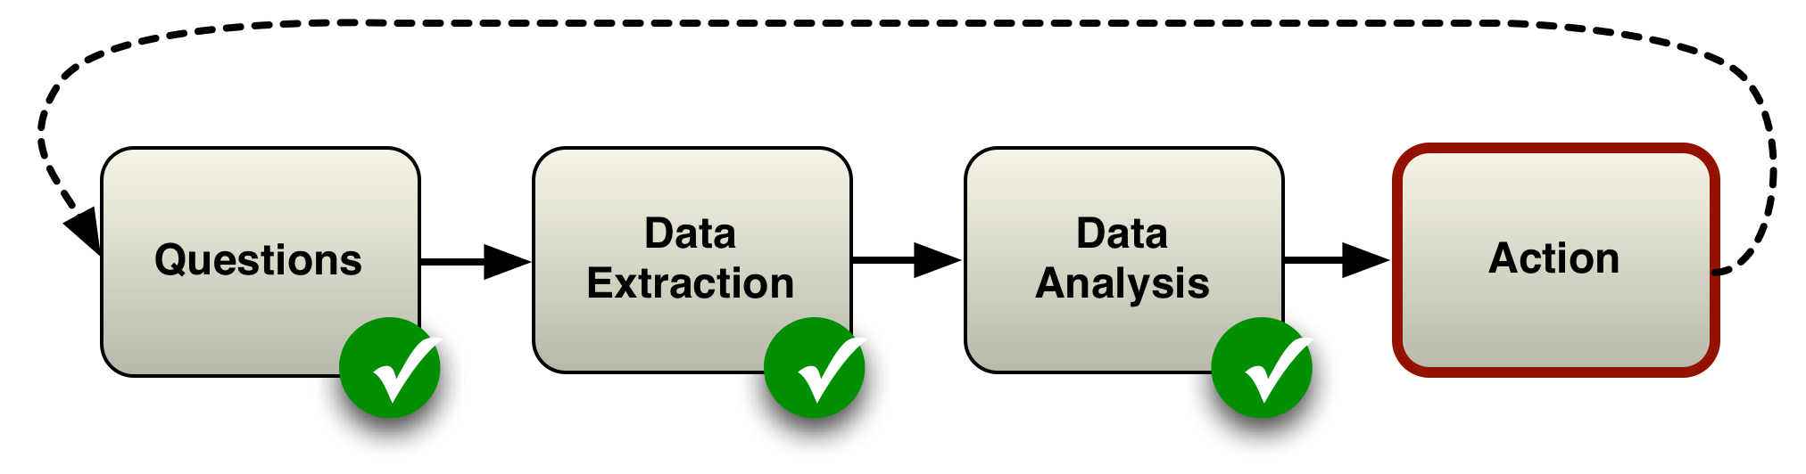
Close the loop
We have learned
How to play with Disco to discover a process model
We have found
opportunities to improve the process
Now: Take action and verify results
69

Slide 70
Bonus
Import data again and configure both ‘Activity’ and ‘Role’ column as ‘Activity’
    Can you see what happens now?
70

Slide 71
Outline
0. What is Process mining?
Example Scenario
Roadmap
Hands-on Session
Take-away Points
71

Slide 72
Take-away Points
Real processes are often more complex than you would expect
There is no one “right” model:
You can take multiple views on the same data
Process mining is an explorative, interactive activity
72

Slide 73
Questions?
Want to use these techniques in your research?
andrea.vandin@santannapisa.it
73

