Slide 1
Topics in Statistical Learning Final project
Analysis on credit card customers dataset:
predicting customers attrition
Yijiang Fan, Filippo Michelis, Tommaso Perniola, Luisa Wall

Slide 2
Dataset
10027 observation (customers)
19 features (5 categorical, 14 continuous)
2 categorical variables transformed in continuous variables (Education_Level, Income_Category)
KNN imputation for missing values in the variables Education_Level, Marital_Status, Income_Category

Slide 3
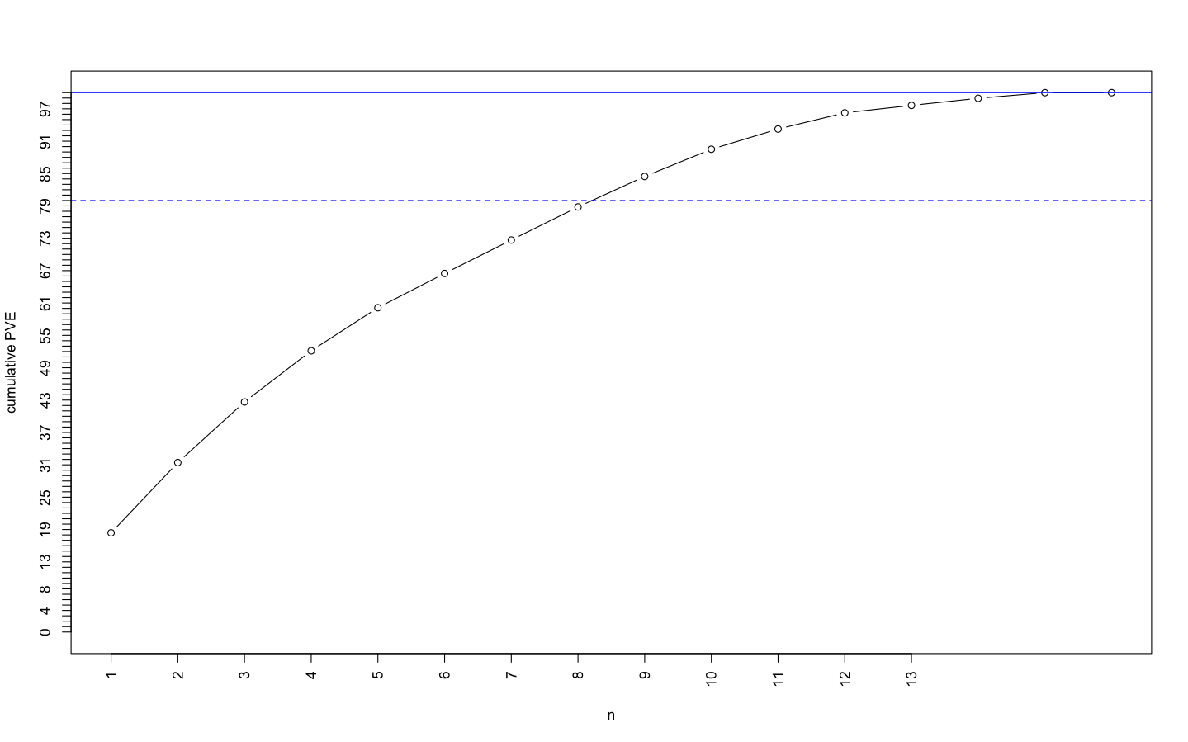
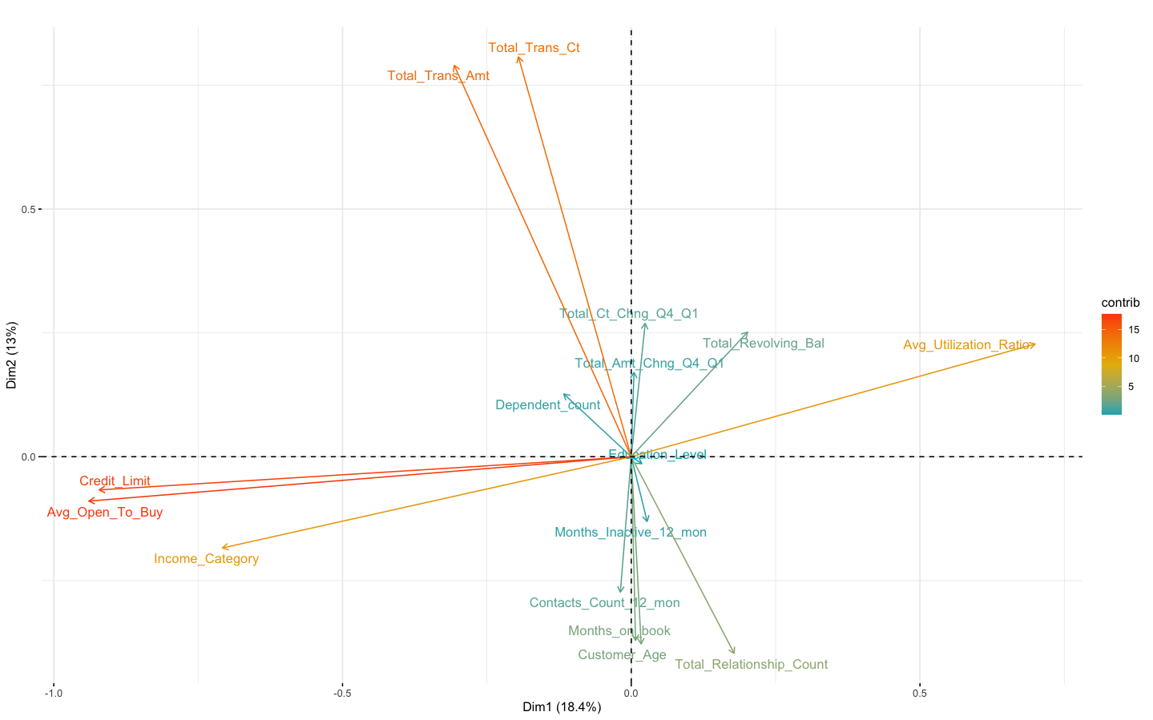
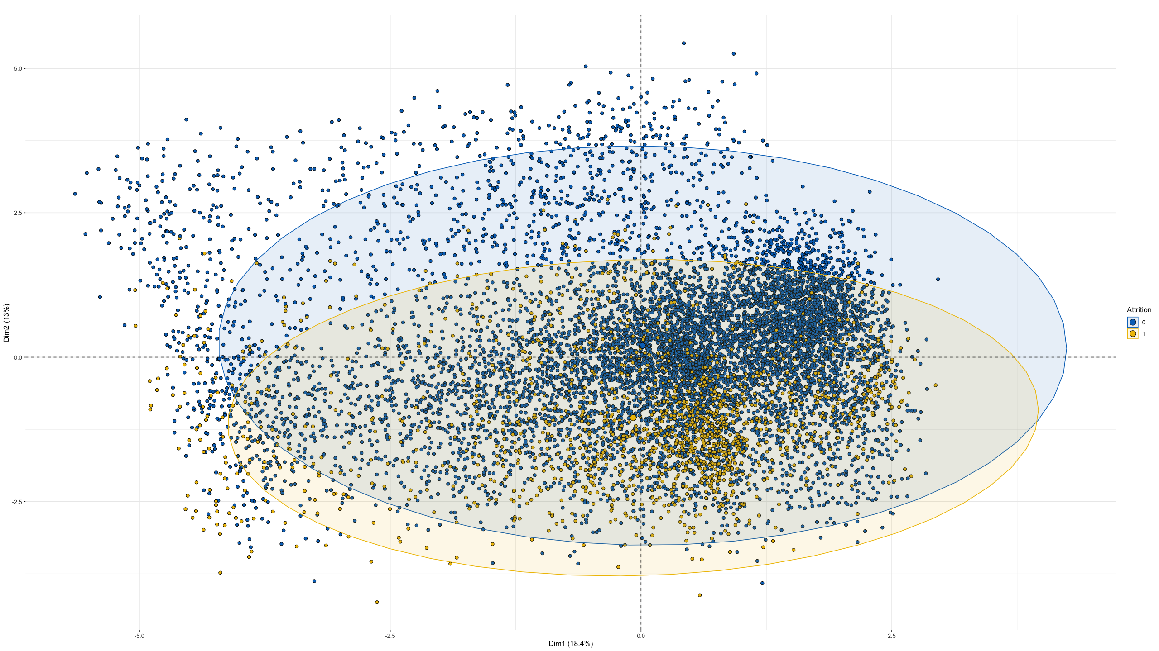
PCA
PC1 explains 18,4 % of the variability
PC2 explains 13% of the variability

Slide 4
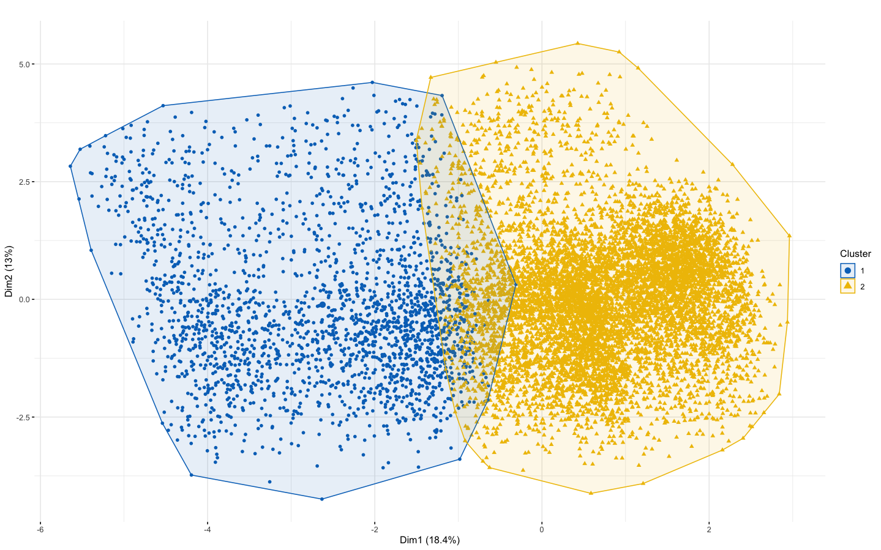
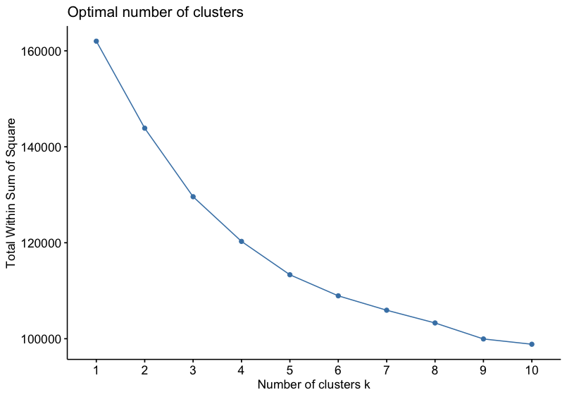
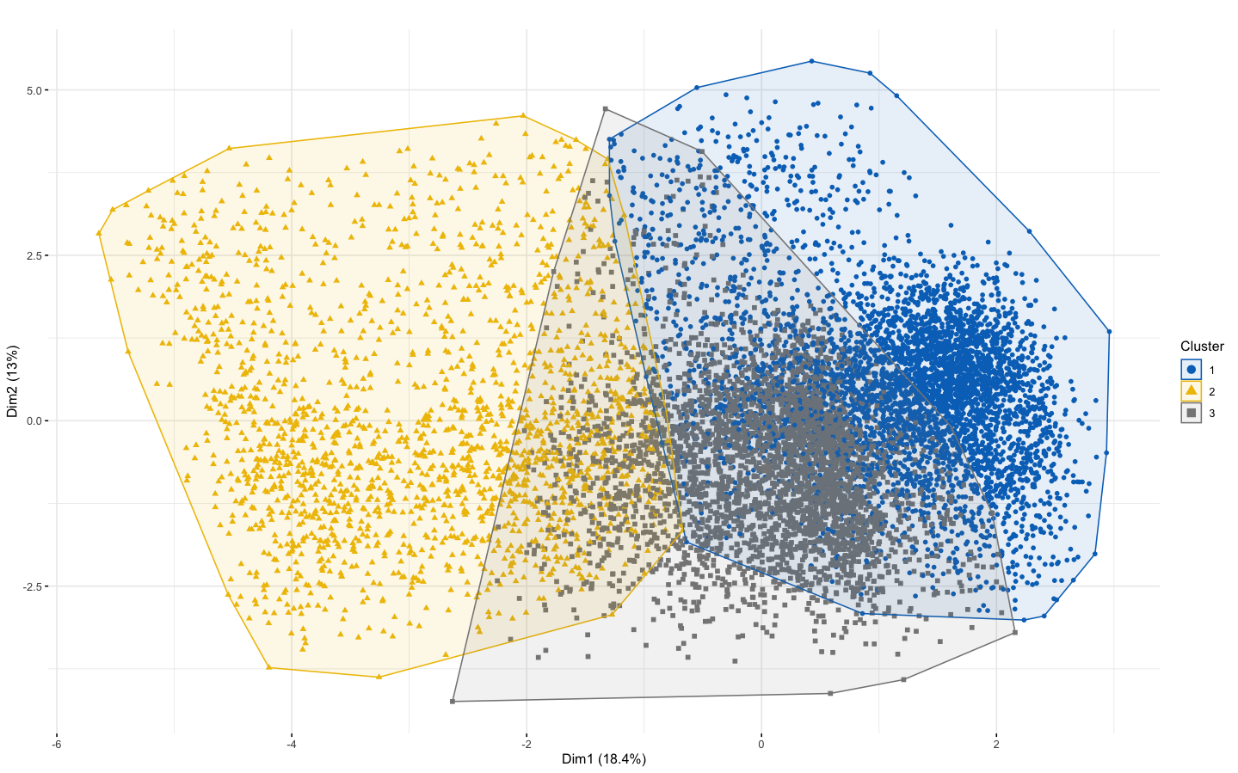
K-Means Clustering

Slide 5
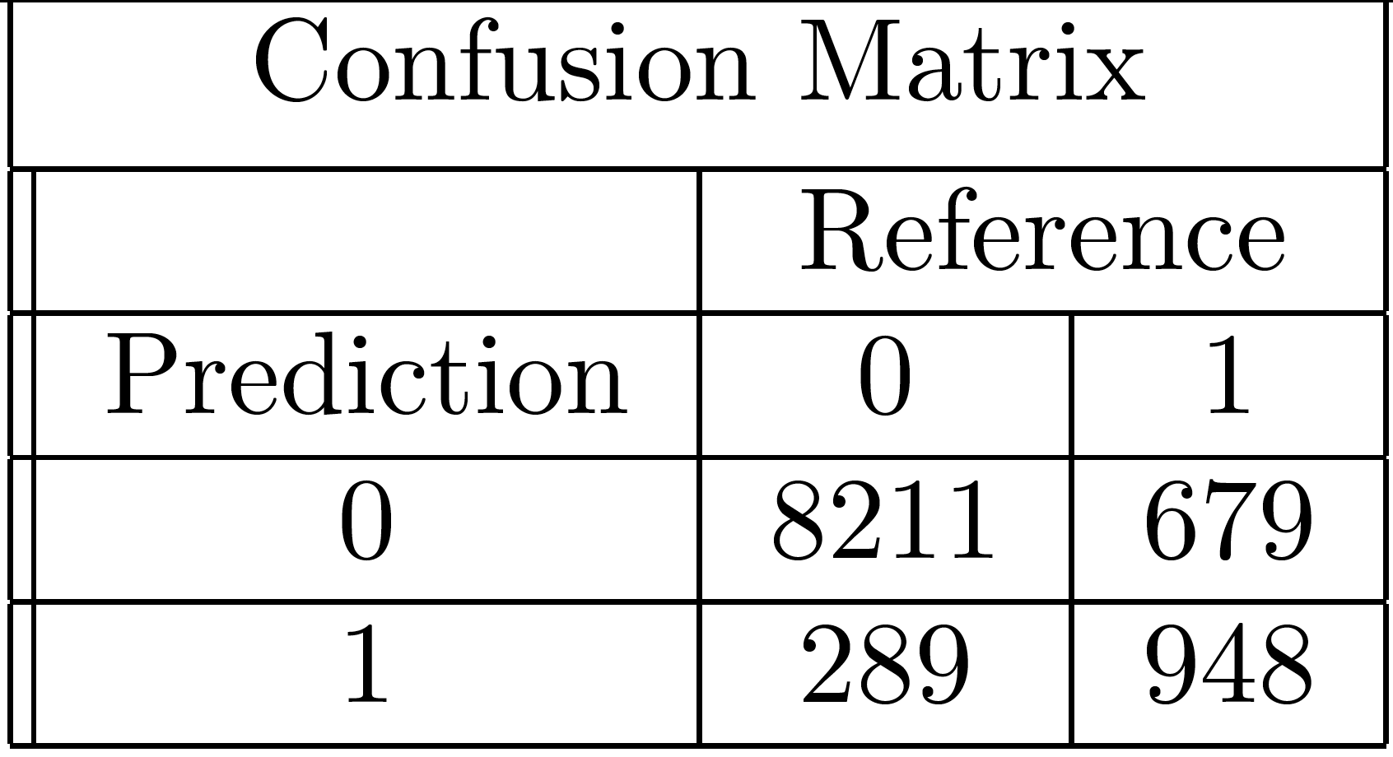
Performing classification on unbalanced data
Unbalanced data. Non attrition (0): 8500 Costumer Attrition (1):1627
Predicting Non attrition (0) and Attrition (1) using logistic regression
Cross-Validated (10 fold) Confusion Matrix
Logistic model estimates betas to maximize the likelihood function, getting the best accuracy. However, positive responses (Y=1) are undersampled
Good overall accuracy, less good sensitivity
Specificity (rate of 0 predicted corr.): 0.966
Sensitivity (rate of 1 predicted corr.): 0.5826675
Accuracy: 0.9037

Slide 6
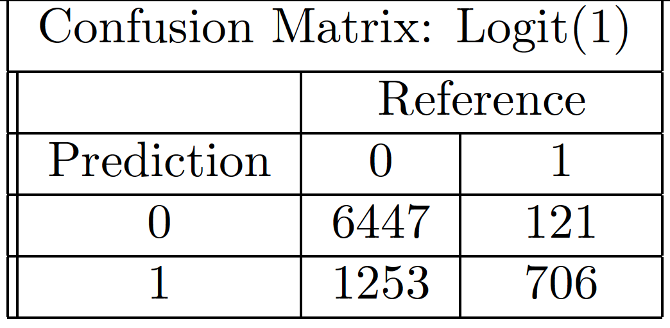
Performing classification on a balanced sample
Solution 1. Getting a balanced sample from the original dataset
Training sample: 800 Non attrition (0) and 800 Attrition (1)
Test sample: remaining observations -> 7700 Non attrition (0) and 827 Attrition (1)
Step 1: Training logistic regression model using a train function that also performs a 10 fold cross validation.
Step 2: Confronting the predictions of logistic regression model with the observations in test sample (unbalanced).
Confusion matrix:
Specificity (rate of 0 predicted corr.) : 0.8343
Sensitivity (rate of 1 predicted corr.) : 0.8519
Accuracy : 0.8502

Slide 7
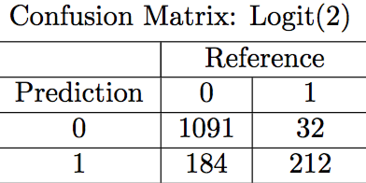
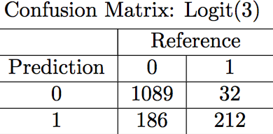
Performing classification on a balanced sample
Solution 2: duplicate observations with AttritionFlag==1
Solution 3: duplicate observations with AttritionFlag==1 and adding a random error
Logistic regression:
Accuracy: 0.8578
Sensitivity: 0.8689
Accuracy: 0.83648
Sensitivity: 0.86885

Slide 8
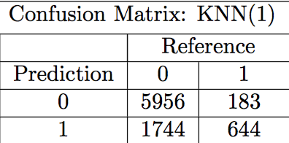
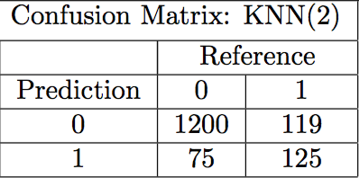
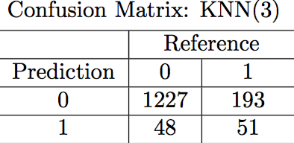
Performing classification on a balanced sample
Knn:
Accuracy: 0.7740
Sensitivity: 0.7787
Accuracy: 0.8723
Sensitivity: 0.5123
Accuracy: 0.8413
Sensitivity: 0.2090

Slide 9
Feature selection
21 variables (best subset selection computationally too expensive)
Shrinkage
LASSO (variable selection)

Slide 10
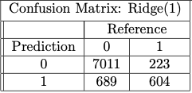
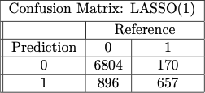
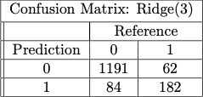
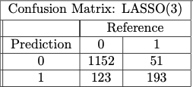
Ridge and LASSO
As a result of the LASSO algorithm, two features equal zero

Slide 11
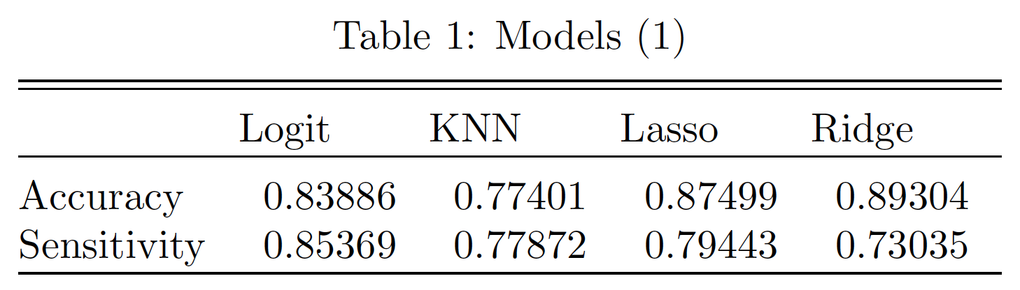
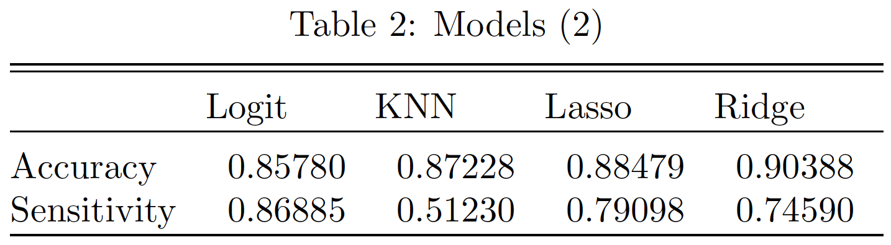
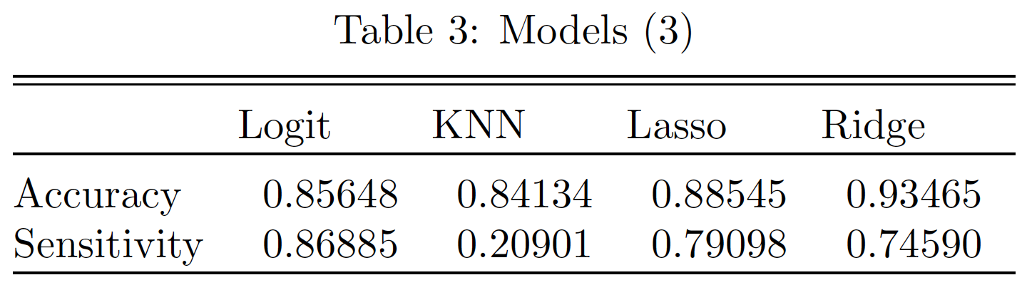
Conclusions
Unsupervised: absence of clusters
Supervised:

Slide 12
References
James, G., Witten, D., Hastie, T., & Tibshirani, R. (2013). An introduction to statistical learning (Vol. 112, p. 18). New York: springer.
Menardi, G., & Torelli, N. (2014). Training and assessing classification rules with imbalanced data. Data mining and knowledge discovery, 28(1), p. 92-122.
Credit card customers (2019) from Kaggle (https://www.kaggle.com/sakshigoyal7/credit-card-customers).

