Slide 1
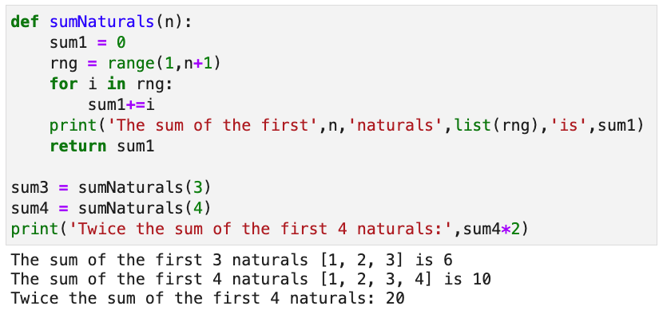
Keyword to
declare a
function
Name of the function
List of parameters
Local variables. Exist only within a function invocation
Body specified by
the indentation rule
Return value
Actual parameters. Same as n=3
Function invocations
Store return value in sum3

