Slide 1
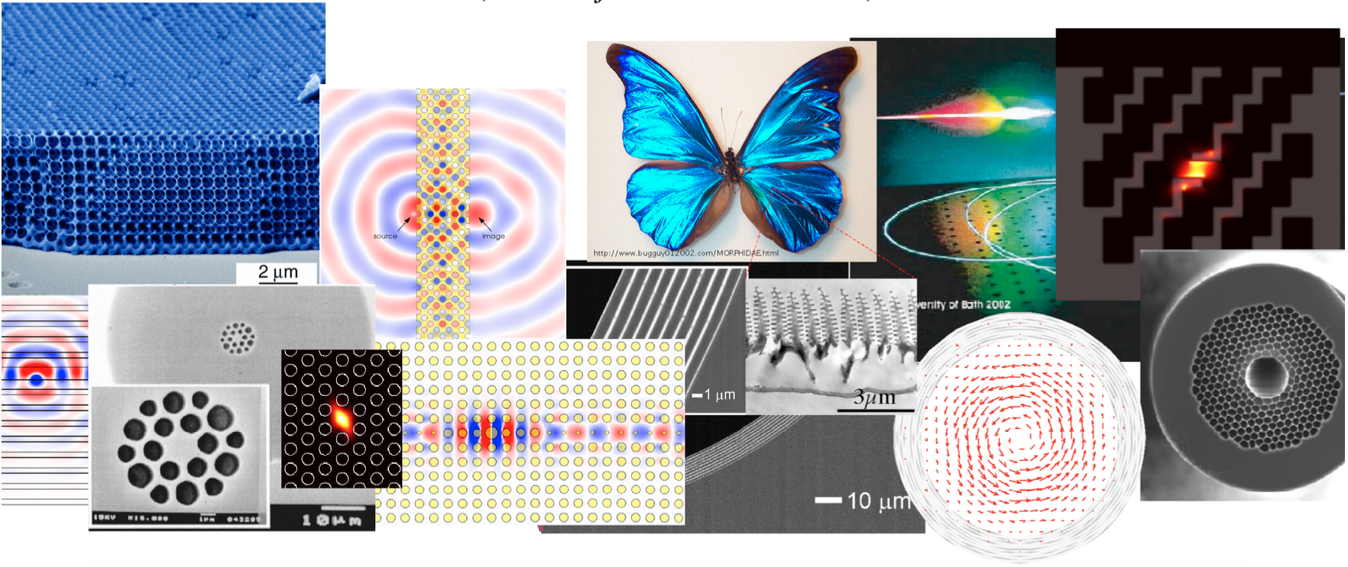
18.369/8.515[J]
Mathematical Methods in Nanophotonics
github.com/mitmath/18369
take it this spring — offered every two years!
Tired of doing electromagnetism like it’s 1869?
Find out what’s changed from 8.02/8.07/8.311 in the last 30 years, in this course surveying the physics and mathematics of nanophotonics—electromagnetic waves in media structured on the scale of the wavelength.
In this regime — iridescent butterfly wings, distributed-feedback lasers, integrated optical devices, optical fibers, … — the century-old analytical techniques of 8.02/8.07/8.311 aren’t as useful. Instead, we cover algebraic and computational methods familiar from solid-state quantum mechanics: linear algebra and eigensystems, group theory for symmetry, Bloch's theorem and conservation laws, perturbation methods, and coupled-mode theories, to understand surprising optical phenomena from band gaps to slow light and nonlinear filters.
Prerequisites: Experience with PDEs and linear algebra (e.g. 8.05, 8.07, 18.303, 6.013, 3.21, or 2.062). For graduate students and advanced undergraduates.

