Slide 1

Wscope manual at IRFM How to plot Tore Supra or WEST data?
Wscope is a simplified interface of the Python software πScope and dedicated to Tore Supra and WEST data.
Syun’Ichi Shiraiwa (MIT/PSFC) | Julien Hillairet
10/05/2016

Slide 2
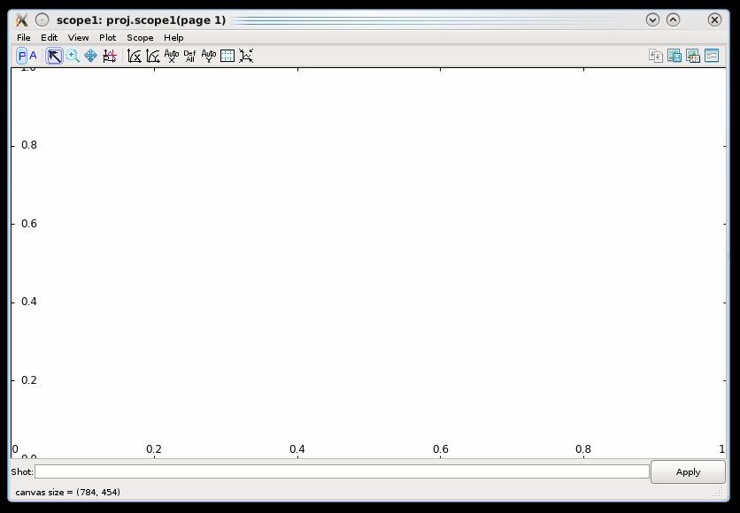
Wscope: WEST scope
Once logged into a Linux server with NX (e.g.: naos)
Open a terminal and type the command:
module load wscope
Then:
wscope
The following window should appear:

Slide 3
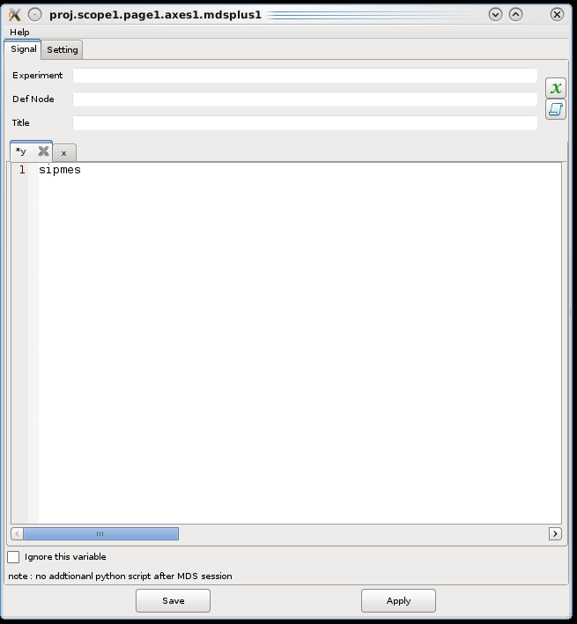
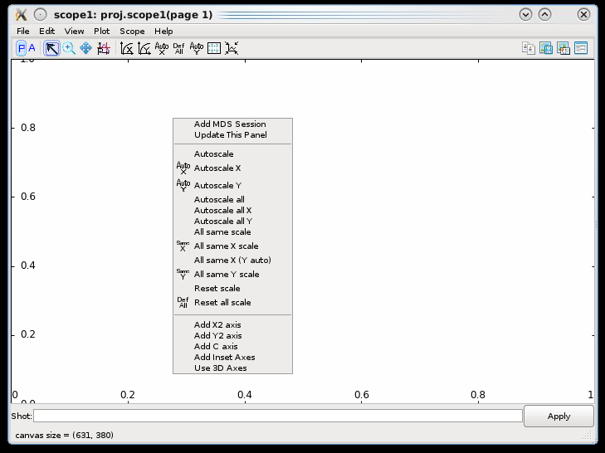
Plotting a signal for a shot number (1/2)
Right-click on the empty plot, click on “Add MDS Session”
This will open a new window. Enter the name of the signal to read in the “y” text input
Example: sipmes (= plasma current)
Click on “Save”. You can close this window.

Slide 4
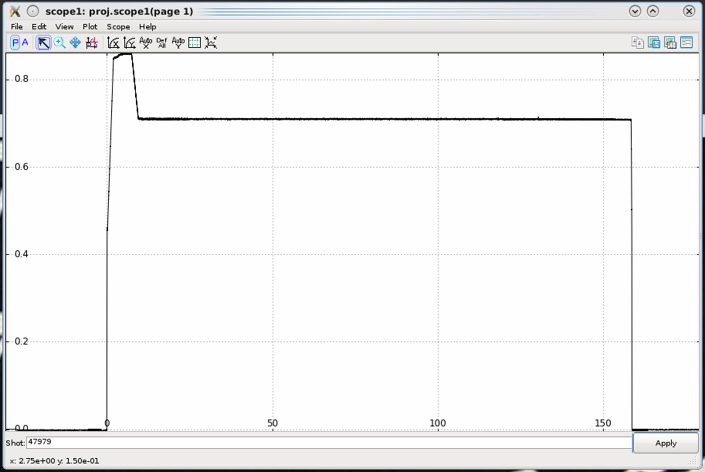
Plotting a signal for a shot number (2/2)
In the bottom text input, enter a shot number
Example: 47979
Then click on “Apply”. The time trace should look like:

Slide 5
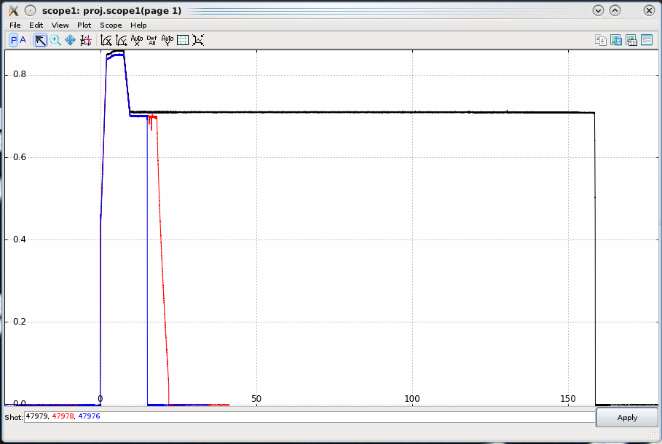
Comparing traces for few shots
You can add few shot numbers, separated by comma (,)
Click on “Apply” : the traces will superpose with different colors.
Tricks: you can also use the shortcuts “+1”, “+2”, “-1”, etc., with respect to the previous shot number

Slide 6
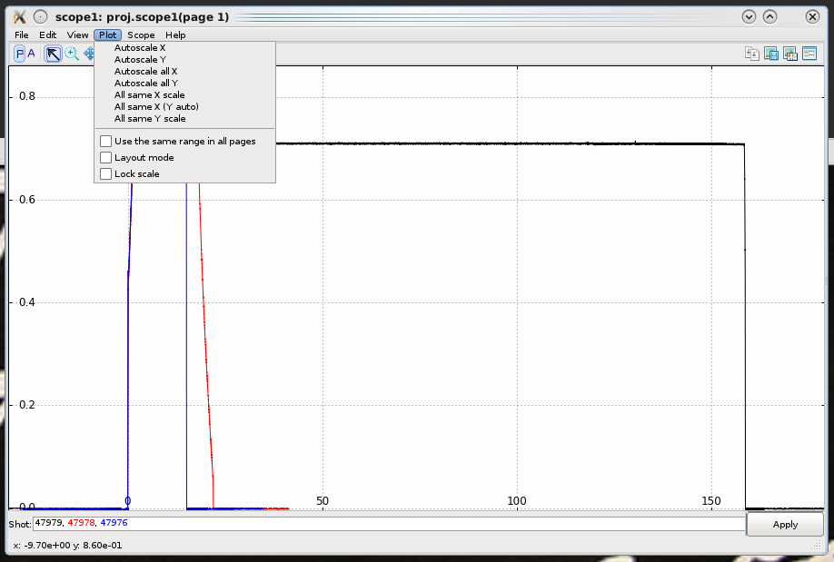
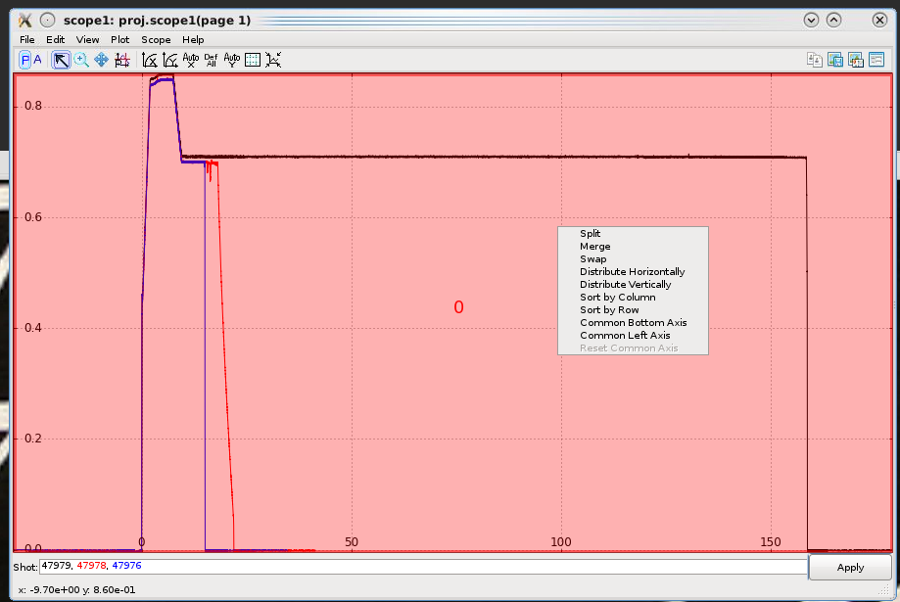
Creating subplots (1/3)
Click on the “Plot” menu, then check the boxe ‘Layout mode’
The plot window should now appears in pink
Right-click on the plot window and select ‘split’

Slide 7
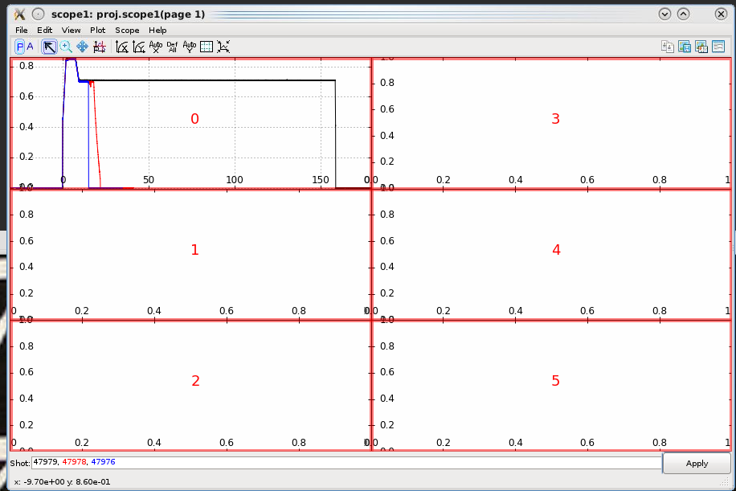
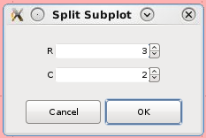
Creating subplots (2/3)
Select how many rows (R) and columns (C) you want to split your figure in
Example below: 3 rows and 2 columns
Once done, quit the ‘Layout mode’ by unchecking the checkbox in the Plot menu.
Note: you can split each subplots into other subplots if needed. Or merge some.

Slide 8
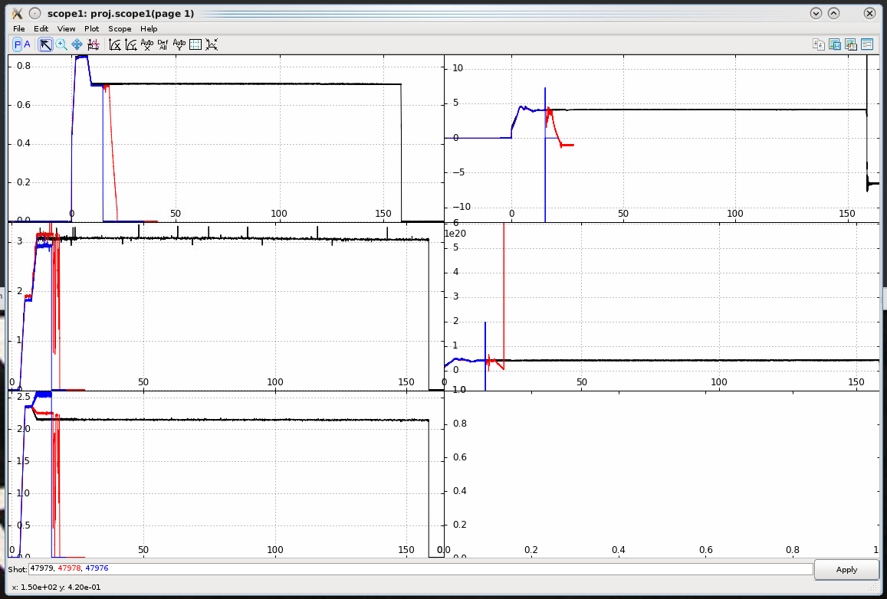
Creating subplots (3/3)
Define the signal name you want to plot in each subplot:
by right-clicking into a subplot,
then “Add MDS Session”.
Enter the name of the signal in the “y” text input and “Save”.
Example with signals: sipmes, gphyb%1, gphyb%2, snli, gne

Slide 9
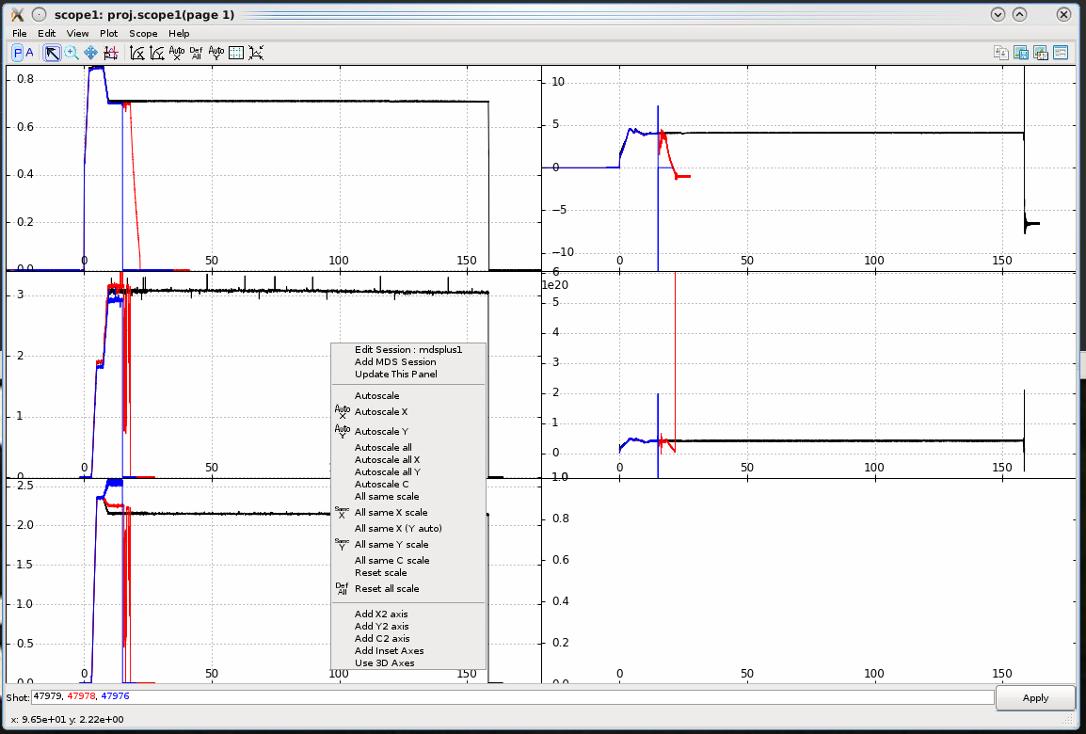
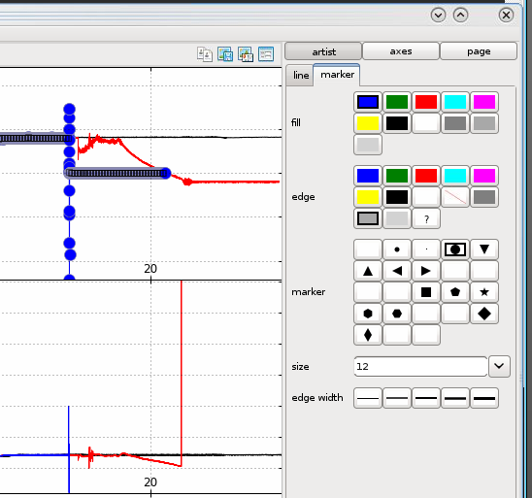
Scope options
You can tune the figure by right-clicking on a plot
Example: selecting “All same X scale” will make the subplot sharing the same X view
The left toolbox panel allows you to add annotation, zoom in/out, pan, plot a cursor, change scale, remove/add a grid, etc.
The right toolbox panel allows you to export graphics, or tune the plot properties (line style, marker, etc). You can click on a curve to select it.

Slide 10
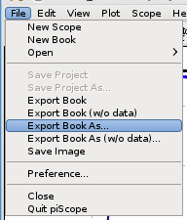
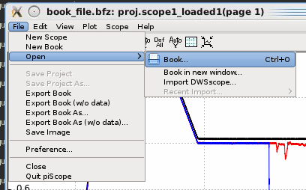
Saving/Openning a scope
Once your scope has been setup, you can export it to reopen it later with the same config. (Or to share it to a colleague.)
Click on “File” menu, then either “Export Book As” or “Export Book As (w/o data)”. The latter will not save the trace data in the scope file.
Save the scope file (.bfz)
If you quit the application and reopen a new scope, you can open a scope book (.bfz) file from “File” -> “Open” -> “Book”.

Slide 11
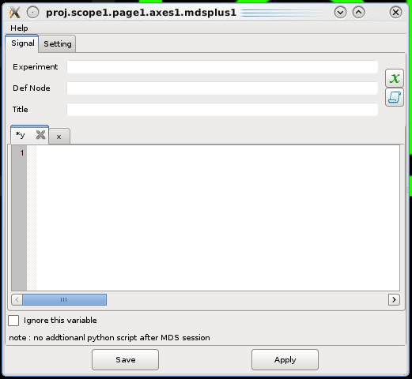





Creating Intermediate Variables
Let’s say you want to plot y = A – B where A and B are two signals from the database
Create a new variable
Create a new script
Example
A new variable “C3” defined as gphyb%1
A new variable “C4” defined as gphyb%2
A new script defined as :
→ Will plot C3 – C4 in the figure

