Slide 1
Workflow of the CHOSEN data
Notes:
Comprehensive Hydrologic Observatory Sensor Network

Slide 2
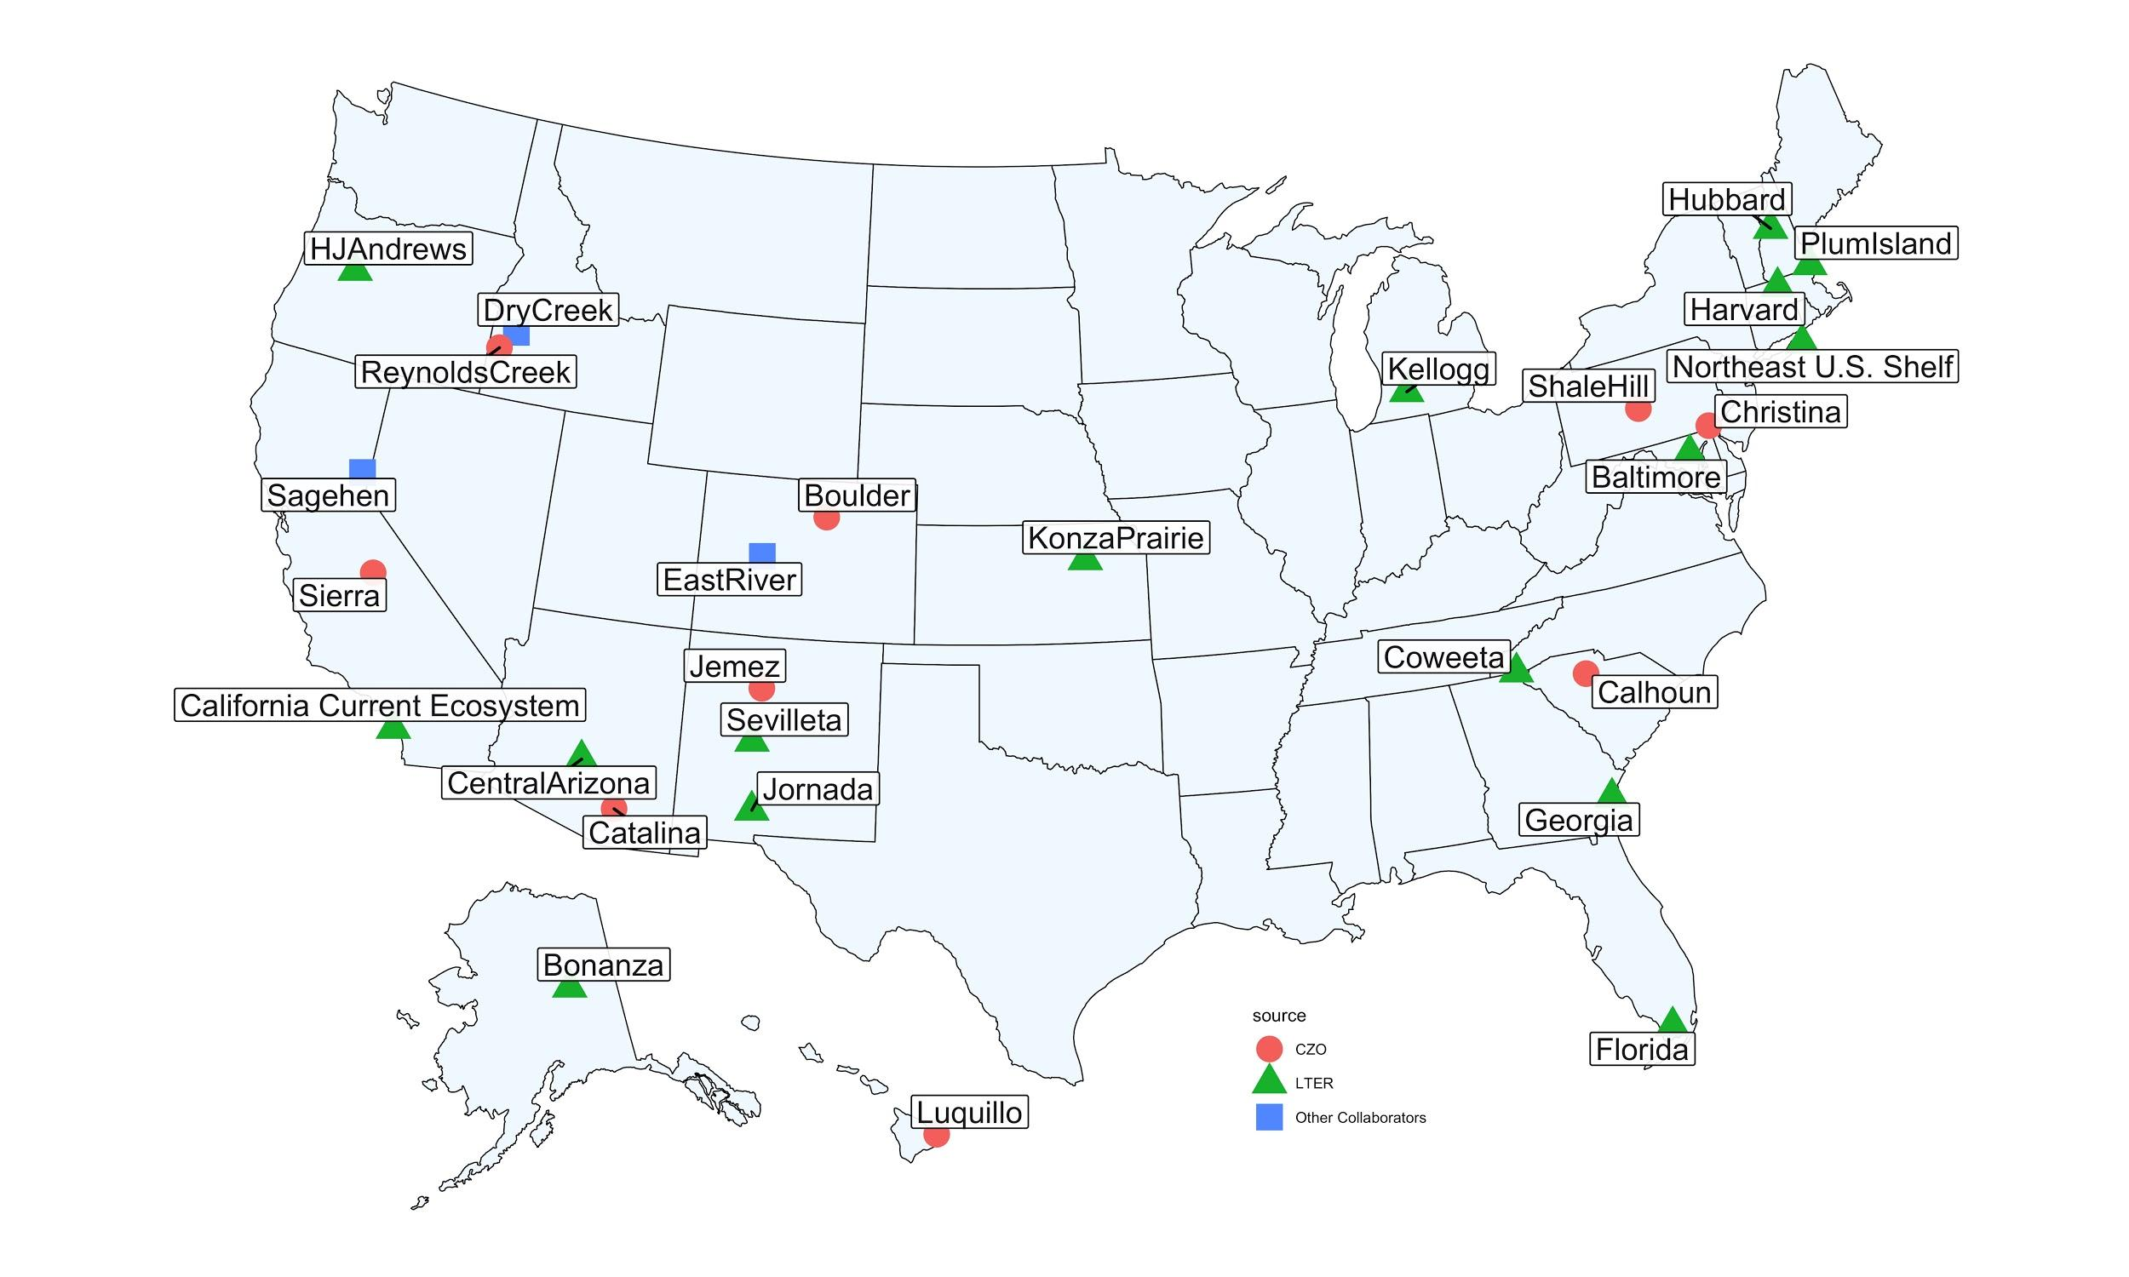
CHOSEN data
28 intensively measured watershed across the US
Supporting model development and hydrological analysis beyond streamflow prediction
Enable watershed inter-comparison studies.
Notes:
We collected hydrometeorological data for 28 intensively measured watersheds with the goal of supporting – model development and calibration that goes beyond streamflow prediction.
The data come from

Slide 3
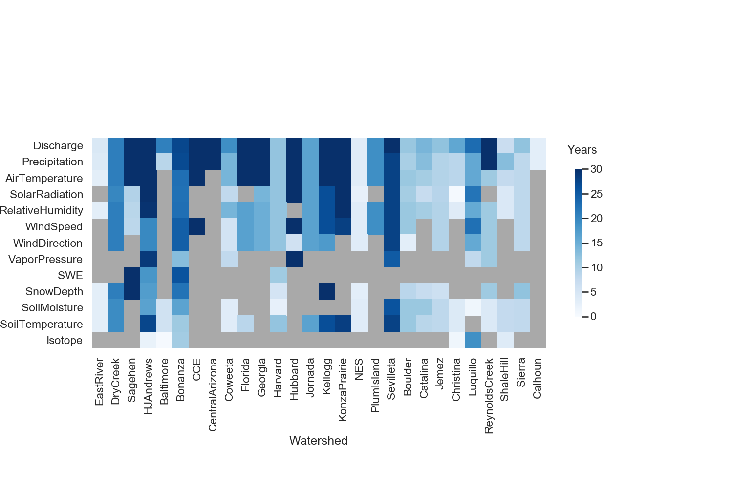
Hydrometeorological Variables
Notes:
The data collected includes: Streamflow, snow melt, soil moisture, and isotope data
Thus, these data can help in going beyond streamflow prediction.

Slide 4
Workflow Steps
Jupyter notebook pipeline
Quality control and standardization
Gap filling
Final product generation
Quality control
Names and units
Temporal Aggregation (daily)
Linear interpolation
Spatial regression
Climate catalog (temporal regression)
NetCDF files
Notes:
The workflow we followed has three components:
Quality control and consistency
Gap filling – where we fill missing values using different alternatives.
Dissemination – to help as efficiently disseminate the data we are using NetCDF data.

Slide 5
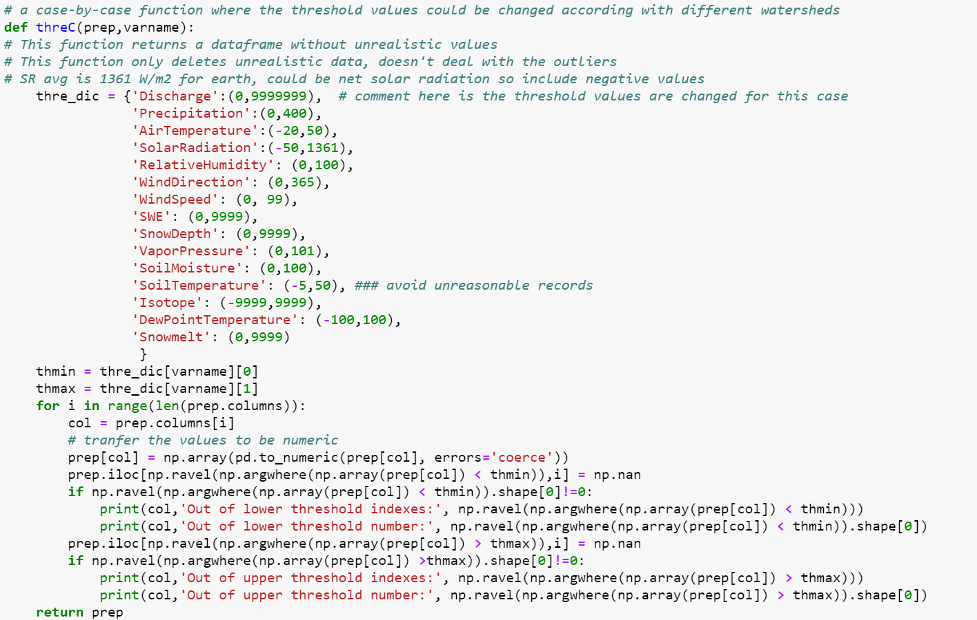
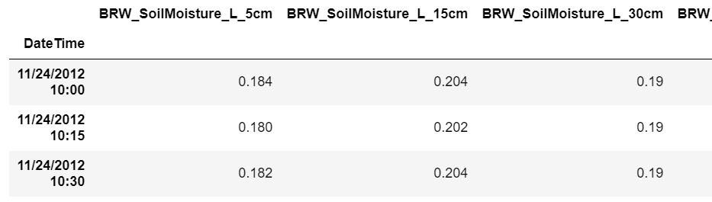
Quality control and naming
Unrealistic values (Define realistic ranges)
Consistent naming standard (StationName_VariableName_Depth)
Aggregation of sub-daily data to a daily scale
Use of interactive plots
Notes:
We used thresholds to fend of unrealistic and erroneous data. For example, relative humidity not to pass 100% or identifying unrealistic streamflow values using interactive plotting.
Consistent names important for later gap filling
Aggregation - sum and mean

Slide 6
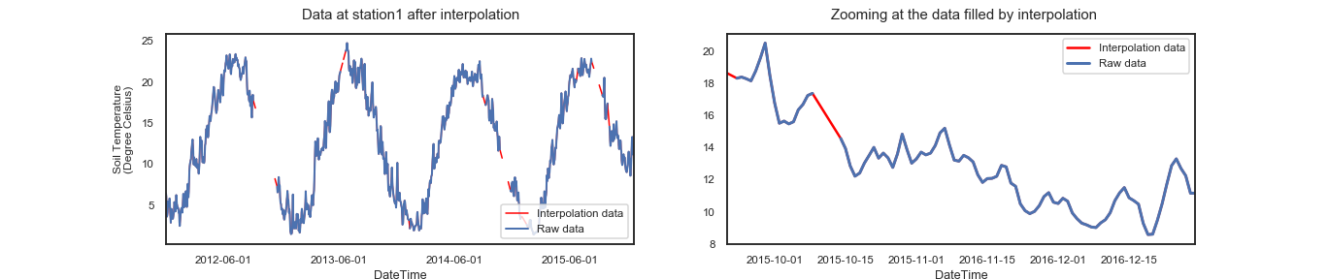
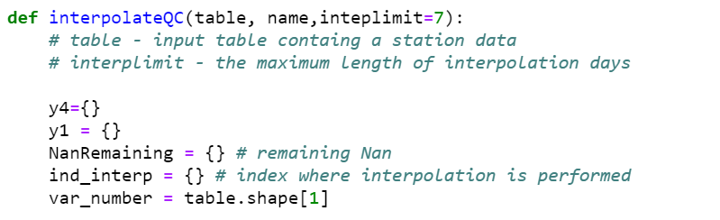
Gap filling - Interpolation
Linear interpolation
Length of interpolation (e.g., less than a week)
Notes:
The first step in our data filling is interpolation.
Here, we have some subjective decisions we can be made interactive. (Linear or non-linear interpolation)
For example, interpolation limits 7 days, 3 days, or depending on variable types. Lower for precipitation and longer for soil moisture.

Slide 7
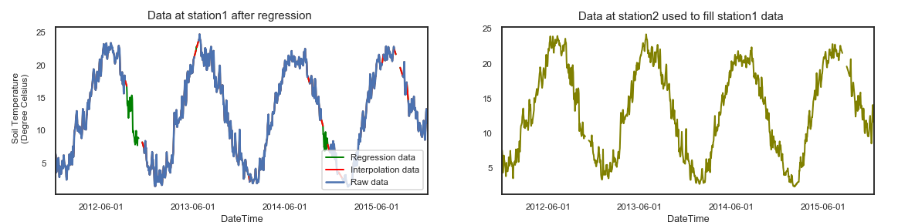
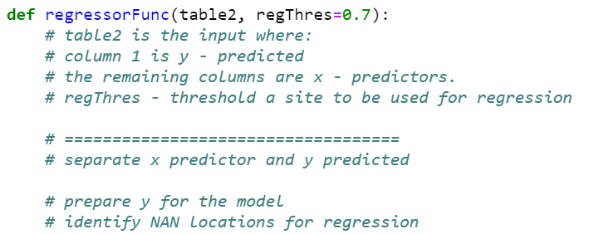
Gap filling - Regression
One at a time regression
Donor/predictor station with highest correlation coefficient (r²)
A threshold of r² > 0.7 for a station to be a donor
Notes:
The second step is the use of regression: Missing values in a station is filled by a data from a donor station.
We use one at a time interpolation to fend of multi-collinearity.
Hence, we identify which donor station has the highest correlation coefficient as a donor.
We also used a threshold for a station to be a donor – 0.7 is used.

Slide 8
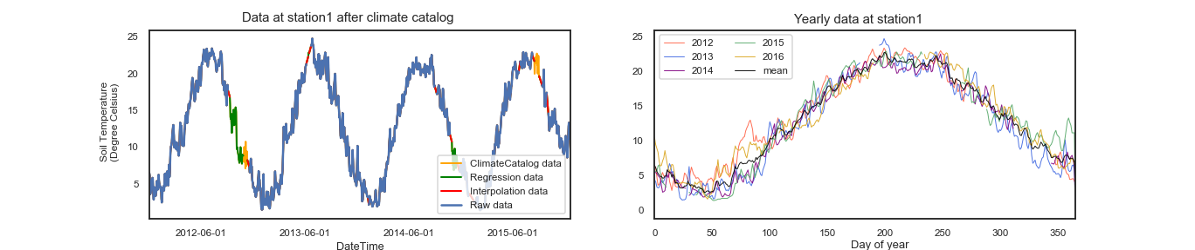
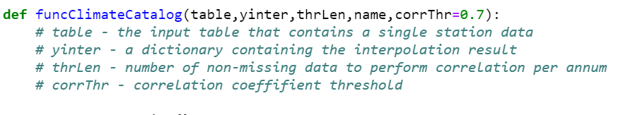

Gap filling Climate catalog
Temporal regression
Threshold missing year length
Threshold donor r²
$D_{y=missing year}= D_{y=max⁡_r^{2}}+N(0,σ)$
Notes:
Similar to regression but, here we use time as a regressor. Regressing a missing year with a closest year.

Slide 9
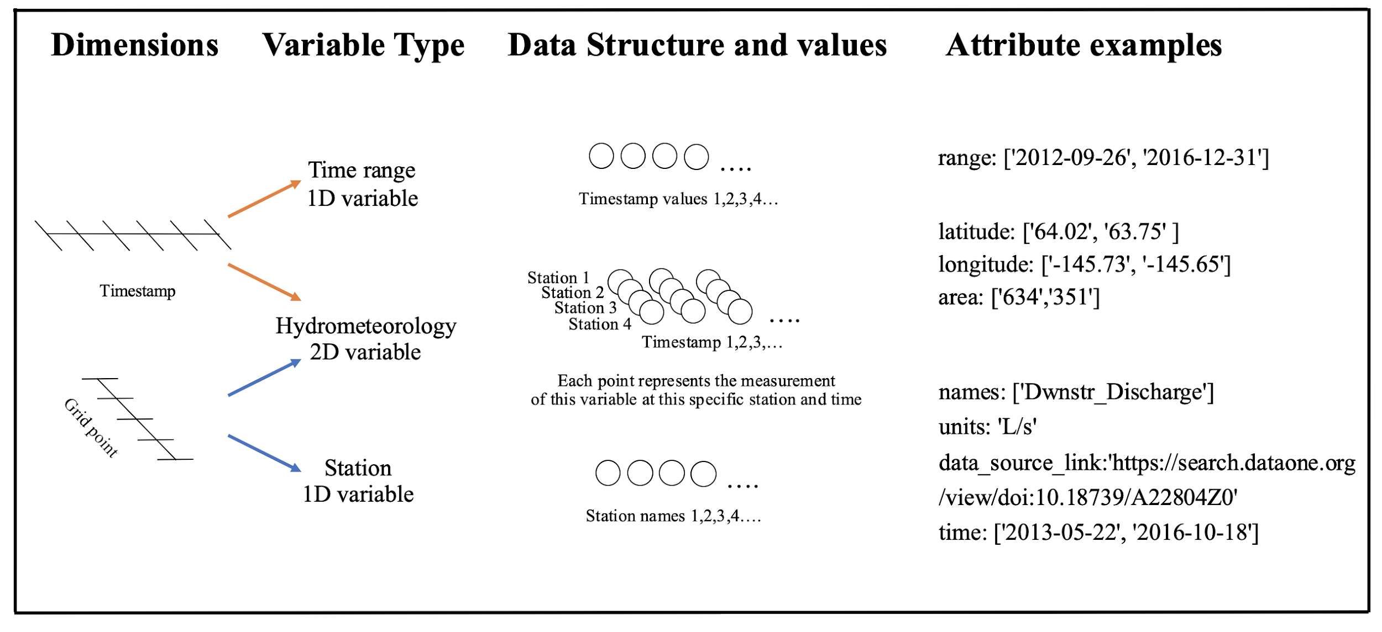
Final Product
Notes:
A final NetCDF file with number of station, source website and location are released.

Slide 10
Potential notebook improvements
Interactive gap filling and quality control
Easy to use notebooks with/in interactive dashboards
Visualizations beyond basic plots
Ease of disseminations and wider access
Notes:
The goal is not publishing CHOSEN and finish the work. We have a plan to make it a continuous work that can be supplied by multiple researchers.
Thus, we want to make the workflow and dissemination as smooth as possible for any one with basic coding skills or none.
Subjective decisions that benefits from interactive coding with widgets and gui look a like platform.

