Slide 1

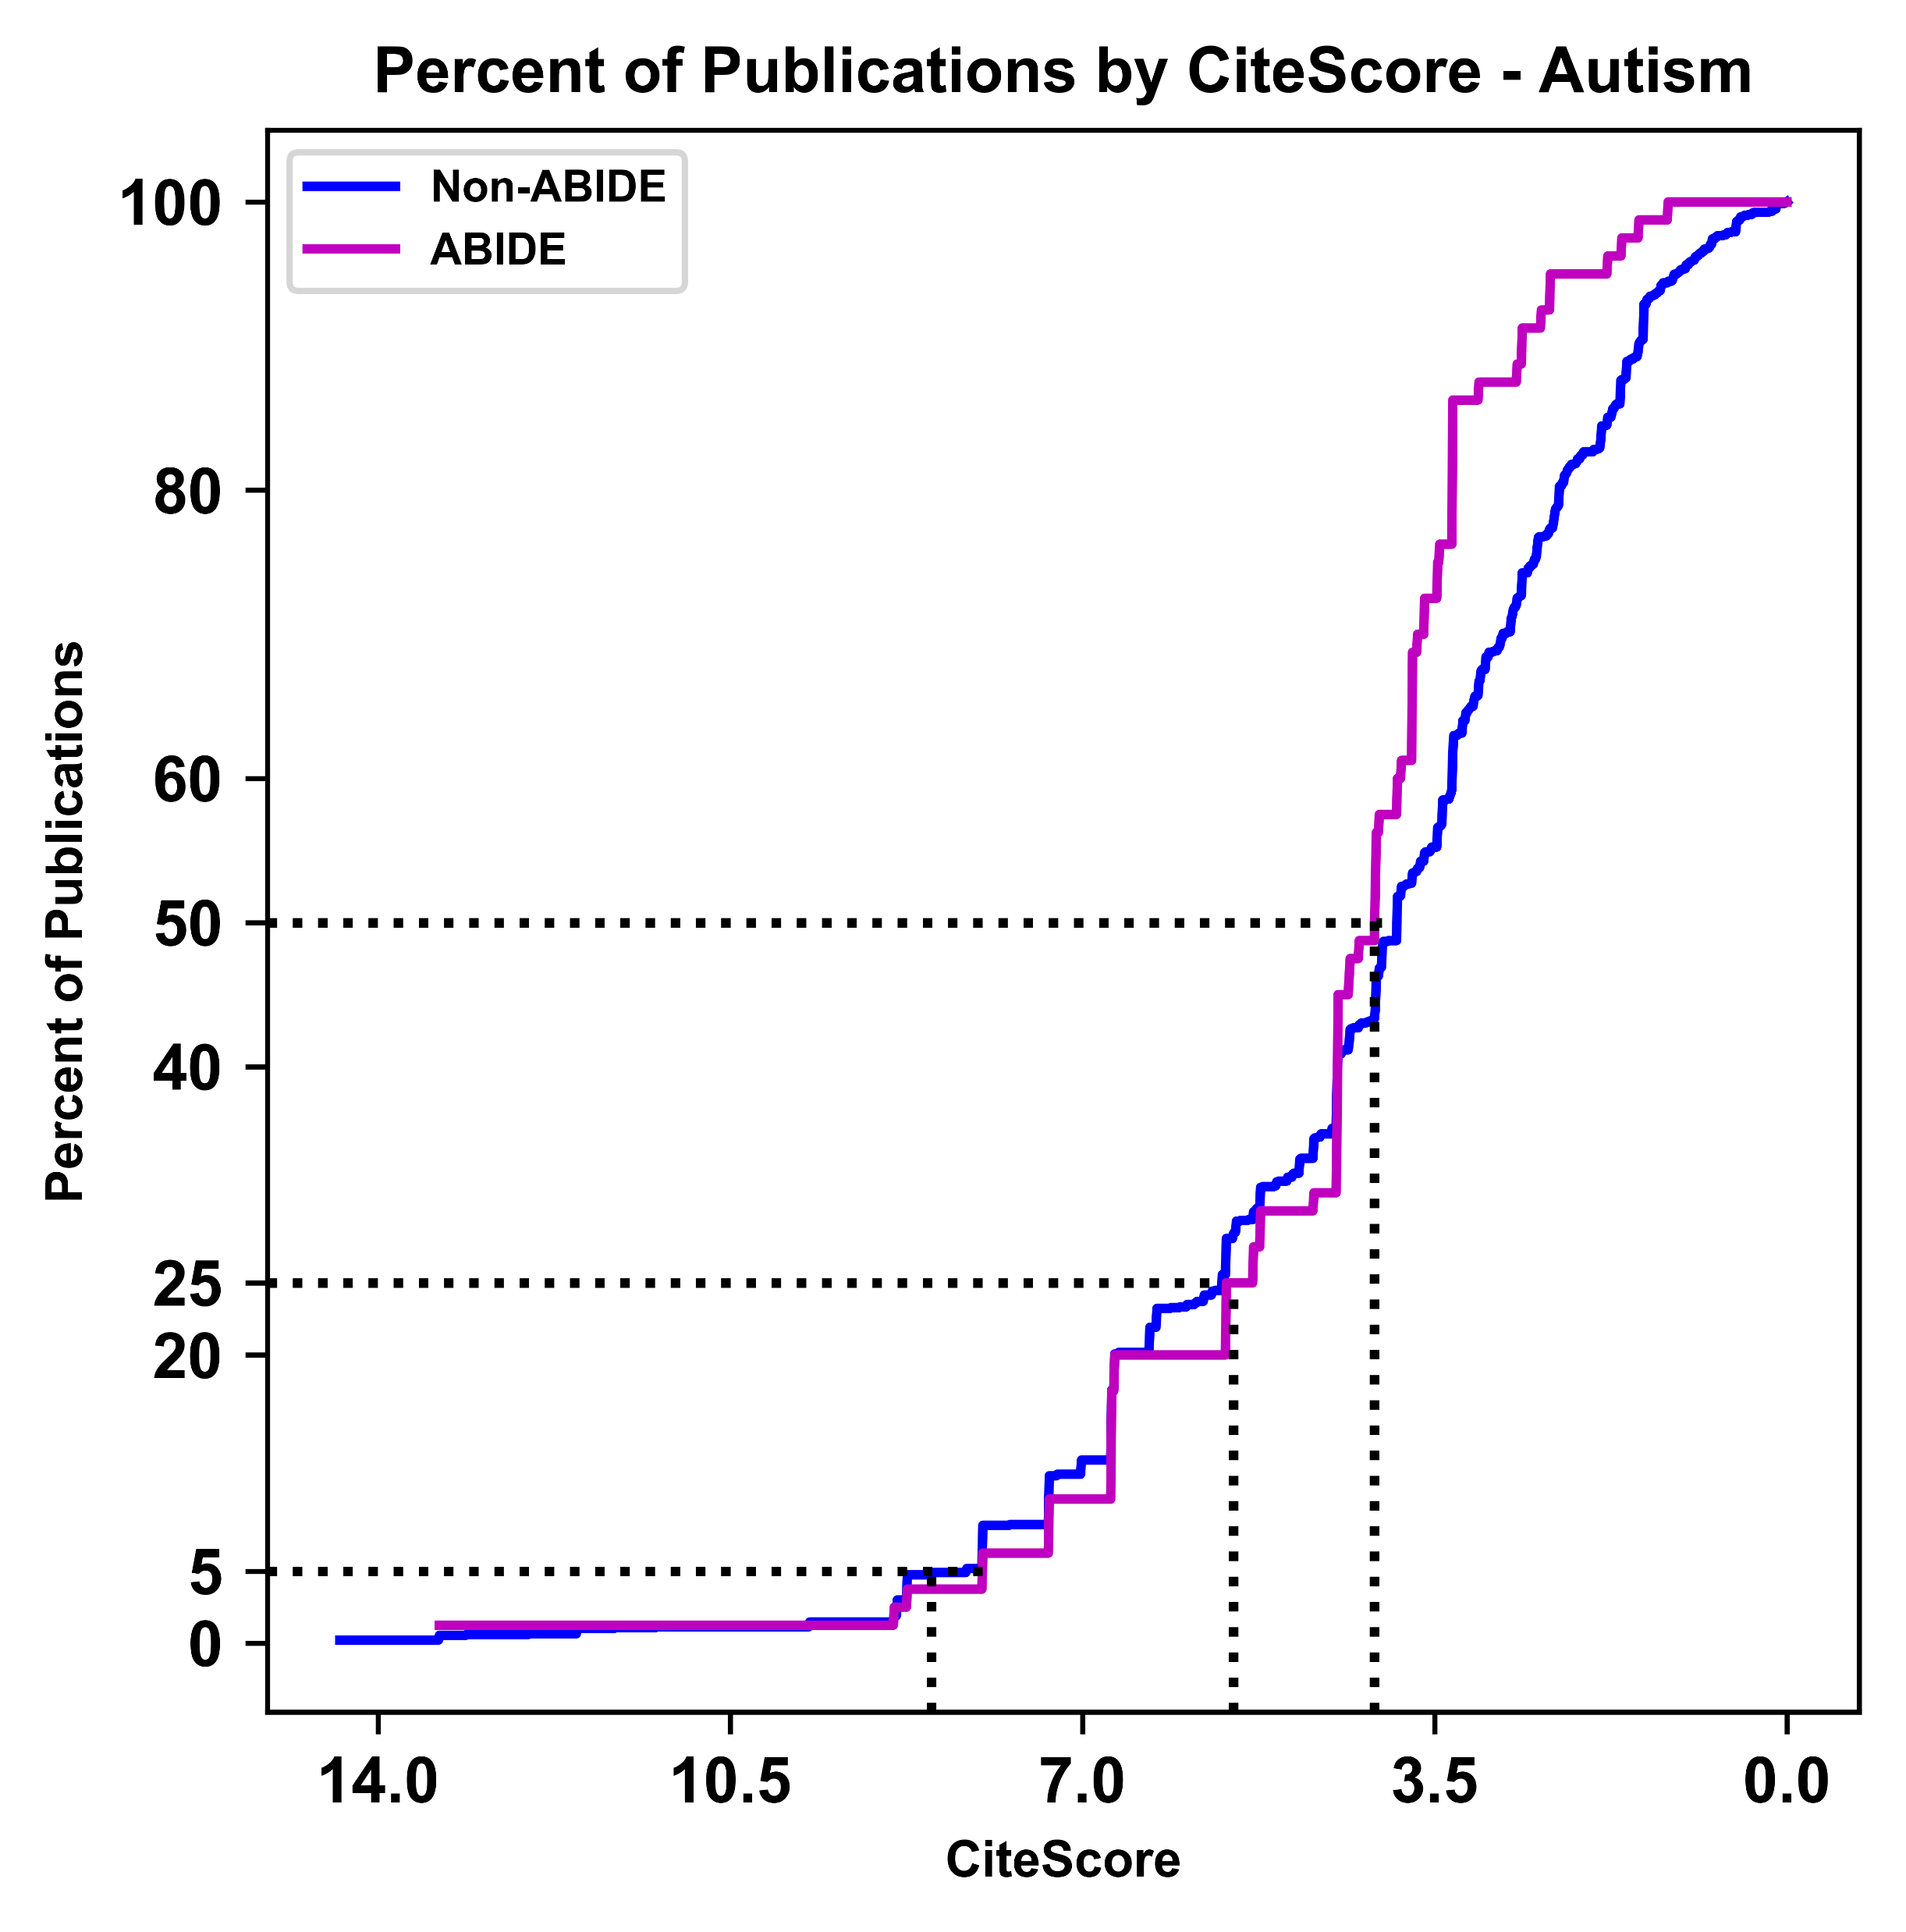
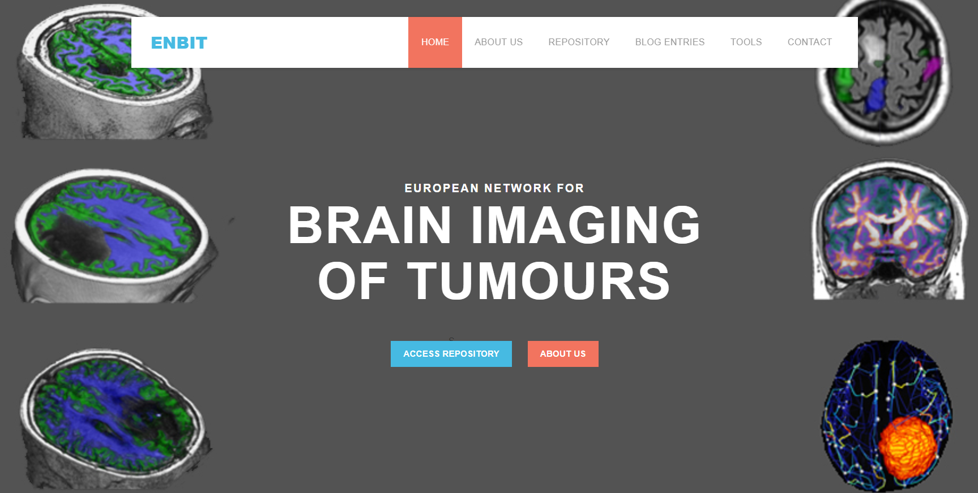
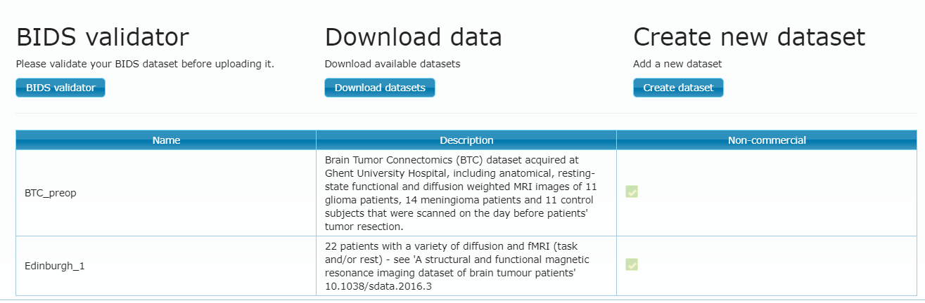
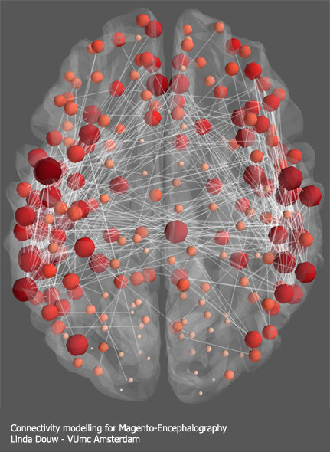
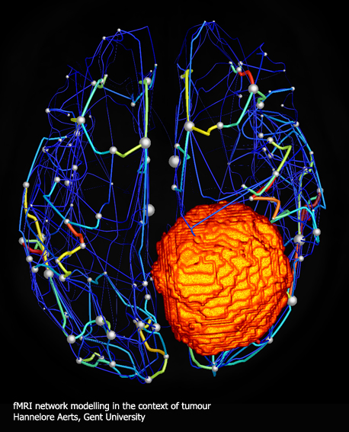
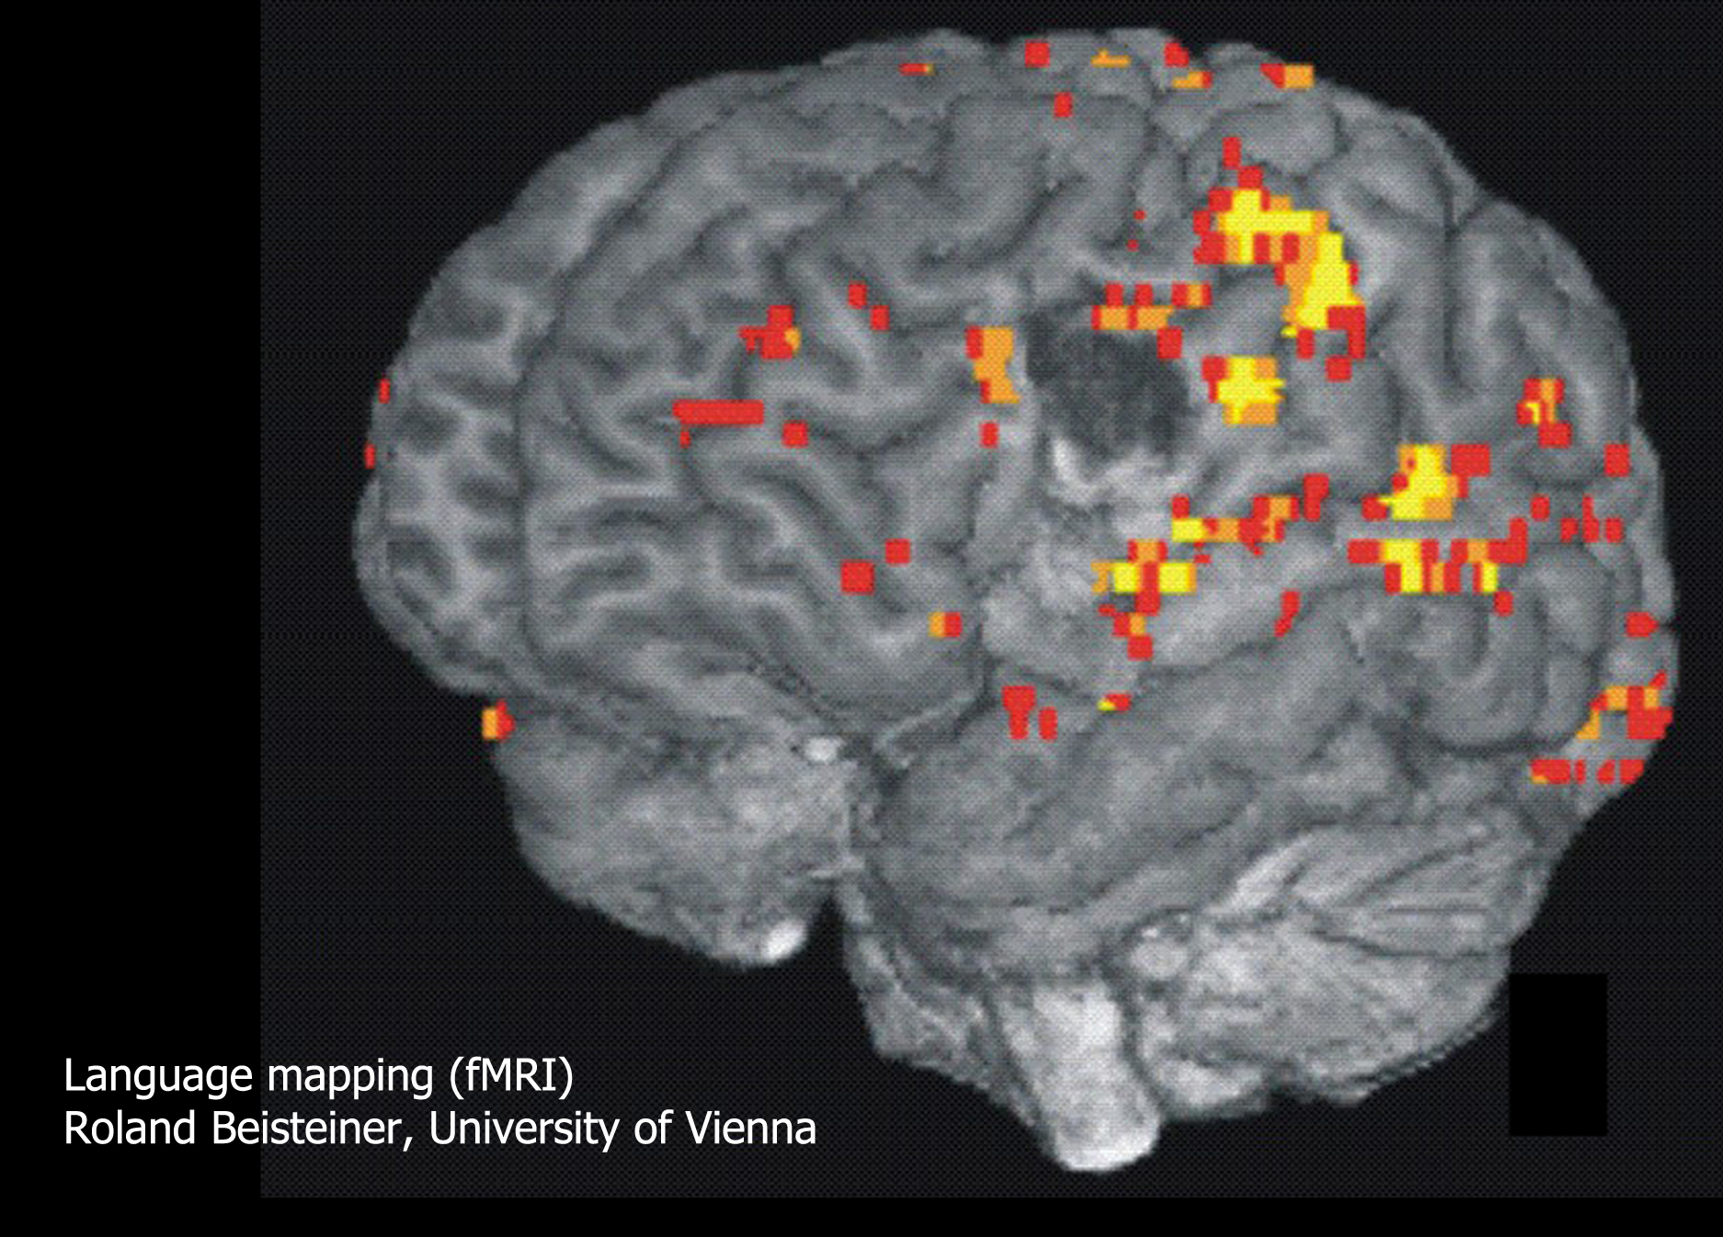


European Network for
Brain Imaging of Tumours
CR Pernet¹, R Beisteiner², C Stippich³, L Douw⁴, Daniele Marinazzo⁵ & Anders Eklund⁶
1 University of Edinburgh, United Kingdom, 2 Medical University of Vienna, Austria,
3 University Hospital of Zurich, Switzerland; 4 VUmc Amsterdam, Netherlands,
5 Gent University, Belgium, 6 Linkoping University, Sweden
enbit.ac.uk
There is evidence that sharing complex imaging data increases the scale of scientific studies performed recruiting scientists from a broad range of disciplines (Milham et al. 2018).
Download data
Upon registration and a quick check the user is a real person, access is granted.
Data download: Data are listed per data set and downloadable as such, along with their own licence.
Datasets follow BIDS to facilitate data analysis and reproducibility
Data restrictions: only contributors have access to fresh data (<1 year), some data can be commercially restricted.
Despite successes in general cancer therapy, patients with brain tumours have very low survival rates and to improve clinical outcomes, we have launched ENBIT supporting any advanced brain imaging (MRI, MEEG) in the hope to engage the community in solving challenges associated to treatments.
Sharing your data
Upload data in the brain imaging data structure (BIDS: Gorgolewski et al., 2016), to facilitate data analysis and reproducibility. A BIDS validator verifies that requirements are met. http://bids.neuroimaging.io/
To link imaging and genetic data and describe what genetic information
is available, we developed the BIDS genetics extension
specify metadata associated with the disease, BIDS brain tumours is also being developed – all welcome to contribute here: https://tinyurl.com/bids-tumours
References
Milham et al. (2018). Assessment of the impact of shared brain imaging data on the scientific literature. Nature Communications volume 9, Article number: 2818
Gorgolewski et al. (2016). The brain imaging data structure, a format for organizing and describing outputs of neuroimaging experiments, Scientific data, 3, 160044.

