Slide 1

DEPARTMENT OF COMPUTER SCIENCE & ENGINEERING
Project Work - II

Slide 2



Intern At Subex
By: Aayush Agrawal
EN18CS301003
Medi-Caps University, Indore

Slide 3

Faculty: Mr. Ashish Kumawat
Guide: Mr. Kiran Kumar KP (Technical Architect at Subex)

Slide 4
Abstract:
Telecom industry is becoming a top performing industry in the last few years.
This industry has a unique set of challenges from the technology front and the customer demands due to its wide range of sectors.
Telecom industry consists of a set of sectors like wireless communication, satellite communication, Internet Service Provider etc.
Telecom industry builds, maintains and operates telecommunication network and thereby makes communication possible globally through internet or phone for a human being and this service plays a vital role in anyone’s life.

Slide 5
Introduction
Telecommunication:
Telecommunication, also known as telecom, is the exchange of information
over significant distances by electronic means and refers to all types of voice, data and
video transmission.
Support Systems involved in Telecommunication:
Operations Support Systems (OSS)
Business Support Systems (BSS)
Components of Telecommunication Network:
BTS (Base Transceiver Station)
BSC (Basic Station Controller)
MSC (Mobile Switching Center)

Slide 6
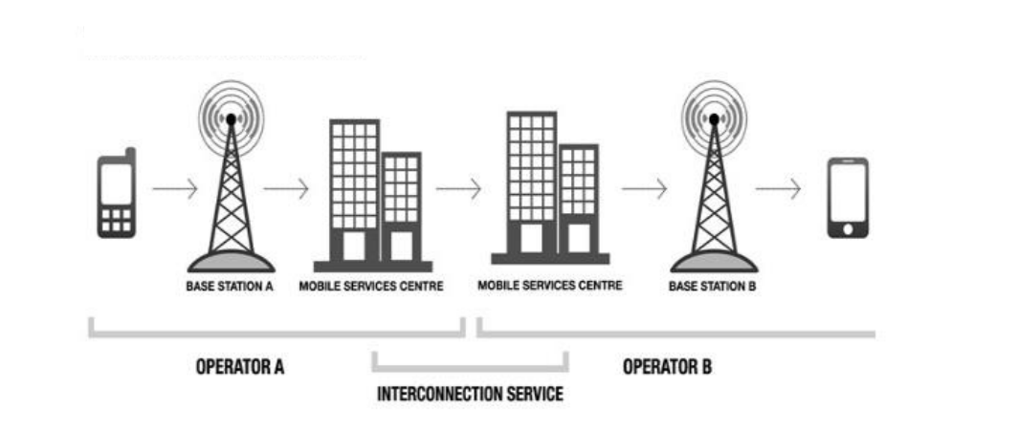
Interconnect:
In telecommunications, interconnection is the physical linking of a carrier's network with equipment or facilities not belonging to that network.

Slide 7






Mobile Development Tech Stack

Slide 8

BENEFITS OF ANGULAR

Slide 9
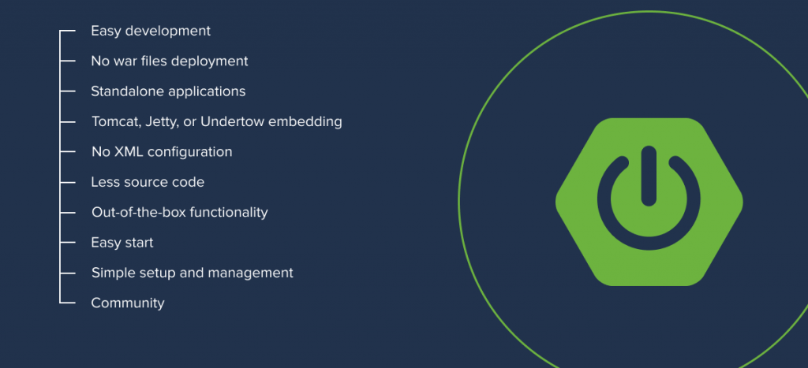
Features of Spring Boot

Slide 10
Project Objectives
We will attempt to attain these objectives in our mobile app:
Specific to business users
Seamless user experience with enhanced UI
One code base for both android and IOS platforms
Optimized to use less storage and make less API calls to server
Same codebase can also be used to make progressive web and web applications
To provide important bill details directly on user’s mobile screen
More attractive UI.

Slide 11
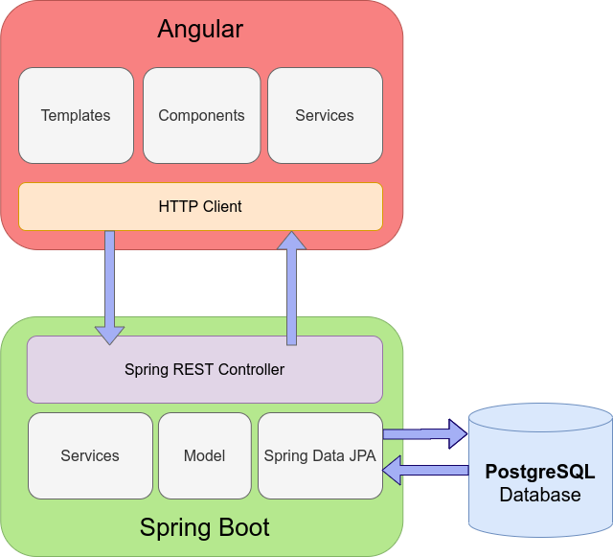
Project WorkFlow

Slide 12
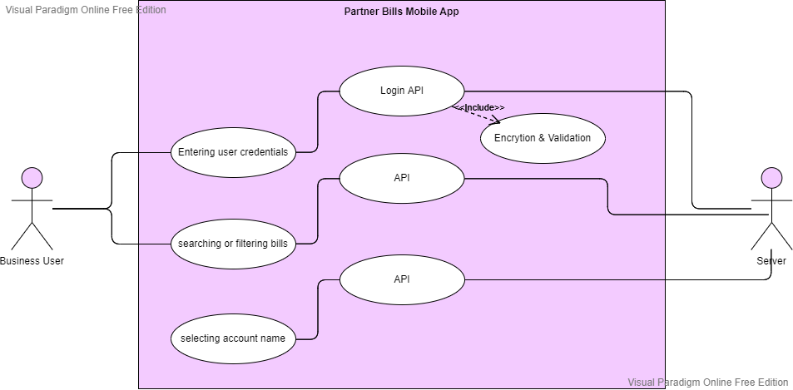
Use Case Diagram

Slide 13
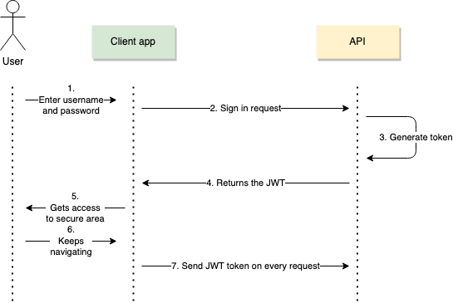
Sequence Diagram

Slide 14
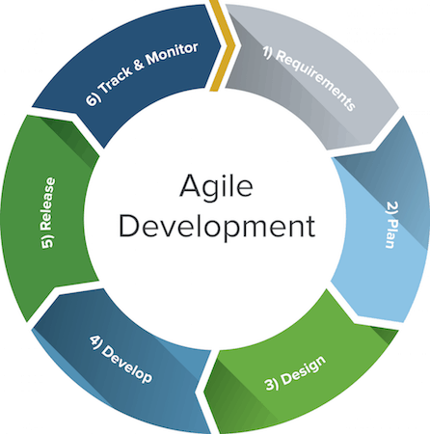
Approach

Slide 15
Working Demo

Slide 16
Thank you !
Presented by :
Aayush Agrawal
EN18CS301003

