Slide 1

E-Commerce Website
Medi-Caps University
A presentation
Submitted in partial fulfillment of requirement of the Degree of
BACHELOR OF TECHNOLOGY
in
COMPUTER SCIENCE AND ENGINEERING
BY
Mohd. Farhan Khan (EN18CS301145)

Slide 2
Company Profile
Indvibe Infotech Pvt. Ltd. is an IT based company located in Indore M.P. It’s main area of work is in the field of Web Development and development of mobile applications with use of various contemporary technologies like Python,IoT, Artificial Inteligence etc.
They provide various services like:
Web Development
Mobile Development
Python Development
AI based applications
MEAN stack Development
The Corporate Identification Number (CIN) of Indvibe Infotech Private Limited is U72900MP2021PTC054712. The registered office of Indvibe Infotech Private Limited is at 302-B, RAJAT COMPLEX 18 KIBE COMPOUND, INDORE, Indore, Madhya Pradesh.

Slide 3
Introduction
An eCommerce website is an information technology method in which traders, businesses/distributors/marketers can sell products/services and the customer can purchase on that website electronically by using the internet on the mobile and computer. It means an e-commerce website is an online shop. e means electronic. Commerce means business. Website means the group of HTML web pages and that is created to market/sell information/product/services.
From a bigger perspective, every website on the internet is the eCommerce Website. It can be the platform, it can be a marketplace, it can be a portal, it can be apps, it can be an entertainment website, shopping website, online courses website and online degree college.

Slide 4
FEATURES
SIGN-UP - The new user have to create account on the website through sign-up information required from the user like email, phone number , password , name, address etc.
LOGIN - The user credentials are typically some form of username and a matching password,and these credentials themselves are sometimes referred to as login.
CUSTOMER – Includes user information about the user,products ,purchased,cancelled etc.
CATEGORY - The user can apply filter according to their needs.
PRODUCTS – The upcoming and the newly launched products will appear here.
HOME - The homepage is often the highest traffic page on an e-commerce site. This single page is responsible for building trust, driving sales, and creating lifelong customers
CART - You can add and remove items as you wish, just like you would in the real world.
CHECKOUT - This includes every step that a customer goes through to proceed through to checkout.
WISHLIST - A Wishlist allows shoppers to create personalized collections of products they want to buy and save them in their user account for future reference.

Slide 5
Technology
Mainly we will be using Django framework of python for developing our web application.
Django is a high-level Python web framework that enables rapid development of secure and maintainable websites. Django helps eliminate repetitive tasks making the development process an easy and time saving experience.
Django follows the MVT pattern, the Model-View-Template (MVT) is slightly different from MVC. In fact the main difference between the two patterns is that Django itself takes care of the Controller part (Software Code that controls the interactions between the Model and View), leaving us with the template. The template is a HTML file mixed with Django Template Language (DTL).
HTML is a markup language. It provides the structure of a website so that web browsers know what to show.
CSS is a Cascading Style Sheet. CSS let’s web designers change colors, fonts, animations, and transitions on the web. They make the web look good.

Slide 6
SCOPE
The scope of the project will be limited to some functions of the e-commerce website. It will display products, customers can select catalogs and select products, and can remove products from their cart specifying the quantity of each item. Selected items will be collected in a cart.
At checkout, the item on the card will be presented as an order. Customers can pay for the items in the cart to complete an order. This project has great future scope. The project also provides security with the use of login ID and passwords, so that no unauthorized users can access your account. The only authorized person who has the appropriate access authority can access the software.

Slide 7
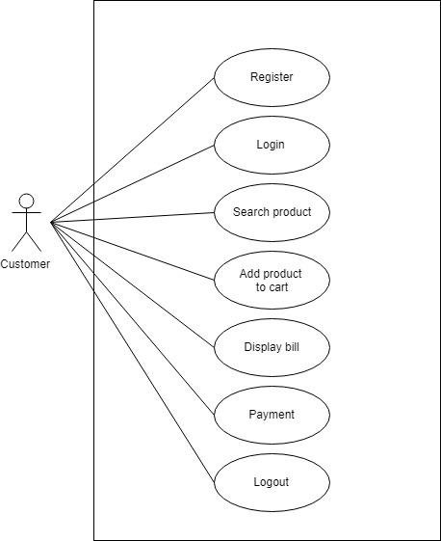
Use-Case Diagram
Use case diagram represents the interactions of the system administrator, bet creator and the participants to this system, it is a graphical depiction of the user’s possible interactions with the system.
Below diagram shows the use-case diagram of an e commerce website.

Slide 8
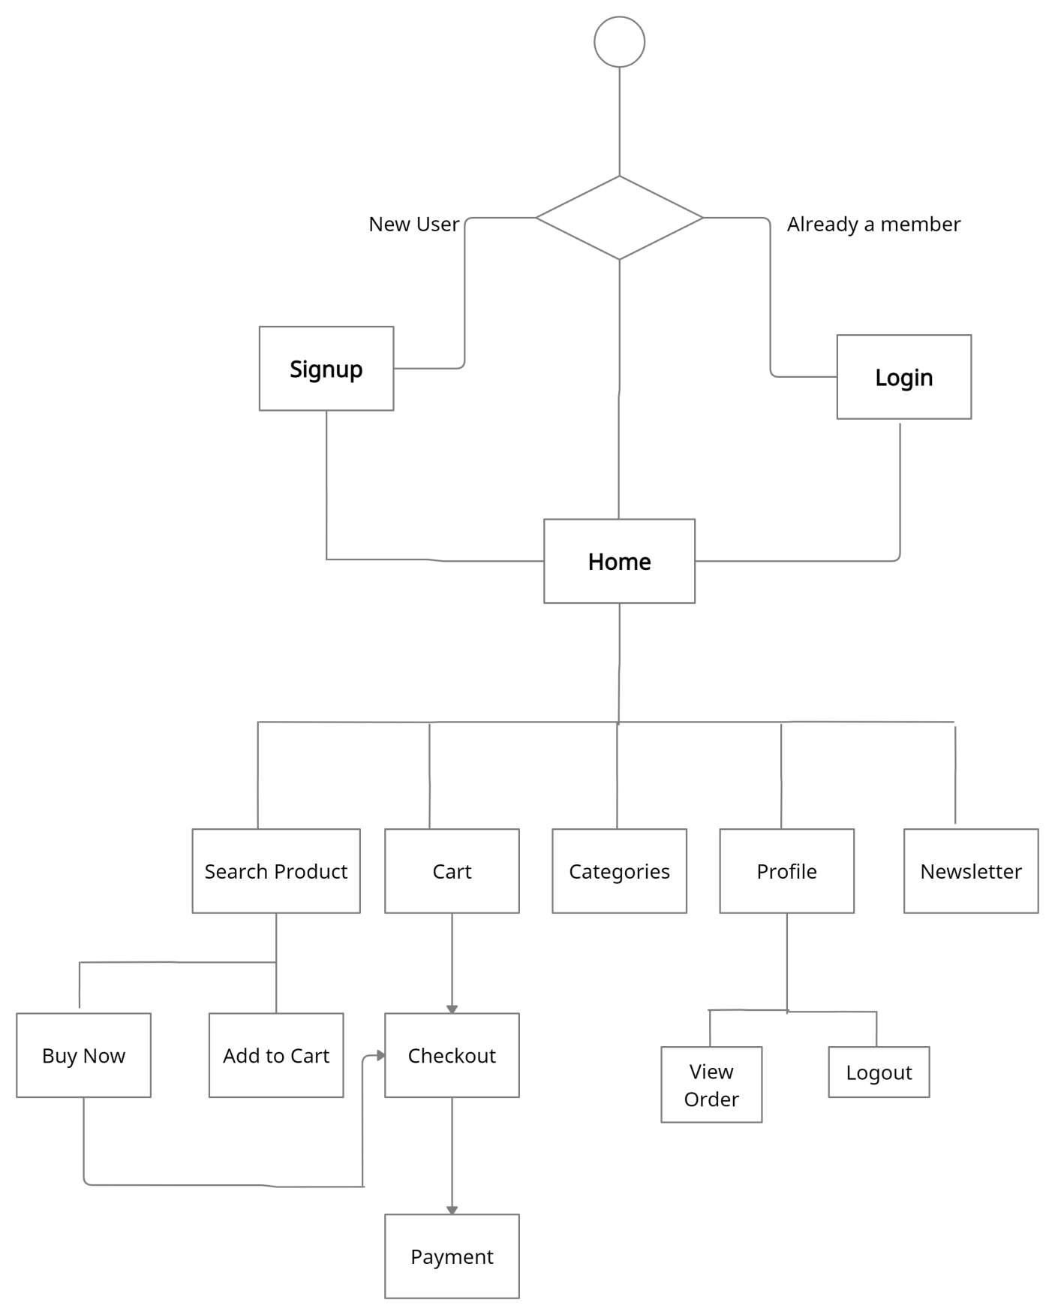
State-Chart Diagram
Statechart diagram describes the flow of control from one state to another state.

Slide 9
Project Modules
1.User Registration Module.
User registration, Profile creation
Profile management – Name, billing, shipping address
Track Order module link
Forget Password Retrieval
2.Users
Display Of Items with Details under Categories
Search Products by User input & Category

Slide 10
Add To Cart
Select Quantity
Price Calculated
3. Shopping Cart Module.
Normal Shopping Cart functionality – Add more product, Update cart, Remove product, checkout
Gift Packaging feature – selecting Gift package type
Shipping location wise shipping charge display
Billing Address > Shipping Address (same or separate)
4. Payment module
Payment module integration
User can pay through this module in time of shopping.

Slide 11
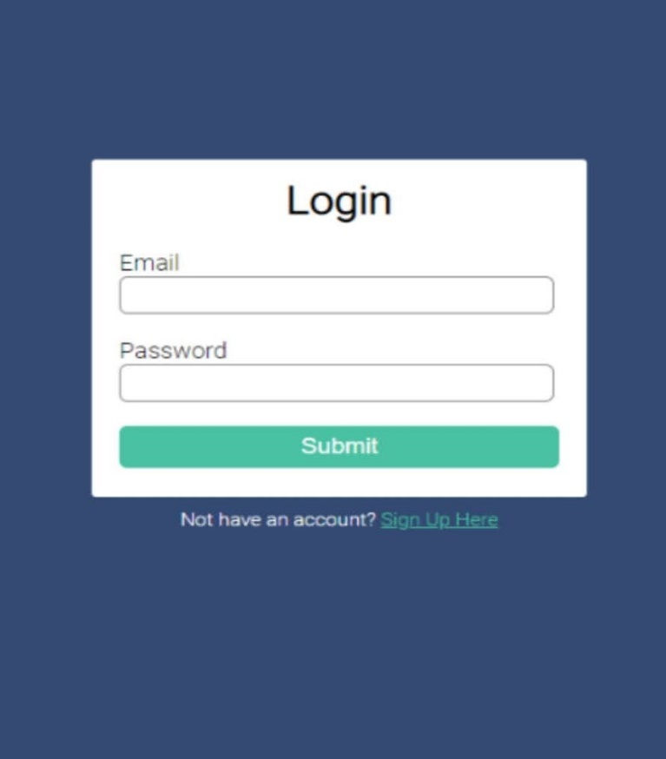
Project screenshots
Login Page:

Slide 12
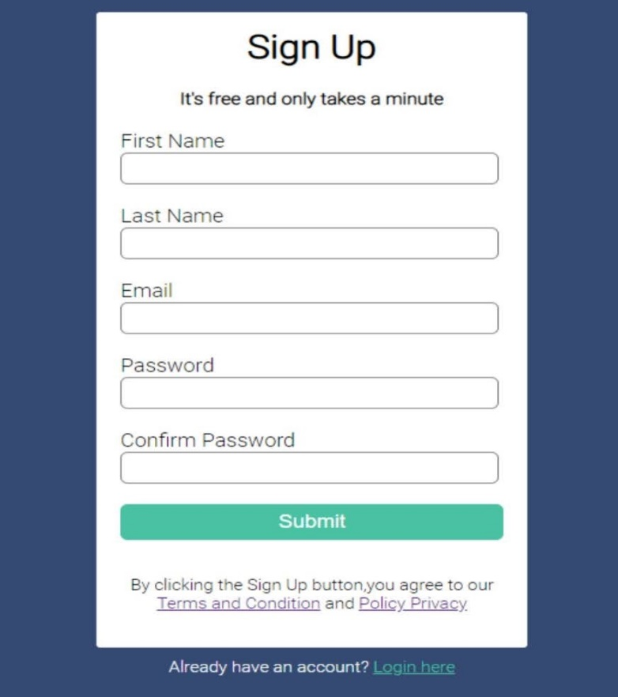
SignUp page:

Slide 13
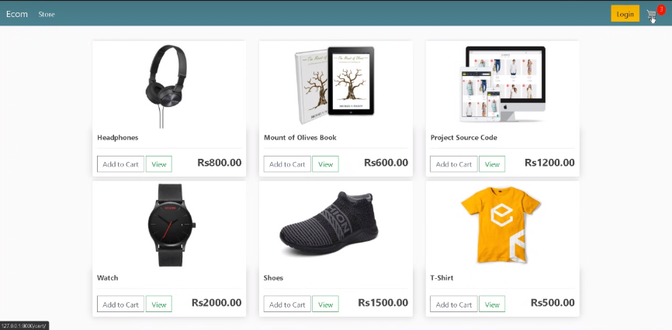
Store Page:

Slide 14
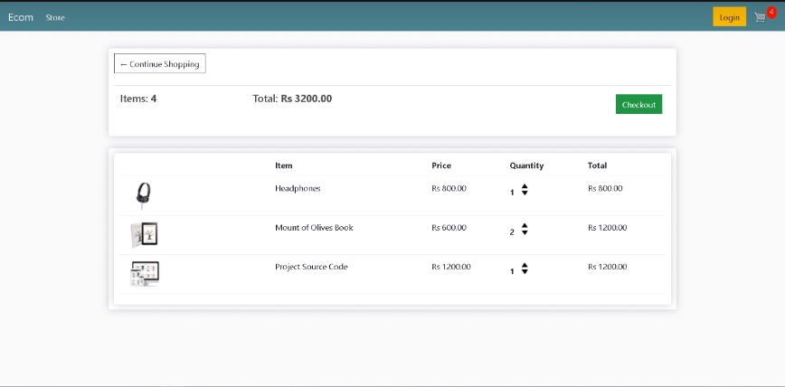
Cart Page:

Slide 15
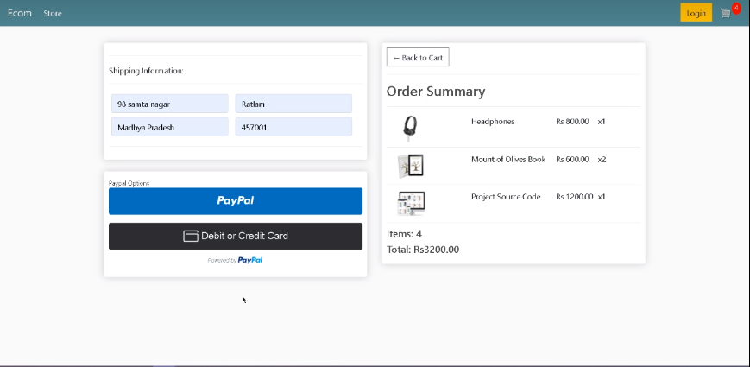
Checkout Page:

Slide 16
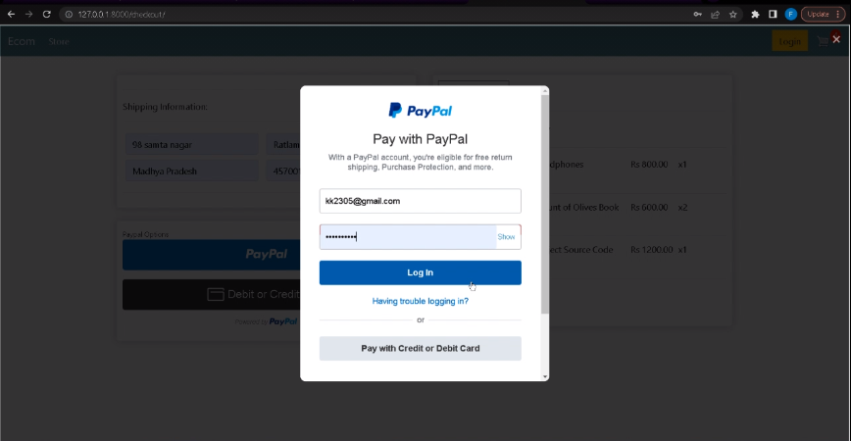
Payment Page:

Slide 17
Thankyou

