Slide 1

B.Tech External Project Evaluation ,VIIIth Sem
Urdu Heritage Translation Project: Reviving Historical Documents for Modern Understanding
Presented by :
Enayat Ullah(2021504061)
Aditya Kumar Mehta(2021481653)
Muzamil Hussain Mir(2021317028)
Under the Supervision of:-
Dr. Manmohan Singh Yadav
Asst. Professor
DEPARTMENT OF COMPUTER SCIENCE & ENGINEERING
SHARDA SCHOOL OF ENGINEERING AND TECHNOLOGY
May 2025
1

Slide 2
Approval from guide for the evaluation

Slide 3
Contents of the Presentation
Introduction to the project
Motivation for the project
Problem Statements/Objectives of the Project
Literature Survey
Workload distribution/ Team Work
Project Planning
Methodology used
Solution Approach
Algorithms and framework
Outcome Produced
Proof of the Outcome

Slide 4
Introduction to the project
Objective: To develop a tool that digitally recognizes and translates old Urdu handwritten documents into modern Urdu.
Key Technology: AI models for text detection, character recognition, and sequence modeling.
Target Outcome: A system that can preserve and translate historical Urdu texts to make them accessible to a wider audience.

Slide 5
Motivation for the project
Preserving Heritage: Many Urdu texts from the past are at risk of being lost or inaccessible due to their old form and difficult handwriting.
Accessibility: Digitizing and translating these documents will make them more accessible to researchers, students, and general readers.
Cultural Significance: Urdu, with its rich history, needs to be preserved and understood better by modern generations.

Slide 6
Problem Statements/Objectives of the Project
Challenges:
Nastaliq Script Recognition:
OCR struggles with the complex and stylized Nastaliq script.
Handwritten Text Variability:
Handwritten text varies, making it difficult to decode accurately.
Objectives:
Accurate Urdu Text Recognition:
Develop an OCR system to recognize printed and handwritten Urdu text.
Accessible Platform:
Provide an easy-to-use platform for users to access digitized and translated documents.

Slide 7
Literature Survey
S. No. | Title | Author(s) | Publication Date | Algorithm/Methodology | Result (Accuracy or Other Parameters) | Pros | Cons
1 | Optical Character Recognition System for Urdu Words in Nastaliq Font | Safia Shabbir and Imran Siddiqi | 2015 | Recognition of Urdu words in Nastaliq font using ligatures as units of recognition. Ligatures recognized using right-to-left HMMs. | Segmentation-free and size invariant technique. Promising recognition rates at ligature and word levels. | High accuracy for ligatures and words. Size invariant technique. | Limited existing literature on Urdu OCR. Over-reliance on ligature recognition may lead to inaccuracies.
2 | Segmentation-free Optical Character Recognition for Printed Urdu Text | Israr Ud Din, Imran Siddiqi, Shehzad Khalid, and Tahir Azam | 2017 | Segmentation-free OCR system for printed Urdu Nastaliq font using ligatures as units of recognition. Statistical features and Hidden Markov Models employed for classification. | Ligature recognition rate of 92% on more than 6000 query ligatures. | High recognition rate for printed Urdu text. | May struggle with handwritten or stylized text.

Slide 8
3 | A Multi-Faceted OCR Framework for Artificial Urdu News Ticker Text Recognition | Sami-Ur-Rehman, Burhan Ul Tayyab, Muhammad Ferjad Naeem, Adnan Ul-Hasan, and Faisal Shafait | 2020 | First instance of Urdu news ticker detection and recognition. Bi-Directional Long Short-Term Memory (BDLSTM) network architecture utilized. | Outperformed Google’s commercial OCR engine in two of the four experiments conducted. | High accuracy for Urdu news ticker text recognition. Comprehensive dataset from 41 news channels. | Accuracy may decrease with low-quality videos or heavily distorted text.
4 | MMU-OCR-21: Towards End-to-End Urdu Text Recognition Using Deep Learning | Tayyab Nasir, Muhammad Kamran Malik, and Khurram Shahzad | 2021 | Large Multi-level and Multi-script Urdu corpus (MMU-OCR-21) proposed for deep learning techniques. Experimented with multiple state-of-the-art deep learning techniques. | Largest-ever Urdu corpus suitable for deep learning techniques. | Addressed limitations of existing Urdu corpora. | Challenges in maintaining consistency across different fonts and styles.
5 | Handwriting Recognition of Historical Documents with Few Labeled Data | Edgard Chammas, Chafic Mokbel, Laurence Likforman-Sulem | 2022 | Handwriting recognition of historical documents with limited labeled data. | Not specified. | Addressed challenges of handwriting recognition with limited labeled data. | Accuracy may decrease with highly degraded or poorly preserved documents.

Slide 9
Workload distribution/ Team Work
Data Collection & Preprocessing: [Aditya Kumar Metha] - Collected and preprocessed old Urdu documents.
Model Development: [Muzamil Hussain mir, Enayat Ullah] - Developed AI models for text detection and recognition.
UI Design: [Enayat Ullah, Aditya Kumar Mehta] - UI design web page design .
Paper work: [Aditya Kumar Mehta] , [Enayat Ullah]
Collaboration: Regular updates and collaboration ensured the project was progressing smoothly.

Slide 10
Project Planning
1. Goal
OCR system to convert historical Urdu texts into modern readable Urdu.
2. Team Roles
Developer: OCR & web integration.
UI: Design the web interface.
Tester: Ensure accuracy.
3. Timeline
Phase 1: Research
Phase 2: Development
Phase 3: UI Design
Phase 4: Testing
4. Milestones
M1: OCR
M2: Web Interface
5. Future Plans
Improve accuracy for handwritten texts.
Expand support to additional languages.

Slide 11
Methodology used
Architecture
Hybrid CNN-RNN Model
Convolutional Neural Network (CNN): Extract features from Urdu text, basically used for image recognition and processing .
recurrent neural network (RNN): Capture sequence patterns and context.
Prediction: Integrated prediction stage for accurate text output.
MMU-OCR-21 Dataset:
A high-quality dataset for diverse, real-world Urdu text recognition.
Covers multiple fonts, sizes, and layouts.

Slide 12
Key Metrics:
Character Accuracy (CLA): Correct characters out of total characters.
Word Accuracy (WLA): Correct words out of total words.
Word Error Rate (WER): Measures mistakes in word predictions.
Character Error Rate (CER): Measures mistakes in character predictions.
F1-Score: Combines Precision and Recall for overall performance.
Other Metrics:
Robustness: Performance with different fonts and layouts.
Consistency: Stable performance across various datasets.
Inference Time: Speed of recognizing text in real-time.

Slide 13
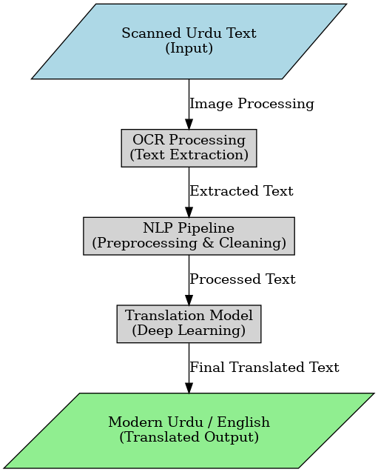
Solution Approach
Step 1: Preprocessing: Normalize the image for consistent input.
Step 2: Text Detection: Detect text lines using YOLO.
Step 3: Character Recognition: Use Bidirectional LSTM to recognize characters in the text lines.
Step 4: Result Output: Show the original image with recognized text .

Slide 14
Algorithms and framework
1. Feature Extraction
Extracts key visual features using models like HRNet, DenseNet, ResNet, etc.
2. Sequence Modeling
Utilizes LSTM, BiLSTM, GRU(Gated Recurrent Unit) to capture feature sequence and context.
3. Dropout Layers
Prevents overfitting by randomly deactivating features during training.
4. Prediction
Uses CTC for basic predictions or Attention for context-aware results.
Key Flow:
Feature Extraction: Capture visual features from images.
Sequence Modeling: Understand feature sequence and context.
Dropout: Enhance model by random feature deactivation.
Prediction: Generate predictions with CTC or Attention.
Key Benefits:
Flexible: Supports diverse models for extraction and sequence modeling.
Robust: Dropout and attention boost accuracy.

Slide 15
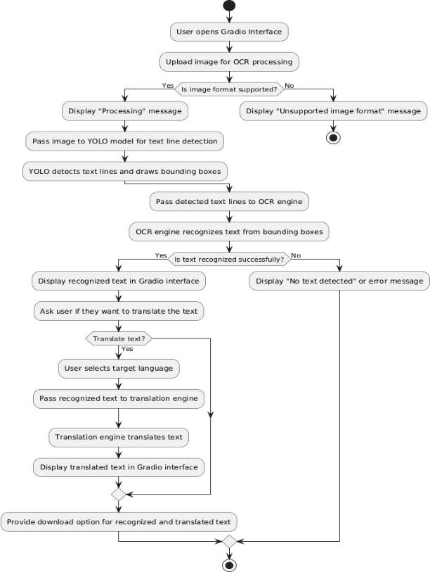
Overall Project Workflow

Slide 16
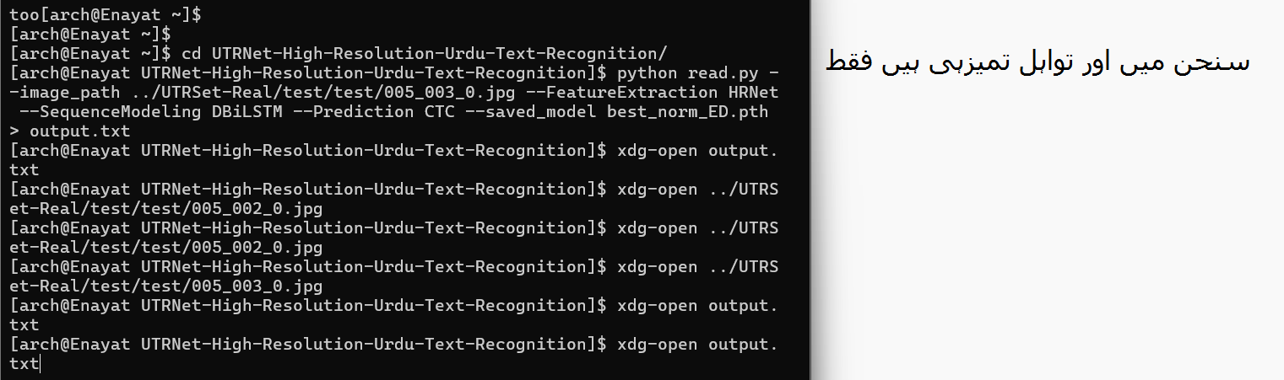
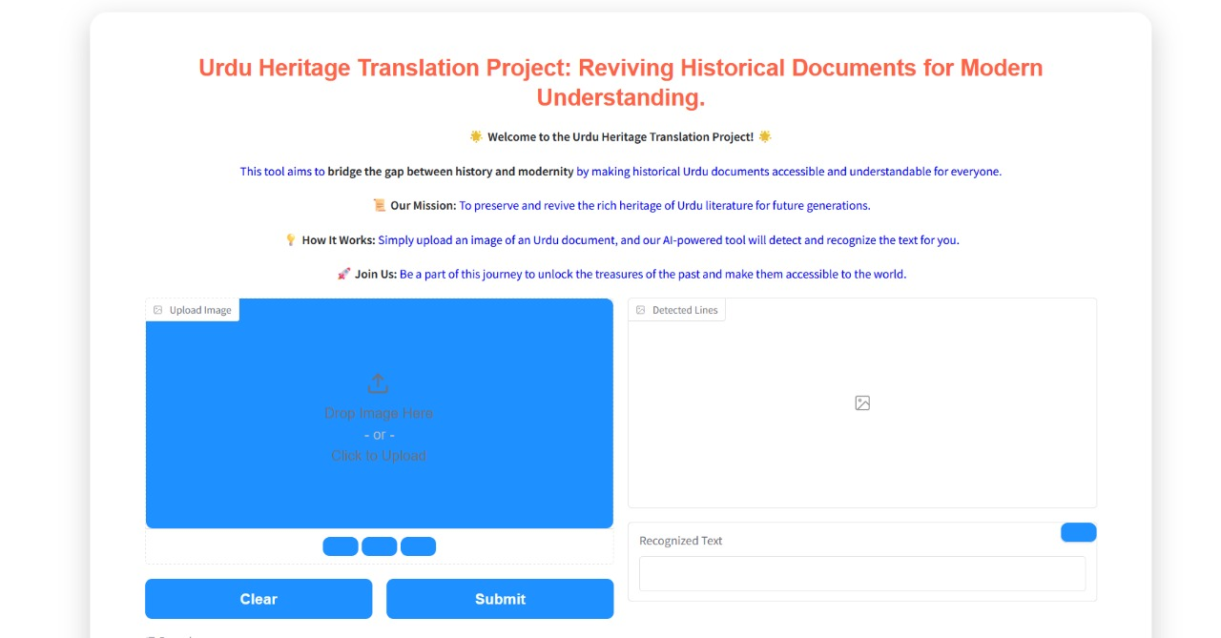
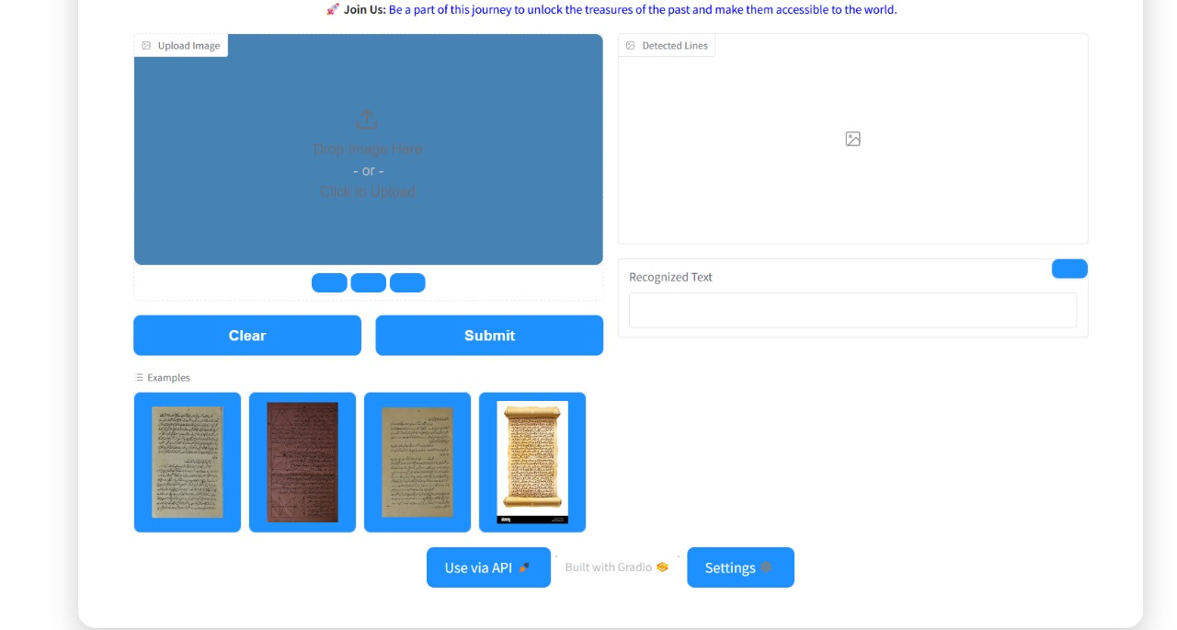
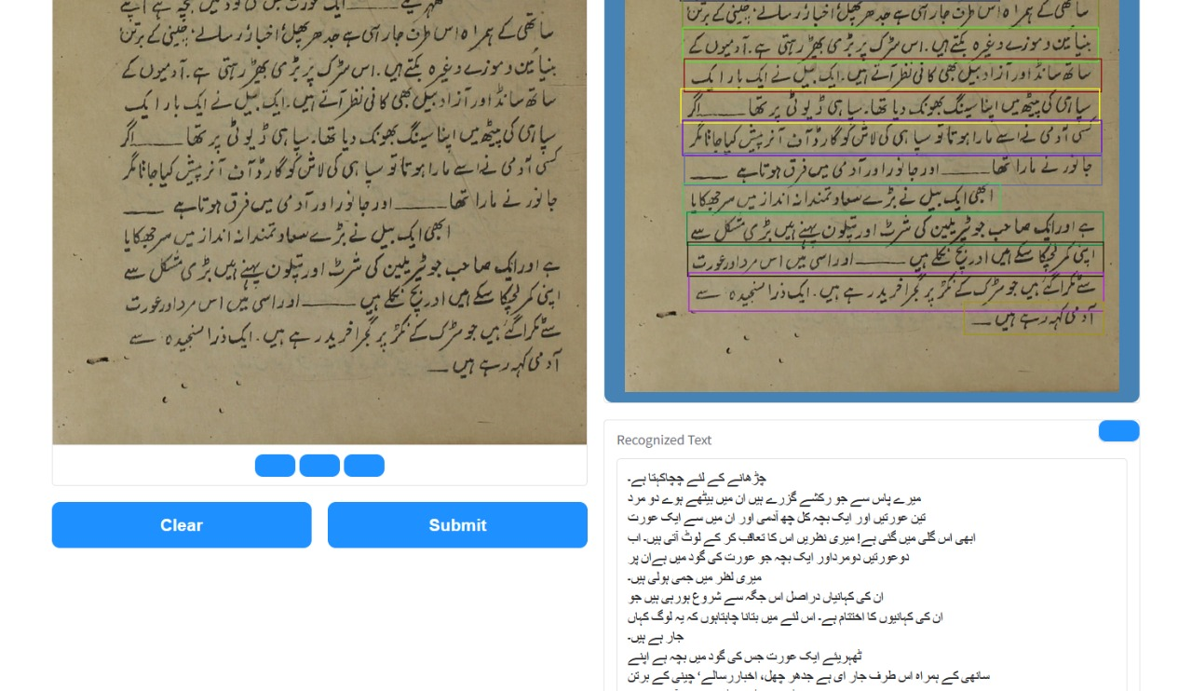
Outcome Produced
OCR Results
Web page result

Slide 17
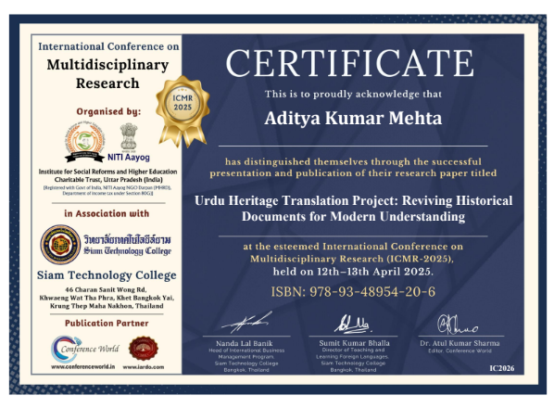
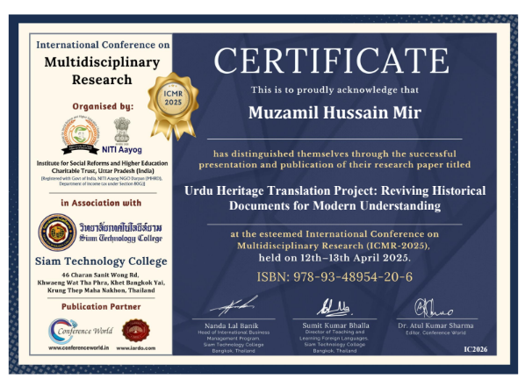
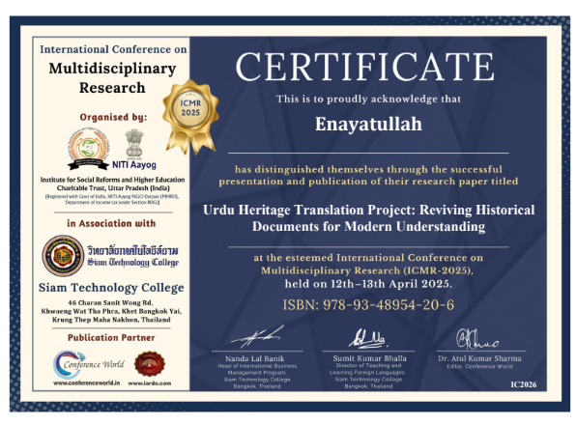
Proof of the Outcome

Slide 18
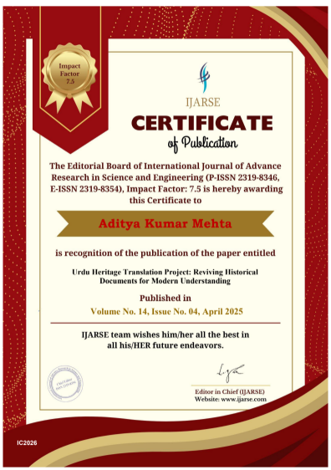
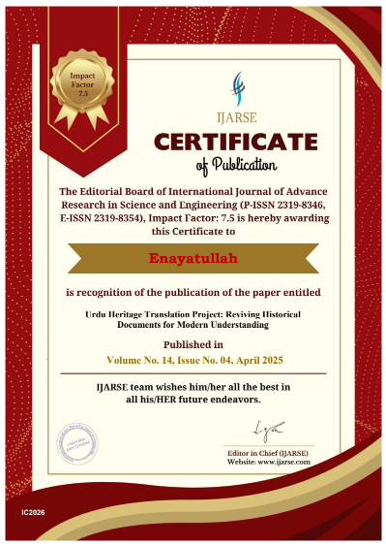
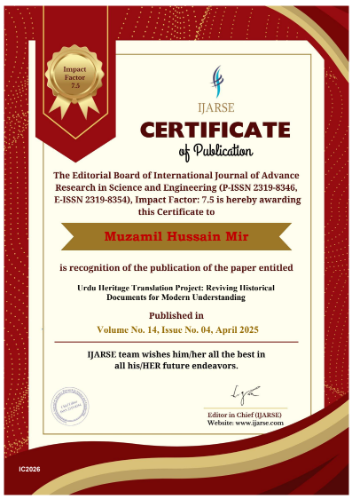

Slide 19


