Slide 1
An overview of OpenFOAM

Slide 2
What is OpenFOAM?
Open Source Field Operation and Manipulation
A computational fluid dynamics (CFD) software
Solves equations of fluid motion with finite volume method
First developed by OpenCFD Ltd
Open source
The source code is written in C++

Slide 3
OpenFOAM versions
There are two main variants of OpenFOAM:
OpenCFD version :
New versions released twice a year (June-December)
Versions are named as (vYYMM) like v1912
Website: https://www.openfoam.com
OpenFOAM foundation version :
No defined date for new release
Versions are named with with two digits like 4.1
Website: https://openfoam.org

Slide 4
OpenFOAM versions What is the story behind this?
First version of OpenFOAM was released by OpenCFD in 2004
OpenCFD kept issuing new releases up to 2.0.1 (2011)
Silicon Graphics International (SGI) acquired OpenCFD
OpenFOAM foundation was created with permission of using OpenFOAM trademark
Since 2016, OpenCFD has started issuing OpenFOAM by itself

Slide 5
OpenFOAM versions Which version to use?
Depends on the feature you want to use
Check the website and release notes to see which one fits better to your framework
If both include the features you need, do some performance and accuracy benchmarks to see which one is better
Otherwise it is just matter of taste!
We will be using v1912 for the training

Slide 6
OpenFOAM environment
OpenFOAM installation directory
platforms
applications
src
tutorials
Includes executables
for the flow solvers
Includes source codes
of the flow solvers
Includes source codes
of the flow solver modules
Includes example cases

Slide 7
OpenFOAM input files To setup a case, you need to have 3 directories in your case directory
Your OpenFOAM case directory
system
constant
0
contains input files for grid generators and solvers
Contains transport properties of the fluid e.g. density, viscosity etc.
contains initial fields of the flow e.g. velocity, pressure etc.

Slide 8
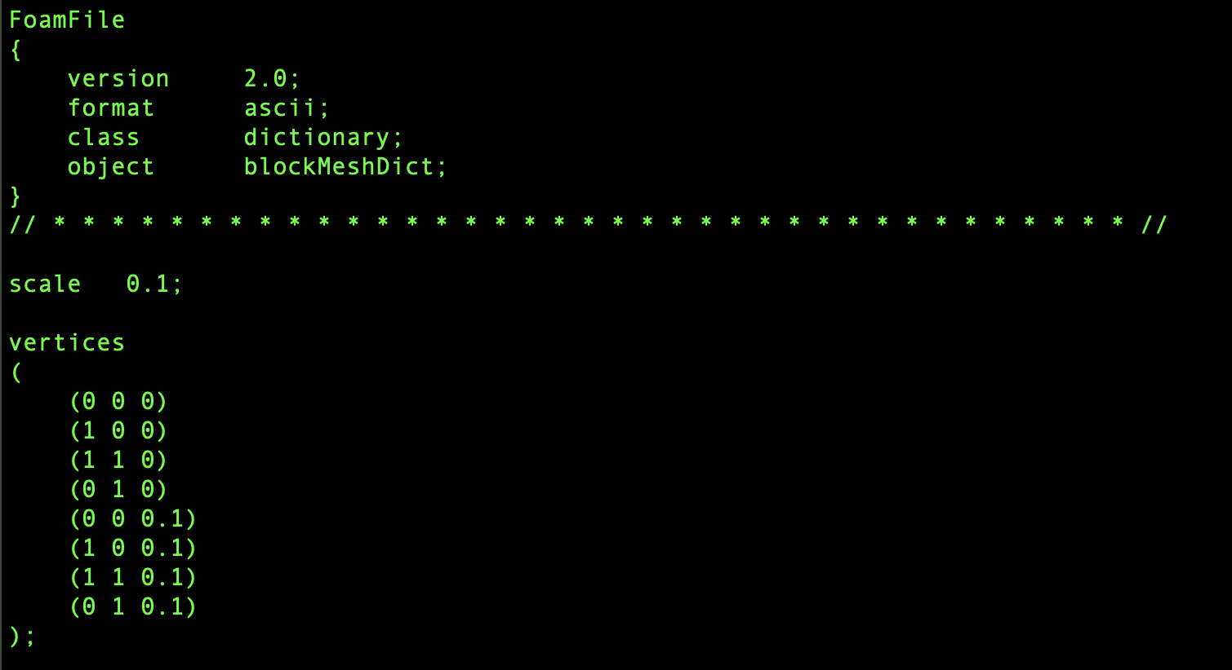
OpenFOAM input files Input file format
For input files, OpenFOAM uses a plain text dictionary format with keywords and values
keyword
value

Slide 9
OpenFOAM executables
Unlike many other software, OpenFOAM does not have a unique executable. For every solver, mesh generation etc. there is a separate executable!
You should run the right executable according to the solver you are using!
‘simpleFoam’: if you use SIMPLE algorithm
‘icoFoam’: if you use PISO algorithm for laminar flow
…
Check the documentation to see recommended solvers for different cases

Slide 10
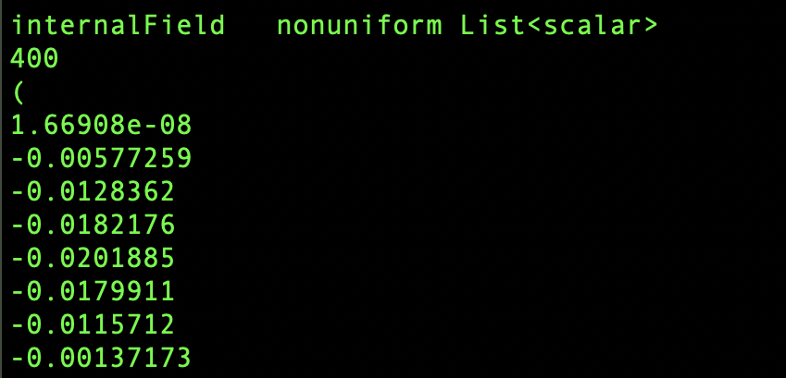
OpenFOAM output files
Similar to the input files, the output files are also in plain text dictionary format
Do not worry if you have not understood anything! We will go through the files with an example

Slide 11
Postprocessing of the output data
ParaView is the main tool for postprocessing of the output data
ParaView is a general visualization tool (not part of OpenFOAM)
It can be used in several ways to visualize OpenFOAM results:
Load the output data using ParaView data loader for OpenFOAM
Load the output data using the reader module supplied by OpenFOAM
Convert output data to VTK format by OpenFOAM conversion module and load it to ParaView
Convert output data to VTK in runtime using OpenFOAM function objects
‘paraFoam’ is an OpenFOAM script to launch ParaView with OpenFOAM reader module

Slide 12
Parallelisation in OpenFOAM
Parallelisation in OpenFOAM is Message Passing Interface (MPI)
Sub-domain 0 | Sub-domain 1
CPU
Memory
CPU
Memory
network

