Slide 1




The Computer Vision Toolkit: Tasks, Architectures, and a Real Retina Pipeline
Author: Elena-Anca PARASCHIV
National Institute for Research & Development in Informatics - ICI Bucharest, Romania
Romanian National Competence Center in HPC - RoNCC

Slide 2
1. Introduction into computer vision - key concepts & applications 2. Deep Learning for Computer Vision 3. Computer Vision Tasks 4. Applications of Deep Learning in Computer Vision 5. Convolutional Neural Networks: Architectures, Convolution/Pooling layers 6. Vision Transformers 7. Use case application on retinal diseases detection using CNNs 8. Wrap-up & Discussions
Contents for today

Slide 3
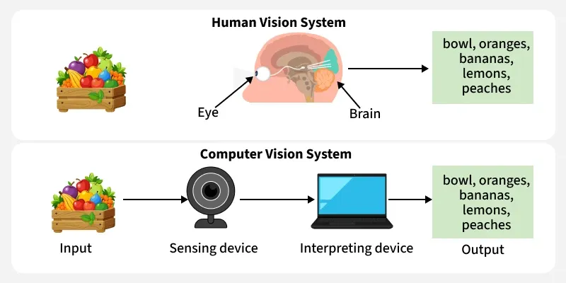
What is Computer Vision? Computer Vision (CV) in artificial intelligence (AI) help machines to interpret and understand visual information similar to how humans use their eyes and brains. It involves teaching computers to analyze and understand images and videos, helping them "see" the world. From identifying objects in images to recognizing faces in a crowd, it is revolutionizing industries such as healthcare, automotive, security and entertainment.
Introduction into computer vision - key concepts & applications
https://www.geeksforgeeks.org/computer-vision/computer-vision/

Slide 4
I. Image Processing: It refers to techniques for manipulating and analyzing digital images. Common image processing tasks include: 1. Image Transformation (Geometric Transformations, Fourier Transform, Intensity Transformation) 2. Image Enhancement (Histogram Equalization, Contrast Enhancement, Image Sharpening, Color Correction) 3. Noise Reduction Techniques (Median Filtering, Bilateral Filtering, Wavelet Denoising) II. Feature Extraction: It involves identifying distinctive elements within an image for analysis and its techniques include: 1. Edge Detection Techniques - Computer Vision Algorithms, Edge Detection Techniques, Canny Edge Detector, Sobel Operator Laplacian of Gaussian (LoG) 2. Corner and Interest Point Detection - Harris Corner Detection 3. Feature Descriptors - SIFT (Scale-Invariant Feature Transform), SURF (Speeded-Up Robust Features), ORB (Oriented FAST and Rotated BRIEF), HOG (Histogram of Oriented Gradients)
Key Concepts in Computer Vision
https://www.geeksforgeeks.org/computer-vision/computer-vision/

Slide 5




Popular Libraries for Computer Vision
Mostly used open-source library for computer vision tasks like image processing, video capture and real-time applications.
A popular deep learning framework that includes tools for building and training computer vision models.
Another deep learning library that provides great flexibility for computer vision tasks for research and development.
A part of the scikit-learn ecosystem, this library provides algorithms for image processing and computer vision.
https://www.geeksforgeeks.org/computer-vision/computer-vision/

Slide 6
Deep learning for Computer Vision
1. Convolutional Neural Networks (CNNs)
Convolutional Neural Networks are designed for learning spatial hierarchies of features from images and its key components include:
Deep Learning for Computer Vision
Deep learning
Convolutional Neural Networks
Convolutional Layers
Pooling Layers
Fully Connected Layers
https://www.geeksforgeeks.org/computer-vision/computer-vision/

Slide 7
Deep learning for Computer Vision
2. Generative Adversarial Networks (GANs)
It consists of two networks (generator and discriminator) that work against each other to create realistic images. There are various types of GANs each designed for specific tasks and improvements:
Generative Adversarial Networks (GANs)
Deep Convolutional GAN (DCGAN)
Conditional GAN (cGAN)
Cycle-Consistent GAN (CycleGAN)
Super-Resolution GAN (SRGAN)
StyleGAN
https://www.geeksforgeeks.org/computer-vision/computer-vision/

Slide 8
Deep learning for Computer Vision
3. Variational Autoencoders (VAEs)
They are the probabilistic version of autoencoders which forces the model to learn a distribution over the latent space rather than a fixed point, some other autoencoders used in computer vision are:
Autoencoders
Variational Autoencoders (VAEs)
Denoising Autoencoders (DAE)
Convolutional Autoencoder (CAE)
https://www.geeksforgeeks.org/computer-vision/computer-vision/

Slide 9
Deep learning for Computer Vision
4. Vision Transformers (ViT)
They are inspired by transformers models to treat images and sequence of patches and process them using self-attention mechanisms, some common vision transformers include:
Vision Transformers (ViT)
Swin Transformer
CvT (Convolutional Vision Transformer)
https://www.geeksforgeeks.org/computer-vision/computer-vision/

Slide 10
Deep learning for Computer Vision
5. Vision Language Models
They integrate visual and textual information to perform image processing and natural language understanding.
Vision language models
CLIP (Contrastive Language-Image Pre-training)
ALIGN (A Large-scale ImaGe and Noisy-text)
BLIP (Bootstrapping Language-Image Pre-training)
https://www.geeksforgeeks.org/computer-vision/computer-vision/

Slide 11
Computer Vision Tasks
1. Image Classification
Image classification is one of the most fundamental tasks in computer vision, where the goal is to assign a label to an image from a predefined set of categories. Deep learning, particularly convolutional neural networks (CNNs), has significantly improved the accuracy and efficiency of image classification tasks.
Applications:
Medical Diagnosis: CNNs are used to classify medical images, such as X-rays and MRIs, to detect diseases like pneumonia, tumors, and other conditions.
Autonomous Vehicles: In self-driving cars, image classification helps in identifying road signs, pedestrians, and other vehicles.
Retail: Retailers use image classification to organize and categorize product images, enhancing search functionality and customer experience.
https://www.geeksforgeeks.org/computer-vision/deep-learning-for-computer-vision/

Slide 12
Computer Vision Tasks
2. Object Detection
Object detection goes beyond image classification by not only identifying objects within an image but also locating them using bounding boxes. Deep learning models such as Faster R-CNN, YOLO (You Only Look Once), and SSD (Single Shot MultiBox Detector) are widely used for this purpose.
Applications:
Surveillance: Object detection is used in security systems to detect and track people, vehicles, and suspicious activities in real-time.
Healthcare: In medical imaging, object detection helps in identifying and localizing abnormalities, such as tumors, in radiological images.
Manufacturing: In automated inspection systems, object detection ensures quality control by identifying defects in products on production lines.
https://www.geeksforgeeks.org/computer-vision/deep-learning-for-computer-vision/

Slide 13
Computer Vision Tasks
3. Image Segmentation
Image segmentation involves partitioning an image into multiple segments or regions to locate objects and boundaries accurately. Semantic segmentation assigns a class label to each pixel, while instance segmentation distinguishes between different objects of the same class.
Applications:
Medical Imaging: Image segmentation is crucial for delineating anatomical structures and abnormalities in medical scans, aiding in precise diagnosis and treatment planning.
Autonomous Driving: Segmentation helps self-driving cars understand their environment by identifying lanes, road signs, and obstacles.
Augmented Reality: Image segmentation enhances augmented reality applications by accurately overlaying virtual objects onto real-world scenes.
https://www.geeksforgeeks.org/computer-vision/deep-learning-for-computer-vision/

Slide 14
Computer Vision Tasks
4. Facial Recognition
Facial recognition systems identify and verify individuals based on their facial features. Deep learning models, particularly CNNs, have significantly improved the accuracy and robustness of facial recognition technologies.
Applications:
Security and Surveillance: Facial recognition is widely used in security systems for identifying individuals in public places, access control, and monitoring.
Smartphones: Many modern smartphones use facial recognition for user authentication and unlocking devices.
Social Media: Platforms like Facebook use facial recognition to automatically tag individuals in photos, enhancing user experience and engagement.
https://www.geeksforgeeks.org/computer-vision/deep-learning-for-computer-vision/

Slide 15
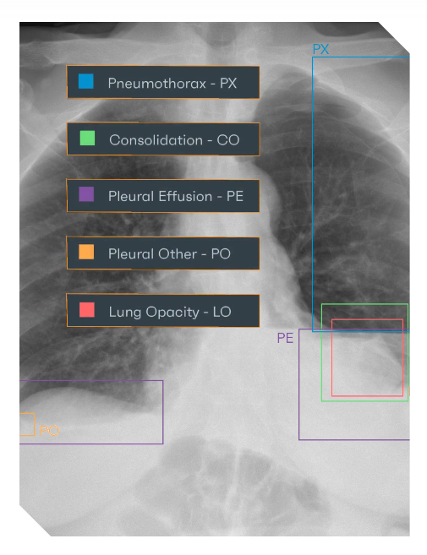
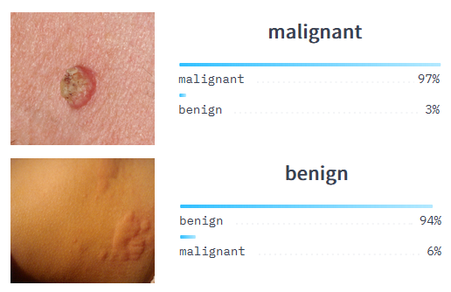
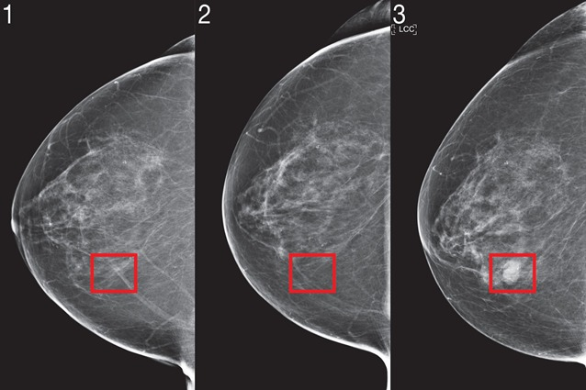
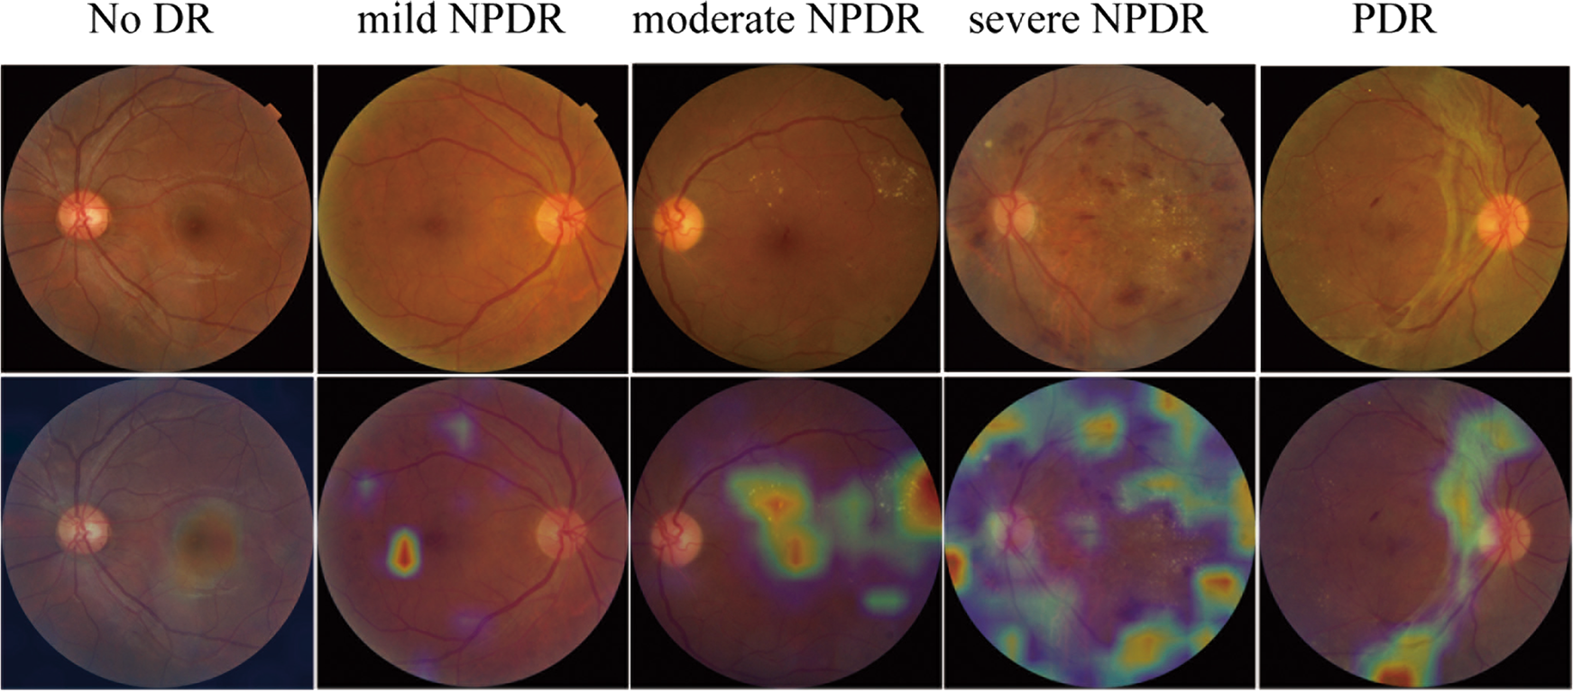
Applications of Deep Learning in Computer Vision
https://rayscape.ai/
https://news.mit.edu/2021/robust-artificial-intelligence-tools-predict-future-cancer-0128
https://www.nature.com/articles/s41433-019-0562-4

Slide 16
Convolutional Neural Networks
Convolutional Neural Networks (CNNs), also called ConvNets, follow the same core idea as standard neural networks: they learn weights and biases that transform inputs into outputs through a sequence of linear operations (dot products) followed by non-linear activations.
What makes CNNs especially suited for images is that they can take raw pixel values as input and gradually build up more meaningful representations, ending with class scores (e.g., “CNV”, “DME”, “Drusen”, “Normal”).
Like other neural networks, a CNN defines a single differentiable mapping from input to output, is trained end-to-end by minimizing a loss function (such as Softmax cross-entropy), and benefits from the same training practices used for regular neural networks.

Slide 17
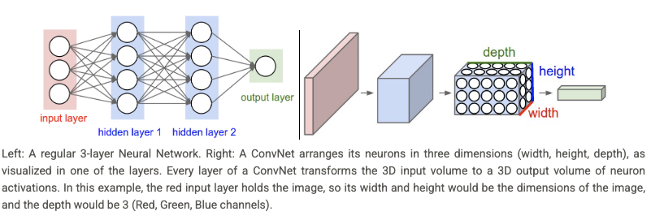
Convolutional Neural Networks
A standard (fully connected) neural network takes an input as a single long vector and passes it through hidden layers where every neuron connects to every neuron in the previous layer.
This becomes impractical for images: even a small 32×32×3 image already requires 3,072 weights per neuron, and a 200×200×3 image would require 120,000 weights per neuron, leading to huge models that are slow to train and prone to overfitting. CNNs solve this by keeping the image structure and using 3D feature volumes (width × height × depth).
Instead of full connectivity, CNN neurons connect only to local regions of the previous layer, gradually transforming raw pixels into higher-level features, and finally compressing the representation into a compact output (e.g., 1×1×N class scores).

Slide 18
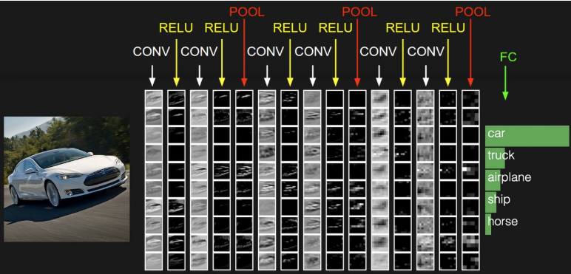
Convolutional Neural Networks
INPUT [32x32x3] will hold the raw pixel values of the image, in this case an image of width 32, height 32, and with three color channels R,G,B.
CONV layer will compute the output of neurons that are connected to local regions in the input, each computing a dot product between their weights and a small region they are connected to in the input volume. This may result in volume such as [32x32x12] if we decided to use 12 filters.
RELU layer will apply an elementwise activation function, such as the max(0,x) thresholding at zero. This leaves the size of the volume unchanged ([32x32x12]).
POOL layer will perform a downsampling operation along the spatial dimensions (width, height), resulting in volume such as [16x16x12].
FC (i.e. fully-connected) layer will compute the class scores, resulting in volume of size [1x1x10], where each of the 10 numbers correspond to a class score, such as among the 10 categories of CIFAR-10. As with ordinary Neural Networks and as the name implies, each neuron in this layer will be connected to all the numbers in the previous volume.

Slide 19
Convolutional Neural Networks
- Convolutional layer
The input is a 3D volume (width × height × channels): here 7×7×3 because we added padding = 1 around the original image.
A filter (kernel) must match the input depth, so each filter is 3×3×3: it has one 3×3 slice per channel (shown as w[:,:,0], w[:,:,1], w[:,:,2]).
For one output pixel, we take a 3×3 patch from each channel (blue), do element-wise multiply with the filter weights (red), sum everything across all channels, then add a bias → this gives one number in the output.
The filter then slides to the next position (here the output is 3×3, which typically means the stride is >1), repeating the same computation to fill the feature map.
Each filter produces one feature map (e.g., 3×3). Using two filters (W0 and W1) gives two feature maps, stacked as an output volume 3×3×2 (green).

Slide 20
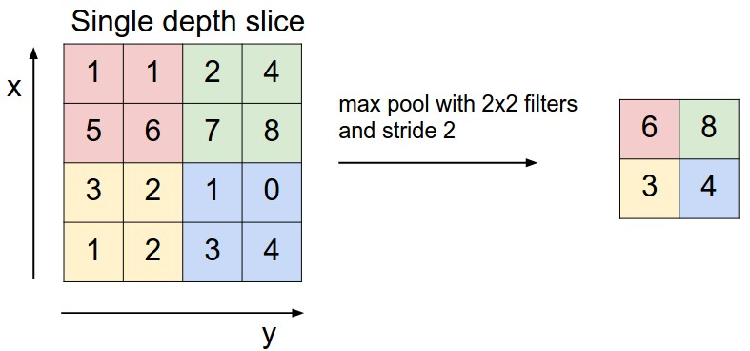
Convolutional Neural Networks
- Pooling layer
Pooling is inserted between convolution layers to reduce the spatial size of feature maps (width & height).
This cuts computation, reduces the number of activations, and helps limit overfitting.
It works independently on each channel (depth slice) — it does not mix channels.
The most common version is Max Pooling (2×2, stride 2):
takes the maximum value from each 2×2 region
halves width and height (e.g., 224×224×64 → 112×112×64)
depth stays the same.

Slide 21
Convolutional Neural Networks building blocks
- what can we tune
Kernel (filter) size (e.g., 3×3, 5×5): controls how local the pattern detector is
# Filters (channels) per layer: how many different patterns the layer can learn
Stride: how far the filter moves each step → affects downsampling and detail
Padding: keeps borders / preserves spatial size so edge information isn’t lost
Pooling (max/avg) + pool size: reduces resolution, keeps strongest signals (usually max)
Network depth (# layers/blocks): deeper = more expressive, but harder to train & easier to overfit
Regularization (common extras): dropout, data augmentation, weight decay, batch norm

Slide 22
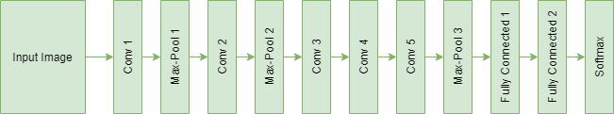
Popular Deep Learning Based Models used in Computer Vision
AlexNet Architecture
AlexNet is one of the pioneering deep learning models that significantly advanced the field of computer vision. Introduced by Alex Krizhevsky and his colleagues in 2012, AlexNet won the ImageNet Large Scale Visual Recognition Challenge (ILSVRC) with a substantial margin, showcasing the power of deep convolutional neural networks (CNNs).

Slide 23
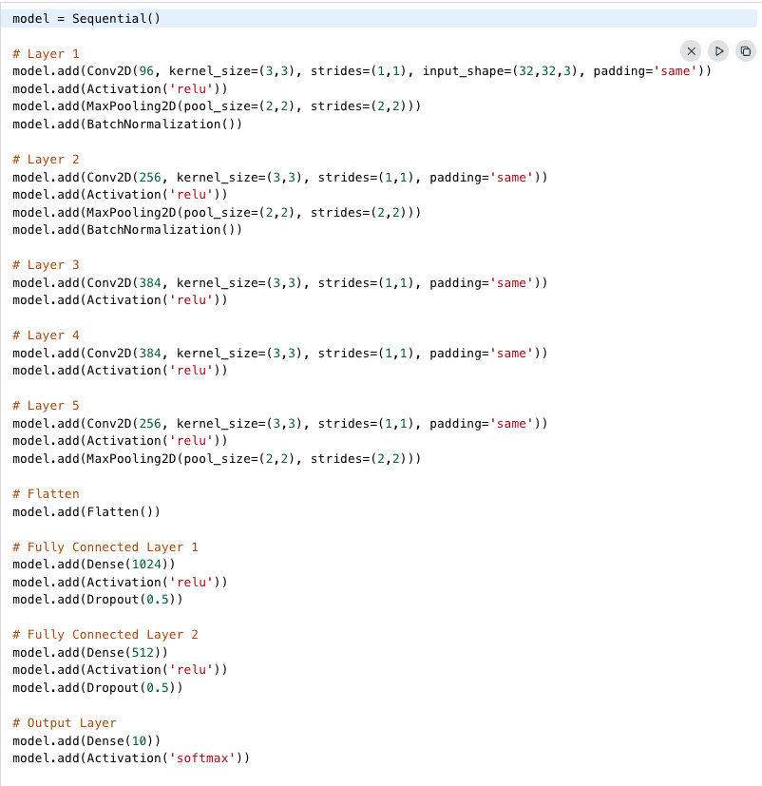
Popular Deep Learning Based Models used in Computer Vision
AlexNet Architecture

Slide 24
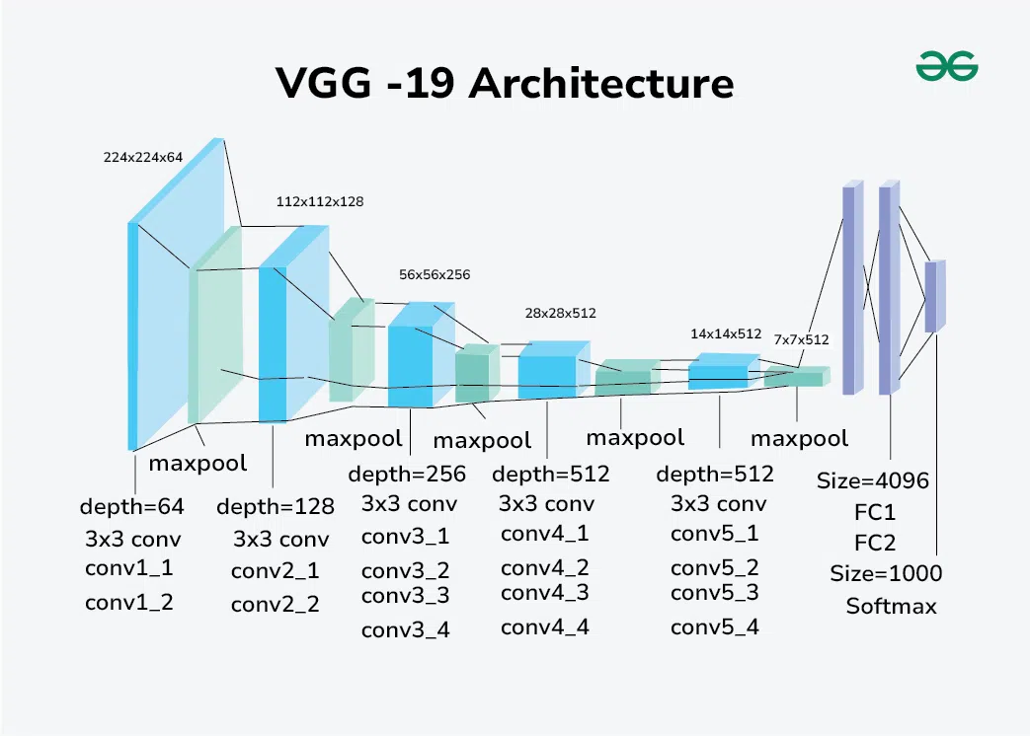
Popular Deep Learning Based Models used in Computer Vision
VGGNet
VGGNet, developed by the Visual Geometry Group at the University of Oxford, is known for its simplicity and effectiveness. Introduced in 2014, VGGNet achieved top results in the ILSVRC competition.

Slide 25
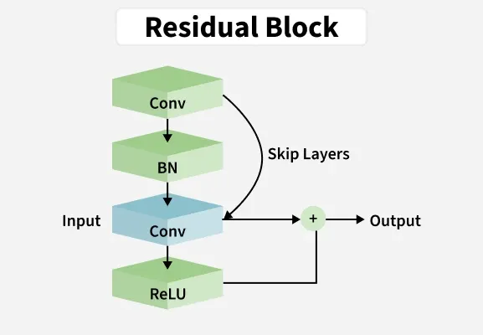
Popular Deep Learning Based Models used in Computer Vision
ResNet
ResNet, or Residual Network, introduced by Kaiming He and his team in 2015, addressed the problem of vanishing gradients in very deep networks. ResNet won the ILSVRC competition in 2015 and set new benchmarks for image recognition.

Slide 26
Popular Deep Learning Based Models used in Computer Vision
ResNet
Challenges in Deep Neural Networks
Deep Neural Networks are useful models but they also come with several training challenges, especially as the network depth increases.
Two major issues are
1. Vanishing/Exploding Gradient Problem: As the number of layers in a neural network increases, the gradients of the loss function with respect to the weights can become extremely small or excessively large during backpropagation.
2. Degradation Problem: The degradation problem occurs when increasing the network depth does not improve performance and may even worsen it. This problem has two aspects:
Performance Plateau: Training error saturates after a certain depth meaning additional layers do not significantly reduce the error.
Accuracy Degradation: Beyond a certain depth validation error increases and the model performs poorly on unseen data.

Slide 27
Popular Deep Learning Based Models used in Computer Vision
DenseNet
DenseNet revolutionized the field of computer vision by proposing a novel connectivity pattern within CNNs, addressing challenges such as feature reuse, vanishing gradients, and parameter efficiency. Unlike traditional CNN architectures where each layer is connected only to subsequent layers, DenseNet establishes direct connections between all layers within a block. This dense connectivity enables each layer to receive feature maps from all preceding layers as inputs, fostering extensive information flow throughout the network.

Slide 28
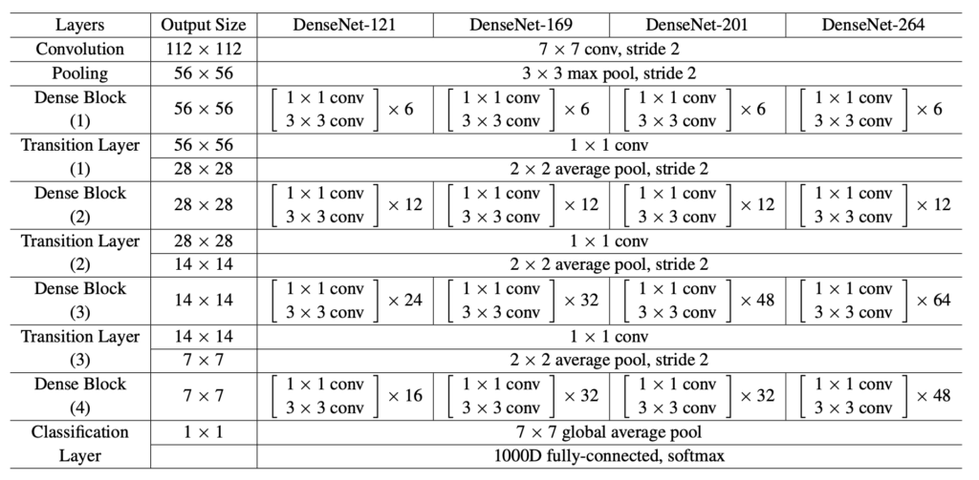
Popular Deep Learning Based Models used in Computer Vision
DenseNet
DenseNets link each layer directly to every layer that comes before it in a feed-forward sequence. As a result, each layer gathers the combined knowledge of all previous layers and contributes its outputs to those that follow.

Slide 29
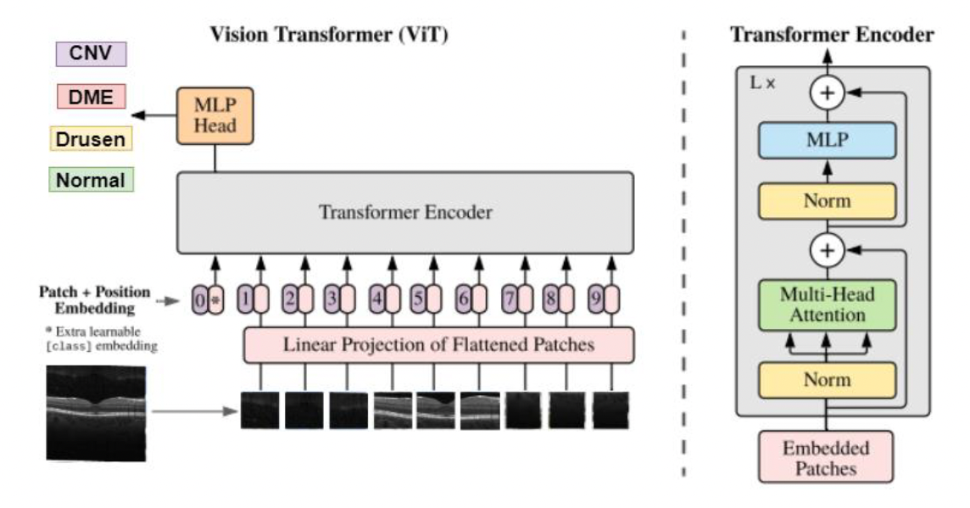
DL models applied for OCT classification – Vision Transformers (ViT)-based models
1. ViT - a new method for image classification as it enables self-attention rather than traditional convolutional filters;
In comparison with CNNs, which uses convolutional layers to extract features, ViT divides an image into non-overlapping patches and processes them as a sequence, similar to how the Transformer processes words in a sentence.
Fig. 5. ViT architecture (adapted from [76])
Notes:
The concept of Transformer was initially created for NLP. It provided highly effective capabilities in capturing extended dependencies, and their application to computer vision is now transforming medical image analysis.
The development of the Transformer architecture by Vaswani et al. [73] represented a fundamental change in DL. It replaced conventional sequential models such as recurrent neural networks (RNNs) and long short-term memory networks (LSTMs) with a self-attention-based mechanism. The Transformer architecture uses positional encodings, which preserve sequence order, represented as a necessity in NLP models where word position affects semantics. As Transformers lack the inherent spatial hierarchy of CNNs, these positional embeddings are very important when applying Transformers to image classification tasks. They allow the model to recognize spatial relationships between image regions.

Slide 30
DL models applied for OCT classification – Vision Transformers (ViT)-based models
2. DeepViT - an improved version of the standard ViT; developed to solve some of the problems found in early transformer models, especially their need for very large datasets and their limits in learning layered features.
DeepViT brings several new directions that make it another model to be used for medical image analysis:
DeepViT uses more transformer encoder layers than the original ViT;
It uses a re-attention mechanism;
DeepViT combines hierarchical feature learning with robust regularization strategies (drop-path or stochastic depth).
Notes:
The concept of Transformer was initially created for NLP. It provided highly effective capabilities in capturing extended dependencies, and their application to computer vision is now transforming medical image analysis.
The development of the Transformer architecture by Vaswani et al. [73] represented a fundamental change in DL. It replaced conventional sequential models such as recurrent neural networks (RNNs) and long short-term memory networks (LSTMs) with a self-attention-based mechanism. The Transformer architecture uses positional encodings, which preserve sequence order, represented as a necessity in NLP models where word position affects semantics. As Transformers lack the inherent spatial hierarchy of CNNs, these positional embeddings are very important when applying Transformers to image classification tasks. They allow the model to recognize spatial relationships between image regions.

Slide 31
What is the problem? The detection of retinal diseases based on OCT images has been an area of focus due to the prevalence and severity of retinal diseases (Age-related Macular Degeneration, Diabetic Retinopathy, Glaucoma etc.) => leading causes of vision impairment and blindness worldwide;
What do we need? An early detection for effective treatment and prevention of further damage of sight;
What is currently being used? Traditional approaches: manually interpret OCT images by experienced clinicians => time-consuming, subjective and prone to errors;
What can we do? Automatically detect these diseases;
How can we do this? With AI-based models and techniques: to learn complex patterns and features;
What are the advantages & disadvantages?
ability to detect subtle changes in OCT images, timely treatment and prevention of further damage
vs.
the lack of diverse and representative datasets, the interpretability of deep learning models
What is the purpose of this application? To present a DL models based on CNNs that can be used for the early detection of retinal diseases => great potential for an accurate and efficient diagnosis.
Use case of using Deep Learning Computer Vision algorithms for retinal diseases diagnosis based on Optical Coherence Tomography imaging

Slide 32
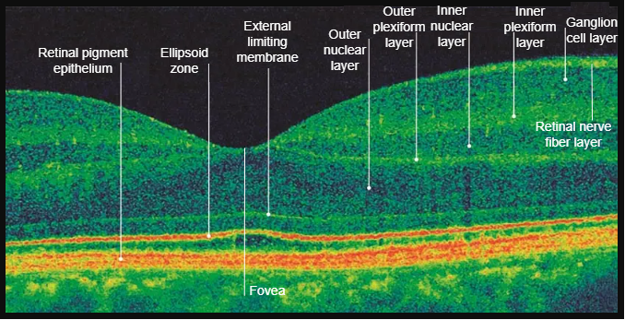
Imaging the Retina: Optical Coherence Tomography (OCT)
Retina: 0.5 mm thickness structure which converts the light that enters the eye into an electrical impulse that is sent to the brain via the optic nerve;
OCT:
a cross-sectional view of the retina that provides its distinctive layers;
a non-invasive, high-resolution imaging technique that enables the visualization of the anterior eye together with the morphologic features of the retina;
The measurements: critical in retinal diseases diagnosis - choroidal neovascularization (CNV), diabetic macular edema (DME) or the appearance of yellow deposits (DRUSEN);
Manually assessing the presence of retinal diseases can be subjectively interpreted.

Slide 33
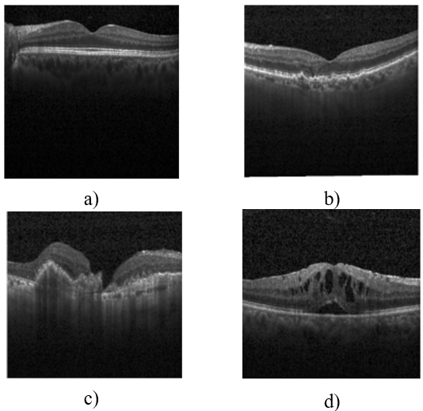
About the dataset
Dataset: 84,484 OCT images, from 4,686 patients;
Training and Testing Datasets
 | Class
 | CNV | DME | Drusen | Healthy retina
Train | 37,205 | 11,348 | 8,616 | 26,315
Test | 250 | 250 | 250 | 250
Drusen - characterized by a bumpy RPE layer
CNV - involves an anomalous increase in the number of vessels
DME - characterized by the accumulation of intraretinal fluids
Representative OCT images from the dataset (a) healthy retina OCT; b) retina affected by Drusen; c) retina affected by Choroidal Neo-vascularization (CNV); d) retina affected by Diabetic Macular Edema (DME).
https://www.kaggle.com/datasets/paultimothymooney/kermany2018

Slide 34
Leonardo + JupyterLab setup
1. Authenticate + connect
eval "$(ssh-agent -s)"
step ssh login 'email' --provisioner cineca-hpc
ssh username@login01-ext.leonardo.cineca.it
2. Allocate compute node
srun -p boost_usr_prod -A tra26_castiel2 --time=02:00:00 \
--cpus-per-task=4 --mem=32G --pty bash
hostname # e.g., lrdn3421
3. Load python + activate (jlab)
module purge
module load python/3.11.7
source ~/venvs/jlab/bin/activate #prompt becomes (jlab)

Slide 35
Leonardo + JupyterLab setup
4. Start Jupyter
jupyter lab --no-browser --ip=0.0.0.0 --port=8880
# copy token URL
5. Create tunnel (in new terminal)
ssh -N -L 8880:<COMPUTE_HOSTNAME>:8880 eparasch@login01-ext.leonardo.cineca.it
# example: ssh -N -L 8880:lrdn3421:8880 ...
6. Browser
Open: http://127.0.0.1:8880/lab (paste token if needed)
Select kernel: “Leonardo (jlab)”

Slide 36




Thank you for your attention!
Wrap-up & Discussions
elena.paraschiv@ici.ro

