Slide 1

Explainable AI for Network Intrusion Detection
Course: Computer Networks | Course Code: 71305001009 / 73305001001
Faculty Mentor: [Faculty Guide Name] | Unitedworld Institute of Technology (UIT)
Karnavati University, Gandhinagar, Gujarat
Submitted by:
Name | KU ID | Enrollment No.
Het Detroja | [KU ID] | 202407020072
Mahir Patel | [KU ID] | 202407020119
FLOW FEATURES
NETWORK FLOW
INTRUSION DETECTION
AI / ML
NORMAL / SUSPICIOUS
XAI EXPLANATION
RANDOM FOREST

Slide 2

DISCUSSION & REVISION
1. What is a Network Intrusion Detection System (NIDS)?
2. How does a Random Forest classify Normal and Suspicious network flows?
3. Why are precision, recall, and F1-score important for intrusion detection?
4. What is the difference between global and local Explainable AI?
5. Why must synthetic-data accuracy not be treated as real-world detection performance?

Slide 3
What is this project about?
Networking Link
Uses flow-level attributes such as protocol, duration, packet counts, byte counts, and traffic rates when available.
Expected Output
Predicted class and probability, evaluation metrics, confusion matrix, global feature importance, and local prediction explanation.
Project Focus
The prototype is an offline decision-support tool. It does not capture live packets or automatically block network connections.
COMPUTER NETWORKS | EXPLAINABLE AI MINI PROJECT

Slide 4
Introduction to Network Intrusion Detection
Why do computer networks require intelligent threat monitoring?
Network Security
Networks exchange data across hosts and services; intrusion detection monitors activity for patterns that may violate security policies.
Detection Challenges
Large traffic volumes, changing attack patterns, class imbalance, and false alerts make reliable detection difficult.
AI Opportunity
Supervised machine learning learns patterns from labelled flow records and helps prioritize traffic for human review.
COMPUTER NETWORKS | EXPLAINABLE AI MINI PROJECT

Slide 5
Problem
A classifier may label traffic as suspicious but provide little information about which input features influenced its decision.
The challenge we want to solve
Need
A practical system that identifies potentially suspicious flows and makes model behaviour more understandable.
Project Scope
An offline CSV-based prototype using preprocessing, Random Forest classification, and global/local explanations in a Streamlit dashboard.
Explainability Gap
A prediction alone does not show why a flow was flagged. XAI adds global feature importance and a local explanation for an individual record.
COMPUTER NETWORKS | EXPLAINABLE AI MINI PROJECT

Slide 6
Aim
Develop an explainable AI prototype for Normal vs. Suspicious network-flow classification.
Project goals
Objective 1
Load labelled network-flow data, map labels, and prepare numeric and categorical features.
Objective 2
Train a reproducible Random Forest pipeline using a stratified train/test split.
Objective 3
Evaluate with accuracy, precision, recall, F1-score, and confusion matrix; explain predictions using feature importance and local sensitivity.
Objective 4
Present model behaviour clearly through feature-importance plots, local sensitivity analysis, and an interactive dashboard.
COMPUTER NETWORKS | EXPLAINABLE AI MINI PROJECT

Slide 7
Existing System and Limitations
Traditional intrusion detection approaches
Traditional Approach
Signature-based detection compares traffic with known patterns; rule-based systems apply predefined conditions; anomaly detection flags deviations.
Limitations
Known signatures may miss new variations; rules require maintenance; black-box predictions can be difficult to interpret; false positives and missed attacks remain possible.
Balanced View
Machine learning can support detection, but depends on representative labelled data, careful evaluation, and human review.
COMPUTER NETWORKS | EXPLAINABLE AI MINI PROJECT

Slide 8
Proposed Explainable AI System
Machine-learning and explanation workflow
Input
Labelled network-flow CSV with features such as protocol, flow duration, packet counts, byte counts, and rates where available.
Preparation
Map labels, handle missing values, encode categorical columns, and split data into training and test sets.
Prediction
Train a Random Forest classifier to predict Normal or Suspicious traffic.
Output
Predicted class and probability, evaluation metrics, confusion matrix, permutation importance, and local sensitivity explanation.
COMPUTER NETWORKS | EXPLAINABLE AI MINI PROJECT

Slide 9
Computer Networks Concepts Used
Connection to core networking and security concepts
Network and Transport Layers
IP communication, TCP/UDP behaviour, ports, packet exchange, and flow-level summaries provide context for network-flow features.
Network Security & Management
Intrusion detection, traffic monitoring, security policy, false alarms, incident triage, and human validation connect the model to network administration.
COMPUTER NETWORKS | EXPLAINABLE AI MINI PROJECT

Slide 10
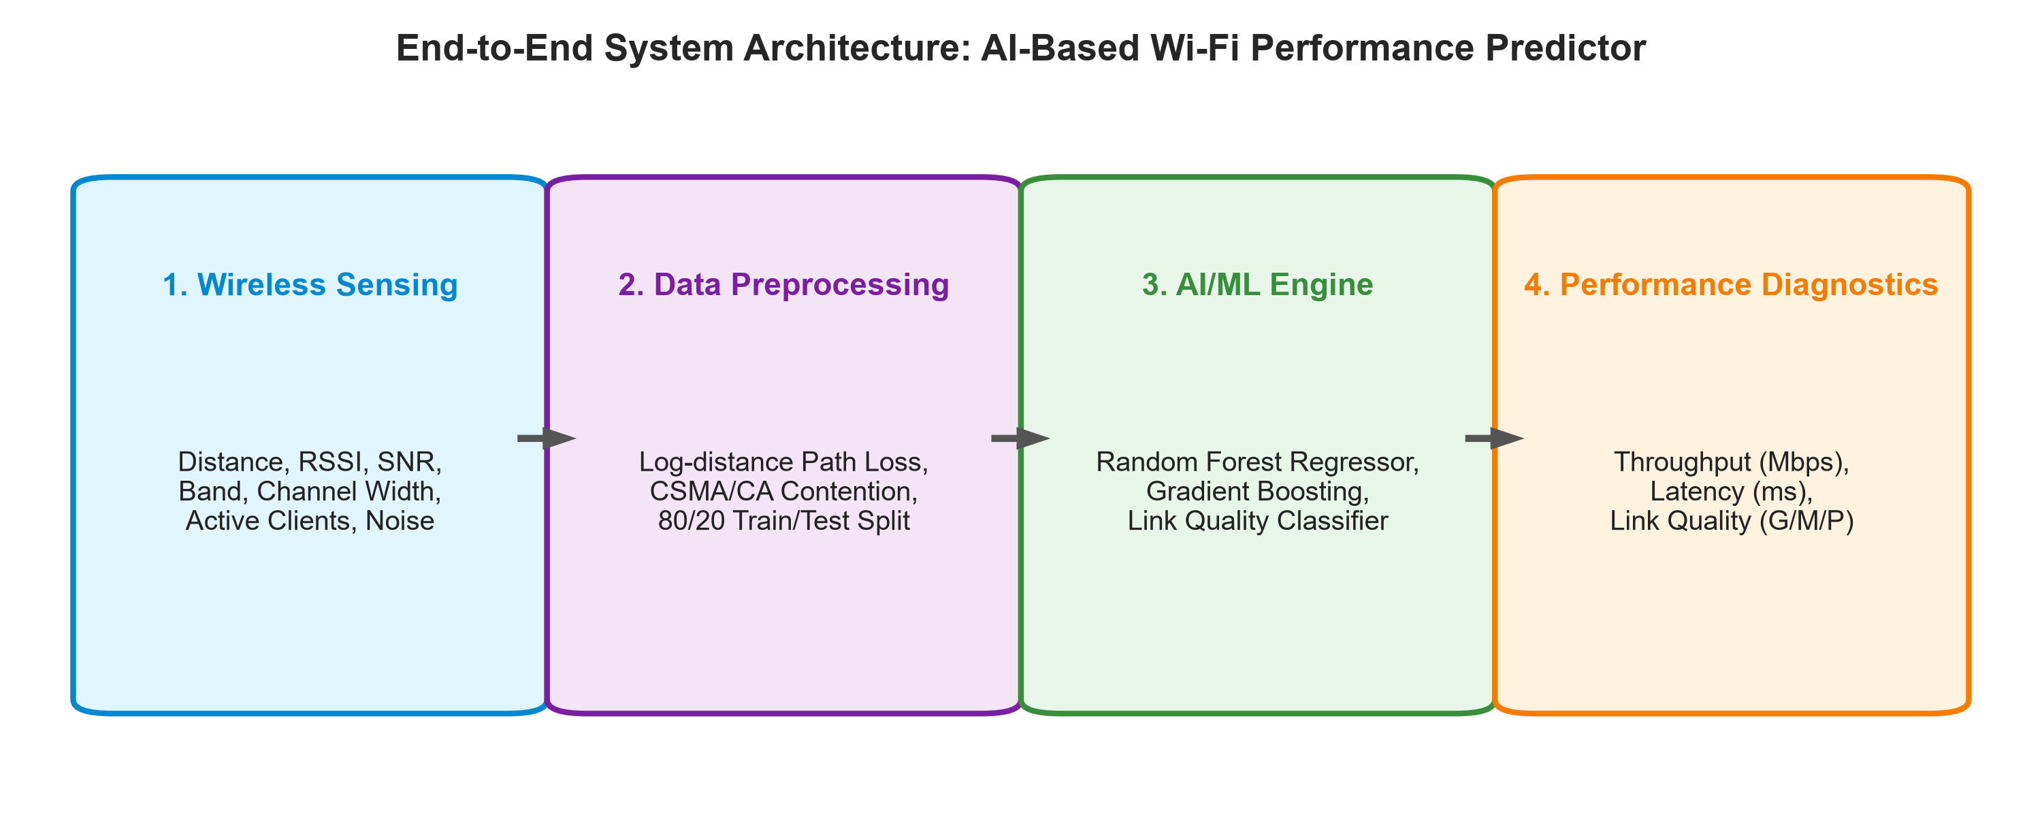
System Architecture
High-level design
1. Dataset Input
Load a labelled network-flow CSV from the bundled demo or a user-provided file.
2. Preprocessing
Map target labels, impute missing values, encode categorical features, and prepare train/test partitions.
3. AI Engine
Train a Random Forest classifier to distinguish Normal and Suspicious flows.
4. XAI Dashboard
Show performance metrics, confusion matrix, global permutation importance, local sensitivity, and custom-flow predictions.
COMPUTER NETWORKS | EXPLAINABLE AI MINI PROJECT

Slide 11
Dataset and Network Traffic Features
Use documented and correctly labelled data
Dataset Specification
The bundled dataset is synthetic demonstration data used to test the application workflow. Public-dataset evaluation using CIC-IDS2017 is planned.
Input Features
Candidate attributes include protocol, duration, forward/backward packet counts, byte totals, packet lengths, and flow rates; exact columns depend on the CSV.
Target Variable
Binary classification: Normal or Suspicious. Label mapping must be checked against the chosen dataset documentation.
Data Integrity
Inspect missing values, duplicates, identifiers, class balance, and leakage; fit preprocessing only on training data.
COMPUTER NETWORKS | EXPLAINABLE AI MINI PROJECT

Slide 12
AI/ML Algorithm and Methodology
Supervised learning and explainability
Classifier
Random Forest combines multiple decision trees and aggregates their class votes to model non-linear patterns in flow data.
Pipeline Workflow
CSV loading -> label mapping -> preprocessing -> stratified train/test split -> Random Forest training -> evaluation.
Global Explanation
Permutation feature importance measures how model performance changes when one feature is shuffled on test data.
Local Explanation
One-feature-at-a-time sensitivity changes a selected input feature and observes how the Suspicious probability changes.
COMPUTER NETWORKS | EXPLAINABLE AI MINI PROJECT

Slide 13
Tools and Technologies
Implementation stack
Language & Platform
Python 3.11 on Windows; project developed and run using Cursor.
Core ML Libraries
Scikit-learn, Pandas, NumPy, and Joblib for preprocessing, classification, metrics, and model storage.
User Interface
Streamlit dashboard for dataset preview, evaluation, explanation, and custom-flow testing.
Visualization
Matplotlib for confusion-matrix and feature-importance visualizations.
COMPUTER NETWORKS | EXPLAINABLE AI MINI PROJECT

Slide 14
Implementation and Working
How the prototype runs
Step 1: Data Loading
Load the bundled synthetic demonstration CSV or upload a labelled network-flow CSV.
Step 2: Preprocessing
Separate the target, map labels, handle missing values, encode categories, and prepare train/test data.
Step 3: Model Training
Fit the preprocessing pipeline and Random Forest classifier on the training partition.
Step 4: Evaluation & XAI
Calculate test metrics and confusion matrix; generate permutation importance and local sensitivity explanations.
Step 5: Dashboard Testing
Select a test record or enter custom flow features to view a Normal or Suspicious prediction.
Step 6: Interpretation
Review the predicted class, suspicious probability, important features, and limitations before drawing a conclusion.
COMPUTER NETWORKS | EXPLAINABLE AI MINI PROJECT

Slide 15
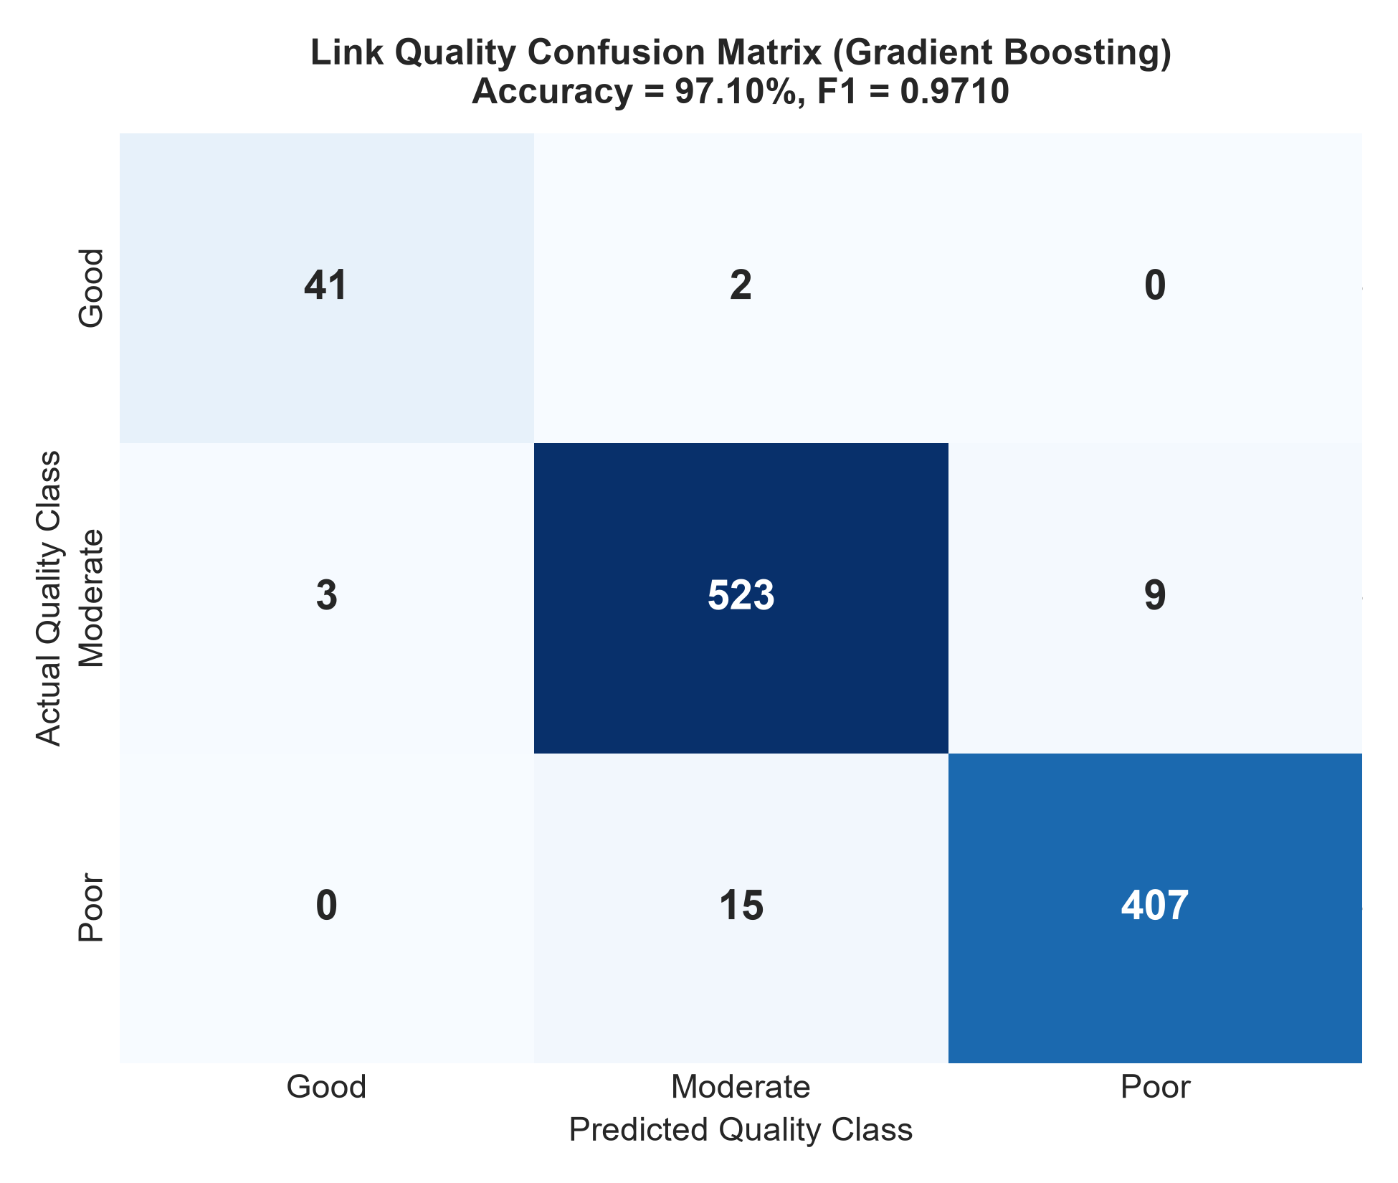
Results and Performance Metrics
Preliminary synthetic demonstration run only
Accuracy: 89.33%
Held-out test accuracy on synthetic demo data; not a real-traffic benchmark.
Confusion Matrix
[[167, 5], [19, 34]] in class order [Normal, Suspicious].
Suspicious Class
Precision: 0.87 | Recall: 0.64 | F1-score: 0.74 (rounded).
Validation Status
Real public-dataset evaluation is pending. Synthetic results do not establish real-world effectiveness.
Normal Class
Precision: 0.90 | Recall: 0.97 | F1-score: 0.93 (rounded).
COMPUTER NETWORKS | EXPLAINABLE AI MINI PROJECT

Slide 16
What the project can and cannot do
Capabilities, limitations, and responsible use
Advantages
Combines classification and explanations; displays precision, recall, F1-score, and confusion matrix; supports interactive flow testing.
Limitations
Current prototype is offline and CSV-based; synthetic demo data is not a benchmark; binary labels do not identify attack families.
Applications
Academic demonstration, traffic-record triage, model evaluation, and learning how XAI can support network security analysis.
Ethics & Privacy
Use only datasets and traffic you are authorized to access. A suspicious prediction is an alert for review, not proof of malicious intent.
COMPUTER NETWORKS | EXPLAINABLE AI MINI PROJECT

Slide 17
Conclusion
The prototype combines network-flow classification with model explanations in one dashboard.
Summary and improvements
Conclusion
The prototype demonstrates a workflow for classifying labelled network flows and presenting model explanations alongside predictions.
Future Scope 1: Real Dataset
Evaluate on a documented public intrusion-detection dataset with clear label mapping and leakage checks.
Future Scope 2: Stronger XAI
Add SHAP explanations and compare them with permutation importance and local sensitivity.
Future Scope 3: Live Traffic
Explore authorized packet capture and flow extraction, then validate feature compatibility before real-time monitoring.
COMPUTER NETWORKS | EXPLAINABLE AI MINI PROJECT

Slide 18
References
Sources supporting the project methodology
Dataset Reference
Canadian Institute for Cybersecurity, CIC-IDS2017 Dataset, University of New Brunswick: https://www.unb.ca/cic/datasets/ids-2017.html
Machine Learning
L. Breiman, “Random Forests,” Machine Learning, vol. 45, pp. 5–32, 2001.
Technical Documentation
Scikit-learn documentation: Random Forest, model evaluation, and permutation feature importance: https://scikit-learn.org/
Networking Literature
J. F. Kurose and K. W. Ross, Computer Networking: A Top-Down Approach, 8th Edition, Pearson, 2021.
COMPUTER NETWORKS | EXPLAINABLE AI MINI PROJECT

