Slide 1
LootPusher
Application for keeping abreast of your
Path of Exile character gear progression

Slide 2
Path of Exile
developed 2013 by GGG, a NZ game studio
isometric multiplayer arpg, strong influences from Diablo I/II
consists of standard league and fresh league that lasts 3-4 months; all new characters transfer to standard at the end of league
tracking character items after 30+ leagues is painful, so there is a need for the application

Slide 3
overview
scan characters to register based on account, league, level range
each character has 10 item slots
each item has name, item level, 3 max. mods for prefixes and suffixes and tier for each mod
choosing character displays character gear, default view is weapon 1 slot
user can toggle activated slot and save state
compare (unfinished feature) checks item against every activated item based on same type; announces if item is better than every character has

Slide 4
Server Architecture
Client
www-root: lootpusher.html, styles, images
server.js
scanAPI
scanDAO
Database
gearAPI
gearDAO
activateAPI
activateDAO
compareAPI
compareDAO

Slide 5
LootPusher API
Method | Url | Description
Get | /api/scan/{id} | Load all characters by account
Get | /api/gear/{id} | Load one specific character + loot
Put | /api/activate/{id} | Toggle activate gear check by slot
Get | /api/compare/{id} | Compare new gear to all activated slots

Slide 6
CLIENT ARCHITECTURE

Slide 7
DATA MODEL
Character
Id
accountName
leagueId
name
level
class
ascendancy
Stats
Id
itemId
modId
tier
value
Item
Id
charId
iLvl
name
baseItem
slot
Mods
Id
mod
pos

Slide 8
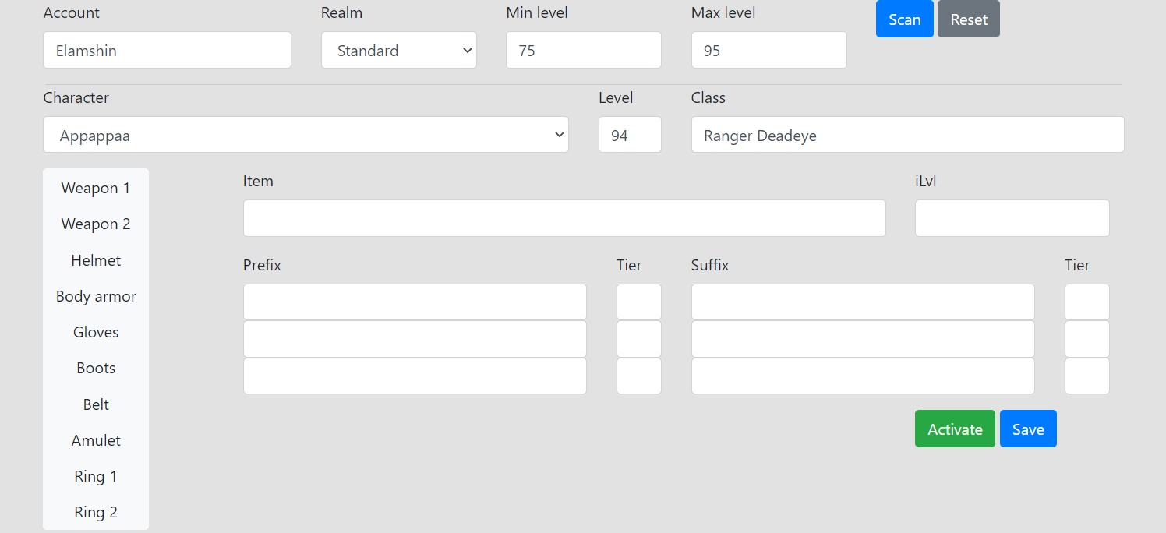
UI

Slide 9
DEVELOPMENT PROCESS
client app
projectroot/
client-dir
npm
test
gulp
build
wwwroot/app/
lp.bundle.js
mocha
server app
projectroot/
Server/
*.test.js

Slide 10
SECURITY

