Slide 1

Network Traffic Analysis
Presented By:
Abhay raj (ENG19CS0005)
Abhi Raj(ENG19CS0007)
Akshat Mishra(ENG19CS0021)
Arnav Gupta(ENG19CS0041)
Ayan Sarkar(ENG19CS0054)

Slide 2
Network Traffic Analysis
Network traffic analysis (NTA) is a method of monitoring network availability and activity to identify anomalies, including security and operational issues. Common use cases for NTA include:
Collecting a real-time and historical record of what’s happening on your network
Detecting malware such as ransomware activity.
Detecting the use of vulnerable protocols and ciphers.
Troubleshooting a slow network.
Improving internal visibility and eliminating blind spots.
However, knowing how to monitor network traffic is not enough. It’s important to also consider the data sources for your network monitoring tool; two of the most common are flow data (acquired from devices like routers) and packet data (from SPAN, mirror ports, and network TAPs).

Slide 3
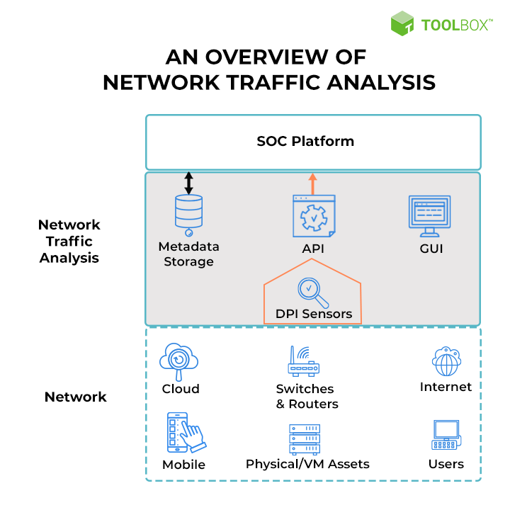

Slide 4
What is the purpose of analyzing and monitoring network traffic?
Many operational and security issues can be investigated by implementing network traffic analysis at both the network edge and the network core.
With the traffic analysis tool, you can spot things like large downloads, streaming or suspicious inbound or outbound traffic.
Firewall logs are also problematic when a network is under attack.
With the rise in mobile devices, IoT devices, smart TV’s, etc., you need something with more intelligence than just the logs from firewalls.

Slide 5
The importance of network traffic analysis
Keeping a close eye on your network perimeter is always good practice.
A network monitoring solution should be able to detect activity indicative of ransomware attacks via insecure protocols.
Monitoring traffic inside your firewalls allows you to validate rules, gain valuable insight, and can also be used as a source of network traffic-based alerts.
Be sure to check your network data for any devices running unencrypted management protocols, such as:
Telnet.
Hypertext Transport Protocol (HTTP, port 80).
Simple Network Management Protocol (SNMP, ports 161/162).
Cisco Smart Install

Slide 6
What to look for in a network traffic analysis and monitoring solution
All the network analysis tools are different. We can categorize them into two types, first is Flow-based tools, and the second is Deep Packet inspection tools.
These tools provide the features of software agents, storing historical data, and intrusion detection systems.
Historical data helps to analyze past events. Some tools maintain the data for a limited period. You should check this limitation.
All the network analysis tools don’t collect the flow data and packet data coming from different sources. You can choose the tool according to your network traffic, deciding the critical pieces, and compare the tool’s capabilities against these factors.

Slide 7
Network Traffic Analysis Tools
1) Auvik :
Auvik is cloud-based network management and monitoring solution with the capabilities of intelligently analyzing the network traffic.
Auvik TrafficInsights provides insights on who is on the network, what are they doing, and where their traffic is going.
2) SolarWinds Network Traffic Analysis Tool:
SolarWinds provides the Network Traffic Analysis Solution, NetFlow Traffic Analyzer. It can perform in-depth network traffic analysis with accuracy.
Its customizable reports and alerts will help you with streamlining network traffic analysis.

Slide 8
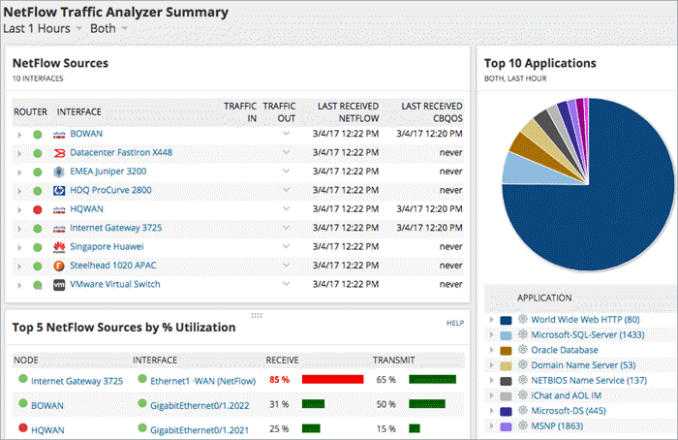

Slide 9
3) Perimeter 81:
Perimeter 81 is a cloud-based network management/monitoring solution with amazing analytical capabilities.
The software arms its users with a comprehensive monitoring dashboard, which provides greater visibility into their networks.
As the information on this dashboard is updated every 2-3 minutes, you basically get real-time data into your network usage.
4) Paessler Network Analysis Tool:
PRTG Network Analyzer is a powerful and user-friendly solution. It can analyze all elements of your network. It will accelerate troubleshooting and avoid bottlenecks.
5) Wireshark:
Wireshark is a network protocol analyzer that will give you detailed information about what is happening on your network.
It can capture live and perform offline analysis. It supports Windows, Mac, Linux, Solaris, FreeBSD, NetBSD, etc.

Slide 10
Conclusion
Network traffic analysis is an essential way to monitor network availability and activity to identify anomalies, maximize performance, and keep an eye out for attacks.
With NTA added as a layer to your security information and event management (SIEM) solution, you’ll gain visibility into even more of your environment and your users.

