Slide 1
Deep learning
Ashish Kumar
ENG19CS0047

Slide 2
Deep Neural Networks
An artificial network consists of a pool of simple processing units which communicate by sending signals to each other over a large number of weighted connections. Many Neural networks together forms DNN.
It mainly has dense layers which consists of input, output and dense neurons.

Slide 3
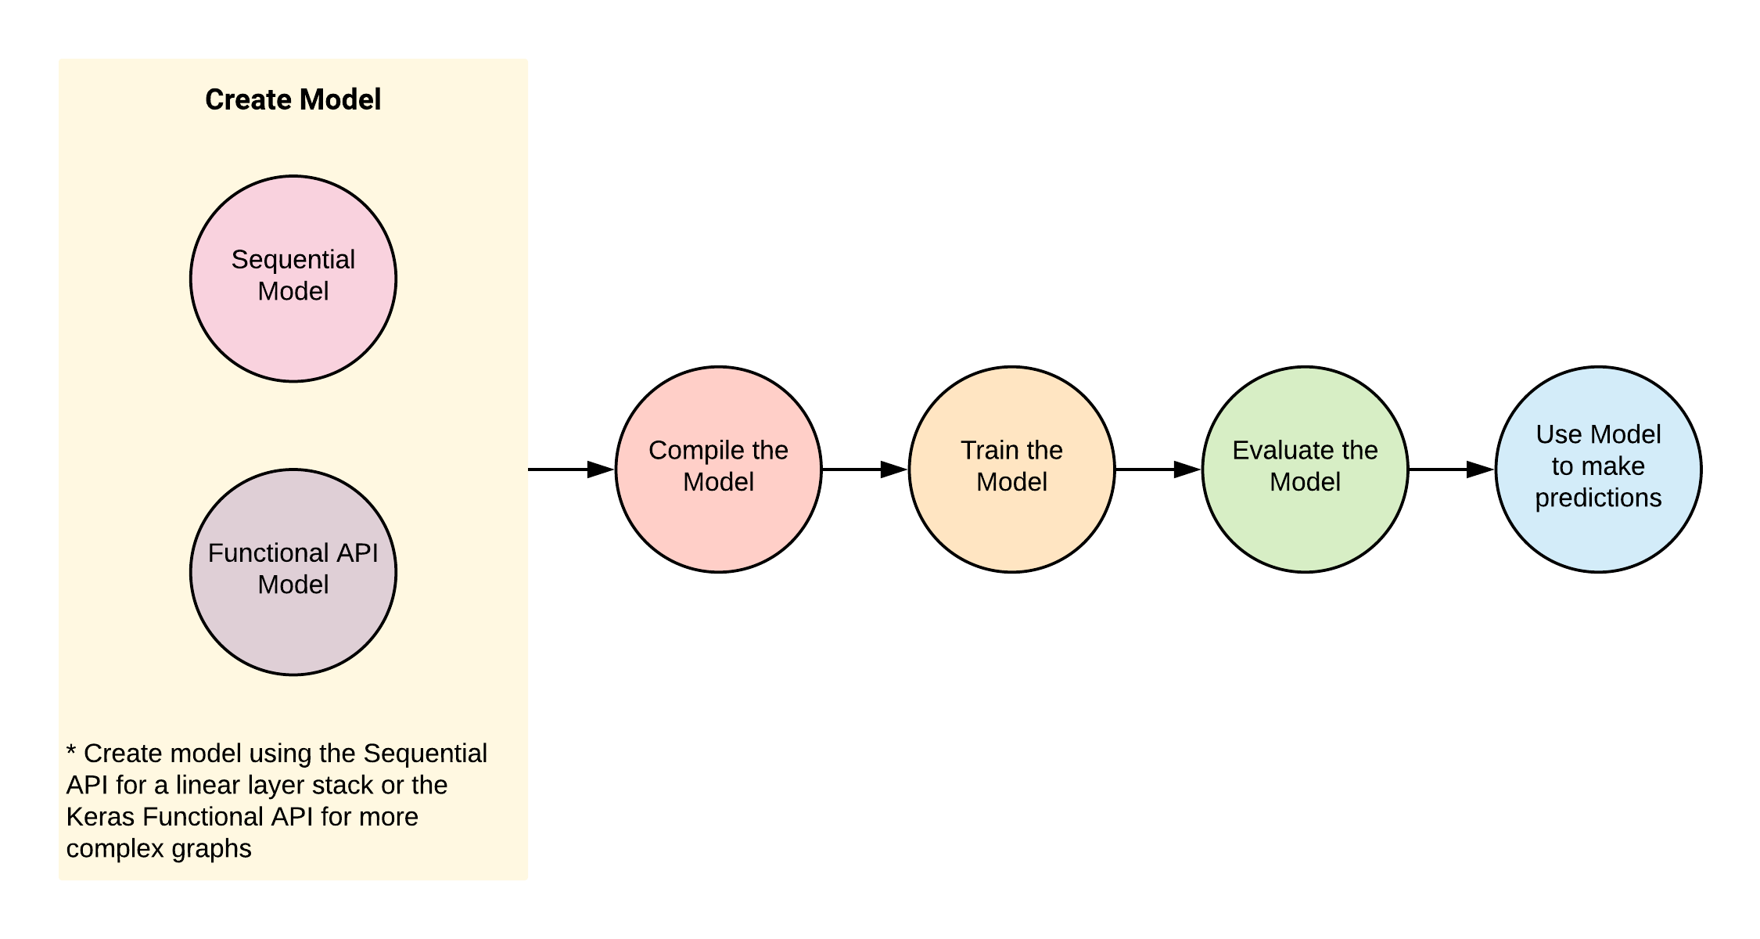
Deep Neural Networks

Slide 4
Convolutional neural network(cnn)
Convolutional Neural Network or CNN is a type of artificial neural network, which is widely used for image/object recognition and classification. Deep Learning thus recognizes objects in an image by using a CNN. CNNs are playing a major role in diverse tasks/functions like image processing problems, computer vision tasks like localization and segmentation, video analysis, to recognize obstacles in self-driving cars, as well as speech recognition in natural language processing.

Slide 5
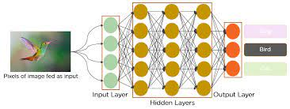
cnn

Slide 6
Application of cnn
Image processing problems
Video analysis
Recognize obstacles in self-driving cars

Slide 7
Recurrent Neural Networks(rnn)
Recurrent Neural Networks (RNN) are a class of Artificial Neural Networks that can process a sequence of inputs in deep learning and retain its state while processing the next sequence of inputs. Traditional neural networks will process an input and move onto the next one disregarding its sequence.

Slide 8
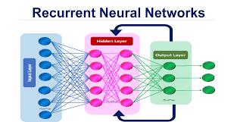
RNN

Slide 9
Application of RNN
Prediction problems.
Machine Translation.
Speech Recognition.
Language Modelling and Generating Text.
Video Tagging.
Generating Image Descriptions.
Text Summarization.
Call Center Analysis.

Slide 10
Generative Adversarial Networks (GAN)
Generative Adversarial Networks, or GANs for short, are an approach to generative modeling using deep learning methods, such as convolutional neural networks.
GANs are an exciting and rapidly changing field, delivering on the promise of generative models in their ability to generate realistic examples across a range of problem domains, most notably in image-to-image translation tasks such as translating photos of summer to winter or day to night, and in generating photorealistic photos of objects, scenes, and people that even humans cannot tell are fake.

Slide 11
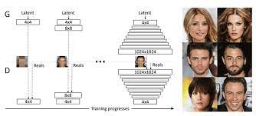
GAN

Slide 12
Application of gan
Generate Examples for Image Datasets
Generate Photographs of Human Faces
Generate Realistic Photographs
Generate Cartoon Characters
Image-to-Image Translation
Text-to-Image Translation
Semantic-Image-to-Photo Translation
Face Frontal View Generation
Generate New Human Poses
Photos to Emojis
Photograph Editing
Face Aging
Photo Blending

Slide 13
REference
Google colab :
https://colab.research.google.com/drive/1Y6EWRVUHJ1cxQokVSGeiH0UGHr7Bx2HS?usp=sharing
Github:
https://github.com/ENG19CS0047-ASHISH/Assignment3_DL

Slide 14
Thank you!

