Slide 1



Tejaal M
Shwetha M
Shravani B S
ENG19CS0334
ENG19CS0307
ENG19CS0301

Slide 2

INTRODUCTION
NetworKit is a growing open source toolkit
for large scale-network analysis.
Its aim is to provide tools for the analysis of large
networks in the size range from thousands to
billions of edges.
NetworKit is capable of quickly processing
large-scale networks for a variety of analytics kernels,
and does so faster and with a lower memory footprint
than closely related software.

Slide 3
DESIGN GOALS
Performance: Algorithms and data structures are selected and implemented with high performance and parallelism in mind.
Usability: A practical tool for network analysis should provide modular functions which do not restrict the user to predefined workflows.
Integration: NetworKit can be seamlessly integrated with Python libraries for scientific computing and data analysis.
Design Principles: Scalable algorithms to support network analysis on massive networks.

Slide 4
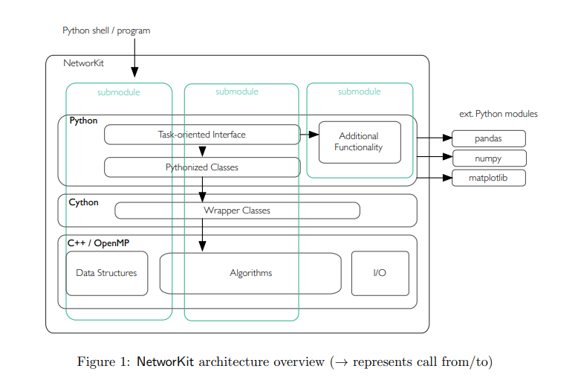
ARCHITECTURE

Slide 5
ARCHITECTURE
NetworKit as a two-layer hybrid of performance-aware code written in C++ with an interface and additional functionality written in Python.
NetworKit is distributed as a Python package, ready to be used interactively from a Python shell.
The code can be used as a library for application programming as well, either at the Python or C++ level.
Nodes are represented by 64 bit integer indices from a consecutive range, and an edge is identified by a pair of nodes
NetworKit is an algebraic interface that enables the implementation of graph algorithms in terms of various matrices describing the graph, while transparently using the same graph data structure.

Slide 6
DEMONSTRATION OF NETWORKIT
DEMO

Slide 7

TO KNOW!
Networkit is an open-source software library developed by the Network Theory Group at the Karlsruhe Institute of Technology (KIT) in Germany.
The project was initiated in 2012 and has been actively developed and maintained by the group since then. The Network Theory Group is led by Prof. Dr. Henning Meyerhenke, and comprises a team of researchers and developers working on graph algorithms and network analysis.
Networkit is available under the MIT License, which allows for free use, modification, and distribution of the software.
As an open-source project, Networkit welcomes contributions from the community, and anyone can contribute to the project by reporting issues, submitting bug fixes or feature requests, or by contributing code.
SAP:for analyzing large-scale graphs, such as social networks, to provide insights for their enterprise software solutions.
Huawei: for analyzing large-scale networks in various domains, including telecom and transportation.
NVIDIA: The graphics processing unit (GPU) manufacturer has contributed to the development of Networkit and uses it in their work on graph analytics and machine learning.
Fraunhofer Institute: The research organization has used Networkit for analyzing social networks and other complex networks in various research projects.

Slide 8
ADVANTAGES OF NETWORKIT
High Performance
Versatility
Open-Source
Easy to Use
Active Development

Slide 9

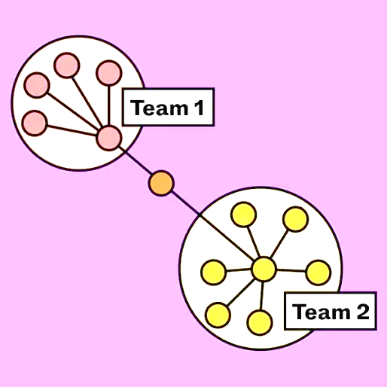
ADVANTAGES OVER OTHER TOOLS
Scalability: Networkit can handle large-scale networks with millions of nodes and edges, making it an ideal tool for analyzing complex social systems.
Speed: Networkit is optimized for performance and can analyze large networks in a matter of seconds or minutes, even on a single machine.
Flexibility: Networkit supports a wide range of network analysis algorithms and provides a flexible framework for developing new algorithms and techniques.
Interoperability: Networkit is designed to work with other popular data science tools such as Python and Jupyter Notebooks, making it easy to integrate with existing workflows.
Open-source: Networkit is an open-source software package, which means it is freely available to anyone and can be modified and extended by the community.

Slide 10
DISADVANTAGES OF NETWORKIT
Steep Learning Curve: While Networkit is user-friendly and well-documented, it can still be challenging for users who are not familiar with network analysis concepts or programming languages like C++ and Python. This may require additional time and effort to learn how to use the tool effectively.
Limited Functionality for Non-Network Data: While Networkit is highly specialized for network analysis, it may not be the best tool for analyzing other types of data. For example, if you want to analyze data that is not structured as a network, you may need to use a different tool.
Lack of User Community: While Networkit has an active development team, it may not have as large a user community as some other social networking tools. This could make it harder to find support or get answers to questions from other users.
Limited Integration with Other Tools: While Networkit can be used as a standalone tool, it may not integrate as seamlessly with other software tools as some other social networking tools. This could make it harder to incorporate Networkit into your existing workflow.
Limited Graphical User Interface: Networkit has a basic graphical user interface, but it may not have the same level of interactive visualization capabilities as some other social networking tools. This could make it harder to explore and analyze network data in real-time.

Slide 11
APPLICATIONS OF NETWORKIT
Biological Network Analysis: used to analyze biological networks, such as protein-protein interaction networks and gene regulatory networks. It can help identify functional modules, detect disease-associated genes, and predict drug targets.
Transportation Network Analysis: used to analyze transportation networks, such as road networks and public transportation networks. It can help optimize traffic flow, identify critical nodes, and plan infrastructure development.
Communication Network Analysis: can be used to analyze communication networks, such as email networks and phone call networks. It can help identify communication patterns, detect anomalies, and predict user behavior.
Financial Network Analysis: used to analyze financial networks, such as stock market networks and banking networks. It can help identify systemic risk, detect fraud, and optimize investment strategies.
Internet Network Analysis: used to analyze internet networks, such as the World Wide Web and social media networks. It can help identify web page ranking, detect spam, and analyze user behavior.

Slide 12
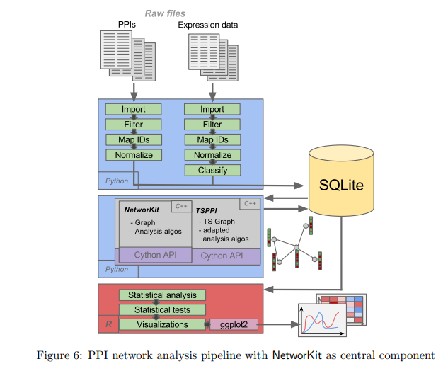
EXAMPLE USE CASES
As a Library in an Analysis Pipeline
Exploratory Network Analysis with Network Profiles

Slide 13
COMPARISON TO RELATED SOFTWARE
Recent years graph processing and network analysis tools which vary widely in terms of target platform, user interface, scalability and feature set.
We therefore locate NetworKit relative to these efforts.
Although the boundaries are not sharp, we would like to separate network analysis toolkits from general purpose graph frameworks,which are less focused on data analysis workflows.
Other projects are geared towards network science but differ in important aspects from NetworKit.
The variant PajekXXL uses less memory and thus focuses on large datasets.

Slide 14
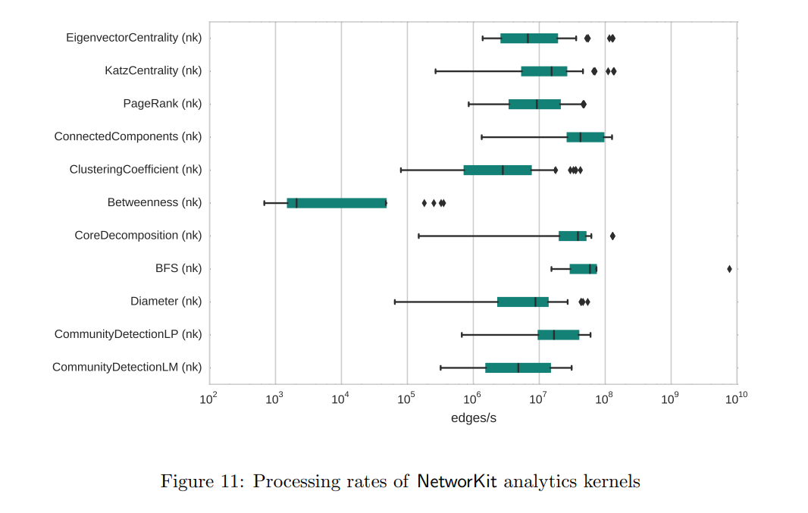
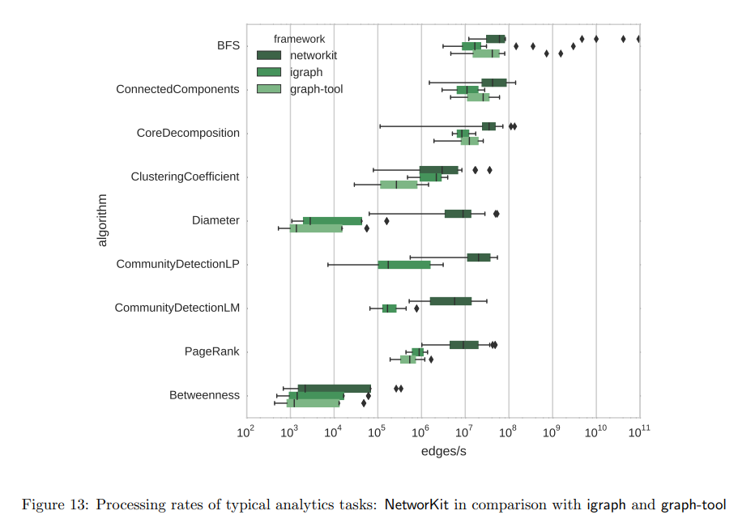
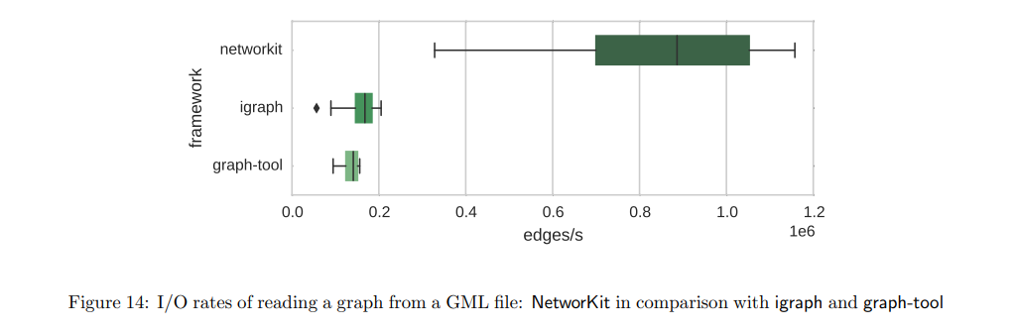
PERFORMANCE EVALUATION
Benchmark ii) Comparative Benchmark

Slide 15
OPEN SOURCE DEVELOPMENT
AND DISTRIBUTION
Through open-source development we would like to encourage usage and contributions by a diverse community, including data mining users and algorithm engineers.
The core developer team is located at KIT, NetworKit is becoming a community project with a growing number of external users and contributors.
The code is free software licensed under the permissive MIT License.

Slide 16
CONCLUSION
The NetworKit project exists at the intersection of graph algorithm research and network science.
With Net-worKit, we provide a package of network analytics kernels,network generators and utility software.
Its contributors develop and collect state-of-the-art algorithms for network analysis tasks and incorporate them into ready-to-use software.
The open-source package is under continuous development.
The result is a tool suite of network analytics kernels, network generators and utility software to explore and characterize large network data sets on typical multicore computers.
Our experimental study showed that NetworKit is capable of quickly processing large-scale networks for a variety of analytics kernels in a reliable manner.

