Slide 1
PROPOSAL FOR THE WATER SITUATION IN TANZANIA VICTORIA INC. LTD By. Maureen Auka

Slide 2
Introduction
Tanzania, a developing nation, faces challenges in supplying its more than 57,000,000 inhabitants with water that is safe for drinking.
According to the Sustainable Development Goals (SDG) standards, just 61% of Tanzanian households presently have access to a basic water supply, 32% to basic sanitation, and 48% to basic hygiene.
Tanzanians rely heavily on groundwater as their primary supply of water.
The project aims to builds classification model, using an iterative approach, to predict the condition of water wells in Tanzania.

Slide 3
Business Understanding
Victoria Inc. has been procured by the Government of Tanzania on a consultancy basis to study the severe water crisis experienced by the country and propose a data driven solution to clean water accessibility. Victoria Inc. is tasked with coming up with a model that predicts the operating condition of the water points. This model will assist the government to:
Prioritize maintenance and repairs based on operating status;
Understand the failure rate of the water points;
Optimize allocation of resources to restore the water points.

Slide 4
Problem Statement, Metric of Success & Methodology
Problem Statement
Predicting the operating condition of water points and advising the government on the critical points to be addressed.
Metrics of Success
Developing of a Machine Learning model with an accuracy score of 80%:
Methodology
The five phases of CRISP – DM:
Domain knowledge (Business Understanding),
Data Understanding
Data Preparation.
Explanatory Data Analysis
Modelling

Slide 5

Analysis and Findings

Slide 6
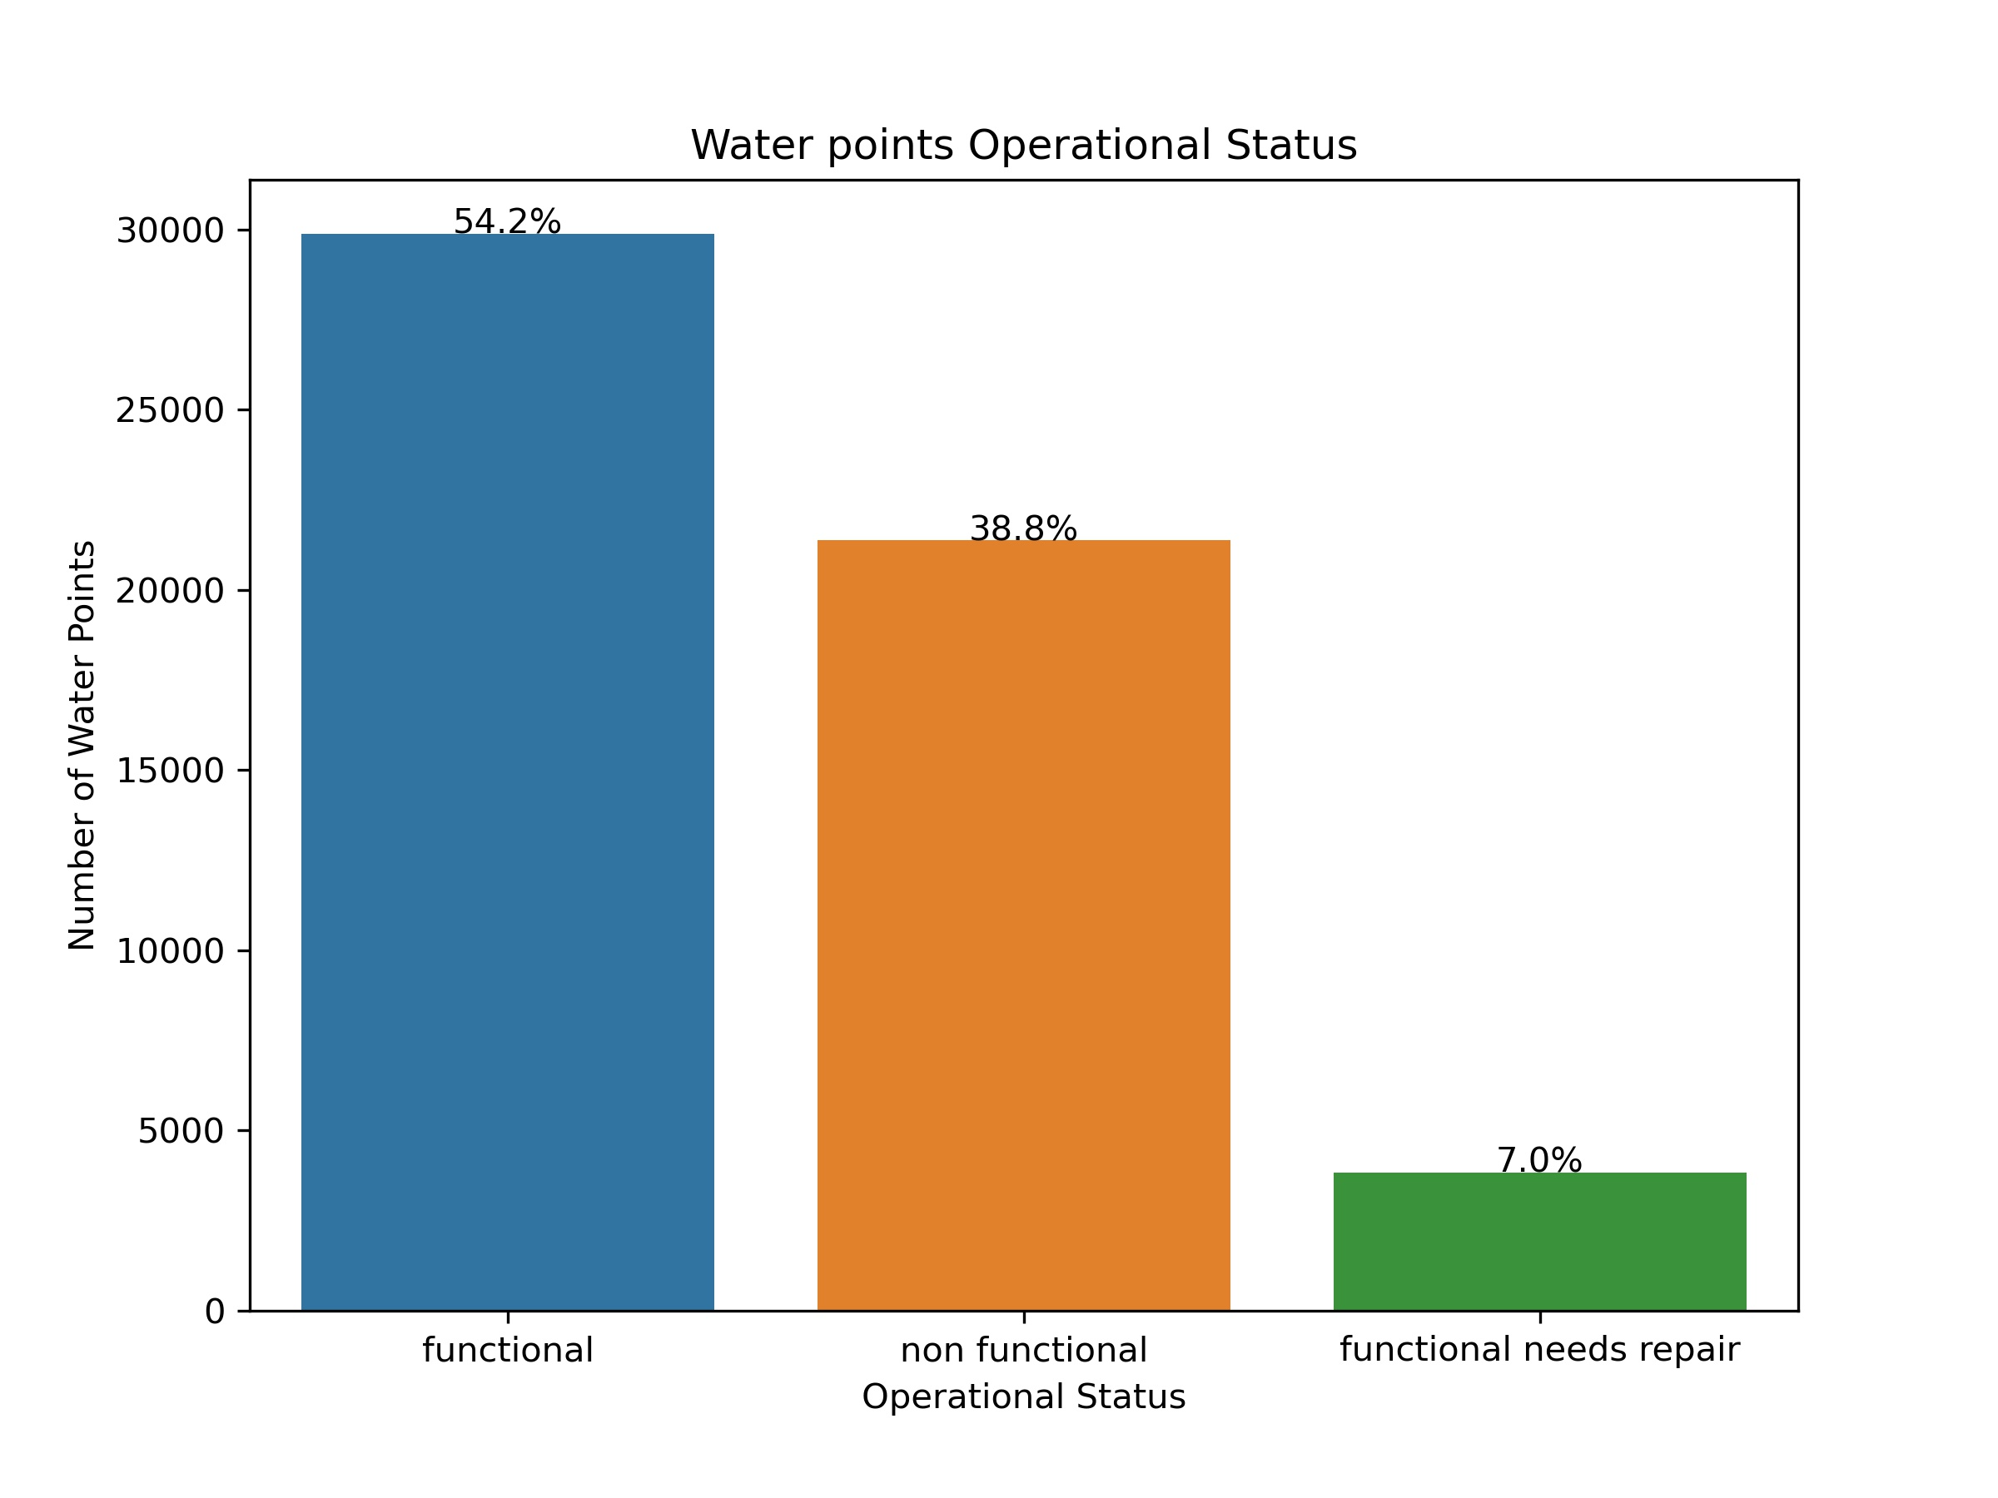
Summary Statistics

Slide 7
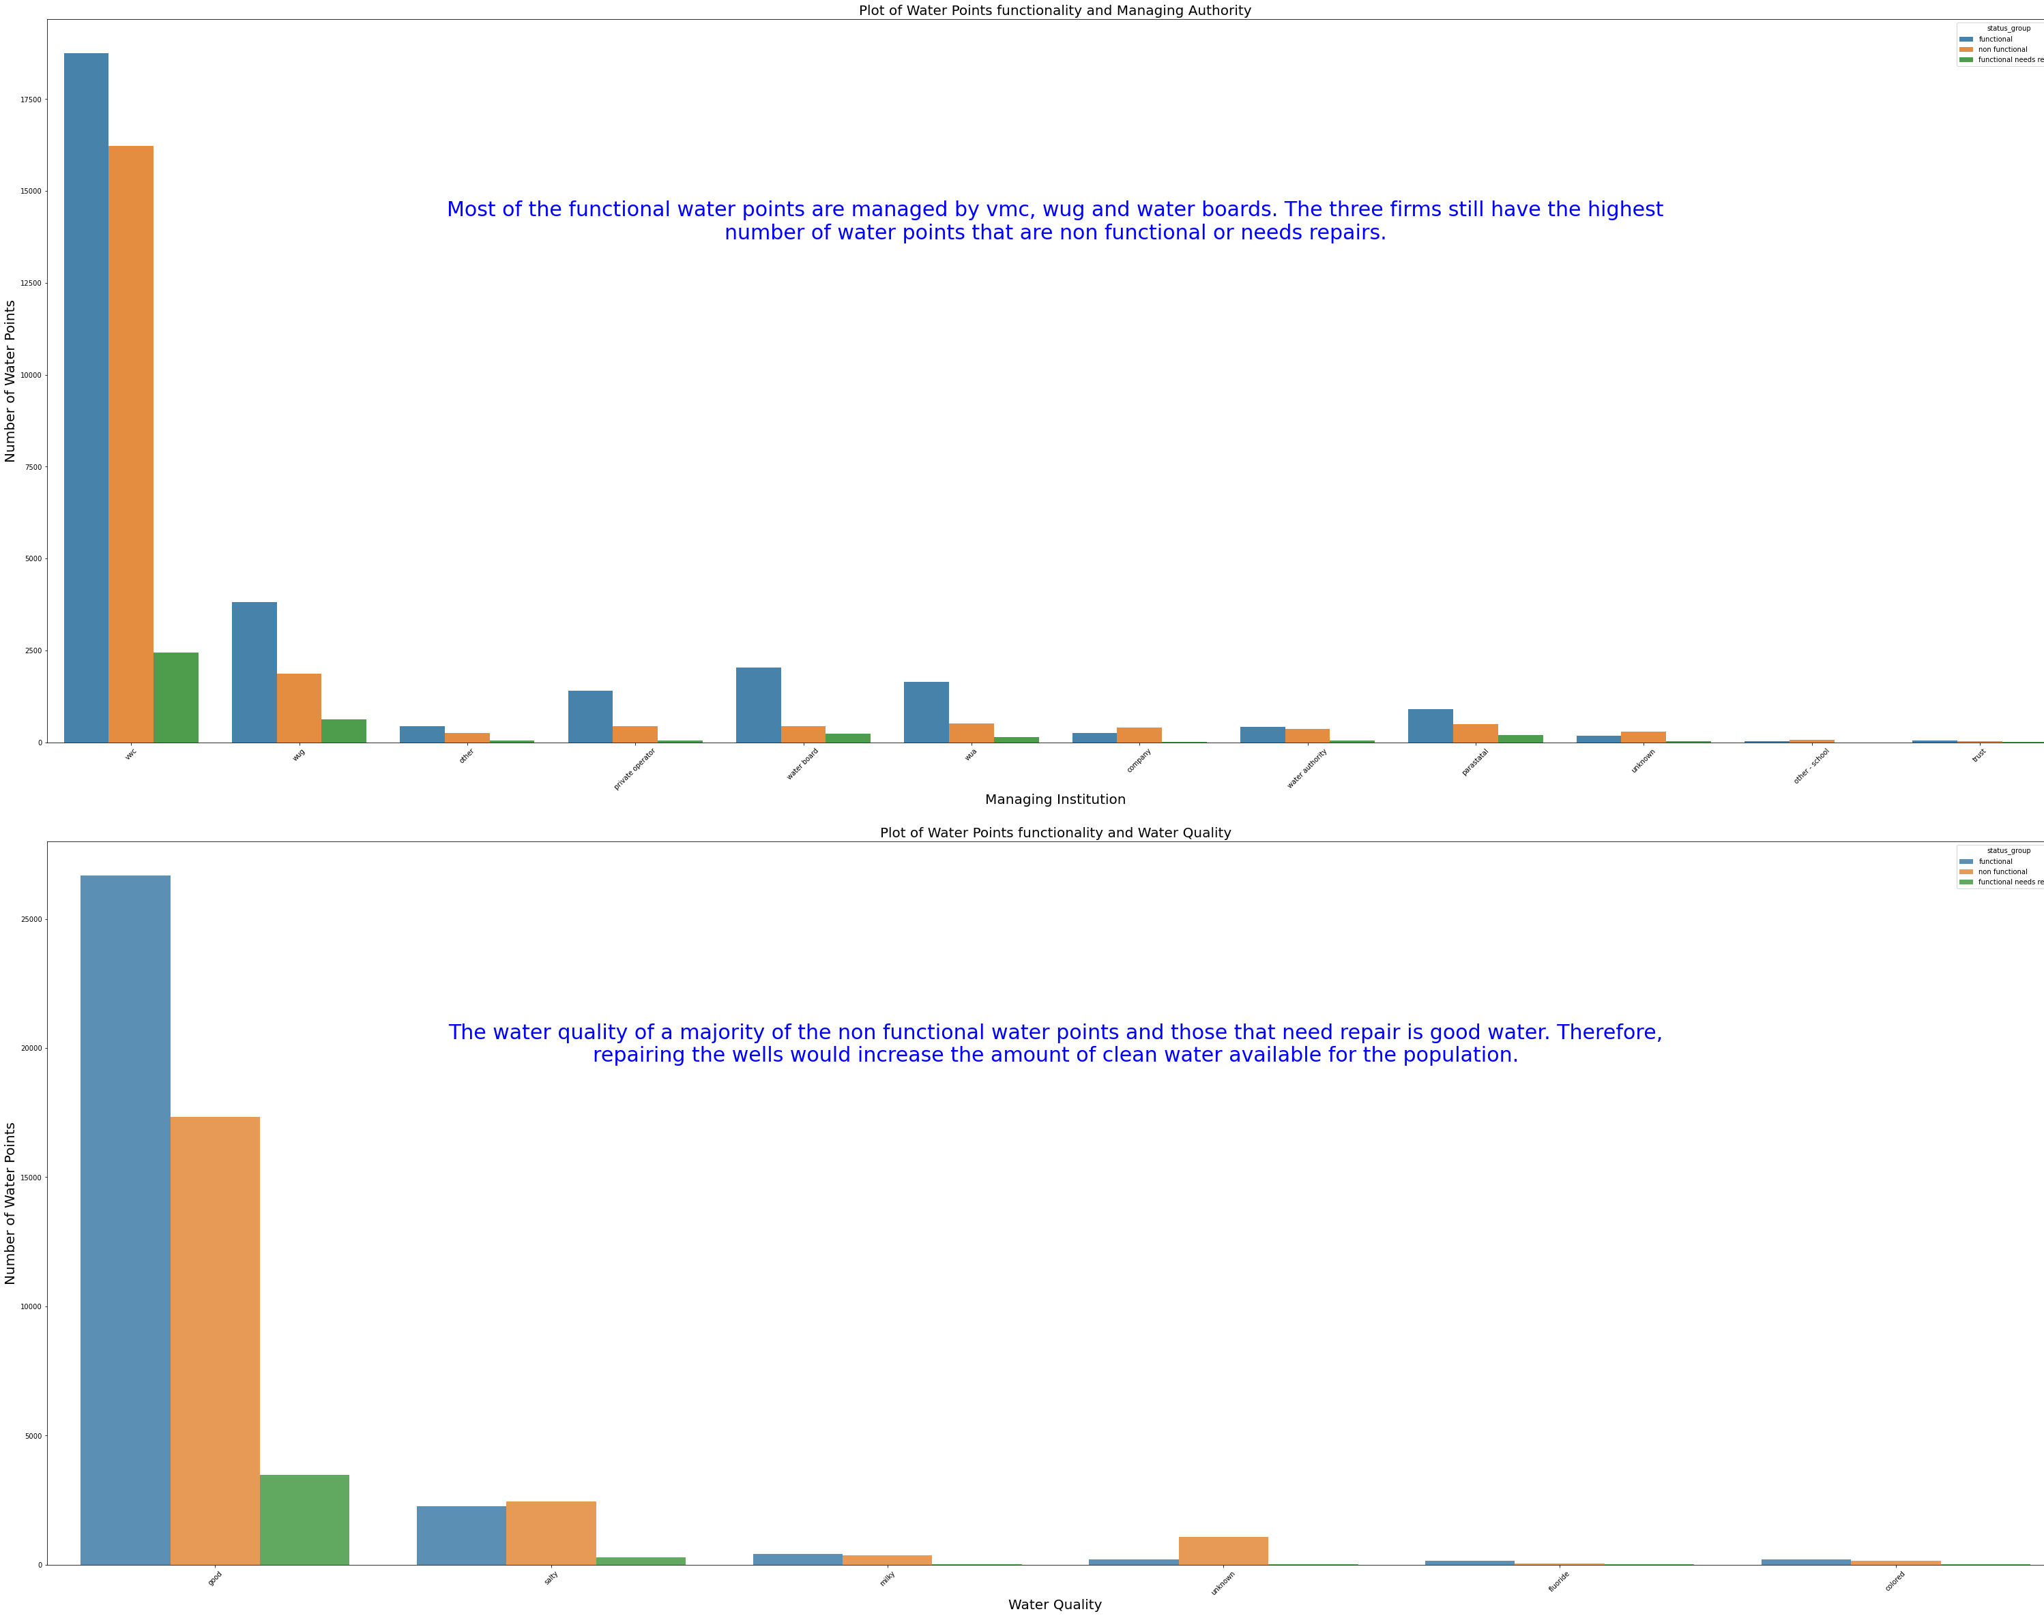

Slide 8
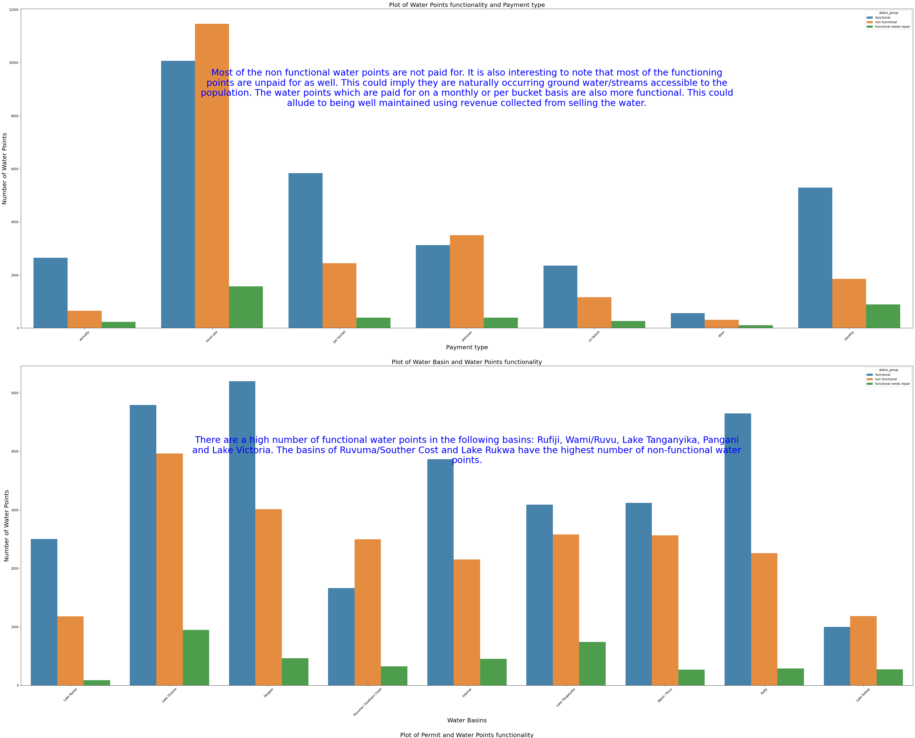

Slide 9
Analysis and findings
The main source of water for Tanzania is ground water.
Payment provides incentive and means to keep wells functional. Wells with no fees are more likely to be non functional.
The most important features are quantity of water (enough), water point type and extraction type for the waterpoint. There are over 8,000 waterpoints that have enough water in them but are non functional. These are recommended as high priority class to repairs.

Slide 10
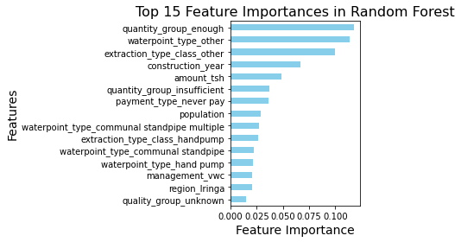
Important Features for Water Point Performance

Slide 11

Recommendations

Slide 12
The Tanzanian government should allocate more resource for repair of non functional water pumps to the following regions Mbeya, Lindi, Rukwa, Tabora and Mara. The regions have a higher number of non function pumps water points as the situation is critical.
The functional but need repairs water points in Lake Victoria, Southern Coast, Lake Rukwa, Pangani and Lake Tanganyika basins should be addressed to prevent failure which can be more expensive to repair.
Repairs and Maintenance for the over 8,000 waterpoints that have enough water in them but are non functional should be prioritized.
VMC, WUG and Water Board have a lower rate of pump failure. This alludes to their good water points management strategies. It is therefore recommended that the other companies benchmark with the three firms.

Slide 13
Thank you

