Slide 1
PROPOSAL FOR THE NEW AVIATION DIVISION – MAUREEN INC. LTD By. Maureen Auka

Slide 2
Introduction
Aviation industry is made up of for general aviation, commercial aviation, and military activities.
4.6% of Kenya's yearly GDP is contributed by the aviation sector (KNBS, 2022).
In 2017, Kenya handled over 4.6 million passenger travels, resulting in a $3.2 billion gross value addition to the country's GDP from the tourism and aviation sector translating into 410,000 jobs.
Internationally, the commercial aviation sector experienced 30 accidents in 2023 as compared to 42 accidents in 2022. According to a 2022 security audit conducted by the International Civil Aviation Organisation (ICAO), Kenya has the second-best aviation safety standards in Africa, scoring 91.77%.

Slide 3
Business Understanding
Maureen Inc. is diversifying its holdings and considers entry into the aviation industry. Its specific interest is in the general and commercial services. The company plans to procure aircrafts for the new venture. To help in decision making, the company would like insights on the aircrafts that would have the lowest risk for the aviation division.

Slide 4
Problem Statement, Metric of Success & Methodology
Problem Statement
Identify the least risky planes (aircrafts) for Maureen Inc. to launch its new venture
Metrics of Success
Identification of :
Low risk aircrafts models
Factors affecting aircraft safety.
Methodology
The first three phases of CRISP – DM:
Domain knowledge (Business Understanding),
Data Understanding
Data Preparation.

Slide 5

Analysis and Findings

Slide 6
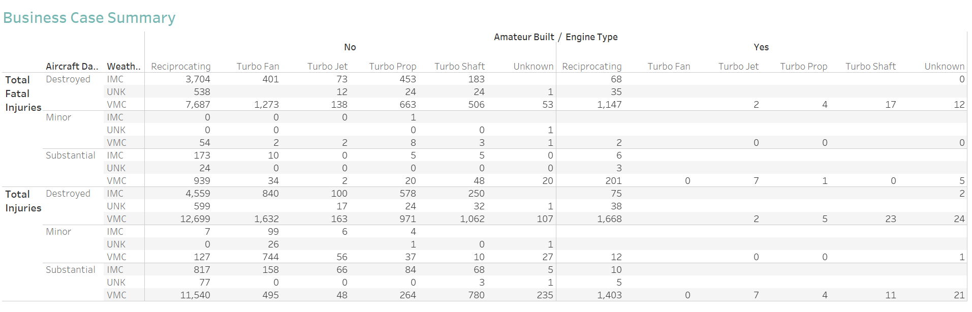
Summary Statistics

Slide 7
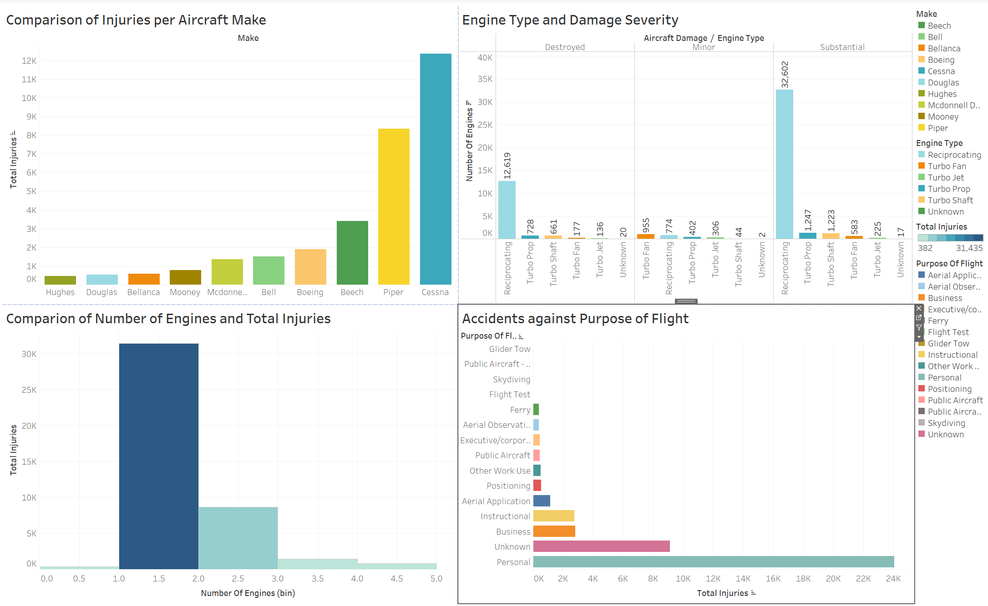
Total Injuries against various aircraft parameters

Slide 8
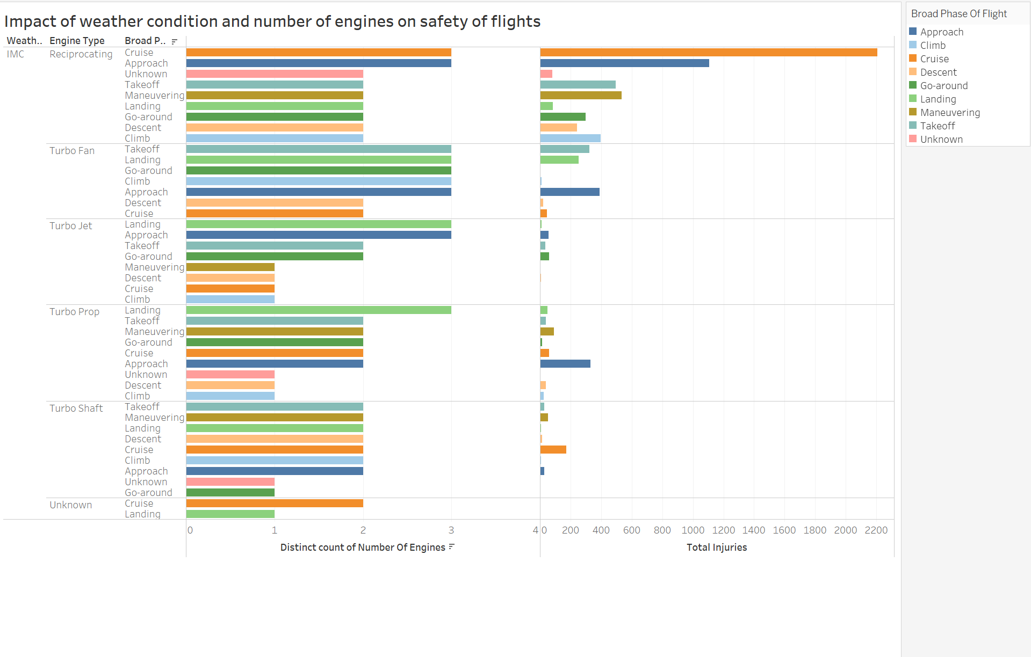
Weather Conditions and Performance

Slide 9
Analysis and findings
A majority of the aircrafts involved in accidents were not amateur built.
Most accidents were reported during landing with VMC weather conditions. As the number of engines increases, the number of accidents reduces. This can be attritubed to the availablility of a redundancy/emergency engine in case of one engine failure

Slide 10

Recommendations

Slide 11
The company should focus on provision of safe aviation transport in the personal (general aviation) niche. Data analysis indicate flights for personal use experienced most accidents and incidences. This is an area with potential growth.
Aircrafts to be procured should have turbo jet or turbo fan engines with at least 3 engines. Aircrafts mounted with reciprocating engines are worst performing in terms of aviation safety. The aircrafts to be procured should have advanced and more sophisticate weather monitoring instrumentations to be used during IMC ( Instrumentation Monitoring Condition) conditions.
A greater percentage of the recorded accidents occurred during VMC (Visual Monitoring Condition) weather conditions. It is therefore recommended that Maureen Inc develops Standard Operating Procedures that are safety stringent during VMC conditions.
Considering the commercial nature of the company, it is recommended that the organizations procures professionally built aircrafts as opposed to amateur built despite the statistics indiation most accidents occured on professionally built aircrafts.

Slide 12
Thank you

