Slide 1

ENME480 Labs Week 1 - Basics
Alex Beyer, Kaustubh Joshi

Slide 2
Introductions
Alex Beyer
6th Year PhD, undergrad in Mechanical Engineering @ UDelaware
Research work in bioinspired robotics, covert communications and robotic metareasoning
Kaustubh Joshi
5th Year PhD, undergrad in Ocean Engineering @ IIT Madras
Research work in underwater robotics, state estimation and control

Slide 3
Todays Plan
Lab Structure & Grading Policies
Lab Schedule & Class Goals
Final Project Description
Overview of Hardware & Software
Online Safety Training & Lab Group Survey

Slide 4
Lab Structure
Two rooms:
KEB2111/2107 (here!)
IDEA3119
Safety training for IDEA3119 next week!
Let the TAs know ASAP if you can’t make it

Slide 5
Lab/Homework Grading
Homework:
Course homeworks are designed as practice for important skills
Labs:
Groups will be assigned soon(™), most lab assignments will be group based
Each topic will have a few studio sessions in Kim followed by one or more weeks in RAL to get data, the writeup will be due before the next lab session
We are fairly flexible with deadlines, but we release answer keys after assignments are due

Slide 6
Lab/Homework Submissions
Only submit PDFs
Labs are graded for correctness
Half the points on the homeworks are for making a clear attempt, half the points are for correctness
Submit legible work! We will deduct points for work which is too messy, disorganized or blurry for us to read, regrades and resubmissions are limited
Check ELMS submissions after uploading!

Slide 7
Course Communications
Use Piazza!
Link on ELMS
We will not respond to emails
Post publicly when possible – if you have a problem so do others

Slide 8
AI Usage Policy
Don’t.

Slide 9
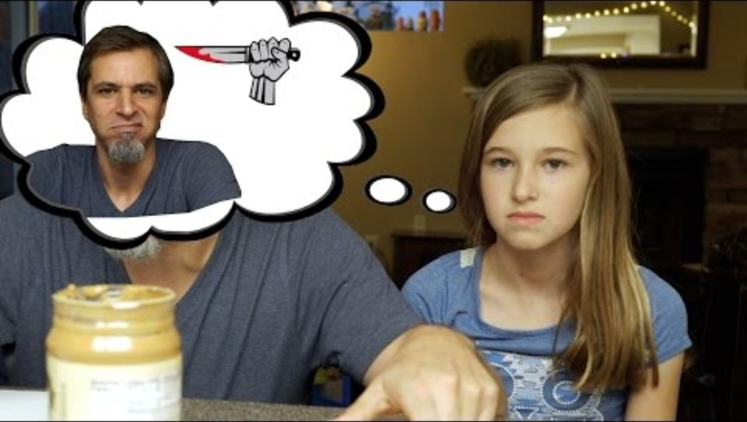
AI Usage Policy

Slide 10
AI Usage Policy
AI is good at:
Broad, high level overviews
General questions
Common problems
AI is bad at:
Bespoke problems
Detailed, technical math
Reading your mind
Using Generative AI to write code which will run on the robots means you won’t be allowed to use the robots again!

Slide 11
Schedule
Weeks | Lab
1-4 | Introductions, Python, ROS, Ubuntu, Gazebo
5, 6 | Forward Kinematics
7 | Makeup/Open Lab (Fall Break, Exam 1)
8-10 | Inverse Kinematics
11, 12 | Cameras
13 | Makeup/Open Lab (Thanksgiving)
14, 15 | Final Project
This is all in the syllabus!

Slide 12
Lab Organization
Programming Studios:
In Kim
Everyone shows up at the same time, brief lecture at the start
Leave when the work is done
Robot Studios:
In IDEA
Groups will be split into 2 rotations, you will only get a robot during your rotation
Free robots are open for anyone to use

Slide 13
Goals
Final Project
Vision Enabled Pick & Place Task using UR3 Arms
Final Project is the final (20% of overall grade)
Labs will walk you through each step involved in building the project (another 20% of overall grade)
Homeworks have been created to tie into the project by giving you easier practice problems

Slide 14
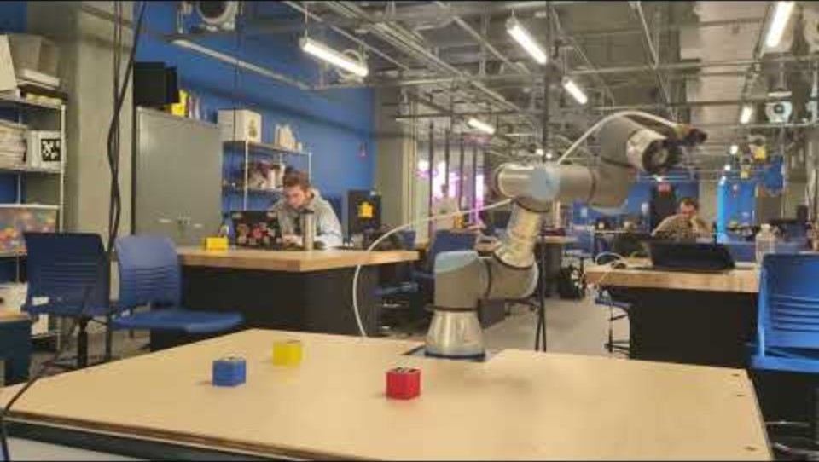
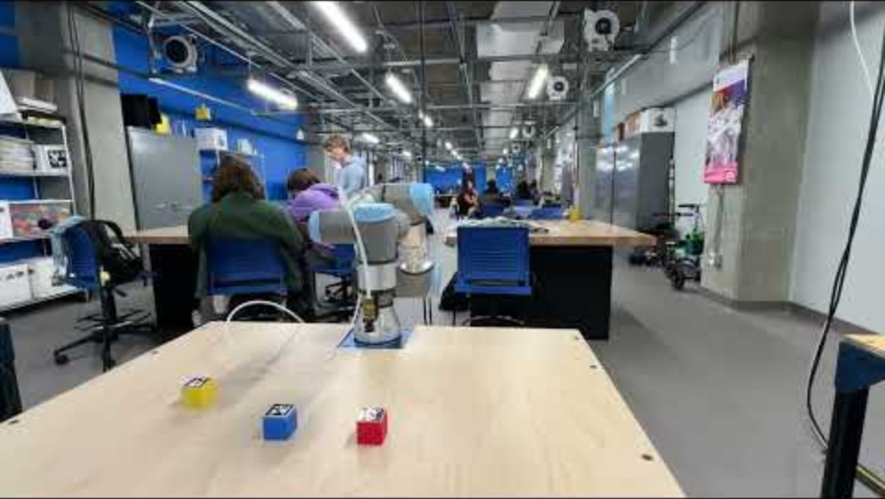
Goals
Credit: Robsun Gina (student from c/o 2024)

Slide 15
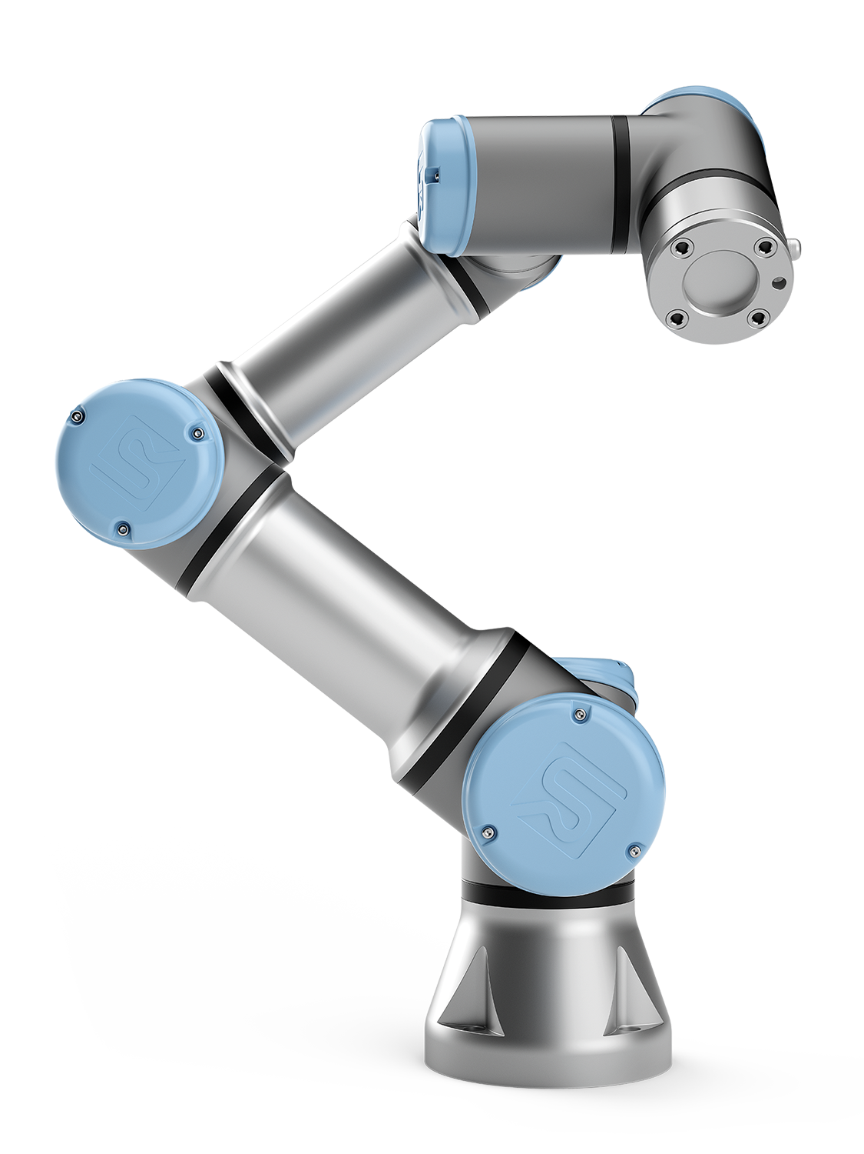
Hardware
Universal Robotics UR3e Robotic Arms
6 DoF Robot
3kg payload
Built in user tablet
Supplied ROS drivers to make programming easier & operation safer

Slide 16


Software
Ubuntu 22.04 with ROS2 (Humble Hawksbill)
Premade Docker image is available
We strongly recommend you use Docker
VirtualBox works but can cause bugs
VMWare Fusion Pro is free but requires a Broadcom account
Dualbooting is another option for more advanced users
WSL2 also offers ROS2 support
Native Windows/OSX support is not good
We aren’t planning to offer support for non-Docker installs
Preferred Python Code Editor (i.e. VSCode)

Slide 17

Why Ubuntu?
Ubuntu is a Linux based OS designed using primarily Free and Open Source Software (FOSS)
Nothing is closed to the user; its extremely customizable
Easy to mod
Runs on almost any hardware made in the last decade
Low overhead, takes very few resources
We will give a more in depth tutorial on Ubuntu next week

Slide 18
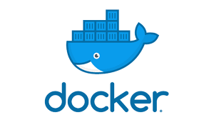
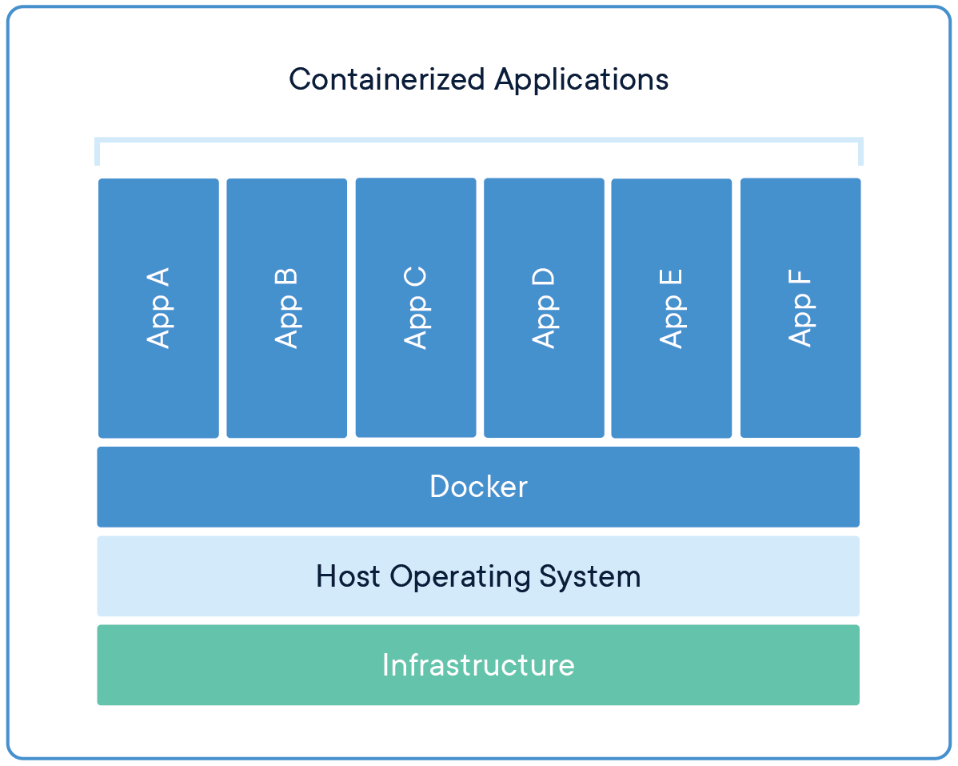
Docker
Let’s you package a bunch of settings and programs into an image that anyone can load and instantly get to a known-stable state
Can be broken then deleted and reinstalled easily to get back to a working state
Super useful for things that break easily, like ROS!

Slide 19
Virtual Machines
Every computer has an Operating System (Windows, MacOS, …) but not all programs run on every OS
VMs let you run one OS within another
For example, ROS has poor Windows support and absolutely no Mac support, but it’s made to run on Ubuntu Linux
VM
VM
Hypervisor
(VMWare, VirtualBox)
Native OS
(Windows, Mac)
Hardware

Slide 20
The Robotics Operating System (ROS)
Modular, open source middleware designed to be a common way of working with robots
ENME480 teaches how to use ROS to develop, test and deploy code from one environment

Slide 21
Deliverables
Next weeks lab will meet here before heading to RAL for an intro and safety briefing, arrive on time!
Robot safety training: academy.universal-robots.com/free-e-learning/e-series-e-learning/
Class survey: go.umd.edu/ENME480-26-Survey
Course wiki: enme480.github.io

