Slide 1


Session 5: Layout Basics
Welcome to Session 5, where we'll delve into the fundamental concepts of web page layout. Mastering layout techniques is crucial for creating visually appealing and user-friendly websites. We'll explore key concepts like the display property, positioning, and the float and clear properties, providing you with a comprehensive understanding of how to arrange and style elements on your web pages.

Slide 2
Display Property
1
Understanding the Display Property
2
Common Display Values
The display property offers a wide range of values, each with its distinct behavior and purpose. We'll examine the most common values, including block, inline, inline-block, and none, and explore how they impact layout.
The display property is a fundamental CSS property that controls the type of rendering box an element occupies. It determines how an element is displayed on the page, influencing its size, positioning, and interaction with other elements.
3
Impact on Layout
4
Creating Responsive Designs
The display property plays a significant role in shaping the visual presentation of your website. By understanding the effects of different display values, you can effectively control the flow and arrangement of elements on your pages, creating clean, organized, and visually appealing layouts.
The display property is essential for creating responsive designs, which adapt to different screen sizes and devices. By using media queries and adjusting the display values, you can ensure your website looks great on all platforms.

Slide 3
block, inline, inline-block, none
Block Elements
Inline Elements
Inline-Block Elements
Block elements are displayed as a block, occupying the full width of their containing element. They break the flow of the text, starting on a new line. Common examples include headings (h1-h6), paragraphs (p), and divs.
Inline elements are displayed within the flow of text. They do not break the line and are typically used for text-level elements like strong (strong), emphasis (em), and links (a).
Inline-block elements combine the characteristics of both block and inline elements. They are displayed in line with other inline elements but allow for width and height properties like block elements. This allows for more flexibility in element positioning.

Slide 4
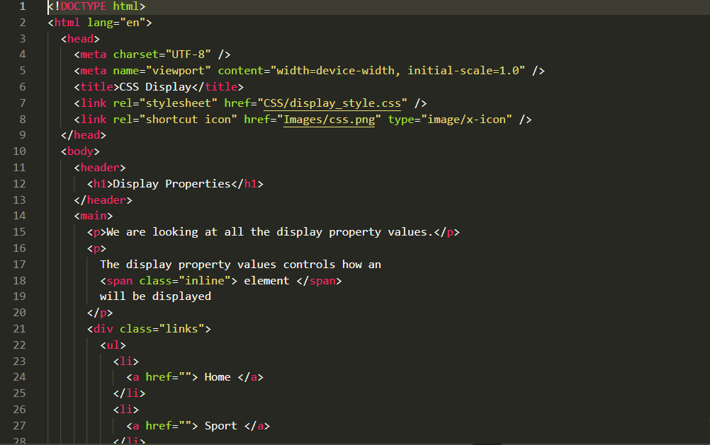
HTML Code Snippet 1 :Display Property

Slide 5
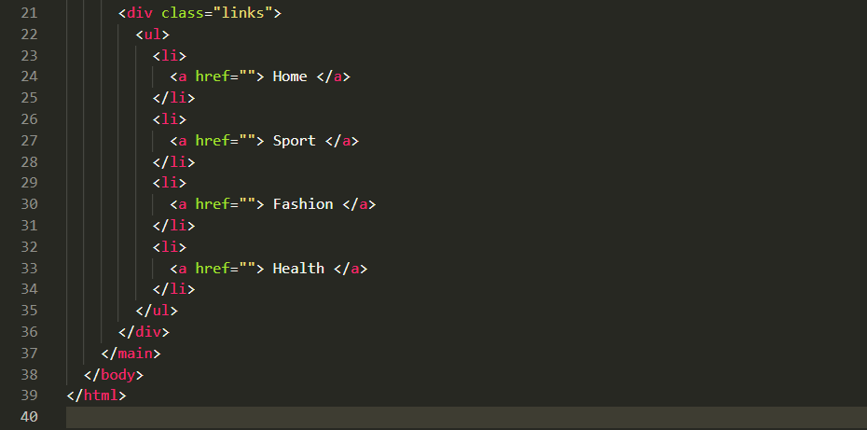
HTML Code Snippet 2 :Display Property

Slide 6
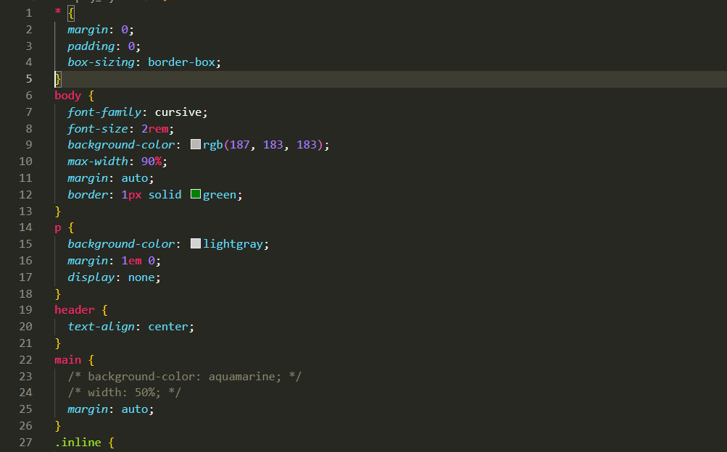
CSS Code Snippet 1 :Display Property

Slide 7
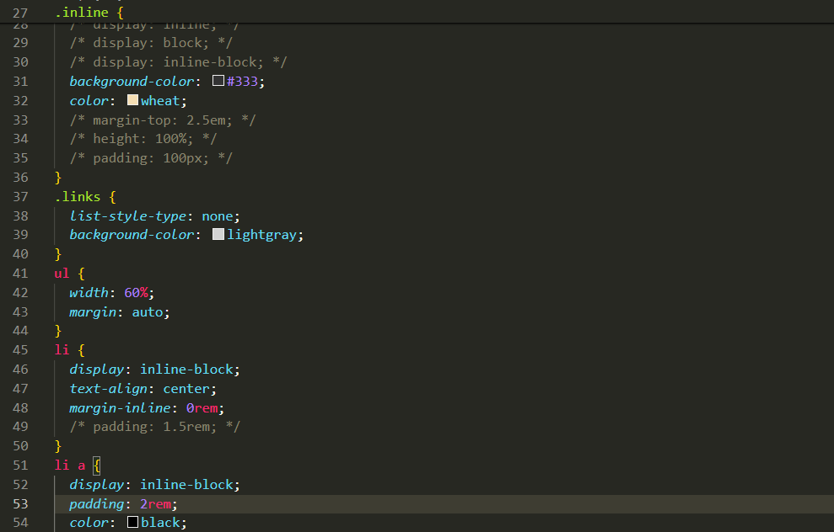
CSS Code Snippet 2 :Display Property

Slide 8
Positioning
1
Static Positioning
The default positioning for all elements. Elements are positioned according to the normal document flow. This is the simplest positioning method and is suitable for elements that should flow naturally with the rest of the content.
2
Relative Positioning
Elements are positioned relative to their normal position in the document flow. You can use top, right, bottom, and left properties to adjust their position. This positioning method allows for fine-grained control over element placement without affecting the layout of other elements.
3
Absolute Positioning
Elements are removed from the normal document flow and positioned relative to the nearest ancestor element that has a position property other than static. This method allows for precise control over element placement, but you need to ensure that the ancestor element has a position property other than static.
4
Fixed Positioning
Elements are positioned relative to the viewport. They remain fixed in their position even when the user scrolls the page. This is useful for creating elements that are always visible, such as navigation bars or headers.
5
Sticky Positioning
A combination of relative and fixed positioning. Elements are positioned relative to their normal position in the document flow until they reach a specific point on the page. Then, they become fixed in relation to the viewport. This is helpful for creating elements that stick to the top or bottom of the screen as the user scrolls.

Slide 9
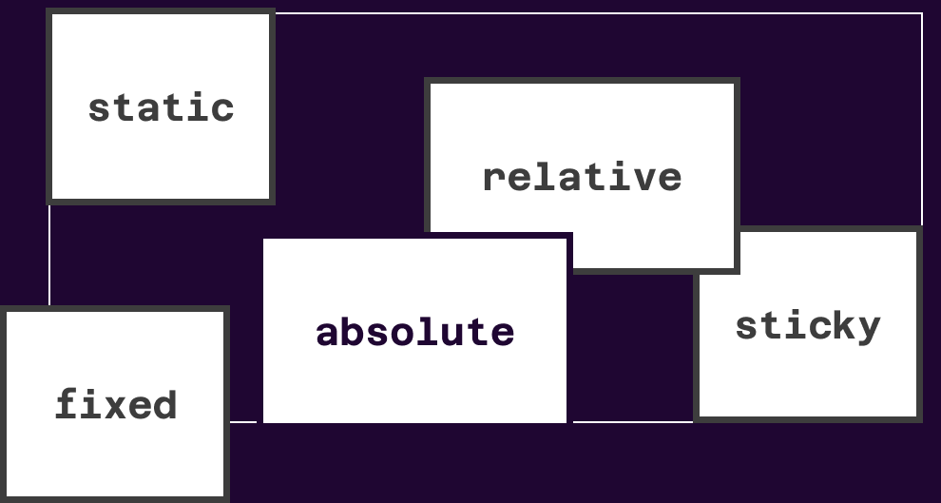
Figure : Positioning property

Slide 10




Float and Clear
Float Property
The float property allows you to position elements to the left or right of their container. Floated elements are taken out of the normal document flow, allowing other content to flow around them.
Clearing Floated Elements
When elements are floated, they can sometimes cause unexpected layout issues, such as content flowing under the floated elements. The clear property is used to prevent this by clearing the float on an element, ensuring that no floated elements appear on either side.
Controlling Layout
The float and clear properties offer a flexible way to control layout and create complex designs. By understanding how these properties work, you can create sophisticated and visually appealing web pages.

Slide 11




Floating elements
Image Placement
Creating Columns
Sidebars and Navigation
Layout Flexibility
Floating images is a common technique to create visually appealing layouts. You can float images to the left or right, allowing the text to wrap around them. This adds dynamism and visual interest to the page.
You can use floating elements to create two-column or multi-column layouts. By floating elements to the left or right, you can control how the content is divided and presented on the page.
Floating offers a flexible approach to layout design. It allows you to create dynamic and adaptable layouts that can respond to different screen sizes and user preferences.
Floating elements are often used for sidebars and navigation menus. By floating them to the left or right, you can create a distinct side area that complements the main content of the page.

Slide 12
Clearing floated elements
Issue
Solution
Floated elements can cause content to flow underneath them, leading to unexpected layout issues.
Use the clear property on an element to prevent floated elements from appearing on either side. This ensures that content flows properly.
The clear property can be applied to any element, such as a div or paragraph, to clear the float on that specific element.
By clearing the float, you can control the flow of content and prevent elements from overlapping or appearing in unexpected positions.

Slide 13
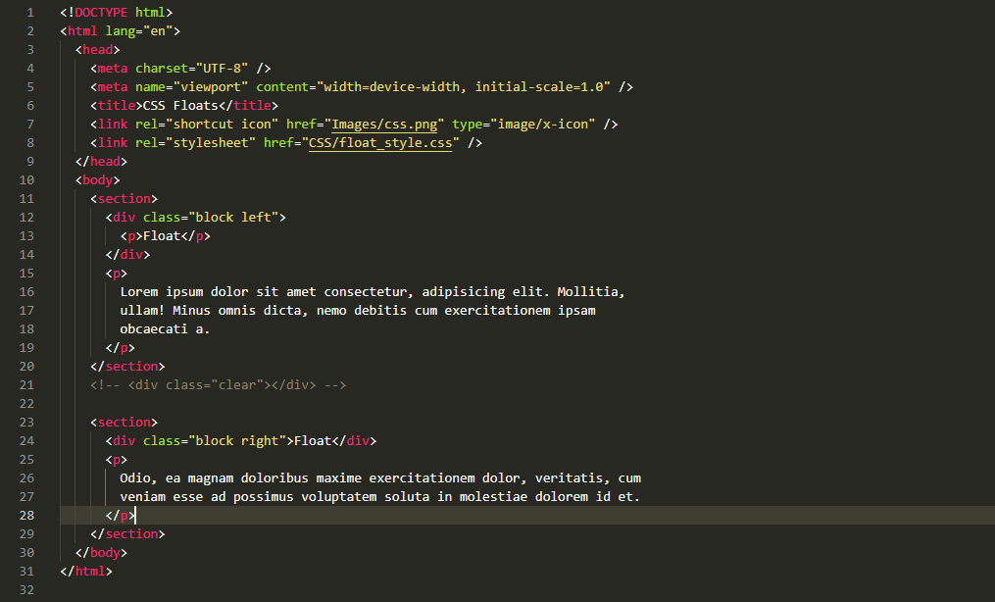
HTML code snippet:Floating elements

Slide 14
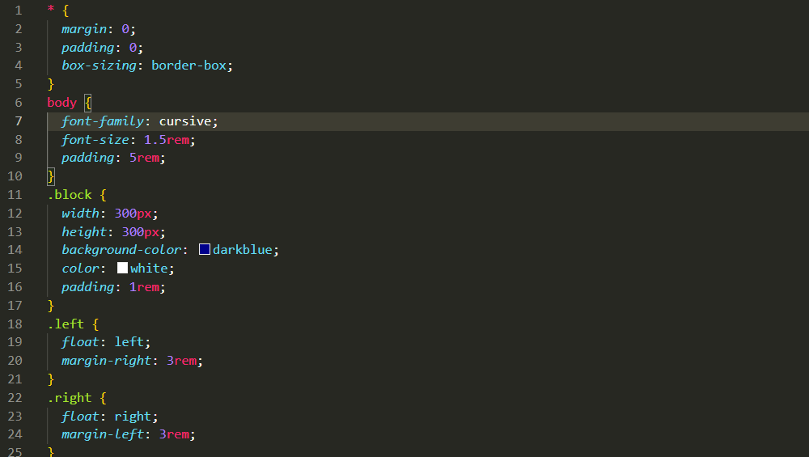
CSS code snippet 1:Floating elements

Slide 15
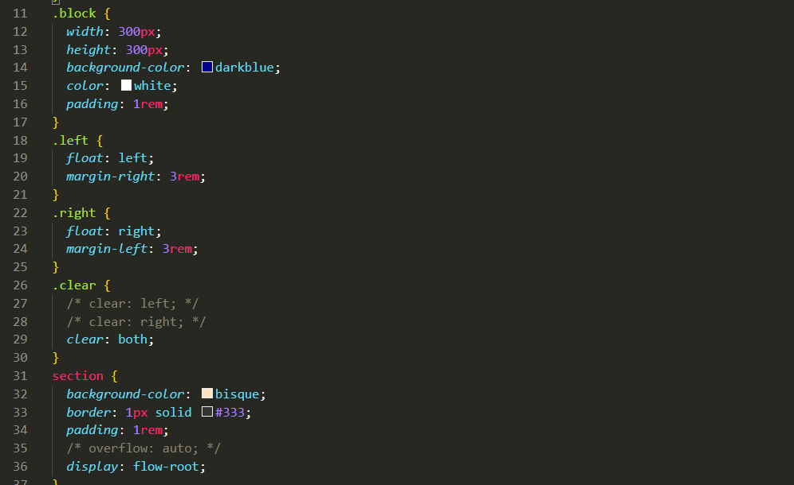
CSS code snippet 2:Floating elements

