Slide 1
Information Assurance Security

Slide 2



Getting Started In Information Security
Information Assurance Security | SPCC

Slide 3
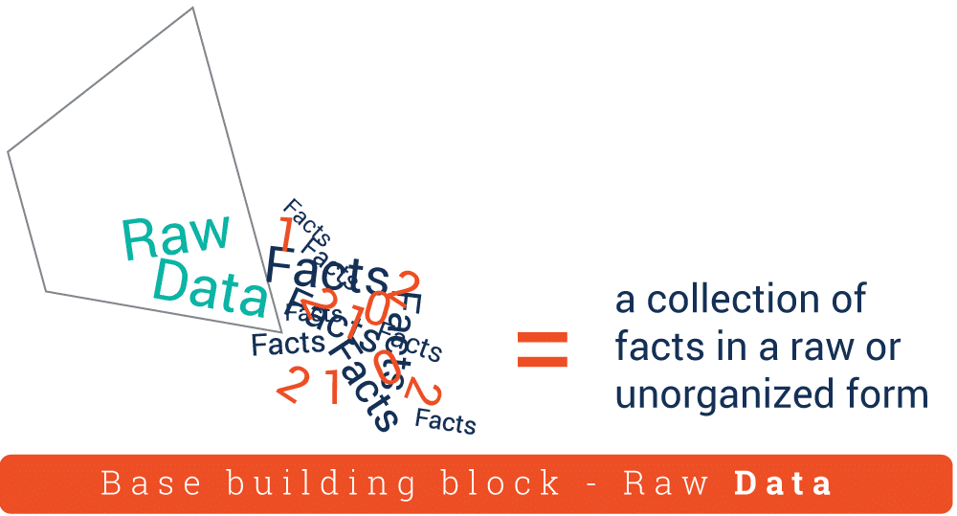
DATA VS INFORMATION
DATA - is any set of characters that is gathered and translated for some purpose; usually analysis. If data is not put into context, it doesn’t do anything to a human or computer.

Slide 4
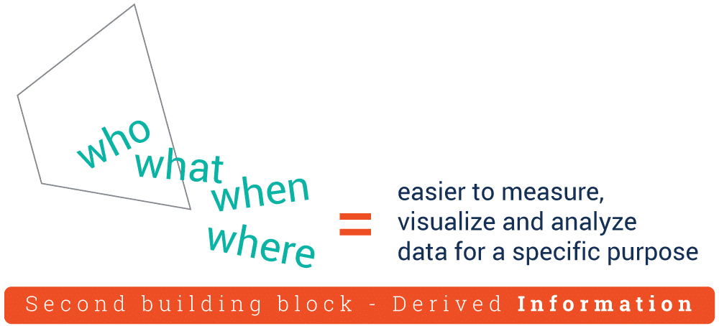
DATA VS INFORMATION
INFORMATION - information is processed, organised and structured data. It provides context for data and enables decision making.

Slide 5
INFORMATION – is an asset which, like other important business assets, has value to an organization and consequently needs to be suitably protected.

Slide 6
DATA VS INFORMATION
11112021

Slide 7
INFORMATION can be:
Created
Stored
Destroyed
Processed
Transmitted
Used
Corrupted
Lost
Stolen
Printed or written on paper
Stored electronically
Transmitted by post or using electronic means

Slide 8
INFORMATION can be:
Shown on corporate videos
Displayed/published on web

Slide 9
CRITICAL CHARACTERISTICS OF INFORMATION
AVAILABILITY
ACCURACY
AUTHENTICITY
CONFIDENTIALITY
INTEGRITY
UTILITY
POSSESION
Notes:
AVAILABILITY - Availability is the characteristic of information that enables user access to information without interference or obstruction and in a required format. Like hardware failures, and system upgrades.
ACCURACY- Information has accuracy when it is free from mistakes or errors and it has the value that the end users expects. If information contains a value different from the user’s expectations, due to the intentional or unintentional modification of its content, it is no longer accurate.
AUTHENTICITY- Authentication occurs when a control provides proof that a user possesses the identity that he or she claims.
CONFIDENTIALITY-ensures that only those with sufficient privileges may access certain information.
INTEGRITY - Integrity is the quality or state of being whole, complete, and uncorrupted. threatened when it is exposed to corruption, damage, destruction, or other disruption of its authentic state.
UTILITY - Information has value when it serves a particular purpose. This means that if information is available, but not in a format meaningful to the end user, it is not useful. Thus, the value of information depends on its utility.
POSSESION - The possession of Information security is the quality or state of having ownership or control of some object or item.

Slide 10
CHARACTERISTICS OF DATA QUALITY AND HIGH QUALITY INFORMATION
Information cannot be partial or have details missing
Mechanisms must be in place to ensure that new data doesn’t contradict existing data
Information must come from a reliable source of information
Information must be distinctive and add value to a database
Information in a database must be timely and up to date

Slide 11
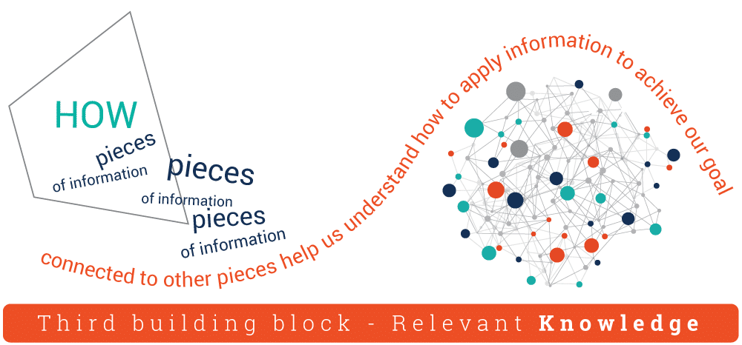
KNOWLEDGE AND WISDOM
KNOWLEDGE - is information that has been processed, analyzed and interpreted, and can be used to make decision.

Slide 12

KNOWLEDGE AND WISDOM
WISDOM - is the synthesis of information and experience in a way that applies knowledge to real-like situations.

Slide 13
DIKW PYRAMID

Slide 14
