Slide 1
FEMA and Natural Disaster Preparedness
Susan Lee, Ebony Plummer, Xiao Yu
Notes:
SUSAN
This past summer, the Atlantic had 16 tropical storms, and 6 major hurricanes, which includes Hurricane Harvey, Irma, and Maria that had huge impacts in Houston, Florida, and Puerto Rico, largely with flooding.
Every year, the US government allocates federal money to the Federal Emergency Management Agency (FEMA). FEMA is an agency of the United States Department of Homeland Security, where their primary purpose is to coordinate the response to a disaster that has occurred in the US that overwhelms the resources of local and state authorities. The governor of the state in which the disaster occurs must declare a state of emergency and formally request from the president for FEMA and the federal government response to the disaster

Slide 2
Presentation Outline
What is our project about?
What questions do we want solve?
Where did we retrieve our data from?
How did we analyze our data?
What were our findings?
How can we improve our analysis?
Questions?
Notes:
SUSAN

Slide 3

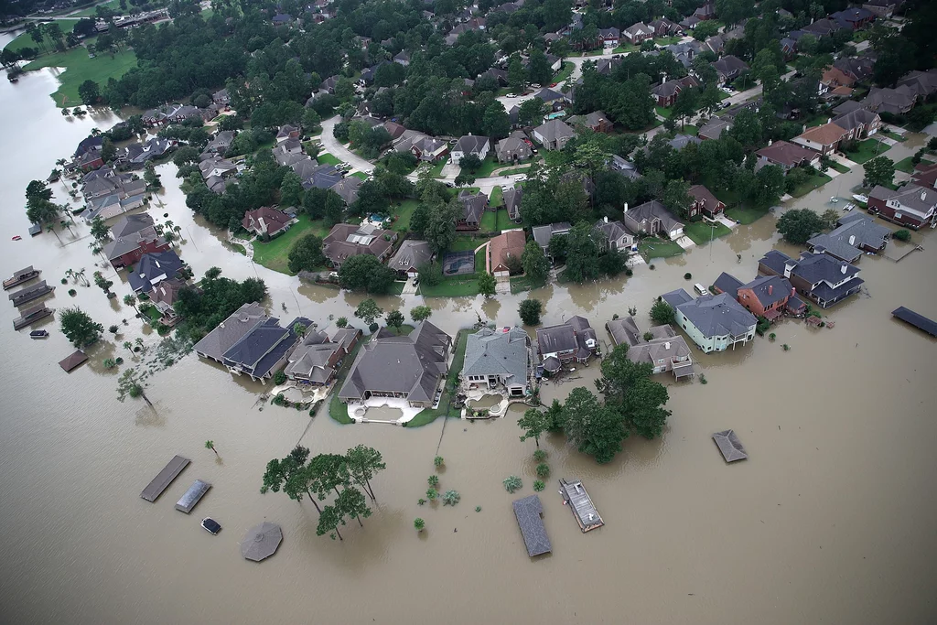

Project Summary
What has been the weather and natural disaster trend over the past decades?
What has our government, Federal Emergency Management Agency (FEMA) specifically, have done to combat natural disasters?
Notes:
SUSAN
With a lot of media coverage on the hurricanes that impacted Houston and Puerto Rico, we learned that there were a lot of problems not only with the PR government, but also with the National Flood Insurance Program (NFIP).
NFIP is a program within FEMA, where it provides affordable insurance to property owners, encourages communities to adopt and enforce floodplain management regulations, and more.
However, there were a lot of news coverage that NFIP has accumulated $25 billions of dollars in debt over the past years. As the frequency and intensity of natural disasters like storms, fires, and hurricanes increase over the years, more assistance will be needed to provide relief for Americans who are affected by current and future disasters. So we wanted to know first, what has been the weather and natural disaster trend over the past decades?
What has our government, Federal Emergency Management Agency (FEMA) specifically, have done to combat natural disasters?

Slide 4
Questions & Data
Has there been an increase in extreme weather events?
Has the temperature overtime been increasing?
What is the trend of natural disaster occurrences over the past years?
Is there a correlation between temperature, precipitation, and natural disasters? What is the weather and natural disaster trend over the past five years?
What are the most frequent natural disasters?
Has there been a trend on the number of claims closed with payment from the National Flood Insurance Program (NFIP)?
What are the projections of FEMA budget each year vs how much money they actually spent? Can we find out how they got into debt? Is there a correlation between natural disasters and US government spending on disaster relief?
Notes:
With the destruction wreaked upon the United States from natural disasters from hurricanes to wildfires it is very important to analyze the number of natural disasters and the response of our government to such events. We wanted to see if the number of natural disasters increases over time and if there was a correlation between temperature and natural disasters.
We needed data on trends on natural disasters, and trends on precipitation and temperature over time. We also wanted to analyze if the U.S. government was properly responding to natural disasters across the country.
We used data from the Environmental Protection Agency, (EPA) and the Federal Emergency Management Agency, (FEMA). We needed data on trends on precipitation, temperature, the number of natural disasters that occurred over time, and the FEMA’s fiscal response to natural disasters that have occurred.

Slide 5
The Data Needed for our Analysis
We needed the following data:
Trends in average temperature.
Extreme precipitation trends over time.
Number of natural disasters declared over time by FEMA.
Claims paid by FEMA.
FEMA funding.
Flood risk data.
Notes:
Data that we needed:
Data on average temperature.
Extreme precipitation trends.
Information on natural disasters.
Information on claims paid by FEMA.
Information on FEMA funding.
Flood risk data.

Slide 6
Where We Found Our Data
Our data came mostly from the Environmental Protection Agency (EPA) and the Federal Emergency Management Agency, (FEMA). The following is a list of the the sources we used for our data:
Summary of Disasters and Grants-FEMA
Disaster Aid Spending: FEMA’s Track Record-Mercatus Center
Climate Change Indicators: Heavy Precipitation-EPA
Climate Change Indicators: U.S. and Global Temperature-EPA
FEMA Disaster Declarations Summary- Open Government Dataset-FEMA
Historical Flood Risks and Costs-FEMA
Notes:
The majority of our data came from the FEMA and EPA websites.

Slide 7
Data Cleanup & Exploration
1.Declare discrepancy 2.Set filepath 3.Set table 4.Group by data mainly by years 5.Set DataFrame distinguished by type of disasters.
Notes:
Describe the exploration and cleanup process
1.Declare discrepancy
2.Set filepath
3.Set table
4.Group by data mainly by years
5.Set DataFrame distinguished by type of disasters.
Discuss insights you had while exploring the data that you didn't anticipate
With inflation adjusted data on total paid on closed claims, on average per disaster costs US taxpayer $14k.
Floor prevention is trending more and more positive while clearly one day precipitation and annual average temperatures is trending upward. This is a testament to the strength of US infrastructures
the Federal Flood Risk Mitigation Standard tried to reduce flood risk with a three-pronged approach:
It encouraged new projects to be built on higher ground, away from flood-prone areas.
New infrastructure projects also had to be flood-proofed — new roads and railways would have to be 2 feet above the 100-year flood elevation standard and new hospitals 3 feet above.
Infrastructure projects also had the option to build to standards so they would be safe from a 500-year flood — an extreme but low-probability event on the scale of Hurricane Harvey.
https://www.vox.com/policy-and-politics/2017/8/29/16214558/trump-federal-standards-infrastructure-projects
Gloomier days is ahead: on August 15, President Trump rolled back the Federal Flood Risk Mitigation Standard, which requires public infrastructure projects that received taxpayer dollars to do more planning for floods, including elevating their structures to avoid future water damage and alleviate the burden on taxpayers.

Slide 8
Data Cleanup & Exploration (contin.)
Notes:
The data set in different ranges; for example, the dataset from FEMA Fundings only goes from 2000 to 2010, yet FEMA Declarations of Disasters goes back to the 1950s. The team filtered and the group the data mainly by years and looking out for trends in their own data terms. Finally we tried to compare trends and patterns by the overlapped ranges.
Federal Flood Risk Mitigation Standard requires federal taxpayer backed projects to secure additional funds and measures to prevent future disasters, as you can see both total paid on closed claims and emergency supplemental funding spiked right after Hurricane Katrina in 2005. Unfortunately, after the rollback of the FFRMS, disaster relieved areas such as Puerto Rico may see a sharp drop in funding for future disaster preventions.
Also, the threat of terrorism in the U.S. has been greatly exaggerated compared to other Disaster Incidents. Salute to the troop, who kept America safe and strong.

Slide 9
Data Analysis
The following are the graphs we created based on our data:
Extreme One Day Precipitation Events from 1910-2015
Trends in Annual Average Temperature 1901-2015-Line Graph
Trends in Annual Average Temperature 1901-2015-Bar Graph
Number of Disaster Declarations vs. Year
Number of Disaster Incidents by Type 1953-2015
Claims Closed with Payment for National Flood Insurance Plan.
FEMA Funding in Billions of Real 2010 Dollars
Enacted FEMA Budget vs. Total Paid NFIP Closed Claims

Slide 10
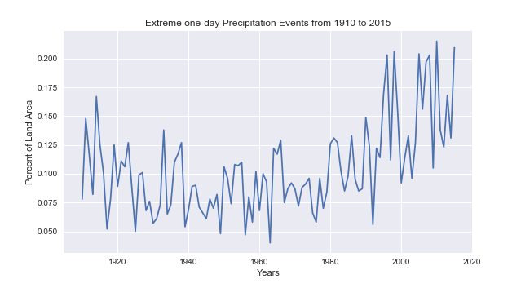
Notes:
Has there been an increase in extreme weather events?
According to our chart “Extreme One Day Precipitation Events from 1910-2015”, extreme precipitation events have filled an increased surface area of land. This could possibly mean that increased precipitation has led to more natural disasters.

Slide 11
Data Analysis
Trends in Precipitation
We got our data on extreme precipitation from the data used for the “Climate Change Indicators: Heavy Precipitation” chart from the EPA website.
The units used in this data set was the percentage of land area that was affected by the extreme precipitation events.
The main take away from this graph is that since the 1990s, the percentage of land area affected by extreme precipitation events has been increasing.
Notes:
Ebony & Susan will take turns explaining our charts and findings.
Data came from “Climate Change Indicators: Heavy Precipitation” chart from the EPA website.
Units of measurement, percent of land area.
Main take away since 1990s the land area affected by extreme precipitation has been increasing.

Slide 12
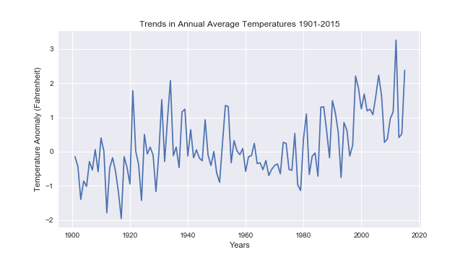
Notes:
Has the temperature overtime been increasing?
In our graphs showing temperature anomalies we have notice a trend of temperatures being consistently above average. In the 1996 to 2015 timeframe, each year the temperature has been above the 1901-2015 period average. This is even more stark when you look at our bar graph “Tends in Annual Average Temperatures 1901-2015”.

Slide 13
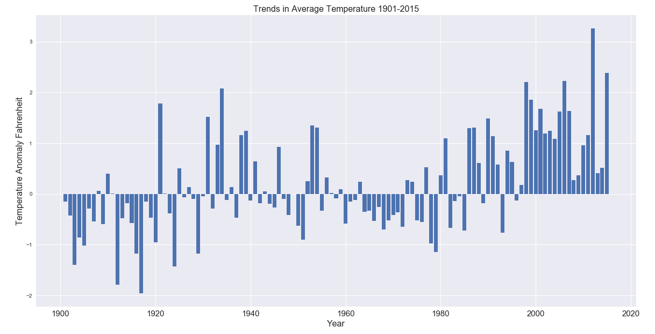
Notes:
Has the temperature overtime been increasing?
This graph shows how annual average temperature in the contiguous 48 states from 1901 to 2015. The graph uses the average from 1901-2000 as a baseline to show anomalies in average temperature.
In our graphs showing temperature anomalies we have notice a trend of temperatures being consistently above average. In the 1996 to 2015 timeframe, each year the temperature has been above the 1901-2015 period average. This is even more stark when you look at our bar graph “Tends in Annual Average Temperatures 1901-2015”.

Slide 14
Data Analysis
Trend in Average Surface Temperature
We got our data on extreme precipitation from the data used for the “Climate Change indicators: U.S. and Global Temperature” chart from the EPA website.
The both the line and bar graphs show how average temperatures have changes in the united states from 1901-2015. The graph uses the mean temperature from 1901-2000 as a baseline to depict change in average temperature.
The key takeaway from these graphs is from 1980 to 2015 the end of our timeframe the average temperature has been over the 1901-2000 mean ever most years.
Notes:
Our line and the bar graph show the trend in the average temperature from 1901-2015.
From 1980-2015 there has been a trend of increasing average temperature.

Slide 15
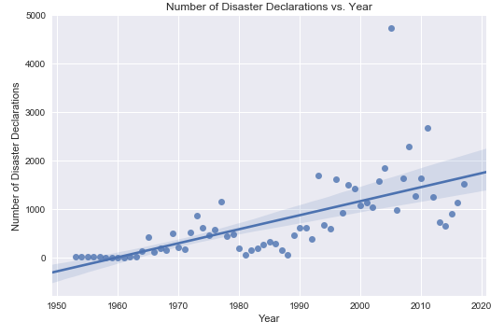
Notes:
What is the trend of natural disaster occurrences over the past years?
Disaster declarations are federally declared disasters that have occurred, which includes common natural disasters like hurricanes and earthquakes, but also includes human caused disasters such as terrorism and chemical spills. As seen in this graph, the number of disaster declarations has increased over the past decades. The beginning few years between 1950s to 1970s may not accurately represent the number of natural disasters that have occurred due to lack of data collected. Regardless, we can see that the number of disasters have increased over the years. The line is the regression line relative to the x and y variables and the shaded area shows the 95% confidence interval for that regression.

Slide 16
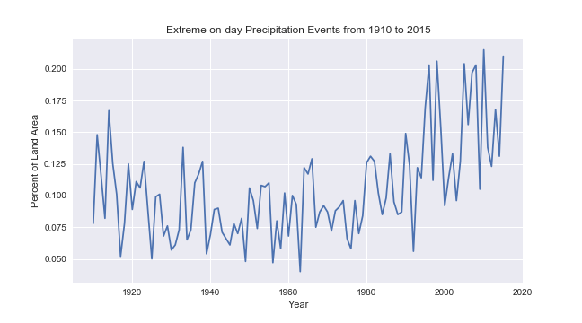
Notes:
Is there a correlation between temperature, precipitation, and natural disasters? What is the weather and natural disaster trend over the past five years?
By comparing our precipitation and temperature data with our disaster declaration data, we can see that there is a positive trend for all three graphs from around 1960 to present. The number of disaster declarations have been steadily increasing over time as temperature and precipitation.

Slide 17
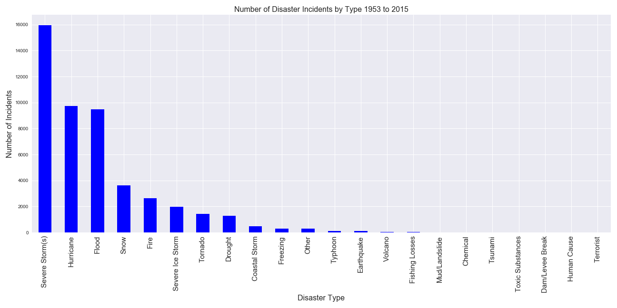
Notes:
What are the trends in FEMA disaster declarations?
According to our data the vast majority of the disaster declarations made by FEMA have been for severe storms and hurricanes. There also has been a very clear increase in disaster declared by FEMA over the years.

Slide 18
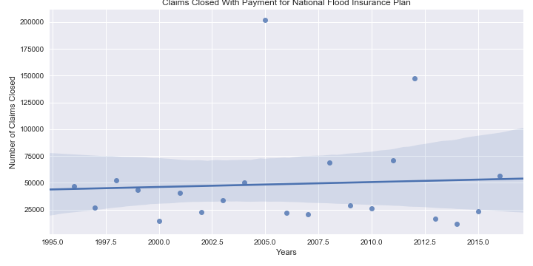
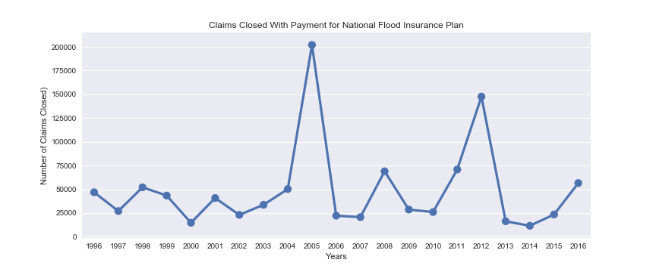
Notes:
Has there been a trend on the number of claims closed with payment from the National Flood Insurance Program (NFIP)?
Severe storms, hurricanes, and flooding are the top three FEMA disaster declarations, so we looked at NFIP. NFIP is designed to provide an insurance alternative to disaster assistance to meet the escalating costs of repairing damage to buildings and their contents caused by floods.
There are outliers in the number of claims closed, but overall, we found that y is not significantly related to x as the slope is closer to zero. The number of claims closed for NFIP has not significantly increased over time.

Slide 19
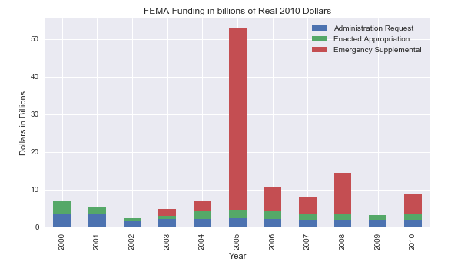
Notes:
What are the projections of FEMA budget each year vs how much money they actually spent? Can we find out how they got into debt?
Is there a correlation between natural disasters and US government spending on disaster relief?
Each fiscal year, FEMA and the Office of Management and Budget (OMB) submit a request to the President for the amount of funding the two agencies determine they should receive, which is show by the blue bar. We see that the administration’s requests are underestimations of the actual appropriations enacted and supplemented (green bars). The red is the Emergency supplemental funding that is in addition to what was previously enacted through the regular appropriations process.
I would like to point out that in the previous graph, it was only the NFIP budget, and this is the entire FEMA budget.

Slide 20
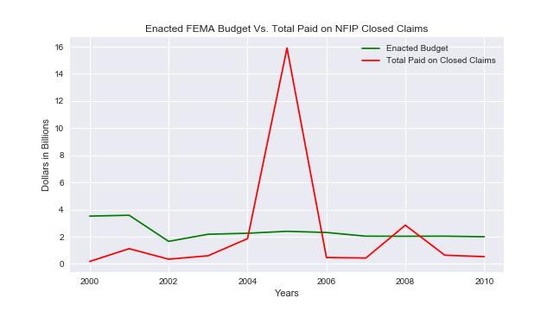
Notes:
What are the projections of FEMA budget each year vs how much money they actually spent? Can we find out how they got into debt?
Is there a correlation between natural disasters and US government spending on disaster relief?
The enacted budget of FEMA exceeds the total paid on NFIP closed claims. However, in 2005 when Hurricane Katrina happened, we see that the NFIP claims exceeded the enacted budget greatly. NFIP is within the FEMA budget, and with just one year of 2005, FEMA has gone into debt. Even when the expected claims exceeds FEMA budget, we can also see that the proximate years’ budgets have not been impacted. With this year with Hurricane Harvey, Maria and Irma, FEMA will further go into debt due to the NFIP.

Slide 21
Conclusions
Notes:
The effect of global warming can be observed through our data sets. All indicators trends upward steadily year over year. Which is what we have expected before the project.
What is very unexpected is the stability of both annual disaster claims and real cost per claim. The trendline is almost horizontal with outliers like 2005 (hurricane Katrina).
We believe the strength of U.S. logistic, military, and social infrastructure contribute greatly to the stability of the trend.

Slide 22
Post Mortem
Notes:
We tried to collaborate remotely through Github by branching and merging from the origin master, and encountered numerous and unforeseen difficulties, much thanks to our inexperience with Github in general. Google drive, sheet and slides came to the rescued. We collaborated in real time and have only one personal push to the origin master on Github. Comments work just as good as branching for Project One.
(Susan)
Finding data that span the same time period
A lot of more useful data from FEMA were not in a format that could be pulled easily since some were in a report form.
FEMA was created in the late 1970s. Data from earlier years may not be always accurate and/or be representative of the entire US.
Finding yearly averages of precipitation and temperature for the entire US were hard to find without finding the average for ourselves, which would have taken a long time.
What’s next if two more weeks:
The intensity of media coverage on Terrorism compare to Natural disaster in dollar amount, there is a discrepancy.
Data scrub on social media(FB, twitter…
Live interviews

Slide 23
Questions?

